Slide 1
Student Centered Learning – Stepping Away From Drill And Kill
FAPSC tampa Region Faculty conference 2016

Slide 2
Student Centered Learning

Slide 3
Why Student Centered Learning?
Andragogy – teaching adult learners
What are we going to learn?
What is student centered learning
Why should we use it?
Why are we going to learn it?
Increase achievement
Increase satisfaction

Slide 4
Why Student Centered Learning?
Vygotsky – scaffolding learning to connect new concepts with what the student already knows
Be relevant
Encourage multiple perspectives
Involve social negotiation and mediation

Slide 5
Why Student Centered Learning?
Active rather than passive learning
Emphasize deep learning and understanding
Students have to be involved
Students have responsibility for their learning

Slide 6
Why Student Centered Learning?

Slide 7
Questions to ask yourself
Which is more important listening or learning?
Do my students have some knowledge about the topic
Am I ok letting my students share things I don’t know

Slide 8
Starts with the syllabus……….
By the end of this course you will be able to
Guidelines for interaction
Personal responsibility

Slide 9
Active Learning in Lectures
Mini Lecture
Introduce Objective
Lecture – 20 minutes
Review
Activity

Slide 10
Before the Lecture
Anticipation Questions and Statements
Pretest
KWL

Slide 11
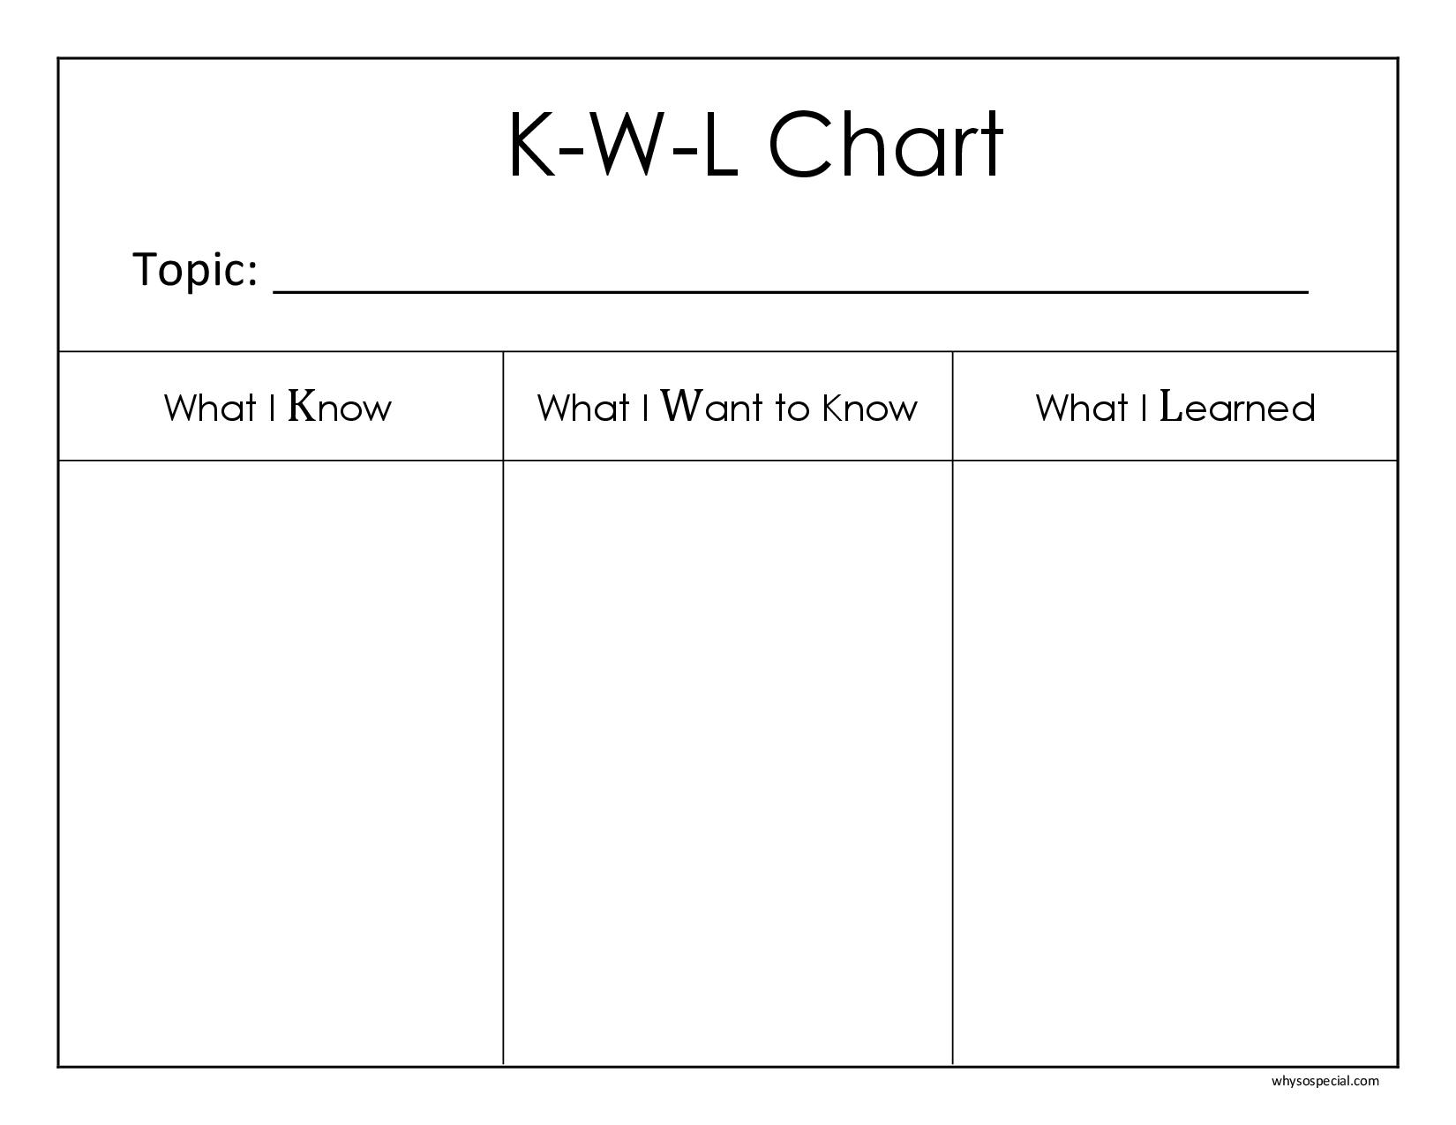

Slide 12
During the Lecture – Guided Note Taking
Notes:
Fish bowl - given index cards, and asked to write down one question concerning the course material. They should be directed to ask a question of clarification regarding some aspect of the material which they do not fully understand; or, perhaps you may allow questions concerning the application of course material to practical contexts. At the end of the class period (or, at the beginning of the next class meeting if the question is assigned for homework), students deposit their questions in a fish bowl. The instructor then draws several questions out of the bowl and answers them for the class or asks the class to answer them. This technique can be combined with others

Slide 13
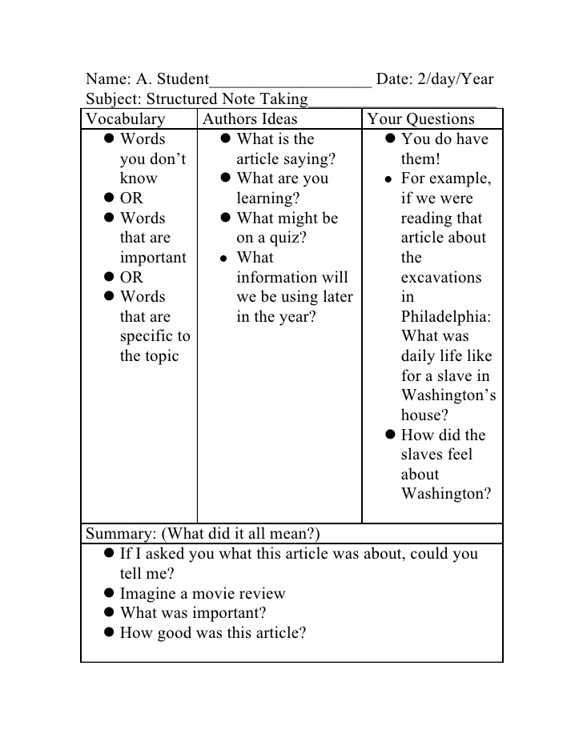

Slide 14
During the Lecture - Other Activities
Wait Time
Student Summary
Fish Bowl
Notes:
Fish bowl - given index cards, and asked to write down one question concerning the course material. They should be directed to ask a question of clarification regarding some aspect of the material which they do not fully understand; or, perhaps you may allow questions concerning the application of course material to practical contexts. At the end of the class period (or, at the beginning of the next class meeting if the question is assigned for homework), students deposit their questions in a fish bowl. The instructor then draws several questions out of the bowl and answers them for the class or asks the class to answer them. This technique can be combined with others

Slide 15
After the lecture……
3-2-1
Gallery Walk
Graffiti Board
Notes:
3 takeaways, 2 questions, 1 aspect they most enjoys
Graffiti board for reactions

Slide 16
After the lecture……
Student Created Review
Flashcards
Summary Lecture
Review notes
Notes:
3 takeaways, 2 questions, 1 aspect they most enjoys
Graffiti board for reactions

Slide 17
One Minute Paper
Pose a question and give 1-2 minutes to respond (clickers / dry erase)
I don’t understand…….
I fully understand…….
What is your reaction to ……….

Slide 18
Games
Bingo
Hangman
Textbook Scavenger Hunt

Slide 19
Share / Pair
Summarize the lecture
Note comparison sharing
Peer review (TAG)
Concept Map

Slide 20
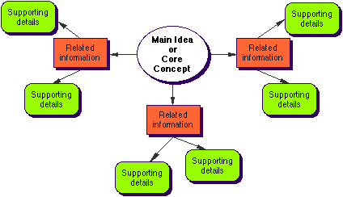

Slide 21
Jigsaw
Form groups of 3-4
Divide the lesson into the same number of segments as the number of students in each group
Assign each student 1 segment – only one person per segment in each group
Give students an appropriate amount of time to read their segment of the lesson / chapter
Have all students with the same segment meet
Have initial groups re-form
Students teach their group members about their segment

Slide 22
Jigsaw
Quiz
Summary
Have each group present to class

Slide 23
Now it’s your turn……
Kristi@dr-Bordelon.com

