Slide 1
Interactions Within Communities
Chapter 1

Slide 2
Obtaining Energy
Try to describe the process of photosynthesis in your own words.

Slide 3
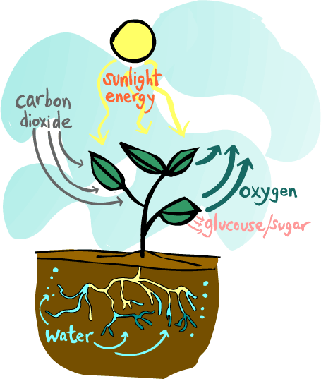
Photosynthesis
The sun(light energy), water, minerals and carbon dioxide are all absorbed by the plant.
The plant then uses them to make glucose/sugar, which is the energy/food for the plant.
Oxygen is also produced by the plant in this cycle, which is then let off into the air!
Have you noticed how clean and pure the air feels when there are plants around? They are filling the air with

Slide 4
Producers
Plants are called producers. This is because they produce their own food!
They do this by using light energy from the Sun, carbon dioxide from the air and water from the soil to produce food - in the form of glucose/sugar. .

Slide 5
Photosynthesis

Slide 6
Chemosynthesis
Some producers do not contain chlorophyll
They do NOT use energy from the sun
These organisms can be found near volcanic vents on the ocean floor
Inorganic molecules in the water provide the energy source for chemosysnthsis

Slide 7
Consumers
Animals are called consumers. This is because they cannot make their own food, so they need to consume (eat) plants and/or animals.

Slide 8
Consumers
Herbivores: Animals that eat only plants.
Carnivores: Animals that eat only animals.
Omnivores: Animals that eat both animals AND plants.
Decomposers consume waste and dead organisms.

Slide 9
Herbivores

Slide 10
Carnivores

Slide 11
Omnivores

Slide 12
Decomposers

Slide 13
Decomposers
Decomposers help recycle once-living matter by breaking it down into simple, energy-rich substances.
These substances might serve as food for decomposers, be absorbed by plant roots, or be consumed by other organisms

Slide 14
Food Chain
At each link in the chain, energy is being transferred from one animal to another.

Slide 15
Food Chain
There is actually even more to this chain. After a hawk dies, fungi (like mushrooms) and other decomposers break down the dead hawk, and turn the remains of the hawk into nutrients, which are released into the soil. The nutrients (plus sun and water) then cause the grass to grow.
It's a full circle of life and energy!!

Slide 16
Food Chain
So food chains make a full circle, and energy is passed from plant to animal to animal to decomposer and back to plant!

Slide 17
Food Chain

Slide 18
Trophic Levels

Slide 19
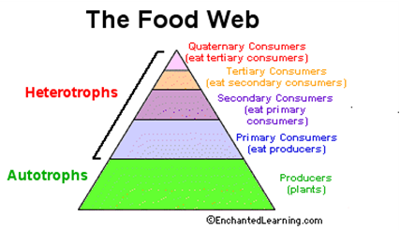
Trophic Levels

Slide 20
Symbiotic Relationships
Not all relationships among organism involve food.
Many organisms live together and share resources in other ways.
Any close relationship between species is called symbiosis.

Slide 21
Types of Symbiotic Relationships
There are three major types of symbiotic relationships:
Mutualism
Commensalism
Parasitism

Slide 22
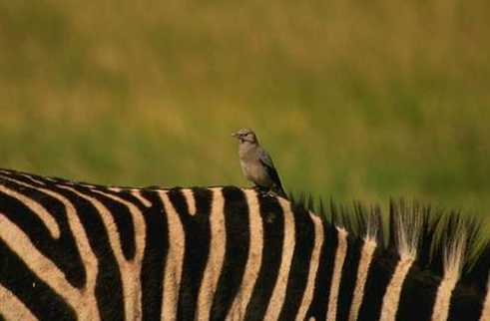
Mutualism
Mutualistic relationship is when two organisms of different species "work together," each benefiting from the relationship.
One example of a mutualistic relationship is that of the oxpecker (a kind of bird) and the rhinoceros or zebra.

Slide 23
Commensalism
Commensalism is a type of relationship where one of the organisms benefits greatly from the symbiosis.
The other is not helped but is not harmed or damaged from the relationship. I
n other words, this is a one-sided symbiotic relationship.
Example: The relationship between cattle egrets and cattle. The cattle egret eats up the insects hiding under vegetation close to the grounds, which get stirred up when the cattle walk through them.

Slide 24
Parasitism
Parasitism is a symbiotic relationship in which one organism benefits but the other is harmed.
A few examples of parasites are tapeworms, fleas, and barnacles.
Tapeworms are segmented flatworms that attach themselves to the insides of the intestines of animals such as cows, pigs, and humans. They get food by eating the host's partly digested food, depriving the host of nutrients.

