Slide 1
PART 2:
2020 Testing Guide
Demos
Checklist
What to do on test day
All of this information and more can be found in the AP Exam Testing Guide linked here.
I have pulled the information I found most important, but I recommend reading through that.

Slide 2
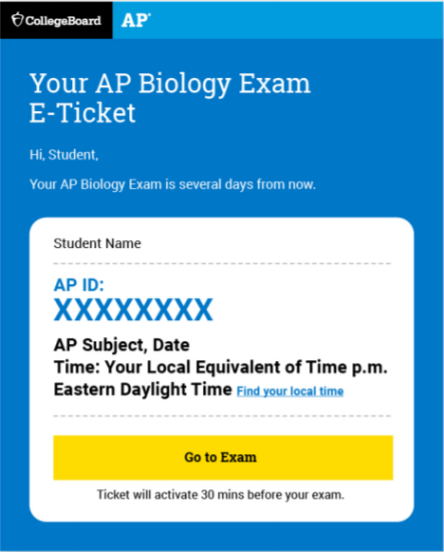
AP Exam E-Ticket
You’ll receive your E-Ticket 2 days before your test.
APUSH is on May 15, you’ll receive your ticket by email on May 13.
One E-Ticket per exam
Can be accessed in your Student Account on My AP.
Do not share your E-Ticket with anyone.
Save the email should you need to request a make-up exam.
The ticket is only valid for the May Exam Schedule. You will receive a different one if you need to test in June.

Slide 3
Reminder!
If you have a conflict for the May 15th test and don’t use your E-Ticket, you can take the test on Wednesday, June 3rd. HOWEVER!
There are no scheduled conflicts for the May 15th test.
There are multiples tests scheduled for the same time in June.
There are no opportunities to test against after June 3rd.
This means if you don’t test in May and then have technology issues in June, you will not be able to make up the test.
Plan to test on May 15th!!!!
Again, here is the testing schedule

Slide 4
AP Exam Calendar
Currently, the exam times listed in your College Board accounted are defaulted to Eastern Time. We are in the Central Time Zone.
You will be taking the AP U.S. History Exam on May 15th at 1:00pm.
Here is a schedule for all AP Exams in Central Time Zone.

Slide 5
What To Expect On The Exam
The exam questions are viewed in a web browser.
Only Chrome, Firefox, Safari, or Edge will work.
You will type or write your response outside that browser and then submit one of 3 ways.
Copy and Paste a typed response
Attach a typed response (like a document)
Attach one of more photos of a handwritten response.

Slide 6
Submission Option #1
Copy and Paste a Typed Response and Hit Submit
A computer is the best device to use.
Type your response in Google Docs, Microsoft Word, Notes, or a similar application. Don’t include images. Save your work often.
Type your AP ID and initials at the top of the response.
When the timer has 5 minutes remaining, copy-and-paste your response into the space indicated, and click Submit.
You will need to open up 2 windows for this. One window to view the question/timer and a second window to type your response.

Slide 7
Submission Option #2
Attach a document and then hit “submit.”
Type your response in Google Docs, Microsoft Word, Notes, or a similar application. Don’t include images. Save your work often.
Save your document in one of these accepted file formats: .doc, .docx, .pdf, .txt, .odt
Type your AP ID and initials at the top of the response.
When the timer has 5 minutes remaining, attach your response and click Submit
You will need to open up 2 windows for this. One window to view the question/timer and a second window to type your response.

Slide 8
Submission Option #3
Attach photos of a handwritten response and then click “submit.”
Write your AP ID, initials, and page number at the top of EACH page of the response.
Write your response clearly with dark pen or pencil.
When the timer has 5 minutes remaining, take a photo of your response in vertical orientation, i.e., not landscape
One page per photo. If your response is longer than one page, you’ll need to attach multiple photos (maximum of 5 photos per test question) before clicking Submit
Make sure to attach all of your pages before you click Submit. Acceptable file formats: .png, .jpg, .jpeg.

Slide 9
Five Steps To Take Before Exam Day
Review Contact Information
If you are not receiving emails from College Board, log in to My AP.
Check your technology
Decide how you will do your test, whether on the computer or a smartphone.
Practice submitting your response.
An online AP Exam demo will be available on May 4th
Gather What You Need for Each Exam
You don’t really need anything additional for APUSH but check this link out.
Receive your exam confirmation and E-Ticket Emails
You’ll get emails with your AP ID and your exam e-ticket. This information will also be in your My AP Account.

Slide 10
Important Things To Note
Your e-ticket will be posted to your My AP Account
If you have GRAMMARLY installed, you will need to deactivate it.
If you choose to use a smartphone, remember you will have to scroll to see the documents for your DBQ.
If you are writing your response, you are limited to 5 pages and it must be on white paper. Use a #2 pencil, or blue/black pen. AP ID and page number must be on each page.
Use auto-save while you are typing your response.

Slide 11
AP Exam Demo
Practice submitting responses with the AP Exam Demo.
On May 4th, you can go to this link and practice submitting documents.
If you cannot connect to the Exam Demo on the device that you are using, you will not be able to connect on Exam Day.
Use this time to troubleshoot. Update your devices, check your connections.
If you cannot connect to the Demo, reach out to your teacher or our AP Coordinator.

Slide 12
What To Have Ready on Exam Day for APUSH
Exam e-ticket email
Completed Exam Day Checklist, including AP ID. Linked here.
Device: laptop, tablet, smartphone
Browser: Chrome (recommended), Firefox, Safari, or Edge.
Internet Connection
Microsoft Word, Google Docs, Notes, or similar application
Allowed: class notes, study guides, etc.

Slide 13
Optional Resources
You are allowed to use class resources and notes during the exam.
Notes, study guides, textbooks, any assignment from the year.
Do NOT open up a shared Google Doc with your friends. That might flag their plagiarism technology. If you have collaborated on a study doc, download it to your computer and open it that way. Do not risk this!
Internet searches will waste your time and put you at risk of an exam violation.
Remember - you only have 45 minutes.
Facts you can find on the internet will not raise your score.
Copying from websites/social media/etc = plagiarism and scores cancelled.

Slide 14
What To Look Out For Now
May 4th
Exam confirmation email with your AP ID and list of exams you’re registered for.
You can see your exam schedule in My AP
This is the day the Demo will go live.
Two Days Before Exam (May 13 for APUSH)
You will receive an email with your personalized e-ticket and AP ID.

Slide 15
Checklist
Linked here for your convenience.
College Board is recommending you fill out a check list for each exam you are taking and have it next to you on test day.
You can also just write the information on a sheet of paper if you don’t want to print.
Most important item: your 8-character AP ID.

Slide 16
Exam Day - What to Expect on May 15th
12:30PM:
Check in using your e-ticket.
Complete identity information
Wait for exam to automatically begin. DO NOT REFRESH YOUR BROWSER.
1:00 pm - 1:45pm (roughly)
You have 45 minutes to read the question, the documents, and develop your response.
1:45pm - 1:50pm (roughly)
Submit your response

Slide 17
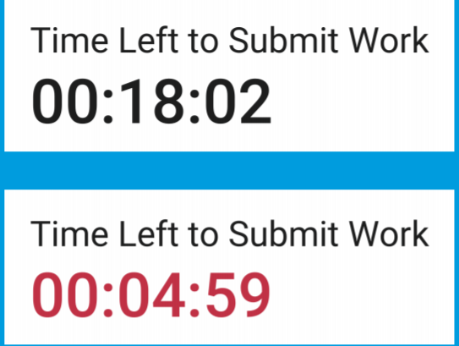
The Timer
A timer will start during the check-in process to show you how much time until the exam starts.
During the test, there will be a timer at the bottom of the screen showing you how much time you have left to write your DBQ and submit.
Five minutes before time is up, the timer will turn red.
STOP writing.
Start copying/pasting, attach your work, or take pictures

Slide 18
Submitting Your Response
Submitting is a two step process.
Attach or paste your response
Hit submit
If you do not hit submit before the timer runs out, your response will not count.
Make sure your submission has fully loaded and been submitted before your exit out of your browser or turn your computer off.
You will receive a message that says “Your AP Exam is Complete” - if you never see that message, you will need to request a make up exam - here is the link where you request a make up.

Slide 19
What If Something Goes Wrong While Testing?
If you accidentally close your browser, your computer crashes, or you lose internet access, click on your exam e-ticket to return to the test.
During the exam, do not refresh your browser or hit the back button.
You can request a make-up exam if you lost too much time due to a technical problem or some other serious disruption.

Slide 20
Videos
Here is a link to a YouTube playlist that will walk you through the 2020 Exams.

Slide 21
Other Resources
Click here if you are having trouble receiving emails from College Board
Click here for official College Board AP Review Sessions
Click here for the complete AP Testing Guide

Slide 22
Thanks to Brittany Schrameyer for this PPT! Please view the first PPT to see more information!

