Slide 1
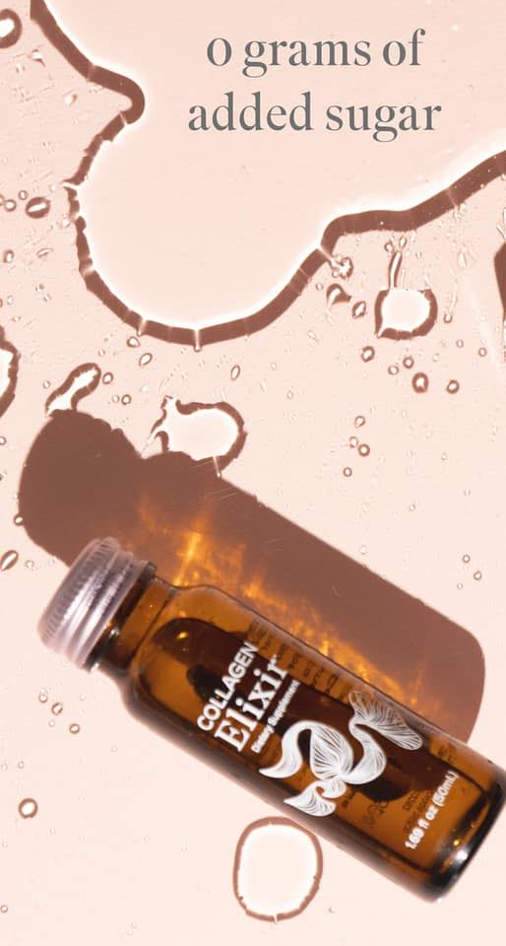
ISAGENIX ELIXIR

Slide 2
The Wait is Almost Over!
Over 8 Million Bottles Sold!
Since January 8
ISAGENIX ELIXIR

Slide 3
Sip your way to a more youthful and healthy glow with:
5 grams of marine collagen peptides
Skin and immune supportive
vitamins and minerals
Powerful ancient beauty blend of natural fruits and botanicals
Great berry fruit flavor, with no added sugar
ISAGENIX ELIXIR

Slide 4
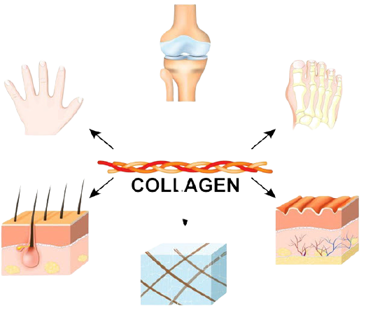
What is Collagen and Why Do We Need It?
Cartilage
Most abundant protein in body
Major building block in bones, skin, muscles, tendons, and ligaments
The “glue” that holds the body together
Collagen must be consumed in diet to support body’s own production
Nails
Bone
Derma
(degradation collagen
In the skin
Leads to wrinkles)
Hair
Connective
Tissue
ISAGENIX ELIXIR

Slide 5
Collagen Types
Cartilage
Nails
Bone
Over 20 types of collagen have been identified, but main types in body are:
Type I – Most common and found in hair, skin, nails, bones, ligaments, and tendons
Type II – Found mainly in cartilage
Type III – Found alongside type I and in blood vessels and internal organs
All collagen types unique due to amino acid profile and concentration of glycine, proline, and hydroxyproline
Derma
(degradation collagen
In the skin
Leads to wrinkles)
Hair
Connective
Tissue
ISAGENIX ELIXIR

Slide 6
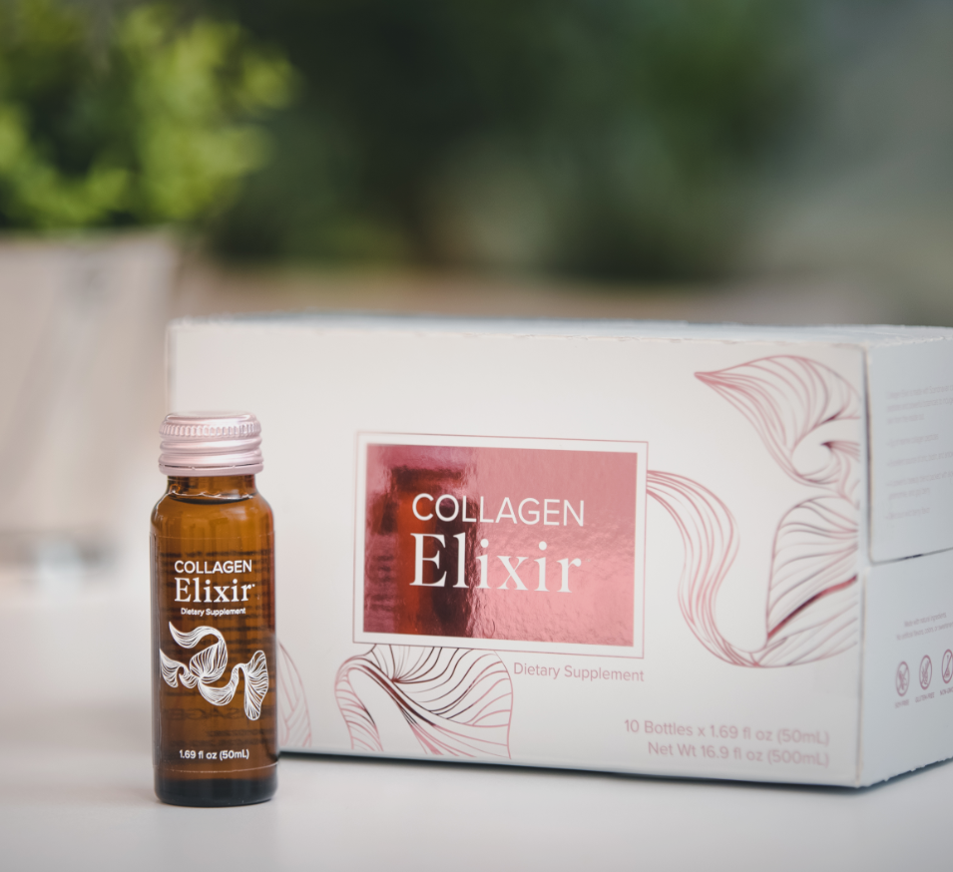
PRODUCT SCIENCE
Crafted from the best that science and nature have to offer…OVER 200 Scientists with 10 years+ of research and development to bring to the market
MARINE COLLAGEN
It could be one of the ocean’s greatest gifts! It’s composed mostly of type I collagen, which is rich in key amino acids. These are the building blocks that support the body’s natural production of collagen. Your hair, skin, and nails — and other vital parts of the body — rely on them.
And it’s where you get that radiant natural glow from within.
ISAGENIX ELIXIR

Slide 7
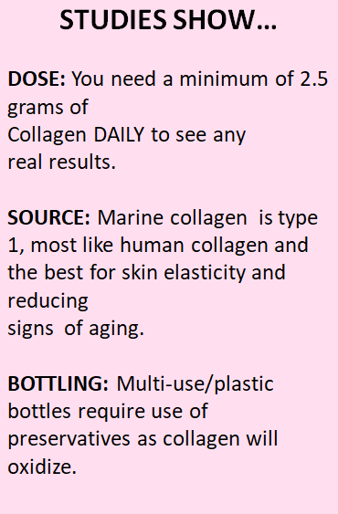
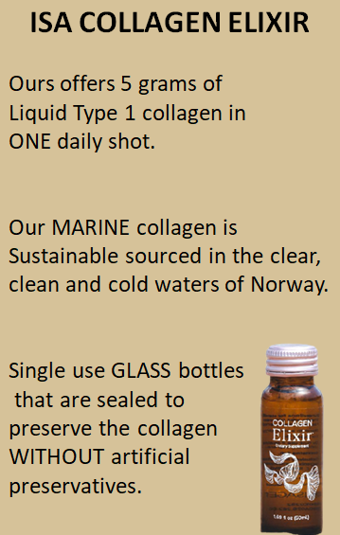
COLLAGEN 101
ISAGENIX ELIXIR

Slide 8
ISAGENIX ELIXIR

Slide 9
Collagen Elixir Features and Benefits
5 Grams of Marine Collagen
With marine collagen peptides sourced from wild- caught fish from Scandinavian waters
More absorbent for skin benefits above other collagen sources like bovine or chicken
More bioavailable and easily absorbed by the body
ISAGENIX ELIXIR

Slide 10
Collagen Elixir Features and Benefits
Vitamins & Minerals
Vitamin C
Supports collagen production and daily immune health*
Zinc
Helps maintain cell functioning and
daily immune health*
Biotin
Keeps skin hydrated and supports hair and nails*
*These statements have not been evaluated by the Food and Drug Administration.This product is not intended to diagnose, treat, cure, or prevent any disease.
ISAGENIX ELIXIR

Slide 11
Collagen Elixir Features and Benefits
Fruit & Botanicals
Goji Berry
Natural source of beta-carotene, known to promote healthy skin*
Aloe Vera
Supports digestive system and increases
bioavailability of other nutrients*
Acerola Berry
Natural source of vitamin C, B vitamins, iron, and calcium
Chamomile
Contains antioxidants to protect the skin from free radicals*
*These statements have not been evaluated by the Food and Drug Administration.This product is not intended to diagnose, treat, cure, or prevent any disease.
ISAGENIX ELIXIR

Slide 12
Collagen Elixir Features and Benefits
Double Nutri Technology
Helps the body absorb nutrients
Serves as emulsifier that more efficiently combines different ingredients with different solubility
Better absorption = better results
ISAGENIX ELIXIR

Slide 13
Collagen Elixir Features and Benefits
Zero Oxidation & No Artificial Preservatives
Packaged in premium glass bottles
that are 100% recyclable
Every bottle sealed in 0.15 seconds to prevent oxidation caused by gas exchange
Sealing in freshness means no need for artificial preservatives - natural freshness for natural results
ISAGENIX ELIXIR

Slide 14
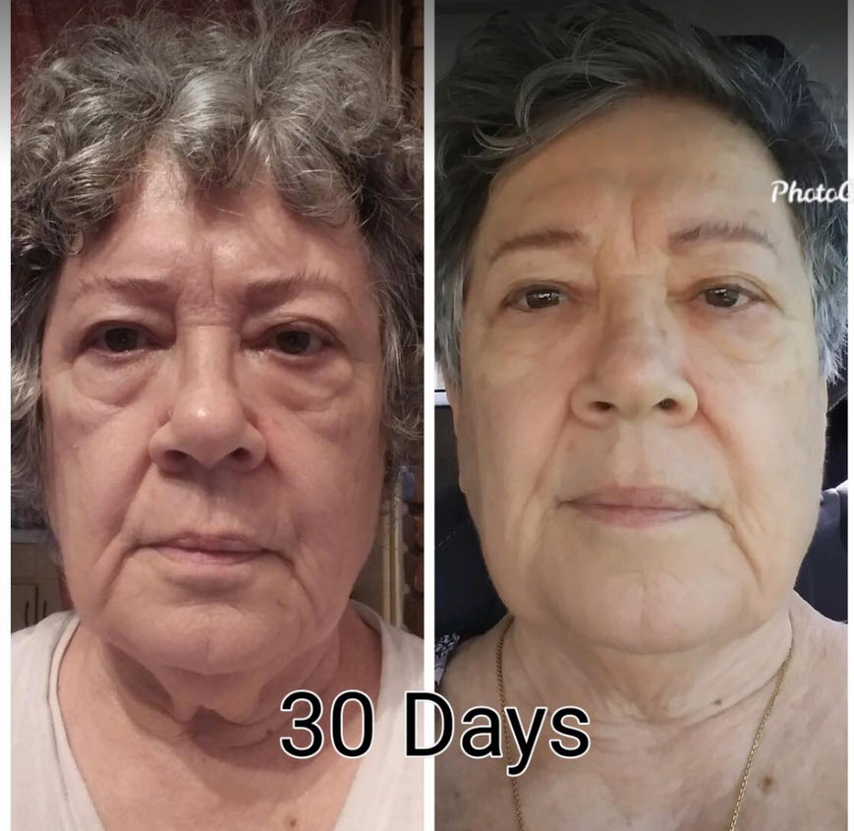
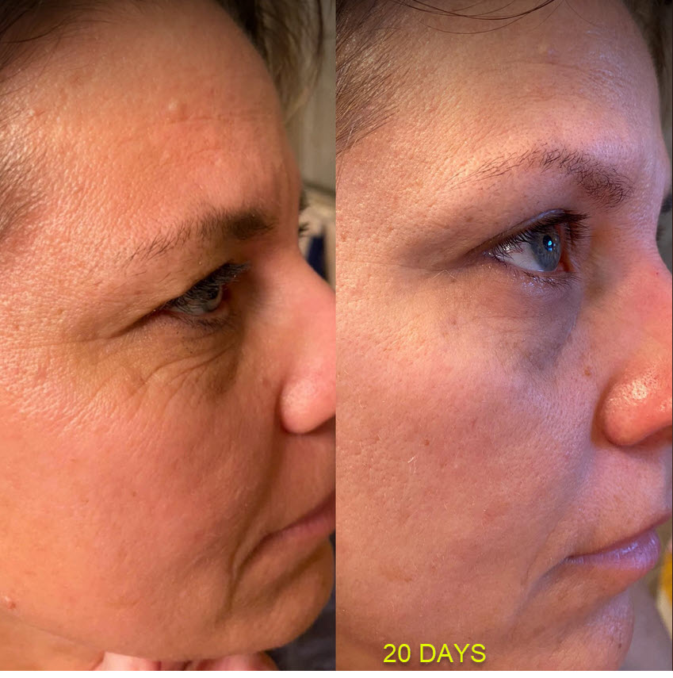
ISAGENIX ELIXIR

Slide 15
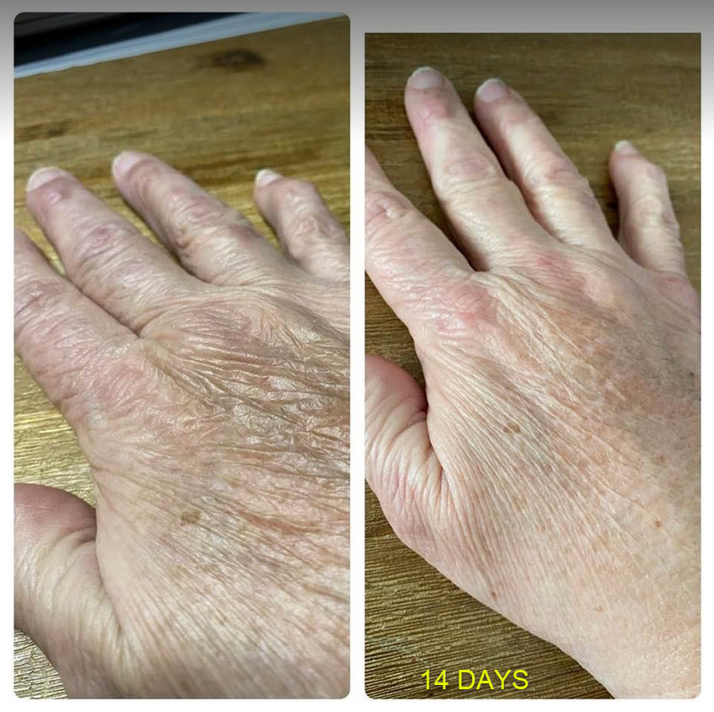
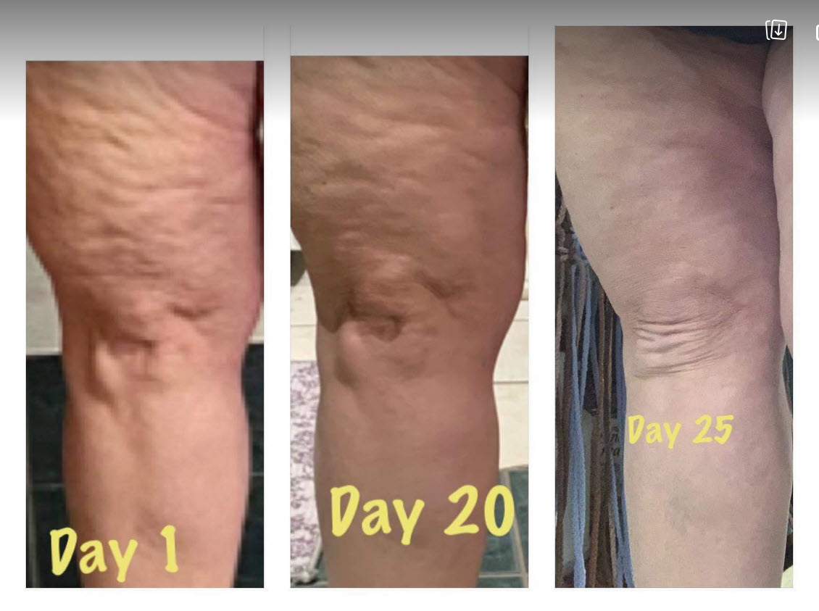
ISAGENIX ELIXIR

Slide 16
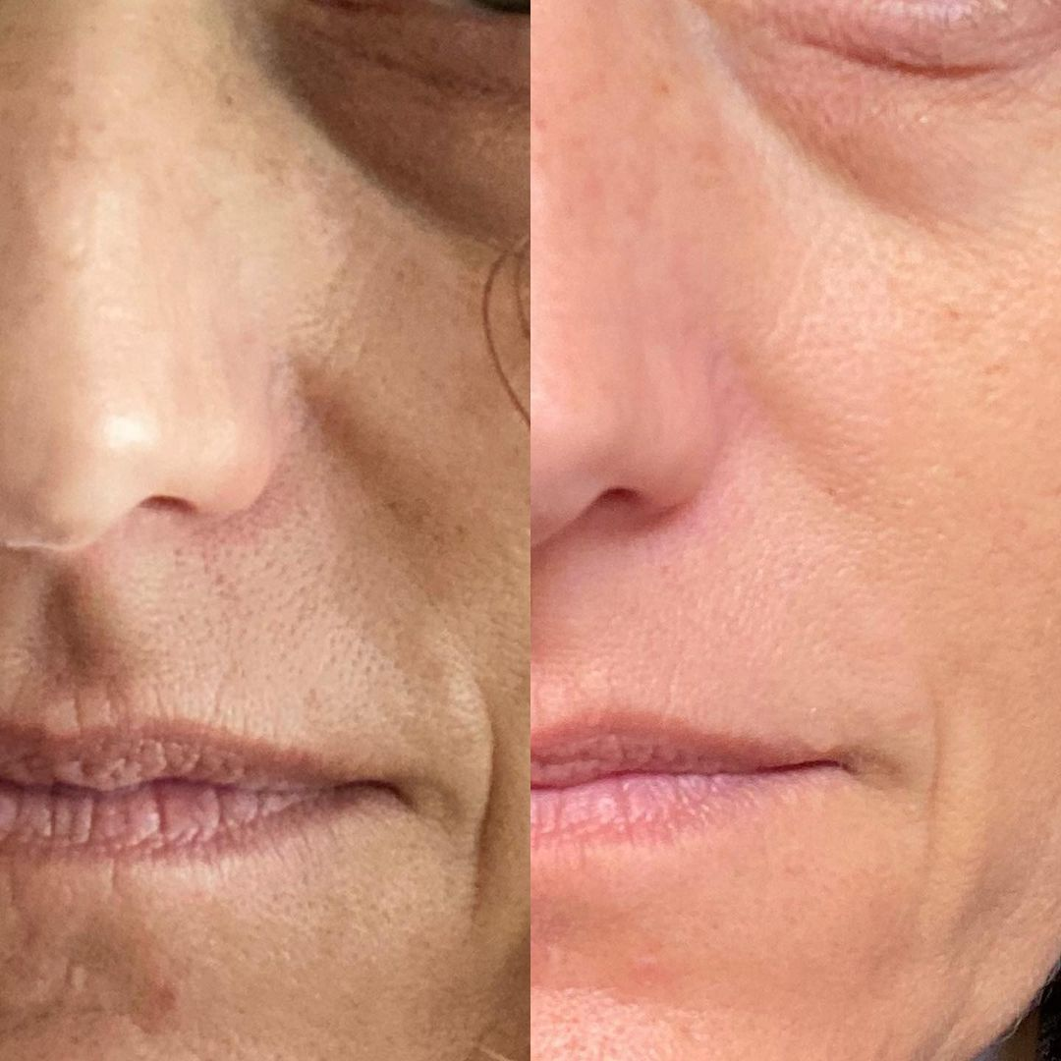
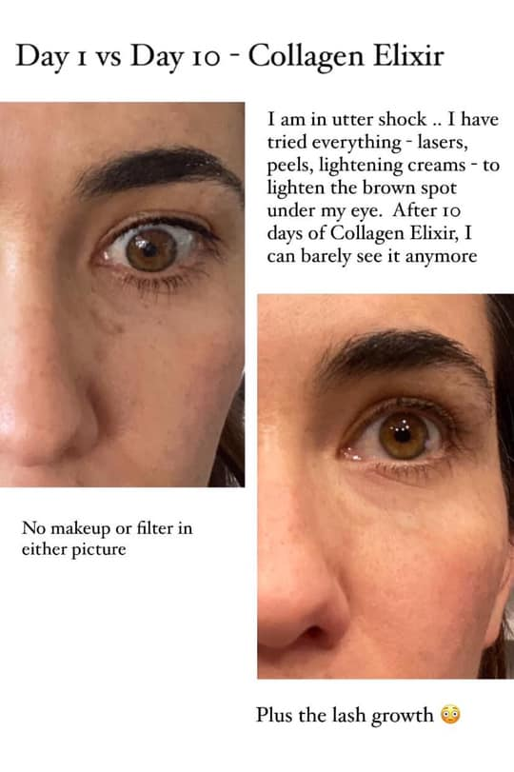
ISAGENIX ELIXIR

Slide 17
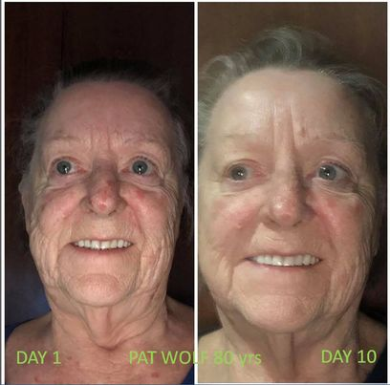
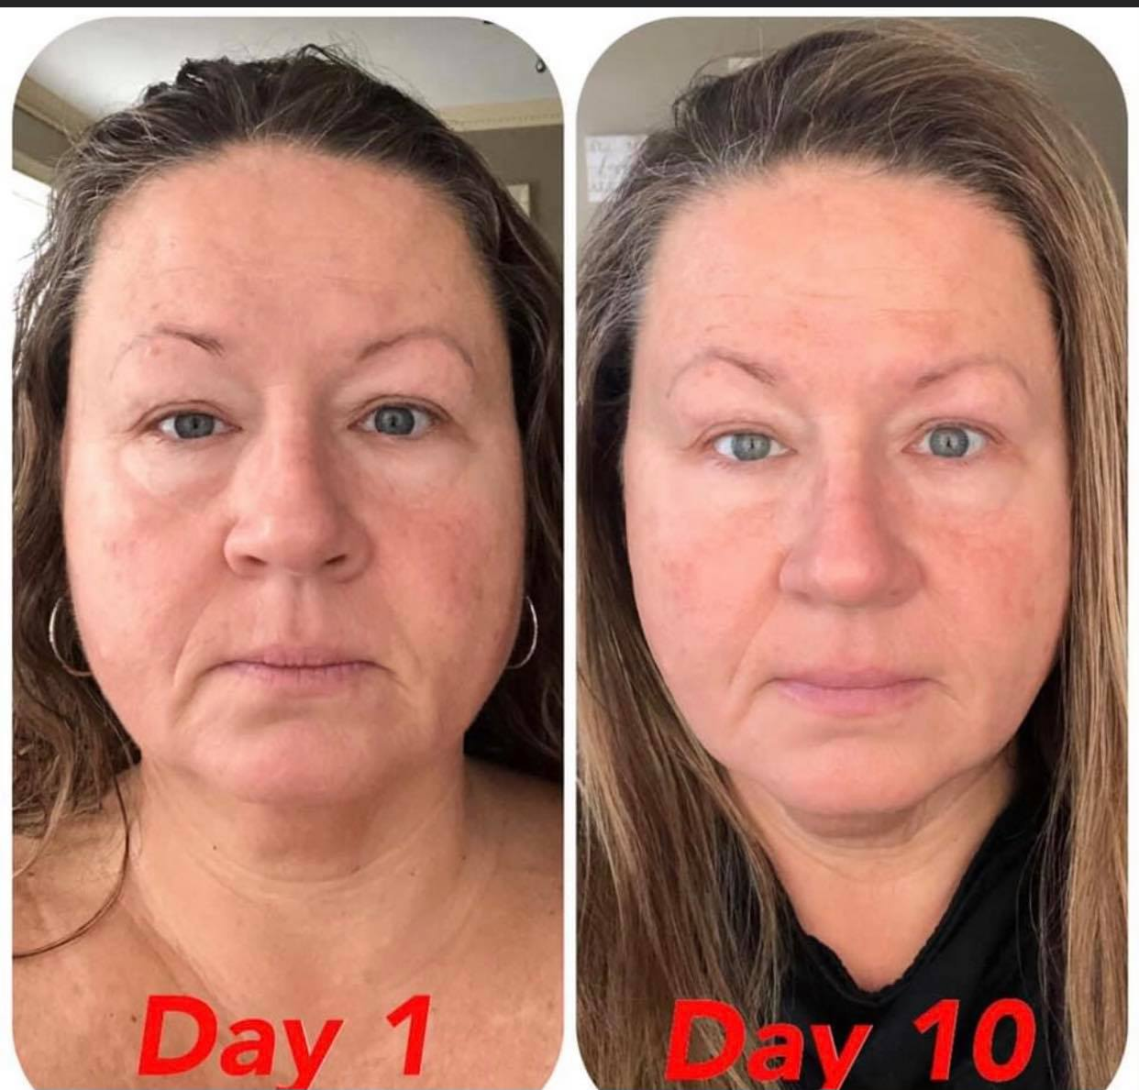
ISAGENIX ELIXIR

Slide 18
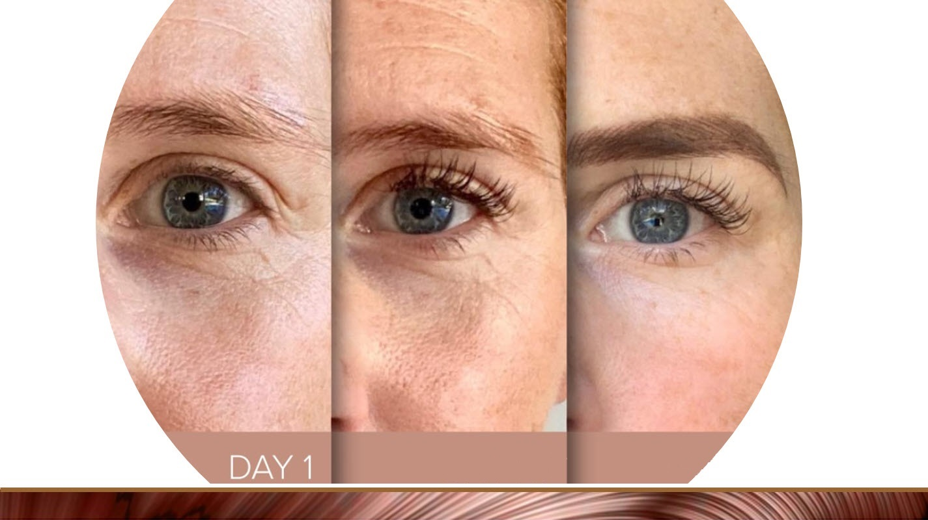
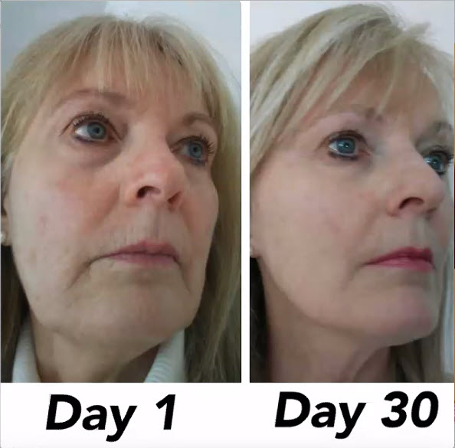
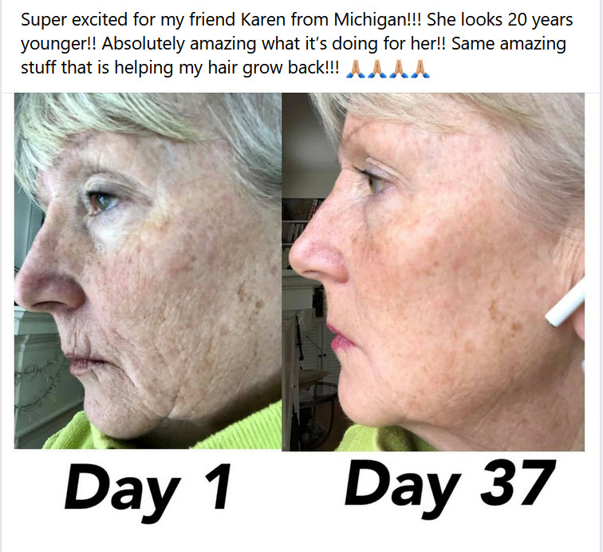
DAY 37
DAY 21
DAY 31
ISAGENIX ELIXIR

Slide 19
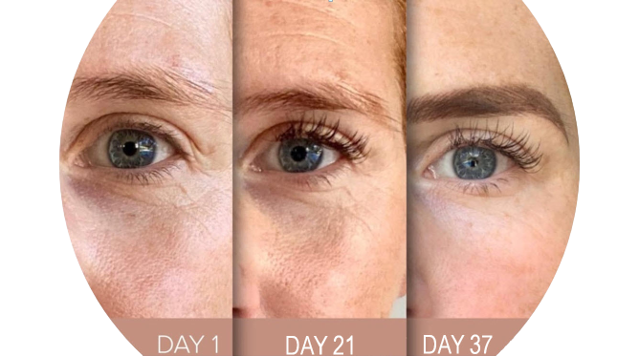
DAY 37
DAY 21
DAY 31
ISAGENIX ELIXIR

Slide 20
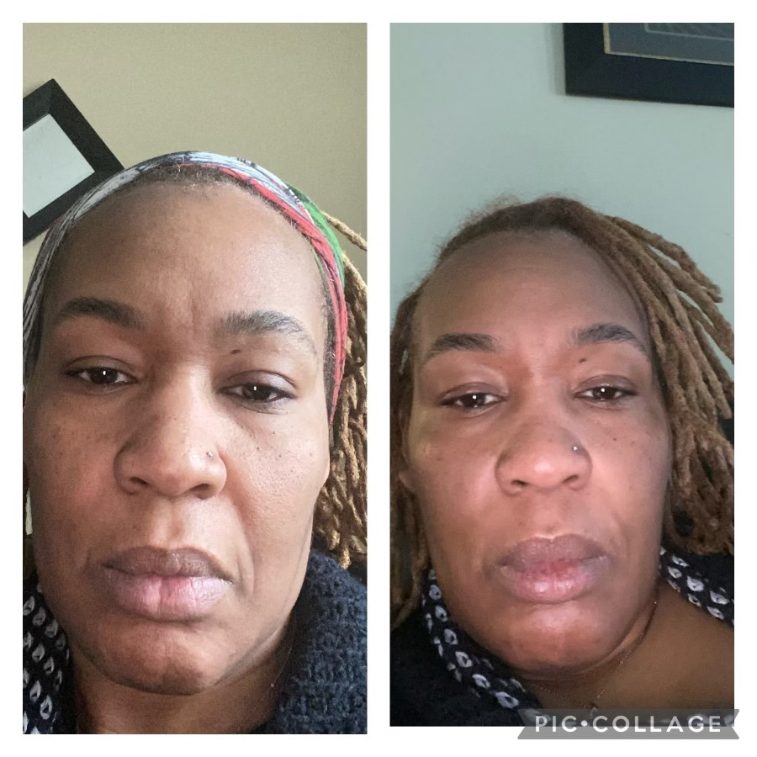
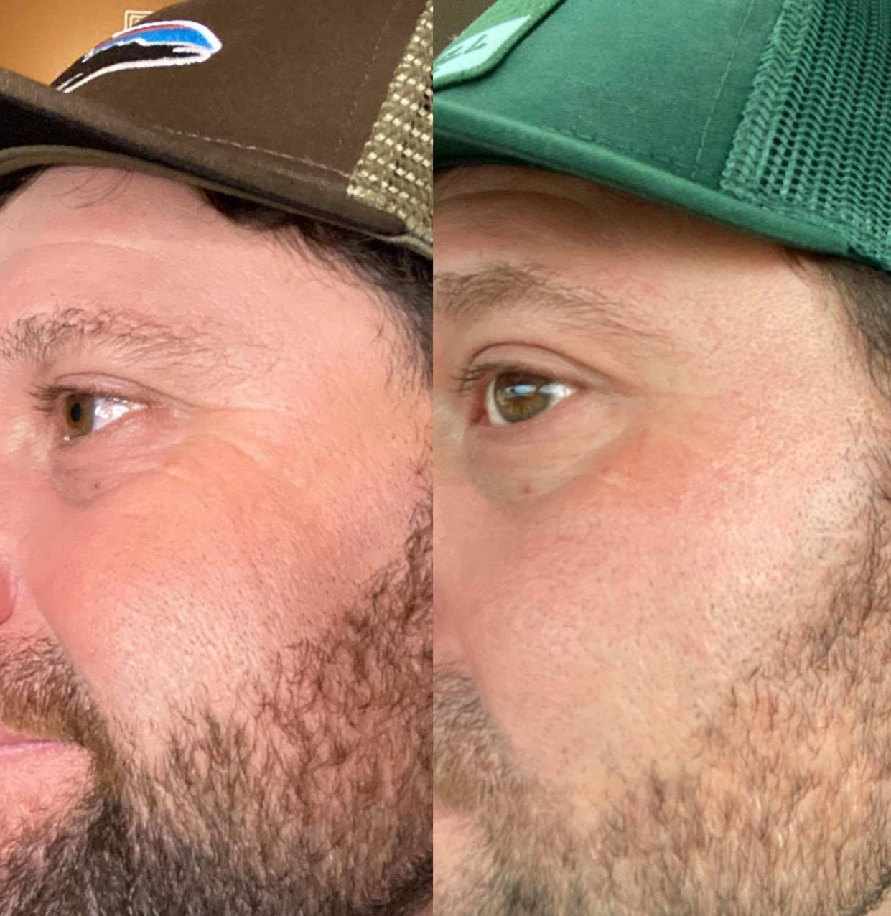
Day 1
Day 10
Day 1
Day 21
ISAGENIX ELIXIR

Slide 21
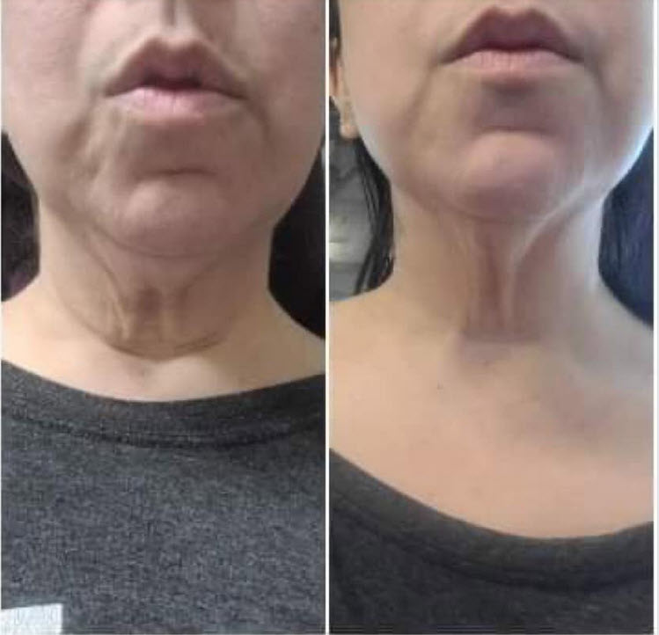
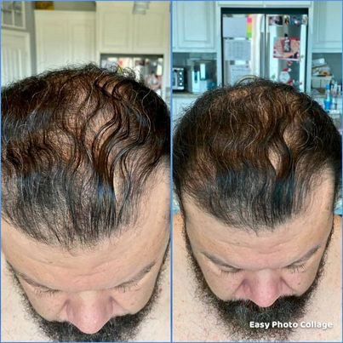
30 DAYS
14 DAYS
ISAGENIX ELIXIR

Slide 22
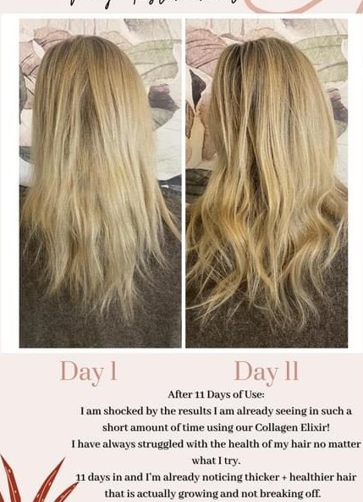
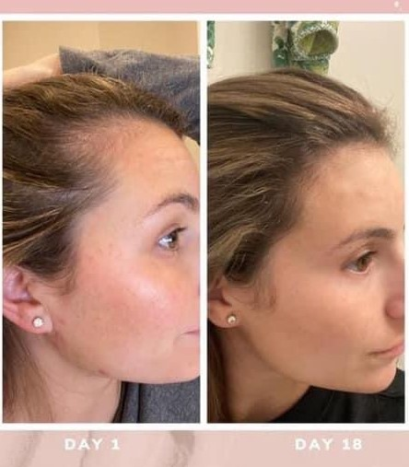
ISAGENIX ELIXIR

Slide 23
How to Use Collagen Elixir
No spoon needed
Simply sip, gulp, or mix into other beverages
Can be had anytime of day
50 calories per shot
No added sugar
Natural sugars from apple juice concentrate
Can be used on Cleanse Days
ISAGENIX ELIXIR

Slide 24
Preferred Customer on Lifestyle Rewards $151.95
ISAGENIX ELIXIR

Slide 25
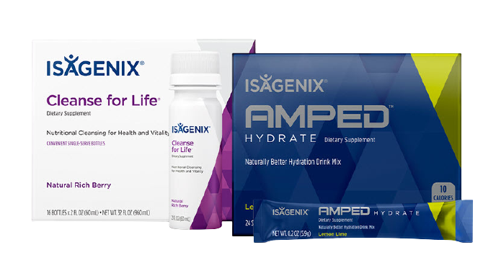
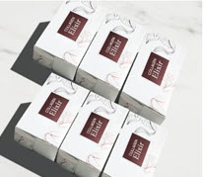
Collect Bonuses for Sharing Products
Upgrade to Associate for $29 in back office
YOU 100BV
2, 6 PK orders same week $100
Crystal Consultant bonus 30 days $100
$61
$25 Product Coupon
$25
US $25 PIB
US $25 PIB
US $50 PIB
2 orders same week
US $50 PIB
TOTAL VALUE $286.00
ISAGENIX ELIXIR

Slide 26
RETAIL: $319.92
$203.95 (with rewards order)
Share with 2 friends: $200
Share with 3 friends: $250
Share with 4 friends: $300
Share with 5 friends: $350
Share with 10 friends: $600
ISAGENIX ELIXIR

Slide 27
Healthy Targeted Solutions
Weight Loss
More Energy
Sleep
Stress
Digestion
Vegetables
Snacks
Performance
ISAGENIX ELIXIR

Slide 28
Get back with the person who sent you here to get started on a system TODAY!
ISAGENIX ELIXIR

