Slide 1
Spring Into New Books
April 3, 2017
Kathleen Spence

Slide 2
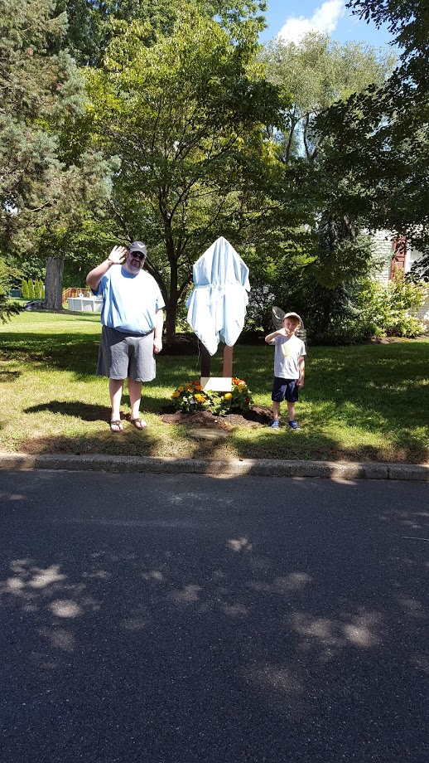
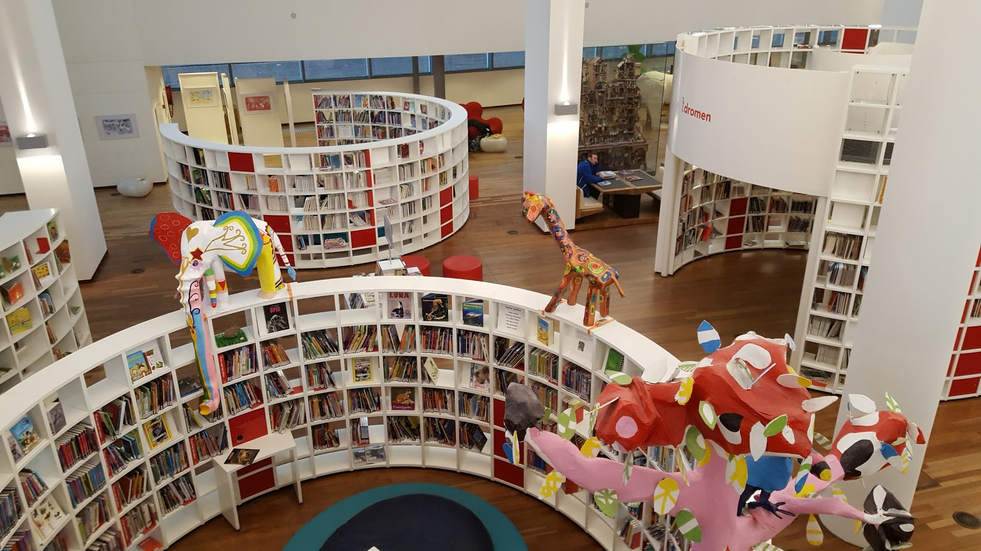
Forming new reading habits

Slide 3
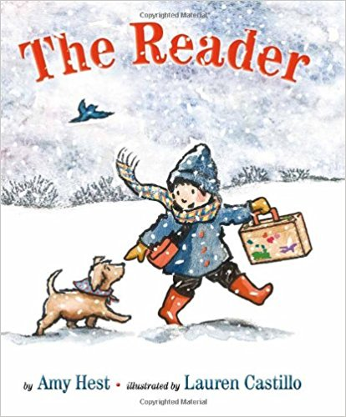
Welcome!
Our hope for all of our children and students.
Written by Amy Hest, illustrated by Lauren Castillo.

Slide 4
Process
Resources
Inspiration
Connections
LFL

Slide 5
Biographies
Six Dots, by Jen Bryant
Ada Lovelace, Poet of Science: The First Computer Programmer, by Diane Stanley
A Poem for Peter, by Andrea Davis Pinkney
Some Writer: The Story of E. B. White, by Melissa Sweet
Radiant Child: The Story of Young Artist Jean-Michel Basquiat, by Javaka Steptoe *

Slide 6
Biographies (cont.), History
Preaching to the Chickens: The Story of a Young John Lewis, by Jabari Asim
March, by John Lewis, Andrew Aydin, and Nate Powell (illus.)
Coretta Scott King Award
Michael L. Printz Award
Robert F. Sibert Informational Book Award
YALSA Award

Slide 7
History, fiction and informational
Freedom in Congo Square, by Carole Boston Weatherford - (Charlotte Zolotow Award)
Freedom Over Me: Eleven slaves, their lives and dreams brought to life, by Ashley Bryan (Newbery Honor)
In the Shadow of Liberty: The Hidden History of Slavery, Four Presidents, and FIVE BLACK LIVES, by Kenneth C. Davis
Sachiko: A Nagasaki Bomb Survivor Story, by Caren Stelson

Slide 8
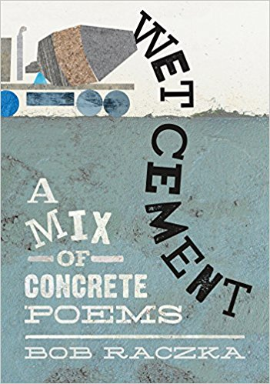
Poetry
Wet Cement: A Mix
Of Concrete Poems,
by Bob Raczka

Slide 9
Poetry
Before Morning, by Joyce Sidman, Illustrated by Beth Krommes

Slide 10
Connections
A Thirst for Home: A Story of Water Across the World, by Christine Ieronimo (2014)
A Long Walk to Water, by Linda Sue Park

Slide 11
Connections
The Power of Kindness: The Unexpected Benefits of Leading a Compassionate Life, by Piero Ferrucci
What Does It Mean to Be Kind?, by Rana DiOrio
We’re All Wonders, by R.J. Palacio

Slide 12
Affective Domain
What Do You Do with a Problem?, by Kobi Yamada
Beautiful Hands, by Kathryn Otoshi
Draw the Line, by Kathryn Otoshi

Slide 13
Amy Krouse Rosenthal
https://www.nytimes.com/2017/03/03/style/modern-love-you-may-want-to-marry-my-husband.html
Cookies
Little Oink
The Wonder Book
Friendshape
That’s Me Loving You

Slide 14
Fiction – Picture books
The Uncorker of Ocean Bottles, by Michelle Cueves
The Cat from Hunger Mountain, by Ed Young
Little Penguins, by Cynthia Rylant
Penguin Problems, by Jory John
Tidy, by Emily Gravett

Slide 15
Fiction Picture Books (cont.)
Ada Twist, Scientist, by Andrea Beaty
Du Iz Tak?, by Carson Ellis (Caldecott Honor book)
I Will Not EAT YOU, by Adam Lehrhaupt
The Branch, by Mireille Messier

Slide 16
Fiction Chapter Books
Just My Luck, by Cammie McGovern
See You in the Cosmos, by Jack Cheng
The Secret Keepers, by Trenton Lee Stewart
The Inquisitor’s Tale, or The Three Magical Children and Their Holy Dog, by Adam Gidwitz

Slide 17
Informational Books
Creature Features: 25 Animals Explain Why They Look the Way They Do, by Steve Jenkins and Robin Page
Flying Frogs and Walking Fish, by Steve Jenkins and Robin Page
Fabulous Frogs, by Martin Jenkins*
The Tragic Tale of the Great Auk, by Jan Thornhill

Slide 18
One Last Thought
A Child of Books, by Oliver Jeffers, illustrated by Sam Winston

