Slide 1

Student Provisioning
Assessment Logistics
September 22,2022
© 2022 Tennessee Department of Education

Slide 3

Agenda
Data Flow
Scheduling for Assessed Courses (SIS)
EIS Business Rules
Visibility Tool & High Priority Metrics

Slide 4
Testing Modes for 2022-23
End of Course (EOC) and Grade 6-8
  Computer-based testing (CBT) via TestNav
    Grades 6-8 and EOC will be online for all subparts of their assessments.
Grades 3-5 and Grade 2 (optional)
  All paper-based testing (PBT) with paper/pencil
  Grade 2 (ELA/Math) and Grade 3 (ELA/Math/Science) in consumable test books
  Grade 3-5 Social Studies remains paused
Notes:
Students testing online will not have a hard copy of the ELA passages.

Slide 5
Data Flow
Overview of provisioning students for TCAP tests.

Slide 6












Data Flow
District SIS
EIS
Visibility Tool PearsonAccess^{Next}

Slide 7
Data Flow
District SIS
EIS
ALL updates to any data must be
completed in your SIS.
Extracts must be sent and received before EIS and Vis Tool update.
Verify that extracts were received if EIS does not update.

Slide 8
Data Flow
EIS
Visibility Tool
VisTool pulls key data points for assessed course codes
It is a data base for ensuring SIS/EIS data is accurate prior to the test administration.
Students will not be in VisTool if all business rules to pull the data are not met in EIS.

Slide 9
Data Flow
Visibility Tool
PearsonAccess^{next}
Pearson receives information containing testing data from VisTool daily.
Pearson uploads that data into the correct administrative platform.
VisTool and PearsonAccess^{next} are “sister platforms” that should be used together when verifying data.

Slide 10
Districts Need Access to These Platforms for Successful Testing
Single Sign ON
  EIS
  VisTool
  TNShare (access to DTC folder)
  Educator Portal
  * The district SIS/EIS Supervisor or Director should submit the District/School Access form to EIS Help Desk.
PearsonAccess^{next}
  DTCs have ability to create accounts for anyone level to or below their role.
  TDOE must create a DTC role.

Slide 11
Scheduling for Assessed Courses
The following course codes register students for specific tests.

Slide 12

Two Very Helpful Webinars
DTC/SIS Supervisor’s Scheduling for Assessment Provisioning webinar
  Recording & FAQ link
  Slide deck
Alternate v. Comprehensive Course Code Training webinar
  Recording & FAQ link
  Slide deck

Slide 13
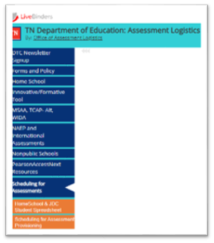


Assessment Course Codes
Scheduling for Assessment Provisioning document in LiveBinders.

Slide 14
Assessed Course Checklist
Appropriate Assessed Course Code
Local Class Number (LCN)
Teacher of Record (TOR) – Only one (“Y”)
Beginning and End dates for the class
  Student
  Teacher
  Class Assignment
Class Period and Duration
Test window set for Fall, Spring, or Traditional.
Notes:
Appropriate Assessed Course Code – Each course code registers a student for a specific test.
Teacher of Record – There can only be one TOR for a class. If the teacher changes, the beginning and end dates cannot overlap. If it is a co-taught class, only one of the teachers can be marked as the TOR.
If adding a new class, double check that the test window is set for the class.

Slide 15
Assessed Course Teacher Checklist
Teacher is listed as a staff member for the school in EIS
Teacher license number
Staff beginning and end dates
  Beginning and end dates cannot overlap when there is a teacher change
Assigned as the TOR of the class
  Only one teacher can be marked as the TOR even if the class is co-taught.

Slide 16
Student Checklist
Active enrollment dates for the district and school in EIS
Current Grade level
Gender
DOB
Other demographic information
Class schedule with at least one assessed course code
  Course Number
  Class section (LCN)
  Student Class Assignment Dates
  Teacher of Record (TOR)
  Period/Duration set

Slide 17

Assessed Course Code Guidance

Slide 18
Different Course Codes
General Education
Tests ACH/EOC
General education students who are taking regular classes
Comprehensive Course Codes
Tests ACH Grades 2-8
For any other student who has significant disabilities but does not meet the eligibility for the alternate assessment
Requires a replacement of core instruction
Alternate Course Codes
Tests TCAP-Alt Grades 3-8
For students who have severe cognitive issues – 1% population

Slide 19

TCAP Achievement (ACH) Assessments Grades 2-8

Slide 20
Achievement Course Codes (ACH)
Grade | Subject | Gen Ed Course Code | Comprehensive Course Code
2 | ELA | G01200 | S01201
2 | MATH | G02200 | S02201
3 | ELA | G01300 | S01301
3 | MATH | G02300 | S02301
3 | SCIENCE | G03300 | S03301
4 | ELA | G01400 | S01401
4 | MATH | G02400 | S02401
4 | SCIENCE | G03400 | S03401
5 | ELA | G01500 | S01501
5 | MATH | G02500 | S02501
5 | SCIENCE | G03500 | S03501
These course codes register students for spring TCAP ACH assessments

Slide 21
Achievement Course Codes (ACH)
Grade | Subject | Gen Ed Course Code | Comprehensive Course Code
6 | ELA | G01600 | S01601
6 | MATH | G02600 | S02601
6 | SCIENCE | G03600 | S03601
6 | SOCIAL STUDIES | G04600 | S04601
7 | ELA | G01700 | S01701
7 | MATH | G02700 | S02701
7 | SCIENCE | G03700 | S03701
7 | SOCIAL STUDIES | G04700 | S04701
8 | ELA | G01800 | S01801
8 | MATH | G02800 | S02801
8 | SCIENCE | G03800 | S03801
8 | SOCIAL STUDIES | G04800 | S04801
These course codes register students for spring TCAP ACH assessments

Slide 22
TCAP End of Course (EOC) Assessments High School

Slide 23
EOC Regular Math Course Codes
Grade Level | Course | Course Code
7-8 | ALGEBRA I | G02X02
9-12 | ALGEBRA I | G02H00
7-8 | GEOMETRY | G02X03
9-12 | GEOMETRY | G02H11
9-12 | ALGEBRA II | G02H05
7-8 | INTEGRATED MATH I | G02X00
9-12 | INTEGRATED MATH I | G02H19
7-8 | INTEGRATED MATH II | G02X01
9-12 | INTEGRATED MATH II | G02H20
9-12 | INTEGRATED MATH III | G02H21
Test windows should be marked fall for fall block classes, spring for spring block classes, and traditional for year-long classes

Slide 24
EOC Extended Scheduling Math Course Codes
Course | Tested Course Code | Elective Course Code
ALGEBRA I (PART 1) |  | G02H01
ALGEBRA I (PART 2) | G02H02
GEOMETRY (PART 1) |  | G02H12
GEOMETRY (PART 2) | G02H13
ALGEBRA II (PART 1) |  | G02H06
ALGEBRA II (PART 2) | G02H07
INTEGRATED MATH I (PART 1) |  | G02H27
INTEGRATED MATH I (PART 2) | G02H28
INTEGRATED MATH II (PART 1) |  | G02H31
INTEGRATED MATH II (PART 2) | G02H32
INTEGRATED MATH III (PART 1) |  | G02H35
INTEGRATED MATH III (PART 2) | G02H36
Used for any student who needs extended learning in math.
Part 1 and 2 are taken during the same school year.
Test window must be set for tested course code.

Slide 25
EOC A/B Math Course Codes
Math courses for students with qualifying disability
Each course counts as a math credit, so one course taken each year of high school.
Test window must be set for tested course code.
Course | Tested Course Code | Non-Tested Course Code
ALGEBRA I A |  | G02H03
ALGEBRA I B | G02H04
GEOMETRY A |  | G02H14
GEOMETRY B | G02H15
INTEGRATED MATH I A |  | G02H29
INTEGRATED MATH I B | G02H30
INTEGRATED MATH II A |  | G02H33
INTEGRATED MATH II B | G02H34

Slide 26
EOC Course Codes for English, Science and Social Studies
Course | Tested Course Code | Non-Tested Course Code
ENGLISH I | G01H09
ENGLISH II | G01H10
BIOLOGY I | G03H03
BIOLOGY I (PART 1) (EXTENDED SCHEDULING) |  | G03H04
BIOLOGY I (PART 2) (EXTENDED SCHEDULING) | G03H05
BIOLOGY A (SPECIAL EDUCATION) |  | G03H06
BIOLOGY B (SPECIAL EDUCATION) | GO3H07
U.S. HISTORY | G04H11
Test windows should be marked fall for fall block classes, spring for spring block classes, and traditional for year-long classes

Slide 27
EOC Course Codes for IGCSE Courses
Course | Tested Course Code | EOC Test
IGCSE ENGLISH LANGUAGE | G01H39 | ENGLISH I
IGCSE ENGLISH LITERATURE | G01H43 | ENGLISH II
IGCSE MATHEMATICS I | G02H54 | INTEGRATED MATH I
IGCSE MATHEMATICS II | G02H55 | INTEGRATED MATH II
IGCSE MATHEMATICS III | G02H56 | INTEGRATED MATH III
IGCSE BIOLOGY | G03H53 | BIOLOGY
Test windows should be marked fall for fall block classes, spring for spring block classes, and traditional for year-long classes

Slide 28
EOC Comprehensive Course Codes
Test registration is based off of course code and grade level
Test window should be set to Spring or Traditional
Testing will occur in the spring semester.
Grade | Subject | Course Code | EOC Test
10 | SCIENCE | S03H03 | BIOLOGY
11 | ENGLISH | S01H04 | ENGLISH II
11 | MATH | S02H04 | ALGEBRA I

Slide 29
TCAP Alternate (ALT) Assessments Grades 2-11

Slide 30
Achievement Course Codes (ACH)
Grade | Subject | Comprehensive Course Code
2 | ELA | S01200
2 | MATH | S02200
3 | ELA | S01300
3 | MATH | S02300
3 | SCIENCE | S03300
4 | ELA | S01400
4 | MATH | S02400
4 | SCIENCE | S03400
5 | ELA | S01500
5 | MATH | S02500
5 | SCIENCE | S03500
These course codes register students for spring TCAP ALT assessments.

Slide 31
Achievement Course Codes (ACH)
Grade | Subject | Comprehensive Course Code
6 | ELA | S01600
6 | MATH | S02600
6 | SCIENCE | S03600
6 | SOCIAL STUDIES | S04600
7 | ELA | S01700
7 | MATH | S02700
7 | SCIENCE | S03700
7 | SOCIAL STUDIES | S04700
8 | ELA | S01800
8 | MATH | S02800
8 | SCIENCE | S03800
8 | SOCIAL STUDIES | S04800
These course codes register students for spring TCAP ALT assessments

Slide 32
EOC Alternate Course Codes
Test registration is based off of course code and grade level.
Test window should be set to Spring or Traditional
Testing will occur in the spring semester.
Grade | Subject | Course Codes
10 | SCIENCE | S03H00, S03H01, S03H02
11 | ENGLISH | S01H00, S01H01, S01H02, S01G03
11 | MATH | S02H00, S02H01, S02H02, S02H03

Slide 33
English Learners (EL) Assessments Grades K-12

Slide 34
EL Course Code Tidbits
EL Course Codes DO NOT provision ELPA.
  ELAP is provisioned by “L” or “W” codes in EIS.
Qualifying students MUST be enrolled in an EL course and ELA/ENG course in the same year (K-8 & 9-12).
K-8 students with WIDA score of 3.5 – 4.2 should be enrolled in course code G22X01 and the appropriate ELA ACH course code.

Slide 35
EL and ELA Course Codes for
Grades 2-8
This
One of these
Grade | EL Course Code | Gen Ed Course Code | Comprehensive Course Code | Alternate Course Code
2 | G22200 | G01200 | S01201 | S01200
3 | G22300 | G01300 | S01301 | S01300
4 | G22400 | G01400 | S01401 | S01400
5 | G22500 | G01500 | S01501 | S01500
6 | G22600 | G01600 | S01601 | S01600
7 | G22700 | G01700 | S01701 | S01700
8 | G22800 | G01800 | S01801 | S01800

Slide 36
EL Course Code Tidbits
Grade 9-12 students must take at lease one ENG assessment while in High School.
  Student must be enrolled in English I or English II the year they take the assessment
WIDA proficiency levels below 3.5 use course codes G22H00 – G22H03.
Course code G22H04 is used when proficiency level is 3.5 or higher.

Slide 37
EL Course Codes Guidance for
Grades 9-12
Grade | WIDA Proficiency | Student must be enrolled in an ESL course | ESL Course Code | Can ESL course count toward 2 of the 4 required English credit graduation requirements? | Is an English course needed in addition to the ELS course?
9 | 1 to 3.4 | Y | G22H00 | Y | N
 | 3.5 and above | Y | G22H04 | N | Y
10 | 1 to 3.4 | Y | G22H01 | Y | N
 | 3.5 and above | Y | G22H04 | N | Y
11 | 1 to 3.4 | Y | G22H02 | Yes, if G22H00 OR G22H01 has been completed No, if two ELS classes have been counted toward English credits | Yes, if two English credits have already been given for ESL courses
 | 3.5 and above | Y | G22H04 | N | Y
12 | 1 to 3.4 | Y | G22H03 | Yes, if G22H00 OR G22H01 has been completed No, if two ELS classes have been counted toward English credits | Y
 | 3.5 and above | Y | G22H04 | N | Y

Slide 38
EIS Business Rules
These Business Rules must be applied for student data to pull into VisTool.

Slide 39

Business Rules for EIS Enrollment
For a student record to result in a test registration, the student must have:
Active Enrollment in a school/district
Instructional Grade record for that enrollment
Student Class Assignment (course code) for that enrollment
Class Section (local class number) for the student class assignment
Teacher identified as the teacher of record for the class section
Valid Teacher License number for the teacher of record
Test Window set (data piece missing most often)
Begin/End Dates for Teacher and Student Class

Slide 40

EIS: Student Enrollment
If either of these are missing, the class schedule will not load
USID: Unique State Identification

Slide 41
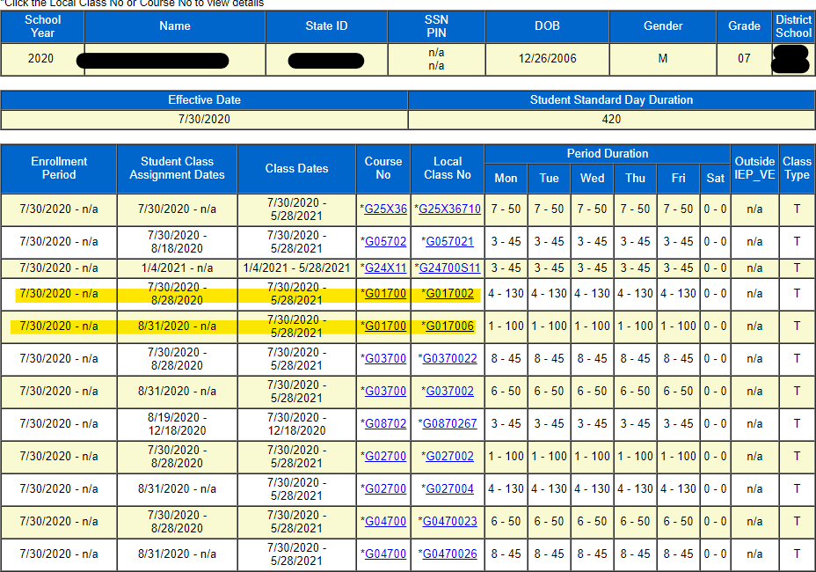

EIS: Student Schedule
If there is a schedule change, dates cannot overlap.

Slide 42
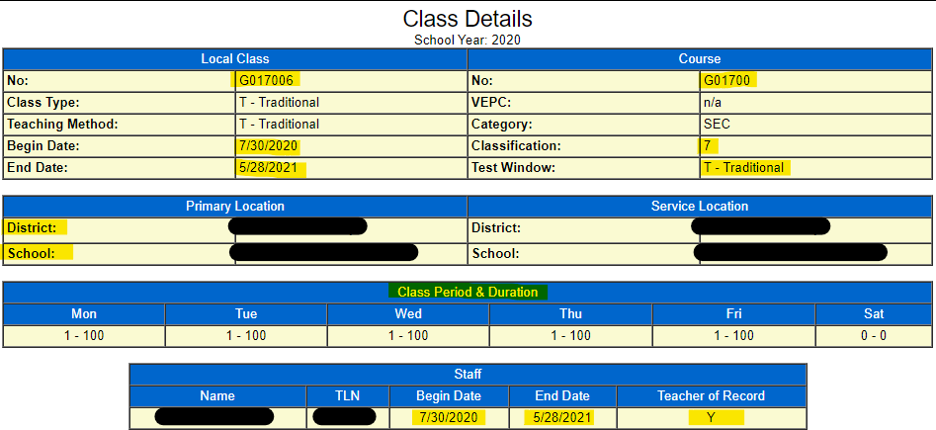

EIS: Student Assessed Course
Check for beginning and end dates for the class
Test window set
Class period and Duration (if pull out, may show 0)
Teacher of record is assigned, has TLN, beginning dates and marked Y as TOR.

Slide 43

Other Data Points
Schedules under Primary Enrollment are the only courses that pull for assessments.
Students can only be enrolled in one school in the testing platform.
A student’s schedule in EIS needs to show the courses and assessments the student is taking.
  An 8th grade student taking Biology for high school credit will take the Biology EOC.
  A student in alternative school must have the assessed course codes on their schedule if they need to take an assessment for a class.

Slide 44
Visibility Tool and High Priority Metrics
How to use VisTool and common High Priority Metrics

Slide 45
Checking TCAP Visibility Tool
VisTool is the platform that helps us know if there are issues with data in the district SIS or in EIS.
It ensures data is clean before PearsonAccess^{next} opens.
It ensures no classes or students are missing so all students will be in PearsonAccess^{next} for all assessed courses.
It is important to start checking VisTool as soon as it opens, and student schedules are in EIS.

Slide 46
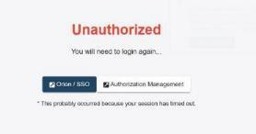
TCAP Visibility Tool Troubleshooting
If you receive this message when logging into VisTool:
  Check the clock on your computer to make sure it has the correct time.
  If it is off by more than 30 seconds of the time in EIS, it will result in this error.
  Reset your computer clock if necessary.

Slide 47
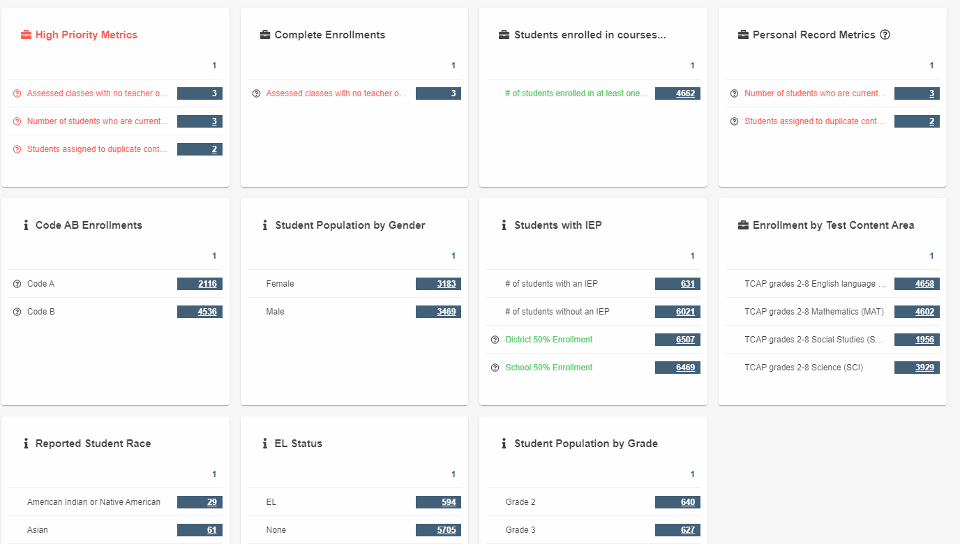
TCAP VisTool
All DTCs and BTCs should have access to this app in SSO.
  SIS/EIS supervisors and special pops supervisors may want access.
Data is pulled from EIS into VisTool daily.
Each Tile gives information on student data.
  Tiles with the i icon contain school information
  Tiles with the briefcase have EIS business rules applied
  Only student scheduled for at least one assessed course will be in VisTool.

Slide 48
TCAP VisTool Tiles
Demographic Tiles ensure the accuracy for reporting. They include:
  Student Population by Gender
  Code AB Enrollments
  Students with IEP
  Reported Student Race
  EL Status
  Student Population by Grade
Enrollment by Test Content Area is a spreadsheet listing all students pulling for a specific subject.
High Priority Metrics show business rules that are not met which may keep students from registering for a test.
Students enrolled in courses lists all assessed courses a student has on their schedule.

Slide 49
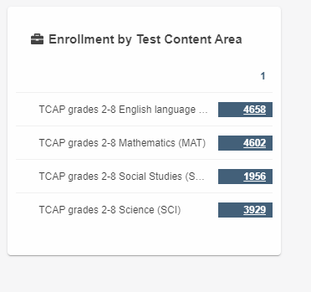
Enrollment by Test Content Area
The number tells how many students are scheduled for the specific test.
You can download the spreadsheet by content area to see a list of students and class information.
If the number is lower than expected, then the test windows may not be set for some sections.
Starting checking data as soon as schedules are loaded into EIS.

Slide 50
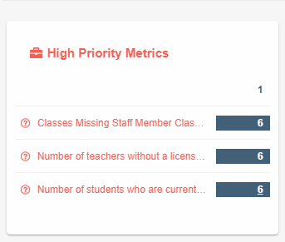
High Priority Metrics
Gives district/school information on why students or classes may not load.
Can only be and must be corrected in your SIS
  Extract to EIS
  In Vis Tool next morning if successful
Use the circled ? to open the list.
Prevents upload into PearsonAccess^{next}.

Slide 51
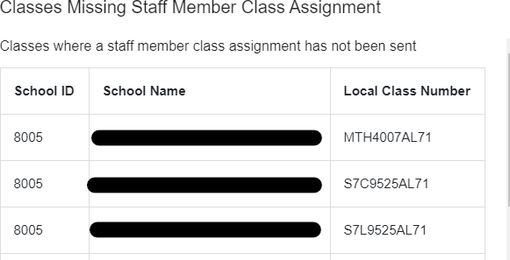
High Priority Metrics
Identifies the type of High Priority Metric
Identifies the local class number in EIS
Identifies the School ID and Name

Slide 52
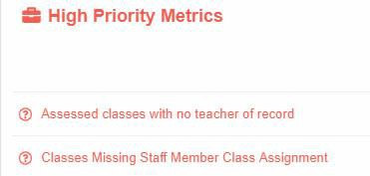
High Priority Metrics (Class)
Assessed classes with no teacher of record*
Classes with multiple teachers of record with same dates or overlapping dates
Classes missing staff member class assignment*
Course codes in the wrong test window
End of date of first semester is in January
  Should be the last day of student attendance for fall semester
High priority metric errors are usually a SIS to EIS issue

Slide 53
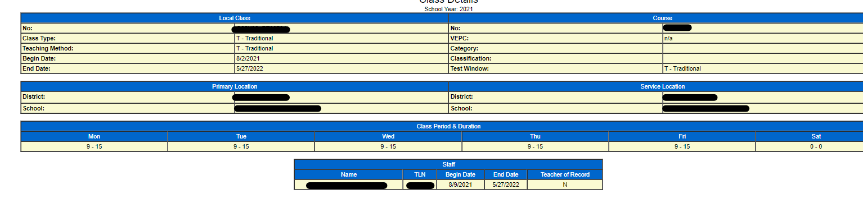
High Priority Metrics (Class)
Assessed Class with no TOR
  Teacher is not marked as TOR as shown
  TOR has an end date before the end of the class meet date
  TOR was deleted so the class will also be deleted from VisTool.

Slide 54
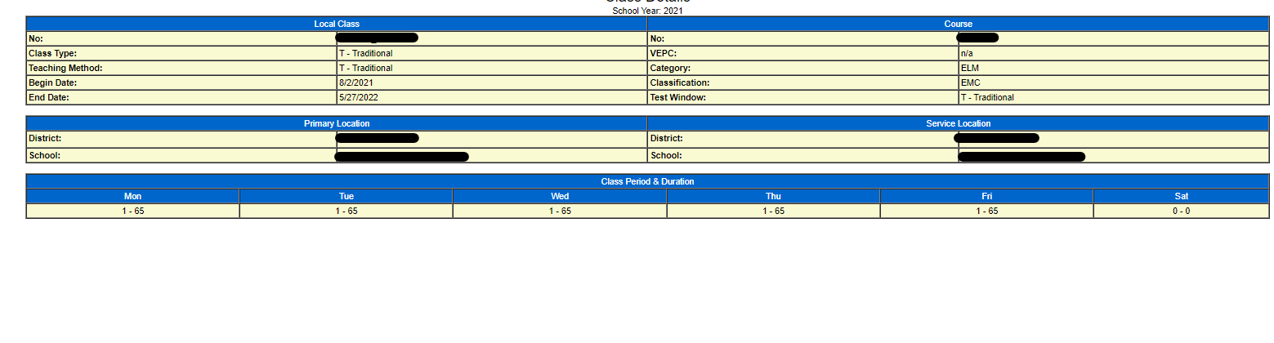
High Priority Metrics (Class)
Classes missing staff member class assignments
  A class with students assigned to it must also have a teacher assigned with a Teacher License Number (TLN).
  Check to see if the missing teacher is on the school staff list in EIS.

Slide 55
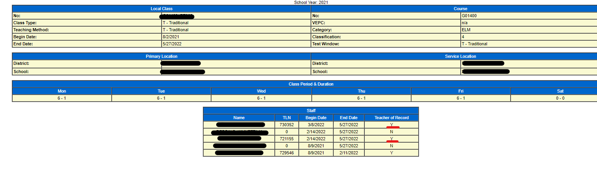
High Priority Metrics (Class)
Multiple teachers of record
  There can only be one teacher marked as the TOR for the class with the same dates
  If the teacher changes during the year, the dates cannot overlap.
  If that happens, check the Enrollment by Content spread sheet to verify the correct TOR is listed. This is the data that gets sent to PearsonAccess^{next}.

Slide 56
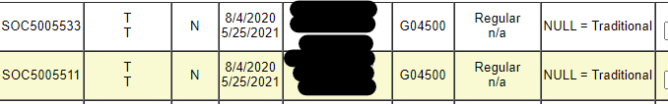
High Priority Metrics (Class)
Test Window Not Set for Class
  Null = Traditional will not pull students into VisTool
  Test window must be set to Fall, Spring, or Traditional according to the class begin and end dates.
    Fall – fall block classes that test in the fall administration.
    Spring – spring block classes that test in the spring administration.
    Traditional- Year-long courses that test in the spring administration.
    All ALT and Comprehensive course codes are set as Traditional or Spring and test during spring administration.

Slide 57
High Priority Metrics (Class)
End Dates
End dates end prior to assessment window
The class will be dropped from VisTool on the end date (10/23/2020)
  Dropped from Vis Tool and PearsonAccess^{next} on end date
  Very Critical when the date occurs during data/student counts in PearsonAccess^{next}
To fix the issue
  Students and teacher should be scheduled for the second part of the semester to pull back into the VisTool and PearsonAccess^{next}
  Change the dates to end after the test administration

Slide 58
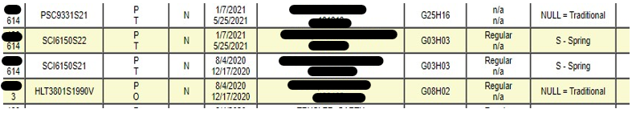
High Priority Metrics (Class)
Test Window does not match with begin/end dates
  Dates are set to fall ending in December.
  Test Window set to Spring.
  Will pull for spring into VisTool or PearsonAccess^{next}.

Slide 59
High Priority Metrics (Class)
End date for class ends in January
  Assessed courses should end on the last day students attend class for the semester.
  Class dates ending in January may not pull into VisTool or PearsonAccess^{next} correctly.

Slide 60
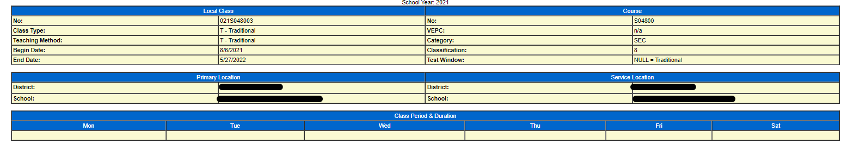
High Priority Metrics (Class)
Class missing class period and duration
  This class won’t pull into Vis Tool because it technically doesn’t meet.
  A class type listed as pull out that has 0-0 in this area does pull.

Slide 61
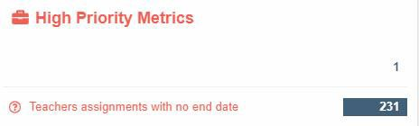
High Priority Metrics (Teacher)
Teachers without an email address
Teachers without a license number
Teacher assignments with no end date for fall administration

Slide 62
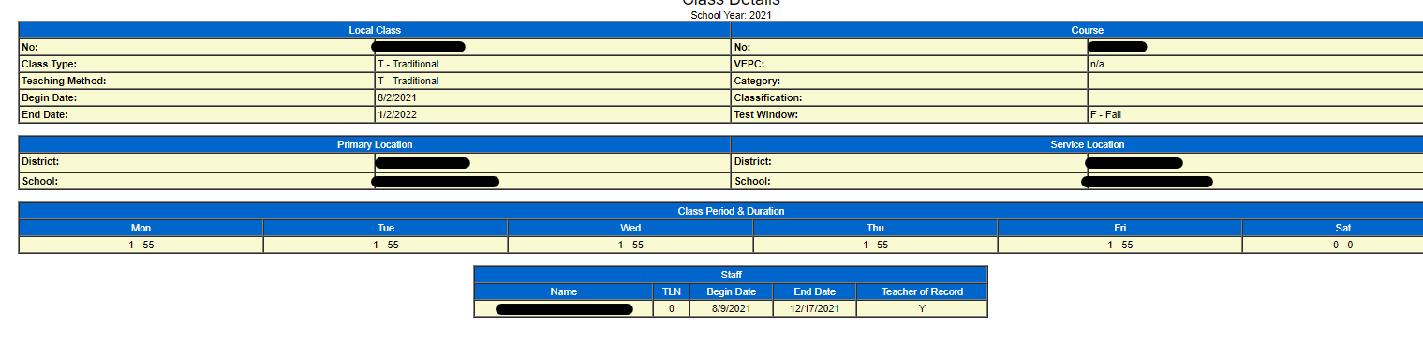
High Priority Metrics (Teacher)
No teacher license number
  Students in a class with a teacher without a teacher license who is marked as the TOR will not pull into VisTool or PearsonAccess^{next}

Slide 63
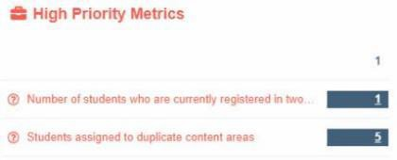
High Priority Metrics (Student)
Students assigned to duplicate content areas
Students who are currently registered in two different districts and/or schools
Students not enrolled in at least one assessed course code
Students with incomplete enrollments
Students with an assigned grade of P3, P4, etc.
Students listed in two different grades

Slide 64
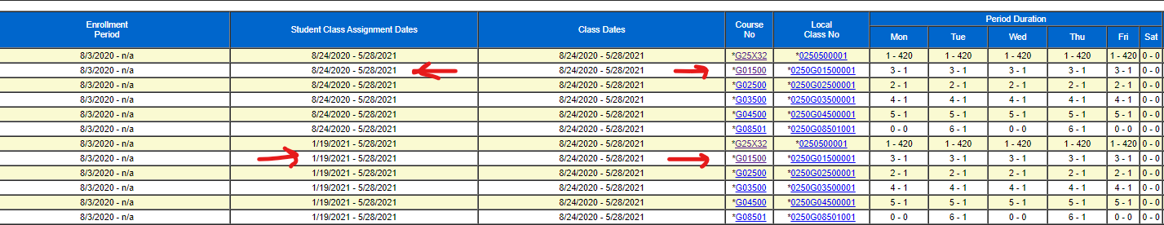
High Priority Metrics (Student)
Students assigned to duplicate content areas
  Students cannot be assigned an assessed course code twice.
  The student class assignment dates cannot overlap if a student changes sections of an assessed course.

Slide 65
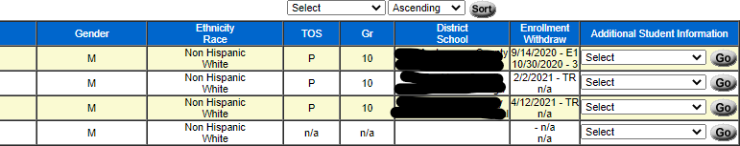
High Priority Metrics (Student)
Students registered in two districts
  Cannot be entered in two districts/schools during the same dates
  The withdraw and enrollment dates should not overlap or be on the same day.

Slide 66
High Priority Metrics (Student)
Students not enrolled in at least one assessed course code
  Must be enrolled in the appropriate assessed course codes to register for testing.
  All assessed course codes can be found in the Provisioning for Assessments Guide in LiveBinders.

Slide 67
High Priority Metrics (Student)
Student with incomplete enrollments
  Check EIS if a student is enrolled in your SIS but not in EIS.
  A student cannot be missing a primary enrollment, grade level, enrollment dates, or a class schedule and demographic information will not pull into the VisTool or PAN.

Slide 68
High Priority Metrics (Student)
Students listed in two different grade levels
  This can happen if districts enroll the student in a different grade level from the previous district or the student is enrolled without a grade level in a district.
  Students will often register as kindergarten students in PAN when this occurs.

Slide 69

Why is Visibility Tool Important?
Eliminates clean-up
Ensures your data is clean
Reduces additional orders for paper tests
Prevents last minute stress to fix and clean data
It is the only way to get data to PearsonAccess^{next}
– Students not in PearsonAccess^{next} will not be able to take tests online during the administration window
Ensure accurate results, data, and next steps!

Slide 70
Support and Resources
District Technology Support Desk
DT.Support@tn.gov
For help with EIS issues
Tonya Chase
Tonya.F.Chase@tn.gov
For help when students are not loading into VisTool or PAN and any questions you may have
Denette Kolbe
Denette.Kolbe@tn.gov
For help when students are not loading into VisTool or PAN and any questions you may have
LiveBinders
Visibility Tool Tab
Assessment Provisioning Guide
Milestones Document

Slide 71







Questions?

Slide 72

Thank You!
#TNBestforAll

