Slide 1
Cancer Care Delivery: Where are we headed?
Anne M Ireland, MSN, RN, AOCN, CENP
Clinical Director, Solid Tumor Program
City of Hope, Duarte, CA

Slide 2
The compelling story
>1.6 million new cases of cancer diagnosed in 2016
600,000 Americans died of cancer in 2016 (the majority of these being >65)
Medical expenditures for cancer in the year 2020 are projected to reach at least $158 billion (in 2010 dollars) –an increase of 27 percent over 2010.

Slide 3
Oncology Care model (OCM)
A bundled payment program established under the Center for Medicare and Medicaid Services Innovation Center (CMMI) as a component of the Affordable Care Act (ACA)
Part of the Obama administration’s commitment to shift 50% of FFS payments to value-based care by the end of 2018
The bundled payment model includes the following characteristics:
Condition specific
Includes nearly all services providers to patients (“episode”)
Episode begins with a trigger event
Total payments during an episode must fall below a threshold in order for a provider to receive savings

Slide 4
Oncology Care Model (OCM)
Focuses on episodes of cancer care that include chemotherapy
Goals are to utilize aligned financial incentives to improve:
Care Coordination
Appropriateness of Care
Access for beneficiaries undergoing chemotherapy
Financial incentives encourage participating practices to work collaboratively with other providers to address the complex care needs of patients receiving chemotherapy and encourage the use of services that improve health outcomes

Slide 5
Ocm overview
Episode-based
Payment model targets chemotherapy and related care during a 6-month period that begins with receipt of chemotherapy treatment
Emphasizes practice transformation
Physician practices are required to implement “practice redesign activities” to improve the quality of care they deliver
Multi-payer model
Includes Medicare fee-for-service and other payers working in tandem to leverage the opportunity to transform care for oncology patients across the practice’s population
Timeline: July 1, 2016-June 30, 2021

Slide 6
Practice redesign activities
Provide Enhanced Services
Provide OCM Beneficiaries with 24/7 access to an appropriate clinician who has real-time access to the Practice’s medical records
Provide the core functions of patient navigation to OCM Beneficiaries
Document a care plan for each OCM Beneficiary that contains the 13 components in the Institute of Medicine Care Management Plan
Treat OCM Beneficiaries with therapies that are consistent with nationally recognized clinical guidelines

Slide 7
Practice redesign activities (cont’d)
Use certified electronic health record technology (CEHRT)
OCM Practices must use CEHRT in a manner sufficient to meet the requirements of an “eligible alternative payment entity” under the MACRA rule implementing the Quality Payment Program.
Utilize data for continuous quality improvement
Practices must collect and report clinical and quality data to the Innovation Center. In addition, the Innovation Center will provide participating practices with feedback reports for practices to use to continuously improve OCM patient care management.

Slide 8
Ocm practices
Nearly 200 oncology practices are participating in OCM.
OCM Practices:–Medicare-enrolled physician groups identified by a single Taxpayer Identification Number (TIN)
Composed of one or more physicians who treat Medicare beneficiaries diagnosed with cancer
Cover urban, suburban and rural areas
Range in size from solo oncologists to large practices with hundreds of providers

Slide 9
Ocm payers
16 commercial insurers including regional and national organizations
Goal is to provide aligned financial support and quality measurement across a practice’s patient population, in order to facilitate whole practice change
CMS and the payers will convene regularly to share lessons learned on engaging in alternative payment model work that supports oncology practice transformation

Slide 10
Ocm-ffs episode definition
Types of cancer
•OCM-FFS includes nearly all cancer types
Episode initiation
Episodes initiate when a beneficiary receives a qualifying chemotherapy drug
The list of qualifying chemotherapy drugs that trigger OCM-FFS episodes includes endocrine therapies but excludes topical formulations of drugs
Included services
All Medicare A and B services that Medicare FFS beneficiaries receive during the episode
Certain Part D expenditures are also included: the Low Income Cost Sharing Subsidy (LICS) amount and 80 percent of the Gross Drug Cost above the Catastrophic (GDCA) threshold
Episode duration
OCM-FFS episodes extend six months after a beneficiary’s triggering chemotherapy claim
Beneficiaries may initiate multiple episodes during the five-year model

Slide 11
Ocm-ffs risk arrangement options
One-Sided
OCM practices are NOT responsible for Medicare expenditures that exceed the target price
Medicare discount = 4%
OCM practices in one-sided risk are in a MIPS APM
Must qualify for performance-based payment by mid-2019 to remain in one-sided risk
Two-Sided
OCM practices are responsible for Medicare expenditures that exceed target price
Option to take two-sided risk begins in 2017
Medicare discount = 2.75%
OCM practices in two-sided risk that meet the QP threshold are in an Advanced APM

Slide 12
ocm-ffs quality measures

Slide 13
Monitoring and evaluation
Monitoring aims to assess participants’ compliance, understand use of model funding, and promote the safety of the beneficiaries and the integrity of model. Monitoring data sources may include:
Claims data;
Practice-reported quality measure and clinical data;
Medical records;
Patient surveys and patient feedback;
Interviews with OCM Beneficiaries and their caregivers;
Site visits;
Documentation requests, including responses to surveys and questionnaires.
Evaluation: CMS’s independent evaluation contractor is employing a non-randomized research design using matched comparison groups to detect changes in utilization, costs, and quality that can be attributed to the model

Slide 14
Caring for Seriously Ill Patients and Implementing Better Symptom Management

Slide 15
Caring for seriously ill patients
25% of all Medicare dollars are spent on treatment during the final year of life
33% of the final-year expenditures is squeezed into the last month of life
80% of spending is for hospital-based treatment, much of it in ICUs
25% of all hospice patients get enrolled 3 days prior to death

Slide 16
Better Symptom Management
Laura Panattoni, MD, Fred Hutchison’s Cancer Research
Analyzed 1,581 patients with solid tumor cancers in Washington state
53% of ED visits categorized as potentially preventable due to cancer-related symptoms
27% of ED visits has a pain diagnosis, followed by fever and dyspnea (6% each)
OCM includes risk-adjusted ED utilization and hospitalization as performance metrics
CMS is proposing a new quality metric – the Admissions and Emergency Dept Visit for Patients receiving Outpatient Chemotherapy Measure – to go into effect 2020

Slide 17
Better Advanced illness management (AIM) – Sutter health
$13 million grant from the CMMI
Focused on providing advanced care planning for patients with advanced chronic illnesses
Home based care by skilled staff
Proactive management of pain and suffering
Patient, family and caregiver education about disease process, prognosis and options for care, including hospice
Frank discussions about what patient wants as disease progresses
Clear documentation across the system
Attention to caregiver needs/burden

Slide 18
Sutter’s report
AIM saved $5,700 per patient in the final month of like and served more than 16,000 patients
High level of patient/family satisfaction
Source: Giving Seriously Ill Patients More Choices About their Care.
Harvard Business Review, May 23, 2017.

Slide 19
Inter-professional Care Coordination of the Complex Patient
A City of Hope Program to improve care coordination for our patients and their families

Slide 20
The Real Challenge
People diagnosed with cancer are faced with
a life-threatening diagnosis
numerous treatment choices
variable levels of severity of short-and long-term toxicities across many months to years
People diagnosed with cancer always worry their cancer will come back someday

Slide 21
The Obvious Need
People diagnosed with cancer need someone to help them navigate through the complexity of their care

Slide 22
The Nursing Intervention
“The oncology nurse functions as a patient coordinator and collaborates with other health care team members to provide high-quality interdisciplinary care. The nurse acts as a patient navigator and advocates for and assists patients and families to gain information, ensuring informed consent for treatment decisions and promoting maximal patient autonomy.”
Source: Brant, J. M. & Wickham, R. (Eds.) (2013). Statement on the Scope and Standards of Oncology Nursing Practice: Generalist and Advanced Practice. Pittsburgh, PA: Oncology Nursing Society

Slide 23
The Reality
Nursing has not consistently demonstrated our role in care coordination
Patients’ care is increasingly fragmented between care providers in multiple organizations
We (Nursing) have to do better

Slide 24
City of Hope Approach
Disease-based Care Teams
- Urology
- GI/Colorectal
- Neuro
- Melanoma
- Pulmonary
- Head and Neck
- Breast/GYN
- Pediatric Sarcoma

Slide 25
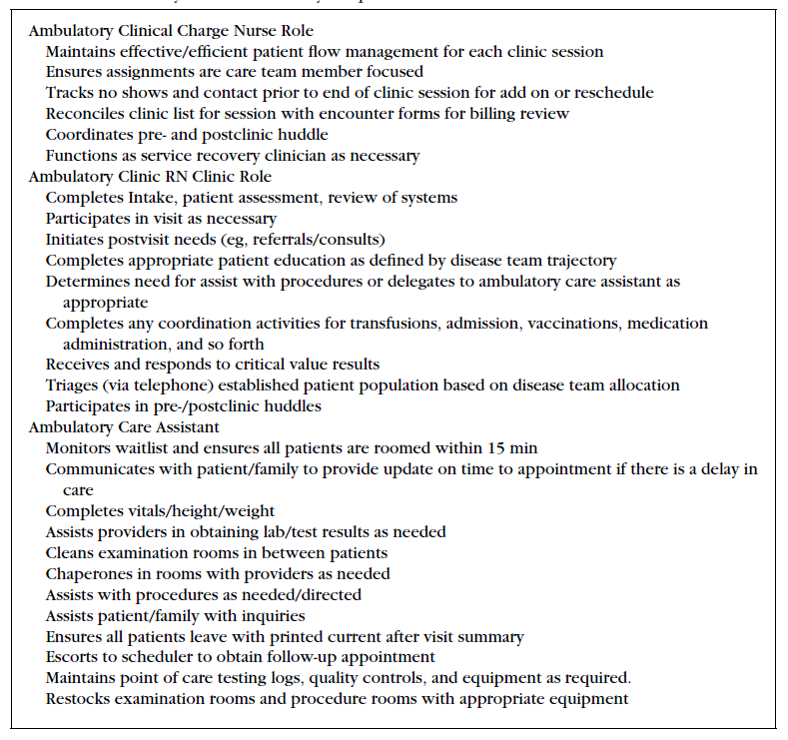
Role clarification in ambulatory setting

Slide 26
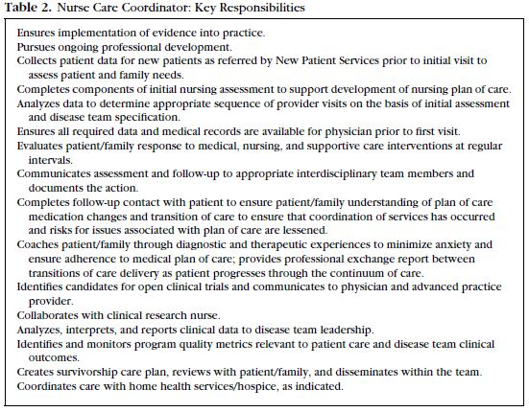
NURSE CARE COORDINATOR- Key Responsibilities

Slide 27
NCC ORIentation/competencies
Disease-specific education
ELNEC (End-of-Life Nursing Education Consortium)
CARES Model
COMFORT Communication Model
Pain Resource Nurse Training
CITI Human Subjects Research Training
ONS Chemotherapy/Biotherapy Course
OCN Certification
Notes:
CARES – Bonnie Freeman
C – comfort
A – aireway
R – restlessness
E – emotional
S – selfcare
COMFORT – Elaine Wittenberg, PhD
Communication – narrative clinical practice
Orientation and Opportunity – health and cultural literacy
Mindful presence – presence in practice
Family – presence of family
Openings – transitions in care
Relating – patient and family needs
Team – teamwork
CITI = Collaborative Institutional Training Initiative – Human Subjects Training course

Slide 28
Staffing Model

Slide 29
Interdisciplinary Team members
Varies based on the disease team and patient population needs:
Clinic Nurse
Clinic MA
Nurse Care Coordinator
Clinical Research Nurse
Case Manager
Nurse Practitioner
Attending Physician
Social Worker
Psychologist/Psychiatrist
Chaplin
Pain/Palliative Care Specialist
Financial Counselor
Occupational Therapist/Physical Therapist
Speech Language Pathologist
Pharmacist
Lay Navigator
Interpreter

Slide 30
Interdisciplinary team Processes
Weekly team meetings
Daily huddles
End of Clinic Debriefs

Slide 31
Interdisciplinary Team challenges
Physical Space limitations
Lack of understanding of roles/capabilities
Clinical Handoffs
Lack of integrated care planning

Slide 32
Progress Report
# patients served in first year = approx. 2500
Average active patient caseload per NCC = 40

Slide 33
Progress Report
Role delineation is illustrating the need for
MORE nurses in Nurse Care Coordinator role
Consider retitling of roles
Clinic RN → Nurse Coordinator
Nurse Care Coordinator → Oncology Nurse Navigator

Slide 34
Outcomes
Patient Satisfaction
Care Coordination
Provider Satisfaction
Unplanned Readmission
Length of Stay

Slide 35
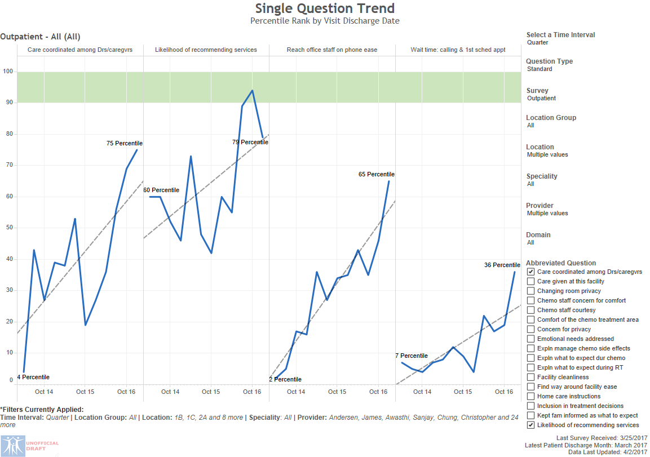
Patient Satisfaction: Breast, Gynecology, Plastics
Notes:
Other projects:
Chemo teaching for Breast med onc- >85% compliance, 56 chemo ed appts to date, scores trending up.
Care model work- team assignments and meetings
Avoid ETC admissions
Tracking call backs
Program implementation- scalp cooling

Slide 36
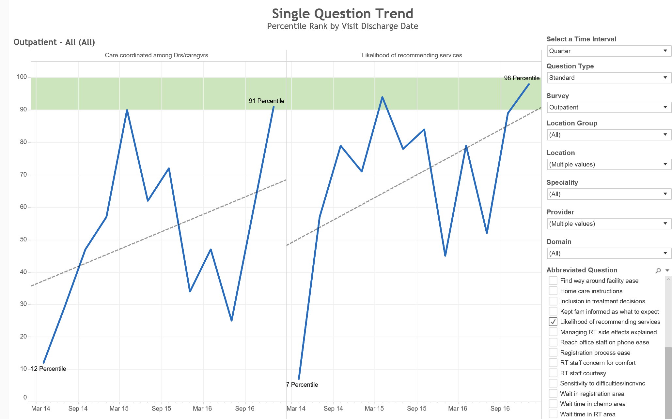
Patient Satisfaction - GU
“Care Coordination”
“Likelihood to Recommend”
b
98th
91st

Slide 37
Provider satisfaction
“I know my team and they know me”
“My patients feel supported throughout the process”
Improved education/support reduces patient phone calls as they know what to expect
Phone calls are managed quickly
Team assist in transitions between treatment modalities
Team facilitates timely and better planning for Survivorship transition

Slide 38
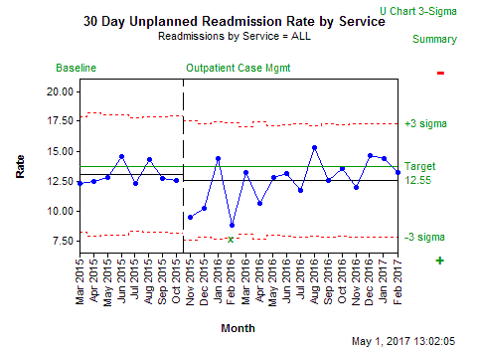
Unplanned readmissions

Slide 39
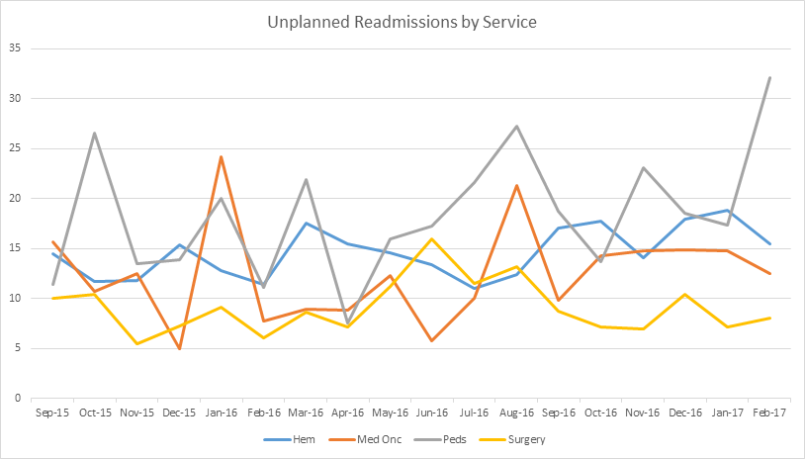
Unplanned readmissions

Slide 40
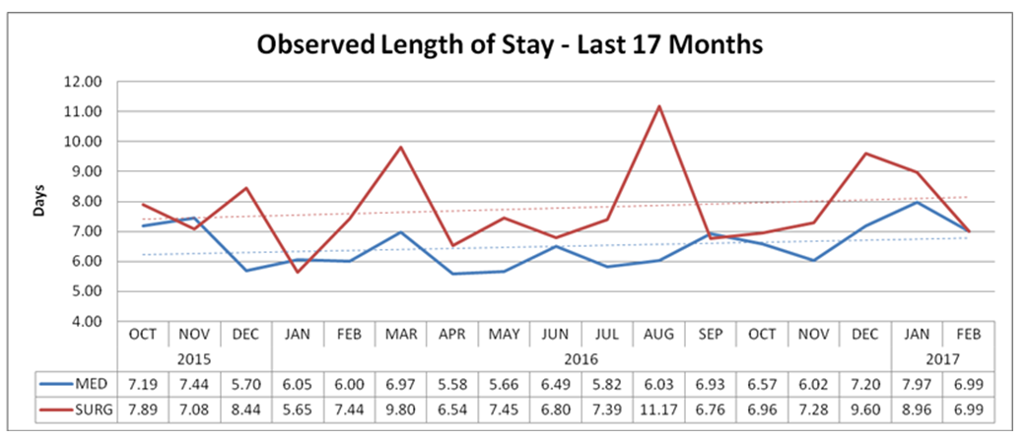
LENgth of stay

Slide 41
What is the future of the ONN Role?

Slide 42
Oncology Nurse Navigation
Results of the ONS/ONCC 2016 Role Delineation Study
“The ONN role is evolving, and more was learned about its key tasks…however, the role delineation study did not find an adequate difference in the knowledge required by the ONN and the clinical or staff nurse to support the need for a separate ONN certification”
Lubejko et al. (2017). Oncology Nurse Navigation: Results of the 2016 role delineation study. CJON, 21 (1), 43-50

Slide 43
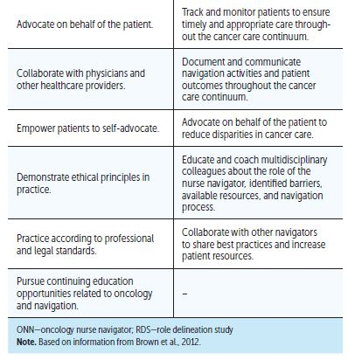
Top Tasks of the ONN
Source: Lubejko et al. (2017). Oncology Nurse Navigation: Results of the 2016 role delineation study. CJON, 21 (1), 43-50

Slide 44
Future Considerations
Survivorship
Home Health
Oral Chemotherapy Monitoring
eHealth
Interdisciplinary education/experiential opportunities

Slide 45
Resources
ONS Oncology Nurse Navigator Toolkit
Helping Patients Navigate Financial Issues
ONN Job Responsibilities & Requirements
2017 ONN Competencies
Blaseg, K.D., Daugherty, P., & Gamblin, K.A. (2014). Oncology Nurse Navigation – delivering patient-centered care across the continuum. Pittsburgh, PA: Oncology Nursing Society

Slide 46
Thank you!
aireland@coh.org

