Slide 1
Chapter 14
Essentials of Leadership

Slide 2
Planning Ahead — Chapter 14 Study Questions
What is the nature of leadership?
What are the important leadership traits and behaviors?
What are the contingency approaches to leadership?
What are current issues in personal leadership development?

Slide 3
Chapter 14 Learning Dashboard
The Nature of Leadership
Leadership and power
Leadership and vision
Leadership as service
Leadership Traits and Behaviors
Leadership traits
Leadership behaviors
Classic leadership styles

Slide 4
Chapter 14 Learning Dashboard
Contingency Approaches to Leadership
Fiedler’s contingency model
Hersey-Blanchard situational model
Path-goal theory
Leader-member exchange theory
Leader-participation model
Personal Leadership Development
Charismatic and transformational leadership
Emotional intelligence and leadership
Gender and leadership
Moral leadership
Drucker’s “old-fashioned” leadership

Slide 5
Takeaway 1: The Nature of Leadership
Leadership
The process of inspiring others to work hard to accomplish important tasks
Contemporary leadership challenges:
Shorter time frames for accomplishing things
High performance expectations
Complex, ambiguous, and multidimensional problems
Scarce resources

Slide 6
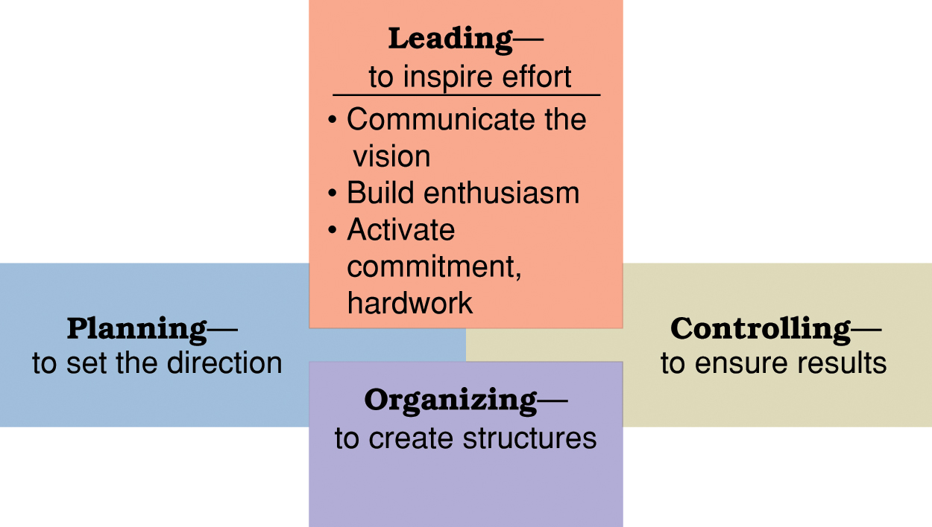
Figure 14.1 Leading viewed in relationship to the other management functions

Slide 7
Takeaway 1: The Nature of Leadership
Power
Ability to get someone else to do something you want done or make things happen the way you want
Power should be used to influence and control others for the common good rather seeking to exercise control for personal satisfaction

Slide 8
Takeaway 1: The Nature of Leadership
Two sources of managerial power:
Position power
Personal power

Slide 9
Takeaway 1: The Nature of Leadership
Position power
Based on a manager’s official status in the organization’s hierarchy of authority
Sources of position power:
Reward power
Capability to offer something of value
Coercive power
Capability to punish or withhold positive outcomes
Legitimate power
Organizational position or status confers the right to control those in subordinate positions

Slide 10
Takeaway 1: The Nature of Leadership
Personal power
Based on the unique personal qualities that a person brings to the leadership situation
Sources of personal power:
Expert power
Capacity to influence others because of one’s knowledge and skills
Referent power
Capacity to influence others because they admire you and want to identify positively with you

Slide 11
Takeaway 1: The Nature of Leadership

Slide 12
Takeaway 1: The Nature of Leadership
Visionary leadership
Vision
A future that one hopes to create or achieve in order to improve upon the present state of affairs
Visionary leadership
A leader who brings to the situation a clear and compelling sense of the future as well as an understanding of the actions needed to get there successfully

Slide 13
Takeaway 1: The Nature of Leadership
Servant leadership
Commitment to serving others
Followers more important than leader
“Other centered” not “self-centered”
Power not a “zero-sum” quantity
Focuses on empowerment, not power

Slide 14
Takeaway 1: The Nature of Leadership
Empowerment
The process through which managers enable and help others to gain power and achieve influence
Effective leaders empower others by providing them with:
Information
Responsibility
Authority
Trust

Slide 15
Takeaway 2: Leadership Traits and Behaviors
Important traits for leadership success
Drive
Self-confidence
Creativity
Cognitive ability
Business knowledge
Motivation
Flexibility
Honesty and integrity

Slide 16
Takeaway 2: Leadership Traits and Behaviors
Leadership behavior
Leadership behavior theories focus on how leaders behave when working with followers
Leadership styles are recurring patterns of behaviors exhibited by leaders
Basic dimensions of leadership behaviors:
Concern for the task to be accomplished
Concern for the people doing the work

Slide 17
Takeaway 2: Leadership Traits and Behaviors
Task concerns
Plans and defines work to be done
Assigns task responsibilities
Sets clear work standards
Urges task completion
Monitors performance results
People concerns
Acts warm and supportive toward followers
Develops social rapport with followers
Respects the feelings of followers
Is sensitive to followers’ needs
Shows trust in followers

Slide 18
Figure 14.2 Blake and Mouton’s Leadership Grid

Slide 19
Takeaway 2: Leadership Traits and Behaviors
Classic leadership styles:
Autocratic style
Emphasizes task over people
Human relations style
Emphasizes people over task
Laissez-faire style
Shows little concern for task
Democratic style
Committed to task and people

Slide 20
Takeaway 3: Contingency Approaches to Leadership
Fiedler’s Contingency Model
Good leadership depends on a match between leadership and situational demands
Determining leadership style:
Low LPC ⎯ task-motivated leaders
High LPC ⎯ relationship-motivated leaders
Leadership is part of one’s personality, and therefore relatively enduring and difficult to change
Leadership style must be fit to the situation

Slide 21
Takeaway 3: Contingency Approaches to Leadership
Fiedler’s contingency model (cont.)
Diagnosing situational control:
Quality of leader-member relations (good or poor)
Degree of task structure (high or low)
Amount of position power (strong or weak)
Task oriented leaders are most successful in:
Very favorable (high control) situations
Very unfavorable (low control) situations
Relationship-oriented leaders are most successful in:
Situations of moderate control

Slide 22
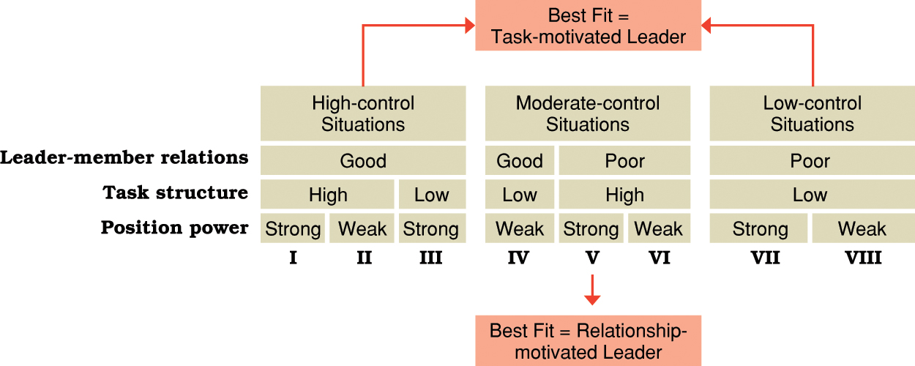
Figure 14.3 Predictions on style-situation fit from Fiedler’s contingency leadership model

Slide 23
Takeaway 3: Contingency Approaches to Leadership
Hersey-Blanchard situational leadership model
Leaders adjust their styles depending on the readiness of their followers to perform in a given situation
Readiness — how able, willing and confident followers are in performing tasks

Slide 24
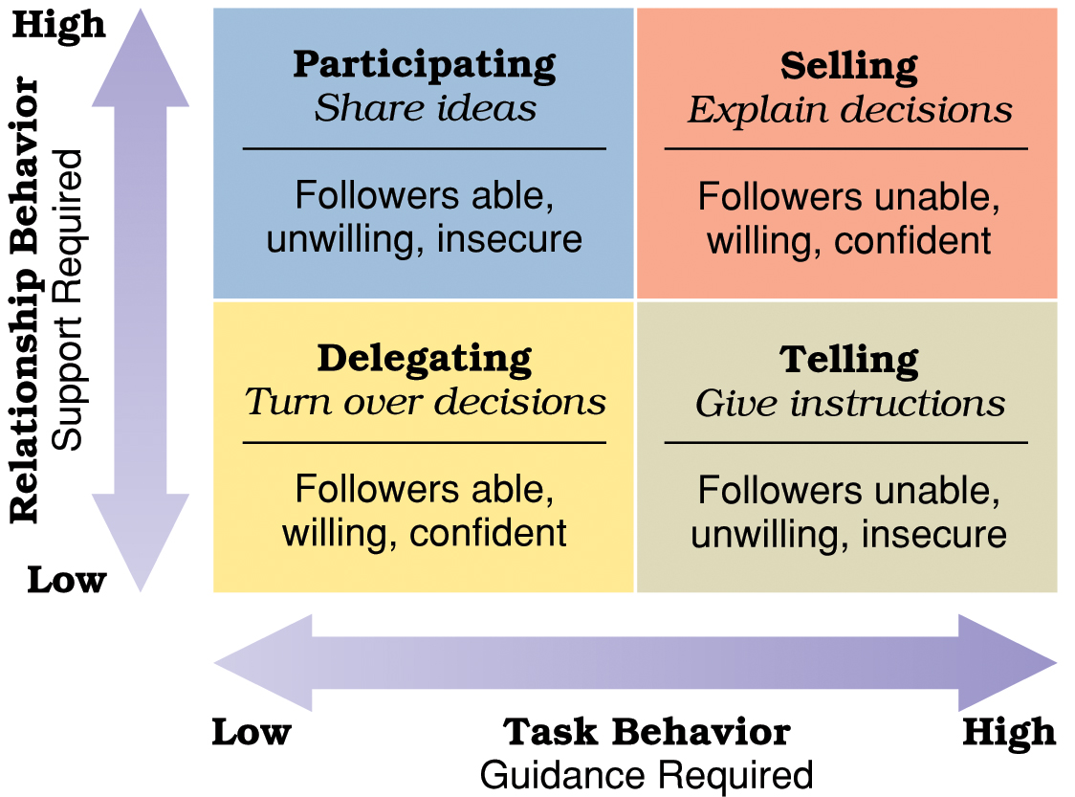
Figure 14.4 Leadership implications of the Hersey-Blanchard situational leadership model

Slide 25
Takeaway 3: Contingency Approaches to Leadership
Hersey-Blanchard leadership styles:
Delegating
Low-task, low-relationship style
Works best in high readiness-situations
Participating
Low-task, high-relationship style
Works best in low- to moderate-readiness situations

Slide 26
Takeaway 3: Contingency Approaches to Leadership
Hersey-Blanchard leadership styles:
Selling
High-task, high-relationship style
Work best in moderate- to high-readiness situations
Telling
High-task, low-relationship style
Work best in low-readiness situations

Slide 27
Takeaway 3: Contingency Approaches to Leadership
House’s path-goal leadership theory
Effective leadership deals with the paths through which followers can achieve goals
Leadership styles for dealing with path-goal relationships:
Directive leadership
Supportive leadership
Achievement-oriented leadership
Participative leadership

Slide 28
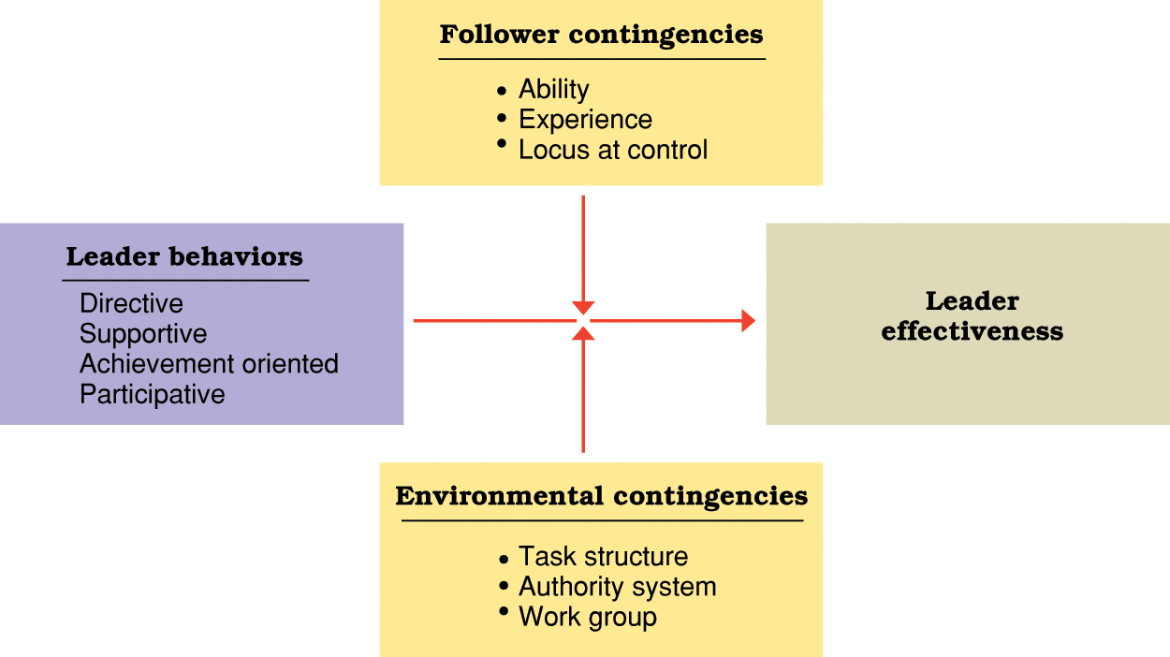
Figure 14.5 Contingency relationships in House’s path-goal leadership theory

Slide 29
Takeaway 3: Contingency Approaches to Leadership
House’s leadership styles:
Directive leadership
Communicate expectations
Give directions
Schedule work
Maintain performance standards
Clarify leader’s role
Supportive leadership
Make work pleasant
Treat group members as equals
Be friendly and approachable
Show concern for subordinates’ well-being
Achievement-oriented leadership
Set challenging goals
Expect high performance levels
Emphasize continuous improvement
Display confidence in meeting high standards
Participative leadership
Involve subordinates in decision making
Consult with subordinates
Ask for subordinates’ suggestions
Use subordinates’ suggestions

Slide 30
Takeaway 3: Contingency Approaches to Leadership
When to use House’s leadership styles:
Use directive leadership when job assignments are ambiguous
Use supportive leadership when worker self-confidence is low
Use participative leadership when performance incentives are poor
Use achievement-oriented leadership when task challenge is insufficient

Slide 31
Takeaway 3: Contingency Approaches to Leadership?
Substitutes for leadership
Factors in the work setting that direct the work efforts without the involvement of the leader
Follower characteristics
Ability, experience, independence
Task characteristics
Routine, feedback
Organization characteristics
Clarity of plans, formalized rules and procedures

Slide 32
Takeaway 3: Contingency Approaches to Leadership
Leader-Member Exchange Theory (LMX)
Not all people are treated the same by leaders in leadership situations
“In groups”
High LMX
“Out groups”
Low LMX

Slide 33
Takeaway 3: Contingency Approaches to Leadership
Leader-Member Exchange Theory (LMX)
Nature of the exchange is based on presumed characteristics by the leader
High LMX relationship:
favorable personality
competency
compatibility
Low LMX relationship:
low competency
unfavorable personality
low compatibility

Slide 34
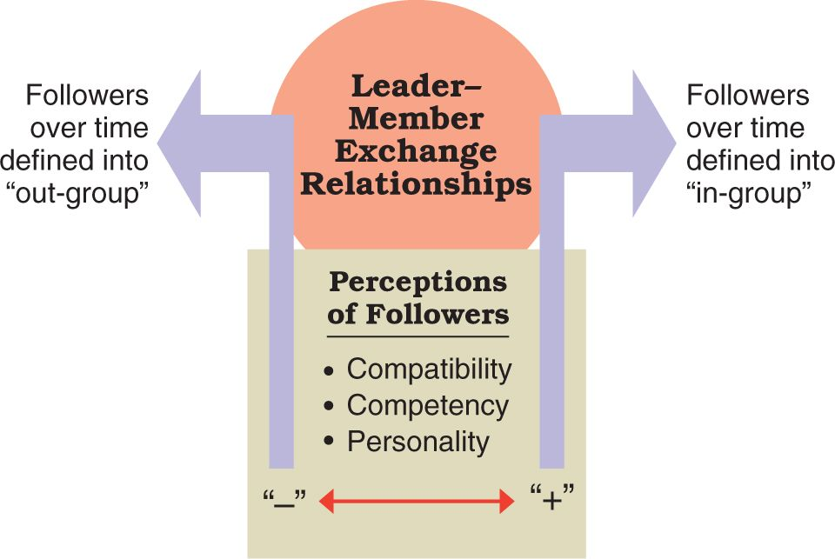
Figure 14.6 Elements of leader exchange theory

Slide 35
Takeaway 3: Contingency Approaches to Leadership
Vroom-Jago leader-participation theory
Helps leaders choose the method of decision making that best fits the nature of the problem situation
Basic decision-making choices:
Authority decision
Consultative decision
Group decision

Slide 36
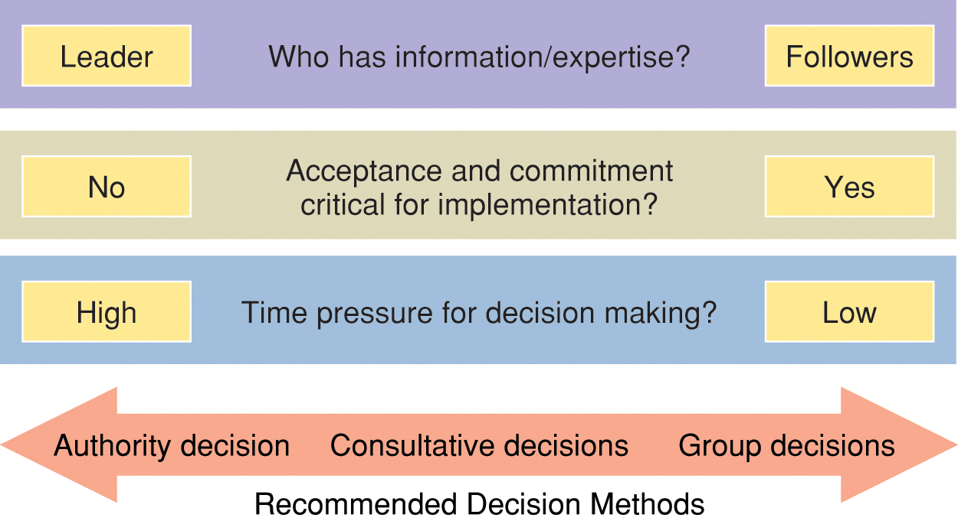
Figure 14.7 Leadership implications of Vroom-Jago leader-participation model

Slide 37
Takeaway 3: Contingency Approaches to Leadership
Decision-making options in the Vroom-Jago leader-participation theory:
Decide alone
Consult individually
Consult with group
Facilitate
Delegate

Slide 38
Takeaway 3: Contingency Approaches to Leadership
Contingency factors in the Vroom-Jago leader-participation theory:
Decision quality
Who has the information needed for problem solving
Decision acceptance
Importance of subordinate acceptance to eventual implementation
Decision time
Time available to make and implement the decision

Slide 39
Takeaway 3: Contingency Approaches to Leadership
According to Vroom-Jago leader-participation theory, a leader should use authority-oriented decision methods when
The leader has greater expertise to solve a problem
The leader is confident and capable of acting alone
Others are likely to accept and implement the decision
Little or no time is available for discussion

Slide 40
Takeaway 3: Contingency Approaches to Leadership
According to Vroom-Jago leader-participation theory, a leader should use group-oriented and participative decision methods when …
the leader lacks sufficient information to solve a problem by himself/herself
the problem is unclear and help is needed to clarify the situation
acceptance of the decision and commitment by others is necessary for implementation
adequate time is available for true participation

Slide 41
Takeaway 3: Contingency Approaches to Leadership
Benefits of participative decision methods:
Help improve decision quality
Help improve decision acceptance
Helps develop leadership potential
Potential disadvantages of participative decision methods:
Lost efficiency
Not particularly useful when problems must be solved immediately

Slide 42
Takeaway 4: Personal Leadership Development
Superleaders
Persons whose vision and strength of personality have an extraordinary impact on others
Charismatic leaders
Develop special leader-follower relationships and inspire others in extraordinary ways

Slide 43
Takeaway 4: Personal Leadership Development?
Transformational leader
Someone who is truly inspirational as a leader and who arouses others to seek extraordinary performance accomplishments

Slide 44
Takeaway 4: Personal Leadership Development
Characteristics of transformational leaders:
Vision
Charisma
Aspiration
Empowerment
Intellectual stimulation
Integrity

Slide 45
Takeaway 4: Personal Leadership Development
Emotional intelligence
The ability of people to manage emotions in social relationships
Characteristics of the emotionally intelligent leader:
High self-awareness
Motivated and persistent
High social awareness
Good self management
Good relationship management

Slide 46
Takeaway 4: Personal Leadership Development
Gender and leadership
Gender similarities hypothesis
Males and females have similar psychological properties
Men and women can be equally effective leaders
Men and women are sometimes perceived as using different styles of leadership

Slide 47
Takeaway 4: Personal Leadership Development
Women tend to use interactive leadership
A style that shares qualities with transformational leadership
Leaders with this style are democratic, participative, and inclusive.
Men tend to use transactional leadership
Interactive leadership provides a good fit with the demands of a diverse workforce and the new workplace

Slide 48
Takeaway 4: Personal Leadership Development
Moral leadership
Ethical leadership that is always “good” and “right”
All leaders are expected to maintain high ethical standards
Long-term, sustainable success requires ethical behavior
Integrity involves the leader’s honesty, credibility, and consistency in putting values into action
Moral overconfidence is an overly positive view of one’s strength of character
Authentic leadership activates positive psychological states to achieve self awareness and positive self-regulation.

Slide 49
Takeaway 4: Personal Leadership Development
Drucker’s “old-fashioned” leadership
Leadership is more than charisma; it is “good old-fashioned” hard work

Slide 50
Takeaway 4: Personal Leadership Development
Essentials of “old-fashioned” leadership:
Defining and establishing a sense of mission
Accepting leadership as a “responsibility” rather than a rank
Surround yourself with talented people
Don’t blame others when things go wrong
Keep your integrity, earn trust
Don’t be clever, be consistent

