Slide 1
Puget Sound Veterans Hope Center
A non-profit organization operated BY veterans for veterans

Slide 2
Puget Sound Veterans Hope Center
VHC is a nonprofit 501(c)(3) veterans’ organization.
VHC operates a clean and sober 10 bed sleeping room for veterans in need of immediate shelter at the Tacoma Rescue Mission.
We provide services, supplies, referrals and transportation to appointments.

Slide 3
Puget Sound Veterans Hope Center
Many of the veterans we serve urgently need stable housing and time to recover
Many have significant disabilities and histories of trauma
They need to live in a clean and sober community with strong peer support

Slide 4
We’ve created a new partnership
Washington State Department of Veterans Affairs
Orting Soldiers Home
Puget Sound Veterans Hope Center
Panza

Slide 5
A non-profit in Olympia that grew out of an alliance of faith communities that hosted a tent camp for homeless adults
Developer and manager of Quixote Village, a community of 30 tiny houses and a community building with a shared kitchen, showers, laundry, and social and office space

Slide 6
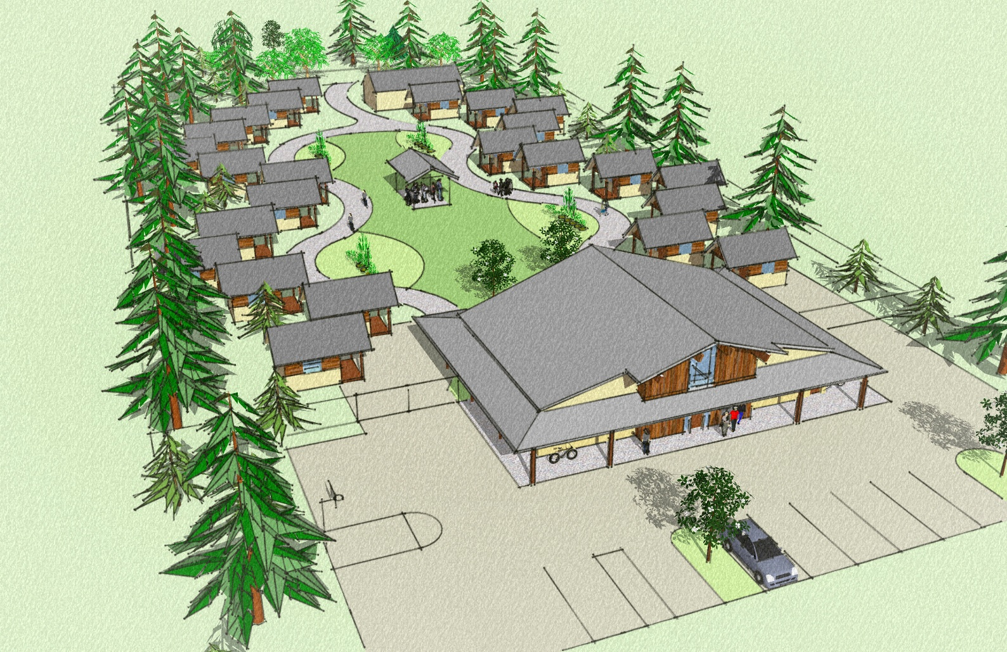

Slide 7
Quixote Village opened in 2013.
The Village cost significantly less than conventional housing
Paid staff manage the facility and help residents get the services and support they need
Residents pay 30% of their income in rent and do routine cleaning and maintenance

Slide 9
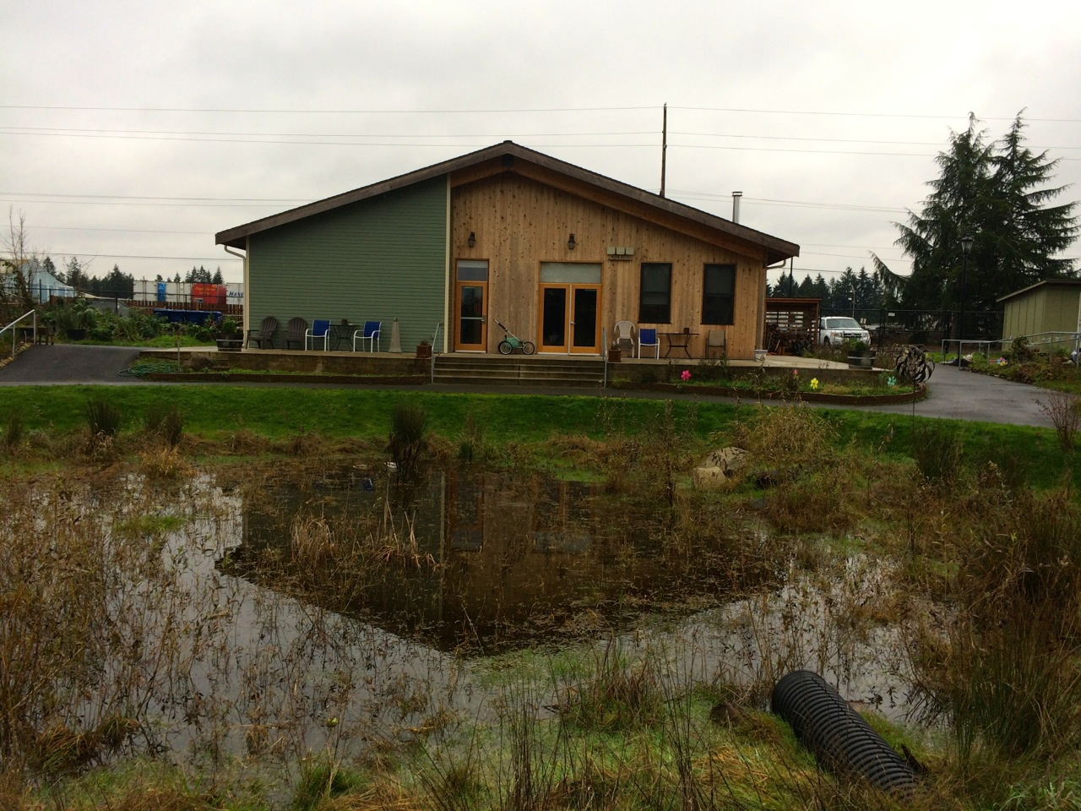

Slide 12
Our shared goal s
Create a tiny house community on the Orting Soldiers’ Home for veterans in need
Build stable and supportive affordable housing for veterans
Help veterans get connected to the benefits they earned by serving our country so that they can be successful in life

Slide 13
Questions?
Contact Information: Puget Sound Veterans Hope Center Maryellen Hill, Program Director kmghill@gmail.com (253) 230-3631 Panza/Quixote Village Sean McGrady, Executive Director symcgrady@gmail.com (310) 740-3101

