Slide 1
Understanding of Operations and Word-Problem Structures

Slide 2
srpowell@austin.utexas.edu
@sarahpowellphd
119

Slide 3
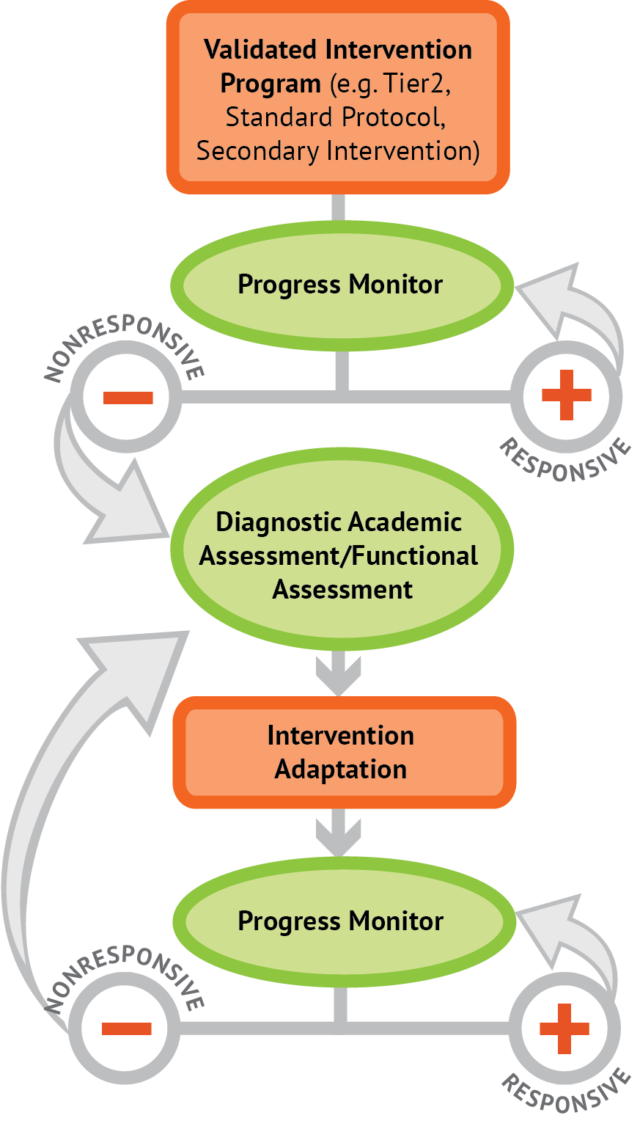
Instructional Platform
INSTRUCTIONAL DELIVERY
Explicit instruction
Precise language
Multiple representations
INSTRUCTIONAL STRATEGIES
Fluency building
Problem solving instruction

Slide 4
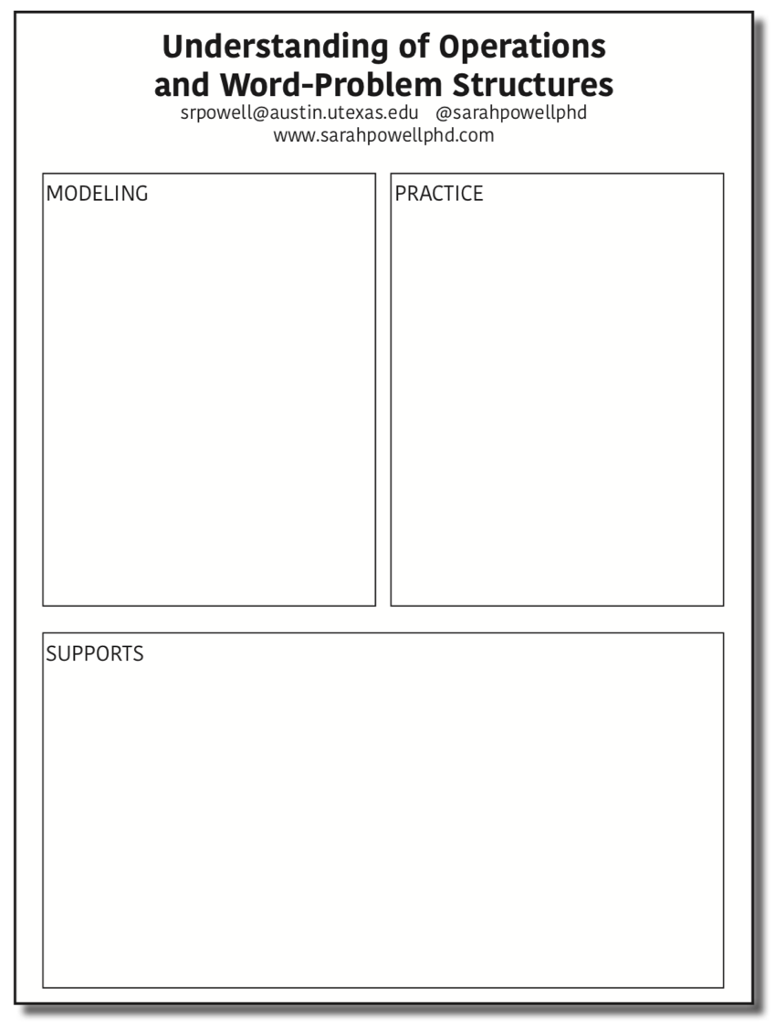

Slide 5
Modeling
Practice
Clear Explanation
Guided
Practice
Planned
Examples
Independent Practice
Supports
Asking the right questions
Eliciting frequent responses
Providing immediate specific feedback
Maintaining a brisk pace

Slide 6
Goal and importance
“Today, we are learning about division. This is important because sometimes you have to share objects or things with your friends.”
Modeling
Practice
Clear Explanation
Guided
Practice
We Do
Planned
Examples
Independent Practice
“Let’s continue working with our three-dimensional shapes and volume. Understanding volume and calculating volume helps with measuring capacity.”
You Do
Supporting Practices
Asking the right questions
Eliciting frequent responses
Providing immediate specific feedback
Maintaining a brisk pace

Slide 7
Goal and importance
Model steps
Modeling
Practice
Clear Explanation
Guided
Practice
“To solve 26 plus 79, I first decide about the operation. Do I add, subtract, multiply or divide?”
We Do
Planned
Examples
Independent Practice
“The plus sign tells me to add. So, I’ll add 26 plus 79. I’ll use the partial sums strategy. First, I add 20 plus 70. What’s 20 plus 70?”
You Do
Supporting Practices
“20 plus 70 is 90. I write 90 below the equal line. Where?”
Asking the right questions
Eliciting frequent responses
Providing immediate specific feedback
Maintaining a brisk pace
“Then I add 6 plus 9. What’s 6 plus 9?”
“6 plus 9 is 15. So, I write 15 here.”
“Finally, we add the partial sums: 90 and 15. 90 plus 15 is 105. So, 26 plus 79 equals 105. What’s 26 plus 79?”

Slide 8
Goal and importance
Model steps
Modeling
Clear Explanation
With examples
Planned
Examples
“Today, we are learning about division. This is important because sometimes you have to share objects or things with your friends.”
Supporting Practices
24 / 6
28 $÷$ 7
35 $)$ 5
Asking the right questions
Eliciting frequent responses
Providing immediate specific feedback
Maintaining a brisk pace
Practice
Guided
Practice

Slide 9
Goal and importance
Model steps
Modeling
Clear Explanation
With examples
Planned
Examples
With non-examples
“Today, we are learning about division. This is important because sometimes you have to share objects or things with your friends.”
32 $÷$ 8
42 $÷$ 7
25 $−$ 5

Slide 10
Modeling
Practice
Clear Explanation
Guided
Practice
Planned
Examples
Independent Practice
Supports
Asking the right questions
Eliciting frequent responses
Providing immediate specific feedback
Maintaining a brisk pace

Slide 11
I Do
Modeling
Practice
Clear Explanation
Guided
Practice
Planned
Examples
Independent Practice
Supporting Practices
Asking the right questions
Eliciting frequent responses
Providing immediate specific feedback
Maintaining a brisk pace

Slide 12
I Do
Modeling
Practice
Teacher and student practice together
Clear Explanation
Guided
Practice
Planned
Examples
Independent Practice
Supporting Practices
Asking the right questions
Eliciting frequent responses
Providing immediate specific feedback
Maintaining a brisk pace

Slide 13
I Do
Modeling
Practice
Clear Explanation
Guided
Practice
Planned
Examples
Independent Practice
Student practices with teacher support
Supporting Practices
Asking the right questions
Eliciting frequent responses
Providing immediate specific feedback
Maintaining a brisk pace

Slide 14
Modeling
Practice
Clear Explanation
Guided
Practice
Planned
Examples
Independent Practice
Supports
Asking the right questions
Eliciting frequent responses
Providing immediate specific feedback
Maintaining a brisk pace

Slide 15
I Do
Modeling
Practice
Clear Explanation
Guided
Practice
We Do
Planned
Examples
Independent Practice
You Do
Supports
Asking the right questions
Eliciting frequent responses
Providing immediate specific feedback
Maintaining a brisk pace

Slide 16
I Do
Modeling
Practice
Clear Explanation
Guided
Practice
Low-level and high-level
We Do
Planned
Examples
Independent Practice
You Do
“What is 7 times 9?”
“Which shape has 6 sides?”
“What do you do when you see a word problem?”
“Why do you have to regroup?”
“How would you solve this problem?”
“Why do you have to use zero pairs?”
Supports
Asking the right questions
Eliciting frequent responses
Providing immediate specific feedback
Maintaining a brisk pace

Slide 17
I Do
Modeling
Practice
Clear Explanation
Guided
Practice
Low-level and high-level
We Do
Planned
Examples
Independent Practice
You Do
Classwide, individual, partner, write on paper, write on whiteboard, thumbs up, etc.
“Turn and discuss the formula for perimeter with your partner.”
“Write the multiplication problem on your whiteboard.”
Supports
Asking the right questions
Eliciting frequent responses
Providing immediate specific feedback
Maintaining a brisk pace
“In your math journal, draw a picture to help you remember to term parallelogram.”

Slide 18
I Do
Modeling
Practice
Clear Explanation
Guided
Practice
Low-level and high-level
We Do
Planned
Examples
Independent Practice
You Do
Classwide, individual, partner, write on paper, write on whiteboard, thumbs up, etc.
Affirmative and corrective
Supports
“Good work using your word-problem attack strategy.”
Asking the right questions
Eliciting frequent responses
Providing immediate specific feedback
Maintaining a brisk pace
“Let’s look at that again. Tell me how you added in the hundreds column.”

Slide 19
I Do
Modeling
Practice
Clear Explanation
Guided
Practice
Low-level and high-level
We Do
Planned
Examples
Independent Practice
You Do
Classwide, individual, partner, write on paper, write on whiteboard, thumbs up, etc.
Affirmative and corrective
Planned and organized
Supports
Asking the right questions
Eliciting frequent responses
Providing immediate specific feedback
Maintaining a brisk pace

Slide 20
Modeling
Practice
Clear Explanation
Guided
Practice
Planned
Examples
Independent Practice
Supports
Asking the right questions
Eliciting frequent responses
Providing immediate specific feedback
Maintaining a brisk pace
Copyright 2018 Sarah R. Powell, Ph.D.

Slide 21
Modeling
Practice
Supports
Introduction of material
Review of material
Modeling
Practice
Modeling
Practice
Supports
Supports

Slide 22
How do you use explicit instruction?
Model steps using concise language
Provide guided practice opportunities
Provide independent practice opportunities
Use supporting practices during modeling and practice
Ask the right questions
Elicit frequent responses
Provide feedback
Be planned and organized

Slide 24
Addition
100 addition basic facts
Single-digit addends sum to a single- or double-digit number
5 (addend)
+ 4 (addend)
9 (sum)

Slide 25
Addition: Total (Part-Part-Whole, Combine)
Count one set, count another set, put sets together, count sum
2 + 3 = 5

Slide 26
Addition: Join (Change Increase)
Start with a set, add the other set, count sum
2 + 3 = 5

Slide 27
Why is it important to understand addition in two separate ways?

Slide 28
Total
Parts put together into a total
Angie saw 4 cardinals and 5 blue jays. How many birds did Angie see?
4 + 5 = ?

Slide 29
Change
An amount that increases or decreases
Pam had $4. Then she earned $3 for cleaning her room. How much money does Pam have now?
4 + 3 = ?

Slide 30
Part-Part-Whole Versus Join
3 + 9 = __
7 + 4 = __

Slide 31
Subtraction
100 subtraction basic facts
Subtrahend and difference are single-digit numbers and minuend is single- or double-digit number
16 (minuend)
– 8 (subtrahend)
8 (difference)

Slide 32
Subtraction: Separate (Change Decrease)
Start with a set, take away from that set, count difference
5 – 3 = 2

Slide 33
Subtraction: Difference (Compare)
Compare two sets, count difference
5 – 3 = 2

Slide 34
Why is it important to understand subtraction in two separate ways?

Slide 35
Change
An amount that increases or decreases
Amanda had 9 cookies. Then she ate 2 of the cookies. How many cookies does Amanda have now?
9 – 2 = ?

Slide 36
Difference
Greater and less amounts compared for a difference
Scott has 9 apples. Cathy has 4 apples. How many more apples does Scott have? (How many fewer does Cathy have?)
9 – 4 = ?

Slide 37
Separate Versus Compare
9 – 5 = __
8 – 3 = __

Slide 39
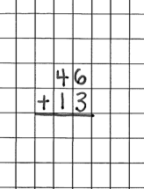
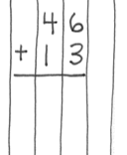
Notation Matters
Work on vertical presentation

Slide 40
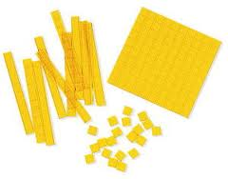
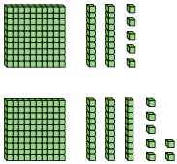
Addition and Subtraction
Focus on place value

Slide 41
Addition and Subtraction
Introduce regrouping/trading/exchanging after mastery of problems without regrouping
10 ones for 1 ten
10 tens for 1 hundred
1 ten for 10 ones
1 hundred for 10 tens
Regroup
Trade
Exchange
Carry
Addition
Regroup
Trade
Exchange
Borrow
Subtraction

Slide 42
Autumn
Traditional
Work right to left (start in ones column)

Slide 43
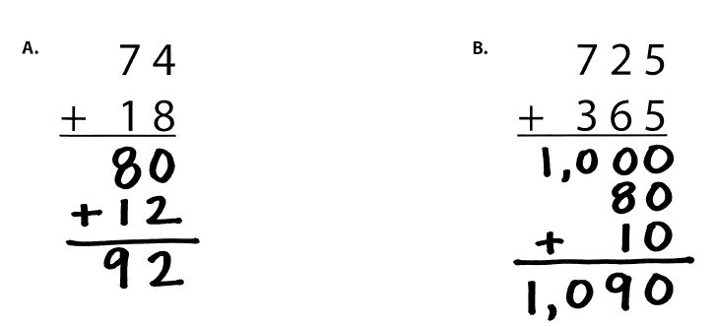
Lydia
Partial Sums
Work left to right

Slide 44
Victoria
Opposite Change
Round one number to nearest ten
Amount added is subtracted from other number

Slide 45
Carol
Column Addition
Work left to right

Slide 47
Julie
Traditional Method
Work right to left (start in ones column)

Slide 48
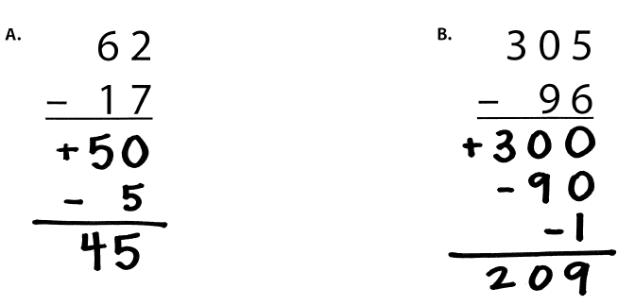
Janie
Partial Differences
Work left to right

Slide 49
Eric
Same Change
Change subtrahend to end in 0

Slide 50
Beth
Add-Up

Slide 53
Multiplication
100 multiplication basic facts
Multiplication of single-digit factors results in a single- or double-digit product
2 (factor)
× 3 (factor)
6 (product)

Slide 54
Multiplication: Equal Groups
Show the groups, show the amount for each group, count product
3 × 2 = 6

Slide 55
Multiplication: Equal Groups
Show the groups, show the amount for each group, count product
3 × 2 = 6

Slide 56
Multiplication: Comparison
Show a set, then multiply the set
3 × 2 = 6

Slide 57
Equal Groups
Groups multiplied by number in each group for a product
Carlos has 2 bags of apples. There are 6 apples in each bag. How many apples does Carlos have altogether?
2 × 6 = ?

Slide 58
Comparison
Set multiplied by a number of times for a product
Beth picked 6 apples. Amy picked 2 times as many apples as Beth. How many apples did Amy pick?
6 × 2 = ?

Slide 59
Equal Groups versus Comparison
2 × 5 = __
4 × 3 = __

Slide 60
Division
90 division basic facts
Divisor and quotient are single-digit numbers and dividend is single- or double-digit number
8 ÷ 4 = 2
(dividend) (divisor) (quotient)

Slide 61
Division: Equal Groups (Partitive Division)
Show the dividend, divide equally among divisor, count quotient
8 ÷ 2 = 4

Slide 62
Division: Equal Groups (Quotative Division)
Show the dividend, make groups of the divisor, count groups
8 ÷ 2 = 4

Slide 63
Why is it important to understand division in different ways?

Slide 64
Equal Groups
Groups multiplied by number in each group for a product
Carlos has 12 apples. He wants to share them equally among his 2 friends. How many apples will each friend receive?
2 × ? = 12
Carlos has 12 apples. He put them into bags containing 6 apples each. How many bags did Carlos use?
? × 6 = 12

Slide 65
Partitive versus Quotative
10 ÷ 5 = __
12 ÷ 4 = __

Slide 67
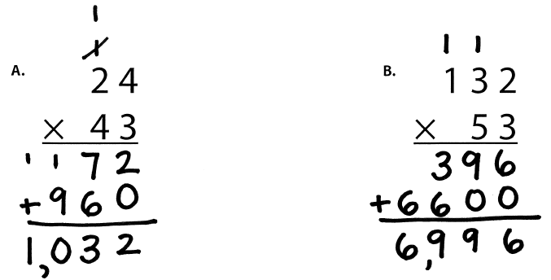
Angie
Traditional
Work right to left (start in ones column)

Slide 68
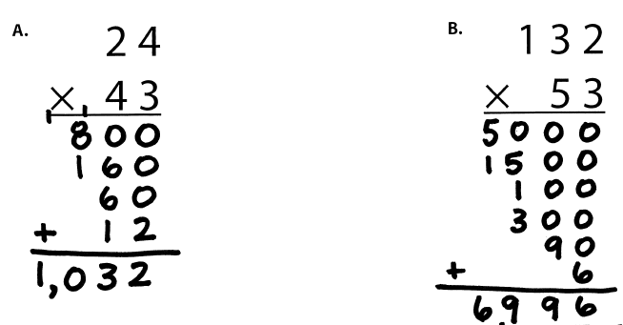
Carlos
Partial Products

Slide 69
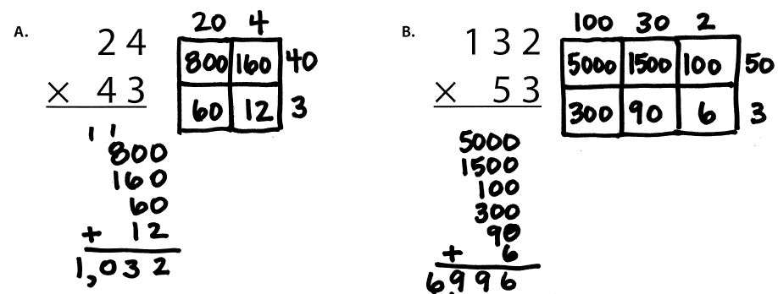
Cathy
Area

Slide 70
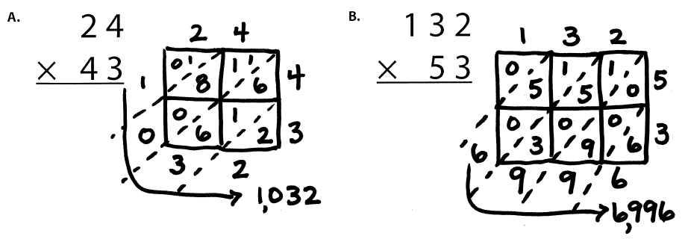
Scott
Lattice Method (383 × 27)

Slide 72
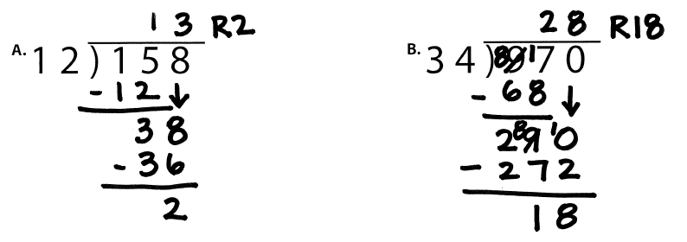
Pam
Traditional Method
Work Left to Right
Notes:
1. Yellow handouts: Multiplication and division

Slide 73
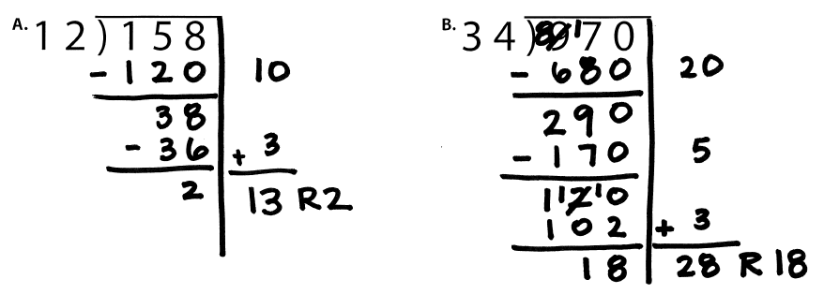
Amanda
Partial Quotients

Slide 74
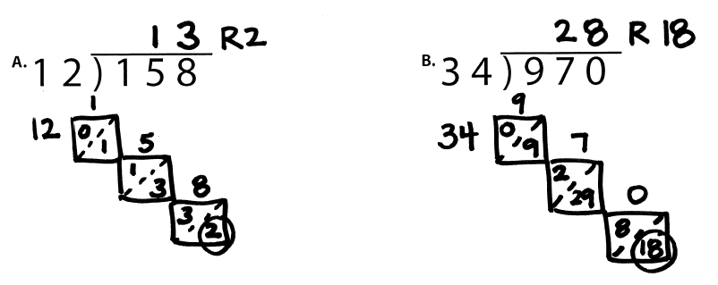
Julie
Lattice Division

Slide 75
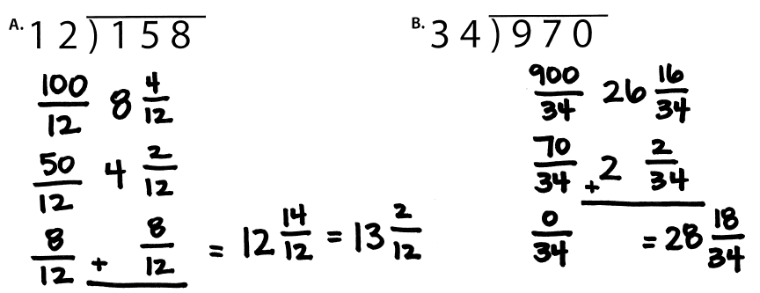
Janie
Division as Fractions

Slide 77
Fluency

Slide 78
Fluency Focus
There are 390 facts.
Addition
Subtraction
Multiplication
Division

Slide 79
Fact Practice
Students should practice small sets of facts
These small sets should include known and unknown facts
BRIEF
(1-2 min)
DAILY
(everyday)

Slide 80
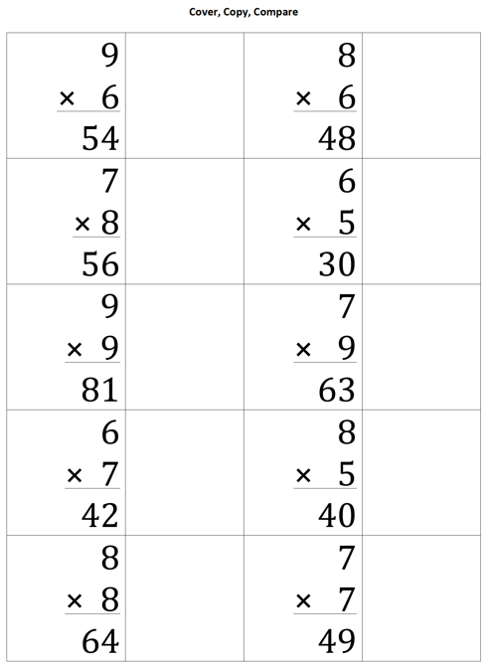
Cover, Copy, Compare
BEFORE
Create sheet with 10-12 answered problems and room to copy facts
DURING
Student reads entire fact
Student covers fact
Student rewrites entire fact
Student compares

Slide 81
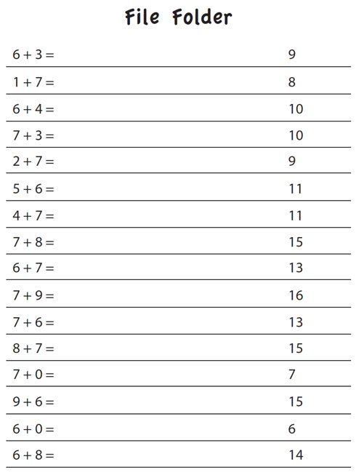
File Folder
BEFORE
Create sheet with 15-25 answered facts
DURING
Student folds answers over
Student writes answers to all facts
Student unfolds answers and compare

Slide 82
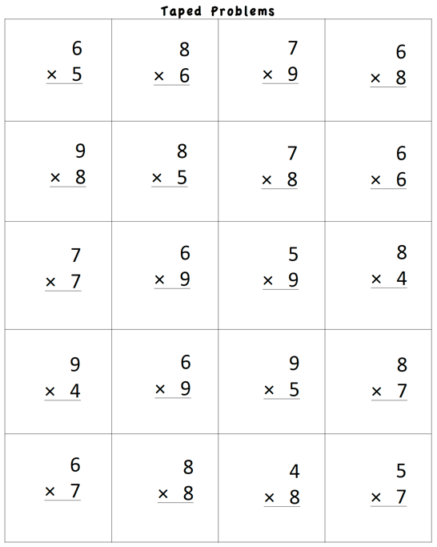
Taped Problems
BEFORE
Create worksheet with 15-25 facts
Make a recording:
Say fact (e.g., “6 times 5 equals…”)
Pause for 1-5 seconds
Say fact answer (e.g., “30”)
Continue with all facts on page
DURING
Student listens to recording
Student writes fact answer before the answer is stated on the recording

Slide 83
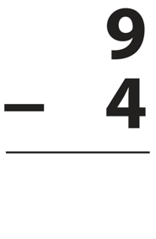
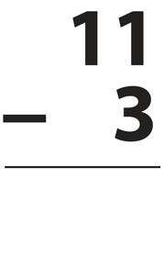
Flash Cards with Constant Time Delay
BEFORE
Collect small set of flash cards
DURING
Show student flash card for 3 seconds
Student answers
If correct, state correct answer and place back in pile
If incorrect, state correct answer and have student repeat it; place back in pile
Work through pile of cards for 1-2 minutes

Slide 84
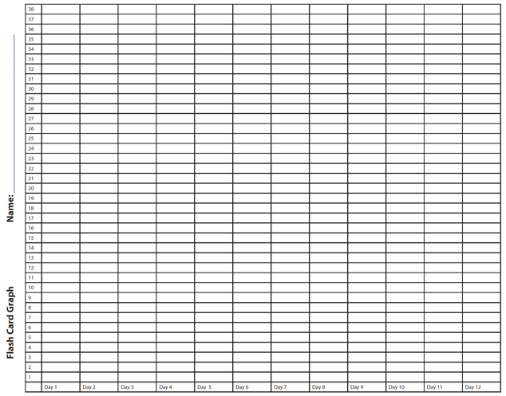
Flash Cards with Graphing
BEFORE
Collect small set of flash cards
DURING
Show student flash card
Student answers flash card
If correct, place in correct pile
If incorrect, review fact
Time for 1-2 minutes
Count total score
Graph total score
Could opt to try to beat score for another 1-2 minutes
Graph highest score

Slide 85
Flash Cards with Incremental Rehearsal
BEFORE
Select 1 unknown fact from a set of flash cards
Select 9 known facts from a set of flash cards
DURING
Read unknown fact aloud, provide answer, and ask student to read problem with you
Keep unknown fact flash card and combine with 1 known fact flash card
Show 2 flash cards to student
If student answer correctly, go to next flash card
If student answers incorrectly, read fact with answer and ask student to read with you
Work on cards until student answers correctly within 2 seconds
Add in 1 known fact flash card; continue with 3 cards
Keep adding in known fact flash cards until student achieves fluency with unknown card
Select new unknown fact and repeat process

Slide 86
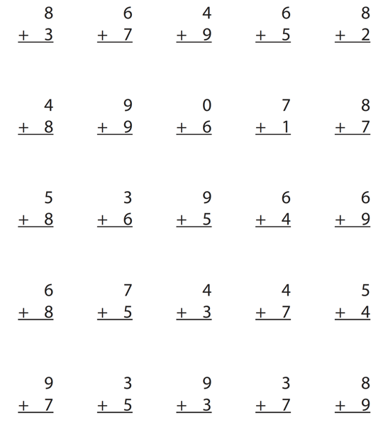
Worksheets
DURING
Students answer facts for 1-2 minutes
Students graph highest score of day or week

Slide 87
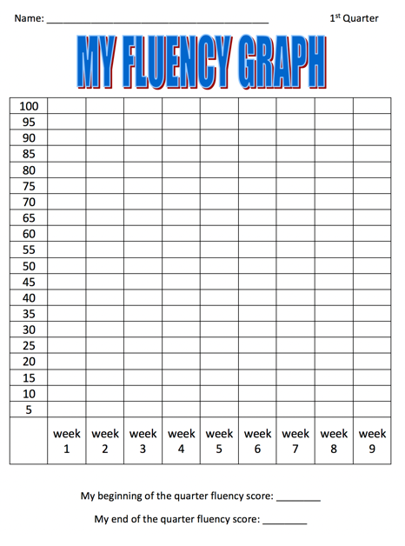
Worksheets with Graphing
DURING
Students answer facts for 1-2 minutes
Students graph highest score of day or week

Slide 88
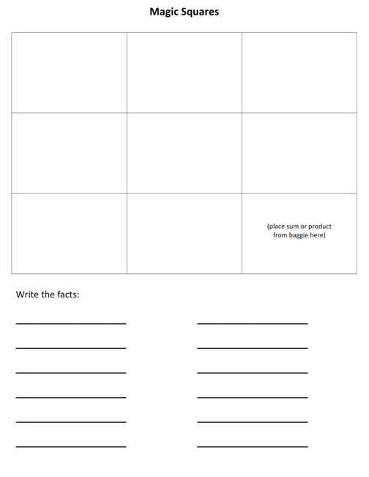
Magic Squares
BEFORE
Create sets of magic squares
See templates http://www.sarahpowellphd.com/presentations.html
DURING
Place sum or product in bottom right corner
In bottom row, create a fact with a sum or product of bottom right corner
In right column, create a fact with a sum or product of bottom right corner
Create two columns with a sum or product of bottom number
Create two rows with a sum or product of right column number
Write created facts
See demonstration on next slide.

Slide 89
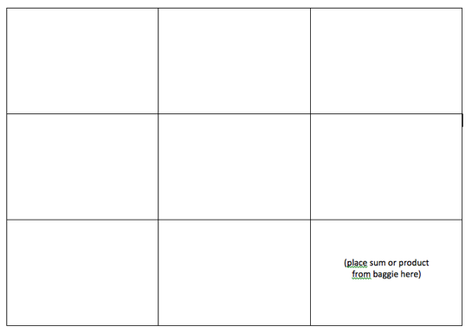
Magic Squares
5
4
12
8
6
1
3
3
6

Slide 90
Playing Cards
BEFORE
Select numbered playing cards from a deck of cards
DURING
Divide deck in half
Students place set of cards face down
Each student flips over top card
First student to add, subtract, or multiply the cards gets to keep both cards; cards go back in student’s set
Students continue until one student has all the cards
This game is similar to War.

Slide 91
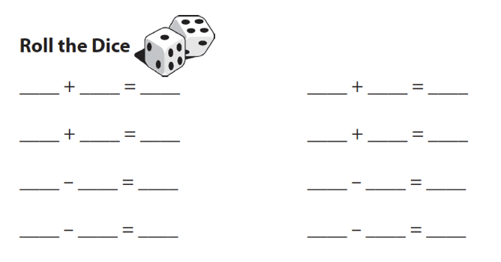
Dice Roll
DURING
Student rolls two die
Student adds, subtracts, or multiplies
Student writes facts

Slide 92
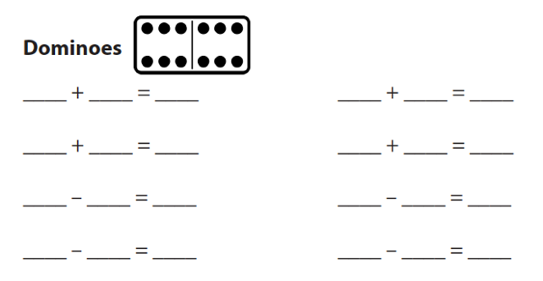
Dominoes
DURING
Student select domino
Student adds, subtracts, or multiplies
Student writes fact

Slide 93
Wrap-Ups
DURING
Student wraps string behind key and places around top left notch
Student answers fact by wrapping string in front of key and around to answer notch
Student brings string around the back to next left notch
Student continues
At end, student checks facts by comparing string to raised pattern on back of key

Slide 94
Mobi
DURING
Students begin with a specific number of blue tiles; the white tiles can be used at anytime
Students create a set of equations that build off of one another (each student makes their own set of equations)
Students draw more blue tiles after blue tiles are used; students rearrange and add to equation set
This game is similar to Bananagrams.

Slide 95
SMATH
DURING
Students use tiles to create equations on a game board
Students take turns and build off of one another’s tiles
This game is similar to Scrabble.

Slide 96
Technology
Individual activity
BEFORE
Select game that will practice small sets of facts
Select game that will track and monitor student progress
Select game that will provide feedback to student (especially when student makes mistake)

Slide 97
Other Ideas
Tic-Tac-Toe (with facts)
Connect Four (with numbers)
Chutes and Ladders (with numbers)
Add to this list!

Slide 98
Word Problems

Slide 99
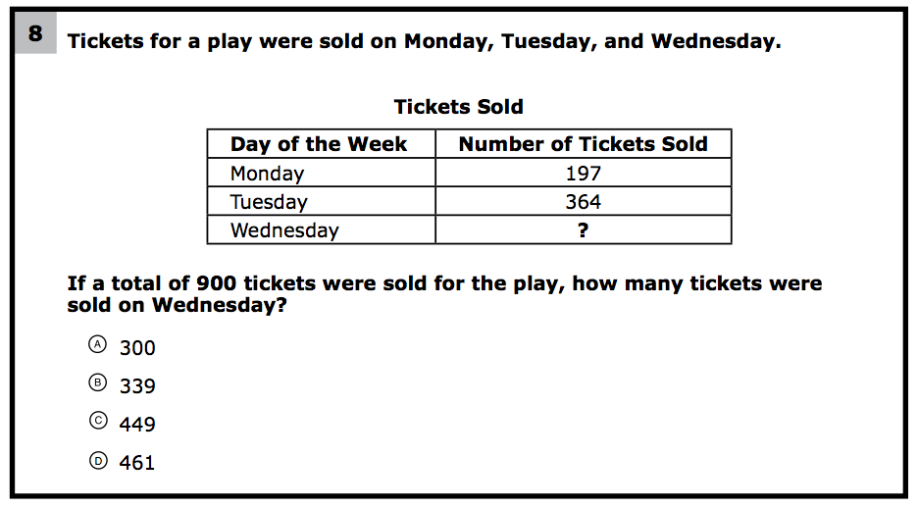
What do students need to know to solve this problem?
What might cause difficulty for students?

Slide 100
Problem Solving Difficulties
Reading problems
Understanding vocabulary
Identifying relevant information
Ignoring irrelevant information
Interpreting charts and graphs
Identifying appropriate operation(s)
Performing the computation(s)

Slide 102
Don’t tie key words to operations
Do have an attack strategy
Do teach word-problem schemas

Slide 103
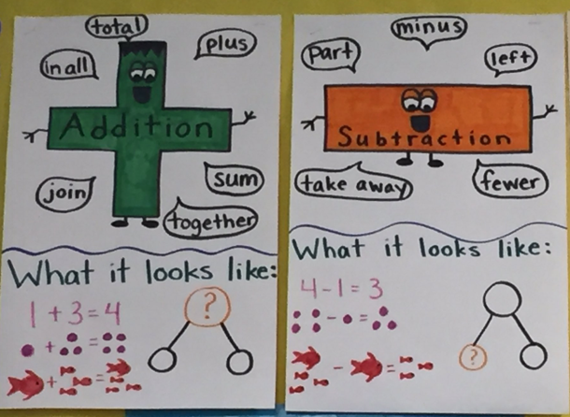
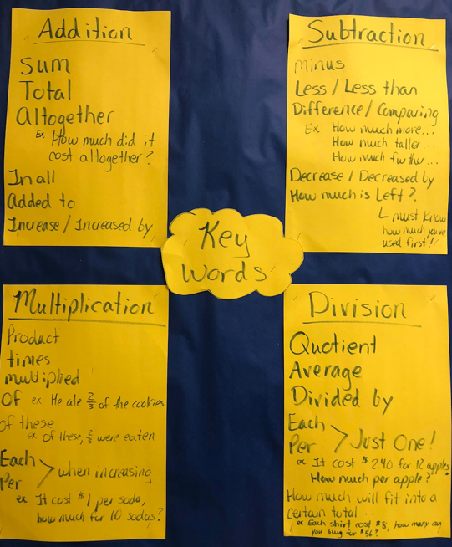

Slide 104
Students need to understand key words. But, key words should not be directly tied to operations.

Slide 105
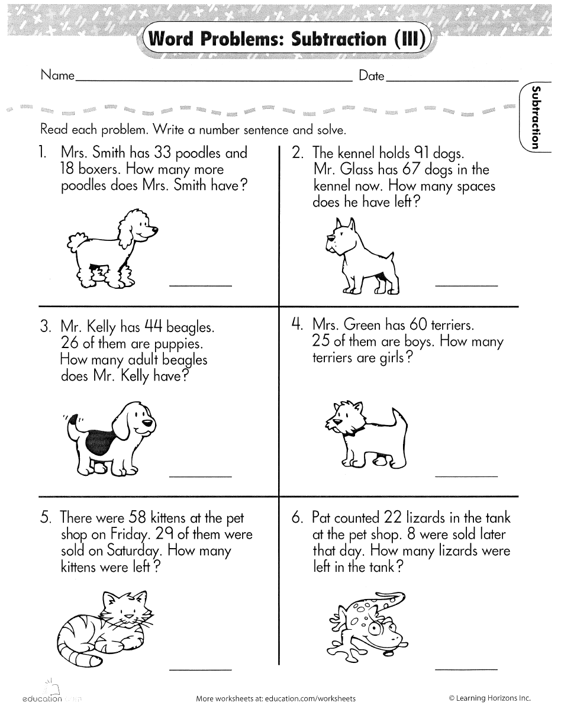

Slide 106
Don’t tie key words to operations
Do have an attack strategy
Do teach word-problem schemas

Slide 107
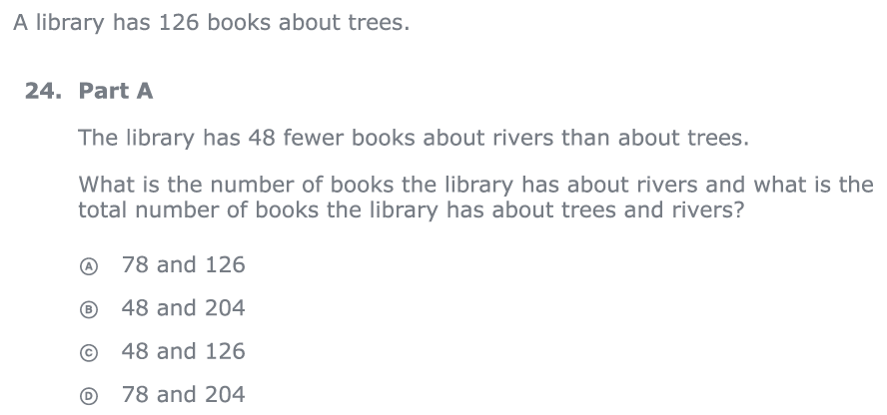
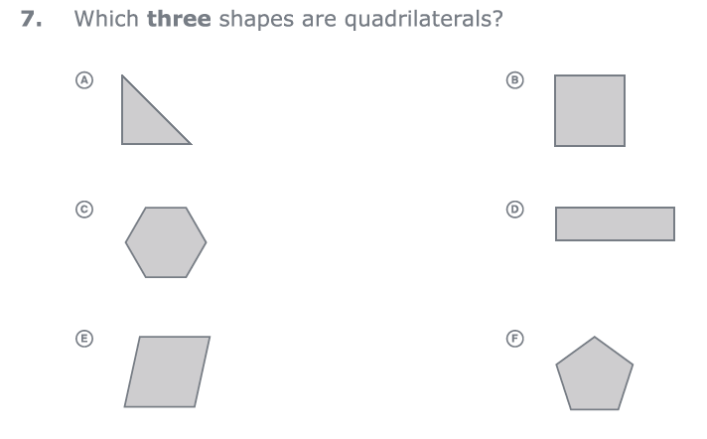
For every word problem
Regardless of problem type, students need an attack strategy for working through the problem
This strategy should work for any problem type
Routine Word Problems
Instructional Word Problems

Slide 108
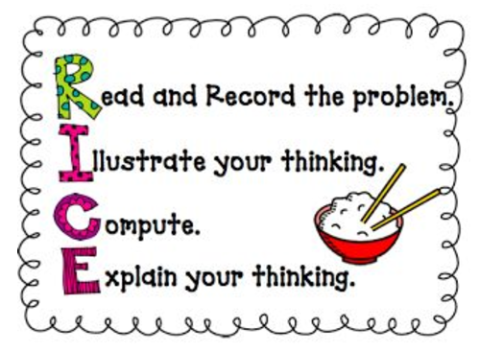
RIDGES
Read the problem.
I know statement.
Draw a picture.
Goal statement.
Equation development.
Solve the equation.
RIDE
Read the problem.
Identify the relevant information.
Determine the operation and unit for the answer.
Enter the correct numbers and calculate, then check the answer.

Slide 110
Don’t tie key words to operations
Do have an attack strategy
Do teach word-problem schemas

Slide 111
Schemas
Total
Difference
Change
Equal Groups
Comparison
Ratios/Proportions

Slide 112
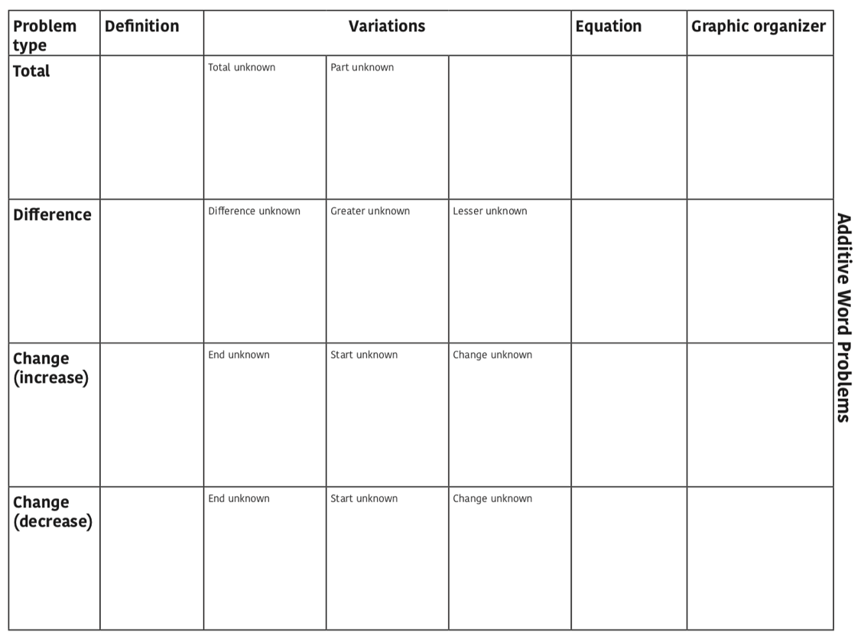

Slide 113
Total
Parts put together into a total
Emily saw 4 cardinals and 5 blue jays. How many birds did Emily see?
4 + 5 = ?
Emily saw 9 birds. If 4 of the birds were cardinals, how many were blue jays?
4 + ? = 9
Emily saw 9 birds. 5 of the birds were blue jays, how many were cardinals?
5 + ? = 9

Slide 114
Total
“Are parts put together for a total?”

Slide 115
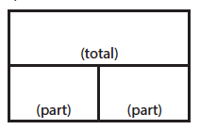
Total
P1 + P2 = T
Fuchs et al. (2008); Griffin & Jitendra (2009)

Slide 116
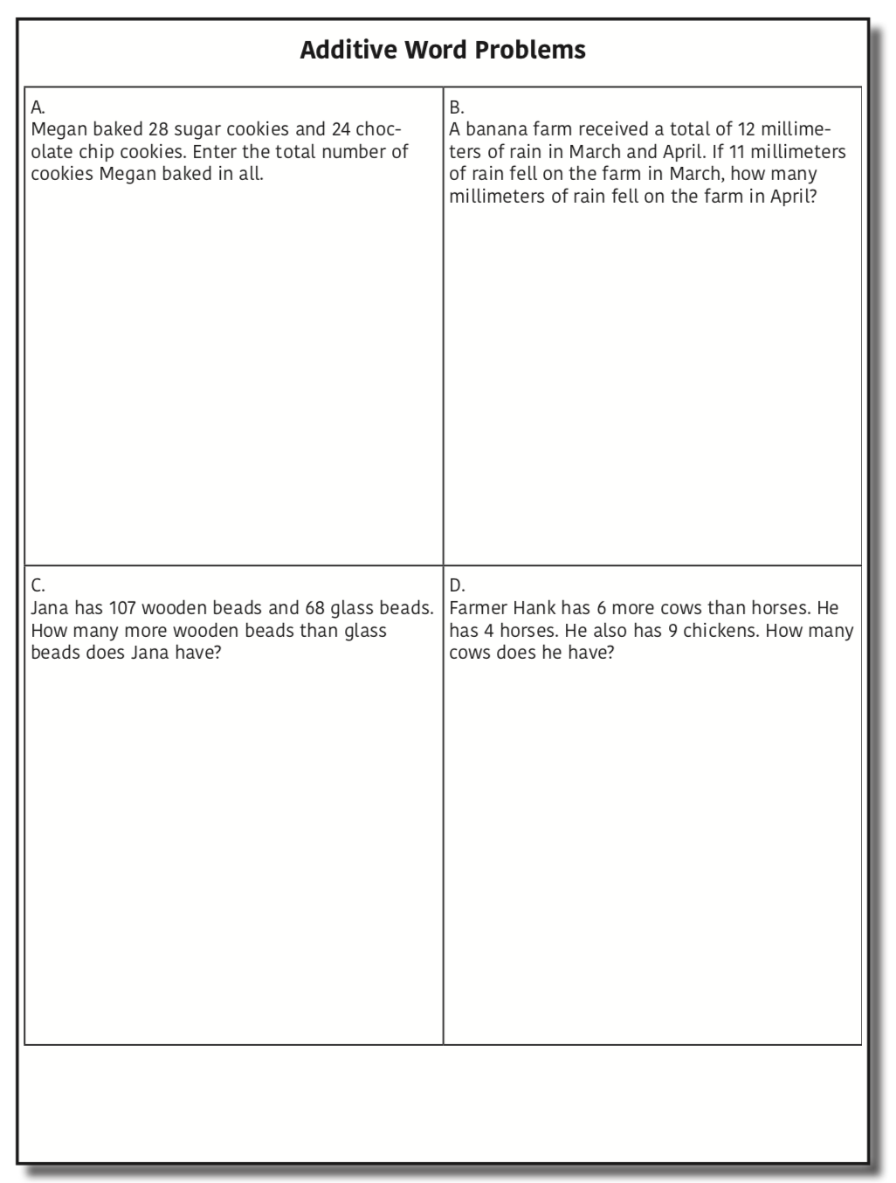
Total

Slide 117
Total
✓
✓
✓
P1 + P2 = T
U
P
S
✓
✓
28
+
24
=
?
✓
✓
28 + 24 = 52
? = 52 cookies
Grade 3 Smarter Balanced

Slide 118
Total
P1 + P2 = T
Fuchs et al. (2008); Griffin & Jitendra (2009)

Slide 120
Difference
Greater and less amounts compared for a difference
Shinead has 9 apples. Amanda has 4 apples. How many more apples does Shinead have? (How many fewer?)
9 – 4 = ?
Shinead has 5 more apples than Amanda. If Amanda has 4 apples, how many does Shinead have?
? – 4 = 5
Amanda has 5 fewer apples than Shinead. Shinead has 9 apples. How many apples does Amanda have?
9 – ? = 5

Slide 121
Total
“Are parts put together for a total?”
Difference
“Are amounts compared for a difference?”

Slide 122
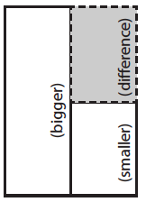
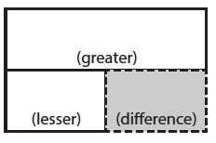
Difference
G – L = D
Fuchs et al. (2008); Griffin & Jitendra (2009)

Slide 123
Difference

Slide 124
Difference
✓
✓
G – L = D
✓
U
P
S
✓
✓
107
-
68
=
B
107
68
68
+ ?
107
✓
107 – 68 = 39
✓
Grade 3 Smarter Balanced
B = 39 more beads

Slide 125
Difference
G – L = D
Fuchs et al. (2008); Griffin & Jitendra (2009)

Slide 127
Change
An amount that increases or decreases
Shannah had $4. Then she earned $3 for cleaning her room. How much money does Shannah have now?
4 + 3 = ?
Shannah has $4. Then she earned money for cleaning her room. Now Shannah has $7. How much money did she earn?
4 + ? = 7
Shannah had some money. Then she made $3 for cleaning her room. Now she has $7. How much money did Shannah start with?
? + 3 = 7

Slide 128
Total
“Are parts put together for a total?”
Difference
“Are amounts compared for a difference?”
Change
“Does an amount increase or decrease?”

Slide 129
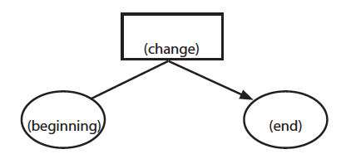
Change
ST +/– C = E
Fuchs et al. (2008); Griffin & Jitendra (2009)

Slide 130
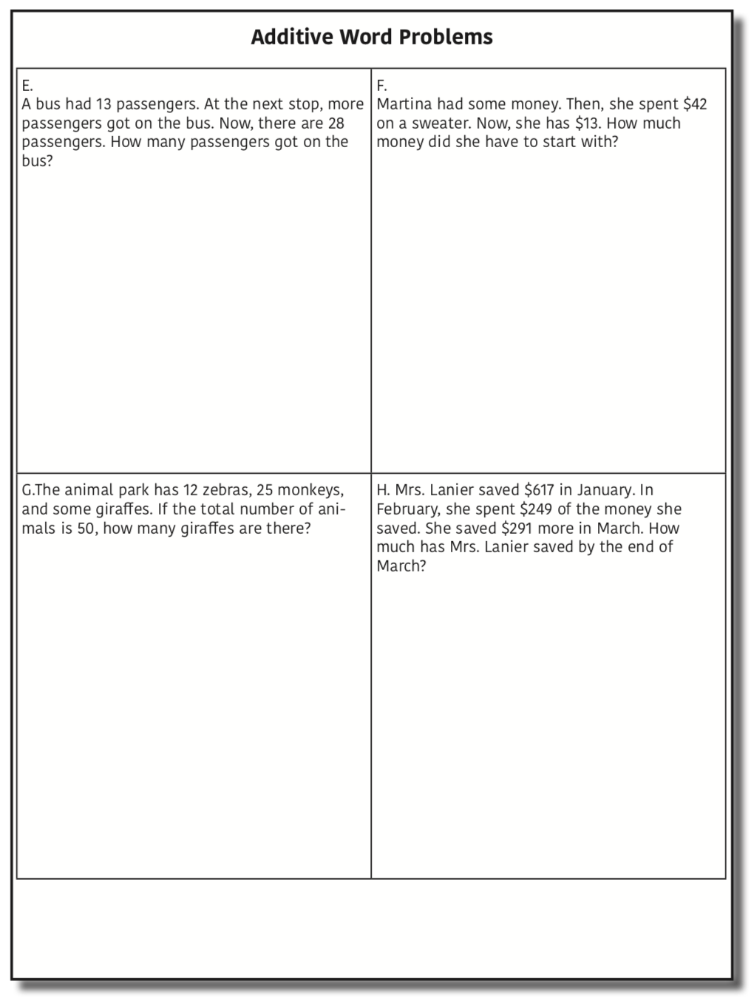
Change

Slide 131
Change
✓
A bus had 13 passengers. At the next stop, more passengers got on the bus. Now, there are 28 passengers. How many passengers got on the bus?
✓
✓
U
P
S
✓
ST + C = E
✓
13
+
?
=
28
✓
28
- 13
✓
13
+ ?
28
13 + 15 = 28
? = 15 passengers

Slide 132
Change
An amount that increases or decreases
Reece baked 9 cookies. Then, she ate 2 of the cookies. How many cookies does Reece have now?
9 – 2 = ?
Reece baked 9 cookies. Then, she ate some of the cookies. Now, she has 7 cookies. How many cookies did Reece eat?
9 – ? = 7
Reece baked some cookies. She ate 2 of the cookies and has 7 cookies left. How many cookies did Reece bake?
? – 2 = 7

Slide 133
Change
ST +/– C = E
Fuchs et al. (2008); Griffin & Jitendra (2009)

Slide 136
Total
P1 + P2 + P3 = T

Slide 137
Change
ST – C + C = E

Slide 138
Let’s Review
What’s a Total problem?
What’s a Difference problem?
What’s a Change problem?

Slide 139
Schema Quiz Time!

Slide 140
Change
Grade 3 PARCC

Slide 141
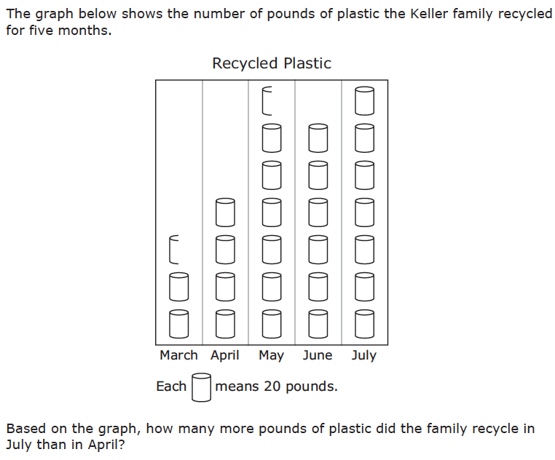
Difference
Grade 3 STAAR

Slide 142
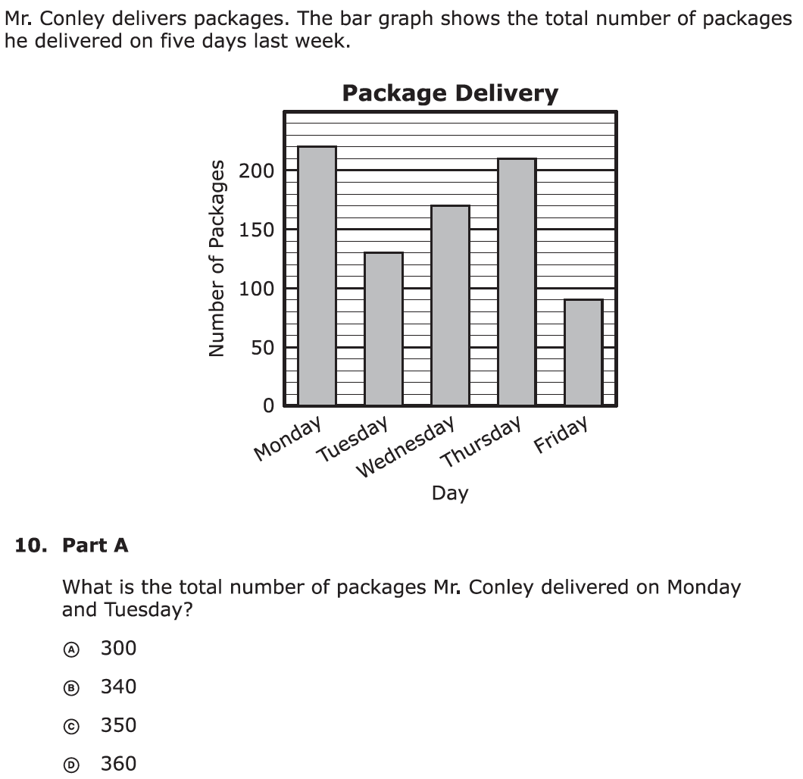
Total
Grade 3 PARCC

Slide 143
Don’t tie key words to operations
Do have an attack strategy
Do teach word-problem schemas

Slide 144
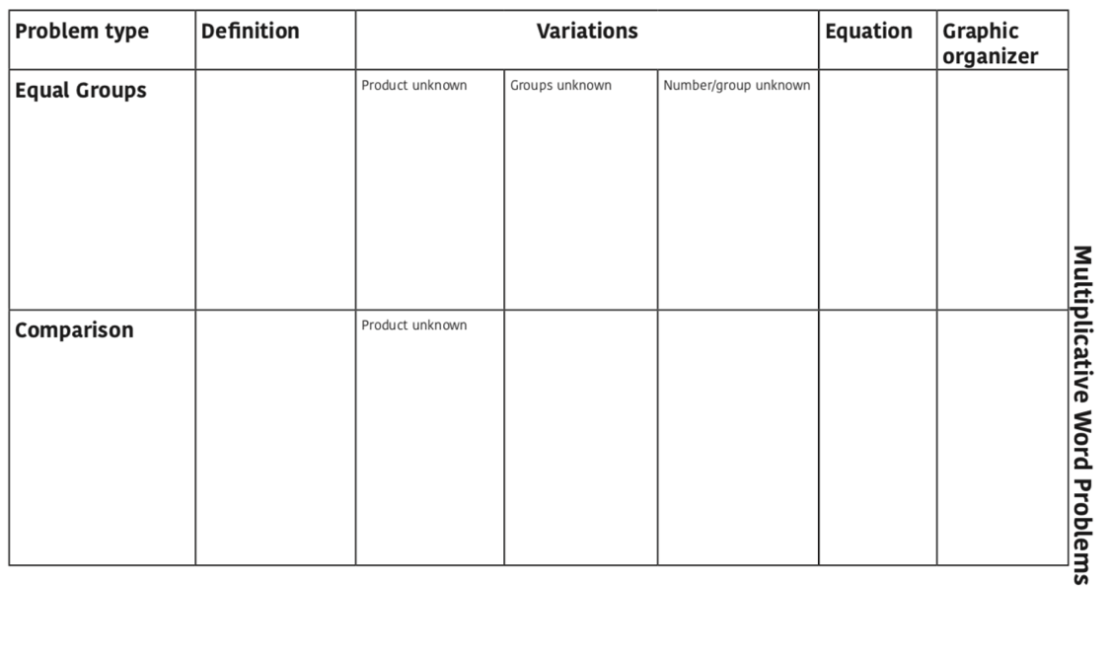

Slide 145
Equal Groups
Groups multiplied by number in each group for a product
Scott has 2 bags of apples. There are 6 apples in each bag. How many apples does Scott have altogether?
2 × 6 = ?
Scott has 12 apples. He wants to share them equally among his 2 friends. How many apples will each friend receive?
2 × ? = 12
Scott has 12 apples. He put them into bags containing 6 apples each. How many bags did Scott use?
? × 6 = 12

Slide 146
Equal Groups
“Are there groups with an equal number in each group?”

Slide 147
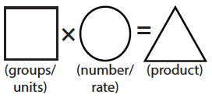
Equal Groups
G × N = P

Slide 148
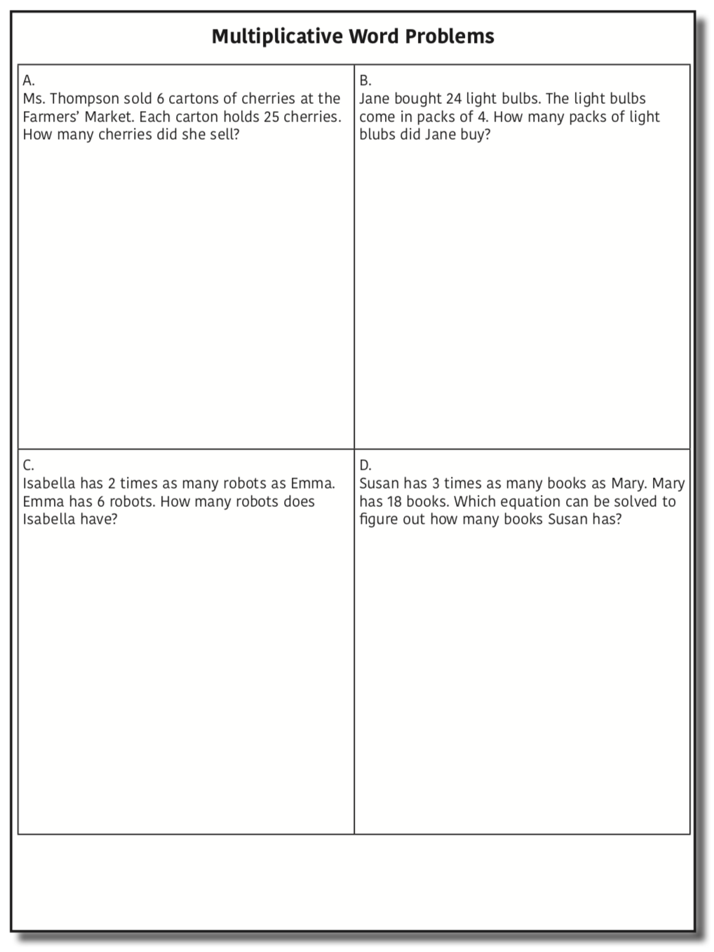
Equal Groups

Slide 149
Equal Groups
✓
✓
✓
G x N = P
U
P
S
✓
✓
x
=
6
25
?
✓
✓
6 x 25 = 150
? = 150 cherries

Slide 150
Equal Groups
G × N = P

Slide 152
Comparison
Set multiplied by a number of times for a product
Julie picked 6 apples. Amy picked 2 times as many apples as Marcie. How many apples did Lisa pick?
6 × 2 = ?
Amy picked 12 apples. She picked 2 times as many apples as Julie. How many apples did Julie pick?
? × 2 = 12
Amy picked 12 apples, and Julie picked 6 apples. How many times as many apples did Amy pick?
6 × ? = 12

Slide 153
Equal Groups
“Are there groups with an equal number in each group?”
Comparison
“Is a set compared a number of times?”

Slide 154
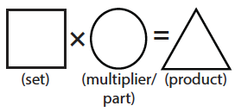
Comparison
S × T = P

Slide 155
Comparison

Slide 156
Comparison
✓
U
P
S
✓
6
2
?
✓
✓
✓
Grade 4 Smarter Balanced
? = 12 robots

Slide 157
Comparison
S × T = P

Slide 159
Let’s Review
What’s an Equal Groups problem?
What’s a Comparison problem?

Slide 160
Schema Quiz Time!

Slide 161
Comparison
Grade 4 Smarter Balanced

Slide 162
Equal Groups
Grade 4 PARCC

Slide 163
Schemas
Total
Difference
Change
Equal Groups
Comparison
Ratios/Proportions

Slide 164
srpowell@austin.utexas.edu
@sarahpowellphd
119

