Slide 1


FACTE Conference & Trade Show
Career Cluster Update
July 26, 2016
Presented by
Anne Nyman, State Supervisor

Slide 2
For sharing your passion
For shaping the future generation
For showing lost kids the way
For making sacrifices
For taking up this selfless profession
For loving children
For helping parents
For caring
For advising
For educating today’s youth
For being here

Slide 3
Program Changes

Slide 4
2016 – 2017 School Year Changes
Education & Training Career Cluster
Program/Course Title | CIP # | Secondary # | PSAV # | AS / CCC Program | Change
New Programs/Courses
Early Childhood Education Associate Degree (60) | 1413121004 | NA | NA | AS | NEW AS Degree consisting of 60 credit hours, replacing 63 credit hour program. AS degree program designed and intended to replace Early Childhood Education Associate Degree 1413121003.
Changed Programs/Courses
Deleted Programs
Early Childhood Education | 0419070910 | 8503210 | V200210 | NA | Deleted
Early Childhood Management | 1419070800 | NA | NA | AS | Deleted
Changes Pending for 2017-2018
Early Childhood Education Associate Degree | 1413121003 | NA | NA | AS | Daggered for deletion. Last year for new enrollments is 15/16. Recommended replacement program is Early Childhood Education Associate Degree 1413121004.

Slide 5
2016 – 2017 School Year Changes
Hospitality & Tourism Career Cluster

Slide 6
2016 – 2017 School Year Changes
Hospitality & Tourism Career Cluster, continued
Hospitality & Tourism (8845100) | 0252190600 | 8845100 | NA | NA | Secondary Program (8845100) daggered for deletion as a result of consolidating Hospitality & Tourism 8845100 and Lodging Operations 8830300; New Program developed with the intention of replacing Hospitality & Tourism Secondary program 8845100 and Lodging Operations 8830300. Last year for enrollment is 2015 – 2016; program will remain in the inventory for teach-out. Recommended replacement program is Hospitality and Tourism Management 8703100.
Lodging Operations | NA | 8830300 | NA | NA | Dagger Secondary program for deletion; Last year for enrollment is 2015 – 2016; program will remain in the inventory for teach-out. Recommended replacement program is Hospitality and Tourism Management 8703100.
Nutrition and Dietetic Services | 0351310402 | NA | V200404 | NA | Dagger for deletion; Last year for enrollment is 2015 – 2016; program will remain in the inventory for teach-out. Recommended replacement program is Nutrition and Dietetic Clerk N300100.

Slide 7
Enrollment Data

Slide 8
2014 – 2015
Enrollment Data
Education & Training

Slide 9
2014 – 2015
Enrollment Data
Hospitality & Tourism

Slide 10
Program Reviews

Slide 11
E & T Program of Work (for 17 - 18 s/y)
Current/Ongoing
Program Type | Program Name
Middle School | N/A
Secondary | Early Childhood Education NEW (8405100)
PSAV | Child Care Center Operations (V200206)
 | Early Childhood Education NEW (E300100)
 | Family Child Care Training (V200410)
AS/AAS/CCC/ATD | Sports, Fitness and Recreation Management (AS – 1731050701)
 | Translation-Interpretation Studies (AS – 1713100303) Interpretation Studies (CCC - 0713100304) Translation Studies (CCC – 0713100305)

Slide 12
H & T Program of Work (for 17 - 18 s/y)
Current/
Ongoing
Program Type | Program Name
Middle School | N/A
Secondary | Culinary Arts (8800500)
 | Culinary and Hospitality Specialties (8800600)
 | Lodging Operations (8830300)
PSAV | Commercial Foods and Culinary Arts (N100500)
 | Lodging Operations (M607010)
AS/AAS/CCC/ATD | Travel & Tourism Industry Management (AS - 1252090300) Travel & Tourism Management (ATD - 0252090301)
 | Hospitality and Tourism Management (AS - 1252090100) Event Planning Management (CCC - 0252090905) Guest Services Specialist (CCC - 0252090403) Rooms Division Specialist (CCC - 0252090405) Rooms Division Operations (CCC - 0252090406) Rooms Division Management (CCC - 0252090402) Food & Beverage Specialist (CCC -0252090507) Food & Beverage Operations (CCC - 0252090508) Food & Beverage Management (CCC - 0252090503)
 | Culinary Management (AS - 1612050400) Culinary Arts (CCC - 0612050301) Chef’s Apprentice (CCC - 0612050302) Culinary Arts Management Operations (CCC - 0612050401)
 | Restaurant Management (AS -1252090500)
 | Diving Business Technology (AAS – 0249030400) Professional Research Diving Specialization Professional Dive Instructor Specialization Introduction to Commercial/Work Diver Specialization Diving Medical Technician Specialization

Slide 13
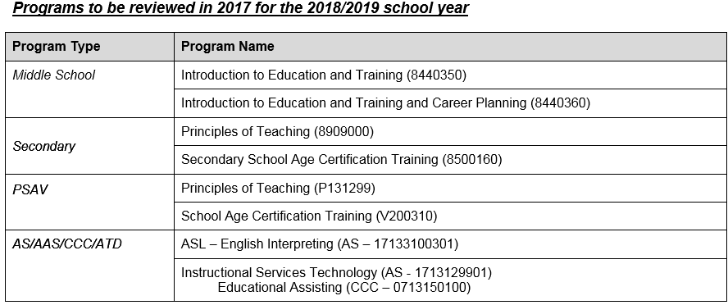
Education & Training Cluster
Next up…

Slide 14
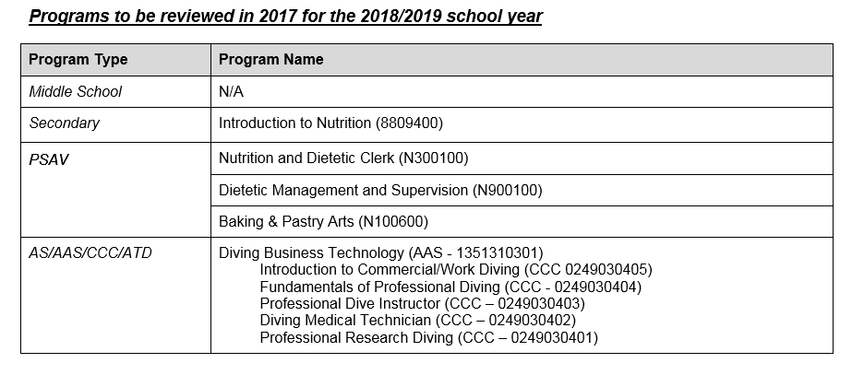
Hospitality & Tourism Cluster
Next up…

Slide 15
Legislation

Slide 16

http://www.fldoe.org/core/fileparse.php/7513/urlt/2016LegislativeReview.pdf

Slide 17
Legislative Changes: HB 249
House Bill 249 was passed during the 2016 regular session and signed into law by the Governor on March 25, 2016 (Chapter 2016-120, Laws of Florida). The bill defines a culinary education program as one that educates enrolled students in the culinary arts, including preparation, cooking, and presentation of food, or provides education and experience in culinary arts-related businesses. A culinary education program is a program provided by a:
  State university; Florida College System institution; Career center as defined in s. 1001.44, F.S.; Charter technical career center as defined in s. 1002.34, F.S.; Nonprofit independent college or university that is located and chartered in this state, meets certain accreditation requirements, and is eligible to participate in the William L. Boyd, IV, Florida Resident Access Grant Program; or Nonpublic postsecondary educational institution licensed pursuant to Part III of s.1005, F.S.
The bill authorizes the issuance of a special license to a culinary education program licensed as a public food service establishment for the sale and service of alcoholic beverages on the licensed premises of the culinary education program. For a licensed culinary education program that also provides catering services, the special license will allow it to sell or serve alcoholic beverages on the premises of events for which it provides prepared food.
The special license does not authorize the culinary education program to conduct any activities that would violate Florida’s Beverage Law, including certain age restrictions, or local law. A culinary education program with a special license may not sell alcoholic beverages by the package for off-premise consumption.
The bill authorizes the Department of Business and Professional Regulation to promulgate rules to administer the bill’s provisions and becomes effective July 1, 2016.

Slide 18


Rescreening of all Owners, Operators, Child Care Personnel, Substitutes and Volunteers hired/working prior to July 1, 2016.
The Child Care Development Block Grant Reauthorization of 2014 requires each state, including Florida, to certify that all individuals working in child care have been screened and are eligible to work in child care based on the new elements of background screening. To facilitate this certification, child care facilities, before and after-school programs, religious exempt child care providers, large family child care homes, family day care homes, nonpublic schools and public schools providing child care, must rescreen personnel to include all owners, operators, child care personnel, household members, substitutes, and volunteers by May 31, 2017.
Upcoming Provider Meetings
Child Care Regulation Updates Presentation
Each region will be hosting a provider meeting to discuss recent federal changes to Child Care regulations and Background Screening requirements. You will find each scheduled meeting further down this page with the same title.
http://www.myflfamilies.com/service-programs/child-care/announcements
Molly.Grant@oel.myflorida.com 850-717-8578

Slide 19
Miscellany

Slide 20


ECE Support
National CDA (CPREC001)
on CAPE Funding List
Webinar August 3rd @9AM
TEACH scholarship information
CDA/ECPC/FCCPC Alignment
Q&A/Best practices

Slide 21
  Please register for the
  ECE/TEACH Webinar
  Wednesday, August 3
  9:00 AM - 11:00 AM EDT at:
  https://attendee.gototraining.com/r/6102439442907881985
  After registering you will receive a confirmation email containing information about joining the training.

Slide 23
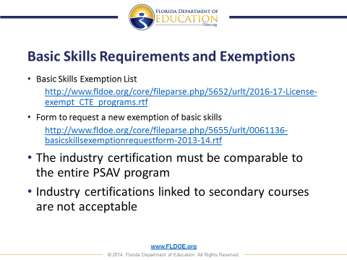

Slide 24
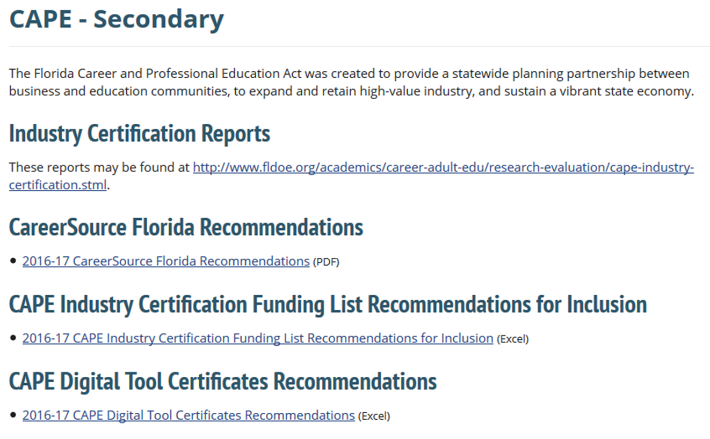
Industry Certification
2016-17 CAPE Funding final list will be released by August 1
http://www.fldoe.org/academics/career-adult-edu/cape-secondary/index.stml
http://www.fldoe.org/core/fileparse.php/9946/urlt/2015-16CAPEPostsecondaryFundingList.pdf

Slide 25


Are you interested?
New State Supervisor
We are planning an Academic Alignment activity in the Spring
Upcoming Program Reviews
If interested in participating, please let me know
Vaughn Hendriex
Government & Public Administration Home
Human Services
Law, Public Safety and Security

Slide 26
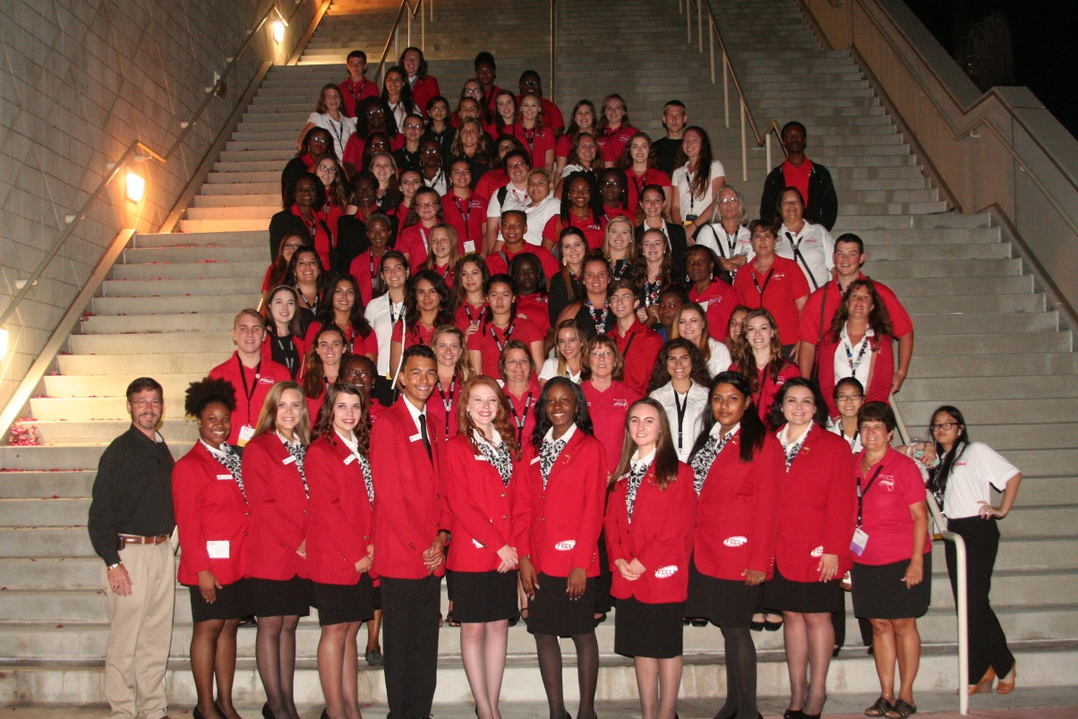

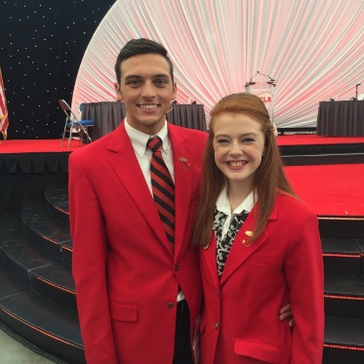

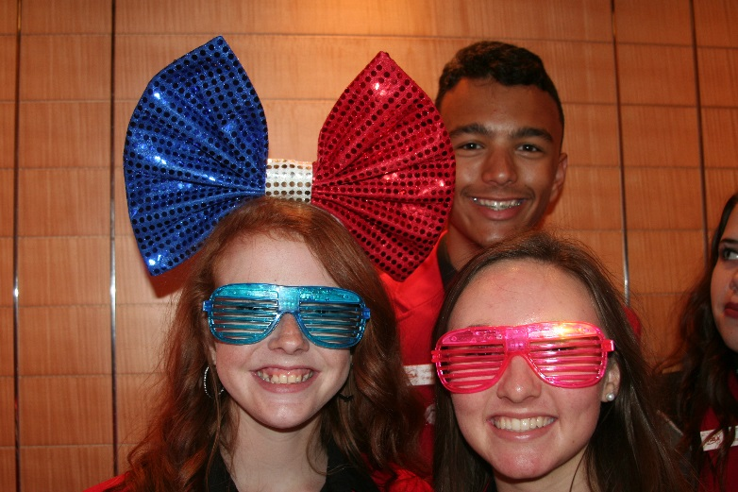
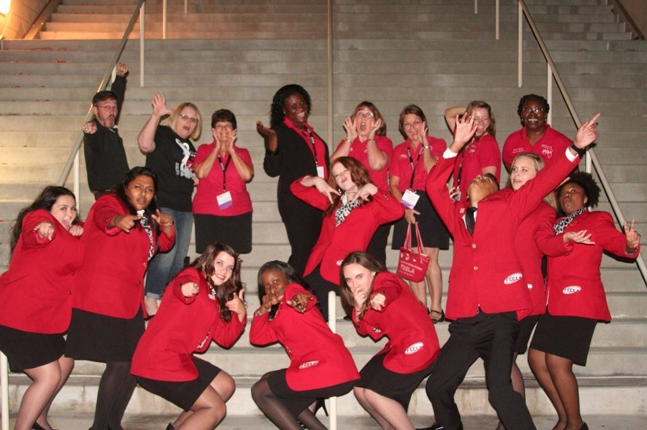


Slide 27
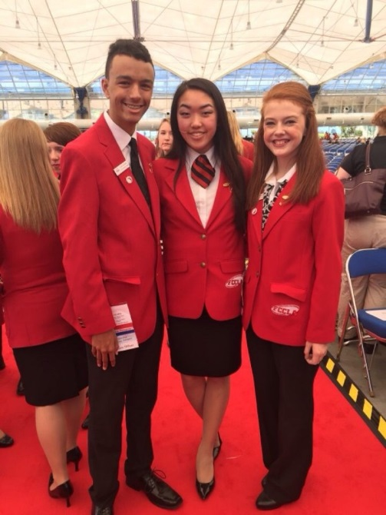
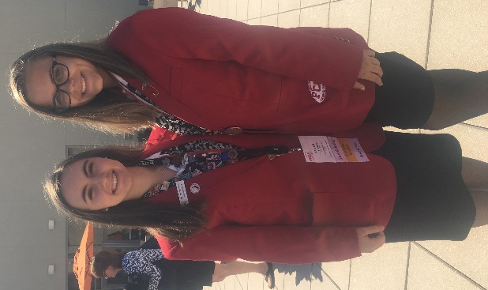
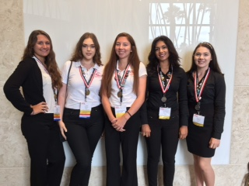
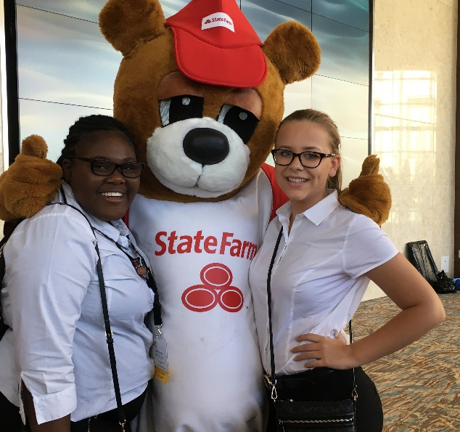
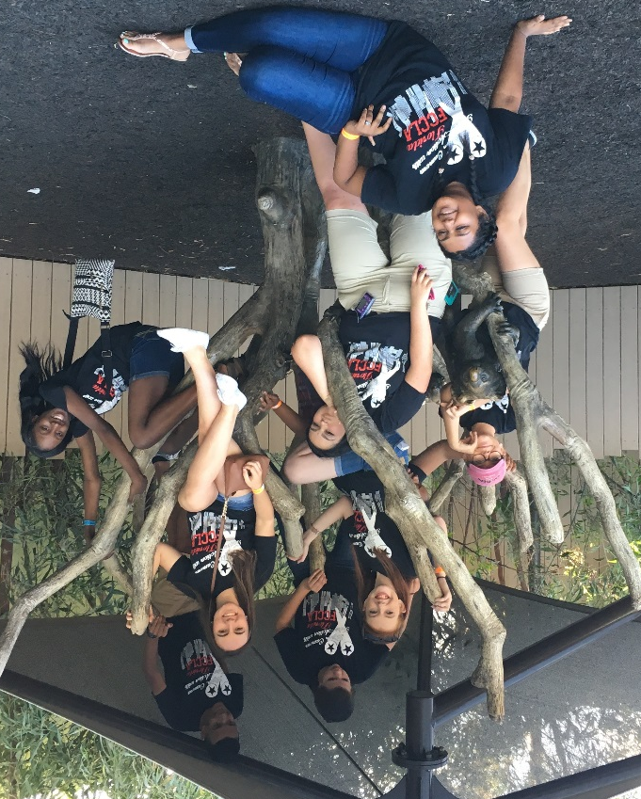
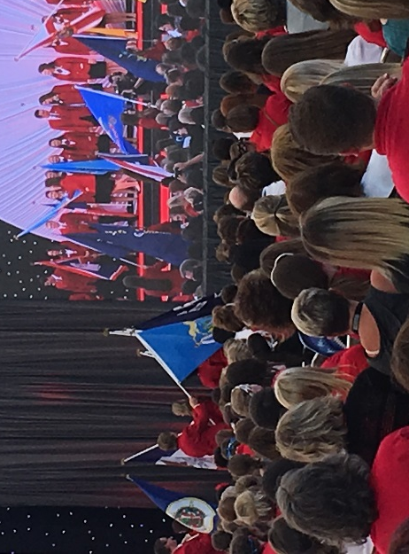

Fashion Institute of Design and Technology

Slide 28
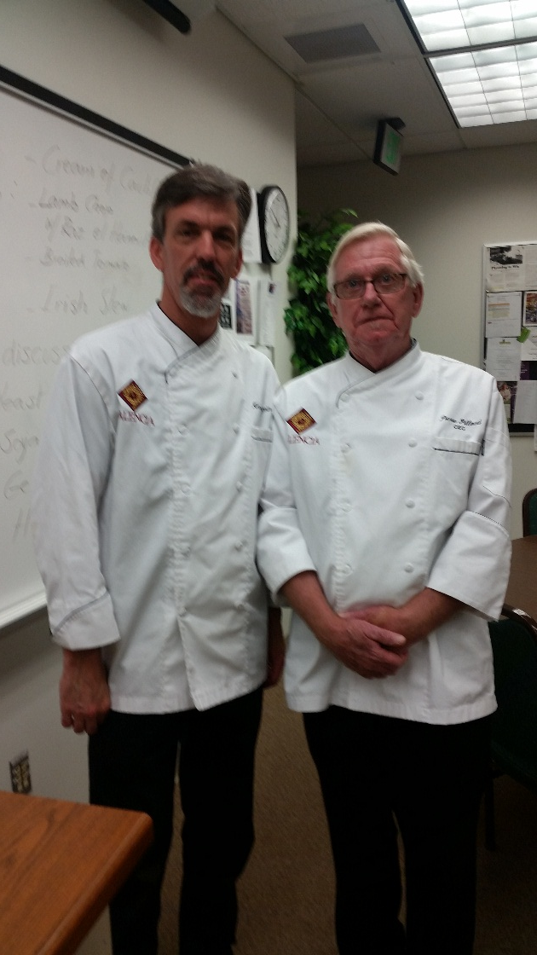
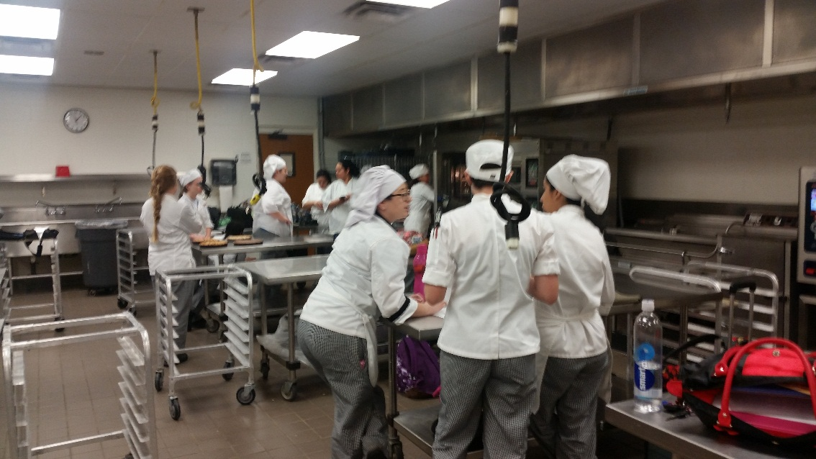
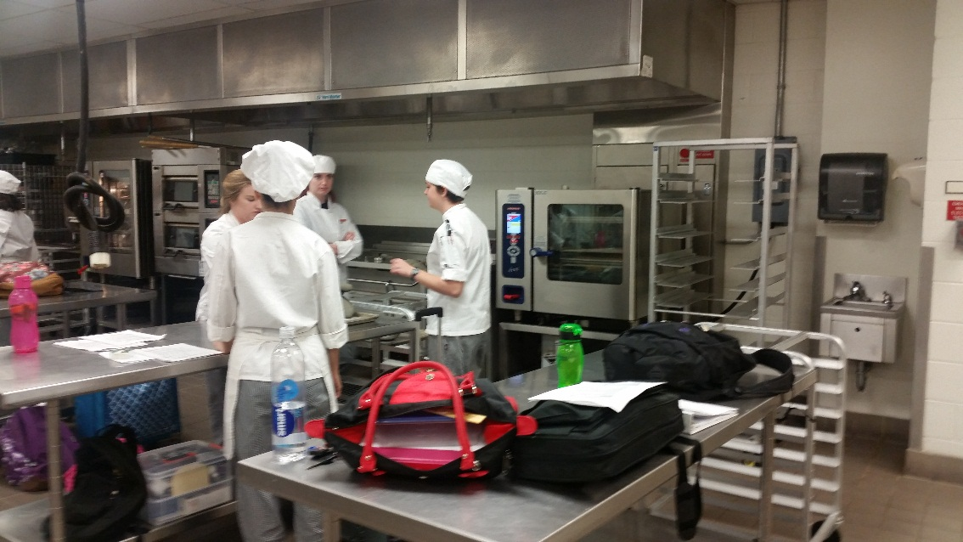
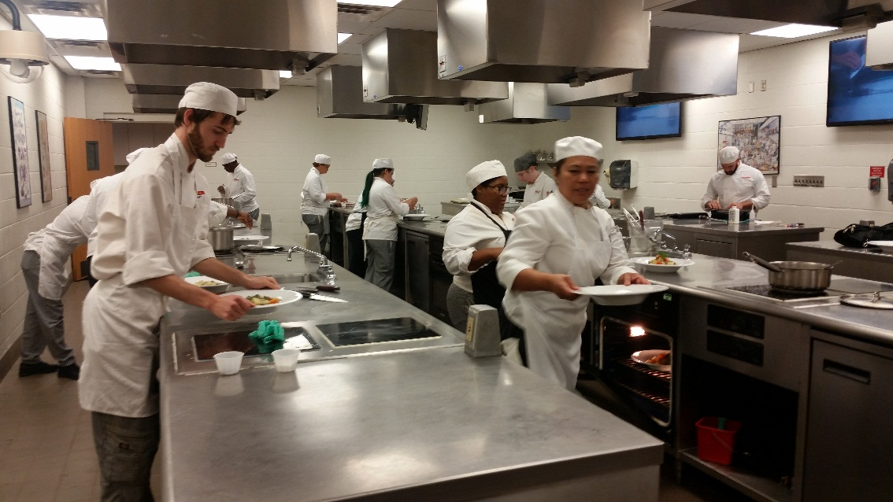
Valencia College Culinary
March 2016
Chef Pierre Pilloud
Chef Kenneth Bourgoin

Slide 29
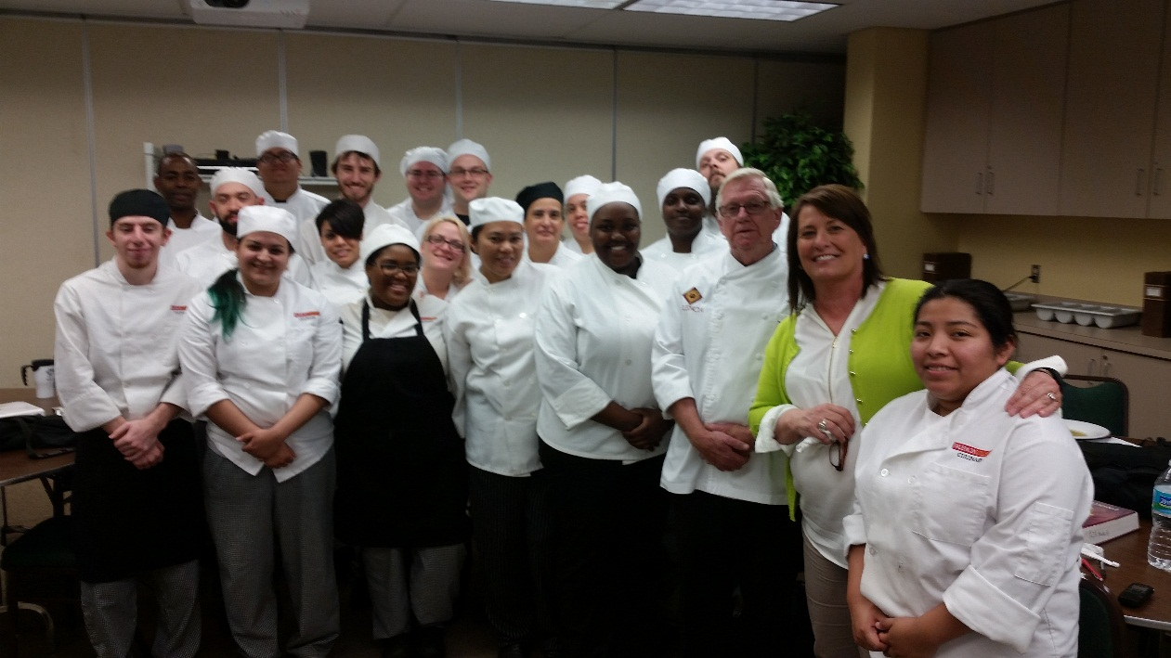
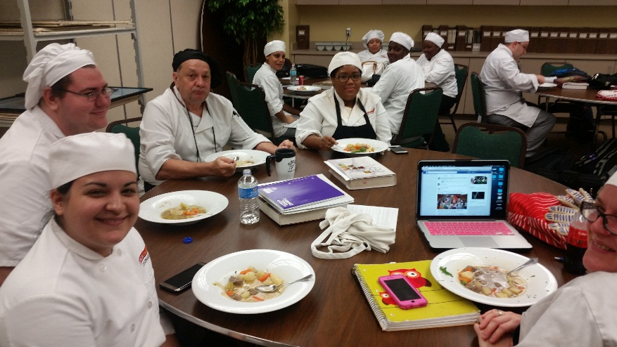
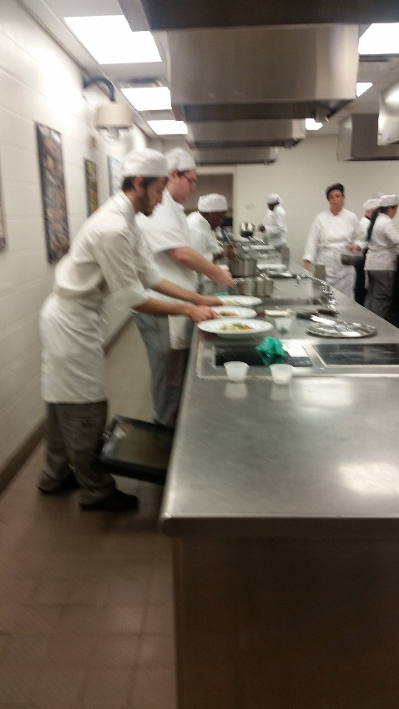
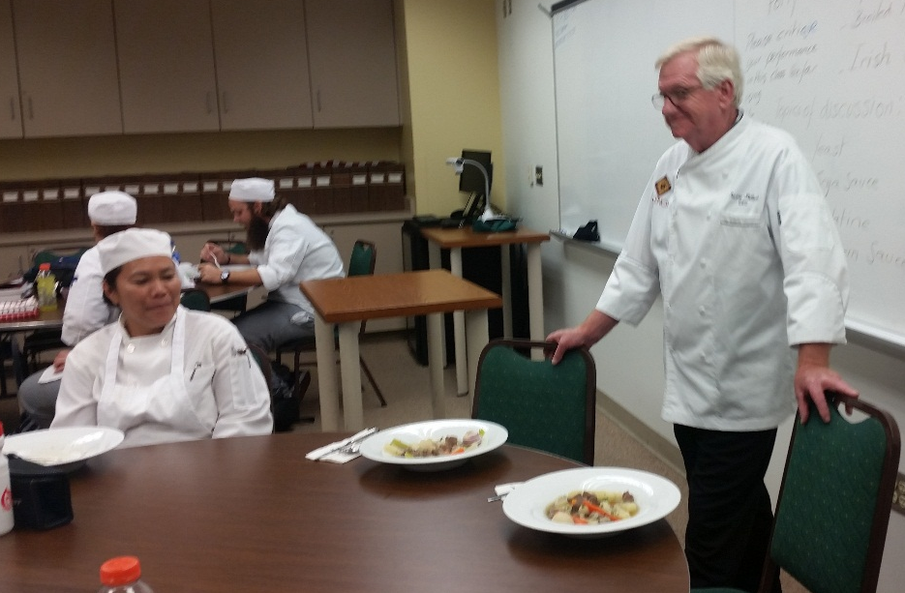
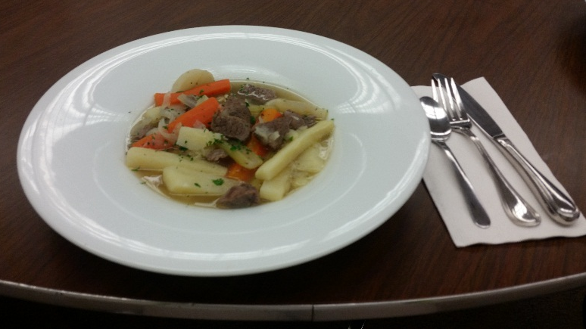
St. Patrick’s Day lunch
Valencia College
Culinary

Slide 30
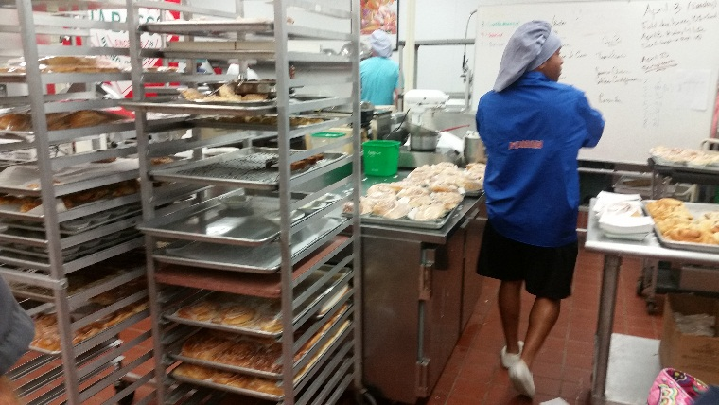
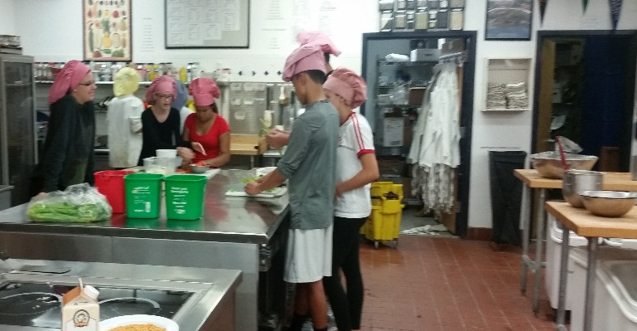
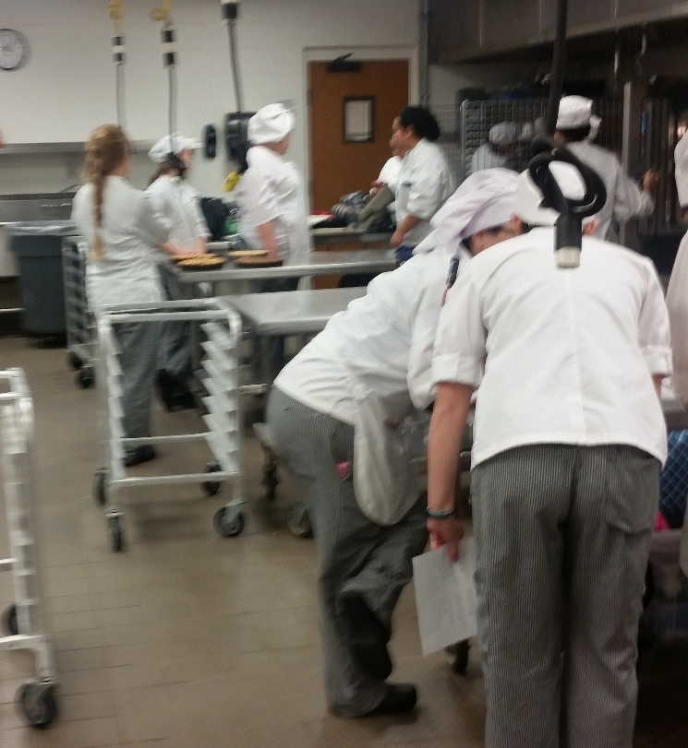
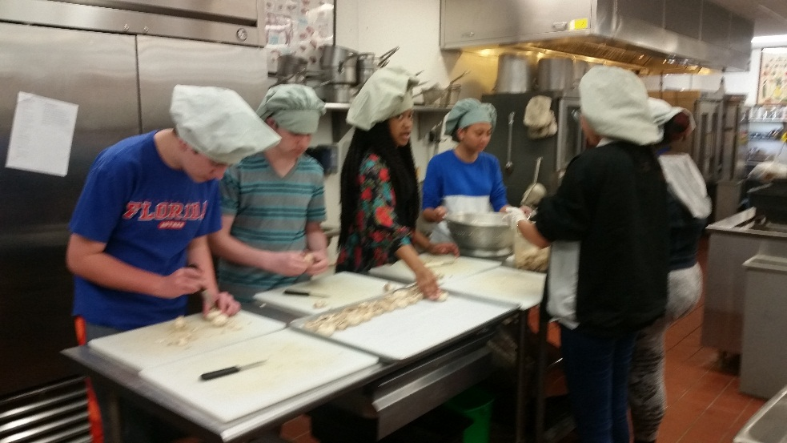
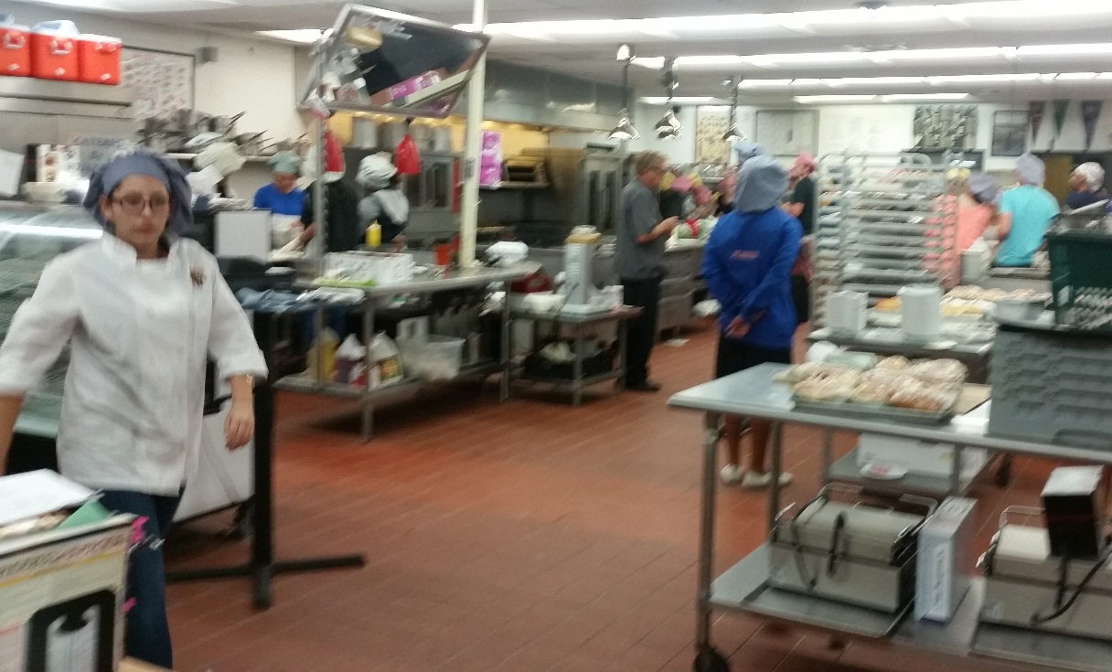
Wharton High School Tampa
Culinary Arts

Slide 31
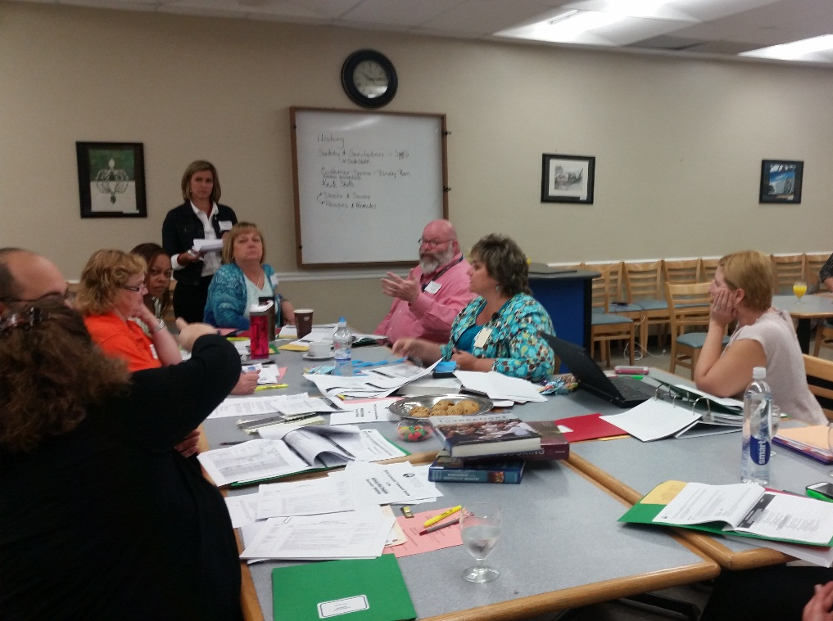
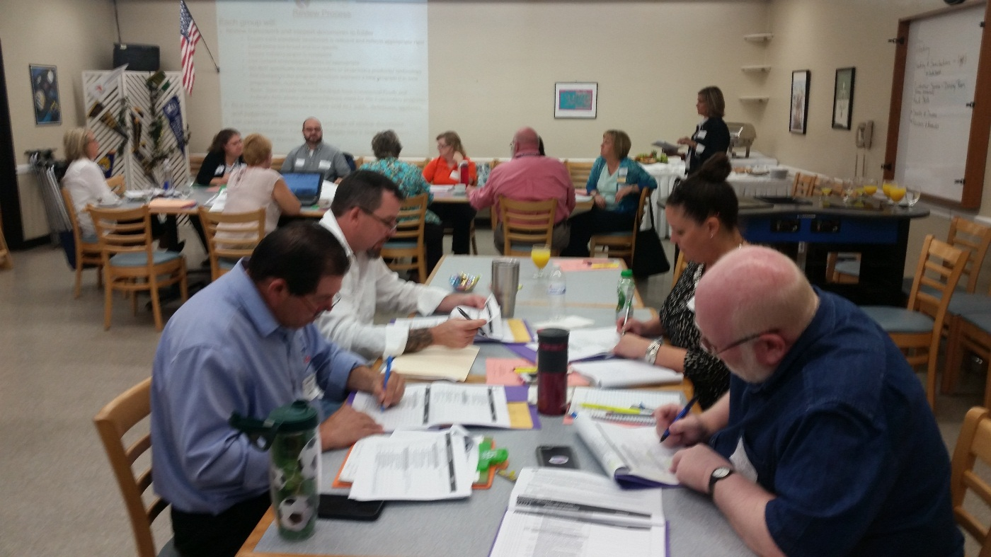
Program Review Committee
Culinary Arts
Commercial Foods & Culinary Arts
hosted by Hillsborough County Schools

Slide 32

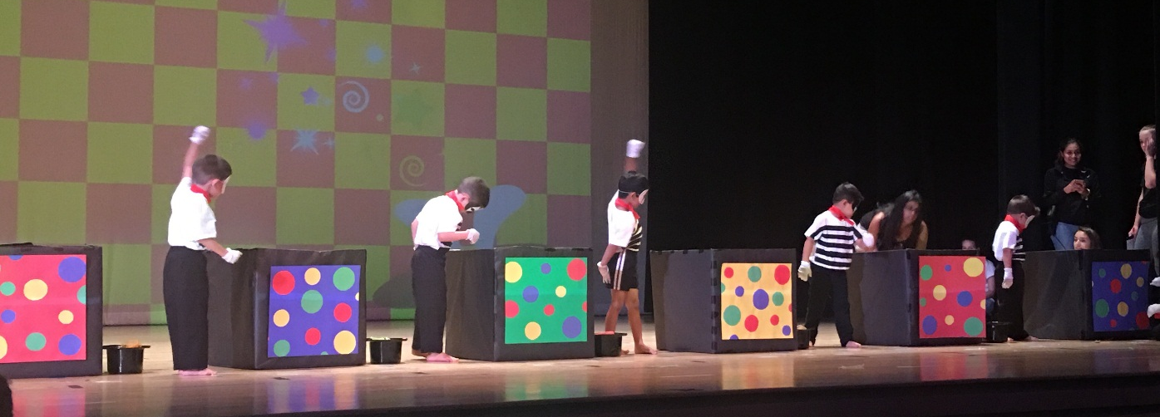
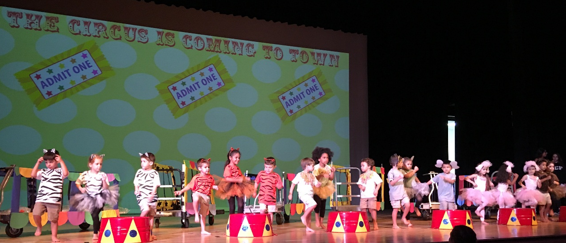
Baby Bobcats Preschool
West Broward High School ECE Program
Dawn Vazquez, Instructor

Slide 33

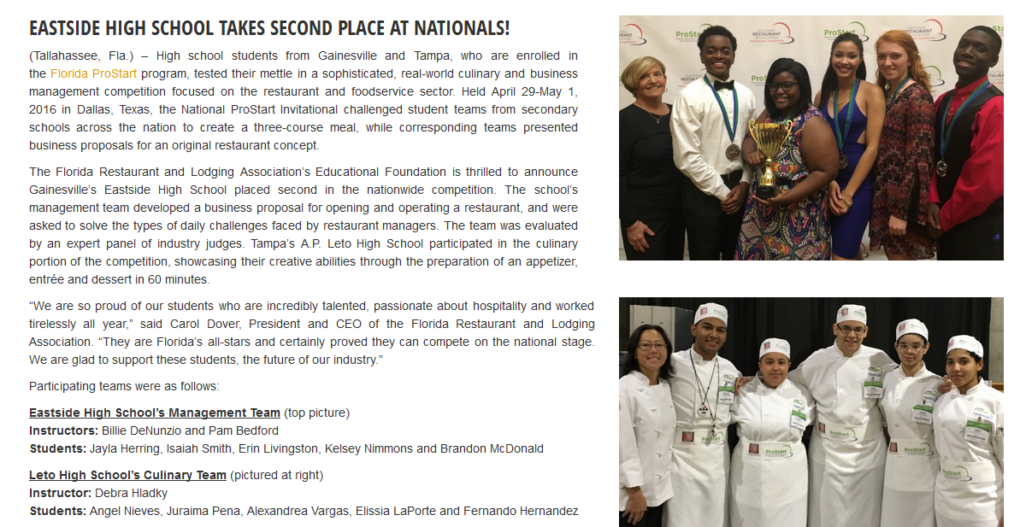

Eastside High School (Gainesville)
takes Second Place at
National ProStart Invitational
Leto High School’s (Tampa) Culinary Tem also showcased their creative abilities at National ProStart
Lee County Schools FCCLA supports Ronald McDonald House with Cinco de Mayo Menu and Pantry collection

Slide 34
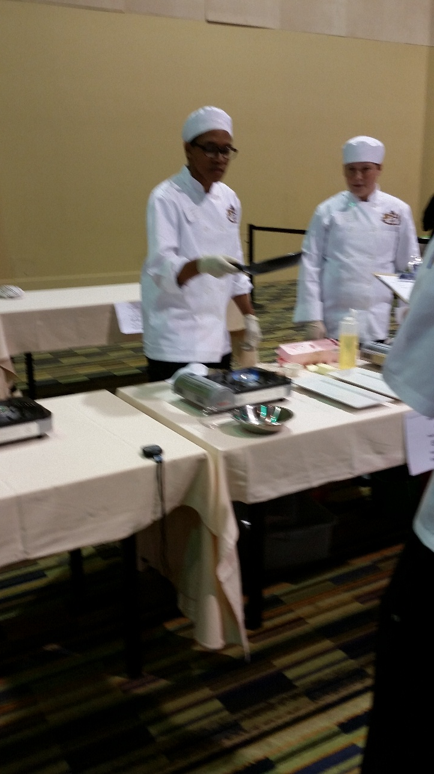
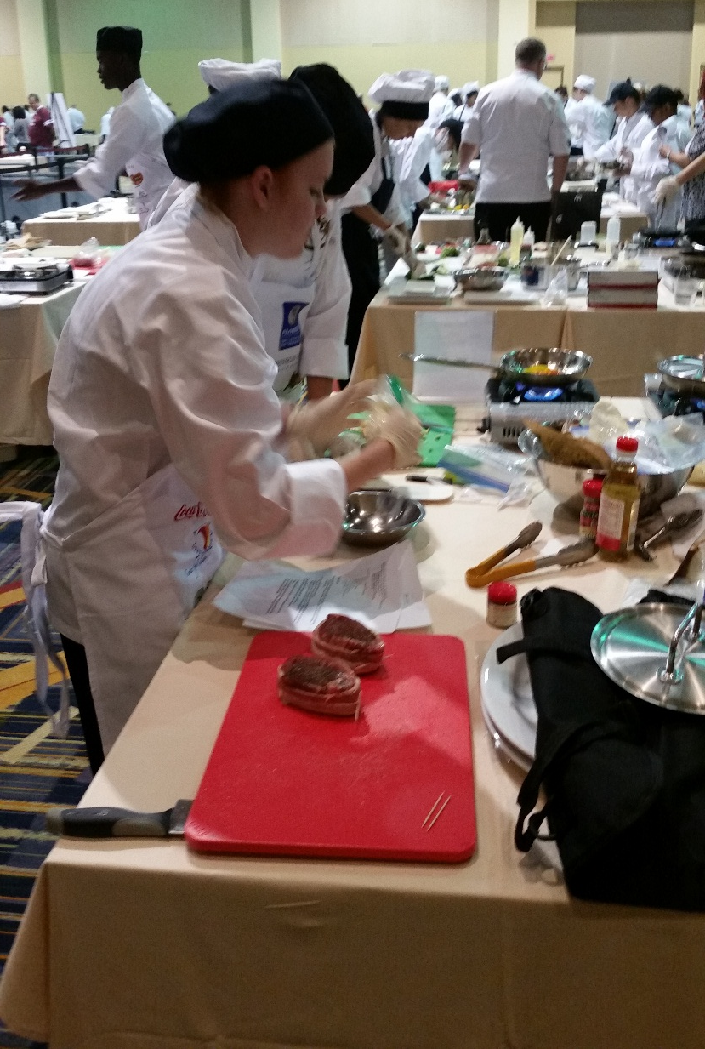
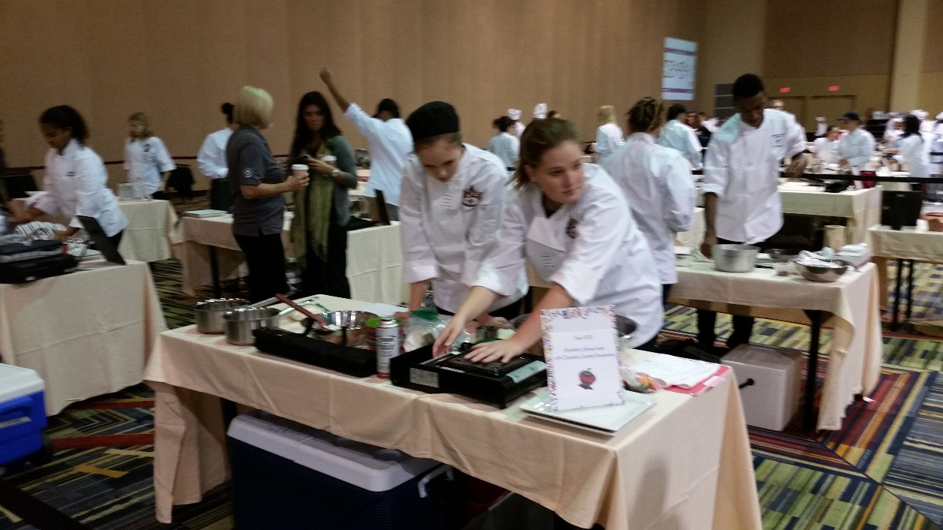
Orange County Public Schools
Culinary Competition
Pat Breeding, OCPS

Slide 35


Slide 36

Anne Nyman
State Supervisor
Education & Training; Hospitality & Tourism
Career and Technical Education
Division of Career and Adult Education
325 West Gaines Street, Suite 701
Tallahassee, Florida 32399-0400
Phone: (850) 245-9900
Fax: (850) 245-9010
Anne.Nyman@fldoe.org
Notes:
Contact Anne Nyman at 850-245-9900 or Anne.Nyman@fldoe.org.
Thank you and have a good day.

