Slide 1
You and WOrk
West Branch Career Based Intervention

Slide 2
What you will learn in this unit
Choosing the right career is one of the most important decisions you will ever make!
You will be able to define a job, an occupation, and a career.
You will be able to describe how your skills, interests, and desired lifestyle can have a major impact on your plans for a career
You will be able to explain how work life affects your lifestyle
Big Idea
Notes:
Why is all of this important?
Click
Because of the big idea.
What is the Big Idea?
click

Slide 3
What is Work?
Notes:
What is work? Ask the students to answer the question.
Is cleaning your room work?
Is racking leaves work?
Do you have to be paid for it to be work?
Can volunteering be work?
So then what is work?

Slide 4
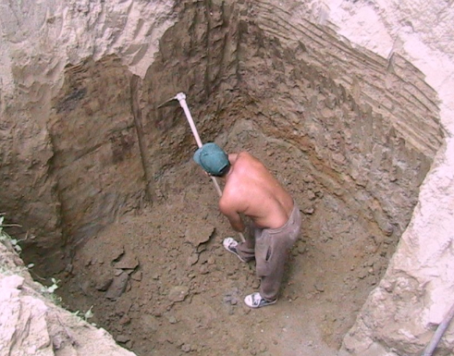
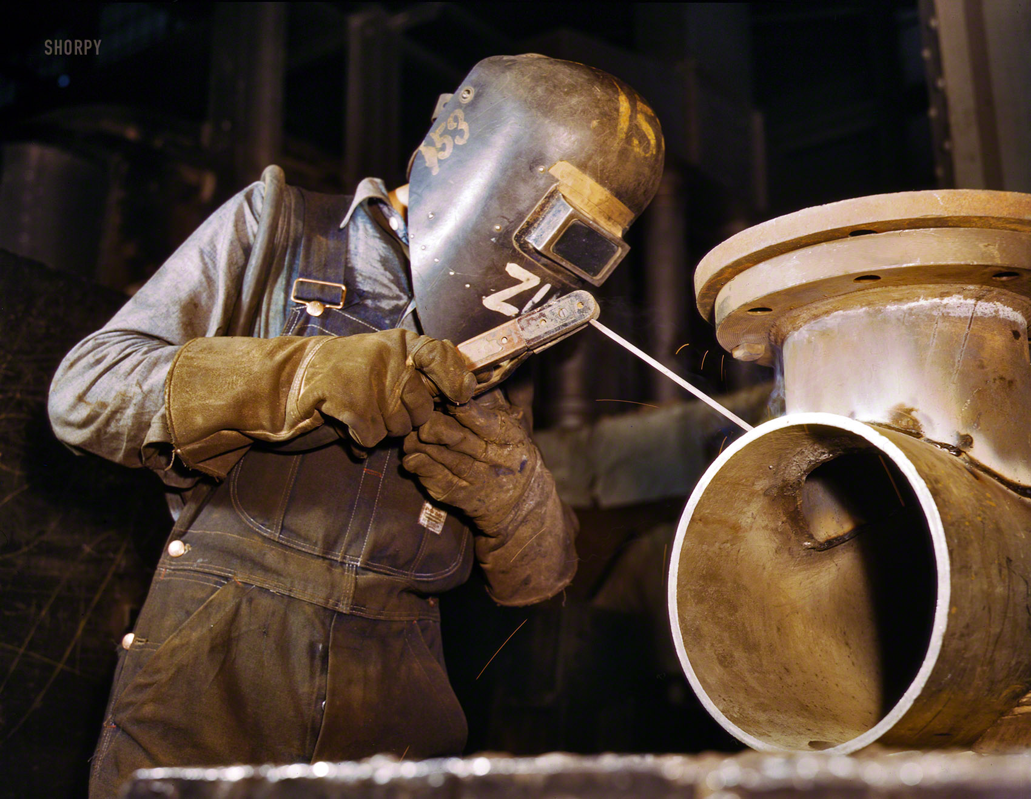
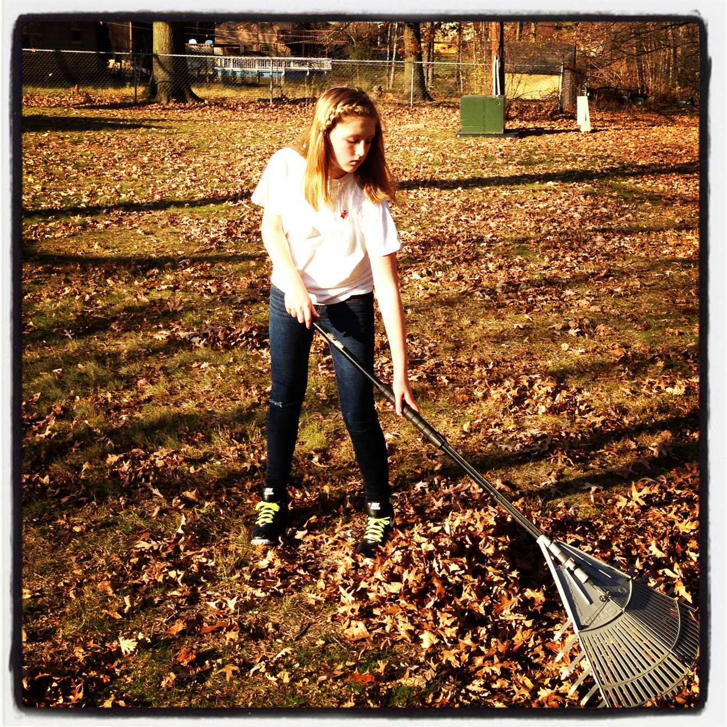
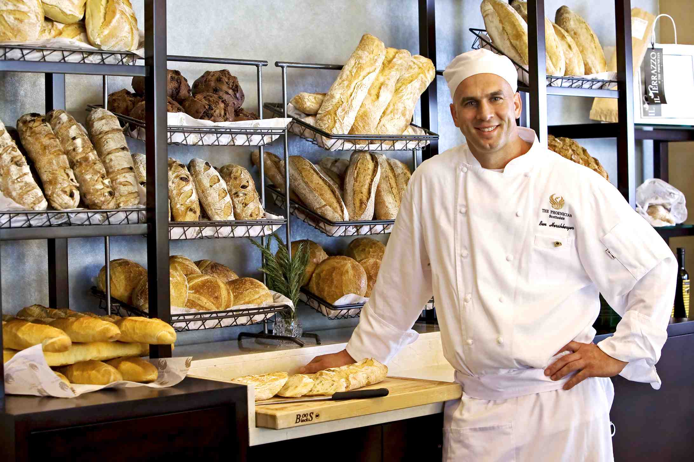
Work is any Activity that is useful
Notes:
Could be digging a hole.
Welding something.
Racking leaves.
Using a cash register.
Baking bread.
Repairing a car.
Any activity that is useful.
Does it have to be useful to just you or can it be useful to anyone?
Does it matter who its useful too?
When we talk about work in the sense of a career the question is:

Slide 5
What kind of work is right for me?
Notes:
This is an extremely important question because with a full time job you could spend more than 2000 hours a year at work.
Imagine spending 2000 hours a year working at something that you hate or not that good at? How long would you last?
How can I find what kind of work might be right for me?
One of those ways is:
Click
How can I identify my skills and interests when I don’t know what they are?
Click

Slide 6
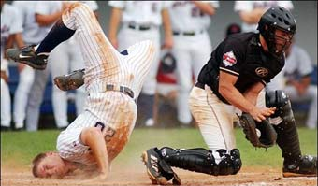
What are interests?
Interests are subjects or activities that you like.
They could be music, sports, or computers.
Notes:
Could even be a subject at school like Math or Science.
What are some other interests?

Slide 7
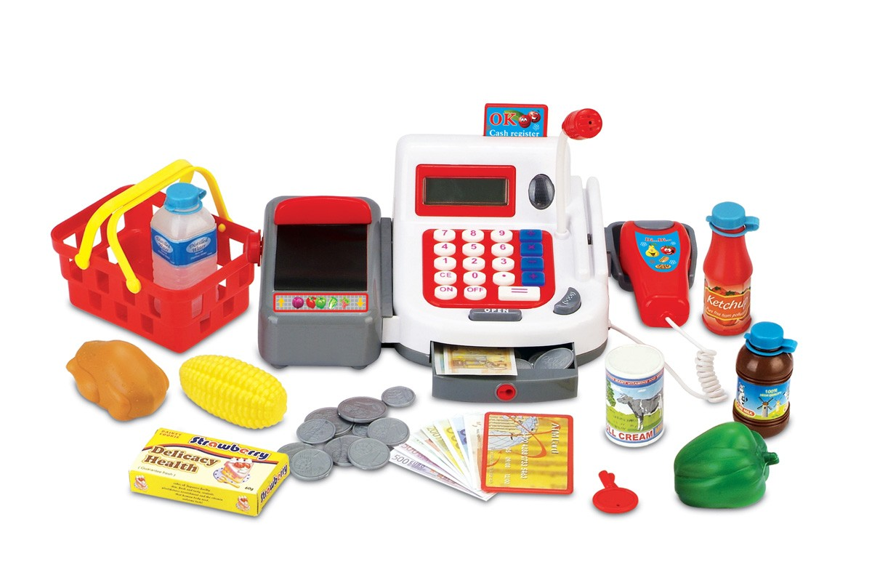
What are skills?
Skills are what you can do.
Some skills you may have are drive a car, make change, care for an animal.
Notes:
There are two kinds of skills.
Regular Skills and Transferable skills.
Skills come from your knowledge and experience.
What are some other skills?

Slide 8
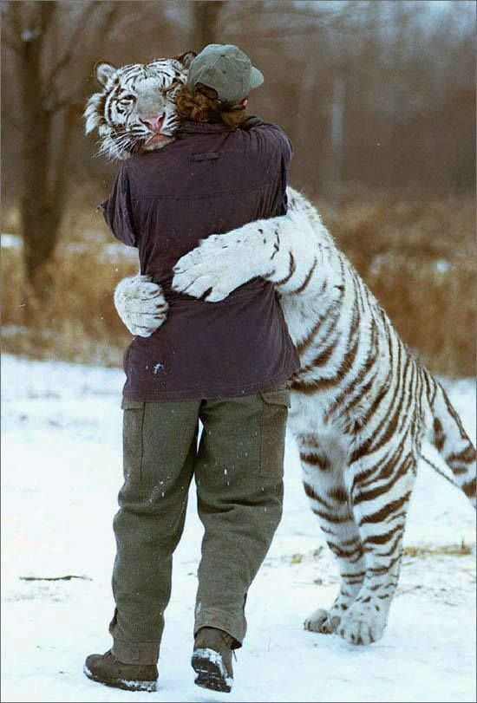
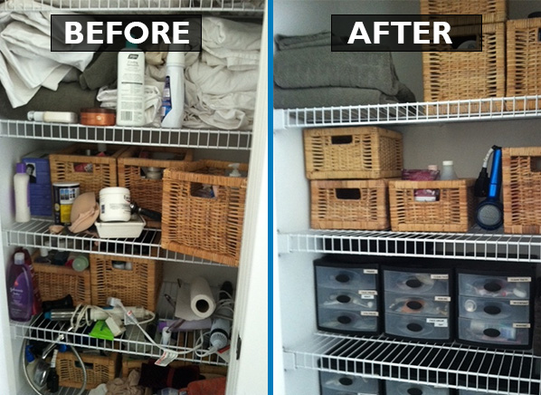
What are Transferable skills?
Transferable skills are skills you can use in many different situations and activities.
Some examples are writing, getting along with people, organizing, and making good decisions.
Notes:
Can you think of any other transferable skills?

Slide 9
Lets review
What is work?
What are interests?
What are skills?
What are transferable skills?
Any activity that is useful
Subjects or activities that you like
What you can do
Skills that you can use in many different situations and activities

Slide 10
Activity #1

Slide 11
You and WOrk
West Branch Career Based Intervention

Slide 12
What will YOU learn today?
The four reasons why people work.
The difference between jobs, occupations, and careers.
Explain how work life affects lifestyle.

Slide 13
Lets review
What is work?
What are interests?
What are skills?
What are transferable skills?
ANY ACTIVITY THAT IS USEFUL.
SUBJECTS OR ACTIVITIES THAT YOU LIKE.
WHAT YOU CAN DO.
SKILLS THAT YOU CAN USE IN MANY DIFFERENT SITUATIONS AND ACTIVITIES.
Jobs, Occupations, and Careers

Slide 14
What is a Job?
A Job is work that you do for money.
Notes:
Examples

Slide 15
What is an occupation?
An Occupation Is the type of work you do for a living.

Slide 16
What is a career?
A career is a series of related jobs or occupations throughout your working lifetime.

Slide 17
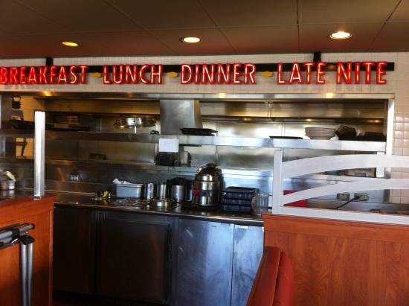
Example
Job
Occupation
Career

Slide 18
What is Lifestyle?
Lifestyle is the way you use your time, energy, and your money.
Notes:
What you do for a living has a large impact on your lifestyle.
Examples: If you make lots of money and you work all of the time. How much time do you get to spend with your family? How much free time do you have?
If you want a big house, two cars, and a swimming pool but you work at KFC as a cook, what are the chances of getting those things?

Slide 19
Review
What is a job?
What is an occupation?
What is a career?
What is lifestyle?
WORK THAT YOU DO FOR MONEY.
THE TYPE OF WORK YOU DO FOR A LIVING.
A SERIES OF RELATED JOBS OR OCCUPATIONS THROUGHOUT
YOUR WORKING LIFETIME.
THE WAY YOU USE YOUR TIME, ENERGY, MONEY.

Slide 20
Activity #2

