Slide 1
Intensive Interventions to Improve Mathematics Outcomes for Students with Learning Difficulties

Slide 2
srpowell@austin.utexas.edu
@sarahpowellphd
119

Slide 3
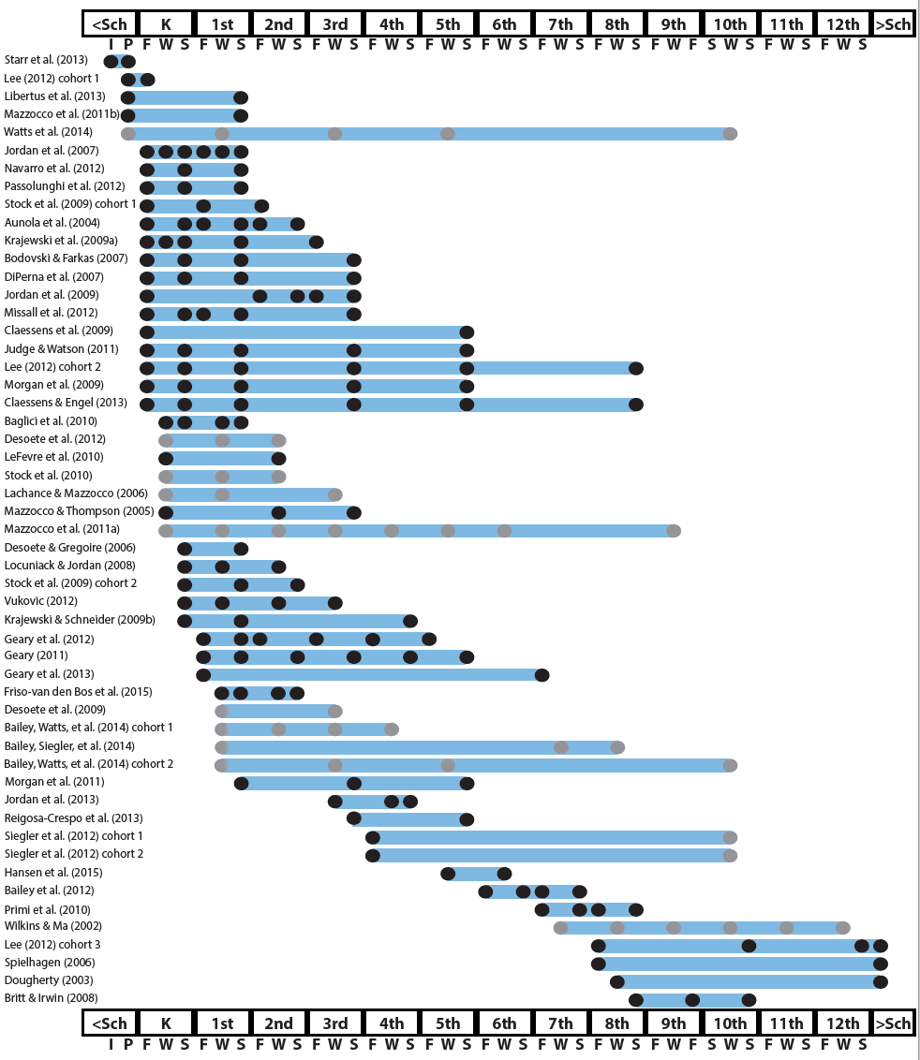
http://www.greatertexasfoundation.org/trajectories-of-mathematics-performance/

Slide 4
Broad math in preK predicted K broad math
Mathematics in preschool predicts later mathematics
http://www.greatertexasfoundation.org/trajectories-of-mathematics-performance/
Broad math in preK predicted grade 10 broad math

Slide 5
Counting in K predicted grade 1 broad math
Mathematics in kindergarten predicts later mathematics
http://www.greatertexasfoundation.org/trajectories-of-mathematics-performance/
Broad math in K predicted grade 8 broad math
K math accurately predicted math performance below 10th percentile in grades 2 and 3 with 84% correct classification

Slide 6
Mathematics in elementary school
predicts later mathematics
Addition influenced arithmetic with increasing importance from grades 1 to 5
http://www.greatertexasfoundation.org/trajectories-of-mathematics-performance/
Grade 1 arithmetic predicted arithmetic at grades 2, 3, and 4
Grade 1 broad math predicted broad math at grades 3, 5, and 10

Slide 7
Mathematics in middle school
predicts later mathematics
Counting and comparison in grades 2 or 4 predicted broad math 1 year later
http://www.greatertexasfoundation.org/trajectories-of-mathematics-performance/
Fractions at 10-12 years old predicted broad math 5 years later
Broad math in grade 7 predicted broad math in grade 8

Slide 8
Broad math in grade 8 predicted completion of 4-year college degree
Mathematics in
high school
predicts later outcomes
http://www.greatertexasfoundation.org/trajectories-of-mathematics-performance/
Students who took algebra in grades 8 took more advanced math courses and enrolled in 4-year colleges more often than students who took algebra in grade 9
Numeracy measured in adolescence impacted hourly earnings 7 to 15 years later

Slide 9
Mathematics in preschool predicts later mathematics
Mathematics in kindergarten predicts later mathematics
http://www.greatertexasfoundation.org/trajectories-of-mathematics-performance/
Mathematics in elementary school
predicts later mathematics
Mathematics in middle school
predicts later mathematics
Mathematics in
high school
predicts later outcomes

Slide 10
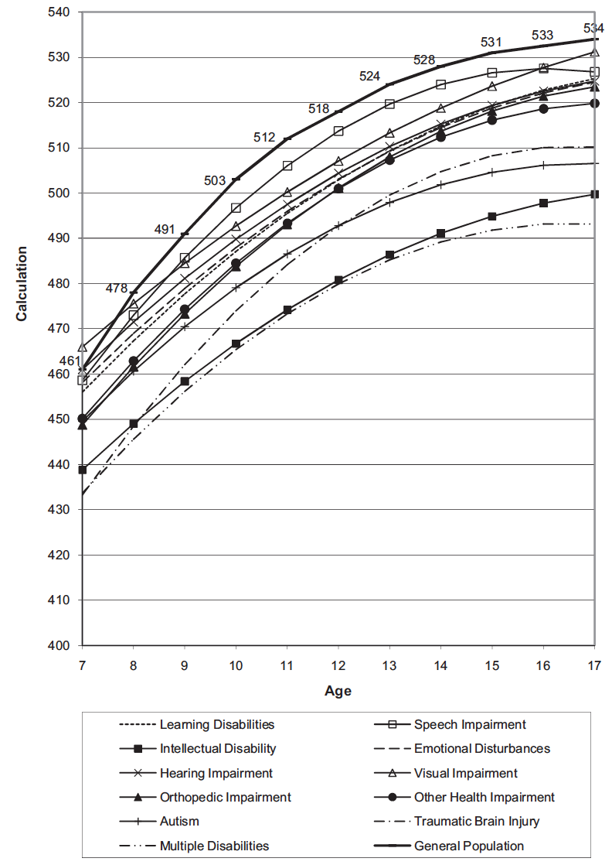
Wei, Lenz, & Blackorby (2013)

Slide 11
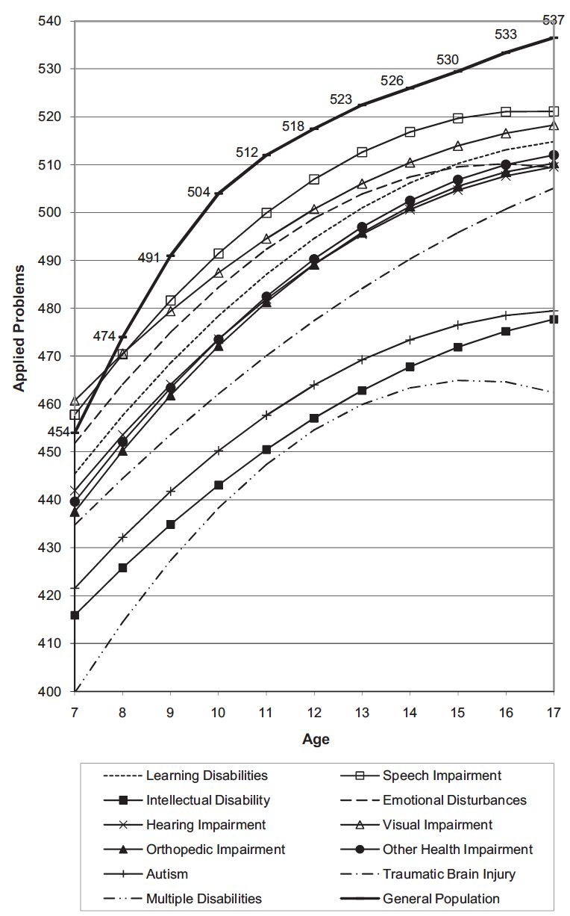
Wei, Lenz, & Blackorby (2013)

Slide 12
Descriptors of mathematics difficulty
Mathematics difficulty/disability
Mathematics learning difficulty/disability
Specific learning disability with IEP goals in mathematics
Dyscalculia

Slide 13
How would you convince your school of the need for providing services to at-risk students?
How would you convince caregivers of the need to provide services for their children?

Slide 14
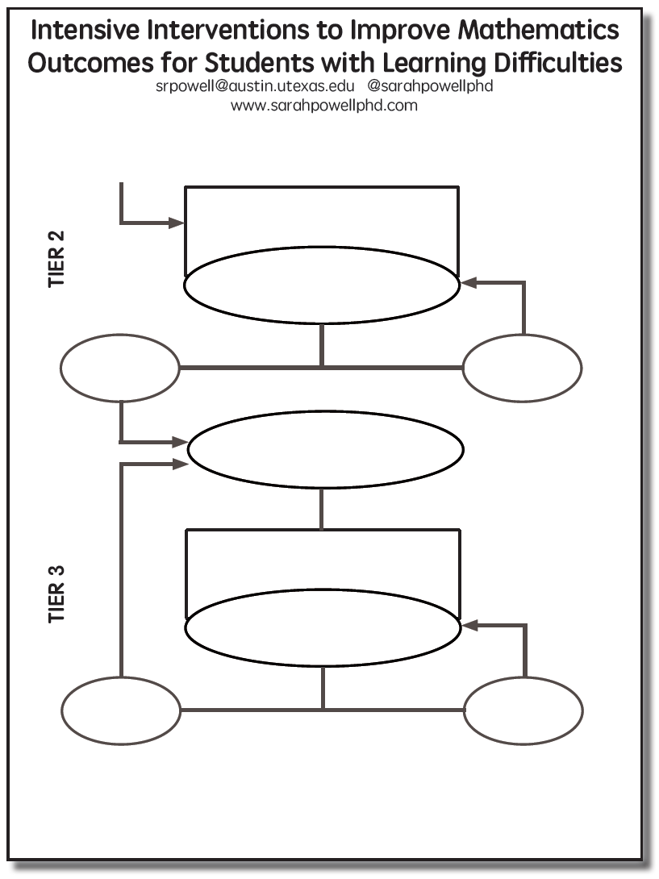

Slide 15
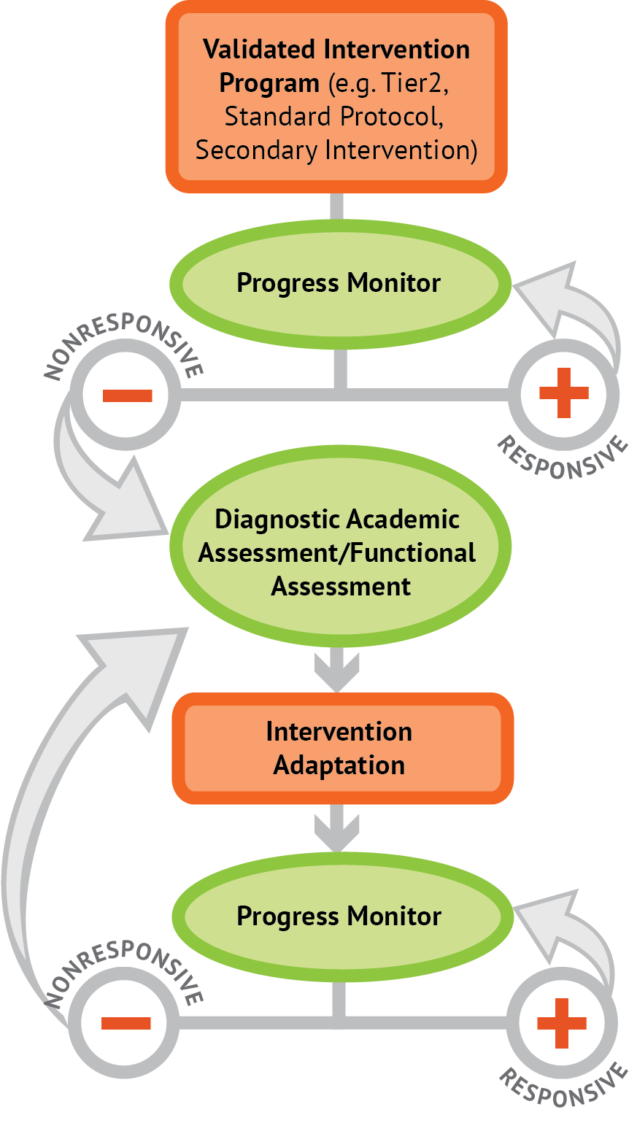
Intervention: Occurs frequently and with intensity
Assessment: Formative
Assessment: Diagnostic
Intervention adaptation: Content, dosage, explicit instruction, attention to transfer
Assessment: Formative

Slide 16
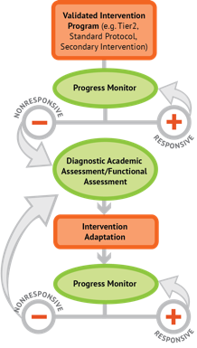
Where student IS
Where student NEEDS TO BE

Slide 17
Before we think about instruction, let’s think about content…

Slide 18
Fluency

Slide 19
Fluently add and subtract within 5.

Slide 20
Fluently add and subtract within 5.
Add and subtract within 20, demonstrating fluency for addition and subtraction within 10.

Slide 21
Fluently add and subtract within 5.
Add and subtract within 20, demonstrating fluency for addition and subtraction within 10.
Fluently add and subtract within 100 using strategies based on place value, properties of operations, and/or relationships.

Slide 22
Fluently add and subtract within 5.
Add and subtract within 20, demonstrating fluency for addition and subtraction within 10.
Fluently add and subtract within 100 using strategies based on place value, properties of operations, and/or relationships.
Fluently multiply and divide within 100, using strategies such as the relationship between multiplication and division…

Slide 23
Fluently add and subtract within 5.
Add and subtract within 20, demonstrating fluency for addition and subtraction within 10.
Fluently add and subtract within 100 using strategies based on place value, properties of operations, and/or relationships.
Fluently multiply and divide within 100, using strategies such as the relationship between multiplication and division…
Fluently add and subtract multi-digit whole numbers using the standard algorithm.

Slide 24
Fluently add and subtract within 5.
Add and subtract within 20, demonstrating fluency for addition and subtraction within 10.
Fluently add and subtract within 100 using strategies based on place value, properties of operations, and/or relationships.
Fluently multiply and divide within 100, using strategies such as the relationship between multiplication and division…
Fluently add and subtract multi-digit whole numbers using the standard algorithm.
Fluently multiply multi-digit whole numbers using the standard algorithm.

Slide 25
Fluently add and subtract within 5.
Add and subtract within 20, demonstrating fluency for addition and subtraction within 10.
Fluently add and subtract within 100 using strategies based on place value, properties of operations, and/or relationships.
Fluently multiply and divide within 100, using strategies such as the relationship between multiplication and division…
Fluently add and subtract multi-digit whole numbers using the standard algorithm.
Fluently multiply multi-digit whole numbers using the standard algorithm.
Fluently add, subtract, multiply, and divide multi-digit decimals using the standard algorithm.

Slide 26
Where student NEEDS TO BE
Fluently add and subtract within 5.
Add and subtract within 20, demonstrating fluency for addition and subtraction within 10.
Fluently add and subtract within 100 using strategies based on place value, properties of operations, and/or relationships.
Fluently multiply and divide within 100, using strategies such as the relationship between multiplication and division…
Fluently add and subtract multi-digit whole numbers using the standard algorithm.
Fluently multiply multi-digit whole numbers using the standard algorithm.
Fluently add, subtract, multiply, and divide multi-digit decimals using the standard algorithm.

Slide 27
Where student IS
Where student NEEDS TO BE
Fluently add and subtract within 5.
Add and subtract within 20, demonstrating fluency for addition and subtraction within 10.
Fluently add and subtract within 100 using strategies based on place value, properties of operations, and/or relationships.
Fluently multiply and divide within 100, using strategies such as the relationship between multiplication and division…
Fluently add and subtract multi-digit whole numbers using the standard algorithm.
Fluently multiply multi-digit whole numbers using the standard algorithm.
Fluently add, subtract, multiply, and divide multi-digit decimals using the standard algorithm.

Slide 28
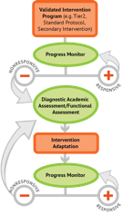
Where student IS
Where student NEEDS TO BE
Fluently add and subtract within 5.
Add and subtract within 20, demonstrating fluency for addition and subtraction within 10.
Fluently add and subtract within 100 using strategies based on place value, properties of operations, and/or relationships.
Fluently multiply and divide within 100, using strategies such as the relationship between multiplication and division…
Fluently add and subtract multi-digit whole numbers using the standard algorithm.
Fluently multiply multi-digit whole numbers using the standard algorithm.
Fluently add, subtract, multiply, and divide multi-digit decimals using the standard algorithm.

Slide 29
Place Value
continuum of mathematics learning

Slide 30
Compose and decompose numbers from 11 to 19 into ten ones and some further ones…
Recognize that in a multi-digit number, a digit in one place represents 10 times as much as it represents in the place to its right and 1/10 of what it represents in the place to its left.
Use place value understanding to round whole numbers to the nearest 10 or 100.
Recognize that in a multi-digit number, a digit in one place represents ten times what it represents in the place to its right…
Understand that the two digits of a two-digit number represent amounts of tens and ones.
Understand that the three digits of a three-digit number represent amounts of hundreds, tens, and ones.

Slide 31
Compose and decompose numbers from 11 to 19 into ten ones and some further ones…

Slide 32
Compose and decompose numbers from 11 to 19 into ten ones and some further ones…
Understand that the two digits of a two-digit number represent amounts of tens and ones.

Slide 33
Compose and decompose numbers from 11 to 19 into ten ones and some further ones…
Understand that the two digits of a two-digit number represent amounts of tens and ones.
Understand that the three digits of a three-digit number represent amounts of hundreds, tens, and ones.

Slide 34
Compose and decompose numbers from 11 to 19 into ten ones and some further ones…
Understand that the two digits of a two-digit number represent amounts of tens and ones.
Understand that the three digits of a three-digit number represent amounts of hundreds, tens, and ones.
Use place value understanding to round whole numbers to the nearest 10 or 100.

Slide 35
Compose and decompose numbers from 11 to 19 into ten ones and some further ones…
Understand that the two digits of a two-digit number represent amounts of tens and ones.
Understand that the three digits of a three-digit number represent amounts of hundreds, tens, and ones.
Use place value understanding to round whole numbers to the nearest 10 or 100.
Recognize that in a multi-digit number, a digit in one place represents ten times what it represents in the place to its right…

Slide 36
Compose and decompose numbers from 11 to 19 into ten ones and some further ones…
Understand that the two digits of a two-digit number represent amounts of tens and ones.
Understand that the three digits of a three-digit number represent amounts of hundreds, tens, and ones.
Use place value understanding to round whole numbers to the nearest 10 or 100.
Recognize that in a multi-digit number, a digit in one place represents ten times what it represents in the place to its right…
Recognize that in a multi-digit number, a digit in one place represents 10 times as much as it represents in the place to its right and 1/10 of what it represents in the place to its left.

Slide 37
Problem Solving
continuum of mathematics learning

Slide 38
Interpret and compute quotients of fractions, and solve word problems involving division of fractions by fractions…
Solve word problems that call for addition of three whole numbers whose sum is less than or equal to 20…
Solve real-world and mathematical problems involving the four operations with rational numbers.
Use addition and subtraction within 100 to solve one- and two-step word problems…
Use multiplication and division within 100 to solve word problems…
Solve real-world and mathematical problems leading to two linear equations in two variables.
Solve addition and subtraction word problems, and add and subtract within 10…
Solve multi-step word problems posed with whole numbers and having whole-number answers using the four operations…
Solve word problems involving addition and subtraction of fractions referring to the same whole, including cases of unlike denominators…

Slide 39
Solve addition and subtraction word problems, and add and subtract within 10…
Solve word problems that call for addition of three whole numbers whose sum is less than or equal to 20…
Use addition and subtraction within 100 to solve one- and two-step word problems…
Use multiplication and division within 100 to solve word problems…
Solve multi-step word problems posed with whole numbers and having whole-number answers using the four operations…
Solve word problems involving addition and subtraction of fractions referring to the same whole, including cases of unlike denominators…
Interpret and compute quotients of fractions, and solve word problems involving division of fractions by fractions…
Solve real-world and mathematical problems involving the four operations with rational numbers.
Solve real-world and mathematical problems leading to two linear equations in two variables.

Slide 40
Where student IS
Where student NEEDS TO BE
Solve addition and subtraction word problems, and add and subtract within 10…
Solve word problems that call for addition of three whole numbers whose sum is less than or equal to 20…
Use addition and subtraction within 100 to solve one- and two-step word problems…
Use multiplication and division within 100 to solve word problems…
Solve multi-step word problems posed with whole numbers and having whole-number answers using the four operations…
Solve word problems involving addition and subtraction of fractions referring to the same whole, including cases of unlike denominators…
Interpret and compute quotients of fractions, and solve word problems involving division of fractions by fractions…
Solve real-world and mathematical problems involving the four operations with rational numbers.
Solve real-world and mathematical problems leading to two linear equations in two variables.

Slide 41
Where student IS
Where student NEEDS TO BE
Use addition and subtraction within 100 to solve one- and two-step word problems…
Use multiplication and division within 100 to solve word problems…
Solve multi-step word problems posed with whole numbers and having whole-number answers using the four operations…
continuum of mathematics learning

Slide 42
Where student IS
Where student NEEDS TO BE
Explain why addition and subtraction strategies work, using place value and the properties of operations.
Understand that the two digits of a two-digit number represent amounts of tens and ones.
Use addition and subtraction within 100 to solve one- and two-step word problems…
Fluently add and subtract within 100 using strategies based on place value, properties of operations, and/or relationships.
Apply properties of operations as strategies to multiply and divide….
Fluently multiply and divide within 100, using strategies such as the relationship between multiplication and division…
Use multiplication and division within 100 to solve word problems…
Fluently add and subtract multi-digit whole numbers using the standard algorithm.
Find whole number quotients and remainders with up to four-digit dividends and one-digit divisors, using strategies based on place value, the properties of operations, and/or the relationship between multiplication and division.
Solve multi-step word problems posed with whole numbers and having whole-number answers using the four operations…
Understand that the three digits of a three-digit number represent amounts of hundreds, tens, and ones.
Fluently multiply multi-digit whole numbers using the standard algorithm.
continuum of mathematics learning

Slide 43
https://achievethecore.org/category/774/mathematics-focus-by-grade-level

Slide 44
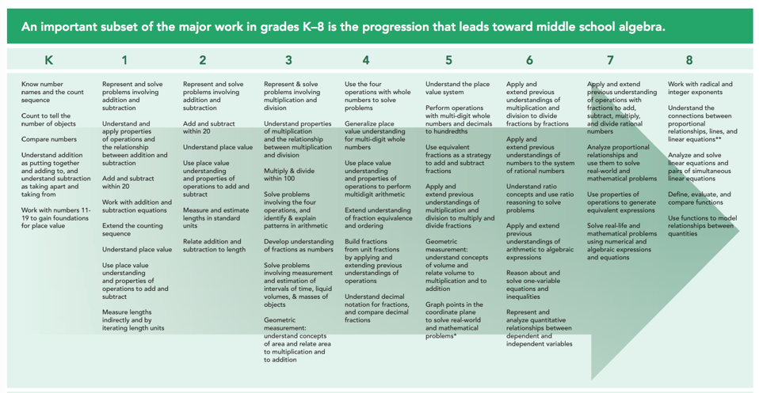
https://achievethecore.org/category/774/mathematics-focus-by-grade-level

Slide 45
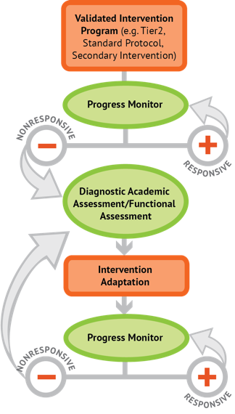
Instructional Platform
INSTRUCTIONAL DELIVERY
Explicit instruction
Precise language
Multiple representations
INSTRUCTIONAL STRATEGIES
Fluency building
Problem solving instruction
Motivation component

Slide 47
Explicit Instruction
Modeling
Practice
Clear Explanation
Guided
Practice
Planned
Examples
Independent Practice
Supporting Practices
Asking the right questions
Eliciting frequent responses
Providing immediate specific feedback
Maintaining a brisk pace

Slide 48
Goal and importance
“Today, we are learning about division. This is important because sometimes you have to share objects or things with your friends.”
Modeling
Practice
Clear Explanation
Guided
Practice
We Do
Planned
Examples
Independent Practice
“Let’s continue working with our three-dimensional shapes and volume. Understanding volume and calculating volume helps with measuring capacity.”
You Do
Supporting Practices
Asking the right questions
Eliciting frequent responses
Providing immediate specific feedback
Maintaining a brisk pace
Copyright 2018 Sarah R. Powell, Ph.D.

Slide 49
Goal and importance
Model steps
Modeling
Practice
Clear Explanation
Guided
Practice
“To solve 26 plus 79, I first decide about the operation. Do I add, subtract, multiply or divide?”
We Do
Planned
Examples
Independent Practice
“The plus sign tells me to add. So, I’ll add 26 plus 79. I’ll use the partial sums strategy. First, I add 20 plus 70. What’s 20 plus 70?”
You Do
Supporting Practices
“20 plus 70 is 90. I write 90 right here.”
Asking the right questions
Eliciting frequent responses
Providing immediate specific feedback
Maintaining a brisk pace
“Then I add 6 plus 9. What’s 6 plus 9?”
“6 plus 9 is 15. So, I write 15 here.”
“Finally, we add the partial sums: 90 and 15. 90 plus 15 is 105. So, 26 plus 79 equals 105.”
Copyright 2018 Sarah R. Powell, Ph.D.

Slide 50
Goal and importance
Model steps
Modeling
Practice
Clear Explanation
Concise language
Guided
Practice
We Do
Planned
Examples
Independent Practice
“To solve 26 plus 79, I first decide about the operation. Do I add, subtract, multiply, or divide?”
You Do
“The plus sign tells me to add. So, I’ll add 26 plus 79. I’ll use the partial sums strategy. First, I add 20 plus 70. What’s 20 plus 70?”
Supporting Practices
Asking the right questions
Eliciting frequent responses
Providing immediate specific feedback
Maintaining a brisk pace
“20 plus 70 is 90. I write 90 right here under the equal line.”
“Then I add 6 plus 9. What’s 6 plus 9?”
“6 plus 9 is 15. So, I write 15 here.”
“Finally, we add the partial sums: 90 and 15. 90 plus 15 is 105. So, 26 plus 79 equals 105.”
Copyright 2018 Sarah R. Powell, Ph.D.

Slide 51
Examples
“Today, we are learning about division. This is important because sometimes you have to share objects or things with your friends.”
Modeling
Practice
Clear Explanation
Guided
Practice
24 / 6
We Do
35 $)$ 5
28 $÷$ 7
Planned
Examples
Independent Practice
You Do
Supporting Practices
Asking the right questions
Eliciting frequent responses
Providing immediate specific feedback
Maintaining a brisk pace
Copyright 2018 Sarah R. Powell, Ph.D.

Slide 52
Examples
“Today, we are learning about division. This is important because sometimes you have to share objects or things with your friends.”
Modeling
Practice
Clear Explanation
Guided
Practice
24 / 6
We Do
35 $)$ 5
28 $÷$ 7
Planned
Examples
Independent Practice
You Do
With non-examples
Supporting Practices
Asking the right questions
Eliciting frequent responses
Providing immediate specific feedback
Maintaining a brisk pace
32 $÷$ 8
42 $÷$ 7
25 $−$ 5
Copyright 2018 Sarah R. Powell, Ph.D.

Slide 53
Modeling
Practice
Clear Explanation
Guided
Practice
Planned
Examples
Independent Practice
Supporting Practices
Asking the right questions
Eliciting frequent responses
Providing immediate specific feedback
Maintaining a brisk pace
Copyright 2018 Sarah R. Powell, Ph.D.

Slide 54
I Do
Modeling
Practice
Clear Explanation
Guided
Practice
Planned
Examples
Independent Practice
Supporting Practices
Asking the right questions
Eliciting frequent responses
Providing immediate specific feedback
Maintaining a brisk pace
Copyright 2018 Sarah R. Powell, Ph.D.

Slide 55
I Do
Modeling
Practice
Teacher and student practice together
Clear Explanation
Guided
Practice
Planned
Examples
Independent Practice
Supporting Practices
Asking the right questions
Eliciting frequent responses
Providing immediate specific feedback
Maintaining a brisk pace
Copyright 2018 Sarah R. Powell, Ph.D.

Slide 56
I Do
Modeling
Practice
Clear Explanation
Guided
Practice
Planned
Examples
Independent Practice
Student practices with teacher support
Supporting Practices
Asking the right questions
Eliciting frequent responses
Providing immediate specific feedback
Maintaining a brisk pace
Copyright 2018 Sarah R. Powell, Ph.D.

Slide 57
Modeling
Practice
Clear Explanation
Guided
Practice
Planned
Examples
Independent Practice
Supporting Practices
Asking the right questions
Eliciting frequent responses
Providing immediate specific feedback
Maintaining a brisk pace
Copyright 2018 Sarah R. Powell, Ph.D.

Slide 58
I Do
Modeling
Practice
Clear Explanation
Guided
Practice
We Do
Planned
Examples
Independent Practice
You Do
Supporting Practices
Asking the right questions
Eliciting frequent responses
Providing immediate specific feedback
Maintaining a brisk pace
Copyright 2018 Sarah R. Powell, Ph.D.

Slide 59
I Do
Modeling
Practice
Clear Explanation
Guided
Practice
Low-level and high-level
We Do
Planned
Examples
Independent Practice
You Do
“What is 7 times 9?”
“Which shape has 6 sides?”
“What do you do when you see a word problem?”
“Why do you have to regroup?”
“How would you solve this problem?”
“Why do you have to use zero pairs?”
Supporting Practices
Asking the right questions
Eliciting frequent responses
Providing immediate specific feedback
Maintaining a brisk pace
Copyright 2018 Sarah R. Powell, Ph.D.

Slide 60
I Do
Modeling
Practice
Clear Explanation
Guided
Practice
Low-level and high-level
We Do
Planned
Examples
Independent Practice
You Do
Classwide, individual, partner, write on paper, write on whiteboard, thumbs up, etc.
“Turn and discuss the formula for perimeter with your partner.”
“Write the multiplication problem on your whiteboard.”
Supporting Practices
Asking the right questions
Eliciting frequent responses
Providing immediate specific feedback
Maintaining a brisk pace
“In your math journal, draw a picture to help you remember to term parallelogram.”
Copyright 2018 Sarah R. Powell, Ph.D.

Slide 61
I Do
Modeling
Practice
Clear Explanation
Guided
Practice
Low-level and high-level
We Do
Planned
Examples
Independent Practice
You Do
Classwide, individual, partner, write on paper, write on whiteboard, thumbs up, etc.
Affirmative and corrective
Supporting Practices
“Good work using your word-problem attack strategy.”
Asking the right questions
Eliciting frequent responses
Providing immediate specific feedback
Maintaining a brisk pace
“Let’s look at that again. Tell me how you added in the hundreds column.”
Copyright 2018 Sarah R. Powell, Ph.D.

Slide 62
I Do
Modeling
Practice
Clear Explanation
Guided
Practice
Low-level and high-level
We Do
Planned
Examples
Independent Practice
You Do
Classwide, individual, partner, write on paper, write on whiteboard, thumbs up, etc.
Affirmative and corrective
Planned and organized
Supporting Practices
Asking the right questions
Eliciting frequent responses
Providing immediate specific feedback
Maintaining a brisk pace
Copyright 2018 Sarah R. Powell, Ph.D.

Slide 63
Modeling
Practice
Clear Explanation
Guided
Practice
Planned
Examples
Independent Practice
Supporting Practices
Asking the right questions
Eliciting frequent responses
Providing immediate specific feedback
Maintaining a brisk pace
Copyright 2018 Sarah R. Powell, Ph.D.

Slide 64
Modeling
Practice
Supporting Practices
Introduction of material
Review of material
Modeling
Practice
Modeling
Practice
Supporting Practices
Supporting Practices

Slide 65
How do you use explicit instruction within intensive intervention?
Model steps using concise language
Provide guided practice opportunities
Provide independent practice opportunities
Use supporting practices during modeling and practice
Ask the right questions
Elicit frequent responses
Provide feedback
Be planned and organized

Slide 66
Describe something you taught (recently) in terms of modeling, practice, and supporting practices.

Slide 67
Instructional Platform
INSTRUCTIONAL DELIVERY
Explicit instruction
Precise language
Multiple representations
INSTRUCTIONAL STRATEGIES
Fluency building
Problem solving instruction
Motivation component

Slide 69
Vocabulary Across Grades

Slide 70
degree

Slide 71
Use formal math language
Use terms precisely

Slide 72
Technical terms
Subtechnical terms
Symbolic terms
General terms
trapezoid
rhombus
numerator
addend
subtract
base
degrees
cube
plane
arc
plus
zero
twelve
dollars
and
above
measure
answer
longest
outside

Slide 73
Instead of…
Say…
“And the last one is 10.”
“8, 9, 10. We’ll stop counting there but we could count more.”
“What number is in the tens place?”
“What digit is in the tens place?”
“Six hundred and forty-eight”
“Six hundred forty-eight”
“Bigger number and smaller number”
“Number that is greater and the number that is less”
Hughes et al. (2016)

Slide 74
Instead of…
Say…
“Numbers in the fraction”
“This fraction is one number.”
“Top number and bottom number”
“Numerator and denominator”
“Reduce”
“Find an equivalent fraction”
“One point two nine”
“One and twenty-nine hundredths”
Hughes et al. (2016)

Slide 75
Instead of…
Say…
“Corner”
“Angle”
“Flips, slides, and turns”
“Reflections, translations, and rotations”
“Box or ball”
“Cube or sphere”
“Long hand and short hand”
“Minute hand and hour hand”
Hughes et al. (2016)

Slide 76
precise
“The denominator is the number of equal parts that make the whole.”
“A difference problem is two amounts compared for the difference.”
“To show the fraction, look at the denominator. A denominator of 5 means I need to break the whole into 5 equal parts.”
concise
“To use partial sums, add the hundreds, then add the tens, then add the ones. Finally, add all the partial sums.”

Slide 77
How do you attend to language within intensive intervention?
Understand why formal mathematical language is important
Plan for mathematical language to be precise
Plan for mathematical language to be concise

Slide 79
Instructional Platform
INSTRUCTIONAL DELIVERY
Explicit instruction
Precise language
Multiple representations
INSTRUCTIONAL STRATEGIES
Fluency building
Problem solving instruction
Motivation component

Slide 80
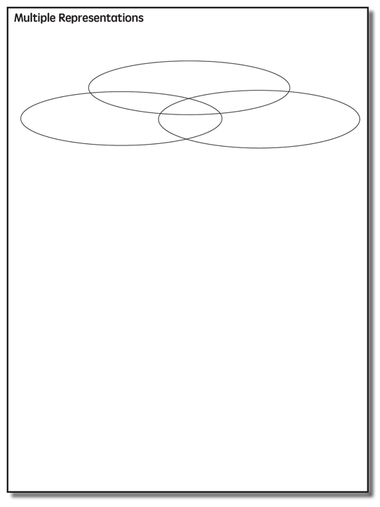

Slide 81
Multiple Representations
Abstract
Pictorial
Concrete

Slide 82
Abstract
Pictorial
Concrete
Three-dimensional objects

Slide 83
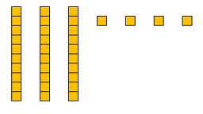
Abstract
Pictorial
Concrete
Two-dimensional images

Slide 84
Abstract
Pictorial
Concrete
Numerals and symbols
2 + 8 = 10
34 = 3 tens and 4 ones
x – 6 = 8
4,179
+ 569

Slide 85
How should multiple representations be used within intensive intervention?
Use three-dimensional concrete materials to teach concepts and procedures
Use two-dimensional representations to teach concepts and procedures
Ensure students understand mathematics with numbers and symbols (i.e., the abstract)

Slide 86
Some examples of Multiple Representations

Slide 87
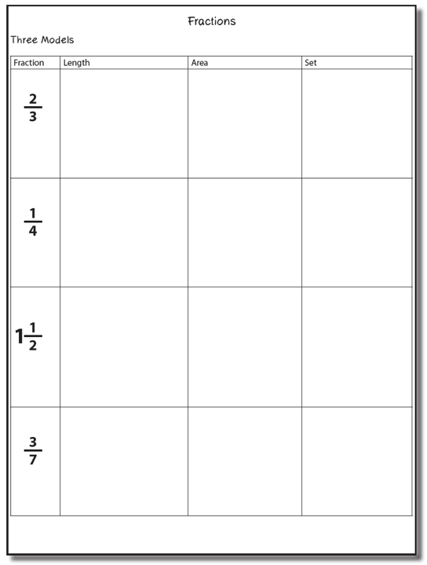

Slide 88
Fraction Models
Length
Area
Set

Slide 89
Length/Measurement
Fractions are appropriated by length
Fraction tiles/bars

Slide 90
Length/Measurement
Fractions are appropriated by length
Cuisenaire rods

Slide 91
Length/Measurement
Fractions are appropriated by length
Number line

Slide 92
Select a fraction and teach using the length model.
Explicit instruction
Multiple representations
Concise language

Slide 93
Area/Region
Shapes divided into equal sections
Fraction circles

Slide 94
Area/Region
Shapes divided into equal sections
Geoboards

Slide 95
Area/Region
Shapes divided into equal sections
Pattern blocks

Slide 96
Area/Region
Shapes divided into equal sections
Legos

Slide 97
Select a fraction and teach using the area model.
Explicit instruction
Multiple representations
Concise language

Slide 98
Set/Discrete
Individual shapes match the fraction
Two-color counters

Slide 99
Set/Discrete
Individual shapes match the fraction

Slide 100
Select a fraction and teach using the set model.
Explicit instruction
Multiple representations
Concise language

Slide 101
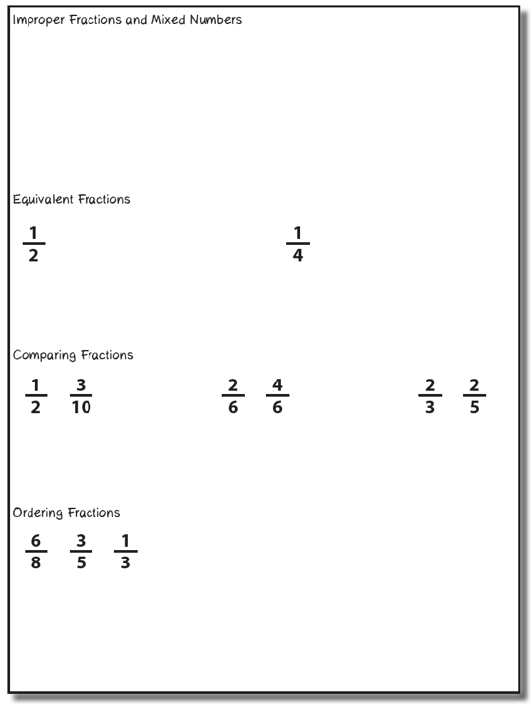
Select one of these four topics. Use explicit instruction, precise language, and multiple representations to teach to your partner.

Slide 102
Instructional Platform
INSTRUCTIONAL DELIVERY
Explicit instruction
Precise language
Multiple representations
INSTRUCTIONAL STRATEGIES
Fluency building
Problem solving instruction
Motivation component

Slide 103
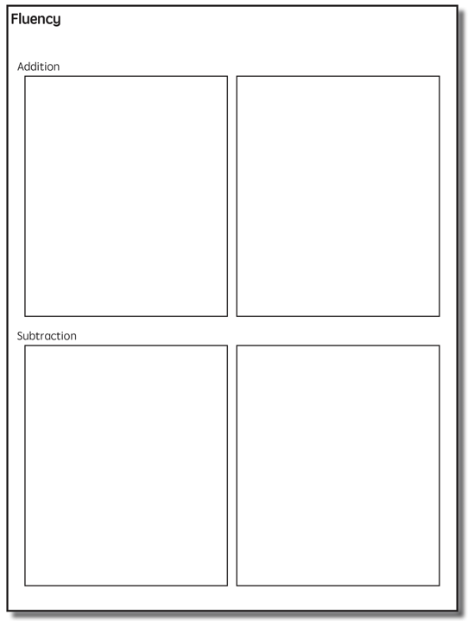

Slide 105
Addition Facts
100 addition basic facts
Single-digit addends sum to a single- or double-digit number
5 (addend)
+ 4 (addend)
9 (sum)

Slide 106
Addition: Part-Part-Whole (Total)
Count one set, count another set, put sets together, count sum
2 + 3 = 5

Slide 107
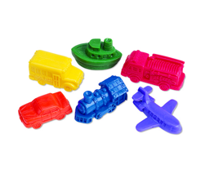
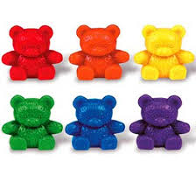
Addition: Part-Part-Whole (Total)
4 + 5 = __
3 + 7 = __
Teach this problem to a student.
Explicit instruction
Multiple representations
Concise language

Slide 108
Addition: Join (Change Increase)
Start with a set, add the other set, count sum
2 + 3 = 5

Slide 109
Addition: Join (Change Increase)
8 + 3 = __
5 + 6 = __
Teach this problem to a student.
Explicit instruction
Multiple representations
Concise language

Slide 110
Why is it important to understand addition in two separate ways?

Slide 111
Total
Parts put together into a total
Freddy saw 4 cardinals and 5 blue jays. How many birds did Freddy see?
4 + 5 = ?
Freddy saw 9 birds. If 4 of the birds were cardinals, how many were blue jays?
4 + ? = 9
Freddy saw 9 birds. 5 of the birds were blue jays, how many were cardinals?
5 + ? = 9

Slide 112
Change
An amount that increases or decreases
Lara had $4. Then she earned $3 for cleaning her room. How much money does Lara have now?
4 + 3 = ?
Lara has $4. Then she earned money for cleaning her room. Now Lara has $7. How much money did she earn?
4 + ? = 7
Lara had some money. Then she made $3 for cleaning her room. Now she has $7. How much money did Lara start with?
? + 3 = 7

Slide 113
Part-Part-Whole Versus Join
3 + 9 = __
7 + 4 = __
Determine a word problem for each schema.
Explicit instruction
Multiple representations
Concise language

Slide 115
Subtraction Facts
100 subtraction basic facts
Subtrahend and difference are single-digit numbers and minuend is single- or double-digit number
16 (minuend)
– 8 (subtrahend)
8 (difference)

Slide 116
Subtraction: Separate (Change Decrease)
Start with a set, take away from that set, count difference
5 – 3 = 2

Slide 117
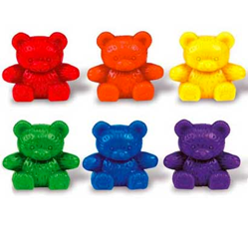
Subtraction: Separate (Change Decrease)
11 – 6 = __
13 – 7 = __
Teach this problem to a student.
Explicit instruction
Multiple representations
Concise language

Slide 118
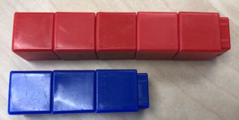
Subtraction: Compare (Difference)
Compare two sets, count difference
5 – 3 = 2

Slide 119
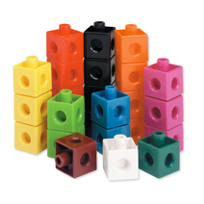
Subtraction: Compare (Difference)
10 – 7 = __
11 – 3 = __
Teach this problem to a student.
Explicit instruction
Multiple representations
Concise language

Slide 120
Why is it important to understand subtraction in two separate ways?

Slide 121
Change
An amount that increases or decreases
Melissa had 9 cookies. Then she ate 2 of the cookies. How many cookies does Melissa have now?
9 – 2 = ?
Melissa had 9 cookies. She ate some of the cookies. Now, she has 7 cookies. How many cookies did Melissa eat?
9 – ? = 7
Melissa had some cookies. Then, she ate 2 of the cookies. Now she has 7 cookies left. How many cookies did Melissa have to start with?
? – 2 = 7

Slide 122
Difference
Greater and less amounts compared for a difference
Pedro has 9 apples. Silvia has 4 apples. How many more apples does Pedro have? (How many fewer does Silvia have?)
9 – 4 = ?
Pedro has 5 more apples than Silvia. If Silvia has 4 apples, how many does Pedro have?
? – 4 = 5
Silvia has 5 fewer apples than Pedro. Pedro has 9 apples. How many apples does Silvia have?
9 – ? = 5

Slide 123
Separate Versus Compare
9 – 5 = __
8 – 3 = __
Determine a word problem for each schema.
Explicit instruction
Multiple representations
Concise language

Slide 125
Multiplication Facts
100 multiplication basic facts
Multiplication of single-digit factors results in a single- or double-digit product
2 (factor)
× 3 (factor)
6 (product)

Slide 126
Multiplication: Equal Groups
Show the groups, show the amount for each group, count product
3 × 2 = 6

Slide 127
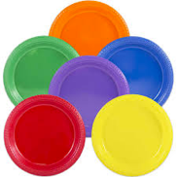
Multiplication: Equal Groups
5 × 3 = __
2 × 5 = __
Teach this problem to a student.
Explicit instruction
Multiple representations
Concise language

Slide 128
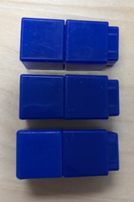
Multiplication: Array/Area
Make the array, count product
3 × 2 = 6

Slide 129
Multiplication: Array/Area
3 × 4 = __
2 × 5 = __
Teach this problem to a student.
Explicit instruction
Multiple representations
Concise language

Slide 130
Multiplication: Comparison
Show a set, then multiply the set
3 × 2 = 6

Slide 131
Multiplication: Comparison
6 × 3 = __
4 × 5 = __
Teach this problem to a student.
Explicit instruction
Multiple representations
Concise language

Slide 132
Why is it important to understand multiplication in different ways?

Slide 133
Equal Groups
Groups multiplied by number in each group for a product
Haley has 2 bags of apples. There are 6 apples in each bag. How many apples does Haley have altogether?
2 × 6 = ?
Haley has 12 apples. He wants to share them equally among his 2 friends. How many apples will each friend receive?
2 × ? = 12
Haley has 12 apples. He put them into bags containing 6 apples each. How many bags did Mark use?
? × 6 = 12

Slide 134
Comparison
Set multiplied by a number of times for a product
Beth picked 6 apples. Marcie picked 2 times as many apples as Beth. How many apples did Marcie pick?
6 × 2 = ?

Slide 136
Division Facts
90 division basic facts
Divisor and quotient are single-digit numbers and dividend is single- or double-digit number
8 ÷ 4 = 2
(dividend) (divisor) (quotient)

Slide 137
Division: Equal Groups (Partitive Division)
Show the dividend, divide equally among divisor, count quotient
6 ÷ 3 = 2

Slide 138
Division: Partitive Division
12 ÷ 4 = __
15 ÷ 3 = __
Teach this problem to a student.
Explicit instruction
Multiple representations
Concise language

Slide 139
Division: Equal Groups (Measurement Division)
Show the dividend, make groups of the divisor, count groups
6 ÷ 3 = 2

Slide 140
Division: Measurement Division
10 ÷ 5 = __
9 ÷ 3 = __
Teach this problem to a student.
Explicit instruction
Multiple representations
Concise language

Slide 141
Why is it important to understand division in different ways?

Slide 142
Equal Groups
Groups multiplied by number in each group for a product
Haley has 2 bags of apples. There are 6 apples in each bag. How many apples does Haley have altogether?
2 × 6 = ?
Haley has 12 apples. He wants to share them equally among his 2 friends. How many apples will each friend receive?
2 × ? = 12
Haley has 12 apples. He put them into bags containing 6 apples each. How many bags did Mark use?
? × 6 = 12

Slide 143
Computation

Slide 145
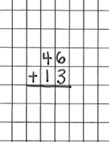
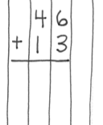
Notation Matters
Work on vertical presentation

Slide 146
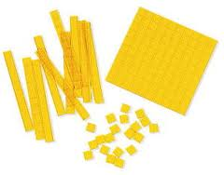
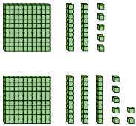
Addition and Subtraction
Focus on place value

Slide 147
Addition and Subtraction
Introduce regrouping/trading/exchanging after mastery of problems without regrouping
10 ones for 1 ten
10 tens for 1 hundred
1 ten for 10 ones
1 hundred for 10 tens
Regroup
Trade
Exchange
Carry
Addition
Regroup
Trade
Exchange
Borrow
Subtraction

Slide 148
Addition Strategies

Slide 149
Linda
Traditional
Work right to left (start in ones column)

Slide 150
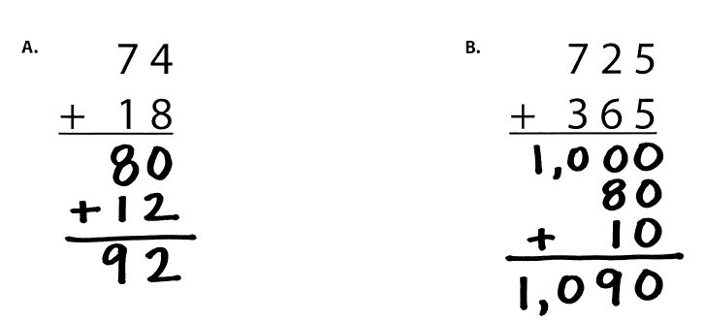
Lluvia
Partial Sums
Work left to right

Slide 151
Jennifer
Opposite Change
Round one number to nearest ten
Amount added is subtracted from other number

Slide 152
Alina
Column Addition
Work left to right

Slide 153
Teach a grade-level addition problem.
Explicit instruction
Multiple representations
Concise language

Slide 154
Subtraction Strategies

Slide 155
Kimberly
Traditional Method
Work right to left (start in ones column)

Slide 156
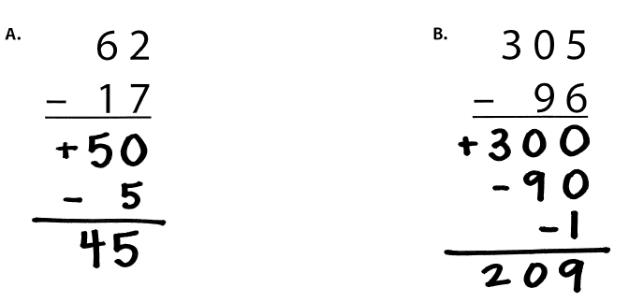
Ricardo
Partial Differences
Work left to right

Slide 157
Tiffiny
Same Change
Change subtrahend to end in 0

Slide 158
Phedra
Add-Up

Slide 159
Teach a grade-level subtraction problem.
Explicit instruction
Multiple representations
Concise language

Slide 161
Multiplication Strategies

Slide 162
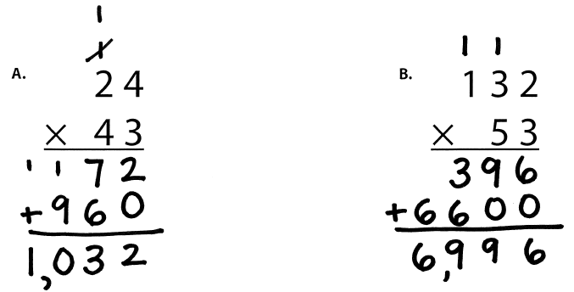
Susan
Traditional
Work right to left (start in ones column)

Slide 163
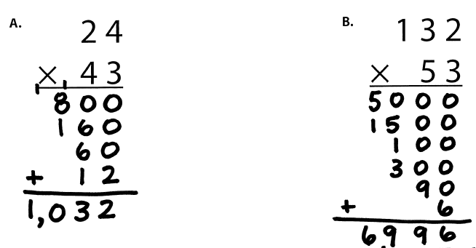
Mary
Partial Products

Slide 164
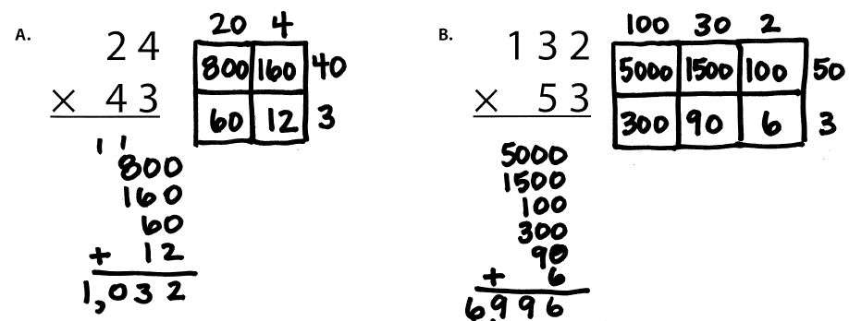
Kathryn
Area

Slide 165
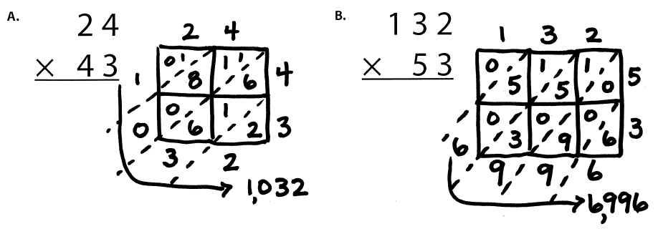
Cynthia
Lattice Method (383 × 27)

Slide 166
Teach a grade-level multiplication problem.
Explicit instruction
Multiple representations
Concise language

Slide 167
Division Strategies

Slide 168
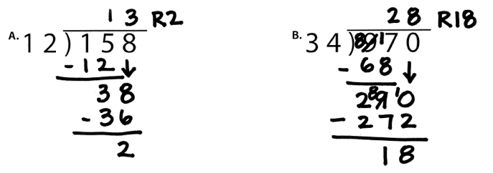
April
Traditional Method
Work Left to Right
Notes:
1. Yellow handouts: Multiplication and division

Slide 169
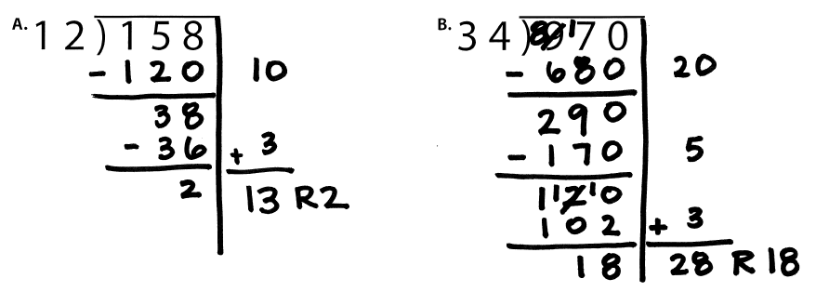
Brian
Partial Quotients

Slide 170
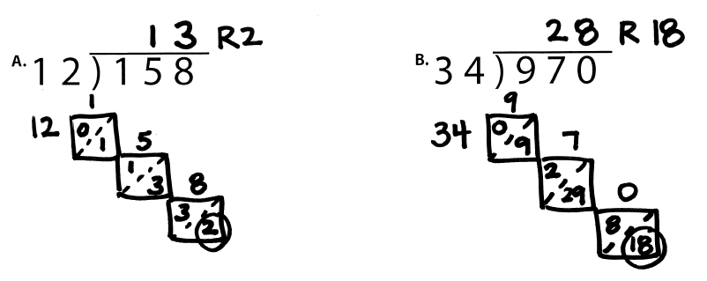
Cheryl
Lattice Division

Slide 171
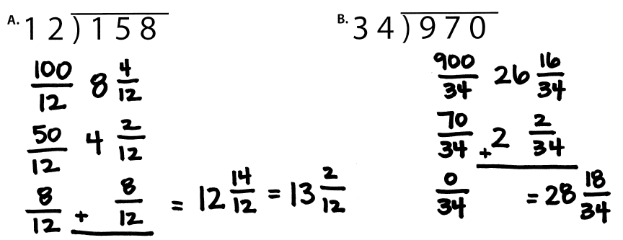
Juanita
Division as Fractions

Slide 172
Teach a grade-level division problem.
Explicit instruction
Multiple representations
Concise language

Slide 173
Instructional Platform
INSTRUCTIONAL DELIVERY
Explicit instruction
Precise language
Multiple representations
INSTRUCTIONAL STRATEGIES
Fluency building
Problem solving instruction
Motivation component

Slide 174
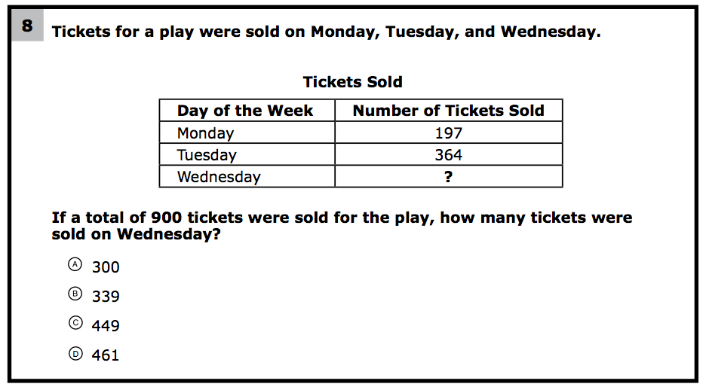
How would you teach this problem?
What do students need to know to solve this problem?
What might cause difficulty for students?

Slide 175
Problem Solving Difficulties
Reading problems
Understanding vocabulary
Identifying relevant information
Ignoring irrelevant information
Interpreting charts and graphs
Identifying appropriate operation(s)
Performing the computation(s)

Slide 177
Don’t tie key words to operations
Do have an attack strategy
Do teach word-problem schemas

Slide 178
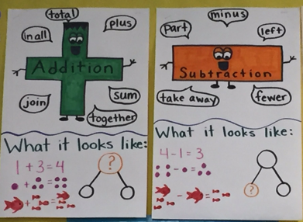
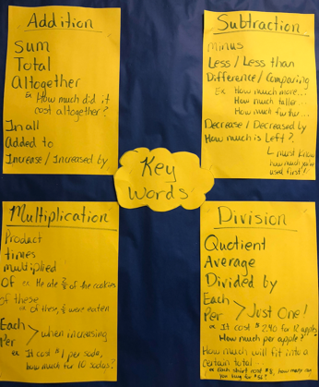

Slide 179
Kasey made $42, and Mandy made $37. How much money did they make in all?
Kasey and Mandy made $79 in all. If Kasey made $42, how much money did Mandy make?

Slide 180
Becky has $70 more than Perla. If Becky has $120, how much money does Perla have?
Becky has $70 more than Perla. If Perla has $50, how much money does Becky have?

Slide 181
Matt baked 18 cookies. His brother baked twice as many. How many cookies did his brother bake?
Matt’s brother baked twice as many cookies as Matt. If Matt’s brother baked 36 cookies, how many did Matt bake?

Slide 182
Rachel wants to share 36 brownies with 6 friends. How many cookies will each friend receive?
Rachel baked 36 brownies and shared 16 brownies with friends. How many brownies does Rachel have now?

Slide 183
Michelle made 17 paper airplanes. Dante made 24 paper airplanes. How many airplanes did they make altogether?
Michelle and Dante made 41 paper airplanes altogether. If Dante made 24 paper airplanes, how many did Michelle make?
Michelle made 4 paper airplanes using 2 pieces of paper for each airplane. How much paper did Michelle use altogether?

Slide 184
Students need to understand key words. But, key words should not be directly tied to operations.

Slide 185
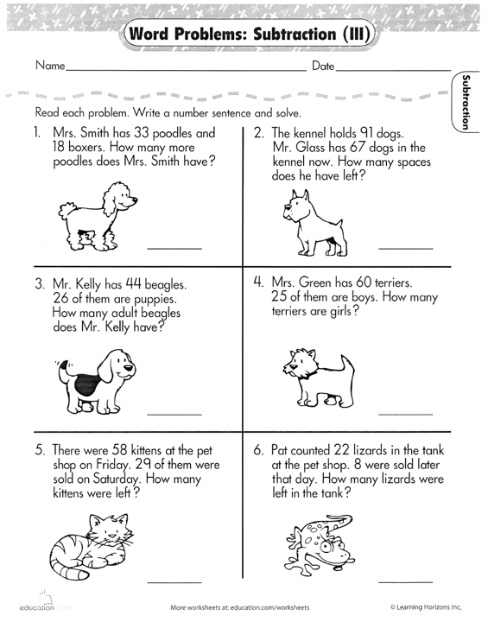

Slide 187
Don’t tie key words to operations
Do have an attack strategy
Do teach word-problem schemas

Slide 188
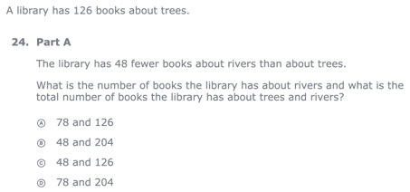
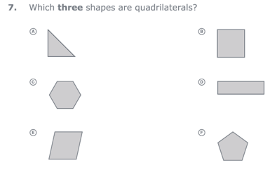
For every word problem
Regardless of problem type, students need an attack strategy for working through the problem
This strategy should work for any problem type
Routine Word Problems
Instructional Word Problems

Slide 189
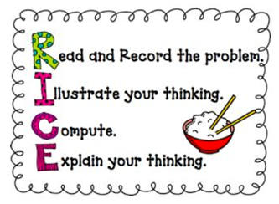
RIDGES
Read the problem.
I know statement.
Draw a picture.
Goal statement.
Equation development.
Solve the equation.
RIDE
Read the problem.
Identify the relevant information.
Determine the operation and unit for the answer.
Enter the correct numbers and calculate, then check the answer.

Slide 190
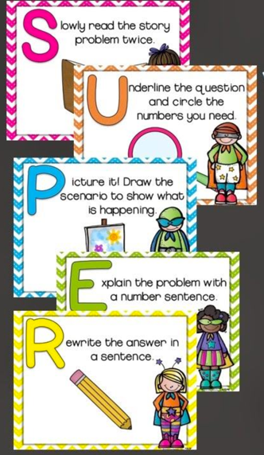

Slide 191
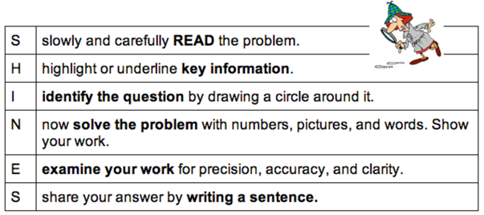
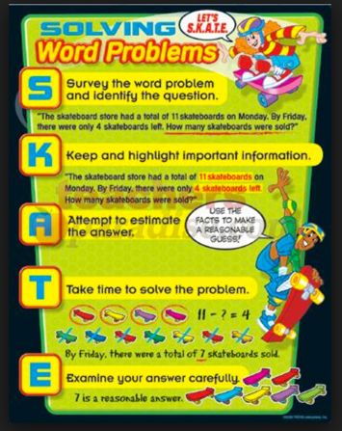
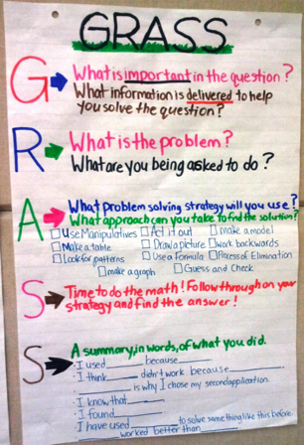

Slide 192
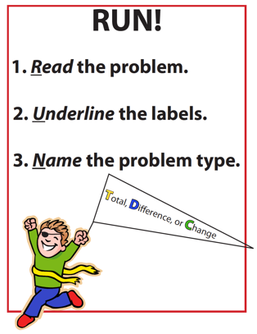
SIGNS
Survey questions
Identify key words
Graphically draw problem
Note operations
Solve and check
SOLVE
Study the problem.
Organize the facts.
Line up the plan.
Verify the plan with computation.
Examine the answer.

Slide 193
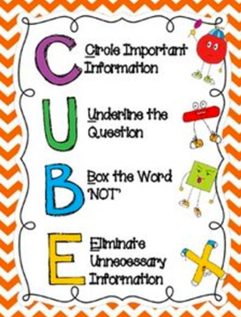
R-CUBES
Read the problem.
Circle key numbers.
Underline the question.
Box action words.
Evaluate steps.
Solve and check.

Slide 194
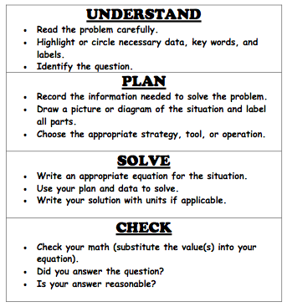

Slide 195
Don’t tie key words to operations
Do have an attack strategy
Do teach word-problem schemas

Slide 196
Additive Schemas

Slide 197
Instruction Using Schemas
A schema refers to the structure of the word problem
Total
Difference
Change

Slide 198
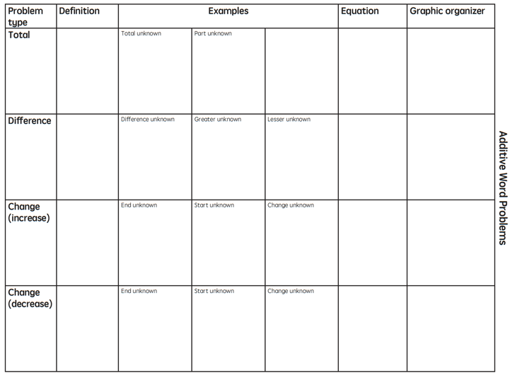

Slide 199
Total
Parts put together into a total
Jennifer saw 4 cardinals and 5 blue jays. How many birds did Jennifer see?
4 + 5 = ?
Jennifer saw 9 birds. If 4 of the birds were cardinals, how many were blue jays?
4 + ? = 9
Jennifer saw 9 birds. 5 of the birds were blue jays, how many were cardinals?
5 + ? = 9

Slide 200
Total
P1 + P2 = T
Fuchs et al. (2008); Griffin & Jitendra (2009)

Slide 201
Total
“Are parts put together for a total?”

Slide 202
Total

Slide 203
Total
✓
✓
✓
P1 + P2 = T
U
P
S
✓
✓
28
+
24
=
?
✓
✓
28 + 24 = 52
? = 52 cookies
Grade 3 Smarter Balanced

Slide 205
Difference
Greater and less amounts compared for a difference
Courtney has 9 apples. Silva has 4 apples. How many more apples does Courtney have? (How many fewer?)
9 – 4 = ?
Courtney has 5 more apples than Silva. If Silva has 4 apples, how many does Courtney have?
? – 4 = 5
Silva has 5 fewer apples than Courtney. Courtney has 9 apples. How many apples does Silva have?
9 – ? = 5

Slide 206
Difference
G – L = D
Fuchs et al. (2008); Griffin & Jitendra (2009)

Slide 207
Total
“Are parts put together for a total?”
Difference
“Are amounts compared for a difference?”

Slide 208
Difference

Slide 209
Difference
✓
✓
G – L = D
✓
U
P
S
✓
✓
107
-
68
=
B
107
68
68
+ ?
107
✓
107 – 68 = 39
✓
Grade 3 Smarter Balanced
B = 39 more beads

Slide 211
Change
An amount that increases or decreases
Sandra had $4. Then she earned $3 for cleaning her room. How much money does Sandra have now?
4 + 3 = ?
Sandra has $4. Then she earned money for cleaning her room. Now Sandra has $7. How much money did she earn?
4 + ? = 7
Sandra had some money. Then she made $3 for cleaning her room. Now she has $7. How much money did Sandra start with?
? + 3 = 7

Slide 212
Change
ST +/– C = E
Fuchs et al. (2008); Griffin & Jitendra (2009)

Slide 213
Total
“Are parts put together for a total?”
Difference
“Are amounts compared for a difference?”
Change
“Does an amount increase or decrease?”

Slide 214
Change

Slide 215
Change
✓
A bus had 13 passengers. At the next stop, more passengers got on the bus. Now, there are 28 passengers. How many passengers got on the bus?
✓
✓
U
P
S
✓
ST + C = E
✓
13
+
?
=
28
✓
28
- 13
✓
13
+ ?
28
13 + 15 = 28
? = 15 passengers

Slide 216
Change
An amount that increases or decreases
Yolanda baked 9 cookies. Then, she ate 2 of the cookies. How many cookies does Yolanda have now?
9 – 2 = ?
Yolanda baked 9 cookies. Then, she ate some of the cookies. Now, she has 7 cookies. How many cookies did Yolanda eat?
9 – ? = 7
Yolanda baked some cookies. She ate 2 of the cookies and has 7 cookies left. How many cookies did Yolanda bake?
? – 2 = 7

Slide 217
Change
ST +/– C = E
Fuchs et al. (2008); Griffin & Jitendra (2009)

Slide 219
Total

Slide 220
Change

Slide 221
Difference

Slide 222
Total
P1 + P2 + P3 = T

Slide 223
Change
ST – C + C = E

Slide 224
Let’s Review
What’s a Total problem?
What’s a Difference problem?
What’s a Change problem?

Slide 225
Schema Quiz Time!

Slide 226
Difference
Grade 3 STAAR

Slide 227
Total
Grade 5 Smarter Balanced

Slide 228
Change
Grade 4 Smarted Balanced

Slide 229
Multiplicative Schemas

Slide 231
Equal Groups
Groups multiplied by number in each group for a product
Kristina has 2 bags of apples. There are 6 apples in each bag. How many apples does Kristina have altogether?
2 × 6 = ?
Kristina has 12 apples. She wants to share them equally among her 2 friends. How many apples will each friend receive?
2 × ? = 12
Kristina has 12 apples. She put them into bags containing 6 apples each. How many bags did Kristina use?
? × 6 = 12

Slide 232
Equal Groups
G × N = P

Slide 233
Equal Groups
“Are there groups with an equal number in each group?”

Slide 235
Equal Groups
✓
✓
✓
G x N = P
U
P
S
✓
✓
x
=
6
25
?
✓
✓
6 x 25 = 150
? = 150 cherries

Slide 236
Comparison
Set multiplied by a number of times for a product
Marcie picked 6 apples. Lisa picked 2 times as many apples as Marcie. How many apples did Lisa pick?
6 × 2 = ?
Lisa picked 12 apples. She picked 2 times as many apples as Marcie. How many apples did Marcie pick?
? × 2 = 12
Lisa picked 12 apples, and Marcie picked 6 apples. How many times as many apples did Lisa pick as Marcie did?
6 × ? = 12

Slide 237
Comparison
S × T = P

Slide 238
Equal Groups
“Are there groups with an equal number in each group?”
Comparison
“Is a set compared a number of times?”

Slide 240
Comparison
✓
U
P
S
✓
6
2
?
✓
✓
✓
Grade 4 Smarter Balanced
? = 12 DVDs

Slide 241
Ratios/Proportions
Description of relationships among quantities
Xin et al. (2005)

Slide 242
Equal Groups
“Are there groups with an equal number in each group?”
Comparison
“Is a set compared a number of times?”
Ratios/Proportions
“Are there relationships among quantities - if this, then this?”

Slide 244
Ratios/Proportions
✓
✓
✓
✓
U
P
S
✓
✓
176
?
? = 110 slices
✓
✓
8
5

Slide 246
Equal Groups

Slide 247
Ratios/Proportions

Slide 248
Comparison
Grade 4 Smarter Balanced

Slide 249
Let’s Review
What’s an Equal Groups problem?
What’s a Comparison problem?
What’s a Ratios/Proportions problem?

Slide 253
✓
✓
✓
U
P
S
✓
✓
18
3
?
✓
✓
? = 54 books
Grade 4 Smarter Balanced

Slide 254
Schema Quiz Time!

Slide 255
Ratios/Proportions
Grade 6 Smarter Balanced

Slide 256
Equal Groups
Grade 4 PARCC

Slide 257
Comparison
Grade 4 Smarter Balanced

Slide 262
Schemas
Total
Difference
Change
Equal Groups
Comparison
Ratios/Proportions

Slide 263
Don’t tie key words to operations
Do have an attack strategy
Do teach word-problem schemas

Slide 264
How do you incorporate effective problem-solving strategies within intensive intervention?
Don’t use key words tied to operations
Do teach students an attack strategy
Do teach students schemas
Do explicitly teach problem solving
Do provide problem-solving instruction regularly (i.e., several times a week)
Do practice schemas that students will encounter regularly

Slide 265
Instructional Platform
INSTRUCTIONAL DELIVERY
Explicit instruction
Precise language
Multiple representations
INSTRUCTIONAL STRATEGIES
Fluency building
Problem solving instruction
Motivation component

Slide 266
Motivation Component
on task
keep attention
regulate behavior

Slide 267
How do you incorporate a motivational component within intensive intervention?
Utilize a motivational component, when necessary

Slide 268
Instructional Platform
INSTRUCTIONAL DELIVERY
Explicit instruction
Precise language
Multiple representations
INSTRUCTIONAL STRATEGIES
Fluency building
Problem solving instruction
Motivation component

Slide 269
srpowell@austin.utexas.edu
@sarahpowellphd
119

