Slide 1
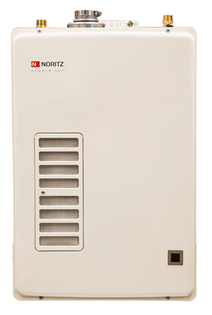
Easy 40 Gallon Tank Replacement

Slide 2
Tank Comparison
Gas Storage Water Heaters
with Gas Tankless Water Heaters
Gas Tankless is at
10%
of the market
In 2013, over 4 Million Gas Tank Water Heaters were sold
Notes:
Tankless water heaters only comprise 10% of the total market share of hot water heaters and Noritz has taken the challenge to capture more of that market share with the EZTR

Slide 3
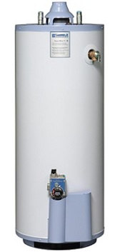
Tank Comparison
VS.
 | TANK | TANKLESS
Endless Hot Water | X | √
Energy Savings | X | √
Space Savings | X | √
½” Gas Line | √ | X
Installation Time | √ | X
Installation Cost | √ | X
Notes:
These are the common comparisons that have been made between Tank vs Tankless. Yes tankless has endless hot water, energy savings and space savings, but compared to a tank, tankless are generally expensive and time consuming to install, with larger units requiring system upgrades to properly operate. Additionally, the existing vent structure needs to be changed out with expensive stainless steel or heavy pvc adding to additional costs and labor to install.
With the introduction of the EZTR, Noritz is challenging the comparison that tankless is expensive and labor intensive to install.

Slide 4
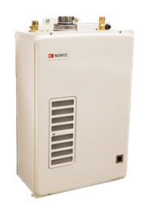
Overview
EZ Tank Replacement
Long-Awaited Breakthrough Product
After extensive hard work from Noritz Japan, we are excited to be able to offer this innovative product
Simple Market Approach and SKU
EZ = Easy, TR = Tank Replacement, 40 = Gallon Tank
40 Gallon Tank replacement without second-guessing
Sales Strategy – Phase 1
Major Focus in Sunbelt Region: California, Southwest & Southeast Regions
Provide education and training to build confidence of tank-only installers
Product Release
January 2015
Market Approach
Notes:
Introducing the easy tank replacement. At least 2 years of market research done in the states.

Slide 5
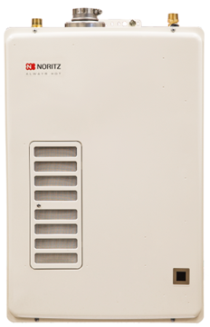
Tank Comparison
We now have a direct replacement!
Top mount water connections
Use existing ½” Gas Line
Use existing B-Vent
2” Flex Vent
40 Gallon Tank
Water Heater
EZTR40
Notes:
The EZTR40 is comparable to a 40 gallon water heater. It was designed to compete with the most common capacity of residential water heater. 40 gallon heaters are seen regularly in 3 bath homes and smaller. In the southern and sunbelt region where we will primarily market the EZTR40 ; it can support 3 fixtures running at the same time in the winter season and will not run out of hot water. Noritz has the EZTR with its top mount water connections and ability to use of existing Bvent and ½” gas line makes tank to tankless transition seemless.

Slide 6
Specifications
Temp Rise (F) | Flow Rate (gpm)
100 | 2.2
90 | 2.5
80 | 2.8
70 | 3.2
60 | 3.7
50 | 4.4
45 | 4.9
40 | 5.6
30 | 6.6
EZTR40
Heater Dimensions | H27.2"×W18.3"×D9.4”
BTU Input | 15,000-120,000 Btuh
Flow Rate Capacity | 0.5-6.6 gal/min
Temperature Settings | 120F, 130F, 135F, 140F 115*-140F with remote
Energy Factor | 0.91
Gas | NPT 1/2“ (bottom)
Water | NPT 3/4” (top)
Vent | 2” Flexible PP Vent
Freeze Protection | 32F
Weight | 50 pounds
Additional Features | Temperature lockout High elevation Built-in display window
Notes:
The EZTR40 is the easy 40 gallon tank replacer. This high efficient condensing water heater inputs up to 120, 000 btu of heat to raise water temperature to a maximum 140F. Its high 0.91 energy factor also qualifies for Energy Star Program. The most prominent feature of this unit are the location of the water connections, now on top of the unit. The relocation of the water connections, the ability to use the existing vent stack, and ½” gas line connection make the EZTR a tank killer in the retrofit market.

Slide 7
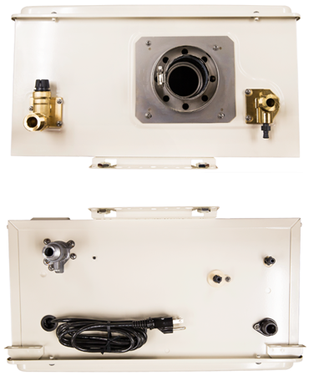
Connections
TOP VIEW
¾” Hot Outlet
¾” Cold Inlet
2” Flex Vent Exhaust
Bottom View
½” Gas Line
½” Condensation Line
6ft Power Cord
Notes:
These are the top and bottom views of the heater. Water and exhaust on top. Gas and condensate drain on bottom. Standard 6ft power cord

Slide 8
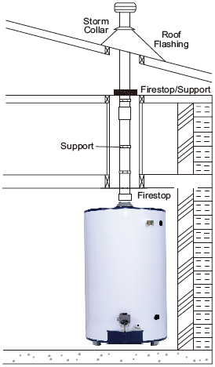
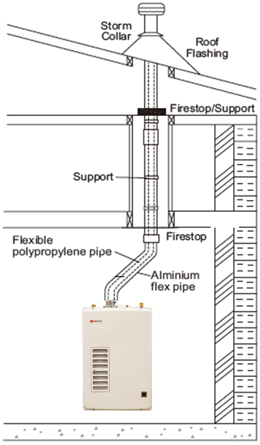
Innovative Venting
Flex Vent System
Ability to vent through existing
B-Vent, save tremendous amount on installation time!
Flex Vent running through existing B-Vent
Perfect for multi-family vertical venting, up to 35 feet, when stainless steel and PVC can be challenging
Notes:
The flex vent system accessories transform the existing B-Vent stack into a useful chase so existing vent removal is not required.

Slide 9
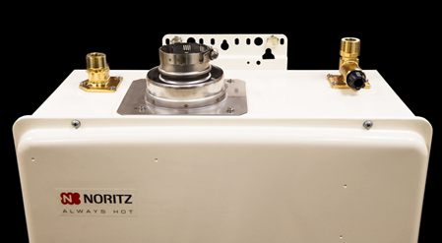
Basic Steps
Installation
1
Disconnect and drain tank water heater
2
In the meantime…slide the Flex Vent through the existing B-Vent
3
Mount the EZTR heater
4
Reattach gas, water, and vent connections
Notes:
The vent installation is designed to be installed fairly quickly. In some cases faster time than it takes for the tank water heater to drain.

Slide 10
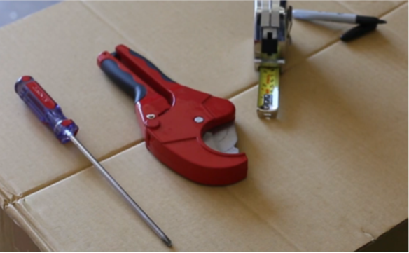
Flathead Screwdriver
PVC / Plastic Pipe Cutter
Measuring Tape
Marker
Notes:
Venting of the EZTR is the most crucial step to ensure safe operation of the heater.
You will need a flat head screw driver, pvc/plastic pipe cutters, measuring tape, and a marker to properly install the flexible venting for the EZTR40

Slide 11
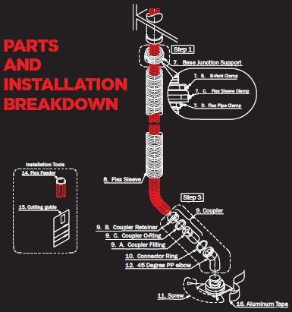
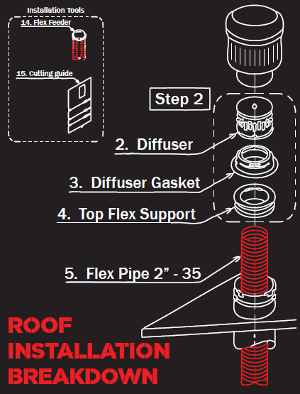
Notes:
The vent instructions are divided up into three sections, with a bag of parts identified for each section. The first step secures the flex vent to the B-vent structure. The second step is completed on the roof and modifies the vent termination. The last step is to secure the venting to the Noritz tankless water heater. The first two steps can likely be completed in the time it takes to fully drain a tank water heater.

Slide 12
120VAC Power Supply
Standard electrical outlet or hardwire to 5A breaker
¾” Water Connection
Located on the top of the unit; use flex lines from stub outs to connect to heater
½” Gas Connection
Refer to installation manual and appropriate gas line sizing table for your gas type, pipe material and diameter
½” Condensate Drain
Connect downward drain line and dispose of condensate according to local code.
Notes:
The installation of the EZTR is the same as our conventional models with the exception of the location of the water connections. Now on top, like storage tank heaters, modifications to the plumbing to accommodate installation are not necessary. Additionally, the ½” gas line will allow the ability to use the existing gas piping provided static gas pressure to the installation site is better than 8” W.C.

Slide 13
Tank Comparison
VS.
 | TANK | TANKLESS
Endless Hot Water | X | √
Energy Savings | X | √
Space Savings | X | √
½” Gas Line | √ | X
Installation Time | √ | X
Price | √ | X
 | TANK | TANKLESS
Endless Hot Water | X | √
Energy Savings | X | √
Space Savings | X | √
½” Gas Line | √ | √
Installation Time | √ | √
Installation Cost | √ | √
Notes:
Looking back at the comparison chart, I believe we have addressed those 3 categories that tankless was less than stellar.
The EZTR has a ½” gas line connection and can support up to a 100ft run of ½” gas line provided available gas pressure is better than 8” wc.
Retrofit installation time is drastically reduced because the utility configurations on the Noritz match up more closely with a tank heater. Additionally, we are using the existing vent stack and gas line too. Usage of these existing manifolds means no waste and no incurred costs with upgrading system requirements. The EZTR makes converting tank owners to tankless a no brainer.

Slide 14
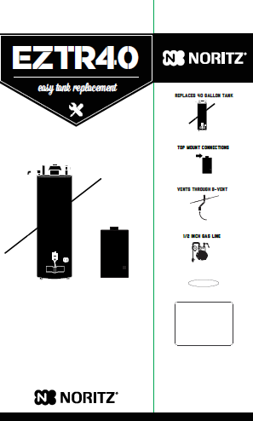
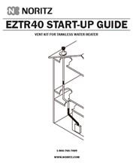
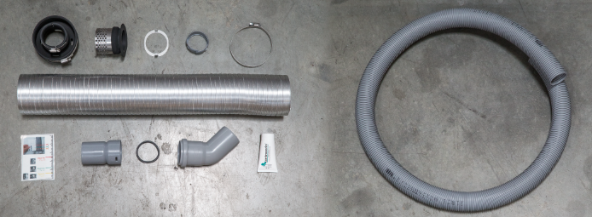
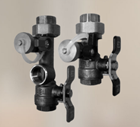
Special Packaging
EZTR40 Heater
Flex Vent System
Isolation Valve Kit
Easy step-by-step manual
Flex Vent System Accessories
Isolation Valves
Package Design
Notes:
The EZTR40 comes with all the accessories needed to seamlessly transition to tankless in a retrofit application. The special packaging will include the innovative tankless water heater, isolation valve kit, and the flex vent system in one standard tank water heater size box.

Slide 15
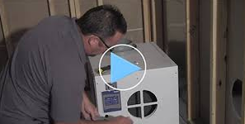
Marketing Activities
Installation Video
Basic Step-By-Step Installation Video
Scanable QR Code on Packaging
Notes:
Not available at this time but video installation will be up by January product release date. QR code for installation video located on packaging of heater.

Slide 16
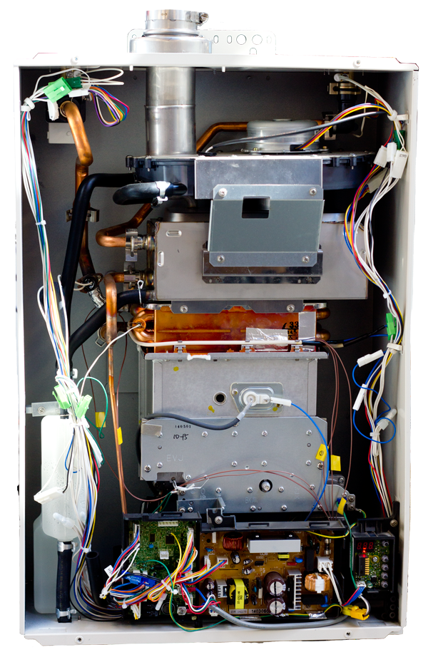
Questions?
Comments?

