Slide 1
Antebellum – Civil War Terms (1820-1877)

Slide 2
Cotton Gin

Slide 3
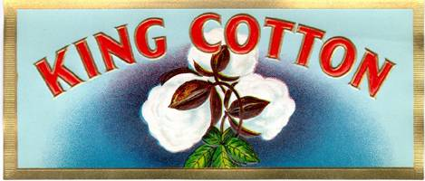
King Cotton

Slide 4
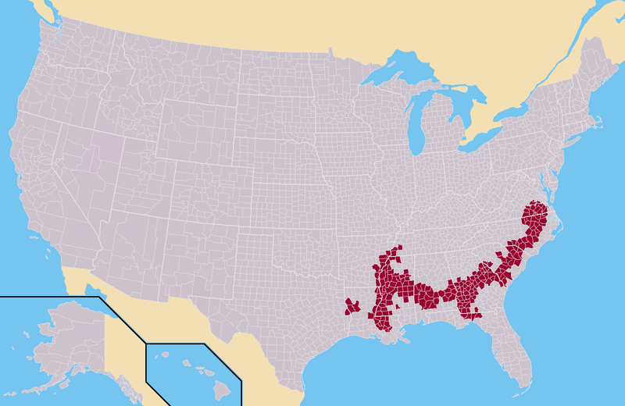
The Black Belt

Slide 5
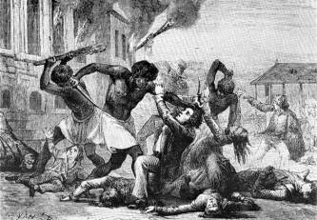
Stono Slave Revolt(1739) (First major American slave Revolt)

Slide 6
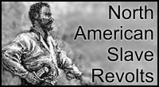
Gabriel Prosser Slave revolt (Burn down Richmond to celebrate 1800)

Slide 7
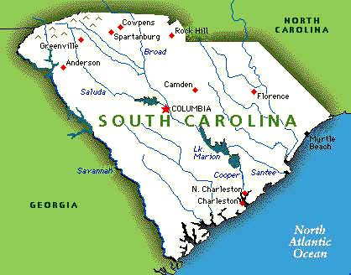
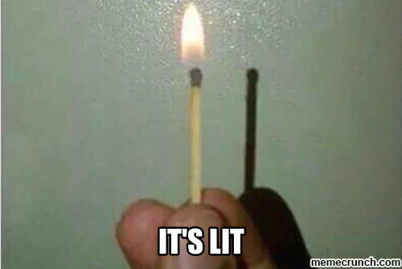
Denmark Vessey Slave Revolt (Burn down Charleston in 1822)

Slide 8
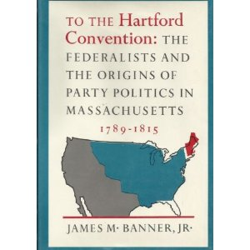
Hartford Convention

Slide 9
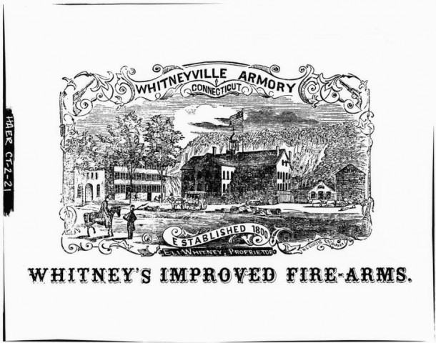
Eli Whitney’s Interchangeable Parts

Slide 10
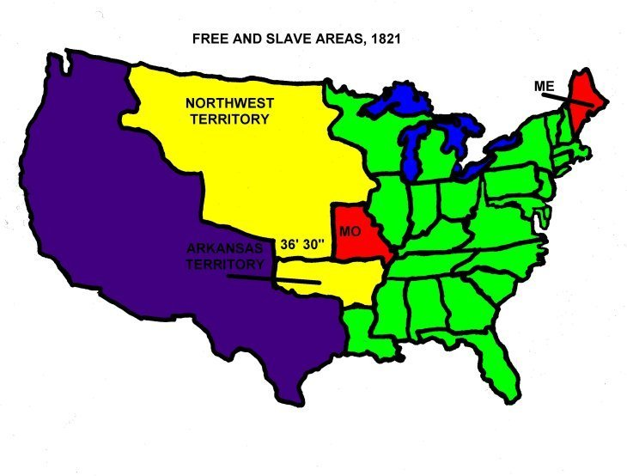
Compromise of 1820

Slide 11
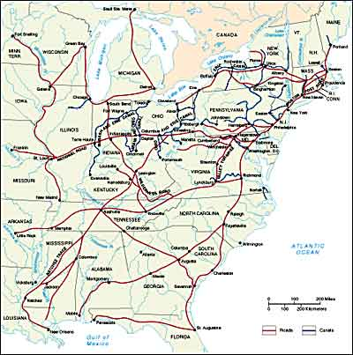
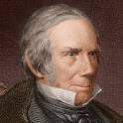
Henry Clay’s American System

Slide 12
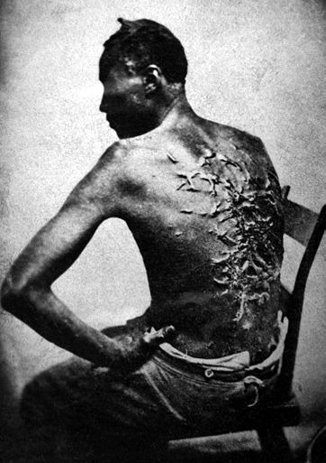
Abolitionism Grows in the North

Slide 13
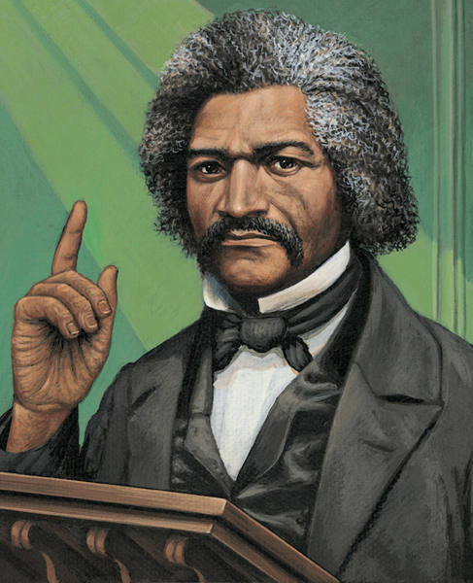
Frederick Douglass

Slide 14
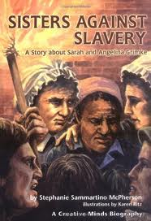
Grimke Sisters

Slide 15
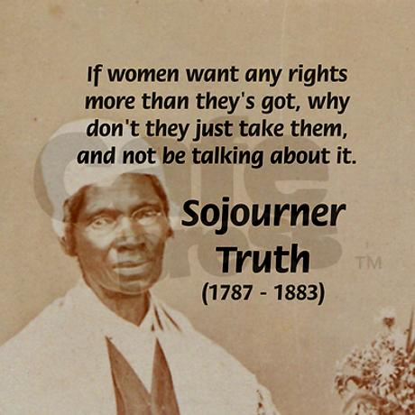
Sojourner Truth

Slide 16
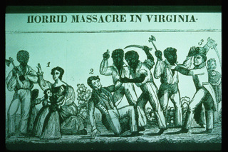
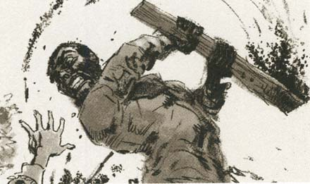
Nat Turner Slave Revolt (1831)

Slide 17
Nullification Crisis

Slide 18
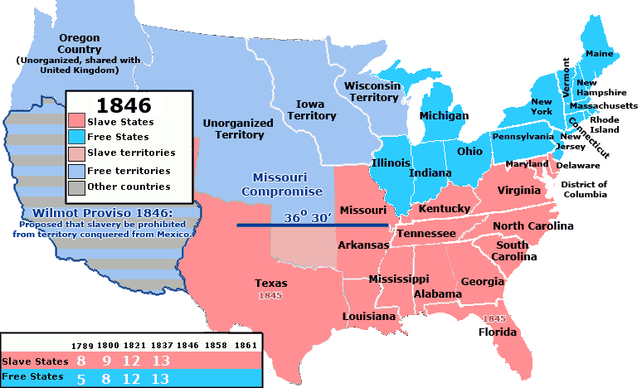
Wilmot Proviso

Slide 19
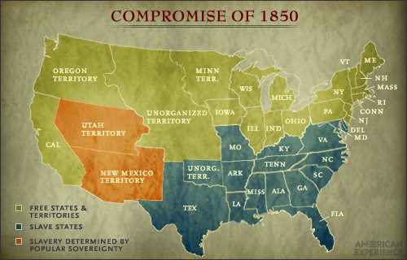
Compromise of 1850

Slide 20
California enters Union (Bear Flag State)

Slide 21
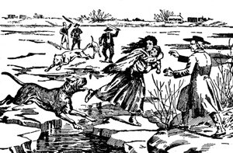
Fugitive Slave Law

Slide 22
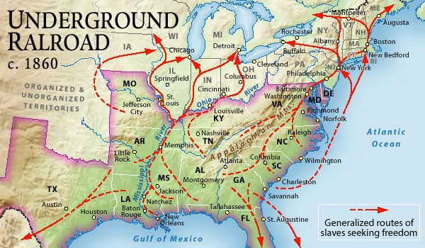
Underground Railroad

Slide 23
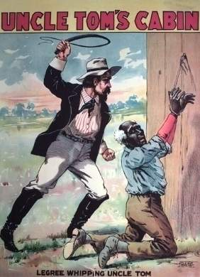
Uncle Tom’s Cabin

Slide 24
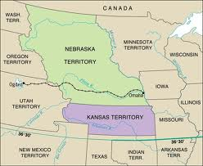
Kansas-Nebraska Act

Slide 25
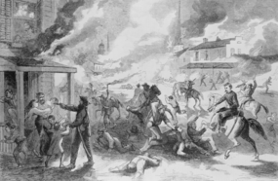
Bleeding Kansas

Slide 26
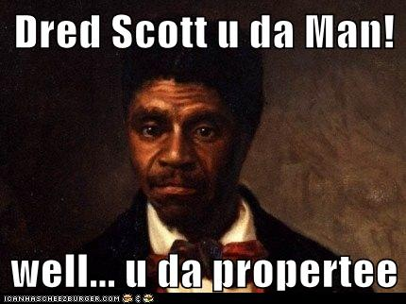
Dred Scott Case

Slide 27
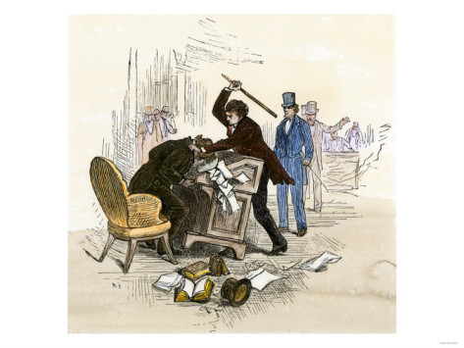
Sumner vs. Brooks Senate Brawls

Slide 28
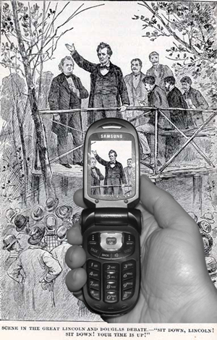
Lincoln-Douglas Debates

Slide 29
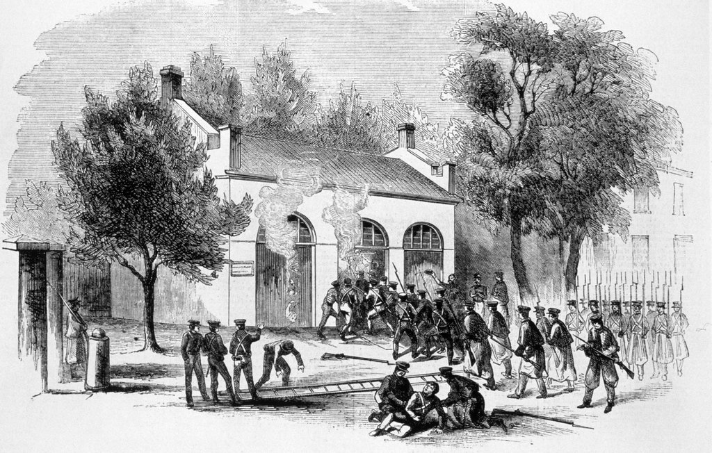
(Crazy Eyes John Brown’s) Harpers’ Ferry Raid

Slide 30
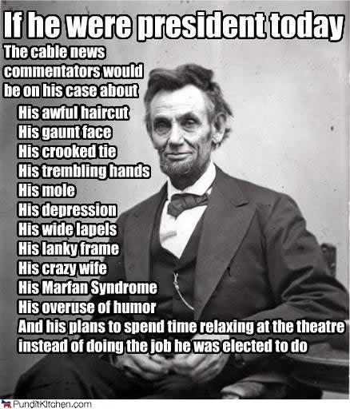
Lincoln Elected

Slide 31
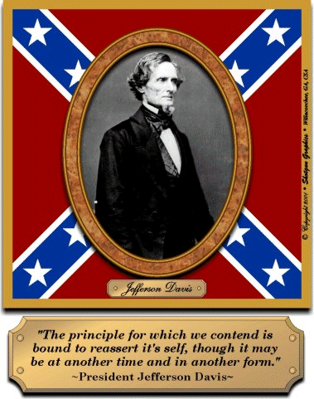
Jefferson Davis

Slide 32
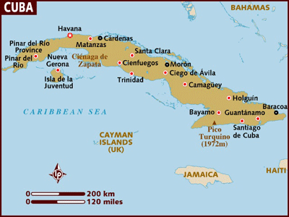
Ostend Manifesto

Slide 33
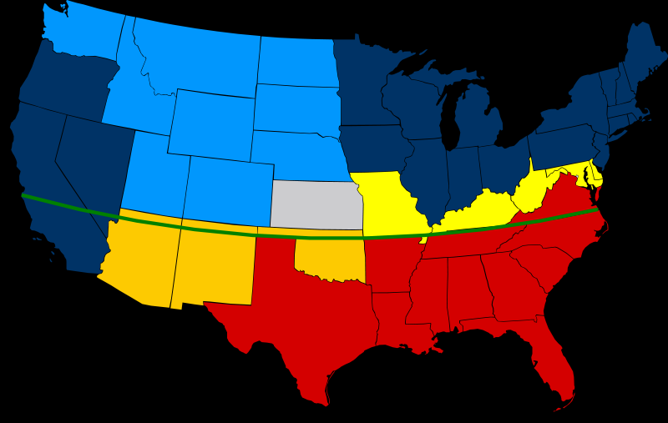
Crittenden Compromise (Last congressional attempt to stop the war in 1860)

Slide 34
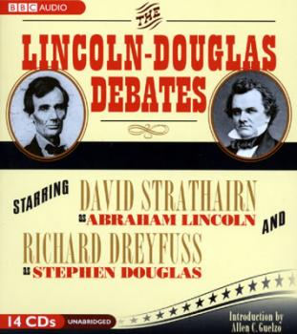
Stephen Douglas

Slide 35
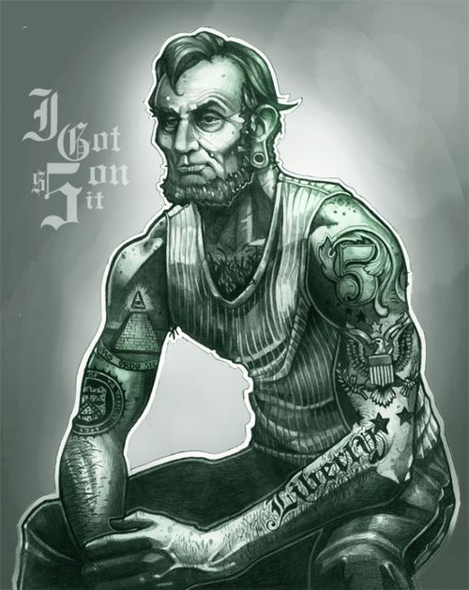
(Abraham Lincoln’s #1 Goal) Preserve the UNION!

Slide 36
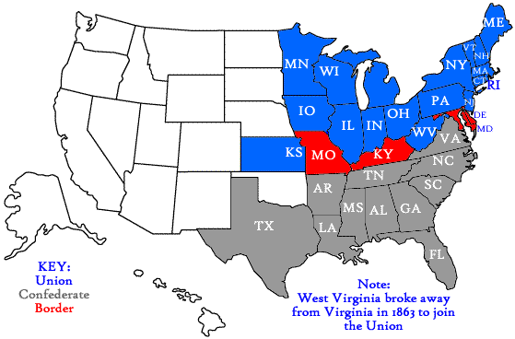
Border States

Slide 37
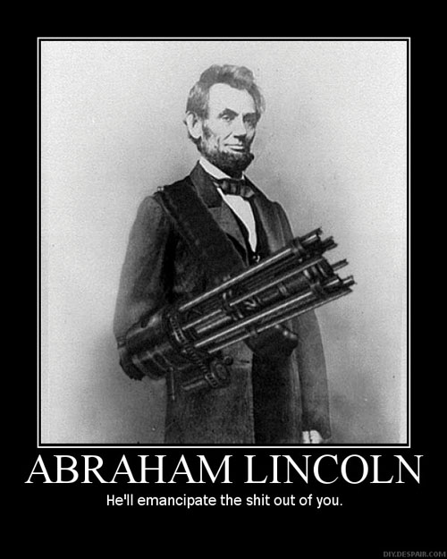
Emancipation Proclamation

Slide 38
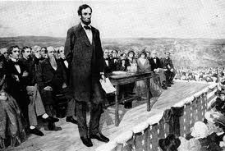
Gettysburg Address (Four Score and seven years ago…)

Slide 39
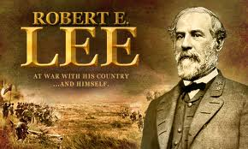
Robert E Lee

Slide 40
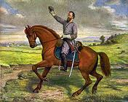
Stonewall Jackson

Slide 41
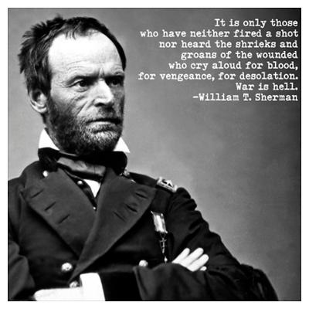
William Tecumseh Sherman

Slide 42
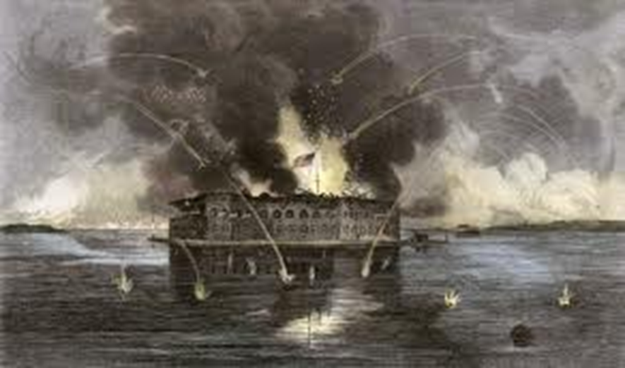
Ft. Sumter

Slide 43
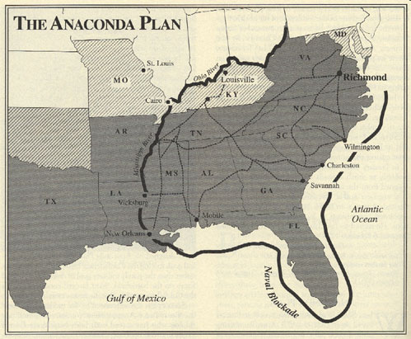
Anaconda Plan

Slide 44
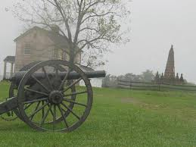
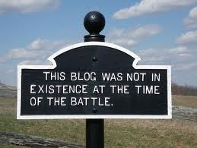
Manassas/ Bull Run

Slide 45
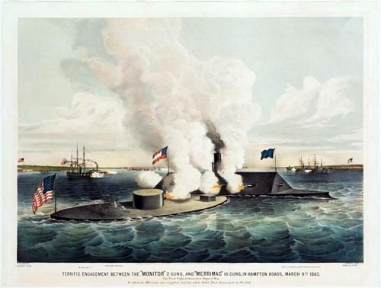
Hampton Roads

Slide 46
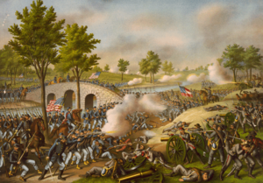
Antietam (Bloodiest 1 day of fighting)

Slide 47
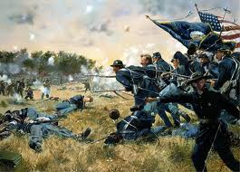
Gettysburg

Slide 48
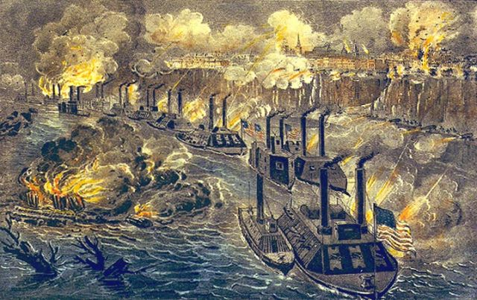
Vicksburg

Slide 49
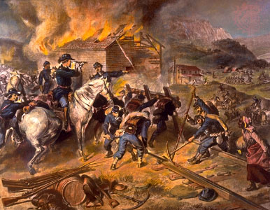
Sherman’s March to the Sea

Slide 50
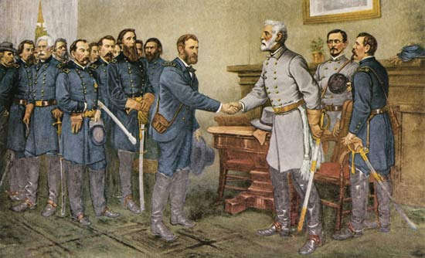
Appomattox Courthouse

Slide 51
CSS Alabama

Slide 52
Laird Rams

Slide 53
Trent Incident

Slide 54
Reconstruction (1865-1877)

Slide 55
John Wilkes Booth

Slide 56
Lincoln’s 10% Plan

Slide 57
Radical Republicans (Thaddeus Stevens & Charles Sumner)

Slide 58
Andrew Johnson

Slide 59
Freedman’s Bureau

Slide 60
Tenure of Office Act

Slide 61
Impeachment of Johnson

Slide 62
Ulysses S Grant

Slide 63
Black Codes

Slide 64
Jim Crow Laws

Slide 65
Sharecropping Tenant farming

Slide 66
13th Amendment

Slide 67
14th Amendment

Slide 68
15th Amendment

Slide 69
Carpetbaggers

Slide 70
Scalawags

Slide 71
Redeemers

Slide 72
Copperheads

Slide 73
KKK / White Leagues

Slide 74
Hayes Tilden Compromise

