Slide 1
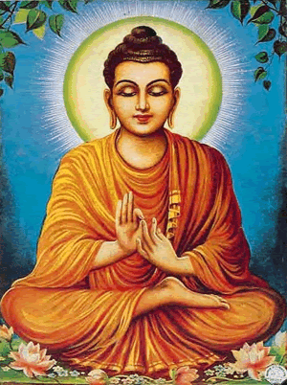
Buddhism
By: Sujay Kamalasanan

Slide 2
Beginning of Buddhism
Siddhartha Gautama was the founder of Buddhism
He was born in 563 B.C.
Being a prince he wondered why people were suffering in life.
At the age of 30 he left home in search of answers.

Slide 3
He spent a total of 6 years trying to find his answers by fasting and meditation.
And he concluded three answers:
1. Wanting what we like, but do not have.
2. Wanting to keep what we like & already have.
3 Not having what we dislike ,but have.

Slide 4
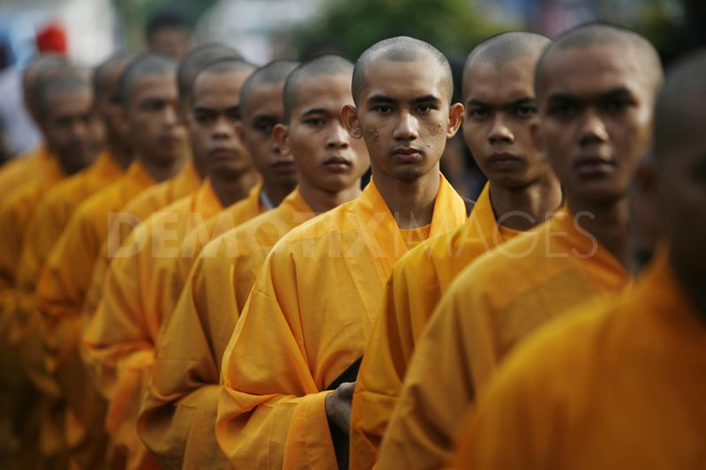
Buddhism Forming
Siddhartha gained many followers, kings & merchants.
They were the first Buddhists.
Like Hinduism, he believed that people should act morally & treat each others well.

Slide 5
The Four Noble Truths
Suffering and unhappiness are a part of human life. No one can escape sorrow.
Suffering comes from our desires for pleasure and material goods. People cause their own misery because they want things they cant have.
People can overcome ignorance and desire by following an 8 fold path that leads to wisdom, enlightment, and salvation.
People can overcome desire, ignorance, and reach nirvana, dharma. Reaching nirvana is like Dharma.

Slide 6
Eightfold path
Believe in the nature of existence as suffering and in the 4 noble truths.
Incline toward goodness and kindness.
Avoid lies and gossip
Don’t steal or harm others
Reject work that harms others
Prevent evil and do good
Control your feelings and do good
Practice proper meditation

Slide 7
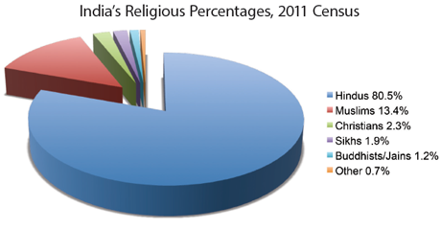
Buddhism v/s Hinduism
Rejected ideas in the Vedas
Didn’t believe Brahmins or their rituals
It does believe in reincarnation

Slide 8
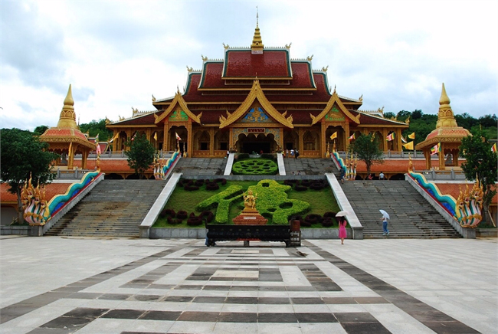
Place Of Worship
Buddhists also pray at temples like Hindus do.

Slide 9
Place Of Worship

Slide 10
Place Of Worship

Slide 11
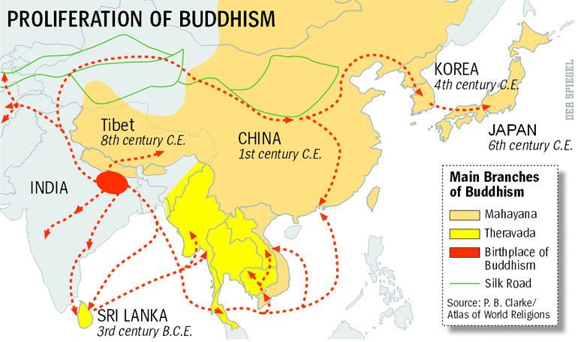
The Spread Of Buddhism

