Slide 1
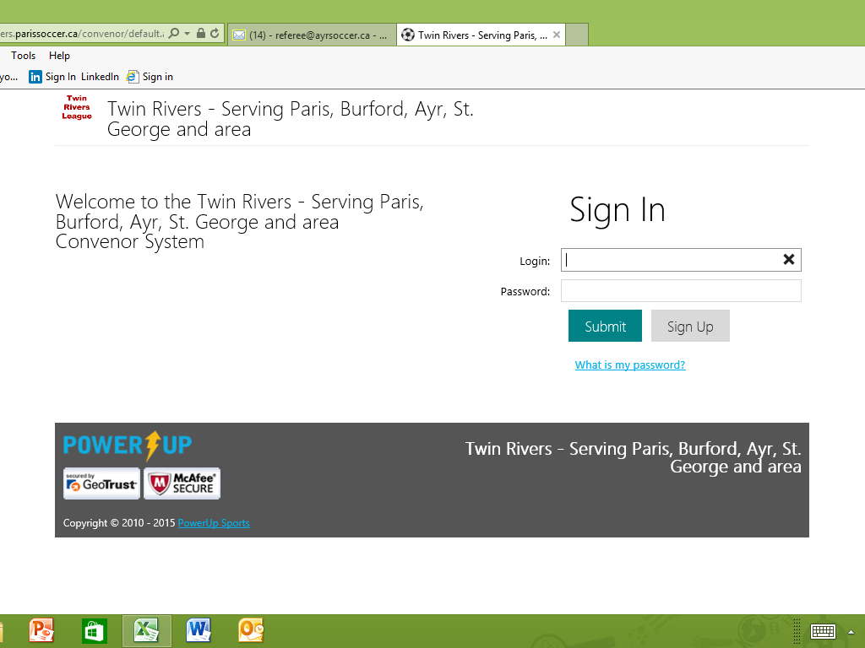
Instructions:
access the www.twinriverssoccer.ca site, then sign-in or sign-up
If you are signing-up please use an email address that is not the same email address you would have used to sign up to be a player… the system does not allow you to have the same email for a player and an official

Slide 2
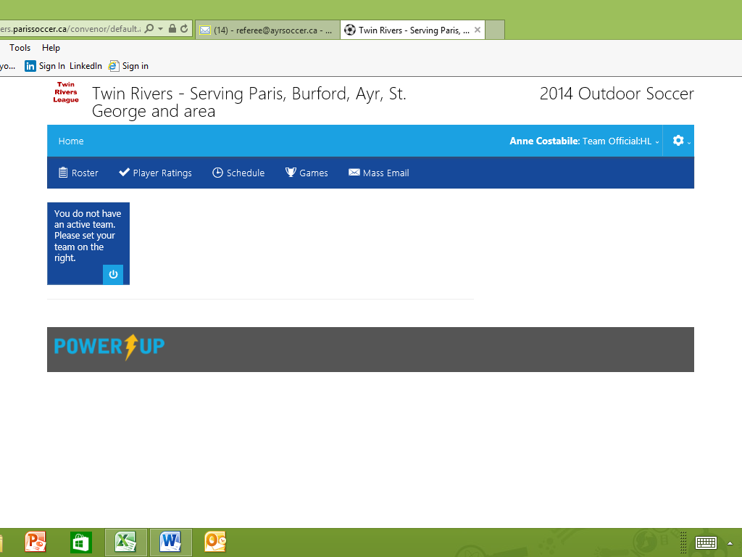
click on the gear
  complete the profile form (be sure to click ‘save”), then
  complete the volunteer form (be sure to click on ‘submit’)
Please use the email address you provided on your Ayr Soccer application form (your game assignments will be mailed to that address)
Be sure to officially log out but clicking on ‘sign out’

