Slide 1
Lesson 7: Deviance
Robert Wonser
Introduction to Sociology

Slide 2
Defining Deviance
Deviance is a behavior, trait, belief, or other characteristic that violates a norm and causes a negative reaction.
The definition of deviance varies widely across cultures, time, and situations.
That is, deviance is relative.
It depends on the reactions from those who witness the act, not qualities of the act itself.

Slide 3
How Does Deviance Relate to Culture?
Norms are a crucial part of culture.
Norms are basic guidelines for behavior.
Following them signifies you are a member of the group.
You are one of us.

Slide 4
Breaking Norms
Ethnomethodology assist in studying norms in social life.
Ethno – group of people
Method – ways of doing things
Ology – study of
A scene from the film Borat. What established scripts did Sacha Baron Cohen’s character Borat violate by going on an elevator naked? How did the unsuspecting woman on the elevator try to cope with the breach?

Slide 5
Deviance As Social Control
Norms create deviance.
As Durkheim noted, crime is a normal part of society.
It is necessary to unite, but it is also necessary to maintain social control.
It is the Deviants among us that hold us together
Self-control is social control; therefore, adherence to social norms is doing what the powerful in society compel you to do.

Slide 6
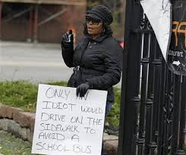
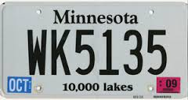
How to Punish Depends on Culture
Because it is so expensive to incarcerate people, other forms of punishment are used elsewhere in the world.
These include shunning, total banishment from a community, or corporal punishment.
Ex: John’s list, public placement of trash cans, ‘whiskey plates’

Slide 7
Theories of Deviance
Functionalists argue that deviance serves a positive social function by clarifying moral boundaries and promoting social cohesion.
Conflict theorists believe that a society’s inequalities are reproduced in its definitions of deviance, so that the less powerful are more likely to be criminalized.
Why is what he’s doing against the law?

Slide 8
Theories of Deviance
Merton’s Structural Strain Theory argues that the tension or strain between socially approved goals and an individual’s ability to meet those goals through socially approved means will lead to deviance as individuals reject either the goals (achieving success), the means (hard work, education), or both.

Slide 9
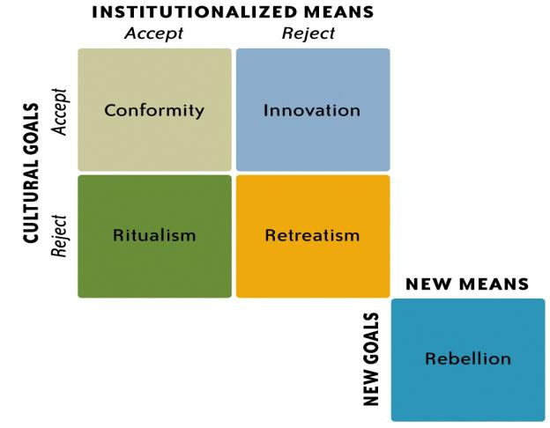
Merton’s Adaptations
Which one would Walter White be?

Slide 10
Conformist
Ritualist
Innovator
Retreatist
Rebel
Which type are you? Do you follow socially accepted means and goals?
You’re a conformist. Doing the bare minimum? You’re probably a ritualist.
If you’re like WorldCom CEO Bernard Ebbers and want to earn big rewards but
have few scruples about how you reach them, you’re an innovator. You’re a
retreatist if you reject all means and goals of society. You’re a rebel, like
Che Guevara, if you not only reject social means and goals but also want to
destroy society itself.

Slide 11
Theories of Deviance
Symbolic Interactionist theories of deviance focus on how interpersonal relations and everyday interactions shape definitions of deviance and influence those who engage in deviant behavior.
Differential association theory states that we learn to be deviant through our associations with deviant peers.

Slide 12
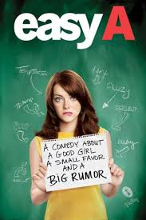
Theories of Deviance
Labeling theory claims that deviance is a consequence of external judgments, or labels, which both modify the individual’s self-concept and change the way others respond to the labeled person.
Labeling theory is also related to the idea of the self-fulfilling prophecy, which is a prediction that causes itself to come true.

Slide 13
Labeling Theory
How did Howard Becker apply labeling theory
to the use of marijuana?
How does one become a marijuana user?

Slide 14
Stigma and Deviant Identity
A stigma is Erving Goffman’s term for any physical or social attribute that devalues a person or group’s identity, and which may exclude those who are devalued from normal social interaction.

Slide 15
Stigma and Deviant Identity
There are three main types of stigma:
physical including physical or mental impairments,
moral signs of flawed character, or
tribal membership in a discredited or oppressed group.
The effects of race and a criminal record

Slide 16
Managing Stigma
One strategy analyzed by Goffman that stigmatized individuals use to negotiate everyday interaction is called passing, or concealing the stigmatizing information.

Slide 17
Managing Stigma
Others have what Goffman called an in-group orientation, where stigmatized individuals follow an orientation away from mainstream society and toward new standards that value their group identity.

Slide 18
Managing Stigma
Finally, others choose deviance avowal, a process by which an individual self-identifies as deviant and initiates his or her own labeling process.

Slide 19
Studying Deviance
Sociologists have often focused on the most obvious forms of deviance – criminals, the mentally handicapped, and sexual deviants – because of deeply rooted social bias in favor of the norms of the powerful.
Remember deviance is the violation of norms …. Whose norms?
Who gets to say what is deviant or not?

Slide 20
Studying Deviance
Because of this bias in favor of those in power,
David Matza urged social scientists to set aside their preconceived notions in order to understand deviants on their own terms.
Is crime going up? Down? Staying the same?

Slide 21
Crime and Punishment
Crime is the violation of a norm that has been codified into law.
Violent crime is a crime in which violence is either the objective or the means to an end, including murder, rape, aggravated assault, and robbery.

Slide 22
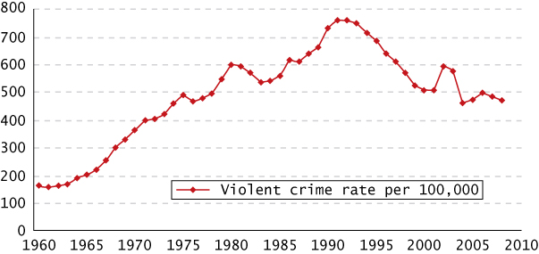
Violent Crime: Total U.S. Violent Crime Rate, 1960–2008

Slide 23
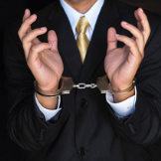
Crime and Punishment
Property crime is crime that does not involve violence, including burglary, larceny theft, motor vehicle theft, and arson.
White-collar crime is crime committed by a high status individual in the course of her or his occupation.

Slide 24
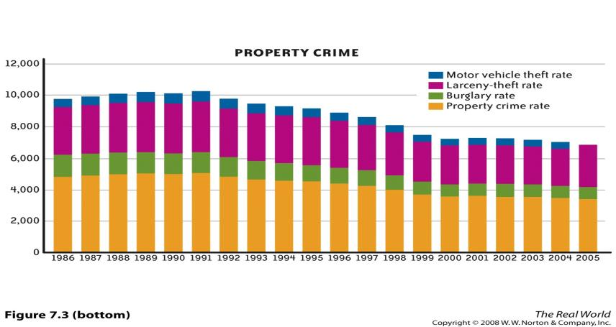
Property Crime

Slide 25
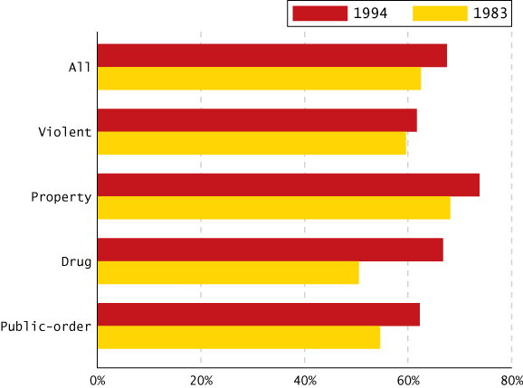
National Recidivism Rates for Prisoners Released in 1983 and 1994

Slide 26
Different Approaches to Punishment
What role should the criminal justice system play in punishing offenders?
Deterrence is an approach to punishment that relies on the threat of harsh penalties to discourage people from committing crimes.
Retribution is an approach to punishment that emphasizes retaliation or revenge for the crime as the appropriate goal.

Slide 27
Different Approaches to Punishment
Incapacitation is an approach to punishment that seeks to protect society from criminals by imprisoning or executing them.
Finally, rehabilitation is an approach to punishment that attempts to reform criminals as part of their penalty.
Which approach best reduces crime?

Slide 28
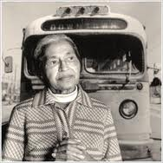
“Positive” Deviance
Positive deviance refers to actions considered deviant within a given context, but which are later reinterpreted as appropriate or even heroic.

Slide 29
Ideas to Remember
Deviance is the flip side of the same coin as conformity
Deviance is relative
Since norms are defined mostly by those in power departing from the norms they’ve established is a process of social control.
Therefore politics pervades discussions of deviance.

Slide 30
Lesson Quiz
1. According to Merton’s structural strain theory, an individual who deals drugs in order to get rich would be called a/an:
a. conformist.
b. innovator.
c. ritualist.
d. retreatist.

Slide 31
Lesson Quiz
2. A student, continually told that he is stupid and will never amount to anything, who eventually drops out of school, is an example of:
a. tertiary deviation.
b. anomie.
c. self-fulfilling prophecy.
d. sanctions.

Slide 32
Lesson Quiz
3. Which of the following is NOT one of the three main types of stigma according to Goffman?
a. self-imposed
b. moral
c. tribal
d. physical

Slide 33
Lesson Quiz
4. The efforts of an ex-convict to hide his stigma would be considered:
a. in-group orientation.
b. an involuntary outsider.
c. deviance avowal.
d. passing.

Slide 34
Lesson Quiz
5. Burglary, arson, and motor vehicle theft are considered:
a. traditional crimes.
b. violent crimes.
c. white-collar crimes.
d. property crimes.

Slide 35
Lesson Quiz
6. The idea that if a punishment is too severe then people won’t commit the crime is related to:
a. rehabilitation.
b. retribution.
c. incapacitation.
d. deterrence.

