Slide 1


Diabetes 102
Meal Planning and Exercise
Diabetes Self Management

Slide 2
Diabetes Meal Planning Guide
Choosing healthy foods can help control sugar
Balance your plate with the six food groups
Starches – potatoes, rice, bread, corn etc
Fruits – apples , oranges, strawberries etc.
Milk Products – yogurt, milk
Non-starch vegetables – carrots, broccoli etc
Meats – fish, poultry, steaks, etc
Fats – butter, vegetable oil, bacon etc.

Slide 3
Nutrition Vocabulary
Carbohydrates – a chemical term for an atom of carbon and water
Needed for energy – starches, vegetables, fruits and milk
Proteins – needed to keep muscles and cells strong as well as immune system
Fats – used for energy also. Found in ingredients of foods i.e., butter, cooking oils

Slide 4
RDA or Recommended Daily Allowance
Carbohydrates – 65%
bread, fruits, milk, Vegetables
Fats – 15% -
bacon, butter, cooking oils, nuts,
Proteins – 20%
meat, fish, chicken, eggs
Vitamins – A,B,C, D
Minerals – Thiamin, calcium, iron, etc
Elements – magnesium, zinc, phosphorus

Slide 5
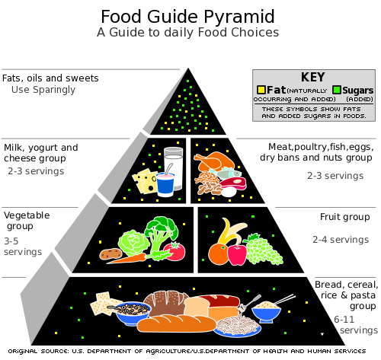

Slide 6

Goal is to have stable sugar
Glucose/sugar levels go up and down in day
Goal of meal planning is to keep sugar stable
Three square meals per day – no skipping
Snacks are OK as long as they are nutritious
Bedtime snack OK, even recommended
Watch for spikes in sugar or drop in sugar

Slide 7

Determine Your Calorie Amount
Depends on how active you are in daytime
If not active at all – about 1200K
If very active – perhaps 2200K
All others in between, perhaps 1600 or 1800
Consult with your patient educator
This determines number of servings per group

Slide 8
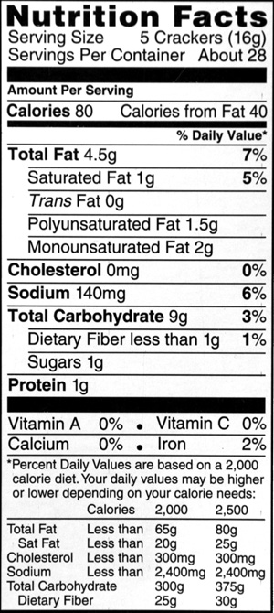
Reading the Label on Foods

Slide 9

More on Food Labels
Calories – unit of energy -keep low as possible, remember your calorie limit for the day
Fat calories – keep low – fats are from grease
Unsaturated fats - are OK. Don’t worry
Cholesterol – as close to zero as possible
Sodium – this is salt – keep as low as possible
Protein – you need this.

Slide 10

Free foods, sweets, substituting
Learn what the free foods are if hungry
Substitute some desserts for starches i.e. a brownie for a potato
Only after mastering the meal plan
Key word is meal plan, not diet
Plan when going grocery shopping

Slide 11
Helpful hints
Keep a 24-hour food diary
Eat a variety of foods
Try out new recipes
Exercise self – discipline when eating
Call it meal planning not a diabetic diet
See what others are cooking
Pay attention to portion sizes
Drink water

Slide 12

What about food preparation?
With meats – get the grease out!
Bake, broil, bar-b-que , steam
George Foreman grill is great
Avoid cooking oils with saturated fat
Use vegetable oil, clear liquid
Cholesterol free butter

Slide 13
Challenges
Read food labels – always choose low sodium and low fat foods
Pay attention to portion sizes
Don’t eat until you “feel full”
Don’t eat in front of the TV
Creative snacking and desserts
Commit to health lifestyle
Exercise after eating

Slide 14

Diabetes Self- Management
What is diabetes Self-Management?
It is you taking control of your diabetes

Slide 15
Goals of Diabetes Self-Management
Blood sugar readings between 79 and 129
The hemoglobin A1c not higher than 7
Meal Plans according to daily activity
Exercise daily – 30 minutes – walking
Check sugar regularly or if sick
Take medications as prescribed by MD
Keep ideal body weight
Annual exams for foot and eyes

Slide 16
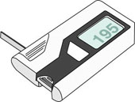
Checking Sugar at Home
Also called blood glucose monitoring
Check sugar fasting – before meals
Record results in log book. Record dosage
Important to do this when starting new med to make sure it is working
Make sure machine is working properly

Slide 17
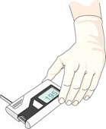
Blood Sugar Machines
Also called glucometers
Find one that is comfortable
Some require test control strips
It is possible to get blood from sites other than finger tips i.e. forearm – finger is best
Make sure battery is good
Ask questions if not sure how to use

Slide 18
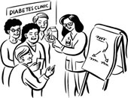
Diabetes Education Classes
Learn all you can – prevention and management can control your blood sugar
Avoid medical complications especially with eyes, feet, kidneys and heart!!

Slide 19
Community Resources
The Local Hospital – Diabetes Classes
Community Health Centers
Physicians who specialize in diabetes
Diabetes support groups (churches)
Social Media, Internet, magazines
Diabetic supply companies have free stuff

Slide 20

Exercise
You must burn more calories than you take in
If calories are not burned, then stored as fat
At least 30 minutes daily, aerobic exercise
This means getting your heart going
Walking, floor exercise, dance, club
Commit to daily time and place
Make a priority – your health is priority

Slide 21

The Foot
Neuropathy – numbness, pain on bottom
Vulnerable to cuts, sores, blisters, corns
Also bruises, ingrown toenails, breaks in skin
People with diabetes heal slowly because of poor circulation
Infection leads to gangrene
Gangrene leads to amputation
Annual foot exam is needed

Slide 22

Taking care of the eyes
Little, tiny, blood vessels go to the eyes
These little, tiny, blood vessels can break
They can break in the pupil or white part
The little blood vessels are on the inside
Eventually, vision is impaired by dark spots
This is known as diabetic retinopathy
If caught early, it can be repaired
Annual eye exam is needed

Slide 23
Summary
Diabetes Self-Management is Priority
Meal planning – keep guide nearby
Exercise – design your own program
Keeping blood sugar normal – check at home
Keep hemoglobin A1c normal
Annual foot and eye exams
Health education classes/support group
Commitment and self-discipline are keys!

