Slide 1
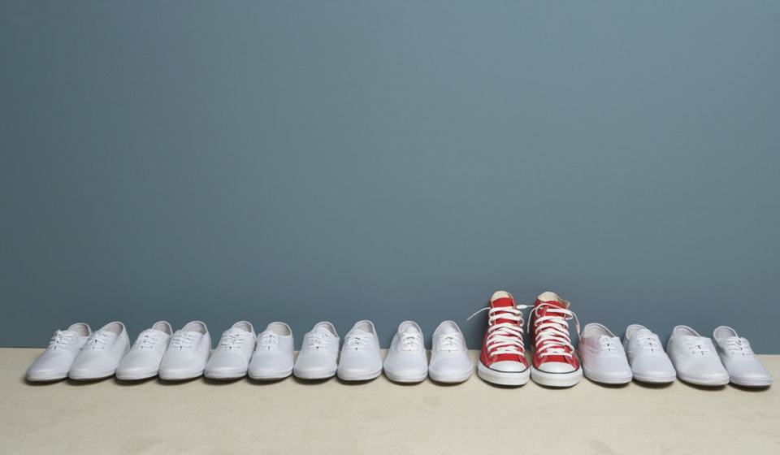
The Link Group
Hello Research, Meet Personality.

Slide 2
Today’s Agenda
Who is TLG?
Market Research & Methodologies
Case Studies

Slide 3
Who is TLG?
Smarter research, better service.

Slide 4
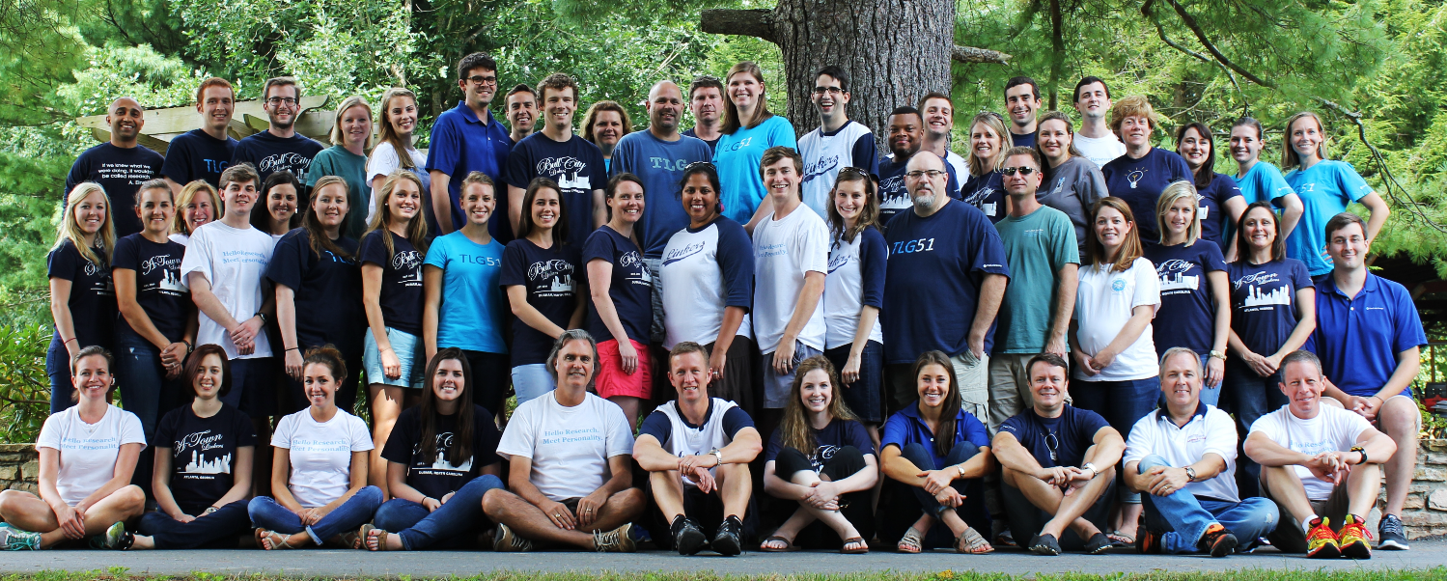
We are TLG.

Slide 5
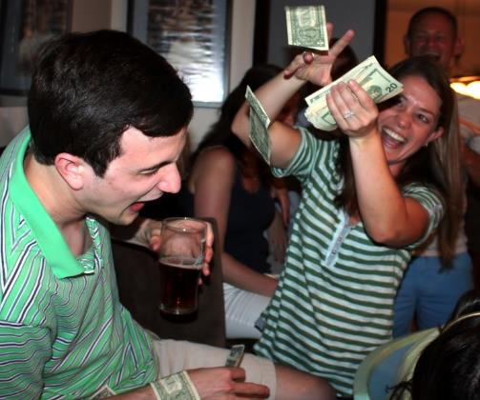
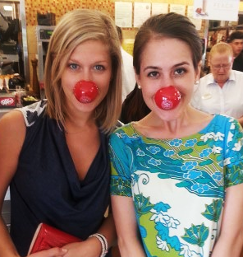
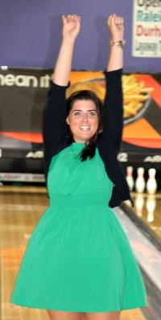
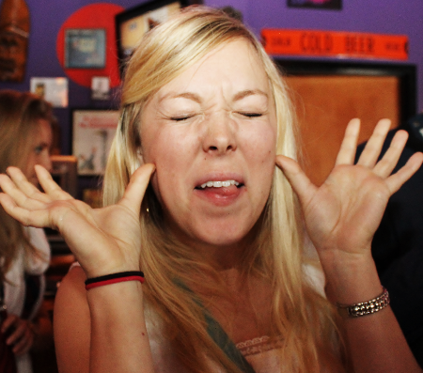
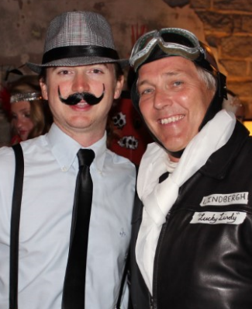
Work hard, play hard.

Slide 6
A little about us.
Primary Market Research founded in 1994
Honomichl Top 50 Research Supplier
Strategic Partner of Fortune 100 & 500 Clients

Slide 7
Some of our clients…

Slide 8
We’ve done research on six out of seven continents.
The Americas US Brazil Canada Colombia Mexico Venezuela Asia Australia China India Indonesia Japan Malaysia New Zealand Saudi Arabia Singapore South Korea Russia Taiwan | Europe Austria Belgium Czech Republic Denmark Finland France Germany Greece Ireland Italy Netherlands Norway Poland Portugal Spain Sweden Switzerland Turkey UK Africa South Africa
Notes:
Here is a list of countries where we have done research in the past.

Slide 9
Market Research & Methodologies
Got questions? We’ll find answers.

Slide 10
MARKET RESEARCH:
Objectively gathering, recording, and analyzing qualitative and quantitative data in order to identify and define marketing opportunities and solutions.
Goal:
To understand how the marketing mix impacts customer behavior.

Slide 11
Market research assists management in their marketing decision making.
Market research starts when our client has a business or marketing question that they need answers to. That is when they come to us for help.
“We have 3 prototypes for a new product. Which one is going to be the most appealing for consumers?”
“What are the attitudes and behaviors of parents who shop for their kid’s shoes?”
“Where in the marketplace are there unmet needs and opportunities for a new product?”
“What is the patient experience on Product Z, a diabetes medication?”

Slide 12
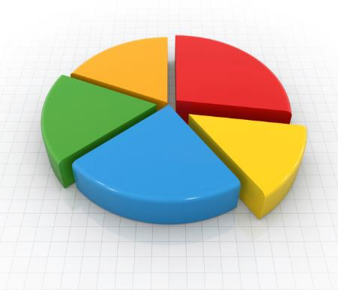
The Tale of Two Methodologies.
Quantitative
Qualitative
Example quantitative questions:
With which of the following social media applications do you have an account? (choose all that apply)
How often do you use each of the following social media applications? (scaled responses such as several times a day, about once a day, once every few days, etc.)
Which social media application do you use most? (choose one)
Example qualitative questions:
How does social media affect your day-to-day life?
In what ways does social media improve your quality of life?
And in what ways does it take away from your quality of life?
How has social media influenced your college experience?
What is the “personality” of each of these social media applications?
Based on Numbers
Broad, Deep Research
Statistical
Not statistical
Answers “How many?”
Answers the “Why?”
Online surveys, customer loyalty
Focus groups, social media, ethnography

Slide 13
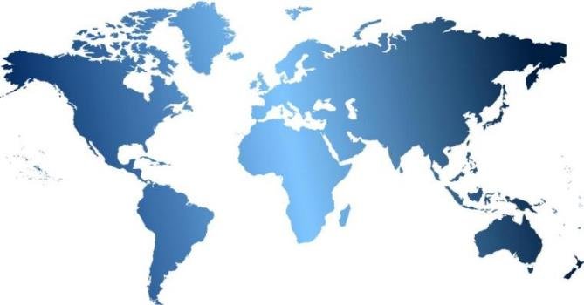
All types of methodologies, for all types of questions.
We go the distance when picking the right methodology for the research: from online consumer surveys, to a jute field in India, to a motor speedway in Tennessee.
Online surveys
Onsite Surveys
Focus Groups
Bulletin Board Focus Groups
In-Depth Interviews
Peer Groups
Onsite Intercepts
Shop-Alongs
In-home Exploration
Heat Mapping
Observations
Hotfoot IDIs
Mobile Groups
Reel Life Documentaries
Out of Box Experience

Slide 14
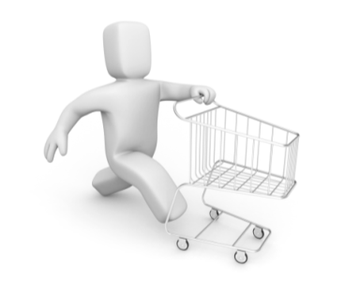
For qualitative research, ethnography is a great way to get to the heart of the matter.
Sometimes phone and in-person interviews just aren’t enough. In order to get a full picture of the marketplace and needs, you need to examine respondent behavior in natural environments.
Reel Life Documentaries allow respondents to video record their day-to-day life, frustrations, challenges and joys – giving us a better picture of their world.
In-Home Observations allow us to be in a respondent’s home and see their behaviors and the tools they use.
In-Facility Observations allow us to be in a facility and observe the interactions between respondents, and understand the behaviors and tools within the context of the facility setting.
Notes:
Jeff

Slide 15
Ethnography can help you…
The Link Group’s "Onsite Insights" behavioral research technique integrates anthropological observation with traditional marketing research methodologies.
Identify attitudes & usage in real settings
Map out processes
Uncover overall shopping and usage experiences
The of
the matter
Record non-verbal's & timed observations
Uncover latent frustrations or compensating behaviors
Notes:
We examine behavior in natural environments.
We have a strong team of on-staff researchers trained to observe and record in the field, instead of using local field services.
Our experience in retail, corporate, and in-home settings provides a well-rounded and adaptable background.

Slide 16
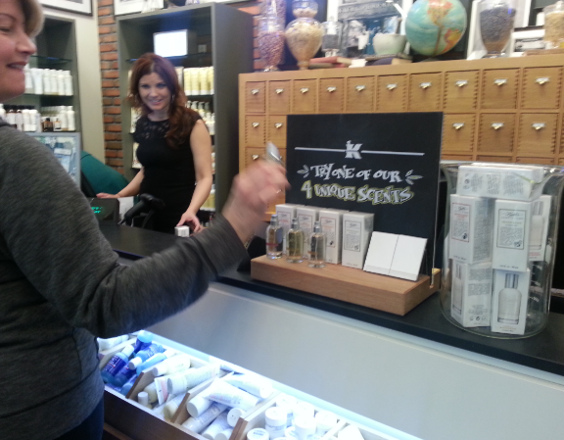
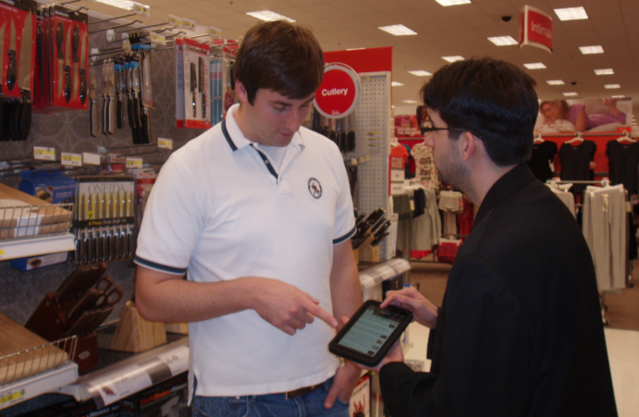
Onsite Intercepts
Onsite intercepts allow us to capture feedback while it is still fresh in the consumers’ minds. In some cases, it can also allow us to have respondents evaluate a specific item within the store.
Notes:
We have access. Over the years we’ve built relationships with corporate offices of major mall chains to facilitate securing mall approval.
We don’t outsource. While some agencies have mall-based research companies do the work for them, The Link Group is directly involved every step of the way.

Slide 17
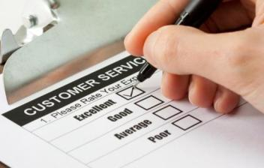
Hotfoot In-Depth Interviews
“Hotfoot IDIs” take a quick pulse of what everyday people feel and think.
6
Notes:
These ultra-rapid, 5 to 10-minute qualitative interviews are conducted with respondents who are intercepted in natural environments.
This methodology works well when testing concepts or assessing brand perceptions.

Slide 18
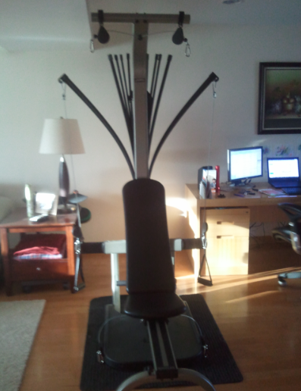
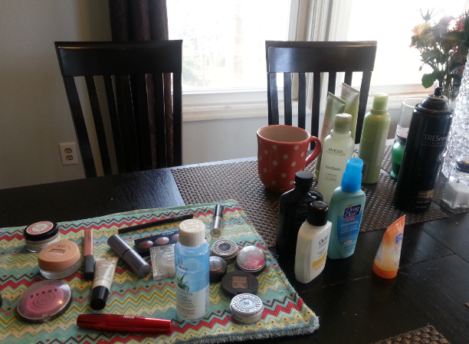
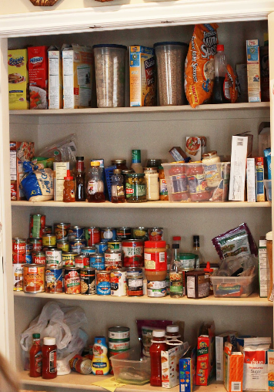
In-Home Explorations
In-home explorations allow us to get an understanding of a respondent’s background and behaviors by seeing how a person lives. We also are able to capture motivations and attitudes by spending time in a respondent’s home.
24

Slide 19
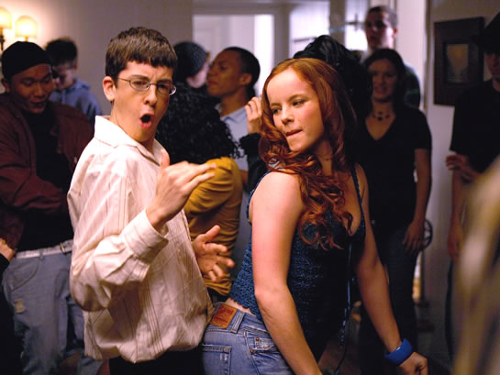
Regardless of where you are or what you’re researching, projective techniques can help you get to the why’s.
What is a projective technique? We’ll show instead of tell.
Brand Personification Exercise
Pick a brand, any brand.
Now, imagine that brand walks into a party.
What do they look like (age, gender, etc.)?
What are they wearing?
What are they drinking?
Do people want to hang out with them?
Now pick another brand.
How do those two brands feel about each other?

Slide 20
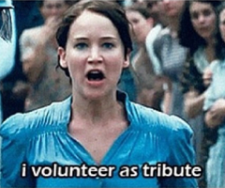
Here, we’ll show you another.
Who wants to volunteer?
That was called emotional laddering.
Self
Knowledge
Values
State of mind the physician is trying to achieve
Psychosocial Consequences
Emotional benefit achieved from experience with the product
Functional Consequences
Immediate and tangible benefits achieved from experience with the product
Product Knowledge
Product
Attribute
Tangible product / service features
The output: Go beyond the rational drivers of choice and perceptions to understand the emotional levers on which people are acting.

Slide 21
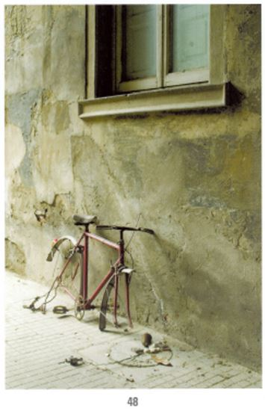
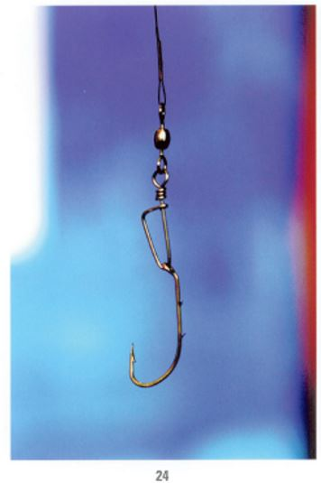
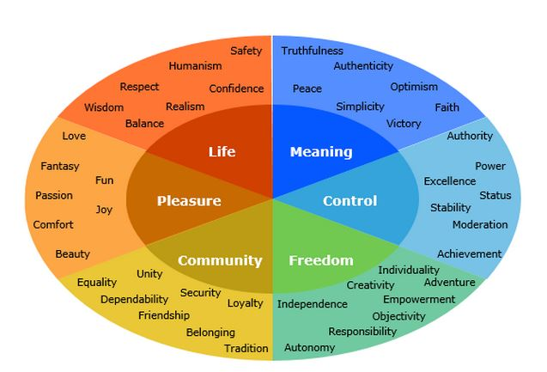
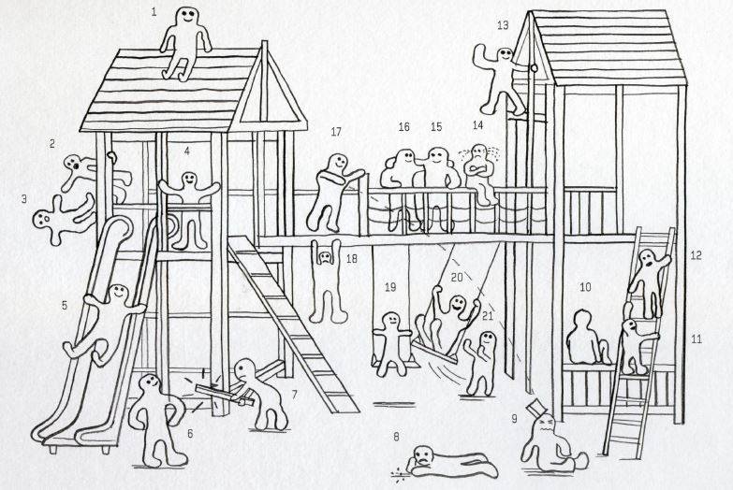
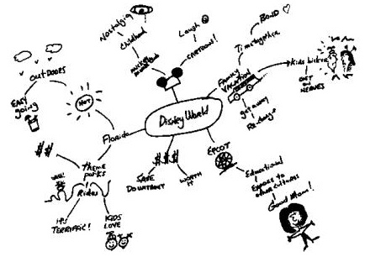
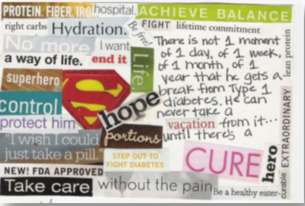
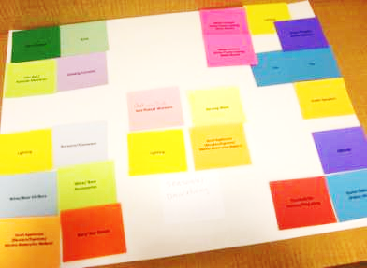
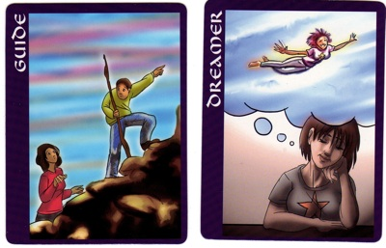
There are many other types of projective techniques.
Here are a few others that we use:
Soularium cards / Iconicards
Post secret
Mind-mapping
Figures on a playground
Think-Say-Feel
Chip allocation
Color / Emotion wheel
Tiling
.

Slide 22
At the end of the research project, you want to make sure your report is grounded and illustrative.
Look for themes or patterns, and find the story.
Apply it to the objective.

Slide 23
Case Studies
Examples of how market research runs the gambit

Slide 24
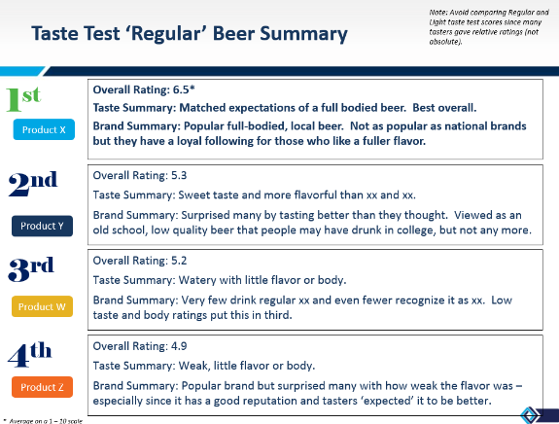
CASE STUDY: Beer Brand Perception and Preference
Methodology: Onsite intercepts & taste tests
Objective: To aid in brand positioning, a national beer manufacturer wanted to gauge customer perceptions of how their product and brand compared to other beer brands.
We also gained insights on…
Drinking motivators, brand choice, and role of taste in decision making
Linkages between these factors and uncover any gaps and opportunities
The impact and perceptions of the packaging and other campaign elements
Potential market share penetration and positioning
Notes:
By conducting a combination of onsite intercepts and taste-tests, we were able to uncover brand perceptions and consumer preferences.

Slide 25
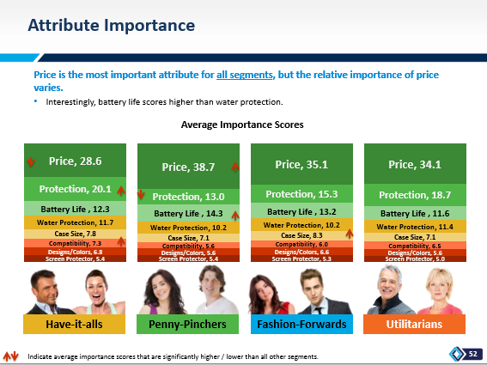
CASE STUDY: Smartphone Case Segmentation
Objective: A smartphone case retailer wants to identify and quantify segments within the smartphone case consumer market so they can determine which of those segments would be their best target.
Approach: Online web segmentation survey with a conjoint analysis. (n=3039, US nationwide)
Output:
High-level overviews of the segmentation with segment market opportunity mapping
Detailed segment profiles
Conjoint simulator that can be used to see how changes in the price or design of a smartphone case might affect a respondent’s likelihood to purchase.

Slide 26
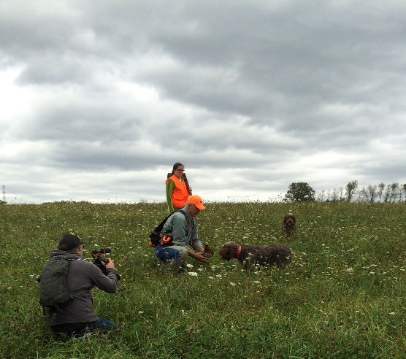
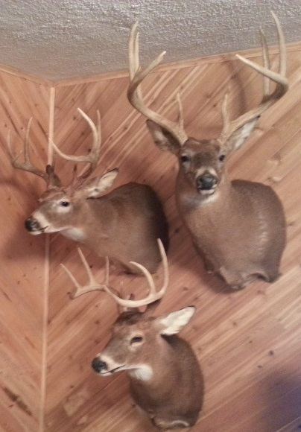
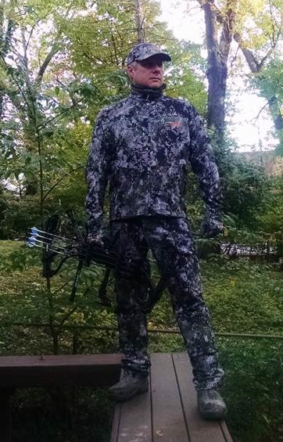
CASE STUDY: Hunter Personas
Objective: A national sporting goods retailer wanted to delve deep into the personality, attitudes, behaviors, preferences and opinions of the outdoorsman to better understand their motivations and build personas around different types of hunters.
Methodology: 48 in-home and shop-along interviews ranging from 3-5 hours in length conducted in 8 markets across the United States. All research sessions were filmed by professional videographers and included a hunting related activity. All respondents were recruited in-house to ensure the highest quality.
Impact: The video from our interviews were clipped to create numerous 3-4 minute shorts that touched on specific themes. These videos were shared with our client’s marketing, merchandising and executive teams.

Slide 27
CASE STUDY: Osteoporosis Patient-Physician Interaction
Objective: Understand what really goes on in treatment conversations between physicians and osteoporosis patients when accelerating treatment.
Methodology: HCP Video Check-Ins, whereby physicians record themselves immediately after seeing an osteoporosis patient to capture the most real-time reactions to and feelings about the conversation.
Impact: A look at the physician’s approach and analysis of real patients, and a realistic look at their actions and perceptions of patient situations.
Eliminates the contrived setting of patient profile evaluation
Avoids “blurriness” associated with recall activities
Heightened emotions from coming directly from the conversation
A compelling video summary that pulls together key themes and findings in the physicians' own words.
Record ~3 min video after each discussion with an applicable patient.
Describe patient, situation, what was said, what the reaction was, and how they feel about it.
Upload to secure collection site. Video summary created.
Follow-up phone interview to deep dive on video commentary.
Physicians receive tablets to use for a 4-week period

Slide 28
CASE STUDY: Path to Purchase of Cosmetics
Methodology: In-home explorations and IDIs, followed by shop-along’s
Objective: An international cosmetic manufacturer wanted to gain insights around the beauty products used by consumers in order to provide direction on how to grow a greater share of consumers’ routine.
This helped us gained insights on:
Overall path-to-purchase beauty products defined by 4 key categories –cosmetics, facial skin care, hair care and hair color
Drivers to revise or build beauty routine
Influencers to purchase from a product, brand and channel lens
The role of beauty “education” and how it can drive sales

Slide 29
CASE STUDY: Search Engine Strategy & Concept Testing
Objectives:
Over several years and roughly 20 projects, we partnered with a search engine to help them understand their consumers’ online behavior, position their brand, and test potential search engine concepts and website features.
Our research with this client was both strategic and tactical – we answered big picture questions (i.e. what is this search engine’s overall strategy?) and specific questions (what do consumers think about this potential feature or function?)
Methodology:
In-depth interviews with target respondents
Focus groups with target respondents
Online surveys among the target market

Slide 30
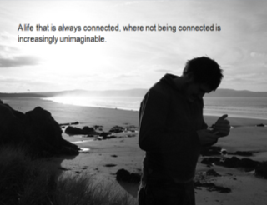
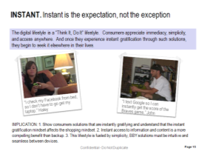
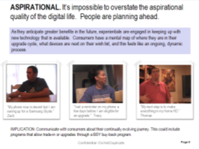
CASE STUDY: Digital Lifestyle Exploration
Objectives:
Understand consumers’ overall digital lifestyle. What are consumers doing online, and why?
Determine the key entry points into a digital lifestyle and barriers to entry
Discover the new pain points introduced by going digital
Methodology:
Focus groups flesh out and gain a deep understanding of the barriers of a digital lifestyle.
Ethnographic interviews to observe respondents in their own environment paying close attention to how technology is integrated into their lifestyle.
Homework assignment with a “Digital Diary” that documents the frequency of usage of digital technology, feelings regarding technology usage in their lives, and any pain points or concerns about current digital products.

Slide 31
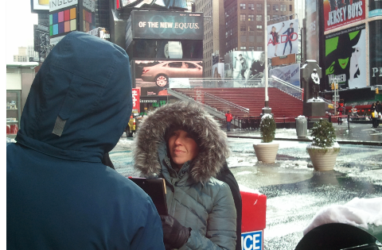
CASE STUDY: Consumer Perceptions of a Clothing Store
Methodology: Hotfoot IDIs
Objective: A national clothing retailer wanted to understand why flagship stores with prime real estate in NYC were underperforming, despite the marketing dollars spent on these locations.
These ultra-rapid IDIs allowed us to…
Understand why store traffic was low in those locations.
Determine what was causing customers to shop elsewhere.
Gauge overall impressions of the brand.
7
Notes:
The key purpose of this research was to determine what is driving consumers to shop at stores in NYC.
We intercepted customers as they walked by storefronts.
Each interview lasted approximately 5 minutes.

Slide 32
Jeff Whiteside| Senior Research Manager
jeff@tlg.com | 919-313-2000
Rachel Williams| Associate Project Manager
rachel@tlg.com | 919-313-2000

