Slide 1
Knowledge Building: Tiers 2 and 3
National Center for Intensive Intervention
November 27, 2018

Slide 2
Contact Information
Sarah Powell, Ph.D
The University of Texas at Austin
srpowell@austin.utexas.edu
@sarahpowellphd
119

Slide 3
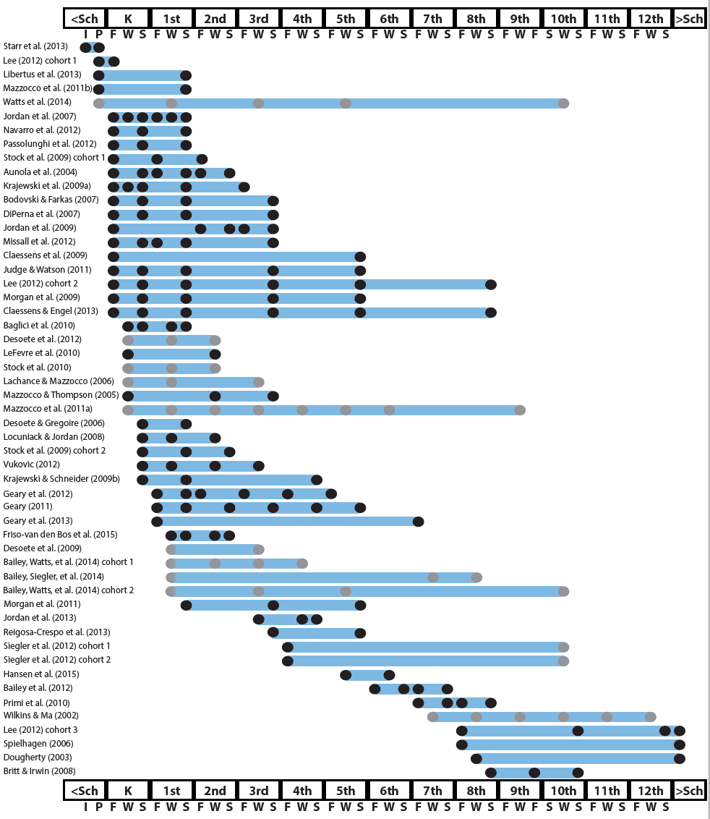
http://www.greatertexasfoundation.org/trajectories-of-mathematics-performance/

Slide 4
Broad math in preK predicted K broad math
Mathematics in preschool predicts later mathematics
http://www.greatertexasfoundation.org/trajectories-of-mathematics-performance/
Broad math in preK predicted grade 10 broad math

Slide 5
Counting in K predicted grade 1 broad math
Mathematics in kindergarten predicts later mathematics
http://www.greatertexasfoundation.org/trajectories-of-mathematics-performance/
Broad math in K predicted grade 8 broad math
K math accurately predicted math performance below 10th percentile in grades 2 and 3 with 84% correct classification

Slide 6
Mathematics in elementary school
predicts later mathematics
Addition influenced arithmetic with increasing importance from grades 1 to 5
http://www.greatertexasfoundation.org/trajectories-of-mathematics-performance/
Grade 1 arithmetic predicted arithmetic at grades 2, 3, and 4
Grade 1 broad math predicted broad math at grades 3, 5, and 10

Slide 7
Mathematics in middle school
predicts later mathematics
Counting and comparison in grades 2 or 4 predicted broad math 1 year later
http://www.greatertexasfoundation.org/trajectories-of-mathematics-performance/
Fractions at 10-12 years old predicted broad math 5 years later
Broad math in grade 7 predicted broad math in grade 8

Slide 8
Broad math in grade 8 predicted completion of 4-year college degree
Mathematics in
high school
predicts later outcomes
http://www.greatertexasfoundation.org/trajectories-of-mathematics-performance/
Students who took algebra in grades 8 took more advanced math courses and enrolled in 4-year colleges more often than students who took algebra in grade 9
Numeracy measured in adolescence impacted hourly earnings 7 to 15 years later

Slide 9
Mathematics in preschool predicts later mathematics
Mathematics in kindergarten predicts later mathematics
http://www.greatertexasfoundation.org/trajectories-of-mathematics-performance/
Mathematics in elementary school
predicts later mathematics
Mathematics in middle school
predicts later mathematics
Mathematics in
high school
predicts later outcomes

Slide 10
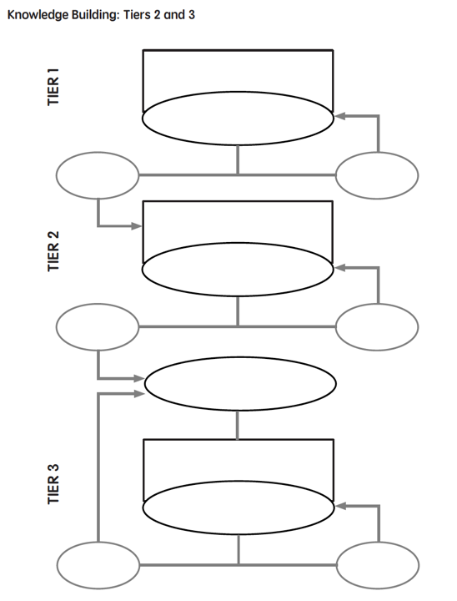

Slide 11
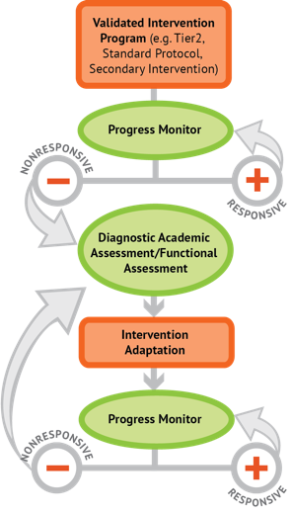
Intervention: Occurs frequently and with intensity
Assessment: Formative
Assessment: Diagnostic
Intervention adaptation: Content, dosage, explicit instruction, attention to transfer
Assessment: Formative

Slide 12
Intervention: Occurs frequently and with intensity
Students tutored in small groups using evidence-based practices
Tutoring occurs 3 to 4 times a week
Sessions last 30 to 60 minutes
Tutoring lasts 10 to 20 weeks

Slide 13
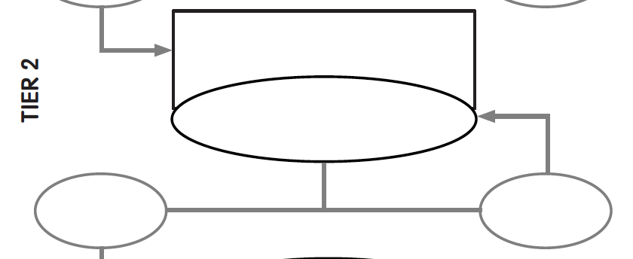
Evidence-based instruction
provided in small groups
Progress monitoring
for 10-20 weeks
Inadequate
response
Adequate
response

Slide 14
Intervention Platform

Slide 15
Let’s start to think about
designing the intervention platform…

Slide 16
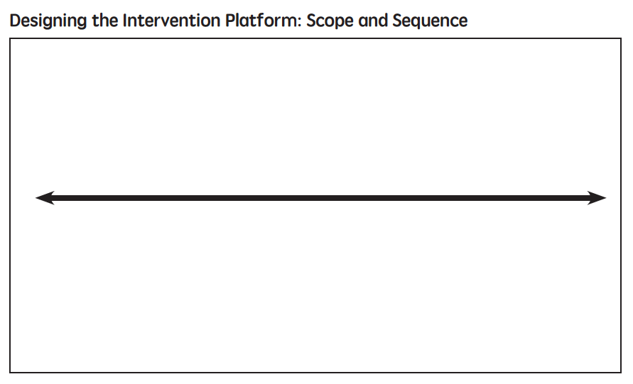

Slide 17
Where student IS
Where student NEEDS TO BE

Slide 18
Fluency

Slide 19
Fluently add and subtract within 5.
continuum of mathematics learning

Slide 20
Fluently add and subtract within 5.
Add and subtract within 20, demonstrating fluency for addition and subtraction within 10.

Slide 21
Fluently add and subtract within 5.
Add and subtract within 20, demonstrating fluency for addition and subtraction within 10.
Fluently add and subtract within 100 using strategies based on place value, properties of operations, and/or relationships.

Slide 22
Fluently add and subtract within 5.
Add and subtract within 20, demonstrating fluency for addition and subtraction within 10.
Fluently add and subtract within 100 using strategies based on place value, properties of operations, and/or relationships.
Fluently multiply and divide within 100, using strategies such as the relationship between multiplication and division…

Slide 23
Fluently add and subtract within 5.
Add and subtract within 20, demonstrating fluency for addition and subtraction within 10.
Fluently add and subtract within 100 using strategies based on place value, properties of operations, and/or relationships.
Fluently multiply and divide within 100, using strategies such as the relationship between multiplication and division…
Fluently add and subtract multi-digit whole numbers using the standard algorithm.

Slide 24
Fluently add and subtract within 5.
Add and subtract within 20, demonstrating fluency for addition and subtraction within 10.
Fluently add and subtract within 100 using strategies based on place value, properties of operations, and/or relationships.
Fluently multiply and divide within 100, using strategies such as the relationship between multiplication and division…
Fluently add and subtract multi-digit whole numbers using the standard algorithm.
Fluently multiply multi-digit whole numbers using the standard algorithm.

Slide 25
Fluently add and subtract within 5.
Add and subtract within 20, demonstrating fluency for addition and subtraction within 10.
Fluently add and subtract within 100 using strategies based on place value, properties of operations, and/or relationships.
Fluently multiply and divide within 100, using strategies such as the relationship between multiplication and division…
Fluently add and subtract multi-digit whole numbers using the standard algorithm.
Fluently multiply multi-digit whole numbers using the standard algorithm.
Fluently add, subtract, multiply, and divide multi-digit decimals using the standard algorithm.

Slide 26
Where student NEEDS TO BE
Fluently add and subtract within 5.
Add and subtract within 20, demonstrating fluency for addition and subtraction within 10.
Fluently add and subtract within 100 using strategies based on place value, properties of operations, and/or relationships.
Fluently multiply and divide within 100, using strategies such as the relationship between multiplication and division…
Fluently add and subtract multi-digit whole numbers using the standard algorithm.
Fluently multiply multi-digit whole numbers using the standard algorithm.
Fluently add, subtract, multiply, and divide multi-digit decimals using the standard algorithm.

Slide 27
Where student IS
Where student NEEDS TO BE
Fluently add and subtract within 5.
Add and subtract within 20, demonstrating fluency for addition and subtraction within 10.
Fluently add and subtract within 100 using strategies based on place value, properties of operations, and/or relationships.
Fluently multiply and divide within 100, using strategies such as the relationship between multiplication and division…
Fluently add and subtract multi-digit whole numbers using the standard algorithm.
Fluently multiply multi-digit whole numbers using the standard algorithm.
Fluently add, subtract, multiply, and divide multi-digit decimals using the standard algorithm.

Slide 28
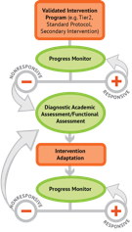
Where student IS
Where student NEEDS TO BE
Fluently add and subtract within 5.
Add and subtract within 20, demonstrating fluency for addition and subtraction within 10.
Fluently add and subtract within 100 using strategies based on place value, properties of operations, and/or relationships.
Fluently multiply and divide within 100, using strategies such as the relationship between multiplication and division…
Fluently add and subtract multi-digit whole numbers using the standard algorithm.
Fluently multiply multi-digit whole numbers using the standard algorithm.
Fluently add, subtract, multiply, and divide multi-digit decimals using the standard algorithm.

Slide 29
Place Value

Slide 30
Compose and decompose numbers from 11 to 19 into ten ones and some further ones…
Recognize that in a multi-digit number, a digit in one place represents 10 times as much as it represents in the place to its right and 1/10 of what it represents in the place to its left.
Use place value understanding to round whole numbers to the nearest 10 or 100.
Recognize that in a multi-digit number, a digit in one place represents ten times what it represents in the place to its right…
Understand that the two digits of a two-digit number represent amounts of tens and ones.
Understand that the three digits of a three-digit number represent amounts of hundreds, tens, and ones.

Slide 31
Compose and decompose numbers from 11 to 19 into ten ones and some further ones…

Slide 32
Compose and decompose numbers from 11 to 19 into ten ones and some further ones…
Understand that the two digits of a two-digit number represent amounts of tens and ones.

Slide 33
Compose and decompose numbers from 11 to 19 into ten ones and some further ones…
Understand that the two digits of a two-digit number represent amounts of tens and ones.
Understand that the three digits of a three-digit number represent amounts of hundreds, tens, and ones.

Slide 34
Compose and decompose numbers from 11 to 19 into ten ones and some further ones…
Understand that the two digits of a two-digit number represent amounts of tens and ones.
Understand that the three digits of a three-digit number represent amounts of hundreds, tens, and ones.
Use place value understanding to round whole numbers to the nearest 10 or 100.

Slide 35
Compose and decompose numbers from 11 to 19 into ten ones and some further ones…
Understand that the two digits of a two-digit number represent amounts of tens and ones.
Understand that the three digits of a three-digit number represent amounts of hundreds, tens, and ones.
Use place value understanding to round whole numbers to the nearest 10 or 100.
Recognize that in a multi-digit number, a digit in one place represents ten times what it represents in the place to its right…

Slide 36
Compose and decompose numbers from 11 to 19 into ten ones and some further ones…
Understand that the two digits of a two-digit number represent amounts of tens and ones.
Understand that the three digits of a three-digit number represent amounts of hundreds, tens, and ones.
Use place value understanding to round whole numbers to the nearest 10 or 100.
Recognize that in a multi-digit number, a digit in one place represents ten times what it represents in the place to its right…
Recognize that in a multi-digit number, a digit in one place represents 10 times as much as it represents in the place to its right and 1/10 of what it represents in the place to its left.

Slide 37
Problem Solving

Slide 38
Solve word problems that call for addition of three whole numbers whose sum is less than or equal to 20…
Solve real-world and mathematical problems involving the four operations with rational numbers.
Use addition and subtraction within 100 to solve one- and two-step word problems…
Interpret and compute quotients of fractions, and solve word problems involving division of fractions by fractions…
Use multiplication and division within 100 to solve word problems…
Solve addition and subtraction word problems, and add and subtract within 10…
Solve real-world and mathematical problems leading to two linear equations in two variables.
Solve multi-step word problems posed with whole numbers and having whole-number answers using the four operations…
Solve word problems involving addition and subtraction of fractions referring to the same whole, including cases of unlike denominators…

Slide 39
Solve addition and subtraction word problems, and add and subtract within 10…
Solve word problems that call for addition of three whole numbers whose sum is less than or equal to 20…
Use addition and subtraction within 100 to solve one- and two-step word problems…
Use multiplication and division within 100 to solve word problems…
Solve multi-step word problems posed with whole numbers and having whole-number answers using the four operations…
Solve word problems involving addition and subtraction of fractions referring to the same whole, including cases of unlike denominators…
Interpret and compute quotients of fractions, and solve word problems involving division of fractions by fractions…
Solve real-world and mathematical problems involving the four operations with rational numbers.
Solve real-world and mathematical problems leading to two linear equations in two variables.

Slide 40
Where student IS
Where student NEEDS TO BE
Solve addition and subtraction word problems, and add and subtract within 10…
Solve word problems that call for addition of three whole numbers whose sum is less than or equal to 20…
Use addition and subtraction within 100 to solve one- and two-step word problems…
Use multiplication and division within 100 to solve word problems…
Solve multi-step word problems posed with whole numbers and having whole-number answers using the four operations…
Solve word problems involving addition and subtraction of fractions referring to the same whole, including cases of unlike denominators…
Interpret and compute quotients of fractions, and solve word problems involving division of fractions by fractions…
Solve real-world and mathematical problems involving the four operations with rational numbers.
Solve real-world and mathematical problems leading to two linear equations in two variables.

Slide 41
Where student IS
Where student NEEDS TO BE
Use addition and subtraction within 100 to solve one- and two-step word problems…
Use multiplication and division within 100 to solve word problems…
Solve multi-step word problems posed with whole numbers and having whole-number answers using the four operations…

Slide 42
Where student IS
Where student NEEDS TO BE
Explain why addition and subtraction strategies work, using place value and the properties of operations.
Understand that the two digits of a two-digit number represent amounts of tens and ones.
Use addition and subtraction within 100 to solve one- and two-step word problems…
Fluently add and subtract within 100 using strategies based on place value, properties of operations, and/or relationships.
Apply properties of operations as strategies to multiply and divide….
Fluently multiply and divide within 100, using strategies such as the relationship between multiplication and division…
Use multiplication and division within 100 to solve word problems…
Fluently add and subtract multi-digit whole numbers using the standard algorithm.
Find whole number quotients and remainders with up to four-digit dividends and one-digit divisors, using strategies based on place value, the properties of operations, and/or the relationship between multiplication and division.
Solve multi-step word problems posed with whole numbers and having whole-number answers using the four operations…
Understand that the three digits of a three-digit number represent amounts of hundreds, tens, and ones.
Fluently multiply multi-digit whole numbers using the standard algorithm.

Slide 43
About those evidence-based practices…

Slide 44
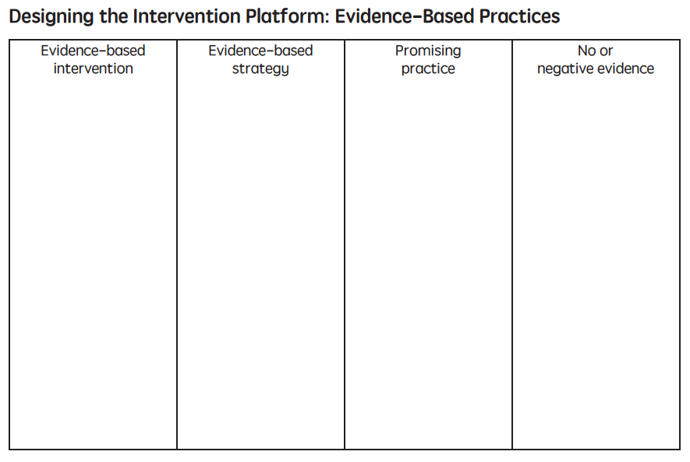

Slide 45
A practice that has shown consistent and positive results
evidence-based practice

Slide 46
evidence-based practice
An intervention (i.e., packaged program) that has shown consistent and positive results
evidence-based intervention

Slide 47
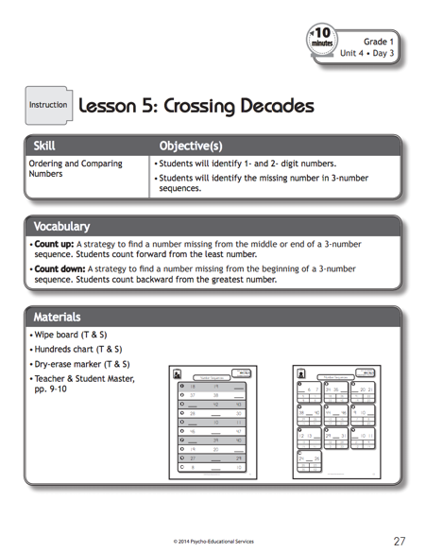
evidence-based practice
evidence-based intervention
Bryant, Bryant, Roberts, Vaughn, Hughes, Porterfield, & Gersten (2011)

Slide 48
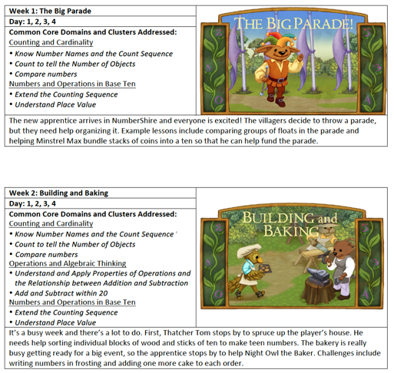
evidence-based practice
evidence-based intervention
https://dibels.uoregon.edu/market/numbershire

Slide 49
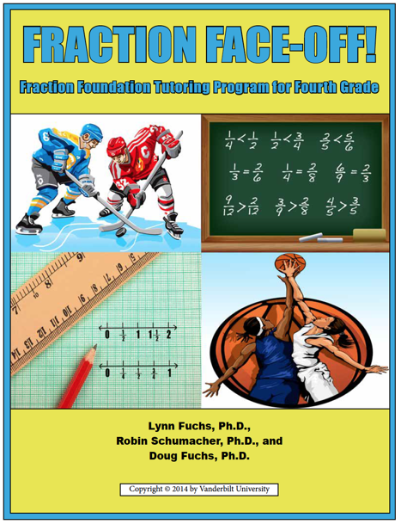
evidence-based practice
evidence-based intervention
Fuchs, Schumacher, & Fuchs (2014)

Slide 50
evidence-based practice
evidence-based intervention
evidence-based strategy
A method or strategy that has shown consistent and positive results

Slide 51
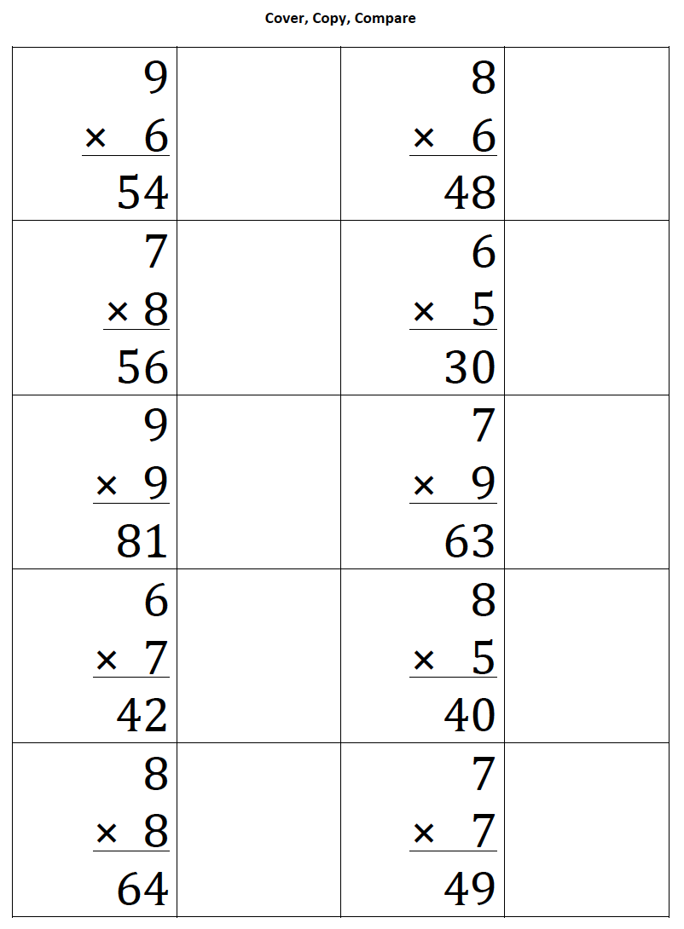
evidence-based practice
evidence-based strategy
ebi.missouri.edu/wp-content/uploads/2013/09/EBI-Brief-Template-Cover-Copy-and-Compare.pdf

Slide 52
evidence-based practice
evidence-based strategy
Strickland & Maccini (2012)

Slide 53
evidence-based practice
5
+ 6
2
+ 2
evidence-based strategy
Burns (2005)
7
+ 4
2
+ 6

Slide 54
evidence-based practice
evidence-based intervention
evidence-based strategy
A method or strategy that has shown a positive result
promising practice

Slide 55
evidence-based practice
evidence-based intervention
evidence-based strategy
promising practice
no or negative evidence

Slide 56
evidence-based practice
evidence-based intervention
evidence-based strategy
promising practice

Slide 57
Assessment data to show results
evidence-based practice
Improvement from before intervention
Improvement compared to no treatment students
Replication
evidence-based intervention
Multiple researchers
evidence-based strategy
Multiple students
Multiple times
promising practice
Setting and students similar to your own

Slide 58
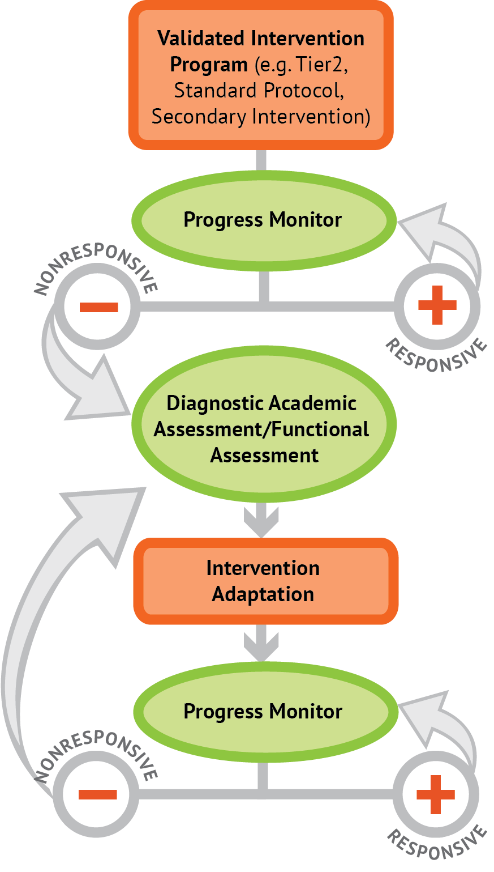
Intervention Platform
1. evidence-based intervention
2. evidence-based strategy

Slide 59
Intervention Platform
INSTRUCTIONAL DELIVERY
Explicit instruction
Concise language
Multiple representations
INSTRUCTIONAL STRATEGIES
Fluency building
Problem solving instruction
Motivation component

Slide 61
Modeling
Practice
Clear Explanation
Guided
Practice
Planned
Examples
Independent Practice
Supporting Practices
Asking the right questions
Eliciting frequent responses
Providing immediate specific feedback
Maintaining a brisk pace

Slide 62
Goal and importance
Modeling
Clear Explanation
“Today, we are learning about division. This is important because sometimes you have to share objects or things with your friends.”
Planned
Examples
“Let’s continue working with our three-dimensional shapes and volume. Understanding volume and calculating volume helps with measuring capacity.”

Slide 63
Goal and importance
Modeling
Clear Explanation
Model steps
Planned
Examples
“To solve 26 plus 79, I first decide about the operation. Do I add, subtract, multiply or divide?”
“The plus sign tells me to add. So, I’ll add 26 plus 79. I’ll use the partial sums strategy. First, I add 20 plus 70. What’s 20 plus 70?”
“20 plus 70 is 90. I write 90 right here.”
“Then I add 6 plus 9. What’s 6 plus 9?”
“6 plus 9 is 15. So, I write 15 here.”
“Finally, we add the partial sums. What do we add?”
”So, we add the partial sums of 90 and 15. 90 plus 15 is 105. So, 26 plus 79 equals 105.”

Slide 64
Goal and importance
Modeling
Clear Explanation
Model steps
Planned
Examples
Concise language
“To solve 26 plus 79, I first decide about the operation. Do I add, subtract, multiply, or divide?”
“The plus sign tells me to add. So, I’ll add 26 plus 79. I’ll use the partial sums strategy. First, I add 20 plus 70. What’s 20 plus 70?”
“20 plus 70 is 90. I write 90 right here.”
“Then I add 6 plus 9. What’s 6 plus 9?”
“6 plus 9 is 15. So, I write 15 here.”
“Finally, we add the partial sums. Why do we add the partial sums?”

Slide 65
Goal and importance
Modeling
Clear Explanation
Model steps
Planned
Examples
Concise language
Examples
“Today, we are learning about division. This is important because sometimes you have to share objects or things with your friends.”
24 / 6
28 $÷$ 7
35 $)$ 5

Slide 66
Goal and importance
Modeling
Clear Explanation
Model steps
Planned
Examples
Concise language
Examples
With non-examples
32 $÷$ 8
42 $÷$ 7
25 $−$ 5

Slide 67
Modeling
Practice
Clear Explanation
Guided
Practice
Planned
Examples
Independent Practice
Supporting Practices
Asking the right questions
Eliciting frequent responses
Providing immediate specific feedback
Maintaining a brisk pace

Slide 68
Practice
Teacher and student practice together
Guided
Practice
Independent Practice

Slide 69
Practice
Teacher and student practice together
Guided
Practice
Independent Practice
Student practices with teacher support

Slide 70
Modeling
Practice
Clear Explanation
Guided
Practice
Planned
Examples
Independent Practice
Supporting Practices
Asking the right questions
Eliciting frequent responses
Providing immediate specific feedback
Maintaining a brisk pace

Slide 71
Low-level and high-level
“What is 7 times 9?”
“Which shape has 6 sides?”
“What do you do when you see a word problem?”
Supporting Practices
“Why do you have to regroup?”
Asking the right questions
Eliciting frequent responses
Providing immediate specific feedback
Maintaining a brisk pace
“How would you solve this problem?”
“Why do you have to use zero pairs?”

Slide 72
Low-level and high-level
Classwide, individual, partner, write on paper, write on whiteboard, thumbs up, etc.
Supporting Practices
Asking the right questions
Eliciting frequent responses
Providing immediate specific feedback
Maintaining a brisk pace
“Turn and discuss the formula for perimeter with your partner.”
“Write the multiplication problem on your whiteboard.”
“In your math journal, draw a picture to help you remember to term parallelogram.”

Slide 73
Low-level and high-level
Classwide, individual, partner, write on paper, write on whiteboard, thumbs up, etc.
Supporting Practices
Asking the right questions
Eliciting frequent responses
Providing immediate specific feedback
Maintaining a brisk pace
Affirmative and corrective
“Good work using your word-problem attack strategy.”
“Let’s look at that again. Tell me how you added in the hundreds column.”

Slide 74
Low-level and high-level
Classwide, individual, partner, write on paper, write on whiteboard, thumbs up, etc.
Supporting Practices
Asking the right questions
Eliciting frequent responses
Providing immediate specific feedback
Maintaining a brisk pace
Affirmative and corrective
Planned and organized

Slide 75
Modeling
Practice
Supporting Practices
Introduction of material
Review of material
Modeling
Practice
Modeling
Practice
Supporting Practices
Supporting Practices

Slide 76
How do you use explicit instruction within intensive intervention?
Model steps using concise language
Provide guided practice opportunities
Provide independent practice opportunities
Use supporting practices during modeling and practice
Ask the right questions
Elicit frequent responses
Provide feedback
Be planned and organized

Slide 78
degree

Slide 79
Vocabulary Across Grades

Slide 80
Language of Mathematics
Technical terms
Subtechnical terms
Symbolic terms
General terms
trapezoid
rhombus
numerator
addend
subtract
base
degrees
cube
plane
arc
plus
zero
twelve
dollars
and
above
measure
answer
longest
outside

Slide 81
Use formal math language
Use terms precisely

Slide 82
Instead of…
Say…
“And the last one is 10.”
“8, 9, 10. We’ll stop counting there but we could count more.”
“What number is in the tens place?”
“What digit is in the tens place?”
“Six hundred and forty-eight”
“Six hundred forty-eight”
“Bigger number and smaller number”
“Number that is greater and the number that is less”
Hughes et al. (2016)

Slide 83
Instead of…
Say…
“Numbers in the fraction”
“This fraction is one number.”
“Top number and bottom number”
“Numerator and denominator”
“Reduce”
“Find an equivalent fraction”
“One point two nine”
“One and twenty-nine hundredths”
Hughes et al. (2016)

Slide 84
Instead of…
Say…
“Corner”
“Angle”
“Flips, slides, and turns”
“Reflections, translations, and rotations”
“Box or ball”
“Cube or sphere”
“Long hand and short hand”
“Minute hand and hour hand”
Hughes et al. (2016)

Slide 85
How do you attend to language within intensive intervention?
Understand why formal mathematical language is important
Plan for mathematical language to be precise
Plan for mathematical language to be concise

Slide 86
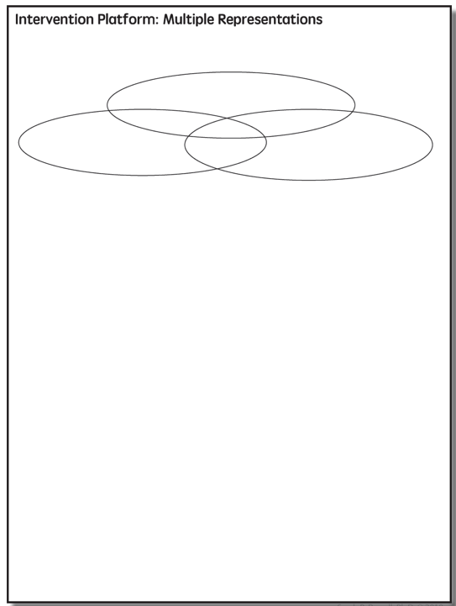

Slide 87
Multiple Representations
Abstract
Pictorial
Concrete

Slide 88
Abstract
Pictorial
Concrete
Three-dimensional objects

Slide 89
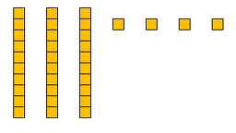
Abstract
Pictorial
Concrete
Two-dimensional images

Slide 90
Numerals, symbols, and words
Abstract
Pictorial
Concrete
34 = 3 tens and 4 ones
2 + 8 = 10
x – 6 = 8
4,179
+ 569

Slide 91
How should multiple representations be used within intensive intervention?
Use three-dimensional concrete materials to teach concepts and procedures
Use two-dimensional representations to teach concepts and procedures
Ensure students understand mathematics with numbers and symbols (i.e., the abstract)

Slide 92
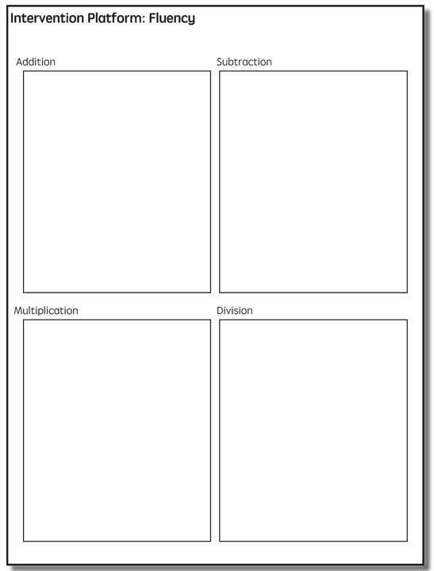

Slide 93
Fluency
Addition
Subtraction
Multiplication
Division

Slide 94
Addition
100 addition basic facts
Single-digit addends sum to a single- or double-digit number
5 (addend)
+ 4 (addend)
9 (sum)

Slide 95
Addition: Part-Part-Whole (Total)
Count one set, count another set, put sets together, count sum
2 + 3 = 5

Slide 96
Addition: Join (Change Increase)
Start with a set, add the other set, count sum
2 + 3 = 5

Slide 97
Subtraction
100 subtraction basic facts
Subtrahend and difference are single-digit numbers and minuend is single- or double-digit number
16 (minuend)
– 8 (subtrahend)
8 (difference)

Slide 98
Subtraction: Separate (Change Decrease)
Start with a set, take away from that set, count difference
5 – 3 = 2

Slide 99
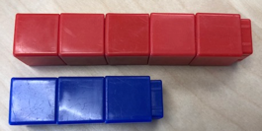
Subtraction: Compare (Difference)
Compare two sets, count difference
5 – 3 = 2

Slide 100
Multiplication
100 multiplication basic facts
Multiplication of single-digit factors results in a single- or double-digit product
2 (factor)
× 3 (factor)
6 (product)

Slide 101
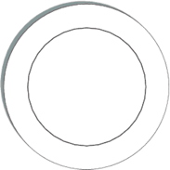
Multiplication: Equal Groups
Show the groups, show the amount for each group, count product
3 × 2 = 6

Slide 102
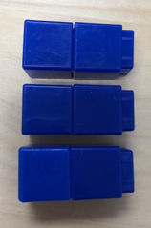
Multiplication: Array/Area
Make the array, count product
3 × 2 = 6

Slide 103
Multiplication: Comparison
Show a set, then multiply the set
3 × 2 = 6

Slide 104
Division
90 division basic facts
Divisor and quotient are single-digit numbers and dividend is single- or double-digit number
8 ÷ 4 = 2
(dividend) (divisor) (quotient)

Slide 105
Division: Equal Groups (Partitive Division)
Show the dividend, divide equally among divisor, count quotient
6 ÷ 3 = 2

Slide 106
Division: Equal Groups (Measurement Division)
Show the dividend, make groups of the divisor, count groups
6 ÷ 3 = 2

Slide 107
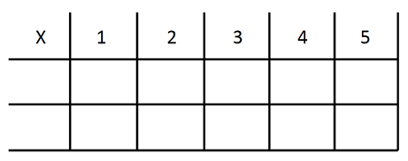
-3 + (-4) = ___ 5 – (-6) = ___

Slide 108
How to build fact fluency within intensive intervention?
Teach the concepts of the operations
Teach strategies to understand how facts fit together
Practice building fluency with a variety of activities and games

Slide 110
Problem Solving Difficulties
Reading problems
Understanding vocabulary
Identifying relevant information
Ignoring irrelevant information
Interpreting charts and graphs
Identifying appropriate operation(s)
Performing the computation(s)

Slide 111
Don’t tie key words to operations
Do have an attack strategy
Do teach word-problem schemas

Slide 112
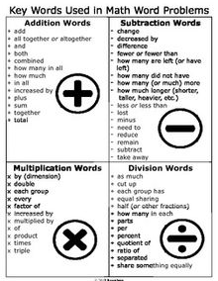
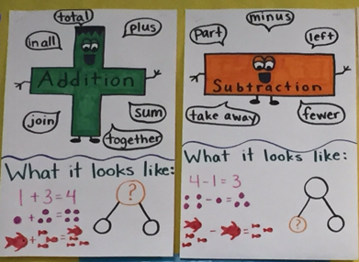

Slide 113
SOLVE
Study the problem.
Organize the facts.
Line up the plan.
Verify the plan with computation.
Examine the answer.
SIGNS
Survey questions
Identify key words
Graphically draw problem
Note operations
Solve and check

Slide 114
Schemas
Total
When teaching about word problems, students should learn the schema of the word problem.
Difference
Change
Equal Groups
Comparison
Ratios/Proportions

Slide 115
How do you incorporate effective problem-solving strategies within intensive intervention?
Don’t use key words tied to operations
Do teach students an attack strategy
Do teach students schemas
Do explicitly teach problem solving
Do provide problem-solving instruction regularly (i.e., several times a week)
Do practice schemas that students will encounter regularly

Slide 116
Motivation Component
on task
keep attention
regulate behavior

Slide 117
How do you incorporate a motivational component within intensive intervention?
Utilize a motivational component, when necessary

Slide 118
Instructional Platform
INSTRUCTIONAL DELIVERY
Explicit instruction
Concise language
Multiple representations
INSTRUCTIONAL STRATEGIES
Fluency building
Problem solving instruction
Motivation component

Slide 120
Intervention: Occurs frequently and with intensity
Assessment: Formative
Assessment: Diagnostic
Intervention adaptation: Content, dosage, explicit instruction, attention to transfer
Assessment: Formative

Slide 121
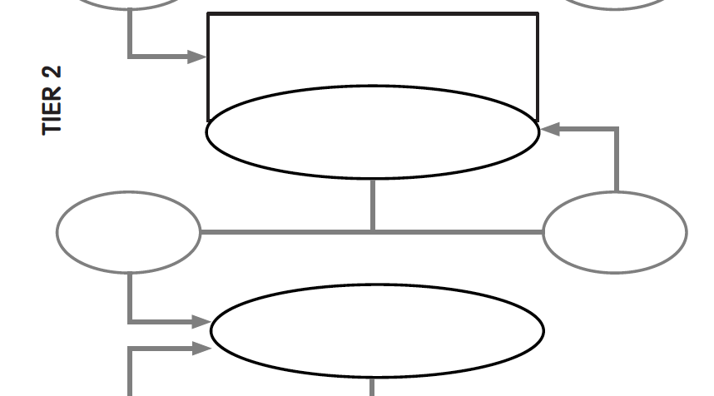
Evidence-based instruction provided in small groups
Progress monitoring for 10-20 weeks
inadequate
response
adequate
response
Diagnostic assessment

Slide 122
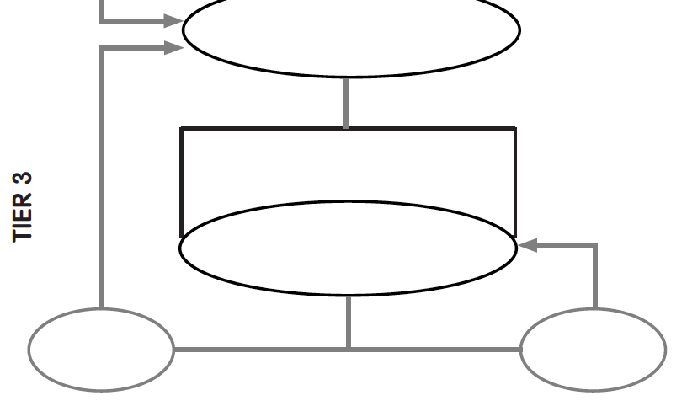
Diagnostic assessment
Evidence-based instruction provided individually or in small groups
Progress monitoring for 10-20 weeks
inadequate
response
adequate
response

Slide 123
Instructional Platform
Adaptations

Slide 124
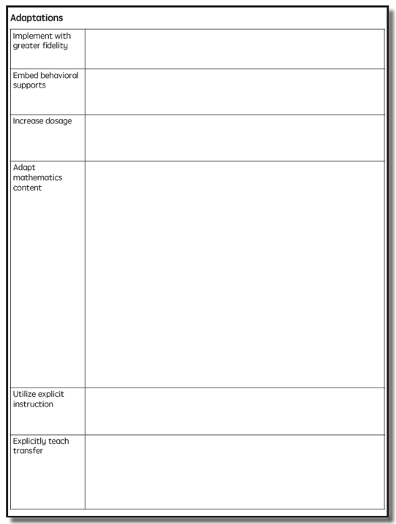

Slide 125
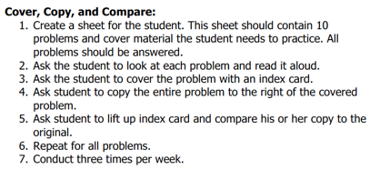
Implement with greater fidelity
Ensure that you are implementing the intervention or strategy with fidelity

Slide 126
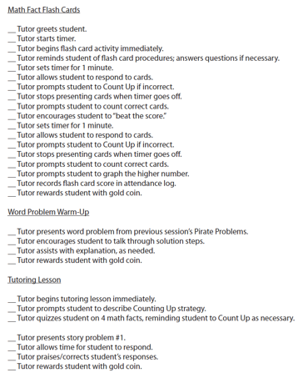
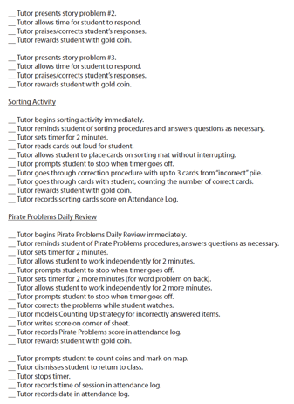
Implement with greater fidelity
Ensure that you are implementing the intervention or strategy with fidelity
Fuchs et al. (2008)

Slide 127
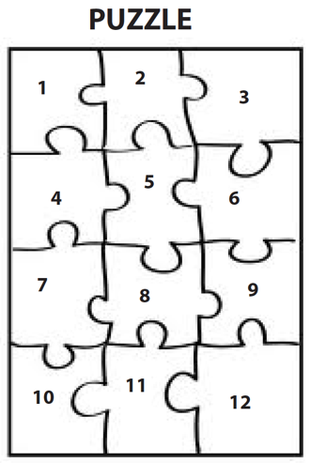
Implement with greater fidelity
Embed behavioral supports
May want to incorporate strategies to improve self-regulation and minimize nonproductive behavior
Powell, Driver, & Julian (2015)

Slide 128
Implement with greater fidelity
Embed behavioral supports
May want to incorporate strategies to improve self-regulation and minimize nonproductive behavior
UPSCheck
Understand
Plan
Solve
Check

Slide 129
Implement with greater fidelity
Embed behavioral supports
Increase dosage
Conduct longer sessions, more sessions per week, or more weeks within DBI

Slide 130
Implement with greater fidelity
Embed behavioral supports
Increase dosage
Conduct longer sessions, more sessions per week, or more weeks within DBI

Slide 131
Implement with greater fidelity
Embed behavioral supports
Increase dosage
Conduct longer sessions, more sessions per week, or more weeks within DBI
Number of weeks left in intervention

Slide 132
Implement with greater fidelity
Embed behavioral supports
Increase dosage
Adapt mathematics content

Slide 133
Implement with greater fidelity
Embed behavioral supports
Increase dosage
Adapt mathematics content
Alter the scope and sequence
Where student IS
Where student NEEDS TO BE
Explain why addition and subtraction strategies work, using place value and the properties of operations.
Use addition and subtraction within 100 to solve one- and two-step word problems…
Fluently add and subtract within 100 using strategies based on place value, properties of operations, and/or relationships.
Apply properties of operations as strategies to multiply and divide….
Fluently multiply and divide within 100, using strategies such as the relationship between multiplication and division…
Fluently add and subtract multi-digit whole numbers using the standard algorithm.
Find whole number quotients and remainders with up to four-digit dividends and one-digit divisors, using strategies based on place value, …
Solve multi-step word problems posed with whole numbers and having whole-number answers using the four operations…
Understand that the two digits of a two-digit number represent amounts of tens and ones.
Use multiplication and division within 100 to solve word problems…
Understand that the three digits of a three-digit number represent amounts of hundreds, tens, and ones.
Fluently multiply multi-digit whole numbers using the standard algorithm.

Slide 134
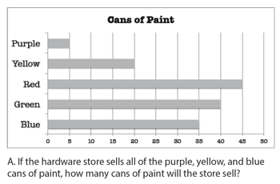
Implement with greater fidelity
Embed behavioral supports
Increase dosage
Solve
Adapt mathematics content
Write equation
Break down problems into smaller steps
Draw picture
Identify schema
Label graph
Underline labels
Read the problem

Slide 135
Implement with greater fidelity
Embed behavioral supports
Increase dosage
Adapt mathematics content
precise
Focus on the language of mathematics
concise

Slide 136
Implement with greater fidelity
Embed behavioral supports
Increase dosage
MATH JOURNAL
Adapt mathematics content
Focus on the language of mathematics
Define: | Characteristics:
Example: | Non-example:

Slide 137
Implement with greater fidelity
Embed behavioral supports
“Tell me how you solved this problem.”
Increase dosage
Adapt mathematics content
“What were you thinking about when you regrouped?”
Engage student in more discourse
“How would you teach this problem to another student?”
“Describe the word problem in 10 words or less.”

Slide 138
Implement with greater fidelity
Embed behavioral supports
Increase dosage
Adapt mathematics content
“Talk through this problem with me.”
Provide worked examples
405
+ 16
405
+ 16
411
421

Slide 139
Implement with greater fidelity
Abstract
Pictorial
Concrete
Embed behavioral supports
Increase dosage
Adapt mathematics content
Utilize more three-dimensional representations

Slide 140
Implement with greater fidelity
Abstract
Pictorial
Concrete
Embed behavioral supports
Increase dosage
Adapt mathematics content
Utilize more two-dimensional representations

Slide 141
Implement with greater fidelity
Abstract
Pictorial
Concrete
Embed behavioral supports
Increase dosage
Adapt mathematics content
Ensure students understand the abstract
34 = 3 tens and 4 ones
2 + 8 = 10
4,179
+ 569
x – 6 = 8

Slide 142
Implement with greater fidelity
Embed behavioral supports
Increase dosage
Adapt mathematics content
Focus on fact fluency
Addition
Subtraction
Multiplication
Division

Slide 143
Implement with greater fidelity
Embed behavioral supports
Increase dosage
Adapt mathematics content
-3 + (-4) = ___ 5 – (-6) = ___

Slide 144
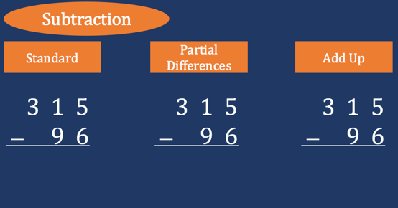
Implement with greater fidelity
Embed behavioral supports
Increase dosage
Adapt mathematics content
Teach alternate algorithms

Slide 145
Implement with greater fidelity
Embed behavioral supports
Increase dosage
Adapt mathematics content
405
+ 16
405
+ 16
Encourage alternate methods and solutions
400
10
11
421
421
+

Slide 146
Implement with greater fidelity
Embed behavioral supports
Don’t tie key words to operations
Teach word-problem schemas
Have an attack strategy
Increase dosage
Adapt mathematics content
Explicitly teach problem solving

Slide 147
Implement with greater fidelity
Additive
Embed behavioral supports
Total
Increase dosage
Adapt mathematics content
Difference
Explicitly teach problem solving
Change
Multiplicative
Equal Groups
Comparison
Ratios/
Proportions

Slide 148
Implement with greater fidelity
Embed behavioral supports
Increase dosage
Adapt mathematics content
Modeling
Practice
Utilize explicit instruction
Clear Explanation
Guided
Practice
Make sure you’re doing it! And do it well!
Planned
Examples
Independent Practice
Supporting Practices
Asking the right questions
Eliciting frequent responses
Providing immediate specific feedback
Maintaining a brisk pace

Slide 149
Implement with greater fidelity
Embed behavioral supports
405
+ 16
4305
+ 216
Increase dosage
Adapt mathematics content
Utilize explicit instruction
Explicitly teach transfer
Marney baked 89 cookies and sold 40 cookies at the bake sale. How many cookies does Marney have left?
Explicitly teach how current learning relates to other learning
Marney had $89 and spent $40 on shoes. How many much does Marney have left?
Marney had $89 and spent $40 on shoes. How much money will Marney have after buying the shoes?

Slide 150
Implement with greater fidelity
Embed behavioral supports
Increase dosage
Adapt mathematics content
Utilize explicit instruction
Explicitly teach transfer

Slide 151
Implement with greater fidelity
Embed behavioral supports
Increase dosage
Adapt mathematics content
Utilize explicit instruction
Explicitly teach transfer

Slide 152
Intervention: Occurs frequently and with intensity
Assessment: Formative
Assessment: Diagnostic
Intervention adaptation: Content, dosage, explicit instruction, attention to transfer
Assessment: Formative

Slide 153
Contact Information
Sarah Powell, Ph.D.
The University of Texas at Austin
srpowell@austin.utexas.edu
@sarahpowellphd
119

