Slide 1

EPIC Immunization
2023 Update
Children, Adolescents, & Adults
®
November 2023
Notes:
Educating Physicians In their Communities is:
A peer-to-peer immunization education program presented in the practice setting for practitioners and staff or in a classroom for students.
Presented by a team of 2 professionals: physician or other primary care provider (nurse practitioner, physician's assistant) and a nurse or office manager.
Our Beginnings…
The first EPIC Immunization Education program was developed and implemented in Pennsylvania (a joint venture between public health and the PA chapter of the American Academy of Pediatrics). The program has been replicated in several states - Georgia most closely resembling the Pennsylvania program. Georgia was first to add adult vaccines to the program. In 2009 the Georgia Chapter created a separate Women’s Health Immunization Education program for obstetricians and gynecologists. Presentations are also available for students in healthcare training. Presentation on Coding are available to members of the Georgia Chapter of AAP.
EPIC programs are designed to meet Standard #10 of the Standards for Child and Adolescent Immunization Practices:
"Persons who administer vaccines and staff who manage or support vaccine administration are knowledgeable and receive on-going education"
And
Standard #8 of the Standards for Adult Immunization Practices: “Persons who administer vaccines are properly trained."

Slide 2
EPIC is presented by:
®
Georgia Chapter - American Academy of Pediatrics
Ga. Dept. of Public Health/Immunization Program
In Cooperation with:
Georgia Academy of Family Physicians
Georgia Chapter - American College of Physicians
Georgia OB/Gyn Society
EPIC® (Educating Physicians & Practices In their Communities) is a registered trademark of the Georgia Chapter of the American Academy of Pediatrics. All rights reserved.
Notes:
The EPIC immunization education program is developed and updated annually, and more frequently when necessary, by the Georgia Chapter of the American Academy of Pediatrics in partnership with the Georgia Immunization Program and in cooperation with the Georgia Academy of Family Physicians, the Georgia Chapter of the American College of Physicians/American Society of Internal Medicine, and the Georgia OB/GYN Society.
EPIC education programs utilize information from the Centers for Disease Control and Prevention, ACIP Recommendations, The Immunization Action Coalition and other reliable resources. When there is more than one vaccine manufacturer for a specific type of vaccine the presenter utilizes the generic name (i.e. Tdap, hepatitis b etc.)

Slide 3
Faculty Disclosure Information
In accordance with ACCME* and ANCC-COA* Standards, all faculty members are required to disclose to the program audience any real or apparent conflict of interest to the content of their presentation.
This presentation will include the most current ACIP recommendations for frequently used vaccines but is not a comprehensive review of all available vaccines.
Some ACIP recommendations for the use of vaccines have not currently been approved by the FDA.
Detailed information regarding all ACIP Recommendations is available at www.cdc.gov/vaccines/acip/recs/index.html
*Accreditation Council for Continuing Medical Education *American Nurses Credentialing Center Commission on Accreditation
Notes:
Presenters for the EPIC program do not discuss vaccines that are not licensed by the FDA or any pending vaccines that are still undergoing clinical trials. Sometimes an ACIP recommendation may not be listed as an indication for a specific vaccine or a specific age group on the manufacturers package insert. Therefore, the recommendation is considered “off label” use of the vaccine. The presenters will discuss the most recent ACIP recommendations during this presentation. All new ACIP Recommendations discussed have been published in MMWR.

Slide 4
Objectives
At the end of this presentation, you will be able to:
Recall the role vaccines have played in preventing diseases
Discuss the importance of vaccines for children, adolescents, and adults
Summarize the most recent CDC recommendations for storage and handling of vaccines
List at least 2 reliable sources for immunization information
Primary Sources of Information for this Presentation:
  ACIP Vaccine Recommendations: https://www.cdc.gov/vaccines/hcp/acip-recs/
  The ’Pink Book: https://www.cdc.gov/vaccines/pubs/pinkbook/index.html
  CDC Immunization Schedules: https://www.cdc.gov/vaccines/schedules/
Notes:
Speaker Notes:
These are the objectives for this EPIC presentation.
Additional Resources:
ACIP Vaccine Recommendations: https://www.cdc.gov/vaccines/hcp/acip-recs/
The ’Pink Book: https://www.cdc.gov/vaccines/pubs/pinkbook/index.html
CDC Immunization Schedules: https://www.cdc.gov/vaccines/schedules/

Slide 5
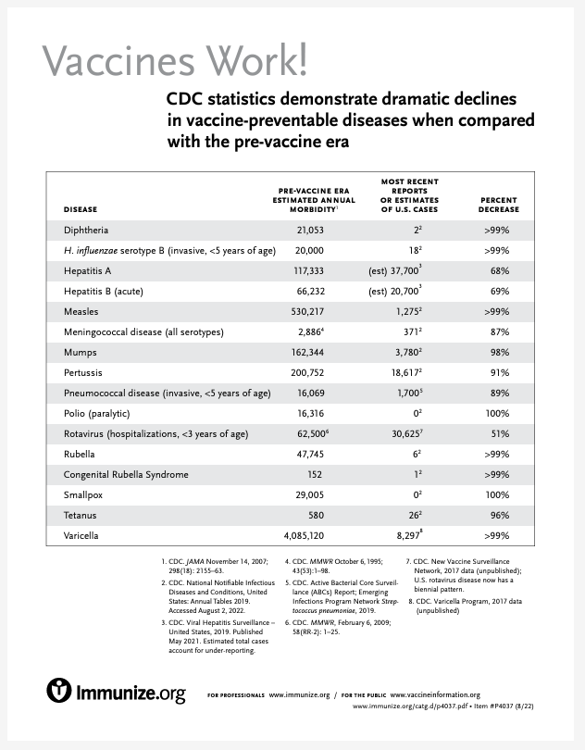
https://www.immunize.org/catg.d/p4037.pdf
Notes:
Reference: https://www.immunize.org/catg.d/p4037.pdf
Speaker Notes:
Read off a few lines of table
Additional Resource:

Slide 6


Advisory Committee on Immunization Practices (ACIP)
15 voting members with expertise in one or more of the following:
Vaccinology
Immunology
Infectious diseases ; Virology
Pediatrics
Internal Medicine; Family medicine
Nursing
Preventive medicine
Public health
Consumer perspectives and/or social and community aspects of immunization programs
ACIP develops recommendations and schedules for the use of
licensed vaccines
Notes:
Reference: https://www.cdc.gov/vaccines/acip/index.html
Speaker Notes: The dramatic reduction of vaccine preventable diseases in the United States can be attributed to the availability of vaccines, as well as recommendations and an organized vaccine schedule developed by the Advisory Committee on Immunization Practices (ACIP).
The overall goals of the ACIP are to provide advice which will assist the Department and the Nation in reducing the incidence of vaccine preventable diseases and to increase the safe usage of vaccines and related biological products.
Additional Information:
For more information: http://www.cdc.gov/vaccines/acip/index.html
For more details about all the vaccine preventable diseases reviewed in this presentation, refer to: Epidemiology and Prevention of Vaccine-Preventable Diseases (The Pink Book). HHS, CDC. https://www.cdc.gov/vaccines/pubs/pinkbook/index.html

Slide 7
Community Immunity
Formerly known as “Herd Immunity”*
Transmitting case
Immune
Immune
Immune
Immune
Immune
Susceptible
(Indirectly
Protected)
Immune
Susceptible
(Indirectly
Protected)
*Presentation from Immunize Georgia, September 9, 2016 by Walt A. Orenstein, MD, Professor of Medicine Global, Health, Epidemiology and Pediatrics
Emory Department of Medicine, Associate Director, Emory Vaccine Center Director, Vaccine Policy and Development, Emory University, Atlanta, GA
Notes:
Reference: See Slide
and Development,
Speaker Notes:
It is probably unrealistic to believe we can immunize everyone appropriately. There will always be young infants who have not received all recommended vaccines because of age and there are a significant number of adults who are not adequately immunized. Herd immunity was the term used previously that refers to a situation in which a high percentage of a population is immune to a disease, essentially stopping the disease in its tracks because it cannot find new hosts.
The preferred term now is Community Immunity.
The threshold for community immunity varies, depending on the disease, with more virulent infectious agents requiring vaccination of a higher percentage of the population to create the desired community immunity. Most vaccination policies are focused on creating community immunity. The creation of community immunity is especially important in crowded environments which facilitate the spread of disease, like schools. It is also extremely important to receive regular boosters, as some vaccines lose their efficacy over time, leaving people vulnerable to an outbreak. Herd immunity led to the eradication of smallpox, and it explains why diseases such as polio and diphtheria are rare in developed nations with established vaccination policies
Additional information: For more information: http://www.cdc.gov/vaccines/acip/index.html
For more details about all the vaccine preventable diseases reviewed in this presentation, refer to: Epidemiology and Prevention of Vaccine-Preventable Diseases (The Pink Book). HHS, CDC. https://www.cdc.gov/vaccines/pubs/pinkbook/index.html

Slide 8
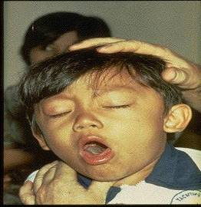
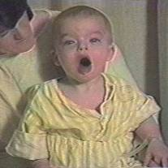

Diphtheria
©AAP
Tetanus
Pertussis
Notes:
We will begin with Diphtheria, Tetanus and Pertussis (Whooping Cough) are all toxin mediated diseases. This means that the toxin or toxins produced by the bacteria are responsible for the symptoms of the disease.
DIPHTHERIA
Slide shows a child with diphtherial membrane in nasopharynx
Diphtheria is caused by a bacteria (Corynebacterium diphtheriae) that produces a toxin.
The bacterial growth and toxin cause local tissue destruction & membrane formation in nasopharynx & larynx & possible obstruction of respiratory tract.
Most common complications are myocarditis & neuritis (motor nerves).
TETANUS
Slide shows a child with muscle rigidity from tetanus.
Tetanus spores that are found everywhere in soil usually enter body through contaminated puncture wounds, lacerations or abrasions. Spores germinate and bacteria (Clostridium tetani) begin to multiply and produce an exotoxin. Toxin affects the neuromuscular junction and produces generalized rigidity and convulsive spasms of skeletal muscles, starting with the jaw and muscles of swallowing (lockjaw).
PERTUSSIS
Slide shows two children with pertussis (whooping cough) with paroxysmal coughing. (Sound is the typical pertussis cough and whoop. Pertussis, caused by a bacterium (Bordetella pertussis), produces multiple antigens and biologically active components that cause inflammation of the respiratory tract, paralysis of the cilia of the respiratory tract and lung damage resulting in pooling of secretions and characteristic cough lasting up to 12 weeks. Humans are the only reservoir. Transmission is by direct contact with respiratory droplets.
Additional information: For more information: http://www.cdc.gov/vaccines/acip/index.html
For more details about all the vaccine preventable diseases reviewed in this presentation, refer to: Epidemiology and Prevention of Vaccine-Preventable Diseases (The Pink Book). HHS, CDC. https://www.cdc.gov/vaccines/pubs/pinkbook/index.html

Slide 9
Diphtheria, Tetanus and Pertussis Vaccines for Children
ACIP Recommendations
DTaP vaccine
  Recommended for children ages 6 weeks through 6 years
  Administered as a 3-dose primary series at ages 2, 4, and 6 months
  Booster doses at 15-18 months and 4-6 years
  NOT recommended for children 7 years and older
Notes:
Reference:
2023 Immunization Schedule: https://www.cdc.gov/vaccines/schedules/hcp/imz/child-adolescent.html#note-dtap
Speaker Notes:
5-dose series at age 2, 4, 6, 15–18 months, 4–6 years
Prospectively: Dose 4 may be administered as early as age 12 months if at least 6 months have elapsed since dose 3.
Retrospectively: A 4th dose that was inadvertently administered as early as age 12 months may be counted if at least 4 months have elapsed since dose 3.
Dose 5 is not necessary if dose 4 was administered at age 4 years or older and at least 6 months after dose 3.
For other catch-up guidance, see Table 2.
Wound management in children less than age 7 years with history of 3 or more doses of tetanus-toxoid-containing vaccine: For all wounds except clean and minor wounds, administer DTaP if more than 5 years since last dose of tetanus-toxoid-containing vaccine.
Additional resources:. Additional information: For more information: http://www.cdc.gov/vaccines/acip/index.html
For more details about all the vaccine preventable diseases reviewed in this presentation, refer to: Epidemiology and Prevention of Vaccine-Preventable Diseases (The Pink Book). HHS, CDC. https://www.cdc.gov/vaccines/pubs/pinkbook/index.html

Slide 10
ADMINISTER THE RIGHT VACCINE!
PRODUCT | COMPONENT(S) | USE FOR AGES | USE FOR DTaP DOSES | ROUTE
Daptacel (SP) | DTaP | 6 wks. thru 6 yrs. | Doses 1 thru 5 | IM
Infanrix (GSK) | DTaP | 6 wks. thru 6 yrs. | Doses 1 thru 5 | IM
Pediarix (GSK) | DTaP-HepB-IPV | 6 wks. thru 6 yrs. | Doses 1 thru 3 | IM
Pentacel (SP) | DTaP-IPV/Hib | 6 wks. thru 4 yrs. | Doses 1 thru 4 | IM
Kinrix (GSK) | DTaP-IPV | 4 thru 6 yrs. | Dose 5 | IM
Quadracel (SP) | DTaP-IPV | 4 thru 6 yrs. | Dose 5 | IM
Vaxelis (Merck & SP) | DTaP-IPV-Hib-Hep B | 6 wks. thru Doses 1 thru 3 IM 4 yrs.
Notes:
Reference: https://www.cdc.gov/vaccines/pubs/pinkbook/index.html
Speaker notes:
Read a few rows from the slide as highlights of how the vaccine components are different.
Discuss avoidance of immunization errors.
Additional information: For more information: http://www.cdc.gov/vaccines/acip/index.html
For more details about all the vaccine preventable diseases reviewed in this presentation, refer to: Epidemiology and Prevention of Vaccine-Preventable Diseases (The Pink Book). HHS, CDC. https://www.cdc.gov/vaccines/pubs/pinkbook/index.html

Slide 11
Improving DTaP 4th Dose Coverage
Prior research has identified the 4th dose of DTaP as one of the main contributors to non-completion of the primary series by age 2.
In the years 2015-2016, Dose #3 coverage = 93.8%, but Dose #4 = 80.3%.
Similarly in 2018-2019, Dose #3 coverage = 94.2% but Dose $ 4 = 81.9%
GRITS can be a valuable tool to help address these challenges.
https://www.cdc.gov/vaccines/imz-managers/coverage/childvaxview/interactive-reports/index.html
Notes:
Reference: https://www.cdc.gov/vaccines/imz-managers/coverage/childvaxview/interactive-reports/index.html
Speaker Notes:
Local, state, and federal health departments use surveys and other data sources such as immunization information systems (IISs) to estimate vaccination coverage (the proportion of children receiving vaccinations) and identify where additional efforts are needed to increase vaccination coverage. ChildVaxView is designed to help you access survey data collected by CDC and translate data into action.
READ Slide bullets

Slide 12
Improving DTaP 4th Dose Coverage (2)
Common Provider Challenges
  Provider confusion about when to administer the 4th dose
  Not scheduling an 18-month well-child visit
  When children are delayed in getting the 1st 3 doses, they may not be eligible to receive the 4th dose at the usual time (12-15 mos.)
  Failure of providers to administer all recommended doses at a visit
  Failure of providers to utilize reminder/recall functions of GRITS or their EMR
GRITS can be a valuable tool to help address these challenges.

Slide 13
Diphtheria, Tetanus and Pertussis Vaccines for Children, Adolescents and Adults
ACIP Recommendations
Tdap---can now be used any time Td is indicated
  Children and adolescents starting at 11 or 12 years of age
  Any adult who has not received a Tdap dose – regardless of time since the last Td dose
  Routine decennial booster
  Tetanus prophylaxis for wound management
  No minimum interval between doses of Td and Tdap
Notes:
Reference: 2023 Immunization Schedule: https://www.cdc.gov/vaccines/schedules/hcp/imz/child-adolescent.html#note-tdap
Speaker Notes: (at your discretion)
Adolescents age 11–12 years: 1 dose Tdap
Pregnancy: 1 dose Tdap during each pregnancy, preferably in early part of gestational weeks 27–36.
Tdap may be administered regardless of the interval since the last tetanus- and diphtheria-toxoid-containing vaccine.
Unvaccinated persons 7-18 yrs. of age
3 doses of Td or Tdap, given at appropriate intervals—see Catch-up Schedule
Children 7-9 years of age who receive Tdap as part of the catch-up series should be given Tdap again at ages 11-12 year
Adolescents age 13–18 years who have not received Tdap: 1 dose Tdap, then Td or Tdap booster every 10 years
Persons age 7–18 years not fully vaccinated* with DTaP: 1 dose Tdap as part of the catch-up series (preferably the first dose); if additional doses are needed, use Td or Tdap.
Tdap administered at age 7–10 years
Children age 7–9 years who receive Tdap should receive the routine Tdap dose at age 11–12 years.
Children age 10 years who receive Tdap do not need the routine Tdap dose at age 11–12 years.
DTaP inadvertently administered on or after age 7 years:
Children age 7–9 years: DTaP may count as part of catch-up series. Administer routine Tdap dose at age 11–12 years.
Children age 10–18 years: Count dose of DTaP as the adolescent Tdap booster.
For other catch-up guidance, see Table 2.
*Fully vaccinated = 5 valid doses of DTaP OR 4 valid doses of DTaP if dose 4 was administered at age 4 years or older.
Wound management in persons age 7 years or older with history of 3 or more doses of tetanus-toxoid-containing vaccine: For clean and minor wounds, administer Tdap or Td if more than 10 years since last dose of tetanus-toxoid-containing vaccine; for all other wounds, administer Tdap or Td if more than 5 years since last dose of tetanus-toxoid-containing vaccine. Tdap is preferred for persons age 11 years or older who have not previously received Tdap or whose Tdap history is unknown. If a tetanus-toxoid-containing vaccine is indicated for a pregnant adolescent, use Tdap.
For detailed information, see www.cdc.gov/mmwr/volumes/69/wr/mm6903a5.htm.

Slide 14

Tdap for Adults
For adults 19 through 64 years, either brand of Tdap may be used.
For adults 65 years and older Boostrix should be used, when feasible. If only Adacel is available, the ACIP recommends giving it to adults aged ≥ 65 years.
Either Tdap or Td can be used for routine decennial booster.
Either can be used for tetanus prophylaxis for wound management.
  There is no minimum interval between doses of Td and Tdap.
Notes:
Reference: MMWR, January 24, 2020/ Vol.69/No. 3
https://www.cdc.gov/vaccines/schedules/hcp/imz/adult.html
Speaker Notes:
As per Slide

Slide 15
Tdap during Pregnancy
ACIP recommends:
One dose of Tdap during each pregnancy, regardless of a prior
history of receiving Tdap.
Optimal timing:
Between 27- and 36-weeks gestation.
Vaccinating earlier in the 27 through 36-week window will maximize passive antibody transfer to the infant.
This has been shown to be 80%-91% effective.
If Tdap is not given during pregnancy, then administer Tdap immediately postpartum.
MMWR, January 24, 2020/ Vol.69/No. 3 and https://www.cdc.gov/mmwr/volumes/67/rr/rr6702a1.htm?s_cid=rr6702a1_w and https://www.cdc.gov/vaccines/pubs/pinkbook/tetanus.html
Notes:
Reference: MMWR, January 24, 2020/ Vol.69/No. 3 and https://www.cdc.gov/mmwr/volumes/67/rr/rr6702a1.htm?s_cid=rr6702a1_w and https://www.cdc.gov/vaccines/pubs/pinkbook/tetanus.html
Speaker Notes:
Guidance on use of Tdap products for pregnant women:
All pregnant women should receive a dose of Tdap during each pregnancy, irrespective of prior history of receiving Tdap. Optimal timing for administration is between 27 and 36 weeks gestation. If a dose is given early in that same pregnancy, do NOT repeat it at 27-36 weeks. If not given during pregnancy, give Tdap immediately postpartum³.

Slide 16
Test Your Knowledge!
Four month old Lucas was given Tdap instead of DTaP.
What should be done?

Slide 17
Test Your Knowledge!
Four month old Lucas was given Tdap instead of DTaP.
What should be done?
If Tdap was inadvertently given to a child under age 7 years:
It should not be counted as either the first, second, or third dose of DTaP.
The dose should be repeated with DTaP. Continue vaccinating on schedule.
If the dose of Tdap was administered for the fourth or fifth DTaP dose, the Tdap dose can be counted as valid.
Please remind your staff to always check the vaccine vial at least 3 times before administering any vaccine.
Immunization Action Coalition, Ask the Experts - Reviewed July 2014

Slide 18
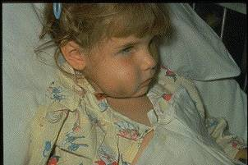
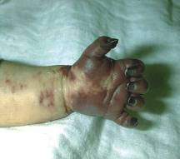
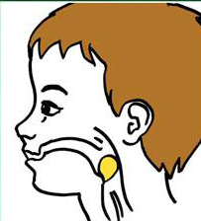
Haemophilus influenzae type b (Hib)*
ACIP recommends Hib vaccine:
3 or 4 doses for children
2 through 15 months of age
Populations at higher risk for disease: One dose of Hib for unimmunized persons 5 through 18 years who have asplenia, sickle cell disease, or HIV infection.
One dose of Hib may be given to adults with immunocompromising conditions.
Notes:
Slide shows a child with cellulitis of cheek and an infant with gangrenous fingers due to invasive Hib disease. The drawing shows a child with a markedly swollen epiglottis due to epiglottitis (croup) due to Hib infection.
Haemophilus influenza infection is caused by a bacteria which has 6 different polysaccharide serotypes and some non-typable strains
Type b (Hib) causes 95% of invasive disease
Hib enters body through the nasopharynx, spreads via blood stream to other sites (meninges, joints, skin, epiglottis and/or bone)
Prior to licensure of a vaccine Hib was the leading cause of bacterial meningitis in young children with a case fatality rate of 2-5%. 15-30% of survivors had hearing impairment and neurologic sequelae.
Hib also causes cellulitis, septic arthritis, osteomyelitis, pneumonia and epiglottitis.
Peak age for infection is 6-7 months. Invasive Hib disease is uncommon beyond 5 years of age.
Before Hib vaccine was licensed there were about 20,000 cases of invasive Hib in the U.S. each year
By 5 years post licensure of Hib vaccine, the incidence decreased by > 99%. In 2013, 31 cases of Hib type b were reported in the U.S. No cases were reported in Georgia.
40 cases were reported in the U.S. in 2014 and 23 cases in 2015.
Many physicians and nurses who were trained after the mid 1990s have never seen a case of invasive Hib
For additional information refer to:
Epidemiology and Prevention of Vaccine-Preventable Diseases, 13th edition 2015. HHS, CDC.

Slide 19
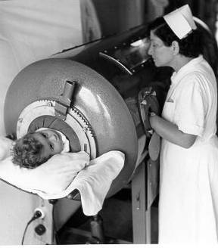
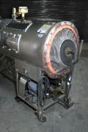
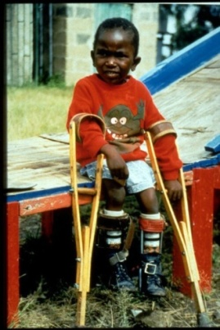
Polio
Children: Four dose series of IPV at : 2, 4, 6 through 18 months and 4 through 6 years of age.
    Minimum interval from dose 3 to dose 4 is six months
    Final dose at 4 years of age or older, regardless of the number of previous doses
Source: World Health Organization
Notes:
References:
http://www.cdc.gov/vaccines/acip/index.html
For more details about all the vaccine preventable diseases reviewed in this presentation, refer to: Epidemiology and Prevention of Vaccine-Preventable Diseases (The Pink Book). HHS, CDC. https://www.cdc.gov/vaccines/pubs/pinkbook/index.htm
Speaker Notes:
Slide shows child in an iron lung due to weak respiratory muscles (common in polio era) and a child with muscle weakness, as a result of polio, requiring the assistance of braces and crutches in order to walk.
Polio, also called poliomyelitis and infantile paralysis is caused by an Enterovirus (Serotypes 1,2,3)
Infection acquired through mouth, virus replicates in pharynx and GI tract, then spreads to lymphatics and other tissues.
Clinical response to infection is varied:Incubation period
3 to 6 days for nonparalytic poliomyelitis
7 to 21 days for onset of paralysis in paralytic poliomyelitis
Paralysis is often permanent
Paralytic disease may be caused by wild-type polioviruses, attenuated polioviruses in oral vaccine, or by vaccine-derived polioviruses
Approximately 70% of all polio infections in children are asymptomatic. Infected individuals without symptoms shed the virus in nasopharyngeal secretions and stool for several days or weeks and are able to transmit the virus to others.
Approximately 24% of polio infections in children consist of a minor, nonspecific illness without clinical or laboratory evidence of central nervous system invasion. This clinical presentation is known as abortive poliomyelitis, and is characterized by a low fever, sore throat, and complete recovery in less than a week.

Slide 20
Polio Vaccination Adults (June 2023 ACIP)
Adults who are known or suspected to be unvaccinated or incompletely vaccinated against polio should complete a primary vaccination series with inactivated polio vaccine (IPV).
Adults who have received a primary series of trivalent oral polio vaccine (tOPV) or IPV in any combination and who are at increased risk of poliovirus exposure may receive another dose of IPV.
Available data do not indicate the need for more than a single lifetime booster dose with IPV for adults.
In general, unless there are specific reasons to believe they were not vaccinated, most adults who were born and raised in the United States can assume they were vaccinated against polio as children.
https://www.cdc.gov/vaccines/acip/index.html
Source: World Health Organization
Notes:
References:
http://www.cdc.gov/vaccines/acip/index.html
For more details about all the vaccine preventable diseases reviewed in this presentation, refer to: Epidemiology and Prevention of Vaccine-Preventable Diseases (The Pink Book). HHS, CDC. https://www.cdc.gov/vaccines/pubs/pinkbook/index.htm
Speaker Notes:
READ Slide.

Slide 21
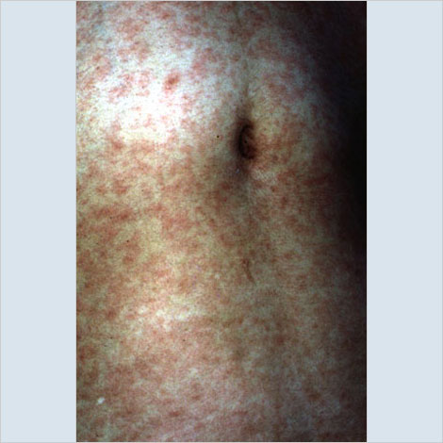
MEASLES
Incubation period---11 to 12 days from exposure to onset of symptoms
Symptoms: fever, cough, coryza, conjunctivitis, maculopapular rash and Koplik spots
Complications: otitis media, pneumonia, croup, diarrhea, encephalitis and death
Subacute sclerosing panencephalitis (SSPE) is a progressive neurological disorder that is rare but always fatal.
Source: Immunization Action Coalition
Notes:
References:
http://www.cdc.gov/vaccines/acip/index.html
For more details about all the vaccine preventable diseases reviewed in this presentation, refer to: Epidemiology and Prevention of Vaccine-Preventable Diseases (The Pink Book). HHS, CDC. https://www.cdc.gov/vaccines/pubs/pinkbook/index.htm
Speaker Notes:
Measles:
The incubation period of measles from exposure to prodrome averages 11 to 12 days. The time from exposure to rash onset averages 14 days, with a range of 7 to 21 days.
The prodrome lasts 2 to 4 days, with a range of 1 to 7 days. It is characterized by fever, which increases in a stepwise fashion often peaking as high as 103°F to 105°F, cough, coryza, and conjunctivitis.
Koplik spots, present on mucous membranes, are considered to be unique to measles. They occur 1 to 2 days before the measles rash (i.e., during the prodromal period), and appear as punctate blue-white spots on the bright red background of the buccal mucosa.
The measles rash is a maculopapular eruption that usually lasts 5 to 6 days. It begins at the hairline, then involves the face and upper neck. During the next 3 days, the rash gradually proceeds downward and outward, reaching the hands and feet. The maculopapular lesions are generally individually distinct but may run together, particularly on the upper body. Initially, lesions blanch (become white or pale) with fingertip pressure. By 3 to 4 days, most do not blanch with pressure. The lesions peel off in scales in more severely involved areas. The rash fades in the same order that it appears, from head to extremities.
Other symptoms of measles include anorexia and generalized lymphadenopathy.
Subacute Sclerosing Panencephalitis (SSPE) is a neurological disorder that can appear years after a person is infected with measles and is always fatal. It is characterized by behavioral and intellectual deterioration and seizures that occur usually 6-8 yrs. after measles infection. In rare cases the virus spreads to the brain, but then becomes dormant. Eventually it can lead to SSPE, resulting in deterioration and death. Researchers don’t know what causes the virus to reactivate. There is no cure for SSPE and the only way to prevent it is to vaccinate everyone against measles. https://www.ninds.nih.gov/health-information/disorders/subacute-sclerosing-panencephalitis#:~:text=What%20is%20subacute%20sclerosing%20panencephalitis,viral%20infection%20related%20to%20measles.

Slide 22
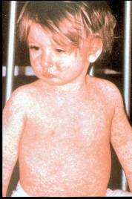
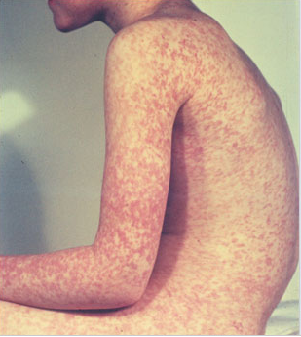
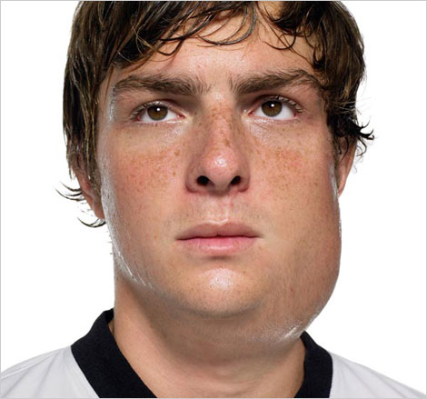
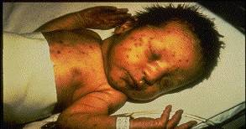
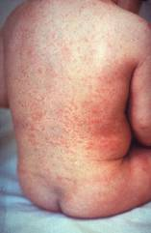
Measles, Mumps, Rubella
Measles (M)
Mumps (M)
Source: American Academy of Pediatrics
Red Book On Line Visual Library
Source: Creative Commons
Rubella (R)
Congenital Rubella (R)
Notes:
MEASLES (caused by paramyxovirus)
Slide shows two children with typical measles rash and conjunctivitis in younger child
Initial symptoms are runny nose, followed by increasing fever (103º-105º), cough, conjunctivitis, Koplik spots, and a maculopapular rash that lasts 5-6 days
Complications include otitis media (7%), pneumonia (6%), and acute encephalitis (0.1%) 1 in 1000 cases, death (0.2%) Although measles elimination was declared in the United States in 2000 , importation of measles cases continues to occur.
MUMPS (caused by paramyxovirus)
Slide shows an adolescent with parotitis due to mumps
Parotitis occurs in 30-40% of infected persons, 40-50% have only nonspecific or respiratory symptoms
Complications include aseptic meningitis, & deafness
Post pubertal individuals may have orchitis, ovarian inflammation, & pancreatitis
RUBELLA (Caused by togavirus)
In children, the rash may be the first manifestation of infection. Adults may have low-grade fever, malaise, URI, and lymphadenopathy prior to rash. Arthralgia and arthritis is common in adults, especially women. Complications include encephalitis and hemorrhagic manifestations
Rubella is no longer endemic in the U.S. However, it is still present in other countries and can be imported
CONGENITAL RUBELLA
Slide shows an adult and child with a typical rash from rubella and an infant with congenital rubella syndrome Infant was infected in utero and has “blueberry muffin spots” on skin due to petechial lesions, cataracts, hearing loss and congenital heart lesion and will most likely be developmentally delayed.
Also common: hearing loss, skin rash, enlarged neck lymph nodes, intellectual disability, malaise, neonatal jaundice, runny nose, or white pupil.
All woman of child bearing age should be certain they are immune to rubella.
For additional information refer to: Epidemiology and Prevention of Vaccine-Preventable Diseases, https://www.cdc.gov/vaccines/pubs/pinkbook/index.htm

Slide 23
MMR Vaccine Recommendations
ACIP recommendations:
Children: 2 doses of MMR:
  Dose 1 @ 12 through 15 months of age
  Dose 2 @ 4 through 6 years of age
  Second dose can be given 28 days after first dose, if necessary.
Adults:
  At least 1 dose MMR for unvaccinated adults
  2 doses MMR for students entering colleges, universities, technical and vocational schools, and other post-high-school educational institutions
  2 doses MMR for measles and mumps and 1 dose MMR for rubella for healthcare personnel
Special Situations:
  Travelers to foreign countries should be appropriately immunized with MMR before leaving U.S.
  Infants 6-12 mos. of age traveling abroad should receive 1 dose of MMR. This dose must be repeated at age 12 -15 months of age and a second dose at least 4 weeks later.
  A 3rd MMR may be recommended in the instance of a public health-declared mumps outbreak.
18
Notes:
References:
http://www.cdc.gov/vaccines/acip/index.html
For more details about all the vaccine preventable diseases reviewed in this presentation, refer to: Epidemiology and Prevention of Vaccine-Preventable Diseases (The Pink Book). HHS, CDC. https://www.cdc.gov/vaccines/pubs/pinkbook/index.htm
Speaker Notes:
Per slide

Slide 24
MMR Vaccine and Immunity
Antibodies develop in approximately 95% of children vaccinated at age 12 months and over 99% of children who receive 2 doses
Immunity long-term and probably lifelong in most persons
Evidence of Immunity: Generally, persons can be considered immune to measles if they were:
  born before 1957,
  have serologic evidence of measles immunity (equivocal test results should be considered negative),
  laboratory confirmation of disease,
  have documentation of adequate vaccination for measles.
Healthcare providers and health departments should not accept verbal reports of vaccination without written documentation as presumptive evidence of immunity.
18
Notes:
Speaker Notes:
MMR vaccine has been successful in reducing the cases of measles in the United States and many young physicians, physician’s assistants and nurse practitioners have never seen an acute case of measles..
Measles antibodies develop in approximately 95% of children vaccinated at age 12 months. Seroconversion rates are similar for single-antigen measles, MMR vaccine, and MMRV vaccine. Approximately 2% to 7% of children who receive only 1 dose of MMR vaccine fail to respond to it, i.e., they experience primary vaccine failure. MMR vaccine failure can occur because of passive antibody in the vaccine recipient, immaturity of the immune system, damaged vaccine, or other reasons. Most persons who fail to respond to the first dose will respond to a second dose. Studies indicate that more than 99% of persons who receive 2 doses of measles vaccine (with the first dose administered no earlier than the first birthday) develop serologic evidence of measles immunity.
https://www.cdc.gov/vaccines/pubs/pinkbook/meas.html#vaccine
Additional Information:
http://www.cdc.gov/vaccines/acip/index.html
For more details about all the vaccine preventable diseases reviewed in this presentation, refer to: Epidemiology and Prevention of Vaccine-Preventable Diseases (The Pink Book). HHS, CDC. https://www.cdc.gov/vaccines/pubs/pinkbook/index.htm

Slide 25
Measles Containing Vaccines
MMR-II
PRIORIX (GSK). ACIP Recommended June 2022
  PRIORIX and M-M-R II are fully interchangeable.
  ACIP General Best Practices states a preference that doses of vaccine in a series come from the same manufacturer; however, vaccination should not be deferred when the manufacturer of the previously administered vaccine is unknown or when the vaccine from the same manufacturer is unavailable
  Studies have shown that PRIORIX is safe and immunogenic when administered as a second dose after M-M-R II
MMRV
Notes:
References:
http://www.cdc.gov/vaccines/acip/index.html
For more details about all the vaccine preventable diseases reviewed in this presentation, refer to: Epidemiology and Prevention of Vaccine-Preventable Diseases (The Pink Book). HHS, CDC. https://www.cdc.gov/vaccines/pubs/pinkbook/index.htm
Speaker Notes:
Priorix: First licensed in Germany in 1997 and approved in over 100 countries
Contains equivalent vaccine virus strains as MMR II (Merck)
No significant differences found in safety or side effects when comparing Priorix to MMR-II.
PRIORIX is supplied as a single-dose vial of lyophilized antigen to be reconstituted with the accompanying prefilled syringe of sterile water diluent. A single dose after reconstitution is approximately 0.5 mL. PRIORIX is formulated without preservatives and is administered as subcutaneous injection (the same as M-M-R II) (5,29).
PRIORIX may be used according to the existing MMR recommendations for both on- and off-label use for prevention of measles, mumps, and rubella†† (1,2). For routine vaccination, 2 doses are recommended, the first at age 12–15 months, and the second at age 4–6 years. For catch-up vaccination of previously unvaccinated children and adolescents, 2 doses should be administered ≥4 weeks apart. Before international travel, infants aged 6–11 months should receive a single dose. Travelers aged ≥12 months who have not received 2 doses of MMR should receive 2 doses separated by ≥28 days.
During a measles outbreak, infants aged 6–11 months should receive a single dose of MMR. For measles postexposure prophylaxis in unvaccinated persons, 1 dose of MMR should be administered within 72 hours of exposure to a person with infectious measles, and the 2-dose series (i.e., the second of 2 MMR doses) should be completed ≥28 days later. During mumps outbreaks, a third dose of MMR is recommended for persons identified by public health authorities as being part of a group or population at increased risk for acquiring mumps because of an outbreak.

Slide 26
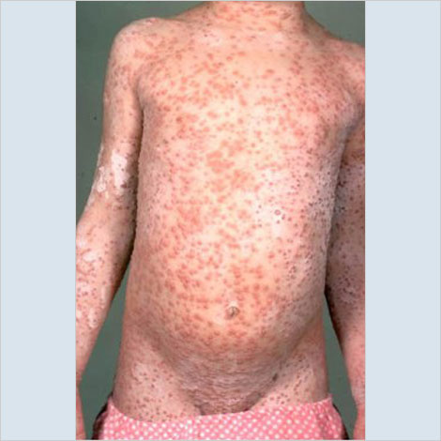
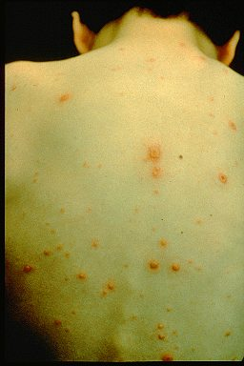
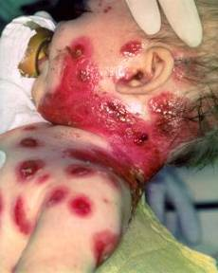
Varicella*
(Chickenpox)
ACIP recommends 2 doses of Varicella Vaccine
Dose 1 @ 12 months through 15 months of age
Dose 2 @ 4 through 6 years of age
Those 13 years of age or older without evidence of immunity should receive 2 doses separated by 4 to 8 weeks.
© Copyright American Academy of Pediatrics
Notes:
References:
http://www.cdc.gov/vaccines/acip/index.html
For more details about all the vaccine preventable diseases reviewed in this presentation, refer to: Epidemiology and Prevention of Vaccine-Preventable Diseases (The Pink Book). HHS, CDC. https://www.cdc.gov/vaccines/pubs/pinkbook/index.htm
Speaker Notes:
Slide shows a child with typical varicella rash and infant with secondary bacterial infected varicella lesions, probably due to staph or strep
Chicken pox or varicella is caused by the varicella zoster virus
Prior to licensure of varicella vaccine approximately 100 previously healthy children died from chicken pox each year
Newborns are in the highest risk group if maternal rash is 5 days before or 2 days after delivery
Adults are 25 times more likely to die than children
Varicella Vaccine: https://www.cdc.gov/vaccines/pubs/pinkbook/varicella.html
Live attenuated virus vaccine licensed in Japan and Korea in 1988, and in U.S. in 1995
One dose of vaccine is 82% effective; two doses provide nearly 92% efficacy.
Breakthrough chicken pox may occur in individuals who have received the vaccine
All cases of breakthrough chicken pox have been mild
Vaccine may be effective in preventing illness if given within 3 days and possibly up to 5 days after exposure.
Children who were up-to-date with one dose of varicella vaccine prior to starting school may not have received the second dose, so should receive it as soon as possible.

Slide 27
Acceptable Evidence of
Varicella Immunity
Written documentation of age-appropriate vaccination
Laboratory evidence of immunity or laboratory confirmation of varicella disease
U.S.-born before 1980
  Does not apply to healthcare personnel or pregnant people
Healthcare provider diagnosis or verification of varicella disease
History of herpes zoster based on healthcare provider diagnosis
Notes:
References:
http://www.cdc.gov/vaccines/acip/index.html
For more details about all the vaccine preventable diseases reviewed in this presentation, refer to: Epidemiology and Prevention of Vaccine-Preventable Diseases (The Pink Book). HHS, CDC. https://www.cdc.gov/vaccines/pubs/pinkbook/index.htm

Slide 28
ACIP Recommendations for use of
MMRV (ProQuad )
®
Licensed for ages 12 months through 12 years
Dose 1 at ages 12 through 47 months
  Either separate MMR and varicella vaccines or MMRV vaccine may be used.
  CDC recommends separate doses of MMR and varicella at early age
    Slightly increased risk of febrile seizures with combination vaccine.
Dose 1 or 2 given at ages 48 months and older
  MMRV vaccine generally is preferred over separate injections of its equivalent component vaccines (i.e., MMR and varicella vaccines).
*MMWR, May 7, 2010, Vol 59, #RR03
And https://www.cdc.gov/vaccines/pubs/pinkbook/varicella.html
Notes:
References:
http://www.cdc.gov/vaccines/acip/index.html
For more details about all the vaccine preventable diseases reviewed in this presentation, refer to: Epidemiology and Prevention of Vaccine-Preventable Diseases (The Pink Book). HHS, CDC. https://www.cdc.gov/vaccines/pubs/pinkbook/index.htm
Speaker Notes:
MMRV vaccine is licensed for use in children age 12 months through 12 years. MMRV vaccine may be used for both dose 1 and dose 2 of measles, mumps, and rubella vaccination and varicella vaccination in children younger than age 13 years. The minimum interval between doses of MMRV is 3 months. However, if dose 2 is administered at least 4 weeks following dose 1, it does not need to be repeated.
For the first dose of measles, mumps, rubella, and varicella vaccines at age 12 through 47 months, either separate MMR and varicella (VAR) vaccines, or MMRV vaccine, may be used. However, the risk of febrile seizures is about twice as high for children receiving MMRV vaccine versus separate MMR and VAR vaccines. Providers who are considering administering MMRV should discuss the benefits and risks of both vaccination options with the parents. Unless the parent or caregiver expresses a preference for MMRV, separate MMR vaccine and VAR vaccine should be administered for the first dose in this age group. For the second dose of measles, mumps, rubella, and varicella vaccines at any age and for the first dose at age 48 months or older, the use of MMRV generally is preferred over separate injections of its equivalent component vaccines (i.e., MMR vaccine and VAR vaccine).
New precaution for MMRV Vaccine Use
A personal or family (i.e., sibling, parent) history of seizures is a precaution for MMRV vaccination. Studies suggest that children who have a personal or family history of febrile seizures or family history of epilepsy are at increased risk for febrile seizures compared with children who do not have such histories. Children with a personal or family history of seizures generally should be vaccinated with MMR and varicella vaccines because the risks of using MMRV vaccine in this group of children generally outweigh the benefit of MMRV vaccine.
CDC has developed materials to help with the implementation of the updated recommendations for use of MMRV vaccine:
https://www.cdc.gov/vaccinesafety/vaccines/mmrv-vaccine.html
* The 47 month cut-off was chosen on the basis of the epidemiology of febrile seizures: first febrile seizures are uncommon after age 4 years, approximately 94% of febrile seizures occur in children aged less than 4 years.
† Provider assessment should include the number of injections, vaccine availability, likelihood of improved coverage, likelihood of patient return, and storage and cost consideration.

Slide 29
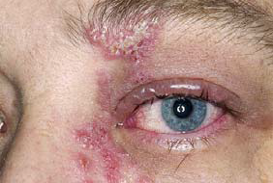
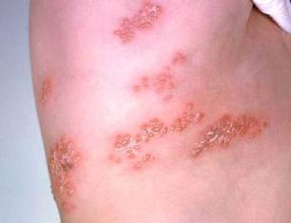
Herpes Zoster
Herpes zoster (HZ), or shingles, occurs through reactivation of latent varicella-zoster virus
Typically characterized by prodromal pain and an acute vesicular eruption (rash) accompanied by moderate to severe pain
One in three persons will develop zoster during their lifetime
Post-herpetic neuralgia PHN is defined as nerve pain persisting longer than 3 mos. after disappearance of the rash.
Risk for zoster and PHN increases with age
Photo courtesy of www.webmd.com
Notes:
References:
http://www.cdc.gov/vaccines/acip/index.html
For more details about all the vaccine preventable diseases reviewed in this presentation, refer to: Epidemiology and Prevention of Vaccine-Preventable Diseases (The Pink Book). HHS, CDC. https://www.cdc.gov/vaccines/pubs/pinkbook/index.htm
Speaker Notes:
The picture on left shows zoster (shingles) on the upper chest and back.
The picture on right shows zoster on the face involving one of the cranial nerves.

Slide 30
Shingrix (RZV) from GSK*
®
As of November 18, 2020, Zostavax (ZVL) is no longer available for use in the United States
Shingrix (RZV) is the only currently licensed Zoster vaccine in the United States
Efficacy (RZV)
  > 91% in preventing zoster in all vaccinated persons in licensed age groups
  > 88% in preventing PHN
  At least 85% vaccine effectiveness >4 years post-vaccination in persons 70 years and older
Notes:
References:
http://www.cdc.gov/vaccines/acip/index.html
For more details about all the vaccine preventable diseases reviewed in this presentation, refer to: Epidemiology and Prevention of Vaccine-Preventable Diseases (The Pink Book). HHS, CDC. https://www.cdc.gov/vaccines/pubs/pinkbook/index.htm
Speaker Notes:
As of November 18, 2020, Zostavax (ZVL) is no longer available for use in the United States.
RZV may be used in adults aged ≥50 years, irrespective of prior receipt of varicella vaccine or ZVL, and does not require screening for a history of chickenpox (varicella).
Persons with a history of herpes zoster. Herpes zoster can recur. Adults with a history of herpes zoster should receive RZV. If a patient is experiencing an episode of herpes zoster, vaccination should be delayed until the acute stage of the illness is over and symptoms abate. Studies of safety and immunogenicity of RZV in this population are ongoing.
Persons with chronic medical conditions. Adults with chronic medical conditions (e.g., chronic renal failure, diabetes mellitus, rheumatoid arthritis, and chronic pulmonary disease) should receive RZV.
Persons known to be VZV negative. Screening for a history of varicella (either verbally or via laboratory serology) before vaccination for herpes zoster is not recommended. However, in persons known to be VZV negative via serologic testing, ACIP guidelines for varicella vaccination should be followed. RZV has not been evaluated in persons who are VZV seronegative and the vaccine is not indicated for the prevention of chickenpox (varicella).
Current herpes zoster infection. RZV is not a treatment for herpes zoster or postherpetic neuralgia and should not be administered during an acute episode of herpes zoster.

Slide 31
Shingrix (RZV) from GSK*
®
RZV is recommended for immunocompetent adults 50 years and older who previously received ZVL and immunocompromised adults 19 years and older.
Two doses of RZV are recommended, regardless of prior history of herpes zoster disease or previous receipt of zoster vaccine live vaccine (ZVL).
RZV may be given ≥2 months after prior receipt of ZVL. People who have received ZVL should be revaccinated with a 2-dose series of RZV vaccine.
RZV may be administered to patients:
  who previously received varicella vaccine.
  while patients are taking antiviral medications.
  at the same visit as other vaccines
Notes:
References:
http://www.cdc.gov/vaccines/acip/index.html
For more details about all the vaccine preventable diseases reviewed in this presentation, refer to: Epidemiology and Prevention of Vaccine-Preventable Diseases (The Pink Book). HHS, CDC. https://www.cdc.gov/vaccines/pubs/pinkbook/index.htm
Speaker Notes:
RZV may be used in adults aged ≥50 years, irrespective of prior receipt of varicella vaccine or ZVL, and does not require screening for a history of chickenpox (varicella).
Persons with a history of herpes zoster. Herpes zoster can recur. Adults with a history of herpes zoster should receive RZV. If a patient is experiencing an episode of herpes zoster, vaccination should be delayed until the acute stage of the illness is over and symptoms abate. Studies of safety and immunogenicity of RZV in this population are ongoing.
Persons with chronic medical conditions. Adults with chronic medical conditions (e.g., chronic renal failure, diabetes mellitus, rheumatoid arthritis, and chronic pulmonary disease) should receive RZV.
Persons known to be VZV negative. Screening for a history of varicella (either verbally or via laboratory serology) before vaccination for herpes zoster is not recommended. However, in persons known to be VZV negative via serologic testing, ACIP guidelines for varicella vaccination should be followed. RZV has not been evaluated in persons who are VZV seronegative and the vaccine is not indicated for the prevention of chickenpox (varicella).
Current herpes zoster infection. RZV is not a treatment for herpes zoster or postherpetic neuralgia and should not be administered during an acute episode of herpes zoster.

Slide 32
Shingrix (RZV) from GSK
®
Store at appropriate refrigerator temperatures
2 doses given IM, 2-6 months apart
Shorter intervals may be used in some persons (including immunodeficient/immunosuppressed)
After reconstitution/mixing, Give only 0.5 ml, not full contents of the vial.
Notes:
Speaker Notes:
Dosing schedule. Two RZV doses are necessary, regardless of previous history of herpes zoster or previous receipt of zoster vaccine live. The second RZV dose should typically be given 2–6 months after the first; for persons who are or will be immunodeficient or immunosuppressed and who would benefit from a shorter vaccination schedule, the second dose can be administered 1–2 months after the first (2). If the second RZV dose is given sooner than 4 weeks after the first, a valid second dose should be repeated at least 4 weeks after the dose given too early. The vaccine series does not need to be restarted if more than 6 months have elapsed since the first dose.
When reconstituted, the volume of Shingrix is more than 0.5 mL. Should the entire volume of reconstituted vaccine be administered or just 0.5 mL as indicated in the package insert?The Shingrix adjuvant solution may contain up to 0.75 mL of liquid. The entire volume of the adjuvant solution should be withdrawn and used to reconstitute the lyophilized vaccine. After mixing, withdraw the recommended dose of 0.5 mL. Discard any reconstituted vaccine left in the vial.
Timing of vaccination. When possible, patients should be vaccinated before becoming immunosuppressed. Otherwise, providers should consider timing vaccination when the immune response is likely to be most robust (i.e., during periods of lower immunosuppression and stable disease). RZV may be administered to patients who previously received varicella vaccine. RZV is not a live virus vaccine; therefore, RZV may be administered while patients are taking antiviral medications.
Coadministration with other vaccines. Recombinant and adjuvanted vaccines, such as RZV, can be administered concomitantly, at different anatomic sites, with other adult vaccines, including COVID-19 vaccines (17). Concomitant administration of RZV with other adult vaccines¶¶¶¶ has been studied, and there was no evidence for interference in the immune response to either vaccine or of safety concerns (18–20). Coadministration of RZV with adjuvanted influenza vaccine (Fluad) and COVID-19 vaccines is being studied.
Counseling for reactogenicity. Before vaccination, providers should counsel patients about expected local and systemic reactogenicity, including grade 3 reactions. It is generally not recommended to take antipyretic or analgesic medications prophylactically before vaccination; however, antipyretic or analgesic medications may be taken for the treatment of postvaccination local or systemic symptoms. Patients should be encouraged to complete the series even if they experienced a (nonanaphylactic) grade 1–3 reaction after receipt of the first RZV dose.
Top

Slide 33

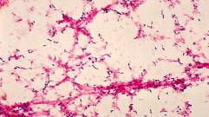

Pneumococcal Disease
Infection with pneumococcal bacteria may cause pneumonia, bacteremia, meningitis, and otitis media resulting in thousands of hospitalizations and deaths each year in the United States
Multi-drug resistant pneumococci are common
Photo courtesy AAP
Notes:
Slide shows a child with orbital cellulitis from pneumococcal disease, the base of a brain with pus from pneumococcal meningitis and a microscopic view of pneumococci in lung tissue
Pneumococcal disease is caused by a bacterium, Streptococcus pneumoniae, also called pneumococcus (about 90 known serotypes)
Causes pneumonia, bacteremia, meningitis and otitis media
Highest rate of invasive disease is in children less than 2 years
Increased risk of infection in children with HIV infection, sickle cell disease, asplenia, day care attendees and in certain ethnic groups (African Americans, Alaskan natives and Native Americans)
Increased risk in children & adults with cardiovascular disease, pulmonary disease, diabetes, alcoholism, cirrhosis, immunocompromising conditions
Individuals who have asthma and those who smoke cigarettes are also at increased risk
Estimated cases in the US each year more than any other vaccine-preventable disease
Some serotypes of pneumococcus have become resistant to antibiotics

Slide 34
Pneumococcal Conjugate Vaccine (PCV13, PCV15, PCV20)
ACIP Recommendations- Children
Children
All children PCV13 or PCV15: 4-dose series at 2, 4, 6 months and 12-15 months
In June 2023, the ACIP recommended:Use of either pneumococcal conjugate vaccines (PCV) PCV15 or PCV20 is recommended for all children aged 2–23 months according to currently recommended PCV dosing and schedules.
For older children and adolescents (2 years through 18 years) with underlying medical conditions, see detailed recommendations at https://www.cdc.gov/vaccines/schedules/hcp/imz/child-adolescent.html#note-pneumo
https://www.cdc.gov/vaccines/acip/index.html
Notes:
References:
http://www.cdc.gov/vaccines/acip/index.html
For more details about all the vaccine preventable diseases reviewed in this presentation, refer to: Epidemiology and Prevention of Vaccine-Preventable Diseases (The Pink Book). HHS, CDC. https://www.cdc.gov/vaccines/pubs/pinkbook/index.htm
Speaker Notes: (Note that the footnotes on the schedule for 2023 may differ from the ACIP recommendations voted on in June 2023).
As of June 2023 ACIP meeting:
Use of either pneumococcal conjugate vaccines (PCV) PCV15 or PCV20 is recommended for all children aged 2–23 months according to currently recommended PCV dosing and schedules.
For children with an incomplete PCV vaccination status, use of either PCV15 or PCV20 according to currently recommended PCV dosing and schedules is recommended for:
Healthy children aged 24–59 months
Children with specified health conditions⁽²⁾ aged 24 through 71 months
For children aged 2–18 years with any risk condition who have received all recommended doses of PCV before age 6 years
Using ≥1 dose(s) of PCV20: No additional doses of any pneumococcal vaccine are indicated. This recommendation may be updated as additional data become available.
Using PCV13 or PCV15 (no PCV20): A dose of PCV20 or PPSV23 using previously recommended dosing and schedules is recommended.
For children aged 6–18 years with any risk condition who have not received any dose of PCV13, PCV15, or PCV20, a single dose of PCV15 or PCV20 is recommended. When PCV15 is used, it should be followed by a dose of PPSV23 at least 8 weeks later if not previously given.
²Risk conditions include: cerebrospinal fluid leak; chronic heart disease; chronic kidney disease (excluding maintenance dialysis and nephrotic syndrome, which are included in immunocompromising conditions); chronic liver disease; chronic lung disease (including moderate persistent or severe persistent asthma); cochlear implant; diabetes mellitus; immunocompromising conditions (on maintenance dialysis or with nephrotic syndrome; congenital or acquired asplenia or splenic dysfunction; congenital or acquired immunodeficiencies; diseases and conditions treated with immunosuppressive drugs or radiation therapy, including malignant neoplasms, leukemias, lymphomas, Hodgkin disease, and solid organ transplant; HIV infection; and sickle cell disease and other hemoglobinopathies).

Slide 35
Pneumococcal Conjugate Vaccine (PCV15, PCV20)
ACIP Recommendations - Adults
Adults
Adults 65 years or older
  (PCV15 or PCV20) for all adults 65 years or older who have never received any pneumococcal conjugate vaccine or whose previous vaccination history is unknown
  For further details see: https://www.cdc.gov/vaccines/vpd/pneumo/hcp/recommendations.html
On October 20, 2021, the Advisory Committee on Immunization Practices recommended 15-valent PCV (PCV15) or 20-valent PCV (PCV20) for PCV–naïve adults who are either aged ≥65 years or aged 19–64 years with certain underlying conditions.
Adults 19 through 64 years old who have certain chronic medical conditions or other risk factors are recommended to receive pneumococcal vaccination. For details see: https://www.cdc.gov/vaccines/vpd/pneumo/hcp/who-when-to-vaccinate.html
Notes:
Adults 65 years or older
Immunization Schedules
View current schedules for children, teens, and adults.
CDC recommends routine administration of pneumococcal conjugate vaccine (PCV15 or PCV20) for all adults 65 years or older who have never received any pneumococcal conjugate vaccine or whose previous vaccination history is unknown:
If PCV15 is used, this should be followed by a dose of PPSV23 one year later. The minimum interval is 8 weeks and can be considered in adults with an immunocompromising condition†, cochlear implant, or cerebrospinal fluid leak.
If PCV20 is used, a dose of PPSV23 is NOT indicated.
See Pneumococcal Vaccination: Summary of Who and When to Vaccinate for CDC guidance on vaccination options for adults who have previously received a pneumococcal conjugate vaccine.
Footnote
† Immunocompromising conditions include chronic renal failure, congenital or acquired asplenia, generalized malignancy, HIV infection, Hodgkin disease, iatrogenic immunosuppression, leukemia, lymphoma, multiple myeloma, nephrotic syndrome, sickle cell disease or other hemoglobinopathies, and solid organ transplant.
In 2021, 20-valent pneumococcal conjugate vaccine (PCV) (PCV20) (Wyeth Pharmaceuticals LLC, a subsidiary of Pfizer Inc.) and 15-valent PCV (PCV15) (Merck Sharp & Dohme Corp.) were licensed by the Food and Drug Administration for adults aged ≥18 years, based on studies that compared antibody responses to PCV20 and PCV15 with those to 13-valent PCV (PCV13) (Wyeth Pharmaceuticals LLC, a subsidiary of Pfizer Inc.). Antibody responses to two additional serotypes included in PCV15 were compared to corresponding responses after PCV13 vaccination, and antibody responses to seven additional serotypes included in PCV20 were compared with those to the 23-valent pneumococcal polysaccharide vaccine (PPSV23) (Merck Sharp & Dohme Corp.). On October 20, 2021, the Advisory Committee on Immunization Practices (ACIP) recommended use of either PCV20 alone or PCV15 in series with PPSV23 for all adults aged ≥65 years, and for adults aged 19–64 years with certain underlying medical conditions or other risk factors* who have not previously received a PCV or whose previous vaccination history is unknown.

Slide 36
Pneumococcal Polysaccharide Vaccine (PPSV23)
ACIP Recommendations:
For children and adolescents 2 years through 18 years and
Adults 19 years and older
REMEMBER PATIENTS WHO ARE AT HIGHER RISK FOR DISEASE
E.G. Sickle Cell Disease, Immunodeficiency
See Summary of recommendations of PPSV23 and timing at:
https://www.cdc.gov/vaccines/vpd/pneumo/hcp/who-when-to-vaccinate.html
Notes:
Speaker Notes:
Due to the complexity of these schedules, refer audience to the schedule and to the helpful CDC tables on the subsequent slides

Slide 37

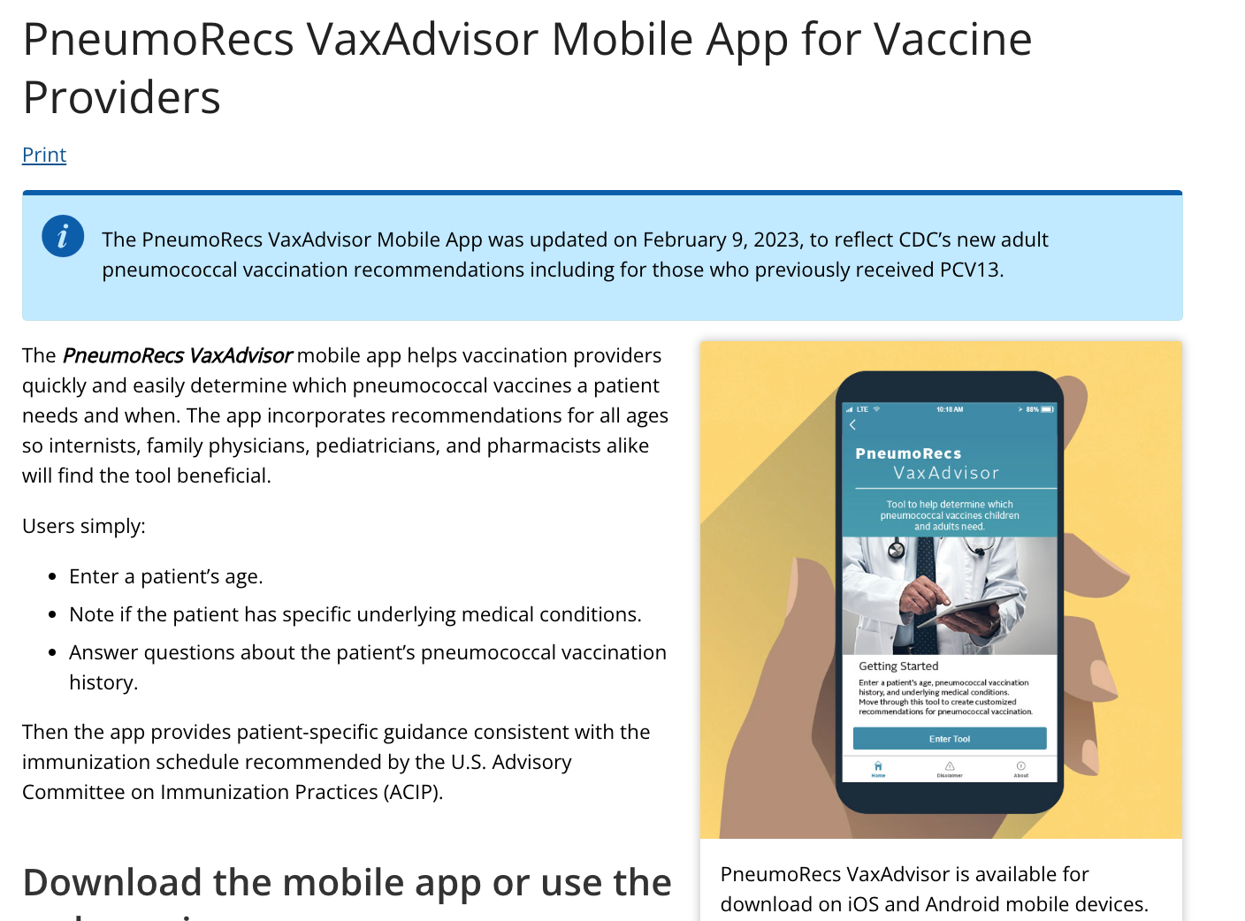
https://www.cdc.gov/vaccines/vpd/pneumo/hcp/pneumoapp.html
Notes:
https://www.cdc.gov/vaccines/vpd/pneumo/hcp/pneumoapp.html

Slide 38
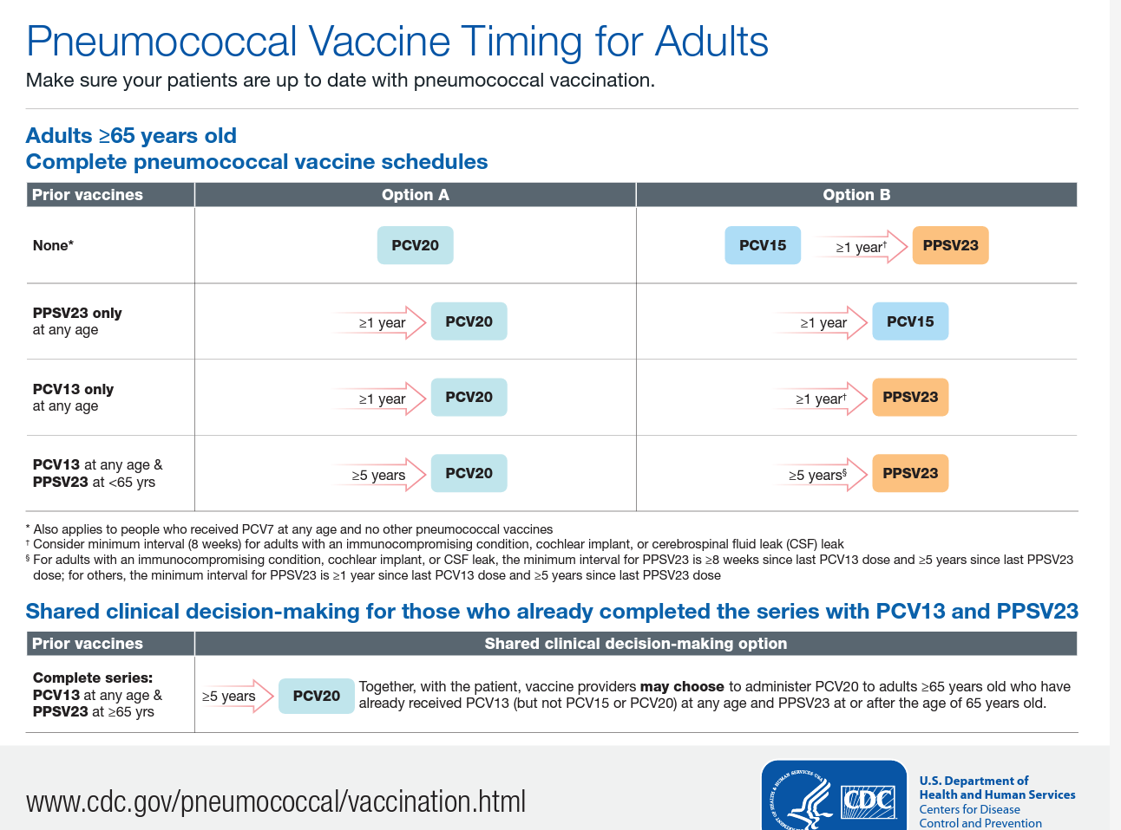
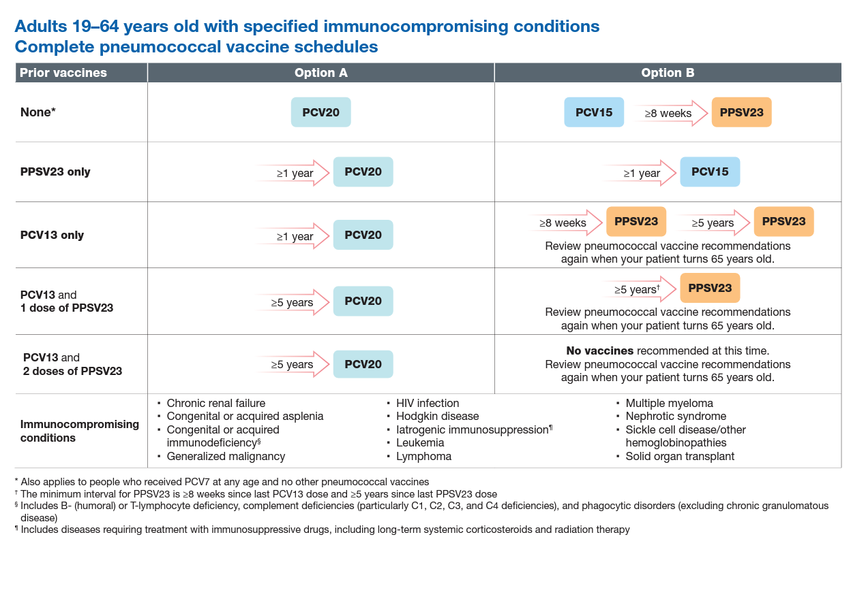
https://www.cdc.gov/vaccines/vpd/pneumo/downloads/pneumo-vaccine-timing.pdf
Notes:
Speaker Notes:
Downloadable Pneumococcal vaccine timing tables for adults:
chrome-extension://efaidnbmnnnibpcajpcglclefindmkaj/https://www.cdc.gov/vaccines/vpd/pneumo/downloads/pneumo-vaccine-timing.pdf

Slide 39
FDA Recommended Influenza Antigens
for 2023-2024 Season in the U.S.
Egg-based influenza vaccines | Cell culture–based inactivated (ccIIV4) and recombinant (RIV4) influenza vaccines
influenza A/Victoria/4897/2022 (H1N1)pdm09-like virus an influenza A/Darwin/9/2021 (H3N2)-like virus an influenza B/Austria/1359417/2021 (Victoria lineage)-like virus an influenza B/Phuket/3073/2013 (Yamagata lineage)-like virus | influenza A/Wisconsin/67/2022 (H1N1)pdm09-like virus an influenza A/Darwin/6/2021 (H3N2)-like virus an influenza B/Austria/1359417/2021 (Victoria lineage)-like virus an influenza B/Phuket/3073/2013 (Yamagata lineage)-like virus
ACIP recommends annual influenza vaccine for all persons 6 months of age and older who do not have contraindications.
https://www.cdc.gov/mmwr/volumes/72/rr/rr7202a1.htm
Notes:
Routine annual influenza vaccination of all persons aged ≥6 months who do not have contraindications continues to be recommended. Primary updates in this report include the following:
The composition of the 2022–23 U.S. seasonal influenza vaccines includes updates to the influenza A(H3N2) and influenza B/Victoria components. For the 2022–23 season, U.S.-licensed influenza vaccines will contain hemagglutinin (HA) derived from an influenza A/Victoria/2570/2019 (H1N1)pdm09-like virus (for egg-based vaccines) or an influenza A/Wisconsin/588/2019 (H1N1)pdm09-like virus (for cell culture–based and recombinant vaccines); an influenza A/Darwin/9/2021 (H3N2)-like virus (for egg-based vaccines) or an influenza A/Darwin/6/2021 (H3N2)-like virus (for cell culture–based or recombinant vaccines); an influenza B/Austria/1359417/2021 (Victoria lineage)-like virus; and an influenza B/Phuket/3073/2013 (Yamagata lineage)-like virus.
Influenza vaccines expected to be available for the 2022–23 season, their age indications, and their presentations are described (Table 1). Afluria Quadrivalent is not expected to be available in a 0.25-mL prefilled syringe presentation. When using Afluria Quadrivalent for children aged 6 through 35 months (who require a 0.25-mL dose), the dose must be obtained from a multidose vial. One labeling change is described. In October 2021, FDA granted approval for the use of Flucelvax Quadrivalent (cell culture–based quadrivalent inactivated influenza vaccine [ccIIV4]) for children aged 6 months through <2 years. As of March 2021, Flucelvax Quadrivalent had been approved for persons aged ≥2 years. Approval for children aged 6 months through <2 years was based on results of a randomized, observer-blind study that compared immunogenicity and safety of Flucelvax Quadrivalent with that of a licensed comparator IIV4 among 2,402 children aged 6 through 47 months, of whom 894 were aged 6 through 23 months. Flucelvax Quadrivalent is now approved for persons aged ≥6 months.
On the basis of review of evidence concerning high-dose inactivated influenza vaccine (HD-IIV), recombinant influenza vaccine (RIV), and MF59-adjuvanted inactivated influenza vaccine (aIIV), recommendations for influenza vaccination of persons aged ≥65 years have been modified. ACIP recommends that adults aged ≥65 years preferentially receive any one of the following higher dose or adjuvanted influenza vaccines: quadrivalent high-dose inactivated influenza vaccine (HD-IIV4), quadrivalent recombinant influenza vaccine (RIV4), or quadrivalent adjuvanted inactivated influenza vaccine (aIIV4). If none of these three vaccines is available at an opportunity for vaccine administration, then any other age-appropriate influenza vaccine should be used. Higher dose vaccines include HD-IIV4 and RIV4, both of which contain a higher dose of HA antigen per virus than standard-dose vaccines (60 µg for HD-IIV4 and 45 µg for RIV4, compared with 15 µg for standard-dose inactivated vaccines). Adjuvanted inactivated influenza vaccine (aIIV4) contains MF59 adjuvant.

Slide 40
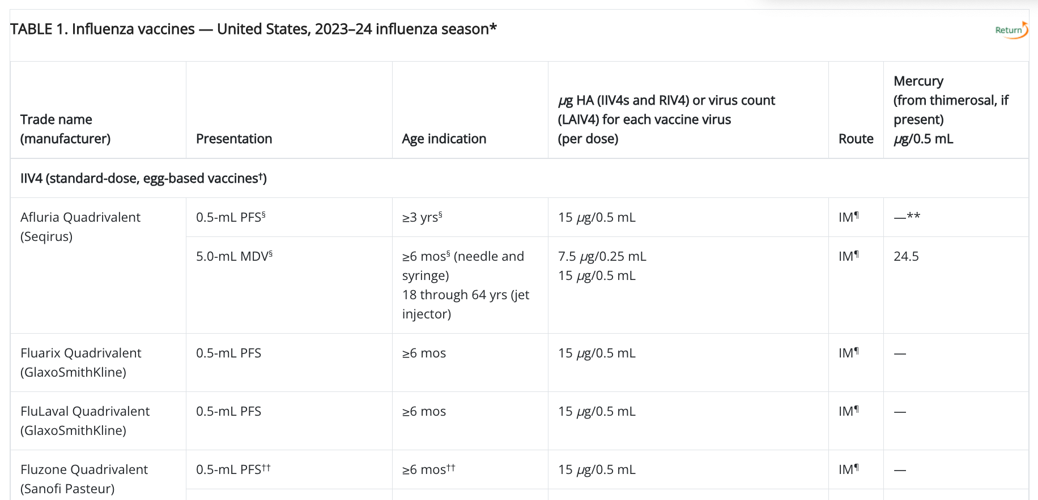
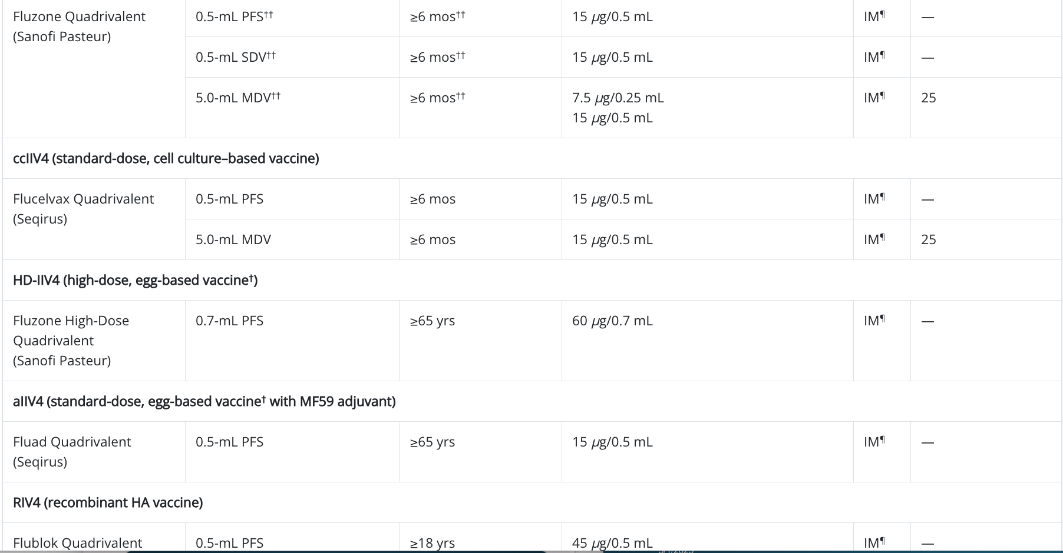
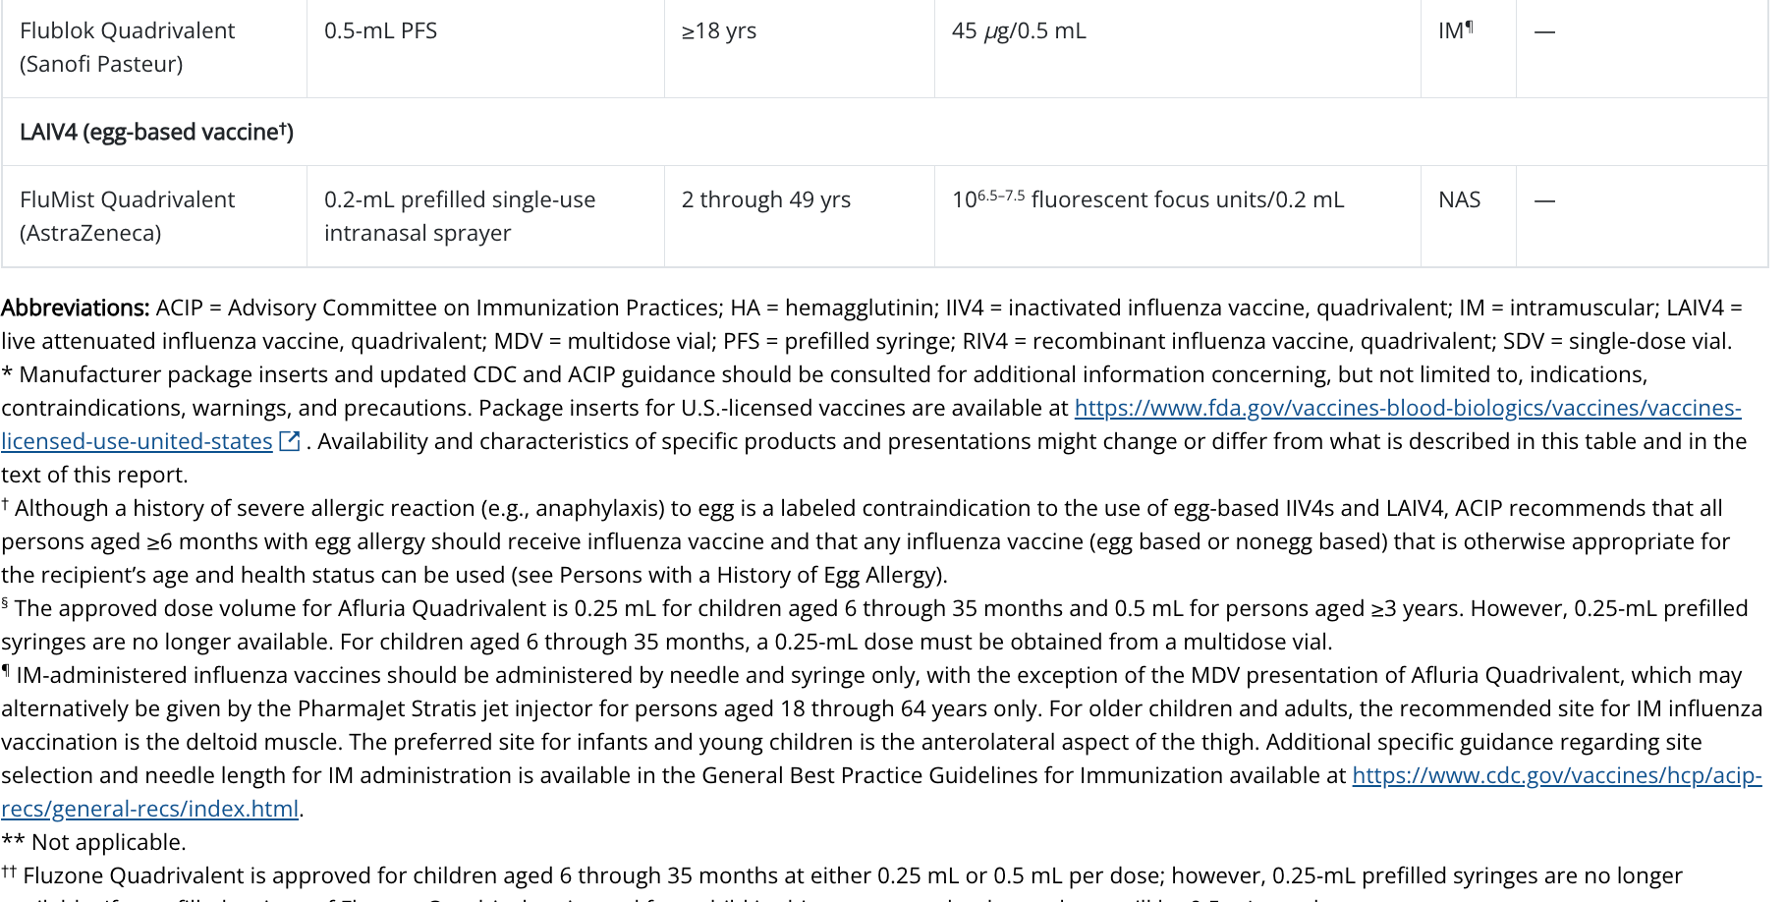
Influenza Vaccines for 2023-2024 Season
https://www.cdc.gov/mmwr/volumes/72/rr/rr7202a1.htm
Notes:
Flu vaccines for 2022-2023
Afluria Quadrivalent is not expected to be available in a 0.25-mL prefilled syringe presentation. When using Afluria Quadrivalent for children aged 6 through 35 months (who require a 0.25-mL dose), the dose must be obtained from a multidose vial.
One labeling change is described. In October 2021, FDA granted approval for the use of Flucelvax Quadrivalent (cell culture–based quadrivalent inactivated influenza vaccine [ccIIV4]) for children aged 6 months through <2 years. As of March 2021, Flucelvax Quadrivalent had been approved for persons aged ≥2 years. Approval for children aged 6 months through <2 years was based on results of a randomized, observer-blind study that compared immunogenicity and safety of Flucelvax Quadrivalent with that of a licensed comparator IIV4 among 2,402 children aged 6 through 47 months, of whom 894 were aged 6 through 23 months. Flucelvax Quadrivalent is now approved for persons aged ≥6 months..
Abbreviations: ACIP = Advisory Committee on Immunization Practices; FDA = Food and Drug Administration; HA = hemagglutinin; IIV4 = inactivated influenza vaccine, quadrivalent; IM = intramuscular; LAIV4 = live attenuated influenza vaccine, quadrivalent; MDV = multidose vial; mos = months; NAS = intranasal; PFS = prefilled syringe; RIV4 = recombinant influenza vaccine, quadrivalent; SDV = single-dose vial
Vaccination providers should consult FDA-approved prescribing information for 2021–22 influenza vaccines for the most complete and updated information, including (but not limited to) indications, contraindications, warnings, and precautions. Package inserts for U.S.-licensed vaccines are available at https://www.fda.gov/vaccines-blood-biologics/approved-products/vaccines-licensed-use-united-states

Slide 41
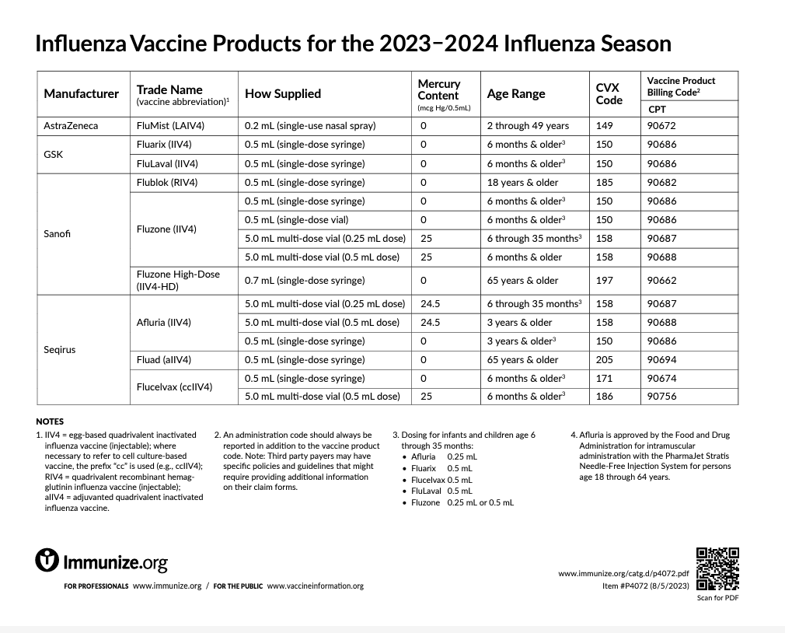
www.immunize.org/catg.d/p4072.pdf
Notes:
Inactivated Influenza Vaccines (IIV4s) for Children 6 through 35 months ▪ Five IIV4s are now approved for this age group ▪ Dose volumes vary: – Fluarix Quadrivalent 0.5 mL/dose – FluLaval Quadrivalent 0.5 mL/dose – Flucelvax Quadrivalent 0.5 mL/dose – Afluria Quadrivalent 0.25 mL/dose – Fluzone Quadrivalent 0.25 mL/dose or 0.5 mL/dose

Slide 42
Live, Attenuated Influenza Vaccine (LAIV4)*
  FluMist® MedImmune (Nasal Spray)
  Licensed for healthy persons 2 through 49 years of age
Contraindications to LAIV include:
  Children 2-4 yrs. of age with a diagnosis of asthma
  Persons receiving aspirin-containing medications – potential risk for Reye syndrome
  Persons who are immunocompromised, by medication or disease, have a CSF leak or cochlear implant, or asplenia
  Close contacts and caregivers of severely immunosuppressed persons
  Persons who have received influenza antiviral medications within the previous days (dependent on antiviral)
  Persons with a cranial CSF leak; people with cochlear implants
  Persons with a severe allergic reaction to any component of the vaccine or to a previous dose of any influenza vaccine (exception for allergy to egg)
  Pregnancy
https://www.cdc.gov/mmwr/volumes/72/rr/rr7202a1.htm
Notes:
History of severe allergic reaction (e.g., anaphylaxis) to any component of the vaccine† or to a previous dose of any influenza vaccine (i.e., any egg-based IIV, ccIIV, RIV, or LAIV)§
• Concomitant aspirin- or salicylate-containing therapy in children and adolescents§
• Children aged 2 through 4 years who have received a diagnosis of asthma or whose parents or caregivers report that a health care provider has told them during the preceding 12 months that their child had wheezing or asthma or whose medical record indicates a wheezing episode has occurred during the preceding 12 months
• Children and adults who are immunocompromised due to any cause, including but not limited to immunosuppression caused by medications, congenital or acquired immunodeficiency states, HIV infection, anatomic asplenia, or functional asplenia (e.g., due to sickle cell anemia)
• Close contacts and caregivers of severely immunosuppressed persons who require a protected environment
• Pregnancy
• Persons with active communication between the CSF and the oropharynx, nasopharynx, nose, or ear or any other cranial CSF leak
• Persons with cochlear implants**
• Receipt of influenza antiviral medication within the previous 48 hours for oseltamivir and zanamivir, previous 5 days for peramivir, and previous 17 days for baloxavir††
Available vaccines: One live attenuated influenza vaccine, FluMist Quadrivalent (LAIV4), is expected to be available during the 2022–23 influenza season. LAIV4 is approved for persons aged 2 through 49 years.
LAIV4 contains live attenuated influenza viruses that are propagated in eggs. These viruses are cold adapted (so that they replicate efficiently at 25°C) and temperature sensitive (so that their replication is restricted at higher temperatures, 39°C for influenza A viruses and 37°C for influenza B viruses). These viruses replicate in the nasopharynx, which is necessary to promote an immune response (101).
No preference is expressed for LAIV4 versus other influenza vaccines used within specified indications.
Dosage and administration: LAIV4 is administered intranasally using the supplied prefilled, single-use sprayer containing 0.2 mL of vaccine. Approximately 0.1 mL (i.e., half the total sprayer contents) is sprayed into the first nostril while the recipient is in the upright position. An attached dose-divider clip is removed from the sprayer to permit administration of the second half of the dose into the other nostril. If the recipient sneezes immediately after administration, the dose should not be repeated. However, if nasal congestion is present that might impede delivery of the vaccine to the nasopharyngeal mucosa, deferral of administration should be considered until resolution of the illness, or another appropriate vaccine should be administered instead. Each total dose of 0.2 mL contains 10^{6.5–7.5} fluorescent focus units of each vaccine virus
Contraindications to use of LAIV
• History of severe allergic reaction (e.g., anaphylaxis) to any component of the vaccine† or to a previous dose of any influenza vaccine (i.e., any egg-based IIV, ccIIV, RIV, or LAIV)§ • Concomitant aspirin- or salicylate-containing therapy in children and adolescents§ • Children aged 2 through 4 years who have received a diagnosis of asthma or whose parents or caregivers report that a health care provider has told them during the preceding 12 months that their child had wheezing or asthma or whose medical record indicates a wheezing episode has occurred during the preceding 12 months • Children and adults who are immunocompromised due to any cause, including but not limited to immunosuppression caused by medications, congenital or acquired immunodeficiency states, HIV infection, anatomic asplenia, or functional asplenia (e.g., due to sickle cell anemia) • Close contacts and caregivers of severely immunosuppressed persons who require a protected environment • Pregnancy • Persons with active communication between the CSF and the oropharynx, nasopharynx, nose, or ear or any other cranial CSF leak • Persons with cochlear implants** • Receipt of influenza antiviral medication within the previous 48 hours for oseltamivir and zanamivir, previous 5 days for peramivir, and previous 17 days for baloxavir††

Slide 43
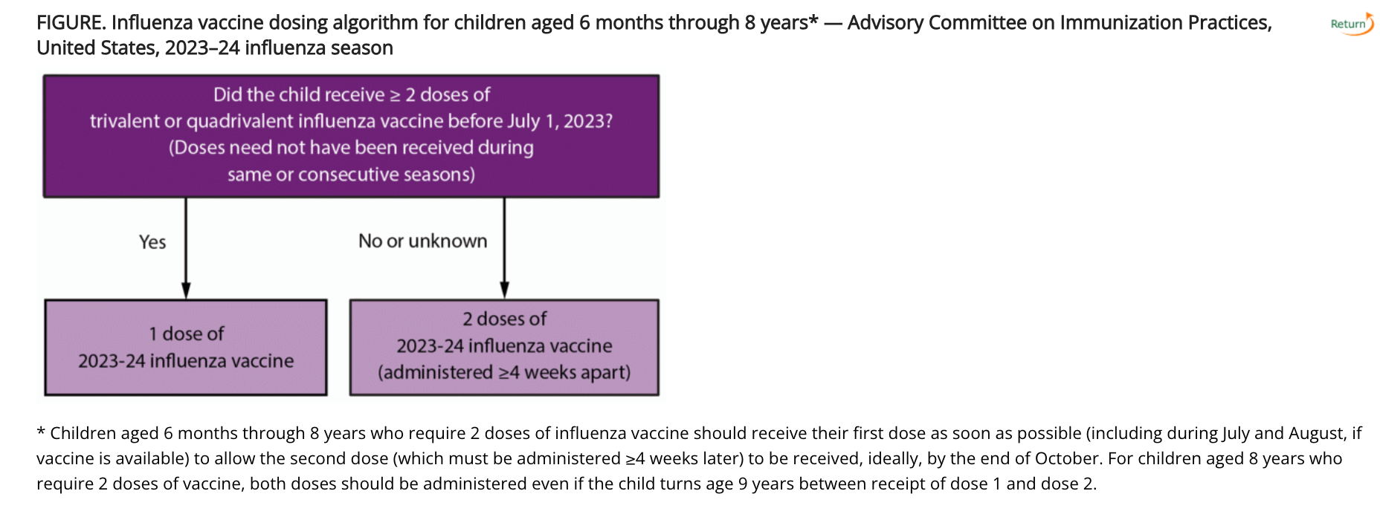
https://www.cdc.gov/mmwr/volumes/72/rr/rr7202a1.htm

Slide 44
History of egg allergy and egg-based Influenza vaccines (update 2023-24 season)
ACIP recommends that all persons aged ≥6 months with egg allergy should receive influenza vaccine.
Any influenza vaccine (egg based or nonegg based) that is otherwise appropriate for the recipient’s age and health status can be used.
It is no longer recommended that persons who have had an allergic reaction to egg involving symptoms other than urticaria should be vaccinated in an inpatient or outpatient medical setting supervised by a health care provider who is able to recognize and manage severe allergic reactions if an egg-based vaccine is used.
https://www.cdc.gov/mmwr/volumes/72/rr/rr7202a1.htm
Notes:
ACIP recommends that all persons aged ≥6 months with egg allergy should receive influenza vaccine. Any influenza vaccine (egg based or nonegg based) that is otherwise appropriate for the recipient’s age and health status can be used (https://www.cdc.gov/vaccines/acip/recs/grade/influenza-egg-allergy.html; https://www.cdc.gov/vaccines/acip/recs/grade/influenza-egg-allergy-etr.html). It is no longer recommended that persons who have had an allergic reaction to egg involving symptoms other than urticaria should be vaccinated in an inpatient or outpatient medical setting supervised by a health care provider who is able to recognize and manage severe allergic reactions if an egg-based vaccine is used. Egg allergy alone necessitates no additional safety measures for influenza vaccination beyond those recommended for any recipient of any vaccine, regardless of severity of previous reaction to egg. All vaccines should be administered in settings in which personnel and equipment needed for rapid recognition and treatment of acute hypersensitivity reactions are available.
Most available influenza vaccines, with the exceptions of RIV4 (Flublok Quadrivalent, licensed for persons aged ≥18 years) and ccIIV4 (Flucelvax Quadrivalent, licensed for persons aged ≥6 months), are prepared by propagation of virus in embryonated eggs and might contain trace amounts of egg proteins, such as ovalbumin. Among those U.S.-licensed influenza vaccines for which ovalbumin content is reported, quantities are generally small (≤1 μg/0.5mL dose) (Table 1).
The Joint Task Force on Practice Parameters of the American Academy of Allergy, Asthma & Immunology (AAAAI) and the American College of Allergy, Asthma, & Immunology (ACAAI) have recommended that administration of influenza vaccine to egg allergic persons requires no additional precautions other than those recommended for administration of any vaccine to any individual (103). Since the 2016–17 influenza season, the American Academy of Pediatrics (AAP) has recommended that no additional precautionary measures are needed when administering influenza vaccine to egg-allergic persons (104). A review of 20 studies (16 of IIVs, one of virosomal influenza vaccine, and three of LAIV) that examined reactions after administration of seasonal influenza vaccines to egg-allergic persons via either full single-dose or split-dose administration protocols (of which 13 reported inclusion of persons with a history of severe reaction or anaphylaxis to egg) included no reports of anaphylaxis (certainty level: very low) (105–122). Less severe reactions not described as anaphylaxis but involving cardiovascular symptoms, respiratory symptoms, angioedema, or generalized urticaria, or which involved treatment with medications or outpatient or emergency department attention occurred with low frequency (<1%). A similar profile was noted among 13 studies of monovalent H1N1pdm09 influenza vaccine, with no reported instances of anaphylaxis; frequency of reactions involving cardiovascular symptoms, respiratory symptoms, angioedema, or generalized urticaria events of <1%, and of events involving treatment with medications or outpatient or emergency department attention of approximately 1.5% (certainty level: very low) (114,115,123–132). One instance of anaphylaxis meeting a surveillance case definition (i.e., Brighton Level 1 criteria) in a person with possible egg allergy was noted in a summary of VAERS reports after administration of monovalent H1N1pdm09 influenza vaccine during the 2009–10 influenza season; no denominator of doses administered was available but it was noted that approximately 127 million doses of monovalent IIV were distributed in the United States that season (133). Of note, severe allergic reactions after administration of the egg-free vaccine RIV to egg-allergic persons have been noted in VAERS reports (134–136). These reports highlight both the possibility that observed reactions after egg-based influenza vaccines might be caused by substances other than egg proteins and the importance of being prepared to recognize and manage serious hypersensitivity reactions when administering any vaccine to any recipient (regardless of allergy history).
Severe and life-threatening reactions to vaccines can rarely occur with any vaccine and in any vaccine recipient, regardless of allergy history. Providers are reminded that all vaccines should be administered in settings in which personnel and equipment needed for rapid recognition and treatment of acute hypersensitivity reactions are available. All vaccination providers should be familiar with their office emergency plan and be certified in cardiopulmonary resuscitation (47). No postvaccination observation period is recommended specifically for egg-allergic persons. However, ACIP recommends that vaccination providers consider observing patients (seated or supine) for 15 minutes after administration of any vaccine to decrease the risk for injury should syncope occur (47).
Although egg allergy is neither a contraindication nor precaution to the use of any influenza vaccine, there are contraindications and precautions related to allergies to vaccine components other than egg and to previous allergic reactions to influenza vaccines (see Persons with Previous Allergic Reactions to Influenza Vaccines and Dosage, Administration, Contraindications, and Precautions) (Tables 2 and 3).

Slide 45
History of egg allergy and egg-based Influenza vaccines (2)
Egg allergy alone necessitates no additional safety measures for influenza vaccination beyond those recommended for any recipient of any vaccine, regardless of severity of previous reaction to egg.
All vaccines should be administered in settings in which personnel and equipment needed for rapid recognition and treatment of acute hypersensitivity reactions are available.
https://www.cdc.gov/mmwr/volumes/72/rr/rr7202a1.htm
Notes:
ACIP recommends that all persons aged ≥6 months with egg allergy should receive influenza vaccine. Any influenza vaccine (egg based or nonegg based) that is otherwise appropriate for the recipient’s age and health status can be used (https://www.cdc.gov/vaccines/acip/recs/grade/influenza-egg-allergy.html; https://www.cdc.gov/vaccines/acip/recs/grade/influenza-egg-allergy-etr.html). It is no longer recommended that persons who have had an allergic reaction to egg involving symptoms other than urticaria should be vaccinated in an inpatient or outpatient medical setting supervised by a health care provider who is able to recognize and manage severe allergic reactions if an egg-based vaccine is used. Egg allergy alone necessitates no additional safety measures for influenza vaccination beyond those recommended for any recipient of any vaccine, regardless of severity of previous reaction to egg. All vaccines should be administered in settings in which personnel and equipment needed for rapid recognition and treatment of acute hypersensitivity reactions are available.
Most available influenza vaccines, with the exceptions of RIV4 (Flublok Quadrivalent, licensed for persons aged ≥18 years) and ccIIV4 (Flucelvax Quadrivalent, licensed for persons aged ≥6 months), are prepared by propagation of virus in embryonated eggs and might contain trace amounts of egg proteins, such as ovalbumin. Among those U.S.-licensed influenza vaccines for which ovalbumin content is reported, quantities are generally small (≤1 μg/0.5mL dose) (Table 1).
The Joint Task Force on Practice Parameters of the American Academy of Allergy, Asthma & Immunology (AAAAI) and the American College of Allergy, Asthma, & Immunology (ACAAI) have recommended that administration of influenza vaccine to egg allergic persons requires no additional precautions other than those recommended for administration of any vaccine to any individual (103). Since the 2016–17 influenza season, the American Academy of Pediatrics (AAP) has recommended that no additional precautionary measures are needed when administering influenza vaccine to egg-allergic persons (104). A review of 20 studies (16 of IIVs, one of virosomal influenza vaccine, and three of LAIV) that examined reactions after administration of seasonal influenza vaccines to egg-allergic persons via either full single-dose or split-dose administration protocols (of which 13 reported inclusion of persons with a history of severe reaction or anaphylaxis to egg) included no reports of anaphylaxis (certainty level: very low) (105–122). Less severe reactions not described as anaphylaxis but involving cardiovascular symptoms, respiratory symptoms, angioedema, or generalized urticaria, or which involved treatment with medications or outpatient or emergency department attention occurred with low frequency (<1%). A similar profile was noted among 13 studies of monovalent H1N1pdm09 influenza vaccine, with no reported instances of anaphylaxis; frequency of reactions involving cardiovascular symptoms, respiratory symptoms, angioedema, or generalized urticaria events of <1%, and of events involving treatment with medications or outpatient or emergency department attention of approximately 1.5% (certainty level: very low) (114,115,123–132). One instance of anaphylaxis meeting a surveillance case definition (i.e., Brighton Level 1 criteria) in a person with possible egg allergy was noted in a summary of VAERS reports after administration of monovalent H1N1pdm09 influenza vaccine during the 2009–10 influenza season; no denominator of doses administered was available but it was noted that approximately 127 million doses of monovalent IIV were distributed in the United States that season (133). Of note, severe allergic reactions after administration of the egg-free vaccine RIV to egg-allergic persons have been noted in VAERS reports (134–136). These reports highlight both the possibility that observed reactions after egg-based influenza vaccines might be caused by substances other than egg proteins and the importance of being prepared to recognize and manage serious hypersensitivity reactions when administering any vaccine to any recipient (regardless of allergy history).
Severe and life-threatening reactions to vaccines can rarely occur with any vaccine and in any vaccine recipient, regardless of allergy history. Providers are reminded that all vaccines should be administered in settings in which personnel and equipment needed for rapid recognition and treatment of acute hypersensitivity reactions are available. All vaccination providers should be familiar with their office emergency plan and be certified in cardiopulmonary resuscitation (47). No postvaccination observation period is recommended specifically for egg-allergic persons. However, ACIP recommends that vaccination providers consider observing patients (seated or supine) for 15 minutes after administration of any vaccine to decrease the risk for injury should syncope occur (47).
Although egg allergy is neither a contraindication nor precaution to the use of any influenza vaccine, there are contraindications and precautions related to allergies to vaccine components other than egg and to previous allergic reactions to influenza vaccines (see Persons with Previous Allergic Reactions to Influenza Vaccines and Dosage, Administration, Contraindications, and Precautions) (Tables 2 and 3).

Slide 46
Co-administration
Inactivated influenza vaccines(IIV4s) and RIV4 may be administered simultaneously or sequentially with other inactivated vaccines or live vaccines. Injectable vaccines that are given concomitantly should be administered at separate anatomic sites.
LAIV4 can be administered simultaneously with other live or inactivated vaccines. However, if two live vaccines are not given simultaneously, then after administration of one live vaccine (such as LAIV4), at least 4 weeks should pass before another live vaccine is administered
Guidance concerning administration of COVID-19 vaccines with other vaccines indicates that these vaccines may be given with other vaccines, including influenza vaccines.
Providers should be aware of the potential for increased reactogenicity with coadministration and should consult the CDC guidance as more information becomes available. (This is more likely with the adjuvanted or high dose IIV4s which are recommended in persons 65 years and older.
https://www.cdc.gov/mmwr/volumes/72/rr/rr7202a1.htm
Notes:
In recent years, multiple vaccines containing nonaluminum adjuvants have been licensed for use in the United States for the prevention of various infectious diseases. Examples include AS01_{B} (in Shingrix, recombinant zoster subunit vaccine) (146), AS01_{E} (in Arexy, respiratory syncytial virus vaccine) (147) MF59 (in Fluad Quadrivalent [aIIV4]) (56), and cytosine phosphoguanine oligodeoxynucleotide (in Heplisav-B, a recombinant hepatitis B surface antigen vaccine) (148). Data are limited regarding coadministration of these vaccines with other adjuvanted or nonadjuvanted vaccines, including COVID-19 vaccines. Coadministration of Shingrix with nonadjuvanted IIV4 has been studied, and no evidence of decreased immunogenicity or safety concerns was noted (149). Data on the immunogenicity and safety of simultaneous or sequential administration of two nonaluminum adjuvant–containing vaccines are limited, and the ideal interval between such vaccines when given sequentially is not known. In the study of Shingrix and IIV4 (149), most reactogenicity symptoms resolved within 4 days. Because of the limited data on the safety of simultaneous administration of two or more vaccines containing nonaluminum adjuvants and the availability of nonadjuvanted influenza vaccine options, selection of a nonadjuvanted influenza vaccine may be considered in situations in which influenza vaccine and another vaccine containing a nonaluminum adjuvant are to be administered concomitantly. However, influenza vaccination should not be delayed if a specific vaccine is not available. As recommended for all vaccines, vaccines with nonaluminum adjuvants should be administered at separate anatomic sites from other vaccines that are given concomitantly (47).
For more recently introduced and new vaccines (e.g., respiratory syncytial virus [RSV] vaccine) data informing simultaneous administration with influenza vaccines might be limited or evolving. Providers should consult current CDC/ACIP recommendations and guidance for up-to-date information.

Slide 47
Influenza Vaccines Preference 2023-24 for Older Adults
ACIP recommends that adults aged ≥65 years preferentially receive any one of the following higher dose or adjuvanted influenza vaccines:
  quadrivalent high-dose inactivated influenza vaccine (HD-IIV4),
  quadrivalent recombinant influenza vaccine (RIV4), or
  quadrivalent adjuvanted inactivated influenza vaccine (aIIV4).
If none of these three vaccines is available at an opportunity for vaccine administration, then any other age-appropriate influenza vaccine should be used.
No preference is expressed for any one of these three vaccines.
https://www.cdc.gov/mmwr/volumes/72/rr/rr7202a1.htm
Notes:
Higher dose vaccines include HD-IIV4 and RIV4, both of which contain a higher dose of HA antigen per virus than standard-dose vaccines (60 µg for HD-IIV4 and 45 µg for RIV4, compared with 15 µg for standard-dose inactivated vaccines). Adjuvanted inactivated influenza vaccine (aIIV4) contains MF59 adjuvant.

Slide 48
Timing of Influenza Vaccination
Influenza vaccines might be available as early as July or August; however, vaccination during these months is not recommended for most groups because of the possible waning of immunity over the course of the influenza season
For most persons who need only 1 dose of influenza vaccine for the season, vaccination should ideally be offered during September or October.
However, vaccination should continue after October and throughout the influenza season as long as influenza viruses are circulating and unexpired vaccine is available.
Notes:
For most adults (particularly adults aged ≥65 years) and for pregnant persons in the first or second trimester: Vaccination during July and August should be avoided unless there is concern that vaccination later in the season might not be possible.
Children who require 2 doses: Certain children aged 6 months through 8 years require 2 doses of influenza vaccine for the season (see Children Aged 6 Months Through 8 Years: Number of Influenza Vaccine Doses) (Figure). These children should receive their first dose as soon as possible (including during July and August, if vaccine is available) to allow the second dose (which must be administered ≥4 weeks later) to be received, ideally, by the end of October.
Children who require only 1 dose: Vaccination during July and August can be considered for children of any age who need only 1 dose of influenza vaccine for the season. Although waning of immunity after vaccination over the course of the season has been observed among all age groups (21–37), there are fewer published studies reporting results specifically among children (21,30,32,33,37). Moreover, children in this group might visit health care providers during the late summer months for medical examinations before the start of school. Vaccination can be considered at this time because it represents a vaccination opportunity.
Pregnant persons in the third trimester: Vaccination during July and August can be considered for pregnant persons who are in the third trimester during these months because vaccination has been associated in multiple studies with reduced risk for influenza illness in their infants during the first months after birth, when they are too young to receive influenza vaccine (38–41). For pregnant persons in the first or second trimester during July and August, waiting to vaccinate until September or October is preferable, unless there is concern that later vaccination might not be possible.
Vaccination efforts should continue throughout the season because the duration of the influenza season varies, and influenza activity might not occur in certain communities until February, March, or later (17). Providers should offer influenza vaccine at healthcare visits to those not yet vaccinated, and organized vaccination campaigns should continue throughout the influenza season, including after influenza activity has begun in the community. Although vaccination by the end of October is recommended, vaccine administered in December or later, even if influenza activity has already begun, might be beneficial in most influenza seasons. Providers should offer influenza vaccination to unvaccinated persons who have already become ill with influenza during the season because the vaccine might protect them against other circulating influenza viruses.

Slide 49
Timing of Influenza Vaccination (2)
Vaccination in July or August may be considered for:
Children who require 2 doses
Children who require only 1 dose who show up for Well child exams in the late summer and may not return later in the year
Pregnant persons in the third trimester
https://www.cdc.gov/mmwr/volumes/72/rr/rr7202a1.htm
Notes:
Because timing of the onset, peak, and decline of influenza activity varies the ideal time to start vaccinating cannot be predicted each season. Decisions about timing necessitate balancing considerations regarding this unpredictability of the influenza season, possible waning of vaccine-induced immunity over the course of a season, and programmatic considerations. For most persons who need only 1 dose of influenza vaccine for the season, vaccination should ideally be offered during September or October. However, vaccination should continue after October and throughout the influenza season as long as influenza viruses are circulating and unexpired vaccine is available.
Influenza vaccines might be available as early as July or August; however, vaccination during these months is not recommended for most groups because of the possible waning of immunity over the course of the influenza season (21–37). However, vaccination of such persons during July and August can be considered in instances where there is concern that the recipient will not be vaccinated at a later date. Considerations for timing of vaccination include the following:
For most adults (particularly adults aged ≥65 years) and for pregnant persons in the first or second trimester: Vaccination during July and August should be avoided unless there is concern that vaccination later in the season might not be possible.
Children who require 2 doses: Certain children aged 6 months through 8 years require 2 doses of influenza vaccine for the season (see Children Aged 6 Months Through 8 Years: Number of Influenza Vaccine Doses) (Figure). These children should receive their first dose as soon as possible (including during July and August, if vaccine is available) to allow the second dose (which must be administered ≥4 weeks later) to be received, ideally, by the end of October.
Children who require only 1 dose: Vaccination during July and August can be considered for children of any age who need only 1 dose of influenza vaccine for the season. Although waning of immunity after vaccination over the course of the season has been observed among all age groups (21–37), there are fewer published studies reporting results specifically among children (21,30,32,33,37). Moreover, children in this group might visit health care providers during the late summer months for medical examinations before the start of school. Vaccination can be considered at this time because it represents a vaccination opportunity.
Pregnant persons in the third trimester: Vaccination during July and August can be considered for pregnant persons who are in the third trimester during these months because vaccination has been associated in multiple studies with reduced risk for influenza illness in their infants during the first months after birth, when they are too young to receive influenza vaccine (38–41). For pregnant persons in the first or second trimester during July and August, waiting to vaccinate until September or October is preferable, unless there is concern that later vaccination might not be possible.
Community vaccination programs should balance maximizing the likelihood of persistence of vaccine-induced protection through the season with avoiding missed opportunities to vaccinate or vaccinating after onset of influenza circulation occurs. Efforts should be structured to optimize vaccination coverage before influenza activity in the community begins. Vaccination should continue to be offered as long as influenza viruses are circulating and unexpired vaccine is available. To avoid missed opportunities for vaccination, providers should offer vaccination during routine health care visits and hospitalizations. No recommendation is made for revaccination (i.e., providing a booster dose) later in the season of persons who have been fully vaccinated for the season, regardless of when the current season vaccine was received.
Optimally, vaccination should occur before onset of influenza activity in the community. However, because timing of the onset, peak, and decline of influenza activity varies, the ideal time to start vaccinating cannot be predicted each season. Moreover, more than one outbreak might occur in a community in a single season. In the United States, localized outbreaks indicating the start of seasonal influenza activity can occur as early as October. However, in 30 (77%) of 39 influenza seasons from 1982–83 through 2021–22, peak influenza activity did not occur until January or later, and in 24 (62%) seasons, the peak was in February or later (42). Activity peaked in February in 17 (44%) of these seasons (42).
Vaccination efforts should continue throughout the season because the duration of the influenza season varies, and influenza activity might not occur in certain communities until February, March, or later (17). Providers should offer influenza vaccine at healthcare visits to those not yet vaccinated, and organized vaccination campaigns should continue throughout the influenza season, including after influenza activity has begun in the community. Although vaccination by the end of October is recommended, vaccine administered in December or later, even if influenza activity has already begun, might be beneficial in most influenza seasons. Providers should offer influenza vaccination to unvaccinated persons who have already become ill with influenza during the season because the vaccine might protect them against other circulating influenza viruses.

Slide 50
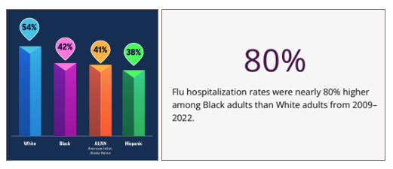
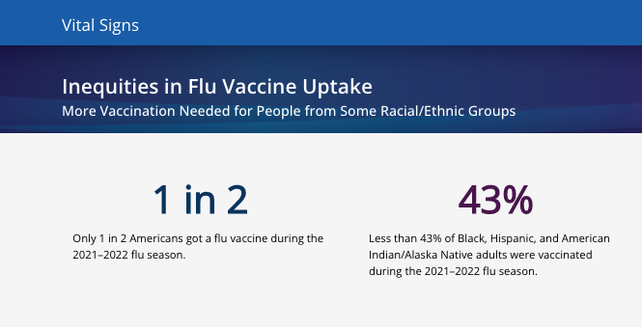
Inequities in Flu Vaccine Uptake
https://www.cdc.gov/mmwr/volumes/71/wr/mm7143e1.htm?s_cid=mm7143e1_w and https://www.cdc.gov/vitalsigns/flu-inequities/index.html
Notes:
Flu can be serious and lead to hospitalization or death. Flu vaccination is the best way to protect against flu. Between 140,000 and 710,000 people were hospitalized with flu each year during 2010–2020. People from some racial and ethnic minority groups are more likely to be hospitalized with flu. Compared to White adults, flu hospitalization rates* are:
Nearly 80% higher among Black adults
30% higher among American Indian/Alaska Native (AI/AN) adults
20% higher among Hispanic adults
Vaccination may not always prevent infection, but it can make symptoms less severe and reduce the risk of being hospitalized. Since 2010, flu vaccination coverage has been consistently lower among Black, Hispanic, and AI/AN adults. During the 2021–2022 season, flu vaccination coverage was 54% among White adults, 42% among Black adults, 38% among Hispanic adults, and 41% among AI/AN adults. There are many reasons for these inequities, including lack of access to health care and insurance, missed opportunities to vaccinate, and misinformation and distrust. Racism and prejudice are known to worsen inequalities. In addition to disparities in vaccine uptake, there are likely other factors contributing to worse outcomes for some groups.
Increasing equitable vaccine uptake requires addressing the range of reasons why people do not get vaccinated. Over the past two years, CDC has begun two programs to address vaccination barriers and raise awareness about the importance of flu vaccination, specifically among people from racial and ethnic minority groups: the Partnering for Vaccine Equity (P4VE) program and a targeted flu vaccination campaign.
Results: From 2009–10 through 2021–22, age-adjusted influenza hospitalization rates (hospitalizations per 100,000 population) were higher among non-Hispanic Black (Black) (rate ratio [RR] = 1.8), American Indian or Alaska Native (AI/AN; RR = 1.3), and Hispanic (RR = 1.2) adults, compared with the rate among White adults. During the 2021–22 season, influenza vaccination coverage was lower among Hispanic (37.9%), AI/AN (40.9%), Black (42.0%), and other/multiple race (42.6%) adults compared with that among White (53.9%) and non-Hispanic Asian (Asian) (54.2%) adults; coverage has been consistently higher among White and Asian adults compared with that among Black and Hispanic adults since the 2010–11 season. The disparity in vaccination coverage by race and ethnicity was present among those who reported having medical insurance, a personal health care provider, and a routine medical checkup in the past year.
Conclusions and Implications for Public Health Practice: Racial and ethnic disparities in influenza disease severity and influenza vaccination coverage persist. Health care providers should assess patient vaccination status at all medical visits and offer (or provide a referral for) all recommended vaccines. Tailored programmatic efforts to provide influenza vaccination through nontraditional settings, along with national and community-level efforts to improve awareness of the importance of influenza vaccination in preventing illness, hospitalization, and death among racial and ethnic minority communities might help address health care access barriers and improve vaccine confidence, leading to decreases in disparities in influenza vaccination coverage and disease severity.

Slide 51
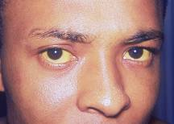
Hepatitis A
Photo Courtesy Immunization Action Coalition
Fecal-Oral transmission
Food borne outbreaks
Adults average 27 lost work days per illness
Risk factors include child or employee in child care facility and travel
Children often asymptomatic – but can infect others
Notes:
Slide shows an adult with jaundiced sclera from acute hepatitis A infection
Hepatitis A is the most commonly reported type of hepatitis; Transmission of the virus is by fecal-oral route (person to person contact or ingestion of contaminated food or water)
Incubation period from infection to symptoms is 15-50 days
Symptoms in older children & adults are fever, malaise, anorexia, nausea, abdominal discomfort, dark urine, jaundice (70%)
70% of children younger than 6 years are asymptomatic
Case fatality rate is 0.3 - 2%
No carrier state has been identified
References:
1. Epidemiology and Prevention of Vaccine-Preventable Diseases, 13th edition 2015. HHS, CDC.
2. Prevention of Hepatitis A Through Active or Passive Immunization - Recommendations of the Advisory Committee on Immunization Practices (ACIP) MMWR Vol. 55/No. RR-7 May 19, 2006

Slide 52
Hepatitis A Vaccine for Children and Adolescents
ACIP recommends 2 doses of hepatitis A vaccine for:
All children 12 through 23 months of age (Separate the 2 doses by a minimum of 6 months)
Notes:
References:
Prevention of Hepatitis A Through Active or Passive Immunization - Recommendations of the Advisory Committee on Immunization Practices (ACIP) MMWR Vol. 55/No. RR-7 May 19, 2006
http://www.cdc.gov/vaccines/acip/index.html
For more details about all the vaccine preventable diseases reviewed in this presentation, refer to: Epidemiology and Prevention of Vaccine-Preventable Diseases (The Pink Book). HHS, CDC. https://www.cdc.gov/vaccines/pubs/pinkbook/index.htm
Hepatitis A occurs throughout the world. It is highly endemic in some areas, particularly Central and South America, Africa, the Middle East, Asia, and the Western Pacific.
Historically, children 2–18 had highest rates of hepatitis A (15 to 20 cases per 100,000)
Prior to 2000, incidence higher in Western states
Rates declined 95.5% since vaccination initiation in 1996 to 2011
From 2016-2021, over 37,000 outbreak-associated cases reported from 35 states
Humans are the only natural reservoir of the virus. There are no insect or animal vectors. A chronic HAV state has not been reported although infections may relapse or be prolonged.
The incubation period of hepatitis A is approximately 28 days (range 15 to 50 days). The clinical course of hepatitis A is indistinguishable from that of other types of acute viral hepatitis. The illness typically has an abrupt onset of fever, malaise, anorexia, nausea, abdominal discomfort, dark urine, and jaundice. Clinical illness usually does not last longer than 2 months, although 10% to 15% of persons have prolonged or relapsing signs and symptoms for up to 6 months. Virus may be excreted during a relapse or prolonged Illness.
The likelihood of symptomatic illness from HAV infection is directly related to age. In children younger than age 6 years, most (70%) infections are asymptomatic. In older children and adults, infection is usually symptomatic, with jaundice occurring in more than 70% of patients.
HAV infection is acquired primarily by the fecal-oral route by either ingestion of contaminated food or water or direct contact with an infectious person. Since the virus is present in blood during the illness prodrome, HAV has been transmitted on rare occasions by blood transfusion as well as solid organ transplantation. Although HAV may be present in saliva, transmission by saliva has not been demonstrated. Waterborne outbreaks are infrequent in the United States and are usually associated with sewage-contaminated or inadequately treated water.
Vaccination – same as MMR, remember 6-11 month old travelers to Hep A endemic areas.

Slide 53
Hepatitis A Vaccine for Children and Adolescents
Additional recommendations:
  All persons >1 year of age at increased risk for HAV infection or at increased risk for severe disease from HAV infection including persons experiencing homelessness, persons with chronic liver disease, persons living with HIV
  1 dose of Hep A Vaccine for Infants 6-11 mos. traveling outside the U.S. when protection against HAV is recommended.
    Revaccinate with 2 doses, separated by at least 6 months, between age 12-23 months.
Notes:
References:
Prevention of Hepatitis A Through Active or Passive Immunization - Recommendations of the Advisory Committee on Immunization Practices (ACIP) MMWR Vol. 55/No. RR-7 May 19, 2006
http://www.cdc.gov/vaccines/acip/index.html
For more details about all the vaccine preventable diseases reviewed in this presentation, refer to: Epidemiology and Prevention of Vaccine-Preventable Diseases (The Pink Book). HHS, CDC. https://www.cdc.gov/vaccines/pubs/pinkbook/index.htm

Slide 54
Hepatitis A Vaccine Recommendations for Adults
      Adults age 19 years or older with risk factors should receive the adult formulation of HepA vaccine.
      Persons at increased risk for HAV infection, or who are at increased risk for severe disease from HAV infection, should be routinely vaccinated.
      Some risk factors include:
        Persons with HIV
        Those traveling or working in countries with high or intermediate endemicity of infection
        Persons experiencing homelessness
        Persons with chronic liver disease or on dialysis
        U. S. Adopters of adoptees from countries with high rates of hepatitis should receive the first dose of the 2-dose series as soon as adoption is planned.
Notes:
HAV in research laboratory settings
Healthy persons through age 40 who have recently been exposed to Hepatitis A virus
5. MMWR, November 2, 2018, Vol. 67, No. 43

Slide 55
Hepatitis B
Hepatitis B is an infectious liver disease caused by the hepatitis virus (HBV) that can lead to cirrhosis, liver cancer, and premature death.
Transmission:
  Percutaneous or mucosal exposure to infected blood or body fluids (e.g. skin puncture, sexual contact, contaminated surfaces)
  Vertical transmission from a HBsAg-positive mother to her newborn at birth
  Infected infants have 90% risk of developing chronic infection if not given HepB vaccine and HBIG at birth
ACIP vaccine recommendations: children and adolescents
  Administer hepatitis B vaccine to all newborns within 24 hours of birth, using single antigen vaccine; Dose 2 at 1-2 mos. of age and Dose 3 at 6-18 mos. of age
  All children and adolescents less than 19 years of age who did not complete the
  series as an infant
Notes:
References:
http://www.cdc.gov/vaccines/acip/index.html
For more details about all the vaccine preventable diseases reviewed in this presentation, refer to: Epidemiology and Prevention of Vaccine-Preventable Diseases (The Pink Book). HHS, CDC. https://www.cdc.gov/vaccines/pubs/pinkbook/index.htm
Speaker notes:
Incubation period from time of infection to onset of symptoms is 45 to 160 days (average, 90 days)
Approximately 10% of acute hepatitis B infections progress to chronic Hepatitis B infection.
90% of infants and 30-50% of children 1-5 years of age with acute hepatitis B infection become carriers
Many with chronic infection are asymptomatic. Chronic infection may progress to cirrhosis, liver failure & hepatocellular carcinoma
Avoid this with vaccination!!! Begin in the prenatal period. All pregnant women should be tested routinely for HBsAg
Vaccinate in the nursery if at all possible, or at the 1 week or 1 month WCC visit.
Timing for Doses 2 and 3 of infant series added to 1st bullet.
All pregnant women should be tested routinely for HBsAg
90% of healthy adults & 95% of infants, children & adolescents develop adequate antibody response after a complete series
If no antibody response after 6 doses, person is a non-responder and is susceptible to hepatitis B
Booster doses NOT recommended for any age group
Additional References:
1. A Comprehensive Immunization Strategy to Eliminate Transmission of Hepatitis B Virus Infection in the United States. Recommendations of the Advisory Committee on Immunization Practices (ACIP) Part 1: Immunization of Infants, Children and Adolescents MMWR Vol. 54/ No. RR-16 December 23, 2005
2. A Comprehensive Immunization Strategy to Eliminate Transmission of Hepatitis B Virus Infection in the United States. Recommendations of the Advisory Committee on Immunization Practices (ACIP) Part 2: Immunization of Adults MMWR Vol. 55/ No. RR-16 December 8, 2006

Slide 56
Hepatitis B-Exposed Infants and Children
Postexposure Prophylaxis (PEP) for infants born to mothers who are HBsAg-positive,
  Administer hepatitis B immune globulin (HBIG) AND hepatitis B vaccine within 12 hours of birth
For infants born to mothers whose HBsAg status is unknown, administer the Hep B vaccine within 12 hours of birth.
  And administer HBIG within 12 hours of birth for infants who weigh less than 2000 grams,
  HBIG can be administered up to 7 days after birth for infants weighing at least 2000 grams if the mother’s hepatitis B surface antigen (HBsAg) lab result is unavailable at delivery and mother is determined to be HBsAg-positive during that time period
  For further details on dosing, please visit: https://www.cdc.gov/vaccines/pubs/pinkbook/hepb.html, Epidemiology and Prevention of Vaccine-Preventable Diseases, Hepatitis B chapter
Notes:
Speaker Notes:
Only single-component vaccine should be used for the birth dose and doses administered before age 6 weeks
As with infants born to HBsAg-positive mothers, for infants weighing less than 2,000 grams, the birth dose should not be counted as part of the vaccine series because of potentially reduced immunogenicity; 3 additional doses of vaccine (for a total of 4 doses) should be administered beginning when the infant reaches age 1 month. Infants with mothers whose HBsAg status is unknown should receive the last dose by age 6 months but not before age 24 weeks.
Preterm infants weighing less than 2,000 grams have a decreased response to HepB vaccine administered before 1 month of age. However, by chronologic age 1-month preterm infants, regardless of initial birth weight or gestational age, are as likely to respond as adequately as full-term infants. Preterm infants of low birth weight whose mothers are HBsAg-negative can receive the first dose of HepB vaccine at chronologic age 1 month. Preterm infants discharged from the hospital before chronologic age 1 month can receive HepB vaccine at discharge if they are medically stable and have gained weight consistently, even if they are less than 2,000 grams.

Slide 57
Post-vaccination serologic testing (PVST)
ACIP Recommendations re: PVST
  PVST recommended for infants born to HBsAg-positive and HBsAg-unknown mothers
  Testing is recommended 1 to 2 months after completion of the final dose of the HepB vaccine series, at 9-12 months of age (not recommended before 9 mos. of age)
  PVST must include hepatitis B surface antigen (HBsAg) AND hepatitis B surface antibody (anti-HBs) tests
*Prevention of Hepatitis B Virus Infection in the United States: Recommendations of the Advisory Committee on Immunization Practices. MMWR Recommendations and Reports 2018;67(No. RR-1):1–31.

Slide 58
Hepatitis B Vaccine Recommendations for adults
All adults aged 19-59 years should receive Hep B vaccine
Hepatitis B vaccine is recommended for adults age 60 years or older with risk factors for hepatitis B virus infection
People age 60 years or older without known risk factors for hepatitis B virus infection may also complete a HepB vaccine series.
Risk factors for hepatitis B virus infection include:
    Chronic liver disease
    Patients on dialysis
    HIV infection
    Sexual exposure risk
    Current or recent injection drug use
    Percutaneous or mucosal risk for exposure to blood
    Incarceration
    Travel in countries with high or intermediate endemic hepatitis B
Persons who have completed a HepB vaccination series at any point or who have a history of HBV infection should not receive additional HepB vaccination, although there is no evidence that receiving additional vaccine doses is harmful
Notes:
Speaker Notes:
Hepatitis B vaccine – Hepatitis B vaccination rates among high-risk adults plateaued below 25 percent over the past decade, whereas incidence rates of acute hepatitis B infection have gradually increased among adults age 30 years and older. Only one-third of reported cases document a risk factor for contracting the infection. The current strategy of vaccinating adults according to a complex list of medical and behavioral risk factors is widely acknowledged as inadequate to meet national hepatitis B disease elimination goals, in contrast to the success of universal childhood hepatitis B vaccination.
To protect more adults against the potentially devastating consequences of hepatitis B infection, ACIP members agreed to broaden and simplify vaccination recommendations for most adults in November 2021.
Age 19 through 59 years: complete a 2- or 3- or 4-dose series
2-dose series only applies when 2 doses of Heplisav-B* are used at least 4 weeks apart
3-dose series Engerix-B, PreHevbrio*, or Recombivax HB at 0, 1, 6 months [minimum intervals: dose 1 to dose 2: 4 weeks / dose 2 to dose 3: 8 weeks / dose 1 to dose 3: 16 weeks])
3-dose series HepA-HepB (Twinrix at 0, 1, 6 months [minimum intervals: dose 1 to dose 2: 4 weeks / dose 2 to dose 3: 5 months])
4-dose series HepA-HepB (Twinrix) accelerated schedule of 3 doses at 0, 7, and 21–30 days, followed by a booster dose at 12 months
*Note: Heplisav-B and PreHevbrio are not recommended in pregnancy due to lack of safety data in pregnant persons.
Age 60 years or older with known risk factors for hepatitis B virus infection should complete a HepB vaccine series.
Age 60 years or older without known risk factors for hepatitis B virus infection may complete a HepB vaccine series.
Risk factors for hepatitis B virus infection include:
Chronic liver disease (e.g., persons with hepatitis C, cirrhosis, fatty liver disease, alcoholic liver disease, autoimmune hepatitis, alanine aminotransferase [ALT] or aspartate aminotransferase [AST] level greater than twice upper limit of normal)
HIV infection
Sexual exposure risk (e.g., sex partners of hepatitis B surface antigen [HBsAg]-positive persons; sexually active persons not in mutually monogamous relationships; persons seeking evaluation or treatment for a sexually transmitted infection; men who have sex with men)
Current or recent injection drug use
Percutaneous or mucosal risk for exposure to blood (e.g., household contacts of HBsAg-positive persons; residents and staff of facilities for developmentally disabled persons; health care and public safety personnel with reasonably anticipated risk for exposure to blood or blood-contaminated body fluids; persons on maintenance dialysis, including in-center or home hemodialysis and peritoneal dialysis, and persons who are predialysis; patients with diabetes)
Incarceration
Travel in countries with high or intermediate endemic hepatitis B
Patients on dialysis: complete a 3- or 4-dose series
3-dose series Recombivax HB at 0, 1, 6 months (note: use Dialysis Formulation 1 mL = 40 mcg)
4-dose series Engerix-B at 0, 1, 2, and 6 months (note: use 2 mL dose instead of the normal adult dose of 1 mL)

Slide 59
Meningococcal Disease (caused by N. meningitidis)
Usually presents as meningitis, bacteremia or both
  Transmitted through direct contact with respiratory tract secretions from patients and asymptomatic carriers
  Nasopharyngeal carriage rate is highest in adolescents and young adults in the U.S.
  Incidence of meningococcal disease declined during 2020– 2021, but increased in 2022
  Recent outbreaks in the US (people experiencing homelessness, men who have sex with men)
  New strains emerging in the US – Predominantly affecting racial and ethnic minority groups – Unclear how this will change overall epidemiology
  More complete 2021 and 2022 data are needed
  More years of data needed to understand post-COVID-19 epidemiology
Notes:
Reference:
https://www.cdc.gov/vaccines/pubs/pinkbook/mening.html
Speaker Notes:
In the United States, incidence of meningococcal disease is highest among infants younger than age 1 year, followed by children age 1 through 4 years. A second peak of disease incidence is found in young adults 17 through 21 years of age. Incidence increases again in adults older than 85 years of age.
Meningococci are classified into serogroups based on the structure of the polysaccharide capsule. Twelve antigenically and chemically distinct polysaccharide capsules have been described and the polysaccharide capsule determines the serogroup labeling. Almost all reported cases of invasive disease worldwide are caused by one of six serogroups: A, B, C, W, X, and Y. The relative importance of each serogroup depends on factors such as geographic location and patient age. Some strains are nongroupable and do not express capsule; these strains are most commonly associated with asymptomatic nasopharyngeal carriage rather than invasive disease.
Serogroups B and C are the major causes of meningococcal disease in the United States and recently Y. The proportion of cases caused by each serogroup varies by age group. See February 2023 ACIP meeting slides: https://www.cdc.gov/vaccines/acip/meetings/downloads/slides-2023-02/slides-02-23/Mening-02-Rubis-508.pdf

Slide 60
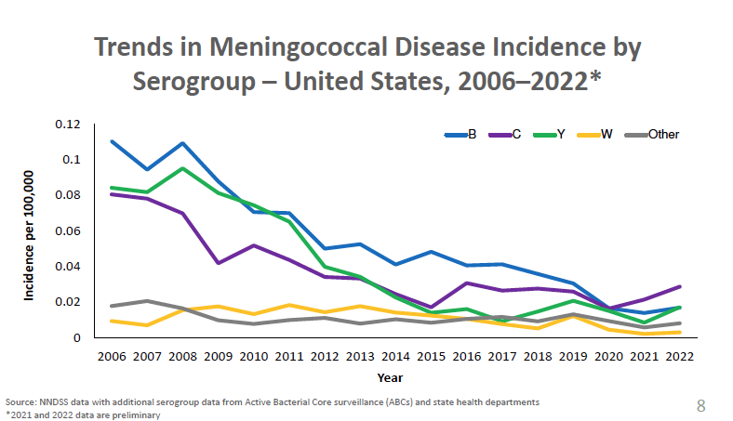

Slide 61
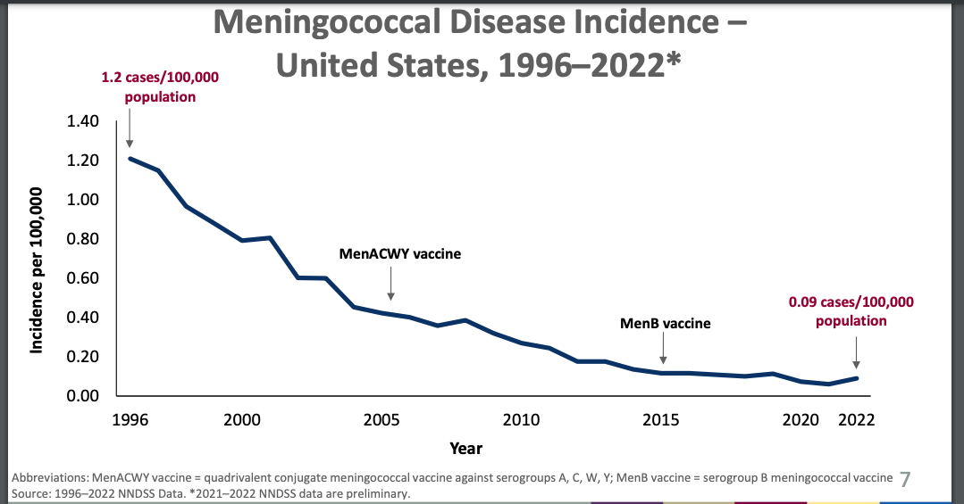
https://www.cdc.gov/vaccines/acip/meetings/downloads/slides-2023-06-21-23/03-Mening-Crowe-508.pdf
Notes:
Reference:
https://www.cdc.gov/vaccines/acip/meetings/downloads/slides-2023-06-21-23/03-Mening-Crowe-508.pdf
Speaker Notes:
Discuss overall incidence of Meningococcal disease

Slide 62
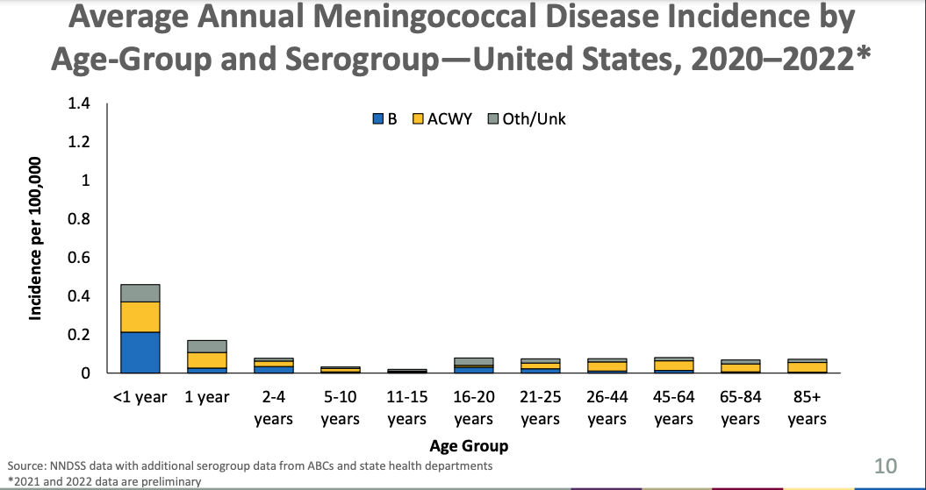
Notes:
Reference:
https://www.cdc.gov/vaccines/acip/meetings/downloads/slides-2023-06-21-23/03-Mening-Crowe-508.pdf

Slide 63
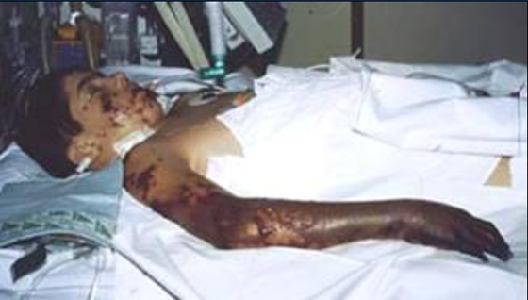
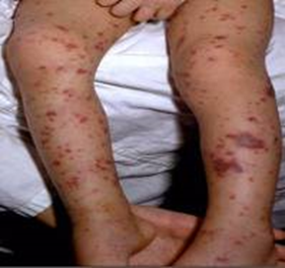
Signs and Symptoms of Meningococcal Disease
Risk factors
  Persistent complement component deficiencies
  Asplenia,
  HIV infection
  Exposure during an outbreak; Travel/residence in a country where disease is endemic/epidemic
  Household crowding, smoking,
  Unvaccinated college freshmen in dorms (particularly serogroup B)
  Military recruits
Symptoms of meningitis
    Sudden onset of fever
    Headache
    Stiff neck
    Photophobia
    Nausea and vomiting
Symptoms of meningococcemia
  All of the above are possible
  Cold hand and feet
  Pruritic rash
https://www.cdc.gov/mmwr/volumes/69/rr/rr6909a1.htm; MMWR, Sept 2020, Vol 69, RR 9
Notes:
Speaker Note:
Very scary:
The incubation period of meningococcal disease is typically 3 to 4 days, with a range of 1 to 10 days.
Meningitis is the most common presentation of invasive meningococcal disease and is found in about 50% of cases in the United States. Symptoms are similar to those seen in other forms of bacterial meningitis, and typically include sudden onset of fever, headache, and stiff neck, often accompanied by other symptoms, such as nausea, vomiting, photophobia (eye sensitivity to light), and altered mental status. Meningococci can be isolated from the blood in up to 75% of persons with meningitis.
Meningococcal septicemia (bloodstream infection or meningococcemia) occurs without meningitis in about 30% of invasive meningococcal infections. This condition is characterized by abrupt onset of fever; chills; cold hands and feet; severe aches or pain in the muscles, joints, chest, or abdomen; vomiting; diarrhea; and a petechial or purpuric rash, often associated with hypotension, shock, acute adrenal hemorrhage, and multiorgan failure.
An additional 15% of U.S. cases present with bacteremic pneumonia; this is the most common presentation in adults over 65 years of age. Other syndromes involving isolation of meningococci from normally sterile body sites, such as septic arthritis, can also occur.
Meningococci also occasionally cause noninvasive infections such as conjunctivitis or urethritis
Risk factors for the development of meningococcal disease include persistent complement component deficiencies (including use of a complement component inhibitor, eculizumab [Soliris®] or ravulizumab-cwvz [Ultomiris]), functional or anatomic asplenia, HIV infection, travel to or residence in a country where meningococcal disease is hyperendemic or epidemic, and exposure during an outbreak of meningococcal disease. Microbiologists who routinely work with isolates of N. meningitidis are also at risk. In addition, household crowding, active and passive smoking, and antecedent viral upper respiratory infection have been associated with meningococcal disease transmission.

Slide 64
Quadrivalent Meningococcal Conjugate Vaccine (MCV4) (Men A,C,W, Y)
Menactra™ licensed for 9 mos. through 55 years
Menveo® licensed for ages 2 mos. through 55 years
MenQuadfi® licensed for ages ≥ 2 yrs. of age
ACIP recommends for adolescents:
  Dose 1---age 11-12 years preferred
  Booster dose---age 16 years
  If 1st dose is received ≥16 years of age, a 2nd dose is not needed, unless they become at increased risk for meningococcal disease
Effective July 1, 2021, for the 2021-2022 school year, a meningococcal conjugate (MCV4/MenACWY) booster was required for all high school students entering the 11th grade and who are 16 years of age or older.
First-year college students who live in residential housing (if not previously vaccinated at age 16 years or older) or military recruits
Notes:
Reference:
http://www.cdc.gov/vaccines/acip/index.html
For more details about all the vaccine preventable diseases reviewed in this presentation, refer to: Epidemiology and Prevention of Vaccine-Preventable Diseases (The Pink Book). HHS, CDC. https://www.cdc.gov/vaccines/pubs/pinkbook/index.htm
ACIP recommends a single dose of MenACWY at age 11 or 12 years followed by a booster dose administered at age 16 years (Table 2). Children who received MenACWY at age 10 years do not need an additional dose at age 11–12 years but should receive the booster dose at age 16 years. Children who received MenACWY before age 10 years and with no ongoing risk for meningococcal disease for which boosters are recommended should still receive MenACWY according to the recommended adolescent schedule, with the first dose at age 11–12 years and a booster dose at age 16 years. For example, a healthy child who received MenACWY at age 9 years because of short-term travel to a country where meningococcal disease is hyperendemic or epidemic and who is not otherwise at increased risk should receive the MenACWY at age 11–12 years according to the recommended ACIP adolescent vaccination schedule. Children who received MenACWY before age 10 years and for whom boosters are recommended because of an ongoing increased risk for meningococcal disease (e.g., those with complement deficiency, HIV infection, or asplenia) should follow the booster schedule for persons at increased risk.
Adolescents who receive their first dose at age 13–15 years should receive a booster dose at age 16–18 years; the booster dose can be administered at any time, as long as a minimum interval of 8 weeks between doses is maintained. Adolescents who receive a first dose after their 16th birthday do not need a booster dose unless they become at increased risk for meningococcal disease. Persons aged 19–21 years who have not received a dose after their 16th birthday can receive a single MenACWY dose as part of catch-up vaccination. MenACWY vaccines are interchangeable; the same vaccine product is recommended, but not required, for all doses. MenACWY vaccines can be administered simultaneously with other vaccines indicated for this age group, but at a different anatomic site, if feasible. MenACWY-TT, which is conjugated to tetanus toxoid, is only licensed for the prevention of meningococcal disease; use of this vaccine does not replace doses or affect the dosing intervals of routinely recommended tetanus toxoid–containing vaccines in any age group.
First-year college students living in residence halls should receive at least 1 dose of MenACWY within 5 years before college entry. The preferred timing of the most recent dose is on or after their 16th birthday. If only 1 dose of vaccine was administered before the 16th birthday, a booster dose should be administered before enrollment. Adolescents who received a first dose after their 16th birthday do not need another dose before college entry unless >5 years have elapsed since the dose. Adolescents who are at increased risk due to medical conditions need a 2-dose primary series of MenACWY vaccine administered 8 weeks apart, as well as regular booster doses every 5 years.
CDC also recommends a booster dose for those at increased risk due to an outbreak if 5 or more years have passed since receiving MenACWY.
https://www.cdc.gov/vaccines/pubs/pinkbook/mening.html

Slide 65
Meningococcal Vaccines for High Risk
Persons 6 weeks – 55 years*
Menactra™ licensed for 9 mos. through 55 years
Menveo® licensed for ages 2 mos. through 55 years
MenQuadfi® licensed for ages ≥ 2 yrs. of age
Recommended for persons 2 months through 55 years**:
human immunodeficiency virus (HIV)***
Persistent complement component deficiency, complement inhibitor
functional or anatomic asplenia (sickle cell disease)
microbiologists exposed to isolates of N. meningitidis
part of a community outbreak due to vaccine serogroups
persons traveling internationally to regions with endemic meningococcal disease
For persons in any of these categories, consult the current ACIP Immunization Schedules for specific dosages and guidelines
*https://www.cdc.gov/mmwr/volumes/69/rr/rr6909a1.htm
Notes:
June 2016, ACIP recommended routine use of meningococcal conjugate vaccine for persons ages >2 months with human immunodeficiency virus infection. The majority of meningococcal disease among HIV-infected persons is caused by these four serogroups.
ACIP recommends HIV-infected infants 2 through 23 months should receive MenACWY-CRM (Menveo). HIV-infected children < 2 years should not receive MenACWY-D(Menactra) due to immune interference with PCV13.

Slide 66
Serogroup B Meningococcal Vaccine
Bexsero® licensed for ages 10 through 25 years (2 dose)
Trumenba® licensed for ages 10 through 25 years (2 or 3 dose)
ACIP recommends serogroup B meningococcal vaccine for*:
Persons with persistent complement component deficiencies
Persons with anatomic or functional asplenia
Persons receiving complement inhibitor
Microbiologists routinely exposed to isolates of Neisseria meningitidis
Persons considered at greater risk because of a serogroup B meningococcal disease outbreak**
Based on shared clinical decision making:
A Men B vaccine series may be administered to adolescents and young adults 16 through 23 years of age to provide short-term protection against most strains of Men B. Preferred age is 16-18 years.
Notes:
“MenB vaccine should be administered as either a 2-dose series of MenB-4C or a 3-dose series of MenB-FHbp. The same vaccine product should be used for all doses.“
On February 26, 2015 the ACIP approved for MenB vaccines be recommended for the use among persons aged >10 years at increased risk for serogroup B meningococcal disease. The ACIP determined that insufficient evidence existed to routinely recommend that all adolescents be vaccinated with MenB vaccines. ACIP agreed that the information provided would allow each individual health care professional to use shared clinical decision making when recommending the vaccine. MenB vaccine series may be administered to young adults 16-23 years of age to provide short-term protection against most strains of MenB.

Slide 67
Serogroup B Meningococcal
Vaccine Administration
Bexsero® licensed for ages 10 through 25 years (2 dose)
Trumenba® licensed for ages 10 through 25 years (2 dose or 3 dose)
The 2 vaccine products are not interchangeable.
MenB-FHbp (Trumenba®)
  2 dose schedule – administered at 0, 6 months; Healthy adolescents who are not at increased risk for meningococcal disease
  3 dose schedule – administered at 0, 1-2, 6 months; persons at increased risk for meningococcal disease and for use during serogroup B outbreaks
MenB-4C (Bexsero®)
  2 dose schedule – 0, 1-2 months
  Given to healthy adolescents who are not at increased risk for meningococcal disease
  Given to persons at increased risk for meningococcal disease and for use during serogroup B outbreaks
Notes:
Reference:
http://www.cdc.gov/vaccines/acip/index.html
For more details about all the vaccine preventable diseases reviewed in this presentation, refer to: Epidemiology and Prevention of Vaccine-Preventable Diseases (The Pink Book). HHS, CDC. https://www.cdc.gov/vaccines/pubs/pinkbook/index.htm
Speaker Notes:
For adolescents who are not otherwise at increased risk for meningococcal disease (e.g., due to complement deficiency or asplenia), a 2-dose series of MenB vaccine may be administered (based on shared clinical decision making) as follows: 2 doses of MenB-FHbp administered at 0 and 6 months or 2 doses of MenB-4C administered at 0 and ≥1 month.
Anatomic or functional asplenia (including sickle cell disease), persistent complement component deficiency, complement inhibitor (e.g., eculizumab, ravulizumab) use:
Bexsero®: 2-dose series at least 1 month apart
Trumenba®: 3-dose series at 0, 1–2, 6 months (if dose 2 was administered at least 6 months after dose 1, dose 3 not needed; if dose 3 is administered earlier than 4 months after dose 2, a 4th dose should be administered at least 4 months after dose 3)
Note: Bexsero® and Trumenba® are not interchangeable; the same product should be used for all doses in a series.
For MenB booster dose recommendations for groups listed under “Special situations” and in an outbreak setting and additional meningococcal vaccination information, see www.cdc.gov/mmwr/volumes/69/rr/rr6909a1.htm.
Primary series vaccination in persons aged ≥26 years and booster vaccination in persons at increased risk for meningococcal disease are not licensed in the United States and are considered off-label (Table 11).
https://www.cdc.gov/mmwr/volumes/69/rr/rr6909a1.htm

Slide 68
Meningococcal Vaccine
Booster Recommendations*
For persons at continued risk
  Meningococcal quadrivalent vaccine for persons who remain at increased risk
  Persons ≥10 years of age who previously received a MenB vaccine series
See *MMWR: Tables 2-11 https://www.cdc.gov/mmwr/volumes/69/rr/rr6909a1.htm#B1_down for further details.
https://www.cdc.gov/vaccines/hcp/acip-recs/vacc-specific/mening.html
Notes:
Speaker Notes: See slide

Slide 69
Rotavirus Vaccines
RotaTeq® (Merck) and Rotarix® (GSK)*
RV 5, RotaTeq®: 3 doses; ages 2, 4, 6 months
RV 1,Rotarix®: 2 doses; ages 2 and 4 months
ACIP recommendation:
2-3 doses depending on brand
Notes:
Reference:
http://www.cdc.gov/vaccines/acip/index.html
For more details about all the vaccine preventable diseases reviewed in this presentation, refer to: Epidemiology and Prevention of Vaccine-Preventable Diseases (The Pink Book). HHS, CDC.
https://www.cdc.gov/vaccines/pubs/pinkbook/rota.html
Rotavirus infection in infants and young children can lead to severe diarrhea, dehydration, electrolyte imbalance, and metabolic acidosis. Treatment is supportive; feeding should be continued during the illness. Children who are immunocompromised because of congenital immunodeficiency or because of bone marrow or solid organ transplantation may experience severe or prolonged rotavirus gastroenteritis and may have evidence of resulting abnormalities in multiple organ systems, particularly the kidney and liver.
The routine use of Rotavirus vaccine has resulted in a dramatic decrease in hospitalizations for the management of dehydration. In the developing world the use of the vaccine has dramatically reduced deaths from rotavirus infection.
Schedule is shown. Beware of min and maximum ages and intervals. Always review this to avoid admin errors!
Rotateq® (Merck & Co) is a live, oral pentavalent vaccine that contains 5 live reassortant rotaviruses. (G1, G2, G3 and G4.) It is referred to as RV5 rotavirus vaccine.
Ref: Rotateq® Prescribing Information December 2009
Rotarix® (GSK) is a live, oral, monovalent attenuated rotavirus vaccine. It is referred to as RV1 rotavirus vaccine. Ref: Rotarix® Prescribing Information October 2008
ACIP does not express a preference for RV5 or RV1.
Interchangeability of Rotavirus Vaccines
ACIP recommends that the rotavirus vaccine series be completed with the same product whenever possible. However, vaccination should not be deferred if the product used for previous doses is not available or is unknown. In this situation, the provider should continue or complete the series with the product available. If any dose in the series was RV5 or the product is unknown for any dose in the series, a total of three doses of rotavirus vaccine should be given.
Contraindications
Latex rubber is contained in the RV1 oral applicator, so infants with a severe (anaphylactic) allergy to latex should not receive RV1. The RV5 dosing tube is latex-free.
A virus (or parts of a virus) called porcine circovirus is present in both vaccines. There is no evidence that this virus is a safety risk or causes illness in humans².
Some studies have shown a small increase in cases of intussusception within one week after the first dose of rotavirus vaccine. The estimated risk is 1 case per 100,000 infants receiving the vaccine². However, the benefits of the vaccine outweigh the risk. Rotavirus vaccination is now contraindicated for 1) infants with a history of severe allergic reaction (e.g., anaphylaxis) after a previous dose of rotavirus vaccine or exposure to a vaccine component, 2) infants diagnosed with severe combined immunodeficiency (SCID), and 3) infants with a history of intussusception.
Reference: 1. Prevention of Rotavirus Gastroenteritis Among Infants and Children - Recommendations of the Advisory Committee on Immunization Practices (ACIP) MMWR; February 6, 2009 / 58(RR02);1-25
2. Rotavirus Vaccine Information Statement 08/26/2013
3. MMWR, October 21, 2011 / 60(41);1427-1427

Slide 70
Rotavirus Vaccines (2)
RotaTeq® (Merck) and Rotarix® (GSK)*
Administer either vaccine as directed below:
  Minimum age for first dose: 6 weeks
  Maximum age for first dose: 14 weeks 6 days. Do not start the series on or after age 15 weeks, 0 days
  Minimum interval between doses: 4 weeks
  Maximum age for any dose: 8 months 0 days
If any dose is Rotateq®, 3 doses are required
Use RotaTeq® if allergy to latex
Notes:
Reference:
http://www.cdc.gov/vaccines/acip/index.html
For more details about all the vaccine preventable diseases reviewed in this presentation, refer to: Epidemiology and Prevention of Vaccine-Preventable Diseases (The Pink Book). HHS, CDC.
https://www.cdc.gov/vaccines/pubs/pinkbook/rota.html
Rotavirus infection in infants and young children can lead to severe diarrhea, dehydration, electrolyte imbalance, and metabolic acidosis. Treatment is supportive; feeding should be continued during the illness. Children who are immunocompromised because of congenital immunodeficiency or because of bone marrow or solid organ transplantation may experience severe or prolonged rotavirus gastroenteritis and may have evidence of resulting abnormalities in multiple organ systems, particularly the kidney and liver.
The routine use of Rotavirus vaccine has resulted in a dramatic decrease in hospitalizations for the management of dehydration. In the developing world the use of the vaccine has dramatically reduced deaths from rotavirus infection.
Schedule is shown. Beware of min and maximum ages and intervals. Always review this to avoid admin errors!
Rotateq® (Merck & Co) is a live, oral pentavalent vaccine that contains 5 live reassortant rotaviruses. (G1, G2, G3 and G4.) It is referred to as RV5 rotavirus vaccine.
Ref: Rotateq® Prescribing Information December 2009
Rotarix® (GSK) is a live, oral, monovalent attenuated rotavirus vaccine. It is referred to as RV1 rotavirus vaccine. Ref: Rotarix® Prescribing Information October 2008
ACIP does not express a preference for RV5 or RV1.
Interchangeability of Rotavirus Vaccines
ACIP recommends that the rotavirus vaccine series be completed with the same product whenever possible. However, vaccination should not be deferred if the product used for previous doses is not available or is unknown. In this situation, the provider should continue or complete the series with the product available. If any dose in the series was RV5 or the product is unknown for any dose in the series, a total of three doses of rotavirus vaccine should be given.
Contraindications
Latex rubber is contained in the RV1 oral applicator, so infants with a severe (anaphylactic) allergy to latex should not receive RV1. The RV5 dosing tube is latex-free.
A virus (or parts of a virus) called porcine circovirus is present in both vaccines. There is no evidence that this virus is a safety risk or causes illness in humans².
Some studies have shown a small increase in cases of intussusception within one week after the first dose of rotavirus vaccine. The estimated risk is 1 case per 100,000 infants receiving the vaccine². However, the benefits of the vaccine outweigh the risk. Rotavirus vaccination is now contraindicated for 1) infants with a history of severe allergic reaction (e.g., anaphylaxis) after a previous dose of rotavirus vaccine or exposure to a vaccine component, 2) infants diagnosed with severe combined immunodeficiency (SCID), and 3) infants with a history of intussusception.
Reference: 1. Prevention of Rotavirus Gastroenteritis Among Infants and Children - Recommendations of the Advisory Committee on Immunization Practices (ACIP) MMWR; February 6, 2009 / 58(RR02);1-25
2. Rotavirus Vaccine Information Statement 08/26/2013
3. MMWR, October 21, 2011 / 60(41);1427-1427

Slide 71
Types of Human Papilloma Virus (HPV)
(More Than 200 Types Identified)
Mucosal/Genital
~40 types
Cutaneous
High risk types
16, 18, 31, 33, 45, 52, 58
(and others)
Low risk types
6, 11 and others
Cervical cancer
Anogenital cancer
Oropharyngeal Cancer
Cancer precursors
Low grade cervical disease
Genital Warts
Laryngeal Papillomas
Low grade cervical disease
Skin warts
Hands and Feet
*Epidemiology and Prevention of Vaccine Preventable Diseases 13th Edition, 2015
*Red Book – AAP 2018 Report of the Committee on Infectious Diseases
* MMWR, August 29, 2014, RR Vol. 63, No. 5
Notes:
Reference:
http://www.cdc.gov/vaccines/acip/index.html
For more details about all the vaccine preventable diseases reviewed in this presentation, refer to: Epidemiology and Prevention of Vaccine-Preventable Diseases (The Pink Book). HHS, CDC.
Speaker Notes:
More than 200 types have now been identified.
Virtually all cases of cervical cancer are caused by HPV viruses
Cervical cancer is the 2nd leading cause of cancer death in women in the world.

Slide 72
HPV Vaccine
Gardasil 9® (9vHPV) HPV types 6, 11, 16, 18, 31, 33, 45, 52, 58
ACIP recommends HPV vaccine starting at age 11 or 12 years for:
  All males and females through 26 years of age
  Catch-up vaccination for persons through age 26 who are not adequately vaccinated
Gardasil 9 is now also licensed for all persons 9 through 45 yrs. of age**
  Use the 3-dose schedule for persons 15-45 years of age
  Based on shared clinical decision making, the series may be given to persons ages 27-45.
Notes:
Recommendations for Use of HPV Vaccines
ACIP recommends that routine HPV vaccination be initiated at age 11 or 12 years. The vaccination series can be started beginning at age 9 years.
Reference:
http://www.cdc.gov/vaccines/acip/index.html
For more details about all the vaccine preventable diseases reviewed in this presentation, refer to: Epidemiology and Prevention of Vaccine-Preventable Diseases (The Pink Book). HHS, CDC.
3. https://www.merck.com/product/usa/pi_circulars/g/gardasil_9/gardasil_9_pi.pdf

Slide 73
2 Dose Schedule:
HPV vaccine initiated between 9-14 years can be given in two doses: 0, 6-12 months.
(If the 2nd dose is administered at least 5 months after 1st dose, it can be counted).
3 Dose Schedule:
HPV vaccine initiated after the 15th birthday or in persons with certain immunocompromising conditions should be vaccinated with the 3 dose schedule: 0, 1-2, 6 months
ACIP Recommendations and Schedule
*MMWR, December 16, 2016, Vol 65, No. 49
Notes:
Reference:
http://www.cdc.gov/vaccines/acip/index.html
For more details about all the vaccine preventable diseases reviewed in this presentation, refer to: Epidemiology and Prevention of Vaccine-Preventable Diseases (The Pink Book). HHS, CDC.
The ACIP meeting October 2016, approved the recommendation for a 2 dose vaccination schedule for HPV. The 2 dose schedule is only for adolescents that initiate the vaccine before the 15th birthday. If one-dose of the vaccine is administered before the 15th birthday and they turn 15 before receiving their 2nd dose, the two dose series can still be applied.
3-dose schedule
Dose 2 should be given at least 1 to 2 months after first dose (1 month minimum); Dose 3 should be given at least 6 months after the first dose
(minimum of 3 months between dose 2 and 3)

Slide 74
Reasons to Immunize Against HPV at age 11-12 Years
Higher antibody level attained when given to pre-teens rather than to older adolescents or women
At this age, more likely to be administered before onset of sexual activity
HPV can be transmitted by other skin-to-skin contact, not just sexual intercourse
There is no link between vaccine and riskier sexual behavior
Even those who abstain from sex until marriage can be infected by their marital partner
Individuals need to complete the series for full protection
This is an anti-cancer vaccine, and………….
Over 90% of HPV cancers are preventable through HPV vaccination.
Bottom line: NOT receiving a healthcare provider’s recommendation for HPV vaccine was one of the main reasons parents reported for not vaccinating their adolescent children.**
Notes:
Providers are less likely to recommend the HPV vaccine to their younger adolescent patients. They may be more comfortable reserving their recommendation for older teens, rather than for 11- and 12-year-olds. Providing clinicians with information about vaccine safety and efficacy to share with parents may increase endorsement of current HPV vaccine recommendations. ​
​
HPV vaccine should be recommended the same way other vaccines (Tdap, influenza and meningococcal) are recommended.​
Provide information about giving vaccine at a young age to increase immune response and protect before sexual activity begins​.
Cervical cancer is the only HPV-associated cancer for which screening is routinely recommended. MMWR/August 23, 2019/Vol. 68/No. 33
​
Reference: Gable, J.,Eder, J., Noonan, K. and Feemstar, K. Increasing HPV Vaccination Rates Among Adolescents: Challenges and Opportunities. PolicyLab: The Children’s Hospital of Philadelphia, 2016.​

Slide 75
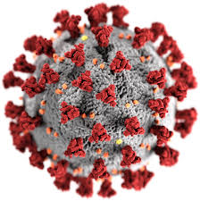
SARS-CoV-2 virus (COVID-19 disease and vaccines)
Insert slides from Full COVID-19 set or Brief Set as applicable
Also include FAQs on COVID at the end

Slide 76
Other vaccine news ACIP Meetings February 2023 and June 2023
Monkeypox – ACIP approved the following recommendation, February 22-24, 2023, meeting:
ACIP recommends the 2-dose JYNNEOS vaccine series for persons aged 18 years and older at risk of mpox during an mpox outbreak. https://www.cdc.gov/vaccines/acip/index.html
Notes:
References:
Per Slide
Also FDA Release:
https://www.fda.gov/news-events/press-announcements/fda-approves-new-drug-prevent-rsv-babies-and-toddlers
Today, the U.S. Food and Drug Administration approved Beyfortus (nirsevimab-alip) for the prevention of Respiratory Syncytial Virus (RSV) lower respiratory tract disease in neonates and infants born during or entering their first RSV season, and in children up to 24 months of age who remain vulnerable to severe RSV disease through their second RSV season.
“RSV can cause serious disease in infants and some children and results in a large number of emergency department and physician office visits each year,” said John Farley, M.D., M.P.H., director of the Office of Infectious Diseases in the FDA’s Center for Drug Evaluation and Research. “Today’s approval addresses the great need for products to help reduce the impact of RSV disease on children, families and the health care system.”
RSV is a virus that causes acute respiratory infection in individuals of all age groups. While most infants and young children experience mild, cold-like symptoms, some infants, especially with their first infection, develop lower respiratory tract disease such as pneumonia and bronchiolitis (swelling of the small airway passages in the lungs), that often leads to an emergency department or physician office visit. Premature infants, and those with chronic lung disease of prematurity or significant congenital heart disease, are at highest risk for severe RSV disease. Approximately 1% to 3% of children under 12 months of age in the United States are hospitalized each year due to RSV, according to the American Academy of Pediatrics.
In most parts of the U.S., RSV circulation is seasonal, typically starting during the fall and peaking in the winter; it is transmitted from person to person through close contact with someone who is infected.
Beyfortus is a monoclonal antibody with activity against RSV. Monoclonal antibodies are laboratory-made proteins that mimic the immune system’s ability to fight off harmful pathogens such as viruses. One dose of Beyfortus, administered as a single intramuscular injection prior to or during RSV season, may provide protection during the RSV season.
The safety and efficacy of Beyfortus were supported by three clinical trials (Trials 03, 04 and 05). The key measure of efficacy was the incidence of medically attended RSV lower respiratory tract infection (MA RSV LRTI), evaluated during the 150 days after Beyfortus administration. MA RSV LRTI included all health care provider visits (physician office, urgent care, emergency room visits and hospitalization) for lower respiratory tract disease with worsening clinical severity and a positive RSV test. Trials 03 and 04 were randomized, double-blind, placebo-controlled, multicenter clinical trials.
Trial 03 included 1,453 preterm infants (born at greater than or equal to 29 weeks of gestational age up to less than 35 weeks of gestation) who were born during or entering their first RSV season. Of the 1,453 preterm infants in the trial, 969 received a single dose of Beyfortus and 484 received placebo. Among infants who were treated with Beyfortus, 25 (2.6%) experienced MA RSV LRTI compared with 46 (9.5%) infants who received placebo. Beyfortus reduced the risk of MA RSV LRTI by approximately 70% relative to placebo.
For Trial 04, the primary analysis group within the trial included 1,490 term and late preterm infants (born at greater than or equal to 35 weeks in gestational age), 994 of whom received a single dose of Beyfortus and 496 of whom received placebo. Among infants who were treated with Beyfortus, 12 (1.2%) experienced MA RSV LRTI compared with 25 (5.0%) infants who received placebo. Beyfortus reduced the risk of MA RSV LRTI by approximately 75% relative to placebo.
Trial 05, a randomized, double-blind, active (palivizumab)-controlled, multicenter trial, supported the use of Beyfortus in in children up to 24 months of age who remain vulnerable to severe RSV disease through their second RSV season. The trial enrolled 925 preterm infants and infants with chronic lung disease of prematurity or congenital heart disease. The safety and pharmacokinetic data from Trial 05 provided evidence for the use of Beyfortus to prevent MA RSV LRTI in this population.
Possible side effects of Beyfortus include rash and injection site reactions. Beyfortus should not be given to infants and children with a history of serious hypersensitivity reactions to Beyfortus’ active ingredients or any of its excipients.
Beyfortus comes with warnings and precautions about serious hypersensitivity reactions, including anaphylaxis, which have been observed with other human IgG1 monoclonal antibodies. Beyfortus should be given with caution to infants and children with clinically significant bleeding disorders.
Beyfortus received a Fast Track designation for this indication.
The FDA granted this approval to AstraZeneca.

Slide 77
Respiratory Syncytial Virus (RSV)
Common respiratory virus
  mild, cold-like symptoms.
  Most people recover in a week or two, but RSV can be serious, especially for infants and older adults.
  Symptoms: upper respiratory tract infection which can include rhinorrhea, pharyngitis, cough, headache, fatigue, and fever.
  Disease usually lasts less than five days.
RSV is the most common cause of bronchiolitis (inflammation of the small airways in the lung) and pneumonia (infection of the lungs) in children younger than 1 year of age in the United States.
RSV is the leading cause of hospitalization in infants in the U.S.
https://www.cdc.gov/rsv/clinical/
Notes:
Reference: https://www.cdc.gov/rsv/clinical/
Speaker Notes:
Healthcare providers should consider RSV in patients with respiratory illness, particularly during the RSV season.
Respiratory syncytial virus (RSV) is recognized as one of the most common causes of childhood illness. It causes annual outbreaks of respiratory illnesses in all age groups. In most regions of the United States, RSV season starts in the fall and peaks in the winter, but the timing and severity of RSV season in a given community can vary from year to year.
Adults who get infected with RSV usually have mild or no symptoms. Symptoms are usually consistent with an upper respiratory tract infection which can include rhinorrhea, pharyngitis, cough, headache, fatigue, and fever. Disease usually lasts less than 5 days.

Slide 78
RSV Transmission
RSV can spread when
An infected person coughs or sneezes
You get virus droplets from a cough or sneeze in your eyes, nose, or mouth
You have direct contact with the virus, like kissing the face of a child with RSV
You touch a surface that has the virus on it, like a doorknob, and then touch your face before washing your hands
People infected with RSV are usually contagious for 3 to 8 days and may become contagious a day or two before they start showing signs of illness.
  However, some infants, and people with weakened immune systems can continue to spread the virus for as long as 4 weeks.
Notes:
Reference: https://www.cdc.gov/rsv/clinical/
Speaker Notes: Read Slide

Slide 79

RSV burden estimates
Each year in the U.S., RSV leads to approximately:
2.1 million outpatient (non-hospitalization) visits among children younger than 5 years old.
58,000-80,000 hospitalizations among children younger than 5 years old.
60,000-160,000 hospitalizations among adults 65 years and older.
6,000-10,000 deaths among adults 65 years and older.
100–300 deaths in children younger than 5 years old.
Notes:
Reference: https://www.cdc.gov/rsv/research/index.html
Speaker Notes: Read Slide

Slide 80
RSV Vaccines for Older Adults (1)
First two (2) vaccines approved by the FDA in May 2023 for prevention of RSV lower respiratory tract disease (LRTD) for use in adults aged ≥60 years.
  RSVPreF3 (Arexvy, GSK) is a 1-dose (0.5 mL) adjuvanted (AS01_{E}) recombinant stabilized prefusion F protein (preF) vaccine
  RSVpreF (Abrysvo, Pfizer) is a 1-dose (0.5 mL) recombinant stabilized preF vaccine

Slide 81
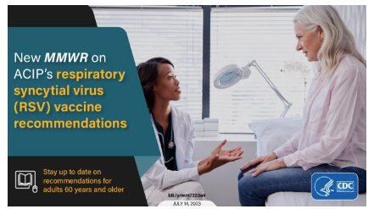
ACIP Recommendations: RSV Vaccines for Older Adults
Both vaccines recommended by ACIP in June 2023: adults aged ≥60 years may receive a single dose of an RSV vaccine, using shared clinical decision-making.
Optimally, vaccination should occur before the onset of the RSV season; however, typical RSV seasonality was disrupted by the COVID-19 pandemic and has not returned to prepandemic patterns.
https://www.cdc.gov/mmwr/volumes/72/wr/mm7229a4.htm
Notes:
Reference: https://www.cdc.gov/mmwr/volumes/72/wr/mm7229a4.htm
RSV Vaccine
RSV vaccine helps protect adults 60 years and older from RSV disease. Older adults are at greater risk than young adults for serious complications from RSV because immune systems weaken with age. In addition, certain underlying medical conditions may increase the risk of getting very sick from RSV and older adults with these conditions may especially benefit from getting RSV vaccine. If you are 60 years and older, talk to your healthcare provider to see if RSV vaccination is right for you.

Slide 82
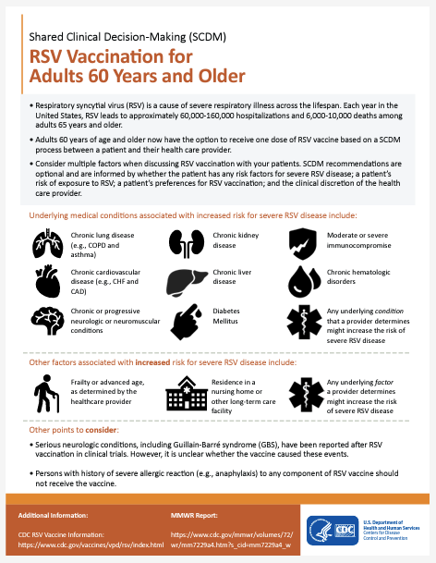
www.cdc.gov/vaccines/vpd/rsv/downloads/provider-job-aid-for-older-adults-508.pdf
Adults 60 years of age and older now have the option to receive one dose of RSV vaccine based on discussion between a patient and their health care provider.
Consider multiple factors should be considered when having the discussion regarding RSV vaccination including:
If the patient has any risk factors for severe RSV disease
A patient’s risk of exposure to RSV
A patient’s preferences for RSV vaccination
The clinical discretion of the health care provider.

Slide 83
RSV Vaccines for Older Adults:
Summary: Vaccine Efficacy and Safety
Vaccination with a single dose of the GSK or Pfizer RSV vaccines demonstrated moderate to high efficacy in preventing symptomatic RSV-associated LRTD over two consecutive RSV seasons among adults aged ≥60 years.
Although trials were underpowered to estimate efficacy against RSV-associated hospitalization and death, prevention of LRTD, including medically attended LRTD, suggests that vaccination might prevent considerable morbidity from RSV disease among adults aged ≥60 years.
Although both vaccines were generally well-tolerated with an acceptable safety profile, six cases of inflammatory neurologic events (including GBS, ADEM, and others) were reported after RSV vaccination in clinical trials. Whether these events occurred due to chance, or whether RSV vaccination increases the risk for inflammatory neurologic events is currently unknown.
https://www.cdc.gov/mmwr/volumes/72/wr/mm7229a4.htm
Notes:
Reference: https://www.cdc.gov/mmwr/volumes/72/wr/mm7229a4.htm
Speaker Note: See Slide
Background information:
GSK Vaccine
Evaluated efficacy evidence for the GSK RSV vaccine consisted of data from one ongoing randomized, double-blind, placebo-controlled phase 3 clinical trial conducted in 17 countries and including 24,973 immunocompetent participants aged ≥60 years randomized 1:1 to receive 1 dose of vaccine (intervention group, 120 μg preF protein with AS01_{E} adjuvant) or saline placebo (control group) (20). Efficacy findings were based on analyses of data collected during May 2021–March 2023, which included two complete RSV seasons for Northern Hemisphere participants and one complete RSV season for Southern Hemisphere participants. Efficacy analyses for season one spanned May 2021–April 2022, while efficacy analyses for season two spanned August 2022–March 2023; exact study-defined season dates were site-dependent. Mean time from vaccination to end of efficacy follow-up across both seasons was approximately 15 months per participant.
The efficacy of 1 dose of the GSK vaccine in preventing symptomatic, laboratory-confirmed RSV-associated LRTD¶ was 82.6% (96.95% CI = 57.9%–94.1%) during the first RSV season and 56.1% (95% CI = 28.2%–74.4%) during the second season (Table 1).** Efficacy of 1 dose over two seasons was 74.5% (97.5% CI = 60.0%–84.5%) in preventing RSV-associated LRTD and 77.5% (95% CI = 57.9%–89.0%) in preventing medically attended RSV-associated LRTD.†† The study was not powered to estimate efficacy against hospitalization (intervention group = one event; control group = five events), severe RSV illness requiring respiratory support (intervention group = one event; control group = five events),§§ or death (no events).¶¶
Evidence regarding safety of the GSK vaccine consisted of data from two randomized, double-blind, placebo-controlled clinical trials, including the same ongoing phase 3 trial (20) and a phase 1/2 trial with 201 participants aged ≥60 years who received either the vaccine formulation used in phase 3 or placebo (21). Across both clinical trials, severe reactogenicity events (grade 3 solicited local or systemic reactions recorded during days 0–4 [phase 3 trial] and days 0–7 [phase 1/2 trial] after vaccination) occurred in 3.8% of the intervention group participants, compared with 0.9% of the control group participants (pooled relative risk [RR] = 4.10; 95% CI = 1.99–8.45) (Table 2). The frequency of serious adverse events (SAEs)*** across both trials was similar in the intervention (4.4%) and control (4.3%) groups (pooled RR = 1.02; 95% CI = 0.91–1.15). A higher number of participants in the intervention group than in the control group reported atrial fibrillation as an unsolicited event within the 30 days after injection (intervention = 10 events [0.1%]; control = four events [<0.1%]), eight of which were SAEs [intervention = seven; control = one]; three of the SAEs corresponded to new onset atrial fibrillation (intervention = two; control = one) (22).
Across all GSK vaccine clinical trials in older adults, inflammatory neurologic events were reported in three of 17,922 participants within 42 days after receipt of the GSK vaccine (23). All three events occurred in trials excluded from GRADE because of lack of an unvaccinated comparator arm. The reported cases included one case of GBS in a participant aged 78 years from Japan with symptom onset 9 days postvaccination in an open-label phase 3 clinical trial and two cases of ADEM among participants in a randomized phase 3 coadministration study (15,22). The two ADEM cases were reported in participants aged 71 years from the same site in South Africa after concomitant receipt of the GSK vaccine and standard dose seasonal influenza vaccine; symptom onset occurred 7 and 22 days postvaccination, and one case was fatal. In both ADEM cases, the diagnosis was based on symptoms and clinical findings only; diagnostic testing (including brain imaging, cerebrospinal fluid testing, and nerve conduction studies) was not performed, leading to uncertainty in the diagnoses. The investigator in the fatal case later revised the diagnosis from ADEM to hypoglycemia and dementia (15,22).
Pfizer Vaccine
Evaluated efficacy evidence for the Pfizer vaccine consisted of data from one ongoing, randomized, double-blind, placebo-controlled phase 3 clinical trial conducted in seven countries and including 36,862 immunocompetent participants aged ≥60 years randomized 1:1 to receive 1 dose of vaccine (intervention group, 120 μg preF protein) or placebo containing the same buffer ingredients as the vaccine but without active components (control group) (24). Efficacy findings were based on analyses of data collected during August 2021–January 2023, which included one complete RSV season for Northern and Southern Hemisphere participants and a partial second season for Northern Hemisphere participants only. Efficacy analyses for season one spanned August 2021–October 2022, while efficacy analyses for season two spanned July 2022–January 2023; exact study-defined season dates were site-dependent. Mean follow-up time from vaccination to end of efficacy follow-up across both seasons, including a gap in RSV surveillance between the first and second RSV seasons, was approximately 12 months per participant.
Efficacy of 1 dose of the Pfizer vaccine in preventing symptomatic, laboratory-confirmed RSV-associated LRTD††† was 88.9% (95% CI = 53.6%–98.7%) during the first RSV season and 78.6% (95% CI = 23.2%–96.1%) during the partial second season (Table 3).§§§ Efficacy of a single dose over two seasons was 84.4% (95% CI = 59.6%–95.2%) in preventing RSV-associated LRTD and 81.0% (95% CI = 43.5%–95.2%) in preventing medically attended RSV-associated LRTD.¶¶¶ The study was not powered to estimate efficacy against hospitalization (intervention group = one event; control group = three events), severe RSV illness requiring respiratory support (intervention group = one event; control group = one event),**** or death (no events).††††
Evidence regarding safety of the Pfizer vaccine consisted of data from two randomized, double-blind, placebo-controlled clinical trials, including the same ongoing phase 3 trial (24), and a phase 1/2 trial with 91 participants aged ≥65 years who received either the vaccine formulation used in phase 3 or placebo (25). Across both clinical trials, severe reactogenicity events (grade 3 or higher local or systemic reactions recorded during days 0–7 after vaccination) occurred in 1.0% of the intervention group participants, compared with 0.7% of the control group participants (pooled RR = 1.43; 95% CI = 0.85–2.39) (Table 4). The frequency of SAEs across both trials was similar in the intervention (4.3%) and control (4.1%) groups (pooled RR = 1.04; 95% CI = 0.94–1.15). A higher number of participants in the intervention group than in the control group reported atrial fibrillation as an unsolicited event within the 30 days after injection (intervention = 10 events [<0.1%]; control = four events [<0.1%], of which seven were SAEs [intervention = four; control = three]). Among participants who reported atrial fibrillation, a medical history of atrial fibrillation was reported by six of 10 Pfizer vaccine recipients and two of four placebo recipients (26).
Across all Pfizer vaccine clinical trials among older adults, inflammatory neurologic events were reported in three of 20,255 participants within 42 days after receipt of the vaccine (15,26,27). The events included GBS in a participant aged 66 years from the United States with symptom onset 14 days postvaccination; Miller Fisher syndrome (a GBS variant) in a participant aged 66 years from Japan with symptom onset 10 days postvaccination; and undifferentiated motor-sensory axonal polyneuropathy with worsening of preexisting symptoms 21 days postvaccination in a participant aged 68 years from Argentina (15,26,27).

Slide 84
ACIP Recommendations(2)
RSV vaccination is currently approved and recommended for administration as a single dose. Currently, there is no recommendation for revaccination .
Optimally, vaccination should occur before the onset of the RSV season; however, typical RSV seasonality was disrupted by the COVID-19 pandemic and has not returned to prepandemic patterns.
https://www.cdc.gov/mmwr/volumes/72/wr/mm7229a4.htm
Notes:
Shared Clinical Decision-Making for Adults Aged ≥60 years. Unlike routine and risk-based vaccine recommendations, recommendations based on shared clinical decision-making do not target all persons in a particular age group or an identifiable risk group. For RSV vaccination, the decision to vaccinate a patient should be based on a discussion between the health care provider and the patient, which might be guided by the patient’s risk for disease and their characteristics, values, and preferences; the provider’s clinical discretion; and the characteristics of the vaccine.
As part of this discussion, providers and patients should consider the patient’s risk for severe RSV-associated disease. Epidemiologic evidence indicates that persons aged ≥60 years who are at highest risk for severe RSV disease and who might be most likely to benefit from vaccination include those with chronic medical conditions such as lung diseases, including chronic obstructive pulmonary disease and asthma; cardiovascular diseases such as congestive heart failure and coronary artery disease; moderate or severe immune compromise (either attributable to a medical condition or receipt of immunosuppressive medications or treatment)¶¶¶¶; diabetes mellitus; neurologic or neuromuscular conditions; kidney disorders, liver disorders, and hematologic disorders; persons who are frail; persons of advanced age; and persons with other underlying conditions or factors that the provider determines might increase the risk for severe RSV-associated respiratory disease (Box). Adults aged ≥60 years who are residents of nursing homes and other long-term care facilities are also at risk for severe RSV disease. It should be noted that the numbers of persons enrolled in the trials who were frail, were of advanced age, and lived in long-term care facilities were limited, and persons with compromised immunity were excluded (some of whom might have an attenuated immune response to RSV vaccination). However, adults aged ≥60 years in these populations may receive vaccination using shared clinical decision-making given the potential for benefit.
RSV Vaccination Timing
RSV vaccination is currently approved and recommended for administration as a single dose; sufficient evidence does not exist at this time to determine the need for revaccination. Optimally, vaccination should occur before the onset of the RSV season; however, typical RSV seasonality was disrupted by the COVID-19 pandemic and has not returned to prepandemic patterns. For the 2023–24 season, clinicians should offer RSV vaccination to adults aged ≥60 years using shared clinical decision-making as early as vaccine supply becomes available and should continue to offer vaccination to eligible adults who remain unvaccinated.

Slide 85
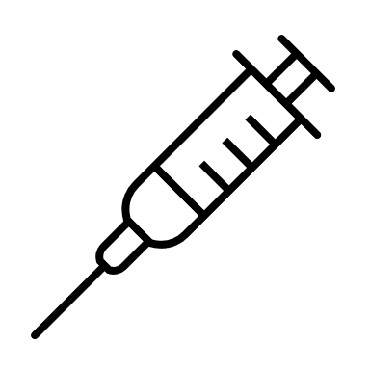
RSV Vaccine Administration
RSV vaccine may be co-administered with other adult vaccines at the same visit.
Administering RSV vaccine with one or more other vaccines at the same visit might increase local or systemic reactogenicity. Data are only available for coadministration of RSV and influenza vaccines, and evidence is mixed regarding increased reactogenicity.
As with all vaccines, RSV vaccination should be delayed for persons experiencing moderate or severe acute illness with or without fever (precaution).
RSV vaccines are contraindicated for and should not be administered to persons with a history of severe allergic reaction, such as anaphylaxis, to any component of the vaccine.
Notes:
Reference: https://www.cdc.gov/mmwr/volumes/72/wr/mm7229a4.htm
Vaccine Administration, Including Coadministration with Other Vaccines
Coadministration of RSV vaccines with other adult vaccines during the same visit is acceptable.***** Available data on immunogenicity of coadministration of RSV vaccines and other vaccines are currently limited. Coadministration of RSV and seasonal influenza vaccines met noninferiority criteria for immunogenicity with the exception of the FluA/Darwin H3N2 strain when the GSK RSV vaccine was coadministered with adjuvanted quadrivalent inactivated influenza vaccine (28,29). RSV and influenza antibody titers were somewhat lower with coadministration; however, the clinical significance of this is unknown.
Administering RSV vaccine with one or more other vaccines at the same visit might increase local or systemic reactogenicity. Data are only available for coadministration of RSV and influenza vaccines, and evidence is mixed regarding increased reactogenicity. Data are lacking on the safety of coadministration with other vaccines that might be recommended for persons in this age group, such as COVID-19 vaccines; pneumococcal vaccines; adult tetanus, diphtheria, and pertussis vaccines; and the recombinant zoster vaccine (the recombinant zoster vaccine and GSK’s RSV vaccine contains the same adjuvant). When deciding whether to coadminister other vaccines with an RSV vaccine, providers should consider whether the patient is up to date with currently recommended vaccines, the feasibility of the patient returning for additional vaccine doses, risk for acquiring vaccine-preventable disease, vaccine reactogenicity profiles, and patient preferences. Postlicensure efficacy and safety monitoring of coadministered RSV vaccines with other vaccines will further direct guidance.
Precautions and Contraindications
As with all vaccines, RSV vaccination should be delayed for persons experiencing moderate or severe acute illness with or without fever (precaution). RSV vaccines are contraindicated for and should not be administered to persons with a history of severe allergic reaction, such as anaphylaxis, to any component of the vaccine (30,31

Slide 86
Respiratory Syncytial Virus (RSV) Prevention in Infants
Infants aged <8 months born during or entering their first Respiratory Syncytial Virus (RSV) season are recommended to receive one dose of nirsevimab (50 mg for infants <5 kg and 100 mg for infants ≥5 kg).
Children aged 8–19 months who are at increased risk of severe RSV disease and entering their second RSV season are recommended to receive one dose of nirsevimab (200 mg).
The CDC Director adopted these recommendations on August 3, 2023 and are now official. They were published in MMWR on August 25, 2023.
https://www.cdc.gov/mmwr/volumes/72/wr/mm7234a4.htm

Slide 87
New RSV Prophylaxis for Infants and Young Children
Nirsevimab (Beyfortus) is a long-term monoclonal antibody product designed to protect infants and high-risk young children from severe RSV disease. (It is not a vaccine)
May be coadministered with other recommended age-appropriate vaccines. Coadministration of nirsevimab with routine vaccines resulted in a similar rate of adverse events compared with administration of vaccines alone
Nirsevimab is not expected to interfere with the immune response to other routine childhood immunizations
https://www.cdc.gov/mmwr/volumes/72/wr/mm7234a4.htm
Notes:
Reference:
https://www.cdc.gov/rsv/clinical/index.html
https://www.cdc.gov/mmwr/volumes/72/wr/mm7234a4.htm
Speaker Notes:
July 17 2023: the U.S. Food and Drug Administration approved Beyfortus (nirsevimab-alip) for the prevention of Respiratory Syncytial Virus (RSV) lower respiratory tract disease in neonates and infants born during or entering their first RSV season, and in children up to 24 months of age who remain vulnerable to severe RSV disease through their second RSV season.
Beyfortus is a monoclonal antibody with activity against RSV. Monoclonal antibodies are laboratory-made proteins that mimic the immune system’s ability to fight off harmful pathogens such as viruses. One dose of Beyfortus, administered as a single intramuscular injection prior to or during RSV season, may provide protection during the RSV season.
The safety and efficacy of Beyfortus were supported by three clinical trials (Trials 03, 04 and 05). The key measure of efficacy was the incidence of medically attended RSV lower respiratory tract infection (MA RSV LRTI), evaluated during the 150 days after Beyfortus administration. MA RSV LRTI included all health care provider visits (physician office, urgent care, emergency room visits and hospitalization) for lower respiratory tract disease with worsening clinical severity and a positive RSV test. Trials 03 and 04 were randomized, double-blind, placebo-controlled, multicenter clinical trials. Possible side effects of Beyfortus include rash and injection site reactions. Beyfortus should not be given to infants and children with a history of serious hypersensitivity reactions to Beyfortus’ active ingredients or any of its excipients.
Palivizumab (Synagis) is a monoclonal antibody product recommended by the American Academy of Pediatrics (AAP) for administration to high-risk infants and young children likely to benefit from immunoprophylaxis based on gestational age and certain underlying medical conditions. It is given in monthly intramuscular injections during RSV season. For the latest palivizumab guidance, please consult the AAP policy statement. An accompanying AAP technical report provides additional context and rationale for the guidance. Interim guidance addressing the disruption in typical RSV seasonal patterns during the pandemic has also been provided: Updated Guidance: Use of Palivizumab Prophylaxis to Prevent Hospitalization From Severe Respiratory Syncytial Virus Infection During the 2022-2023 RSV Season (aap.org)

Slide 88
Nirsevimab use in Young Children
Timing: On the basis of pre–COVID-19 pandemic patterns, nirsevimab could be administered in most of the continental United States from October through the end of March. Infants born shortly before or during the RSV season should receive nirsevimab within 1 week of birth.
  Nirsevimab administration can occur during the birth hospitalization or in the outpatient setting.
  Optimal timing for nirsevimab administration is shortly before the RSV season begins; however, nirsevimab may be administered to age-eligible infants and children who have not yet received a dose at any time during the season.
Dosing: Only a single dose of nirsevimab is recommended for an RSV season. Infants with prolonged birth hospitalizations related to prematurity or other causes should receive nirsevimab shortly before or promptly after hospital discharge
https://www.cdc.gov/mmwr/volumes/72/wr/mm7234a4.htm
Notes:
shortly before the start of the RSV season. On the basis of pre–COVID-19 pandemic patterns, nirsevimab could be administered in most of the continental United States from October through the end of March. Infants born shortly before or during the RSV season should receive nirsevimab within 1 week of birth. Nirsevimab administration can occur during the birth hospitalization or in the outpatient setting. Optimal timing for nirsevimab administration is shortly before the RSV season begins; however, nirsevimab may be administered to age-eligible infants and children who have not yet received a dose at any time during the season. Only a single dose of nirsevimab is recommended for an RSV season. Infants with prolonged birth hospitalizations related to prematurity or other causes should receive nirsevimab shortly before or promptly after hospital discharge.¶¶¶¶ No evidence is available to support use of nirsevimab for prevention of hospital-acquired RSV infection, and nirsevimab is not recommended for this indication.

Slide 89
Nirsevimab (Precautions and Contraindications)
When administering nirsevimab to children with increased risk for bleeding, providers should follow ACIP’s general best practice guidelines for immunization
Nirsevimab is contraindicated in persons with a history of severe allergic reaction (e.g., anaphylaxis) after a previous dose or to a product component.
Adverse reactions might occur after administration of nirsevimab alone; these reactions may be reported to MedWatch online (https://www.fda.gov/medwatch), by fax, by mail, or by contacting FDA at 1-800-FDA-1088.
Adverse reactions might occur after the coadministration of nirsevimab with a vaccine; these reactions should be reported to the Vaccine Adverse Event Reporting System (VAERS), and reports should specify that the patient received nirsevimab on the VAERS form.
https://www.cdc.gov/mmwr/volumes/72/wr/mm7234a4.htm

Slide 90
Health Alert Network Regarding Nirsevimab limited availability, Oct 2023
In the context of limited supply during the 2023–2024 RSV season, CDC recommends:
  prioritizing available nirsevimab 100mg doses for infants at the highest risk for severe RSV disease: young infants (age <6 months) and infants with underlying conditions that place them at highest risk for severe RSV disease.
  Recommendations for using 50mg doses remain unchanged at this time.
  Avoid using two 50mg doses for infants weighing ≥5 kilograms (≥11 pounds) to preserve supply of 50mg doses for infants weighing <5 kilograms (<11 pounds).
  Providers should be aware that some insurers may not cover the cost of two 50mg doses for an individual infant.
https://emergency.cdc.gov/han/2023/han00499.asp

Slide 91
Health Alert Network Regarding Nirsevimab limited availability, Oct 2023
CDC further recommends that providers suspend using nirsevimab in palivizumab-eligible children aged 8–19 months for the 2023–2024 RSV season.
These children should receive palivizumab (Synagis) per the American Academy of Pediatrics (AAP) recommendations.
Nirsevimab should continue to be offered to American Indian and Alaska Native children aged 8–19 months who are not palivizumab-eligible and who live in remote regions, where transporting children with severe RSV for escalation of medical care is more challenging or in communities with known high rates of RSV among older infants and toddlers.
Prenatal care providers should discuss potential nirsevimab supply concerns when counseling pregnant people about RSVpreF vaccine (Abrysvo, Pfizer) as maternal vaccination is effective and will reduce the number of infants requiring nirsevimab during the RSV season.

Slide 92
Frequently Asked Questions- Nirsevimab
CDC: https://www.cdc.gov/vaccines/vpd/rsv/hcp/child.html
AND https://www.cdc.gov/vaccines/vpd/rsv/hcp/child-faqs.html
AAP: https://www.aap.org/en/patient-care/respiratory-syncytial-virus-rsv-prevention/nirsevimab-frequently-asked-questions/?_ga=2.47295983.930835342.1699556459-982398732.1689165195

Slide 93
RSV Vaccine Pregnant People
On August 21, 2023, FDA approved the first vaccine for use in pregnant individuals to prevent lower respiratory tract disease (LRTD) and severe LRTD caused by respiratory syncytial virus (RSV) in infants from birth through 6 months of age.
Abrysvo (Pfizer) is approved for use at 32 through 36 weeks gestational age of pregnancy.
Abrysvo (Pfizer) is administered as a single dose injection into the muscle.
Refer to: https://www.cdc.gov/rsv/clinical/index.html for ACIP recommendations.

Slide 94
Test Your Knowledge!
Emily is 12 years old and comes to your office for a physical exam. Her immunizations were up-to-date when she started kindergarten.
What vaccines do you recommend for her?

Slide 95
Test Your Knowledge!
Emily is 12 years old and comes to your office for a physical exam. Her immunizations were up-to-date when she started kindergarten.
What vaccines do you recommend for her?
Tdap, Meningococcal Conjugate, HPV
Influenza vaccine (in the fall), COVID-19 vaccine
*Current Child and Adolescent Immunization Schedule
Notes:
.

Slide 96
Test Your Knowledge!
Paige is 24 years old. She has well controlled diabetes. She will be getting married in 3 months. Paige has received 2 doses of MMR and her last Td was 4 years ago. She denies ever having chicken pox but her 2 younger siblings had chicken pox.
What vaccines are recommended now?

Slide 97
Test Your Knowledge!
Paige is 24 years old. She has well controlled diabetes. She will be getting married in 3 months. Paige has received 2 doses of MMR and her last Td was 4 years ago. She denies ever having chicken pox but her 2 younger siblings had chicken pox.
What vaccines are recommended now?
Tdap, PPSV23/PCV20/PCV15, hepatitis B, HPV, varicella
Influenza vaccine (in fall), COVID-19 vaccine
*Current Adult Immunization Schedule
Notes:
Tdap
Pneumococcal (PPSV23) and hepatitis B vaccine because of her diabetes.
HPV
Seasonal Influenza
Varicella
MMR? No.
Hepatitis A? No
Meningococcal? No
One point for discussion:
Before administering a two dose series of varicella vaccine the health-care provider should suggest that Paige ask her parent(s)/other relative if she had chicken pox as a child. If her two younger siblings had chicken pox and she did not develop chicken pox at the same time it is likely she had chicken pox previously. If her parents do not remember her having the disease or the history of chicken pox is not reliable or questionable she should be immunized with varicella vaccine.
The ACIP recommends Hepatitis B vaccine for unvaccinated adults with diabetes mellitus ages 19 through 59 years. Hepatitis B vaccine may be administered to those age 60 years and older at the discretion of the treating clinician. (MMWR/December 23, 2011/Vol.60/No. 50)

Slide 98

Critical Elements for
Immunization Services

Slide 99
Strategies to Avoid Missed Opportunities to Vaccinate
Provider Prompts
  Automatic pop-up alerts through your EHR system
  These can sometimes be pre-installed and then customized in your office
Family-friendly office hours
  Occasional evening or Saturday hours
  “No-appointment-required” if needing immunizations only
*https://www.aap.org/en-us/advocacy-and-policy/aap--health-initiatives/immunizations/Practice- Management/Pages/office- strategies.aspx

Slide 100
Strategies to Avoid Missed Opportunities to Vaccinate (2)
Immunization Champion in your practice
  Manage vaccine supply and schedule periodic updates
  Any member of the staff could fill this role
Include all recommended vaccines at each visit
Schedule periodic team meetings with all personnel to:
  Improve patient flow
  Improve quality of care
  Discuss problems within the framework of the practice
*https://www.aap.org/en-us/advocacy-and-policy/aap--health-initiatives/immunizations/Practice- Management/Pages/office- strategies.aspx

Slide 101
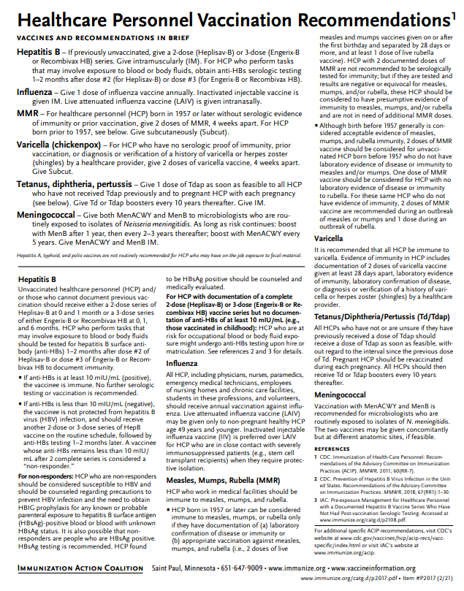
Recommended Healthcare Personnel Vaccinations
Hepatitis B (exposure risk) check immunity
Influenza (annual)
Measles, Mumps, Rubella (MMR)
Varicella (Chickenpox)
Tetanus, Diphtheria, Pertussis (Tdap)
Meningococcal (recommended for microbiologists who are routinely exposed to isolates of N. meningitidis).
COVID-19 vaccine
Are YOU up to date?
Available at www.immunize.org, P#2017
Notes:
Un-immunized HCP
Un-immunized healthcare workers are at risk of infecting patients, family members and community contacts
Immunized HCP
Protect patients from VPD’s
Help offices avoid potential liability cases. (The practice can be liable if an unimmunized HCP becomes infected with a vaccine preventable disease and infects a patient.)
Maintain productivity
Reduce illness and illness-related absenteeism
Evidence of Immunity to MMR
Documented administration of two doses of measles and mumps vaccine and one dose of rubella vaccine OR
Laboratory evidence of immunity or laboratory confirmation of disease (measles, mumps and rubella) OR
Born before 1957 (measles, mumps and rubella)
Because of their contact with patients or infective material from patients, many HCP are at risk for exposure to (and possible transmission of) vaccine-preventable diseases. Employers and HCP have a shared responsibility to prevent occupationally acquired infections and avoid causing harm to patients by taking reasonable precautions to prevent transmission of vaccine-preventable diseases.
Optimal use of recommended vaccines helps maintain immunity and safeguard HCP from infection, thereby helping protect patients from becoming infected. The recommendations for vaccination of HCP are presented in two categories: 1) those diseases for which routine vaccination or documentation of immunity is recommended for HCP because of risks to HCP in their work settings and, should HCP become infected, to the patients they serve and 2) those diseases for which vaccination of HCP might be indicated in certain circumstances. Vaccines recommended in the first category are hepatitis B, seasonal influenza, measles, mumps, and rubella, pertussis, and varicella vaccines. Vaccines in the second category are meningococcal, typhoid, and polio vaccines.

Slide 102

Hepatitis B Immunization Status for Previously Vaccinated HCP with No Post-vaccination Testing
Positive antibody (anti-HBs) = ≥10 mIU/ml
Adequate
Yes
I dose vaccine—retest 4-6 wks.
Yes
Complete vaccine series—retest 4-6 wks.
Yes
Document positive antibody status
No need for Hepatitis B prophylaxis, regardless of source patient Hep B surface antigen status
NO
NO
NO
Document as “non-responder”
Test for HBsAg and anti-HBc (core antigen) to determine infection status
*MMWR, April 20, 2018/Vol. 67/No. 15

Slide 103
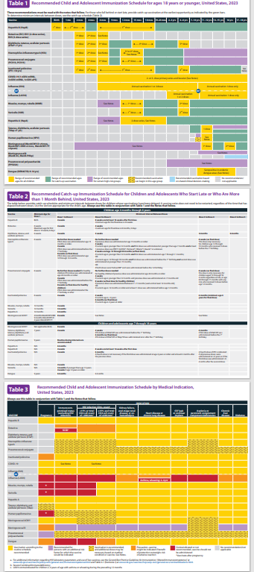
2023 Childhood and Adolescent Immunization Schedules
Recommended Schedule for Children Ages 0-18 Years
Catch-up Schedule
Vaccines that might be indicated for children and adolescents aged 18 years or younger based on medical indications
Changes
Clarification of the charts
Additional information in the Notes section
READ THE FOOTNOTES TO ACCESS SPECIFIC VACCINE ADMINISTRATION DETAILS!

Slide 104
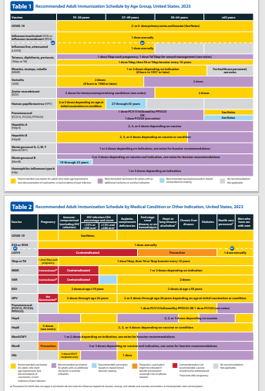
2023 Recommended Immunization Schedule for Adults Aged ≥19 Years
Recommended adult schedule by age group
Recommended immunization schedule for adults aged 19 years or older by medical condition and other indications
Changes
Clarification of the charts
Additional information in the Notes section
READ THE FOOTNOTES TO ACCESS SPECIFIC VACCINE ADMINISTRATION DETAILS!

Slide 105


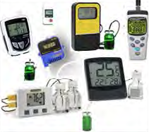
Updated Vaccine Storage and Handling Recommendations
Use stand-alone refrigerator and stand-alone freezer units. If combined, use only refrigerator part.
Do not store any vaccine in a dormitory-style or bar-style combined refrigerator/freezer unit.
Use a bio-safe glycol-encased probe or a similar temperature buffered probe
Probes should be calibrated every 1-2 yrs. or according to manufacturers’ guidelines
Use digital data loggers.
Do not store ANYTHING ELSE in refrigerator.
Review vaccine expiration dates and rotate vaccine stock weekly.
*Vaccine Storage and Handling Toolkit, January, 2020
Notes:
It is estimated that 17-37% of immunization providers expose vaccines to improper storage temperatures. More commonly, refrigerators are kept too cold rather than too warm. The potency of vaccines stored at incorrect temperatures may be irreversibly reduced. A physical change in the vaccine may not be apparent.
Remember: if you find temperatures out of range, TAKE ACTION, DO SOMETHING ABOUT IT!

Slide 106
Maintaining Appropriate
Vaccine Storage & Handling
Assign a primary and alternate vaccine coordinator.
Store all vaccines as recommended by manufacturer and IN ORIGINAL PACKAGING, WITH THE LID CLOSED.
Monitor and record temperatures of refrigerator and freezer twice daily.
Correct ranges: refrigerator 36° F to 46° F; freezer -58° F to +5° F
Maintain temperature log records for 3 years.
Take immediate action for all out-of-range temps.
Implement a vaccine emergency system.
If it is necessary to transport vaccine, do NOT use dry ice. See Vaccine Storage and Handling Toolkit, Section 6 for Transport System Recommendations.
For COVID-19 vaccine, see specific vaccine guidelines.
*Vaccine Storage and Handling Toolkit, January 2020
Notes:
Remember: if you find temperatures out of range, TAKE ACTION, DO SOMETHING ABOUT IT!

Slide 107
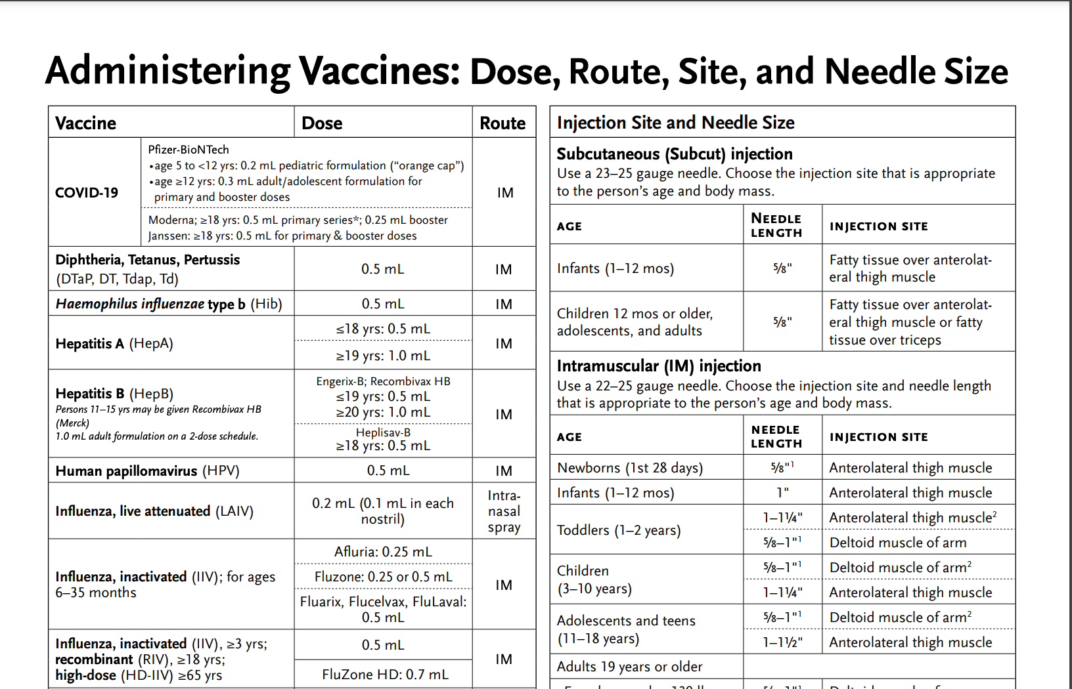
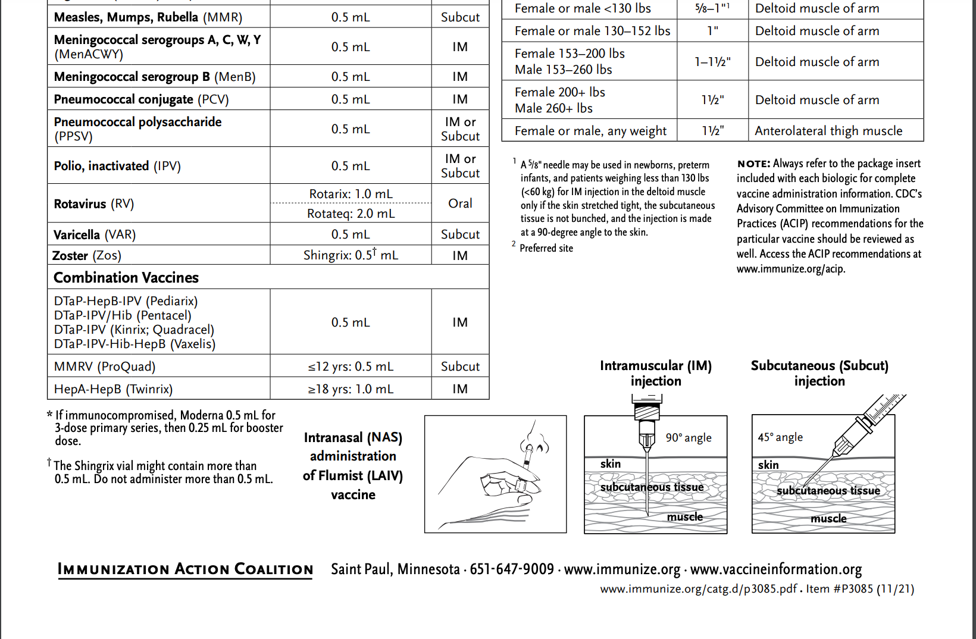
Vaccine Administration Best practices – Route, Dose, Site, Needle Size
https://www.immunize.org/catg.d/p3085.pdf
Notes:
Always verify the dose, route, site and needle size.

Slide 108
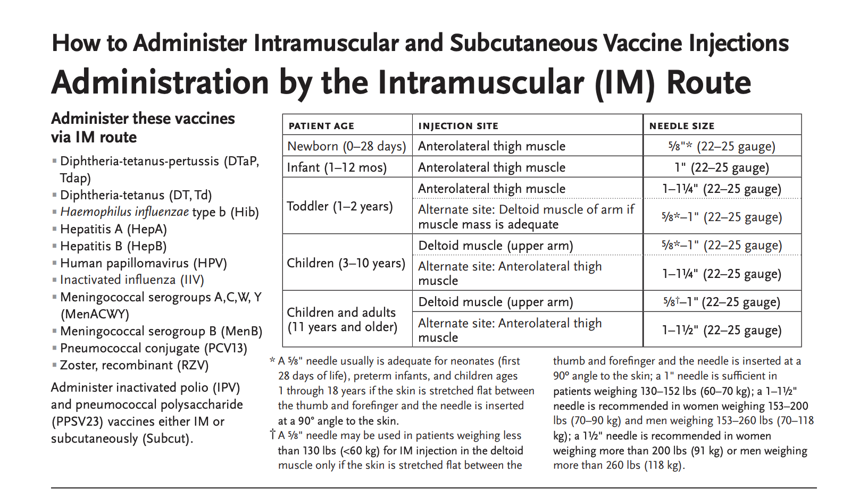
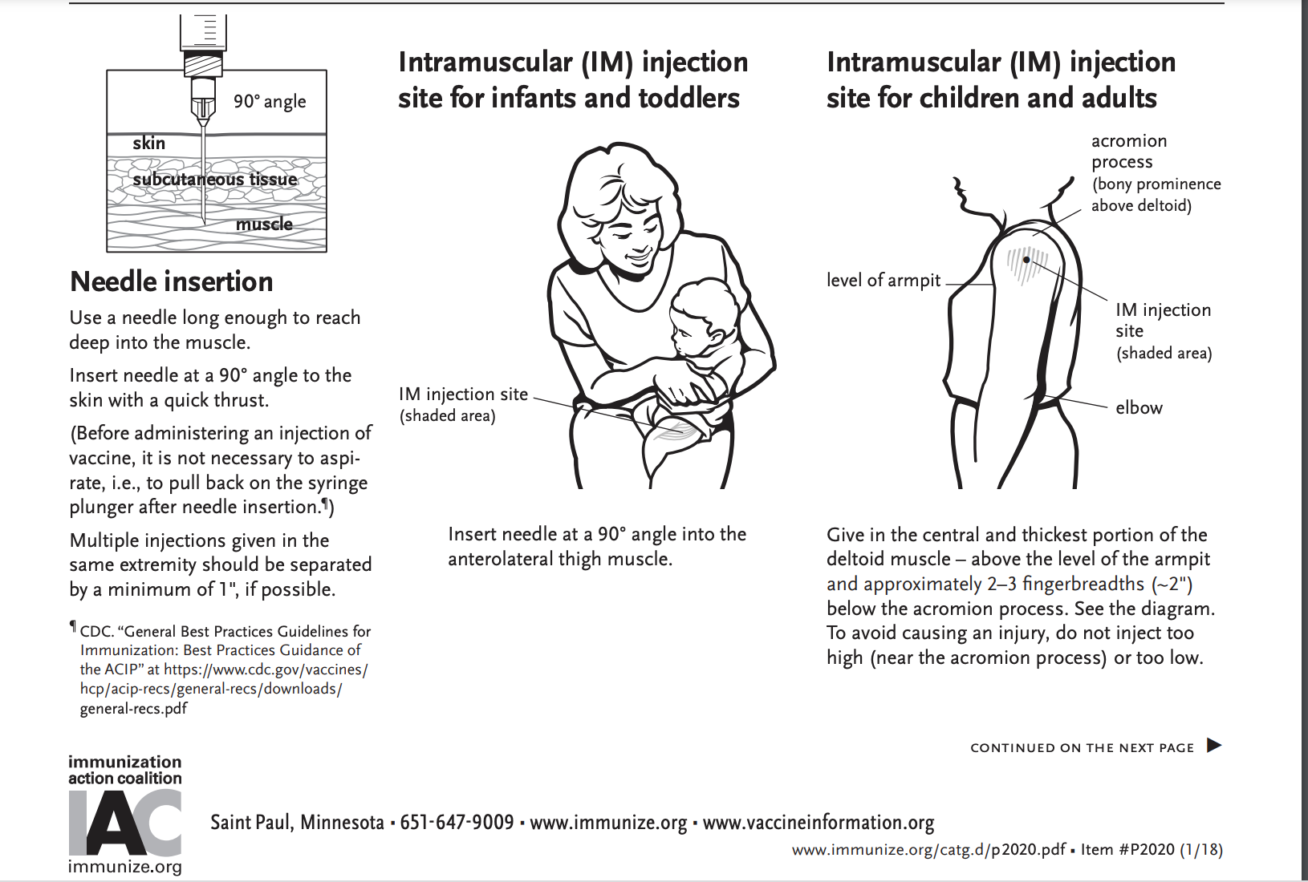
How to administer IM and SC vaccine injections
https://www.immunize.org/catg.d/p2020.pdf

Slide 109
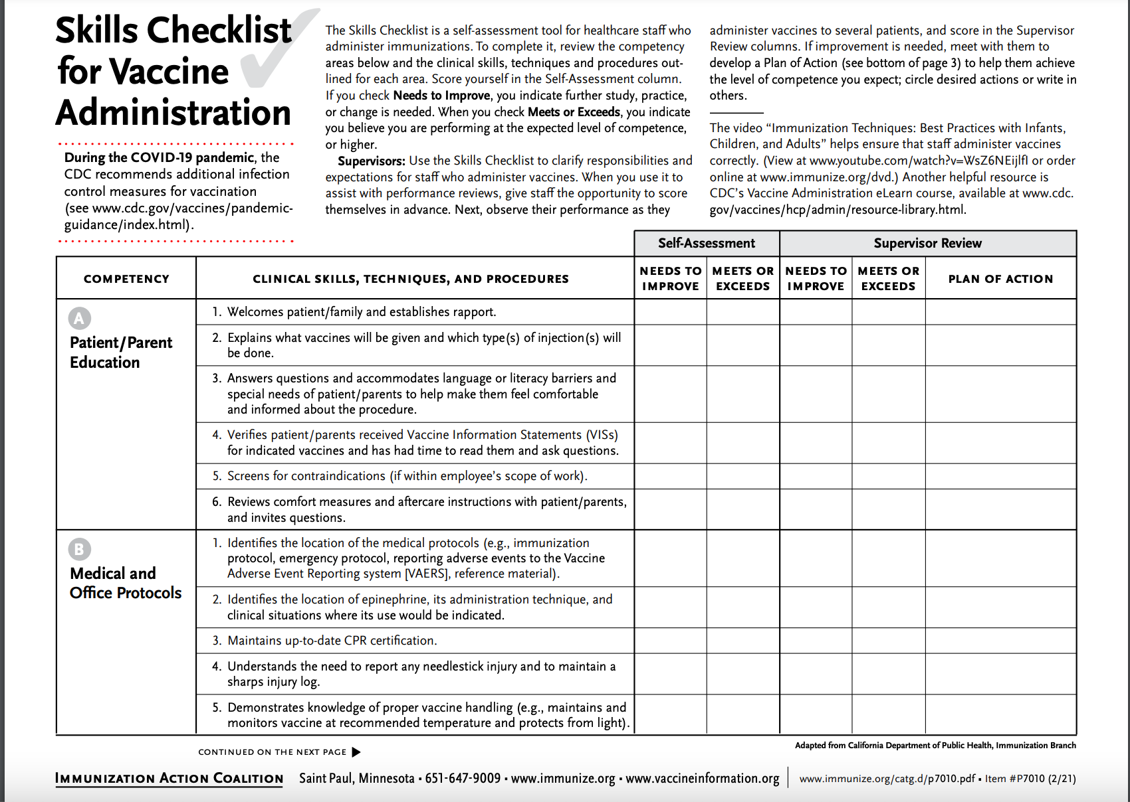


Training Tools: Skills Checklist for Vaccine Administration
https://www.immunize.org/catg.d/p7010.pdf

Slide 110
Improper Immunization Administration
Practices with Any Vaccine
DO NOT re-use needles or syringes, due to the possibility of:
  Transmission of blood-borne viruses (HCV, HBV, HIV)
  Referral of providers to licensing boards for disciplinary action
  Malpractice suits filed by patients
Never use partial doses from 2 or more vials to obtain a dose of vaccine.**
Per OSHA and the CDC, you MAY use the same needle to withdraw a diluent, inject this into a lyophilized vaccine vial, and then administer to a patient, providing the needle or syringe has not otherwise been contaminated.**
*CDC, NCEZIZ, DHQP. Injection Safety Information for Providers: www.cdc.gov/injectionsafety/providers.html
**http://www.immunize.org/askexperts/administering-vaccines.asp
**Vaccine Storage and Handling Toolkit, January, 2020
Notes:
Per OSHA and the CDC, changing needles between drawing vaccine from a vial and injecting it into a recipient is not necessary unless the needle has been damaged or contaminated.

Slide 111



Always Document…
Accept only written documentation of prior immunizations
Provide VIS prior to administration of vaccine
After vaccine administration, document:
  Publication date of VIS & date VIS given
  Date, site, route, antigen(s), manufacturer, lot #
  Person administering vaccine, practice name and address
  Vaccine refusals with a signed “Refusal to Vaccinate Form”—see Online Resources slide for link to this form
  GA law does not require signed consent for immunizations
Notes:
Vaccine Information Sheets
VIS required by law for each vaccine given and each time that vaccine is given. The most current VIS must be used. For VIS statements in English and many other languages: www.immunize.org; www.cdc.gov/vaccines/ or call the National Immunization Program Information Hotline at 800-CDC-INFO (800-232-2522).
VIS can be provided at the same time or prior to allow time for questions and educate the parent/client about the vaccine.
Document all information listed on slide. Information will also be helpful if a specific lot of vaccine is recalled in the future.
Refusal to consent for an immunization should be documented for liability purposes and chart completeness. There is no way to document this in GRITS.
Georgia recognizes only medical and religious exemptions.
Medical exemptions must be documented in GRITS and be re-evaluated every year.
Georgia law does not require signed consent for immunization. Patients, parents or legal guardians may verbally consent to immunization. However, some practices may require written consent for all medical care.

Slide 112

A ‘Birth to Death’ Immunization Registry
Providers administering vaccines in Georgia must provide appropriate information to GRITS.
GRITS personnel can work with your EHR/EMR vendor to create an interface between your system and GRITS.
Use GRITS to generate reminders on medical records and/or notify patients when vaccines are needed.
Assess your immunization rates using GRITS to improve patient care, HEDIS scores, and identify problem areas.
Call the GRITS Training Coordinator (404) 463-0807 or e-mail : https://dph.georgia.gov/georgia-immunization-registry-grits
Notes:
In 2004, House Bill 1526 was passed making the Georgia Immunization Registry a birth to death registry mandating that providers of immunizations in Georgia report those immunizations into the registry database. Immunization data may now be shared by all providers of immunizations to Georgians of any age, and to schools, daycares, colleges and universities, and long term care facilities. The patient (age 18 or older) or parent or legal guardian may OPT-OUT of the registry.
Contact GRITS to enroll: 1-888-223-8644
Benefits of GRITS include: accurate immunization records, inventory tracking, reduction in missed opportunities or over-immunization, generation of school entrance forms/college immunization forms, reminder/recall notices for parents, assistance in generating reporting of immunizations to HEDIS/COCASA, and elimination of phone calls to providers for immunization records. The GRITS program is web-based. New users to the system will have to attend a training session and receive a password.
Advantages of a statewide registry are as follows:
Benefits to the Community
Enhance the overall health status by facilitating identification of inadequately immunized segments of the population
Decrease occurrence of over-immunization due to inability to locate past records
Assist in issuing reminders to patients for pending and overdue immunizations
Benefits to Healthcare Providers
Reduce staff time needed to obtain complete immunization history of patients
Provide printouts of school certificates
Provide vaccine information and simplify complex and dynamic immunization schedules
Streamline vaccine inventory process
Generate HEDIS and other reports
Reinforce the concept of a medical home
Benefits to Public Health Officials
Provide an accurate measure of immunization rates for districts, counties, and the state
Allow Georgia healthcare providers to update and exchange immunization information about their patients in a confidential manner
Facilitate community outreach programs
The Georgia Code 31-12-3.1, which took affect July 1, 1996 and House Bill 1526, which took affect July 1, 2004 states:
Any person who administers a vaccine or vaccines licensed for use by the United States Food and Drug Administration to a person shall, for each such vaccination, provide to the department such data as are deemed by the department to be necessary and appropriate for purposes of the vaccination registry established pursuant to subsection (a) of this Code section…

Slide 113
Test Your Knowledge!
Your office has a large supply of vaccine and space in the refrigerator is always an issue. Since the vaccines can not be stored in the vegetable drawers, the “vaccine manager” removed the bins and is storing some of the vaccines in the space occupied by the drawers.
Is this storage space appropriate?

Slide 114
Test Your Knowledge!
Your office has a large supply of vaccine and space in the refrigerator is always an issue. Since the vaccines can not be stored in the vegetable drawers, the “vaccine manager” removed the bins and is storing some of the vaccines in the space occupied by the drawers.
Is this storage space appropriate?
No! The area is commonly closer to the motor of the refrigerator and temperature may be less stable.
*Immunization Action Coalition – Item #P3036 8/18
Notes:
Vaccines should not be stored in vegetable bins or the space occupied by vegetable bins because this area is commonly closer to the motor of the unit and temperatures may be less stable. The experts recommend that you remove the vegetable bins and put bottles of water in that space to help maintain a constant temperature in your refrigerator. Vaccines should be placed in the center of the refrigerator, away from the walls and floor of the unit in open containers so air can circulate around the vaccines. You also do not want the top shelf in the refrigerator too close to the vents that come from the freezer because this can expose your vaccines to freezing temperatures.
Reference: Ask the Experts (Immunization Action Coalition)

Slide 115
Exemptions From School/Day Care Requirements
Medical Exemption O.C.G.A. §20-2-771(d)
Used when a physical disability or medical condition contraindicates a particular vaccine.
Requires an annual review.
The medical exemption is documented in GRITS.
Religious Exemption O.C.G.A. §20-2-771(e)
Parent or guardian must be directed to http://dph.georgia.gov/immunization-section to obtain an Affidavit of Religious Objection to Immunization form.
This form must be signed and notarized and provided to the school.
Must be kept on file at school/facility in lieu of an immunization certificate.
Affidavit does not expire.
Georgia does NOT have a philosophical exemption.
Notes:
Medical exemptions should be entered in GRITS and will be listed on the immunization certificate. Medical exemptions must be reviewed on an annual basis.
Georgia now has an Affidavit of Religious Objection to Immunization form that must be filled out for if the parent is refusing immunizations due to a religious exemption. See URL on slide.
The form lists all vaccines that are required for admittance into childcare facilities or schools in Georgia. It confirms the safety of vaccines. The form also states that risks if a child is not vaccinated such as, contracting vaccine preventable diseases and spreading them to others. Lastly the form mentions the exclusion of the child from childcare or school during an epidemic or outbreak of a vaccine preventable disease.
The form must be signed and notarized. It does not expire and must be kept on file at the school or childcare facility.

Slide 116

Monitoring Vaccine Safety
VAERS—Vaccine Adverse Event Reporting System
Option 1 - Report Online to VAERS (Preferred)
Submit a VAERS report online. The report must be completed online and submitted in one sitting and cannot be saved and returned to at a later time. Your information will be erased if you are inactive for 20 minutes; you will receive a warning after 15 minutes.
Option 2 - Report using a Writable PDF Form
Download the Writable PDF Form to a computer. Complete the VAERS report offline if you do not have time to complete it all at once. Return to this page to upload the completed Writable PDF form by clicking here.
If you need further assistance with reporting to VAERS, please email info@VAERS.org or call 1-800-822-7967.
FDA and Vaccine Data Link Safety Project
VERP: VACCINE ERROR REPORTING SYSTEM
  On line reporting at http://verp.ismp.org/
  Report even if no adverse events associated with incident
  Will help identify sources of errors to help develop prevention strategies
Notes:
Nothing is 100% risk free. Most reactions to vaccines are mild with very small risk of severe allergic reactions (anaphylaxis).
Systems in place to monitor safety include the FDA (pre and post licensure monitoring) and the Vaccine Safety Datalink (VSD) Project. This large project links 4 HMO's at 10 sites with the CDC to monitor adverse events possibly caused by vaccines.
FDA monitors vaccines for safety before issuing licenses - very stringent licensing involving laboratory and human testing; vaccine safety is also monitored after licensure to ensure each vaccine lot is effective and pure. Vaccine manufacturers also do post-licensure monitoring.
The Institute of Medicine reviews research related to vaccine safety and publishes a report periodically.
VAERS
Updated system. Two options for reporting are outlined in the gray box.
Passive reporting system to monitor vaccine adverse events established by the National Childhood Vaccine Injury Act 1986
Mandates patients/ parents are educated about risk of vaccines and compensated for any injury caused by vaccine.
Emphasize there is no penalty for reporting an “adverse event”. The healthcare provider is only reporting that a specific event occurred after administration of a specific vaccine and is not claiming that the event was caused by the vaccine.
VERP – There is relatively little data available on why vaccine administration errors occur. The Institute for Safe Medication Practice (ISMP) has launched a national patient safety reporting program to capture the unique causes and consequences of vaccine –related errors. The ISMP National Vaccine Error Reporting Program (ISMP VERP) allows healthcare practitioners to report errors and near misses in confidence.
Sources of Vaccine Safety Information:
https://www.cdc.gov/vaccines/hcp/vis/index.html www.cdc.gov/vaccinesafety/
www.idsociety.org www.vaccinesafety.edu
www.acponline.org www.aap.org
www.aafp.org www.immunize.org
www.vaccine.chop.edu www.vaers.hhs.gov

Slide 117
Invalid Contraindications to Vaccine
Mild illness or injury
Antibiotic therapy
Disease exposure or convalescence
Pregnancy or immunosuppression in household
Family history of an adverse event to a vaccine
Breastfeeding
Prematurity
Allergies to products not in vaccine
Need for TB skin testing
Need for multiple vaccines
*https://www.cdc.gov/vaccines/hcp/acip-recs/general-recs/index.html
Notes:
ANTIBIOTIC THERAPY
Antibiotics do not have an effect on the immune response to a vaccine. [Exception: The growth of the live Ty21, a strain of typhoid vaccine, is inhibited in vitro by various antibacterial agents. Some antibacterial agents may interfere with efficacy of Ty21 vaccine. CDC Yellow Book (Health Information for Travelers) recommends delaying vaccine >72 hours after any antibacterial agent. The Typhoid VIS recommends a delay of >24 hours.]
DISEASE EXPOSURE OR CONVALESCENCE
There is no evidence that either disease exposure or convalescence will affect the response to a vaccine or increase the likelihood of an adverse event.
PREGNANCY OR IMMUNOSUPPRESSION IN THE HOUSEHOLD OR BREASTFEEDING
Most vaccines, including live vaccines (MMR, varicella, and yellow fever) can be given to infants or children with pregnant or immunosuppressed household contacts, as well as to breast-feeding infants. Breastfeeding does not decrease the response to routine childhood vaccines and does not extend or improve passive immunity to vaccine-preventable disease provided by maternal antibody.
PREMATURE BIRTH
Vaccines should be started on schedule based on the child's chronological age. Studies demonstrate that decreased seroconversion rates might occur among certain premature infants with low birth weights (i.e., <2,000 grams) after administration of hepatitis B vaccine at birth. However, by one month chronological age, all premature infants, regardless of initial birthweight or gestational age are as likely to respond as adequately as older and larger infants.
NEED OR REQUIREMENT FOR TUBERCULOSIS SKIN TEST (PPD)
All vaccines, including MMR, can be given on the same day as a TB skin test, or any time after a TB skin test is applied. MMR vaccine may decrease the response to a TB skin test, potentially causing a false negative response in someone who actually has an infection with tuberculosis. If MMR has been given and one or more days have elapsed, in most situations it is recommended to wait 4-6 weeks before giving a routine TB skin test. No information on the effect of varicella vaccine on a TB skin test is available. It is prudent to apply rules for spacing measles vaccine and TB skin testing to varicella vaccine."
ADMINISTERING VACCINES TO HOUSEHOLD MEMBERS OF IMMUNOCOMPROMISED PATIENTS
Immunocompetent individuals who live in a household with immunocompromised patients can safely receive inactivated vaccines. They may also receive live virus vaccines such as MMR, varicella, rotavirus, zoster, yellow fever, and oral typhoid vaccines if indicated. LAIV should be avoided in some instances. (See Footnote 3).

Slide 118
Vaccine Risk Perception
Many parents of young children are not familiar with vaccine-preventable diseases and perceive the risks of vaccines outweigh the benefits
Concerns
  Immune system overload
  Children get too many shots at one visit
  Vaccines have side effects (adverse reactions)
  Immunity from the disease is better than immunity from a vaccine (i.e. chicken pox)
  Vaccines cause autism
Notes:
Vaccine Concerns
-One quarter of parents mistakenly believe that vaccines weaken the immune system.
-One quarter of parents believe that children get more immunizations than are good for them.
-On the plus side, the child's health care provider is seen as the most important source for immunization information. (Gellin, B., et.al. "Do parents understand immunizations? A national telephone survey." Pediatrics, 106(5); 1097-1102).
Answers to common concerns about vaccines
Vaccines do not weaken the immune system (we give a small antigen load even at peak times/ages in the vaccine schedule)
Natural immunity is not better than vaccines (ex: shingles in those who have had chicken pox natural illness)
Vaccine-preventable diseases are serious illnesses with the possibility of complications and even death
Well controlled studies during the past 10 years have failed to show any association between MMR vaccine or thimerosal and autism. However, many anti-vaccine groups continue to promote the association of autism and MMR vaccine and the dangers of thimerosal.
For more information about these topics (and others of concern to parents/patients) visit http://www.cdc.gov/vaccinesafety/

Slide 119
Provider Strategies to Improve Vaccination Rates
Strengthening vaccination recommendations
  Increased emphasis in the practice on training re: vaccine safety and efficacy for ALL employees having patient contact
  Having OB doctors begin the promotion of vaccines with expectant mothers, for themselves and for their newborn
  Be alert to avoid missed opportunities
  Decrease acceptance of alternative schedules
Strengthening vaccine mandates
  Eliminating nonmedical exemptions
  Increased enforcement of state mandates by schools and childcare facilities
*Children’s Hospital of Philadelphia, Vaccine Update for Healthcare Providers, “News & Views: Addressing Vaccine Hesitancy,” March 21, 2017

Slide 120
Provider Strategies (cont’d)
Attention to requirements of “informed refusal”**
  Explain basic facts/uses of proposed vaccine
  Review risks of refusing the vaccine(s)
  Discuss anticipated outcomes with and without vaccination
  Parental/patient completion of Refusal to Vaccinate form each visit
Importance of documenting informed refusal to vaccinate**
  Claims of failure to warn of consequences of failing to vaccinate have resulted in successful lawsuits
  Documented informed refusal creates a record of interaction between parents/patients and providers
*Children’s Hospital of Philadelphia, Vaccine Update for Healthcare Providers, “News & Views: Addressing Vaccine Hesitancy,” March 21, 2017
**AAP Publications, “Document informed refusal just as you would informed consent,” James P. Scibilia, M.D. FAAP, October 30, 2018

Slide 121
Vaccine Schedules that Vary From ACIP/AAP/AAFP Recommendations
Alternate Schedules
Dr. Bob’s Selective Vaccine Schedule
Dr. Bob’s Alternative Vaccine Schedule
Parent-derived schedules
Parent/caretaker refusal of all vaccines
Concerns re: alternate schedules
Alternate or delayed schedules have not been tested
No studies to prove they are safer
If any of these Alternate Schedules are requested, the health care provider and staff must spend additional time educating the parent/caretaker about the appropriate use of vaccines.
Notes:
Quote from:
The Problem With Dr Bob's Alternative Vaccine Schedule*
“For parents who are worried about vaccines, Sears offers 2 alternative schedules. One, titled “Dr Bob’s Selective Vaccine Schedule,” is for parents who want to decline or to delay vaccines. Children whose parents choose this schedule might not be receiving the measles, mumps, rubella, varicella, and hepatitis A vaccines and will not be receiving the polio and influenza vaccines or a booster dose of pertussis vaccine. The other schedule, titled “Dr Bob’s Alternative Vaccine Schedule,” is written for parents who worry that children are receiving too many vaccines too early. Children whose parents choose this schedule will not be receiving the influenza vaccine until 5 years of age (which is unfortunate, given that tens of thousands of children 4 years of age are hospitalized with complications resulting from influenza every year),(³⁴) will not be receiving the hepatitis B vaccine until 2.5 years of age, will not be receiving measles vaccine until 3 years of age, and, to space out vaccines so that children do not receive 2 shots at 1 visit, will be visiting the doctor for vaccines at 2, 3, 4, 5, 6, 7, 9, 12, 15, 18, 21, and 24 months and 2, 2.5, 3, 3.5, 4, 5, and 6 years of age. Increasing the number of vaccines, the number of office visits, and the ages at which vaccines are administered will likely decrease immunization rates. In addition to the logistic problem of requiring so many office visits, Sears’ recommendation might have another negative consequence; recent outbreaks of measles showed that several children acquired the disease while waiting in their pediatricians’ offices.⁽⁷⁾
At the heart of the problem with Sears’ schedules is the fact that, at the very least, they will increase the time during which children are susceptible to vaccine-preventable diseases. If more parents insist on Sears’ vaccine schedules, then fewer children will be protected, with the inevitable consequence of continued or worsening outbreaks of vaccine-preventable diseases. In an effort to protect children from harm, Sears’ book will likely put more in harm’s way.”

Slide 122




Anti-Vaccine Movement
Promotes the idea that there is less evidence of disease today and immunizations are no longer needed
Sends confusing & conflicting information
Uses stories, personal statements, and books to play on the emotional side of concerned parents
Encourage parents/patients to:
  Get the facts
  Consider the source
  Discuss their concerns with you
Global Vaccine Awareness League
Notes:
Anti-vaccine issues have been around since the early 1800's.
Most patients/parents haven't seen the diseases so are more concerned about vaccine risk
Media portrays tragedies with emotional appeal
Web sites with anti-immunization information are plentiful with little scientifically-based vaccine information
Address any concerns and questions your patients may have
Anti-Vaccine web sites:
This is just a small list of the many sites available on the internet for anti-vaccine promotion. Please be sure to check some of these locations so that you are aware of the type on information that can be obtained from these sites.
For “Evaluating Information on the Web”
go to http://www.vaccineinformation.org/internet-immunization-info/

Slide 123










Resources for Factual & Responsible
Vaccine Information
www.vaccinesafetynet.org
Notes:
These are sources for scientific and credible information
See information sheet in participant packet
https://www.cdc.gov/vaccinesafety/index.html
www.idsociety.org/Immunization/
www.who.int
www.gaaap.org
www.aap.org
www.cispimmunize.org
www.aafp.org
www.acponline.org
www.immunize.org/resources This site is a good resource for healthcare providers and for information written specifically for patient and parents.
www.nfid.org Great resources for immunization for healthcare professionals; Webinars
www.pkids.org (support and counseling for children with infectious diseases)
www.vaccine.org

Slide 124

Stay Current!
Sign up for listserv sites which provide timely information pertinent to your practice www.immunize.org/resources/emailnews.asp
  AAP Newsletter
  CDC immunization websites (32 in all)
  CHOP Parents Pack Newsletter
  IAC Express, Needle Tips and Vaccinate Adults
  Websites specific to particular vaccines

Slide 125

YOU ARE ALL PART OF THE TEAM THAT CAN
MAKE SURE YOUR PATIENTS RECEIVE THE
IMMUNIZATIONS THEY NEED!

Slide 126
Online Resources
Current Childhood and Adult Immunization Schedules – www.cdc.gov/vaccines/schedules/index.html
Parent’s Guide to Childhood Immunizations – www.cdc.gov/vaccines/parents/tools/parents-guide/index.html
Order Information for Free CDC Immunization Materials for Providers and Patients – wwwn.cdc.gov/pubs/CDCInfoOnDemand.aspx
Vaccine Labels to Organize a Storage Unit – www.cdc.gov/vaccines/hcp/admin/storage/guide/vaccine-storage-labels.pdf
*Course Resource—Epidemiology & Prevention of Vaccine-Preventable Diseases—C296544-E

Slide 127
Vaccine Information Statements (VISs) –www.cdc.gov/vaccines/hcp/vis/current-vis.html
Refusal to Vaccinate Form –
https://www.aap.org/en-us/documents/immunization_refusaltovaccinate.pdf
Standing Orders (Explanation and Templates) – www.immunize.org/standing-orders/
Ask the Experts – www.immunize.org/askexperts/
General Best Practice Guidelines for Immunization – https://www.cdc.gov/vaccines/hcp/acip-recs/general-recs/index.html
*Course Resource—Epidemiology & Prevention of Vaccine-Preventable Diseases—C296544-E

Slide 128
Questions?
Contacts for more immunization information and resources!
National Center for Immunization and Respiratory Diseases, CDC
E-mail ► NIPInfo@cdc.gov
Hotline 800.CDC.INFO
Website http://www.cdc.gov/vaccines
Georgia Immunization Program
E-mail DPH-Immunization@dph.ga.gov
Hotline 404-657-3158
Website http://dph.georgia.gov/immunization-section
Immunization Action Coalition
E-mail admin@immunize.org
Phone 651.647.9009
Website www.immunize.org
Notes:
NIPInfo email site can provide answers to specific questions about immunizations. Experts from the CDC will respond to questions Monday through Fridays in 24 to 48 hours or sooner. It is not a practical source of information if the practitioner has a patient in an exam room waiting for an immunization. However, it a great source for information you can not find in the Pink Book or on the CDC web site.

Slide 129
Test Your Knowledge!
EPIC 2023

Slide 130
Test Your Knowledge!
Five-year-old Tonia received her second MMR a week ago.
How long should she wait before receiving live varicella zoster vaccine?

Slide 131
Test Your Knowledge!
Five-year-old Tonia received her second MMR a week ago.
How long should she wait before receiving live varicella zoster vaccine?
Live vaccines can be administered simultaneously with another live vaccine (for example MMR, varicella),but if not given at the same visit, ACIP recommends waiting 4 weeks before administering the second live vaccine.
*Immunization Action Coalition, Ask the Experts - Reviewed January 2017

Slide 132
Test Your Knowledge!
Logan is an 8 year old boy who has never had DTaP vaccine. His mother was hesitant to immunize him when he was younger. Now she is willing to have him immunized.
What vaccine would you use to immunize him against diphtheria, tetanus and pertussis?

Slide 133
Test Your Knowledge!
Logan is an 8 year old boy who has never had DTaP vaccine. His mother was hesitant to immunize him when he was younger. Now she is willing to have him immunized.
What vaccine would you use to immunize him against diphtheria, tetanus and pertussis?
Logan should receive the following (either Td or Tdap may be used for Dose 2 and/or 3)*:
Dose 1---Tdap
Dose 2 ---Td or Tdap 4 weeks after Dose 1
Dose 3 ---Td or Tdap 6 months after Dose 2
An additional Tdap should be given at age 11-12.
*MMWR, January 24, 2020/ Vol.69/No.

Slide 134
Test Your Knowledge!
Simon received MPSV4 at 5 years of age for international travel and a dose of MCV4 at age 11.
Does he need a booster dose of MCV4 vaccine at age 16?

Slide 135
Test Your Knowledge!
Simon received MPSV4 at 5 years of age for international travel and a dose of MCV4 at age 11.
Does he need a booster dose of MCV4 vaccine at age 16?
Yes. Any meningococcal vaccination given prior to the tenth birthday (either with MCV4 or MPSV4) does NOT count toward routinely recommended doses.
*Immunization Action Coalition, Ask the Experts - Reviewed September 2013

Slide 136
Test Your Knowledge!
Ethan is 17 years old. After his second DTP vaccine at 4 months of age he cried persistently for 4 hours, had a fever of 104°F, and developed a severe local reaction at the injection site.
His pediatrician subsequently administered DT at 6 months, 18 months and 5 years of age. He received Td when he was 12 years old.
With this history of a severe reaction to pertussis vaccine, should he receive Tdap?

Slide 137
Test Your Knowledge!
Ethan is 17 years old. After his second DTP vaccine at 4 months of age he cried persistently for 4 hours, had a fever of 104°F, and developed a severe local reaction at the injection site.
His pediatrician subsequently administered DT at 6 months, 18 months and 5 years of age. He received Td when he was 12 years old.
With this history of a severe reaction to pertussis vaccine, should he receive Tdap?
Yes, administer Tdap. These adverse reactions in infancy are not contraindications or precautions for Tdap vaccination in adolescents.
*Preventing Tetanus, Diphtheria, and Pertussis Among Adolescents: Use of Tetanus Toxoid, Reduced Diphtheria Toxoid and Acellular Pertussis Vaccines MMWR Recommendations and Reports March 24, 2006 / Vol. 55 / No. RR-3

Slide 138
Test Your Knowledge!
Dakota is an 18 year girl who will be starting her first year of college in August. She had her first dose of HPV vaccine on April 5 and her second dose on May 8. She will not be coming home again until late November.
Should you give her the third dose of HPV vaccine before she leaves home in mid August?

Slide 139
Test Your Knowledge!
Dakota is an 18 year girl who will be starting her first year of college in August. She had her first dose of HPV vaccine on April 5 and her second dose on May 8. She will not be coming home again until late November.
Should you give her the third dose of HPV vaccine before she leaves home in mid August?
No! The minimum interval between the second and third doses of vaccine is 12 weeks. The minimum interval between the first and third doses is 24 weeks.
*Immunization Action Coalition, Ask the Experts, April 2012

Slide 140
Test Your Knowledge!
Ben is a 25-year-old plumber. Three months ago he had a motorcycle wreck causing multiple fractures, lacerations, and a ruptured spleen. His spleen was removed. He received Td in the ER.
He had chicken pox when he was 6 years old but has no idea if he ever had an MMR.
What vaccines do you recommend?

Slide 141
Test Your Knowledge!
Ben is a 25-year-old plumber. Three months ago he had a motorcycle wreck causing multiple fractures, lacerations, and a ruptured spleen. His spleen was removed. He received Td in the ER.
He had chicken pox when he was 6 years old but has no idea if he ever had an MMR.
What vaccines do you recommend?
Tdap, MCV4, MenB, PCV15/20, PPSV23, MMR, and consider Hib
Influenza vaccine (in fall), COVID-19 vaccine
HPV?
*Adult Immunization Schedule **Immunization Action Coalition, Ask the Experts- Needle Tips; September 2009
Notes:
Answer: Tdap. MCV4, MenB, PCV13, and PPSV23 because he is asplenic. He can be offered HPV (this is an ACIP permissive recommendation)
Excerpt from Ask the Experts
What vaccines are indicated for someone who has had a splenectomy, and is there concern that they may have a less than optimum response to vaccines?²
Regarding which vaccines are indicated: People who do not have a functioning spleen or who have had a splenectomy do not handle encapsulated bacteria well and, therefore, are at increased risk for infection with encapsulated bacteria, especially Neisseria meningitidis, Streptococcus pneumoniae, and Haemophilus influenzae type b. They should be vaccinated with age-appropriate pneumococcal, meningococcal, and possibly Hib vaccines. Regarding immune response to vaccines: Immunosuppression is not an issue unless the patient has other health issues or treatments that are suppressing the immune system. Their response to vaccination should not be affected by the lack of a functioning spleen. In addition to receiving their routine vaccinations, children and adults without a functioning spleen who are age 2 years and older should receive 1 dose of pneumococcal polysaccharide vaccine (PPSV) and 1 dose of meningococcal conjugate vaccine (MCV4). MPSV4 should be used for adults age 56 and older who have not previously received meningococcal vaccine and anticipate requiring a single dose, such as international travelers and persons at risk as a result of a community outbreak of meningococcal disease. ACIP recommends off-label use of MCV4 for persons age 56 years and older who were previously vaccinated with MCV4 and require revaccination or for whom multiple doses are anticipated, such as persons with asplenia and microbiologists. Men B is also recommended because he is asplenic. Although Haemophilus influenzae type b (Hib) vaccine generally is not recommended for people age 5 years and older, studies suggest good immunogenicity in patients who have had a splenectomy. Giving 1 pediatric dose of Hib vaccine to these patients who have not previously received Hib vaccine is not contraindicated. Ideally, PPSV, meningococcal, and Hib vaccines should be administered at least 2 weeks before a scheduled splenectomy, if possible. If vaccines are not administered before surgery, they should be administered as soon as the person’s condition stabilizes post-operatively.

Slide 142
Test Your Knowledge!
Paige is 24 years old. She has well controlled diabetes. She will be getting married in 3 months. Paige has received 2 doses of MMR and her last Td was 4 years ago. She denies ever having chicken pox but her 2 younger siblings had chicken pox.
What vaccines are recommended now?

Slide 143
Test Your Knowledge!
Paige is 24 years old. She has well controlled diabetes. She will be getting married in 3 months. Paige has received 2 doses of MMR and her last Td was 4 years ago. She denies ever having chicken pox but her 2 younger siblings had chicken pox.
What vaccines are recommended now?
Tdap, PPSV23/PCV20/PCV15, hepatitis B, HPV, varicella
Influenza vaccine (in fall), COVID-19 vaccine
*Current Adult Immunization Schedule
Notes:
Tdap
Pneumococcal (PPSV23) and hepatitis B vaccine because of her diabetes.
HPV
Seasonal Influenza
Varicella
MMR? No.
Hepatitis A? No
Meningococcal? No
One point for discussion:
Before administering a two dose series of varicella vaccine the health-care provider should suggest that Paige ask her parent(s)/other relative if she had chicken pox as a child. If her two younger siblings had chicken pox and she did not develop chicken pox at the same time it is likely she had chicken pox previously. If her parents do not remember her having the disease or the history of chicken pox is not reliable or questionable she should be immunized with varicella vaccine.
The ACIP recommends Hepatitis B vaccine for unvaccinated adults with diabetes mellitus ages 19 through 59 years. Hepatitis B vaccine may be administered to those age 60 years and older at the discretion of the treating clinician. (MMWR/December 23, 2011/Vol.60/No. 50)

Slide 144
Test Your Knowledge!
Sam is a 32 year old carpenter. He punctured the palm of his hand with one of his tools at 6pm Friday. The injury caused minimal bleeding and he says it doesn’t need stitches.
Does he need tetanus vaccine tonight or can he wait until Monday when your office is open?

Slide 145
Test Your Knowledge!
Sam is a 32 year old carpenter. He punctured the palm of his hand with one of his tools at 6pm Friday. The injury caused minimal bleeding and he says it doesn’t need stitches.
Does he need tetanus vaccine tonight or can he wait until Monday when your office is open?
The decision to delay a booster dose of tetanus toxoid following an injury should be based on the nature of the injury and likelihood that the injured person is susceptible to tetanus. If a tetanus booster is recommended he should receive Tdap if he has not received Tdap previously.
*Updated Recommendations for Use of Tetanus Toxoid, Reduced Diphtheria Toxoid and Acellular Pertussis (Tdap) Vaccine from the Advisory Committee on Immunization Practices, 2010 MMWR / January 14, 2011 / Vol. 60 / No. 1
Notes:
Answer:
ACIP has not addressed this issue specifically. Puncture wounds, however, should be attended to as soon as possible. The decision to delay a booster dose of tetanus toxoid-containing vaccine following an injury should be based on the nature of the injury and likelihood that the injured person is susceptible to tetanus. The more likely the person is to be susceptible, the more quickly that tetanus prophylaxis should be administered. A person with a tetanus-prone wound (e.g., punctures, wounds contaminated with soil or fecal material) and who has no history of tetanus immunization must be vaccinated with an age-appropriate dose of DTaP, Td, or Tdap and given tetanus immune globulin (TIG) as soon as possible. He should then complete the other doses of the vaccine series per schedule. A person with a documented series of at least three tetanus toxoid-containing products, with a booster dose within the previous 10 years ago is less likely to be susceptible to tetanus, and the need for a booster dose is not as urgent, particularly if the wound can be thoroughly cleaned. The more likely a person is to be completely susceptible to tetanus (i.e., unvaccinated or incompletely vaccinated), the sooner that TIG and Td/Tdap should be administered, even if it means a trip to the emergency department.
Ref: Immunization Action Coalition Ask the Experts (As of January 18, 2012)

Slide 146
Test Your Knowledge!
A 45-year-old patient will be traveling to Haiti for a mission trip. She doesn’t recall ever getting an MMR booster. She was immune to rubella when pregnant 20 years ago. Her measles titer is negative.
Would you recommend an MMR booster?

Slide 147
Test Your Knowledge!
A 45-year-old patient will be traveling to Haiti for a mission trip. She doesn't recall ever getting an MMR booster. She was immune to rubella when pregnant 20 years ago. Her measles titer is negative.
Would you recommend an MMR booster?
ACIP recommends 2 doses of MMR given at least 4 weeks apart for any adult born in 1957 or later who plans to travel internationally. There is no harm in giving MMR vaccine to a person who may already be immune to one or more of the vaccine viruses.
*Immunization Action Coalition, Ask the Experts - Reviewed July 2014

Slide 148
Test Your Knowledge!
Lillian, a 50 year old grandmother, was given DTaP instead of Tdap.
Does she need to receive one dose of Tdap?

Slide 149
Test Your Knowledge!
Lillian, a 50 year old grandmother, was given DTaP instead of Tdap.
Does she need to receive one dose of Tdap?
Lillian received the appropriate amount of tetanus toxoid and MORE diphtheria toxoid and pertussis antigen than is recommended. Count the dose as Tdap. The patient does not need a repeat dose of Tdap.
Take measures to prevent this error in the future.
*Immunization Action Coalition, Ask the Experts - Reviewed July 2014

Slide 150
Test Your Knowledge!
Morris is a 59 year old accountant. He is an alcoholic with chronic liver disease and smokes 1 pack of cigarettes per day. No other significant medical problems. His last tetanus booster was 12 years ago. He states he has never had measles or chicken pox.
What vaccines does he need?

Slide 151
Test Your Knowledge!
Morris is a 59 year old accountant. He is an alcoholic with chronic liver disease and smokes 1 pack of cigarettes per day. No other significant medical problems. His last tetanus booster was 12 years ago. He states he has never had measles or chicken pox.
What vaccines does he need?
Tdap, hepatitis A, hepatitis B, PPSV23/PCV15/PCV20 (alcoholic, liver disease and smoker) , Shingrix® since he was born before 1980 and therefore could be presumed to have had or developed immunity to chickenpox
MMR (if he has no documentation of MMR)
Influenza vaccine (in fall), COVID-19 vaccine
*Current Adult Immunization Schedule

Slide 152
Test Your Knowledge!
Hazel is 61 years old. She had major surgery one month ago requiring a blood transfusion. During her visit to your office today she tells you she would like to get the shingles vaccine.
How would you respond to her request?

Slide 153
Test Your Knowledge!
Hazel is 61 years old. She had major surgery one month ago requiring a blood transfusion. During her visit to your office today she tells you she would like to get the shingles vaccine.
How would you respond to her request?
Zoster vaccine can be given to persons who have recently received blood products. The amount of antigen in zoster vaccine is so substantial that it overpowers any antibody to herpes zoster that may be in the blood product.
*Immunization Action Coalition, Ask the Experts, September 2011

Slide 154
Test Your Knowledge!
Sixty five year old Nadine requests the shingles vaccine. In addition, she needs pneumococcal and influenza vaccine.
Should she receive all 3 vaccines on the same day?

Slide 155
Test Your Knowledge!
Sixty-five-year-old Nadine requests the shingles vaccine. In addition, she needs pneumococcal and influenza vaccine.
Should she receive all 3 vaccines on the same day?
Yes.
ACIP states that either shingles vaccine may be given at the same visit along with other appropriate and recommended vaccines, such as pneumococcal and/or influenza.
*Immunization Action Coalition, Ask the Experts, February, 2018

Slide 156
Test Your Knowledge!
Varicella vaccine and MMR vaccine were administered to a 12 month old child. Before the child left the office the nurse noticed that the MMR vaccine expired at the end of the previous month (2 days ago).
What action should you take?

Slide 157
Test Your Knowledge!
Varicella vaccine and MMR vaccine were administered to a 12 month old child. Before the child left the office the nurse noticed that the MMR vaccine expired at the end of the previous month (2 days ago).
What action should you take?
The dose must be repeated. Because MMR is a live virus vaccine you must wait at least 4 weeks after the expired dose was given before repeating the vaccine. If the expired dose was an inactivated vaccine, the dose should be repeated as soon as possible.
*Immunization Action Coalition, Ask the Experts IAC Express, Issue number 789: April 6, 2009

