Slide 1
HINDU SCRIPTURES
VEDAS
VEDANGAS
UPANISHADS or VEDANTA
PURANAS
ITHIHASA
OTHER SCRIPTURES

Slide 2
VEDAS (Sanskrit – Knowledge/Wisdom/Vision)
Large body of text originating in ancient India
It is composed in Vedic Sanskrit – the texts are the oldest scriptures of Hinduism
They are the original scriptures of Hindu teachings, and contain spiritual knowledge encompassing all aspects of our life

Slide 3
VEDAS (Sanskrit – Knowledge/Wisdom/Vision)
Vedic literature with its philosophical maxims has stood the test of time and is the highest religious authority for all sections of Hindus in particular and for mankind in general.

Slide 4
Who wrote the Vedas?
Hindus consider Vedas to be “not of a man – superhuman” and “impersonal, authorless”
It is believed that humans did not compose the revered compositions of the Vedas, which were handed down through generations by the word of mouth from time immemorial. The general assumption is that the Vedic hymns were either taught by God to the sages or that they were revealed themselves to the sages of the hymns.
The Vedas were mainly compiled by Vyasa around the time of Lord Krishna (1500 BC)
In the Hindu epic Mahabharata, Brahma is credited with the creation of Vedas.

Slide 5
THE FOUR VEDAS
RIGVEDA
YAJURVEDA
SAMAVEDA
ATHARVAVEDA

Slide 6
What do the Vedas contain?
Information in each veda is identified in four categories:
mantras and benedictions (the Samhitas),
text on rituals, ceremonies, sacrifices and symbolic-sacrifices (the Aranyakas),
commentaries on rituals, ceremonies and sacrifices (the Brahmanas),
text discussing meditation, philosophy and spiritual knowledge (the Upanishads).
Some scholars add a fifth category – worship (the Upasanas)

Slide 7
VEDANGA (Anga – Limbs) “Limbs of the Veda”
Six disciplines
Six disciplines needed to study and understand the Vedas:
1. Shiksha: Phonetics/Phonology
2. Kalpa: Rituals
3. Vyakarana: Grammar
4. Nirukta: Etmology
5. Chandas: Meter
6. Jyotisha: Astrology

Slide 8
UPANISHAD or VEDANTA
The Upanishads are sometimes referred to as Vedanta ("Last part of Veda")
A collection of texts in the Vedic Sanskrit which contain the earliest emergence of some of the central religious concepts of Hinduism, some of which are shared with Buddhism and Jainism.
The Upanishads are considered by Hindus to contain revealed truths concerning the nature of ultimate reality (brahman) and describing the character and form of human salvation (moksha).

Slide 9
UPANISHAD or VEDANTA
More than 200 Upanishads are known.
One does not have to master the Vedas first to study the Upanishads. Hence the Vedas and Upanishads are different, even though they share the same language.
With the translation of the Upanishads in the early 19th century they also started to attract attention from a western audience.

Slide 10
PURANA (Sanskrit - of ancient times)
Ancient Hindu texts giving prominence to various deities through divine stories.
They are usually written in the form of stories related by one person to another and employ an abundance of religious and philosophical concepts
Also described as a genre of important Hindu religious texts with narratives of the history of the universe from creation to destruction, genealogies of kings, heroes, sages, and demigods, and descriptions of Hindu cosmology, philosophy, and geography.

Slide 11
ITIHASA (Sanskrit – historical event) Literally means “so indeed it was” (iti–ha-asa)
Ramayana
Mahabharata

Slide 12
OTHER SCRIPTURES Bhagavad Gita
Song of Bhagavan

Slide 13
Bhagavad Gita (also Gita)
Which Hindu epic is the Gita part of?
Which two central characters of the epic does Gita involve?

Slide 14
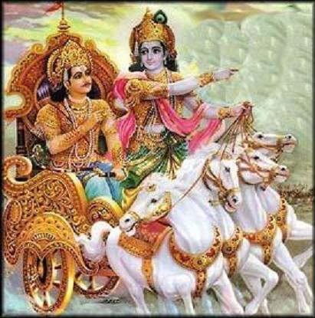

Slide 15
Bhagavad Gita
In the epic Mahabharata a conflict between the Pandavas and their cousins Kauravas results in the Kurukshetra war.
Pandavas (five brothers): Yuddhishtira, Bhima, Arjuna, Nakula & Sahadeva
Kauravas (100 brothers): Oldest two – Duryodana and Dushyasana
In the war, Lord Krishna helps the righteous Pandavas – he does not fight but, serves as Arjuna’s charioteer. Krishna is a cousin to both Pandavas and Kauravas.
During the war, Arjuna, skilled archer puts his bow and arrow down and expresses his inability to carry on with the war.

Slide 16
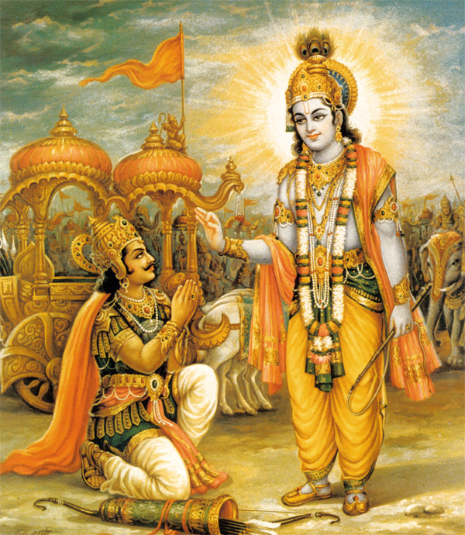
Bhagavad Gita
Krishna explains to Arjuna his duties or Dharma as a warrior and prince in the Gita.
The philosophical concepts in Gita explains the importance of dedication and self-sacrifice, as the dharma, or "holy duty" of each person.

Slide 17
Bhagavad Gita
What language is the Gita written in?
18 chapters – 700 verses of poetry makes up the entire Gita.
Bhagavad Gita’s call for selfless action inspired Mahatma Gandhi – he called it his spiritual dictionary
The Gita has been translated to many languages and is widely read and discussed in modern times.

Slide 18
Bhagavad Gita
Message or teaching of the Gita:
SELFLESS ACTION – performing your duty without expectation of rewards.
Karmanye Vaadhika-raste, Maa Phaleshu Kadachana Maa karma-phala-hetur-bhoorma, MaTe sangostwakarmini.
कर्मण्ये वाधिकारस्ते मा फलेषु कदाचन, मा कर्मफलहेतुर्भूर्मा ते संगोस्त्वकर्मणि ।
Your right is to work only, but never to its fruits. Let not the fruits of action be thy motive, Nor let thy attachment be to inaction.

