Slide 1
How To Rethink Success and Significance in Ministry
Rev. A. Jamale Johnson
Middle District Association
Moderator: Dr. Reginald Wells

Slide 2
OBJECTIVE
To “Rethink” ministry while dealing with a “New Reality”

Slide 3
How to Rethink It?
What are you measuring or rethinking?
Rethink Mission – What are you doing?
Rethink Vision – What is it that you see your church doing?

Slide 4
Definition of Rethinking
“It is the radical redesign of church processes from dramatic improvement in the fulfillment of the church’s purpose and mission.” p. 13
(Rethinking the Church by James Emery White)

Slide 5
Two Important Words
Processes –
“A complete end-to-end set of activities
that together fulfill the purposes and
mission of the church.” p. 13

Slide 6
Processes = Systems
The Eight Systems of the Church
THE EVANGELISM SYSTEM
“How we attract people to our church”
THE WORSHIP SYSTEM
“How we plan, implement, and evaluate the weekend service(s) at our church”
THE ASSIMILATION SYSTEM
“How we move people from first-time guests to members at our church”
THE SMALL GROUPS SYSTEM
“How we fill and reproduce small groups at our church”
THE MINISTRY SYSTEM
“How we mobilize people for significant ministry at our church”
THE STEWARDSHIP SYSTEM
“How we develop extravagant givers at our church”
THE LEADERSHIP SYSTEM
“How we develop leaders at all levels at our church”
THE STRATEGY SYSTEM
“How we constantly evaluate and improve our church”

Slide 7
Two Important Words
2. Improvement –
To make some progress and advances, i.e.,
in ministry

Slide 8
Implementation
1. Do you know your church’s systems or processes?
2. Where does dramatic improvement need to be made?

Slide 9
New Reality
Everything won’t change and some things will remain the same
A. 25-30% Post-Coronavirus will return to normal
B. 25-30% of what we do will return to some semblance of normal but with major or minor adjustments
C. 25-30% of what we do Post-Coronavirus will never return to normal, will completely develop new ways, or the new things we have done during the virus we will continue

Slide 10
5 Key Concepts To Rethink

Slide 11
Concept 1: Personal Growth
A personal growth mindset or open mind, where you are can grow and actively pursuing new ideas.
Fixed Mindset vs.
Growth Mindset

Slide 12
Concept 2: Churches will not abandon Online Church
Fight it, deny it, ignore it, but Online church is here to stay. The church can reach more people and reach people faster until Jesus returns through Online Church.
Online Church = Media/Video Ministry
It is now a vital ministry that needs vision and budgeting.

Slide 13
Concept 2: Churches will not abandon Online Church
Your church will be effective in the near and distance future by offering a slate of services that will include:
Sunday In-person on the Church Campus, i.e., 10:45 (Good time to rethink the times of your services)
Online Services – Different times for the services to be aired on the website.

Slide 14
Concept 3: Embrace and Develop Small Group Ministry

Slide 15
Small Group Definition
Small Groups are places of community where people can belong.
The place where people can grow spiritually and develop relationships with others.

Slide 16
Reasons Why Churches Need Small Groups
Groups encourage people to grow spiritually,
Acts 2:42
2. Groups nourish relational growth,
Hebrews 10:24
3. Groups stimulate persons’ service growth,
I Peter 4:10

Slide 17
Types of Small Groups
Discipleship Groups
Fellowship Groups, Men’s, Women’s, Couples, etc.
Prayer Groups – Supply prayer journals, books on prayer

Slide 18
Promote Small Groups Through
Church Newsletters
Worship Guides
Church Website
Church Instagram and FaceBook pages
One-on-One conversations

Slide 19
Concept 4: Leadership Training is More Important Now than Ever

Slide 20
Important to Rethink
Mission: What is a Mission?
Mission answers the question: What do we do?
Mission statement is a modern and customized restatement of how your church is going to fulfill the Great Commission
The mission is something of which the church must consistently remain focused
The Mission Statement must be short, specific, and meaningful

Slide 21
Important to Rethink
Vision: A clear, clarifying picture of the future of the ministry as you believe it can be and must be.
Vision Statement is where are we going?
The vision creates excitement
The vision promotes excellence
The vision reates a journey ahead

Slide 22
Implementation
Has your church recently rethought the Mission and Vision?

Slide 23
Concept 5 : The Church Should be a Neighborhood Church
COMMUNITY POTENTIAL
What is your community’s greatest challenge?
What problem is no one addressing in your community?
What part of your community’s life is the furthest from God’s original design?
What is your community known for?
What is the historical story of your community?
If one big change could take place in your community that would change it most, what would it be?

Slide 24
Concept 6: Get Back on the Youth Band Wagon
Think through ways to minister to youth and families – ministering to families who have been together for a year
Calls with your parents
Calls with your youth from the pastor
Find out what are their biggest concerns and issues
Find ways to address those issues

Slide 25
Concept 6: Get Back on the Youth Band Wagon
Plan, Plan, and Plan a Summer Youth Academic Program – assess youth shortfalls and give academic tutor and support to prepare them for the next school year.

Slide 26
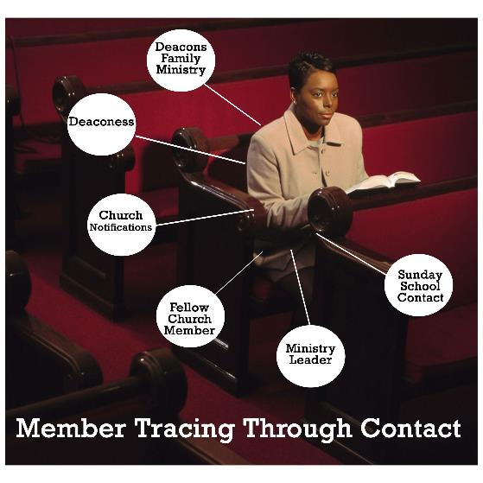
Concept 7: Member Tracing
Where are your members?
Have all the members of the church been accounted for?
Have all members received some type of personal touch?

Slide 27
CONCLUSION | Q&A
“Rethink” ministry while dealing with a “New Reality”
Rev. A. Jamale Johnson
jjohnson@ncrrbiz.com

