Slide 1
Digital Marketing
effective and affordable ways to connect with your audience
by Paula Hook

Slide 2
AGENDA
About PLJ Marketing
About Constant Contact
Email Marketing
Contact Management
Content Planning
Designing Your Email
Review & Strategize
Social Media
Event Planning
Event Marketing

Slide 3
Your Virtual Marketing Assistant...
Whether you just need marketing assistance or an entire program Planned, Managed & Delivered…
PLJ Marketing offers high level VIRTUAL Marketing Solutions.
Digital Marketing
Email marketing, social media, online event marketing and website
Event Marketing & Planning
Roadshows, workshops, tradeshows, social events w/landing page and online registration
Traditional Marketing
Branding, advertising, brochures, public relations, promotions
Strategic Programs
Co-op marketing, customer loyalty, sales incentive programs, budget & business plans

Slide 4
Why Use Constant Contact?

Slide 5
Website • Social Media • Mobile Device

Slide 6
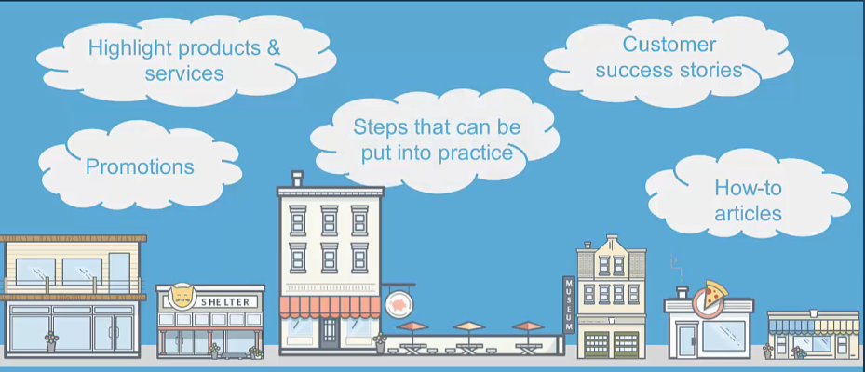
Email Marketing Planning your campaign in advance is key to a successful marketing plan.
Tip #1 What do you want to accomplish?

Slide 7
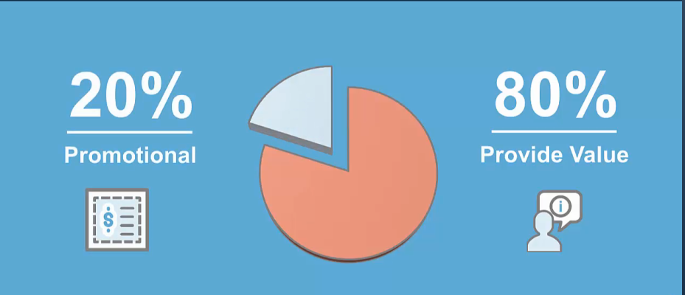
Email Marketing Planning your campaign in advance is key to a successful marketing plan.
Tip #2 Determine Your Metrics

Slide 8
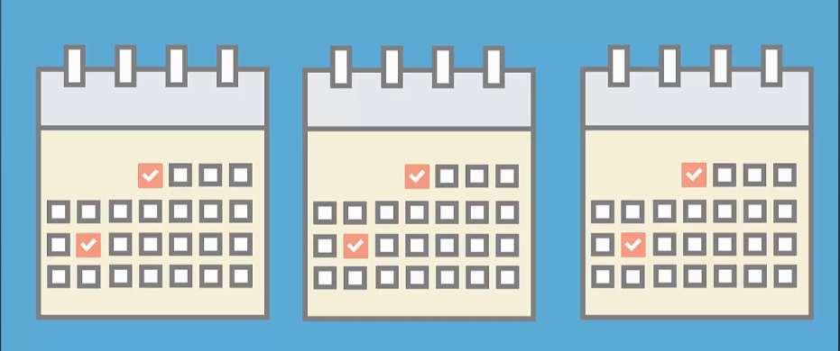
Email Marketing Planning your campaign in advance is key to a successful marketing plan.
Tip #3 Create a Communications Calendar
Add your own spin and be sure to give credit to any original source.

Slide 9
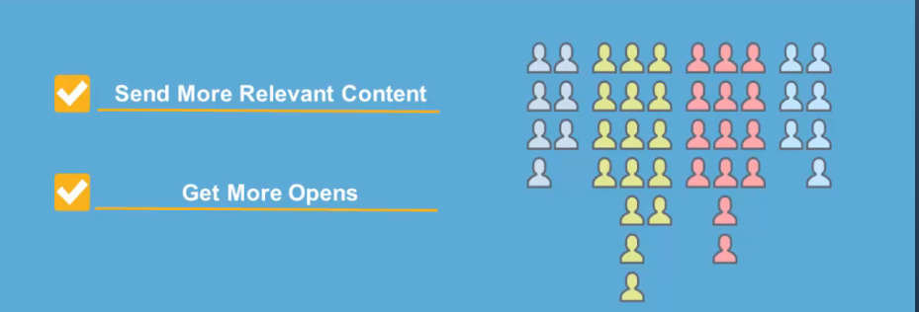
Contact Management Target your audience by using segmentation and tags to manage and grow your lists.
Tip #1 Segment your contacts
Use click segmentation with links and apply tags to contacts.

Slide 10
Contact Management Target your audience by using segmentation and tags to manage and grow your lists.
Tip #2 Grow your list and ask permission
You can also create a WordPress Sign-up Form or utilize the Text to Sign-up tool.

Slide 11
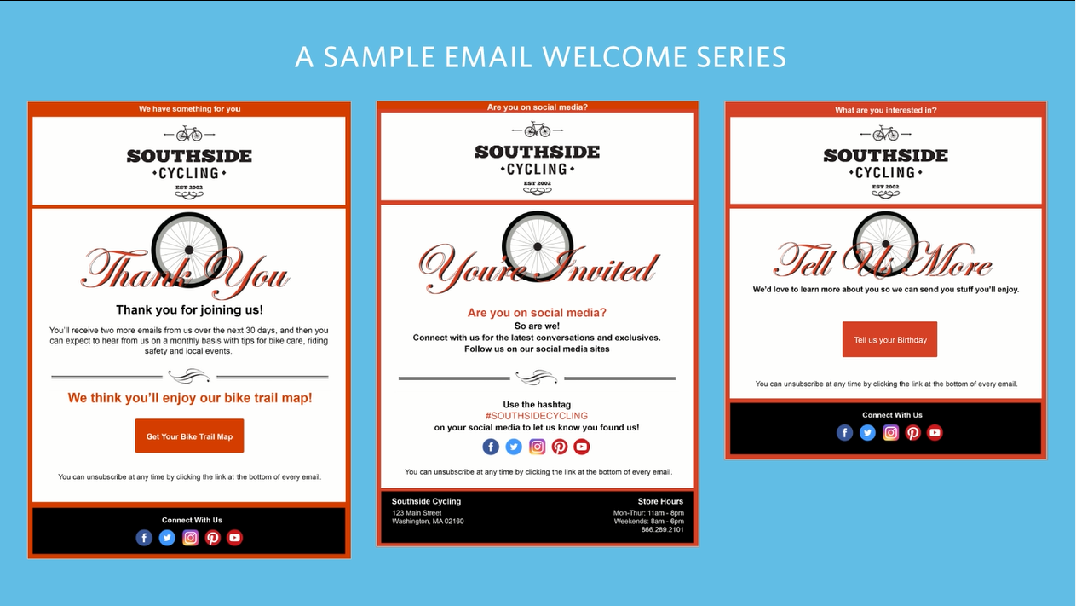
Contact Management Target your audience by using segmentation and tags to manage and grow your lists.
Tip #3 Create A Welcome Series
Ask us for best practices to craft questions - Email Marketing List Growth Checklist.

Slide 12
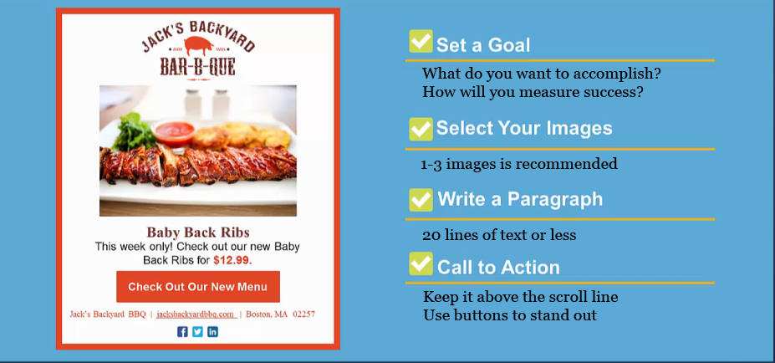
Content Planning Base your content on what differentiates you and what do you do best.
Tip #1 Gather Content You Already Have & Plan

Slide 13
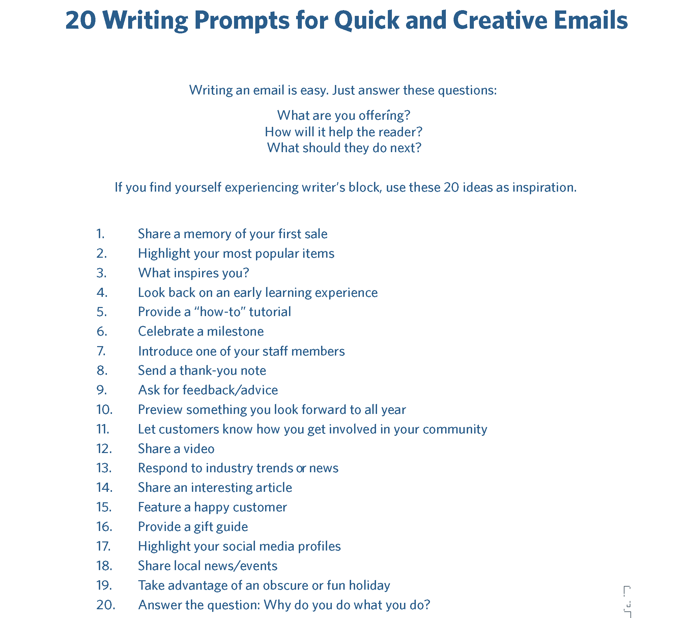

Slide 14
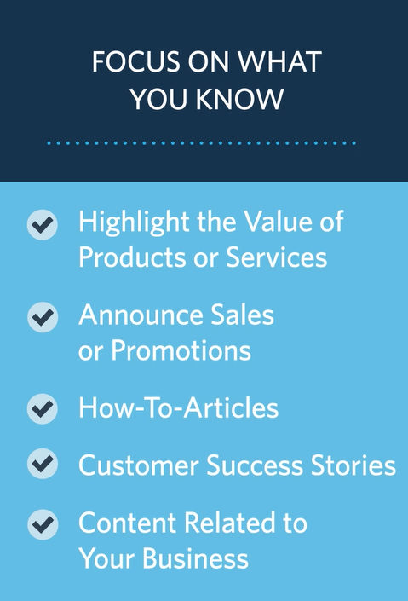
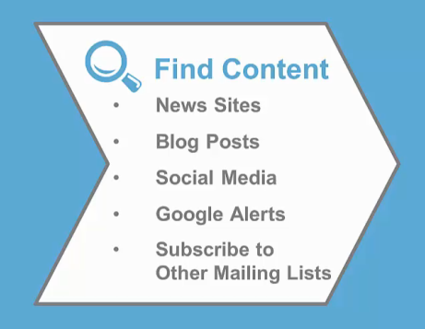
Content Planning Base your content on what differentiates you and what do you do best.
Tip #2 Build a Content Pipeline

Slide 15
Content Planning Base your content on what differentiates you and what do you do best.
Tip #3 Images Are Content Too
Remember that 90% of information processed by the brain is visual.

Slide 16
Designing Your Email Grabbing your contact’s attention and making them want to take action.
Tip #1 Create a Master Template

Slide 17
Designing Your Email Grabbing your contact’s attention and making them want to take action.
Tip #2 Make it Mobile

Slide 18
Designing Your Email Grabbing your contact’s attention and making them want to take action.
Tip #3 Compelling Subject Line
5-8 words
NOT all caps or excessive punctuation
47% recipients open based on the subject line
The prime real estate should be dedicated to your primary message and call to action
…and remember – less is more.

Slide 19
Review & Strategize Is your strategy effective or do changes need to be made?
Tip #1 Determine Contacts Interest and Where
Reports will also show what percentage used mobile over computer.

Slide 20
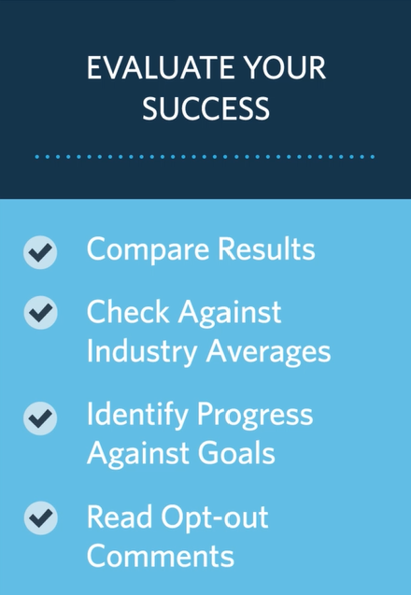
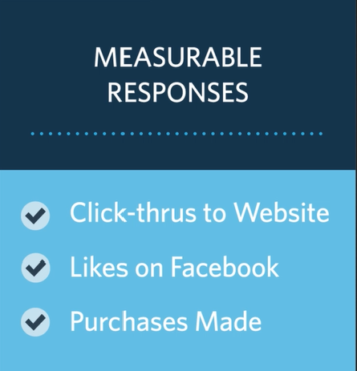
Review & Strategize Is your strategy effective or do changes need to be made?
Tip #2 Measure Whether Goals Were Accomplished

Slide 21
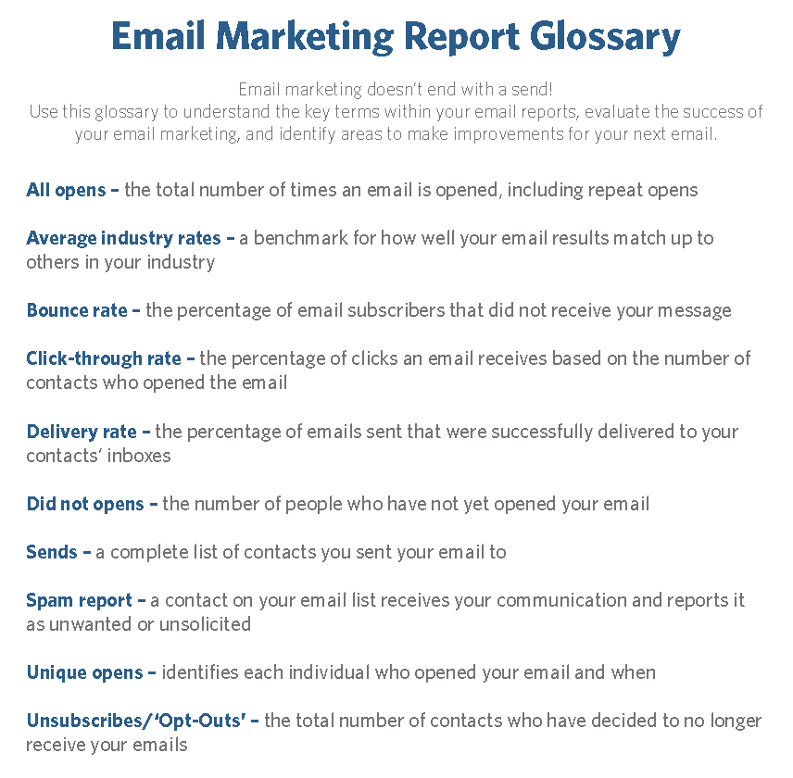

Slide 22
Review & Strategize Is your strategy effective or do changes need to be made?
Tip #3 Don’t Stop – Improve & Follow Your Plan

Slide 23
Social Media A solid social media strategy will help you navigate towards business goals.
Tip #1 Clearly Define Your End Goals
Goals you might want to consider for your social media strategy:
•Increase overall traffic to your website by 50% year over year
•Drive 60% more engagement year over year
•Influence 30% more conversions year over year
•Increase revenue from social media by 20% year over year.
With definitive goals in mind, you can then align everything you do to towards achieving them.
Use Social Share on Constant Contact.

Slide 24
Social Media A solid social media strategy will help you navigate towards business goals.
Tip #2 Identify Your Target Audience
Look at your current customer base + there are tools you can use:
•Google Analytics can help identify demographics, interests and more
•Facebook Insights / Audience Insights - install a Facebook pixel
•Twitter Analytics - demographic and lifestyle data on your followers
•LinkedIn Analytics - if you're in the B2B space
Leveraging data to identify your target audience for a successful social media strategy is a must.

Slide 25
Social Media A solid social media strategy will help you navigate towards business goals.
Tip #3 Build a Diverse Content Strategy
There are only so many possible ways to read, listen, and watch:
•Read - people want to find information quick, like a blog on your website.
•Look - create compelling visuals to tell your story.
•Watch - Video is critical to social media success.
•Listen - Podcasts increased in popularity in 2016 and continue to grow.
The gap between content created and actually consumed on social sites is rapidly widening.
Use Social Share on Constant Contact.

Slide 26
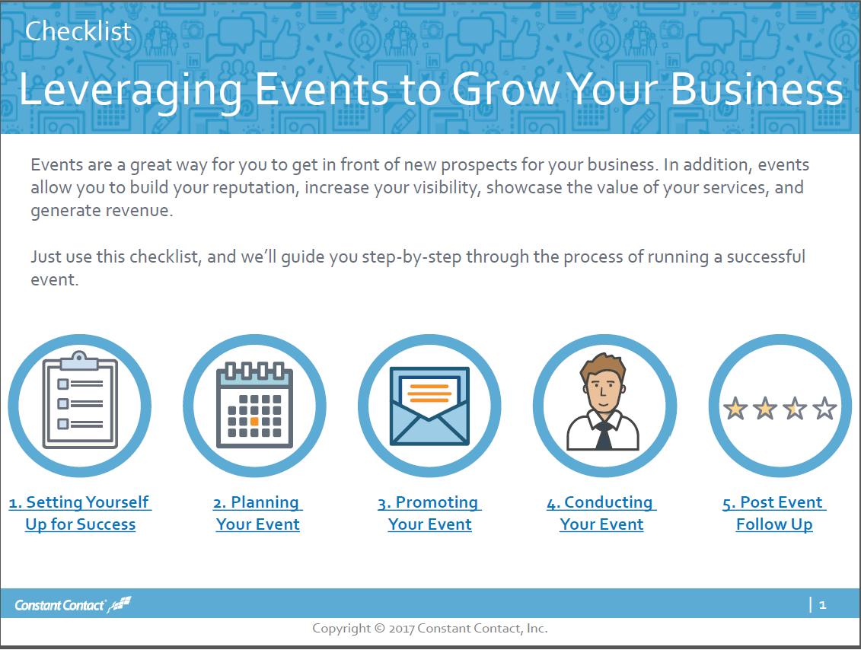
Event Planning With 25 years of experience in planning events, it's is all about the "Attention to Detail".
Follow these 5 Steps to Successful Events

Slide 27
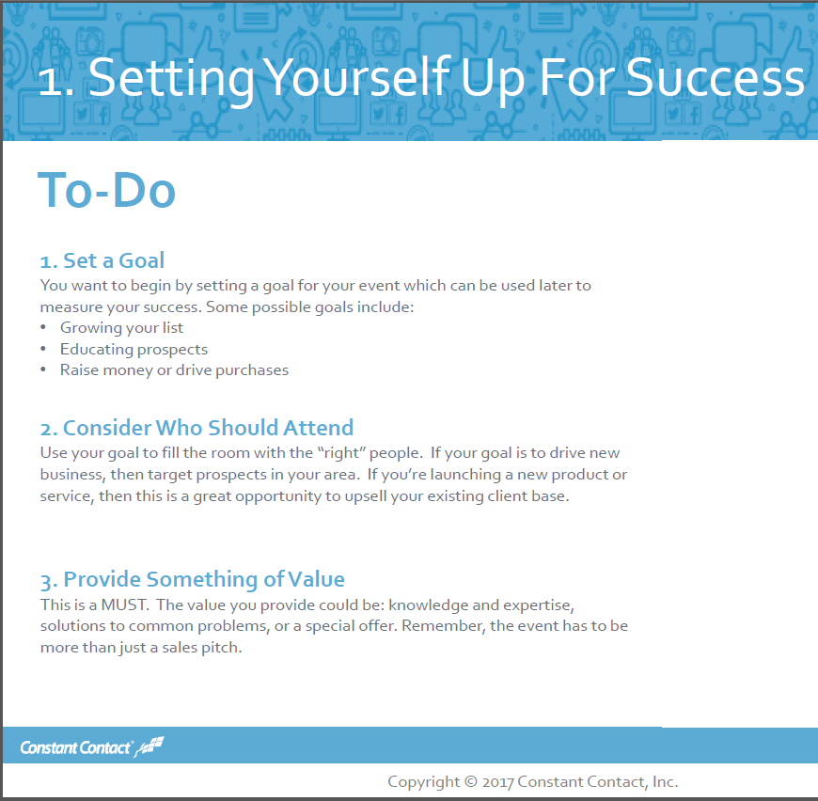

Slide 28
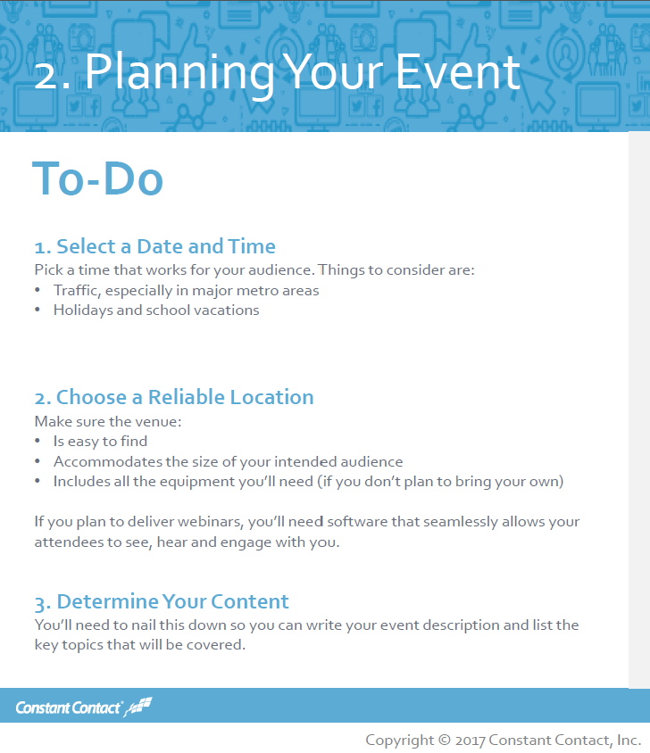

Slide 29
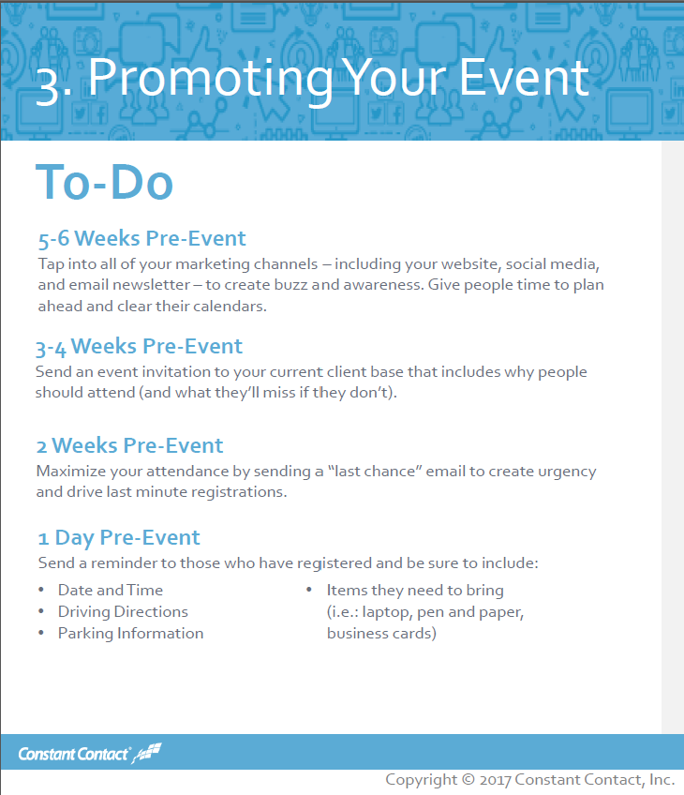

Slide 31
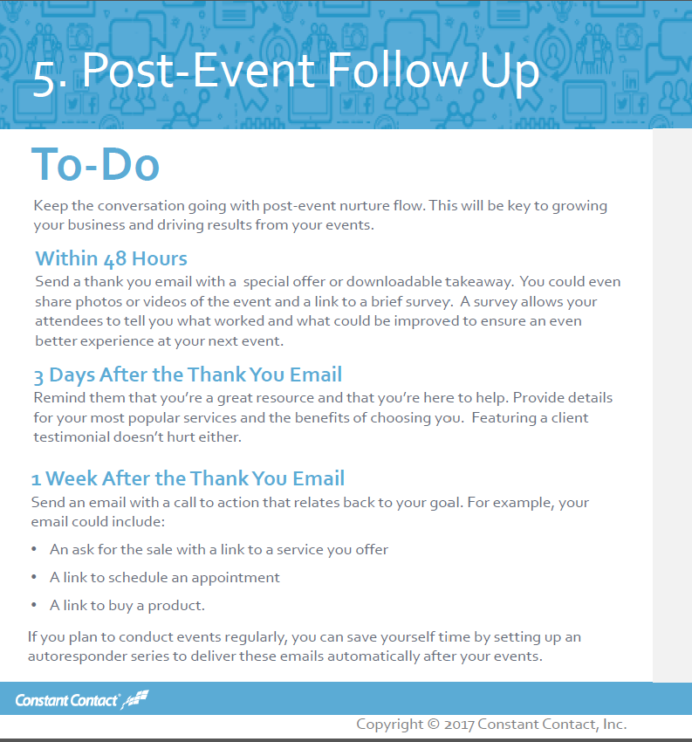

Slide 32
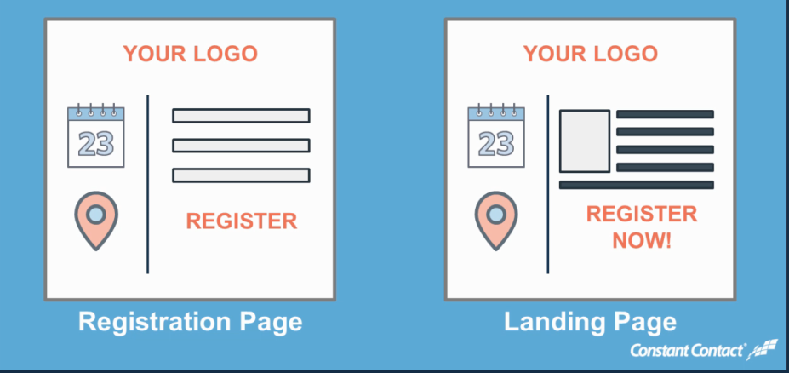
Event Marketing With 25 years of experience in planning events, it's is all about the "Attention to Detail".
Tip #1 Customize your Registration Process
Keep it Short & Simple, Choose a Theme, Add Your Logo, Include Agenda and Biographies

Slide 33
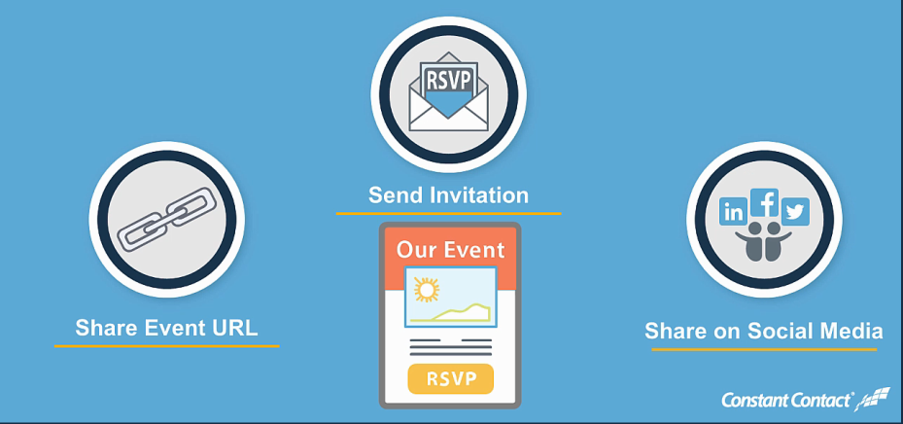
Event Marketing With 25 years of experience in planning events, it's is all about the "Attention to Detail".
Tip #2 Get the Word Out
Include URL on Website, Send Series of 3 Emails and Use Social Share

Slide 34
Event Marketing With 25 years of experience in planning events, it's is all about the "Attention to Detail".
Tip #3 Manage Your Registrations
Send messages to those who registered, declined or remind those who haven’t responded.

Slide 35
All the Tools You Need to Succeed for Marketing Your Small Business
Thank you for being here today!

