Slide 1
Lesson One: Why Sociology?
Robert Wonser
Introduction to Sociology

Slide 2
Important Questions
Why study sociology?
How do social constructions shape reality and human behavior?
Why do people behave as they do in predictable patterns?

Slide 3
Sociology is the Best!
Insights from sociology are instantly applicable to the world around you.
Before you can change the world, you must understand it.
Humans cannot be understood apart from the social context.

Slide 4
But this makes a Sociologist’s job very tough…

Slide 5
The Social Context
Society is a group of people who shape their lives in aggregated and patterned ways that distinguish their group from other groups.
It is a social construction.
Social construction an idea created by humans (i.e. doesn’t exist in the biological world but only in the social world) through social interaction and given a reality through our understanding of it and our collective actions.

Slide 6
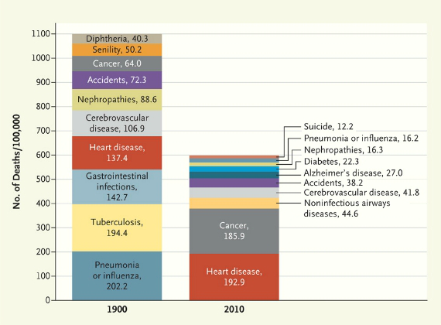
Everything About You…
Society influences everything about you.
How we live, what we do, what we eat, how we act… even how we die.

Slide 7
Individually you all must have come to the same conclusions all on your own, right snowflakes?

Slide 8
2015’s Most Common Names
What’s your favorite color anyway?
What did you eat for breakfast?
Beverage of choice?
Rank | Female Name | Male Name
1 | Charlotte | Ezra
2 | Amelia | Asher
3 | Ava | Atticus
4 | Olivia | Declan
5 | Cora | Oliver
6 | Eleanor | Silas
7 | Isla | Milo
8 | Lucy | Jude
9 | Evelyn | Henry
10 | Penelope | Jasper
Notes:
Source: http://www.babycenter.com/popularBabyNames.htm?year=2015
Source 2015: http://www.today.com/parents/most-popular-baby-names-2015-real-princess-name-soars-fictional-t63581

Slide 9
And 100 Years Ago? 1910s
Rank | Male Name | Number | Female Name | Number
1 | John | 376,321 | Mary | 478,634
2 | William | 303,027 | Helen | 248,150
3 | James | 275,078 | Dorothy | 207,479
4 | Robert | 239,194 | Margaret | 189,232
5 | Joseph | 179,305 | Ruth | 173,675
6 | George | 176,616 | Mildred | 123,990
7 | Charles | 173,540 | Anna | 119,001
8 | Edward | 125,726 | Elizabeth | 116,807
9 | Frank | 116,019 | Frances | 105,595
10 | Thomas | 91,622 | Virginia | 94,322

Slide 10
There are more men on corporate boards named John, Robert, William or James than there are women on boards altogether
Notes:
Source: http://www.washingtonpost.com/blogs/on-leadership/wp/2015/02/25/there-are-more-men-on-corporate-boards-named-john-robert-william-or-james-than-there-are-women-altogether/

Slide 11
Human Behavior is Patterned
Society is made up of social fabric, social fabric includes:
The ordered and persisting relationships among positions (statuses and their associated roles) in society make up the social structure.
Institutions are comprised of social structure
Institutions, then, are organized, patterned, and enduring sets of social structures that provide guidelines for behavior and help each society meet its basic survival needs.
Examples include: Mass media, family, government, religion, education, medicine, military, etc.

Slide 12
Don’t Reach for the Banana

Slide 13
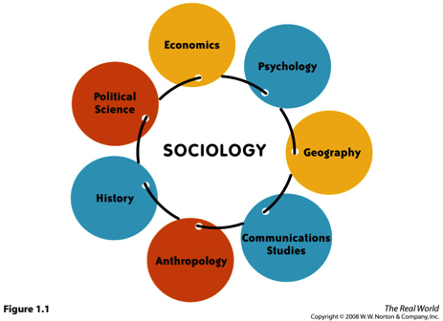
Sociology is a Science
Social sciences deal with human behavior.
Natural sciences deal with the natural world.
Both use the scientific method to explain phenomena.
Where does Sociology fit in?

Slide 14
So, what is Sociology then?
Sociology is the systematic or scientific study of human society and social behavior, from large-scale institutions and mass culture to small groups and individual interactions.
It is also the study of reifications, or social constructions.

Slide 15
What Makes a Science
Theory + Methods = Science
Theory is our next lesson. It covers explanations for observed phenomena and patterns.
Methods are how we get the data and make sense of it.
Sociology has a unique stance on the social world. The sociological perspective involves using a sociological imagination.

Slide 16
Individual vs Society
While it is tempting to explain everything from the point of view of individuals and individuals’ choices, it is important to remember the social context and group affiliations.
For example: Why is there a gender pay gap?
Glass ceiling versus Glass Escalator
Why has the gap between black families income and white families’ incomes remained relatively constant since the Civil Rights Era even though the families themselves are different?
Why are you here today?

Slide 17
No, we’re not!

Slide 18
What Makes Sociology Unique? The Sociological Imagination
C. Wright Mills used the term sociological imagination as a quality of the mind that allows us to understand the relationship between our particular situation in life and what is happening at a social level.
Personal troubles versus public issues
Ex: unemployment, obesity
C. Wright Mills (1916-1962)

Slide 19
Using your Sociological Imagination
In small groups:
How would you explain the following social problems using the sociological imagination/perspective?
Obesity
Homelessness/Poverty
Unemployment
Marriage
The metropolis
War

Slide 20
Making the Familiar Strange
When thinking sociologically, one focuses on the social context in which people live and how that social context has an impact on individuals’ lives. It looks beyond the simple answer for the more complex one.
Making the familiar strange

Slide 21
How to Make the Familiar Strange
One way to gain a sociological perspective is to attempt to create in ourselves a sense of culture shock, which is a sense of disorientation that occurs when one enters a radically new social or cultural environment.

Slide 22
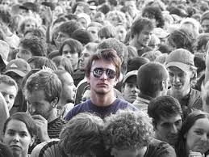
How to Make the Familiar Strange
Bernard McGrane suggests that people wanting to use a sociological perspective should utilize a beginner’s mind, which means approaching the world without preconceptions in order to see things in a new way.

Slide 23
Some Important Realizations
You’re not an individual like you think you are.
Social inequality is a permanent fixture of society.
It is part of society’s fabric. It is intentional. Those with power use their power to ensure inequality persist because they benefit from it. Specific forms include class, race and gender (but there others…).
Sociology likes to debunk ‘what everyone knows’

Slide 24
Lesson Quiz
1. Which of the following is NOT an example of a social science?
a. biology
b. political science
c. psychology
d. economics

Slide 25
Lesson Quiz
2. Sociology is defined as:
a. the scientific study of humans.
b. the study of ancient cultures and behavior.
c. the study of how the brain works.
d. the study of human society and social behavior.
Notes:
E. the best

Slide 26
Lesson Quiz
3. __________ is the level of analysis that studies face-to-face and small-group interactions in order to understand how those interactions affect the larger patterns and institutions of society.
a. Microsociology
b. Macrosociology
c. Sociology
d. Social science

Slide 27
Lesson Quiz
4. The glass escalator effect refers to the:
a. limits on the advancement of women in the workplace.
b. limits on the advancement of men in the workplace.
c. rapid rate of upward mobility for women.
d. rapid rate of upward mobility for men in female-dominated workplaces.

Slide 28
Lesson Quiz
5. A sense of disorientation that occurs when you enter a radically new social or cultural environment is called:
a. cultural mind.
b. culture shakes.
c. cultural fear.
d. culture shock.

