Slide 1
Document & Workflow Management BSBI613

Slide 2
Contents
Workflow Management System
Workflow Modelling
Workflow theories

Slide 3
Workflow Management System
A workflow management system (WfMS) is a software system for the set-up and performance monitoring of a defined sequence of tasks, arranged as a workflow.

Slide 4
Work flow modelling
Workflow model is a visual representation of the flow of work in a business area.
Workflow models are used to document how work processes are carried out, and to find opportunities for process improvement.

Slide 5
Swimlane diagrams
Swimlane diagram is mainly used for Workflow Modeling due to:
-Simplicity
-Requires less training
Represented using three Rs:Roles,Responsibility and routes

Slide 6
Actors
Actors are the swimmers who actually does the work
It can be an identifiable person or group of persons doing a work from initiation to termination
Also known as roles
All work performed by an actor comes in the actors swimlane
Some swimlanes can be wider due to branching

Slide 7
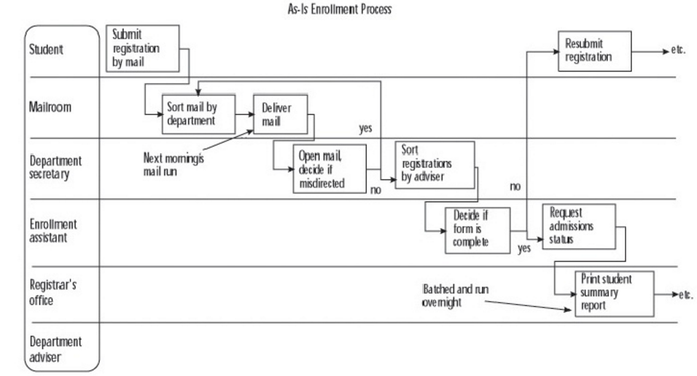
A swimlane diagram

Slide 8
Process steps
A step is a task or a set of tasks performed by an actor
Also called responsibilities, activities, actions etc
Steps are shown using a labelled box in the lane of the actor performing it
Steps can involve multiple actors

Slide 9
A swimlane diagram

Slide 10
Go with the flow
Flow is passing work from one step to the next
Shown using lines with arrow heads
Also known as transitions, routes, events, communications etc
Handoff is a special kind of workflow in which work is passed from or handed off from one actor to another
It is a flow from one swimlane to other
Handsoff are the focus for the process anlysis because they are the source for delay,errors and expense.

Slide 11
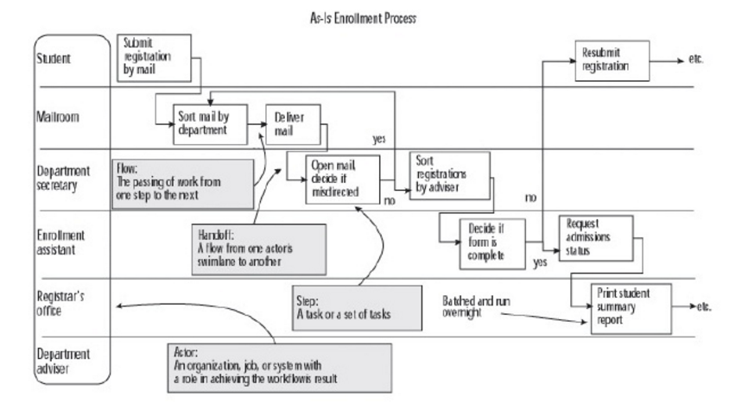

Slide 12
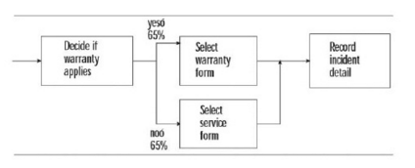
Branching
Branching occurs with a conditional flow, when a decition is made which directs the workflow to one of two or more alteratives.
Box is used for representation

Slide 13
Work flow theories
Evaluation of resources, both physical and human is essential to evaluate hand-off points and potential to create smoother transitions between tasks.
Several workflow improvement theories have been proposed and implemented in the modern workplace. These include:
Six Sigma
Total Quality Management
Business Process Reengineering
Lean systems

Slide 14
Six Sigma
Six Sigma is a set of techniques and tools for process improvement.
It was introduced by engineer Bill Smith while working at Motorola in 1986
Six Sigma seeks to improve the quality of the output of a process by identifying and removing the causes of defects and minimizing variability in manufacturing and business processes.
It uses a set of quality management methods, mainly empirical, statistical methods, and creates a special infrastructure of people within the organization, who are experts in these methods.
Each Six Sigma project carried out within an organization follows a defined sequence of steps and has specific value targets, such as reduce process cycle time, reduce pollution, reduce costs, increase customer satisfaction, and increase profits.

Slide 15
Six Sigma doctrine asserts:
Continuous efforts to achieve stable and predictable process results (e.g., by reducing process variation)
Manufacturing and business processes have characteristics that can be measured, analyzed, controlled and improved.
Achieving sustained quality improvement requires commitment from the entire organization, particularly from top-level management.

Slide 16
Features that set Six Sigma apart from previous quality improvement initiatives include:
A clear focus on achieving measurable and quantifiable financial returns from any Six Sigma project.
An increased emphasis on strong and passionate management leadership and support.
A clear commitment to making decisions on the basis of verifiable data and statistical methods, rather than assumptions and guesswork.

Slide 17
Six Sigma methodologies
DMAIC is used for projects aimed at improving an existing business process
DMADV is used for projects aimed at creating new product or process designs

Slide 18
DMAIC
The DMAIC project methodology has five phases:
Define the system, the voice of the customer and their requirements, and the project goals, specifically.
Measure key aspects of the current process and collect relevant data; calculate the 'as-is' Process Capability.
Analyze the data to investigate and verify cause-and-effect relationships. Determine what the relationships are, and attempt to ensure that all factors have been considered. Seek out root cause of the defect under investigation.
Improve or optimize the current process based upon data analysis using techniques such as design of experiments ,or mistake proofing, and standard work to create a new, future state process. Set up pilot runs to establish process capability.
Control the future state process to ensure that any deviations from the target are corrected before they result in defects. Implement control systems such as statistical process control, production boards, visual workplaces, and continuously monitor the process.

Slide 19
DMADV
The five steps of DMADV
Define design goals that are consistent with customer demands and the enterprise strategy.
Measure and identify CTQs (characteristics that are Critical To Quality), measure product capabilities, production process capability, and measure risks.
Analyze to develop and design alternatives
Design an improved alternative, best suited per analysis in the previous step
Verify the design, set up pilot runs, implement the production process and hand it over to the process owner(s).

Slide 20
Total Quality Management
Total quality management (TQM) consists of organization-wide efforts to install and make permanent a climate in which an organization continuously improves its ability to deliver high-quality products and services to customers.
The key concepts in the TQM include
"Quality is defined by customers' requirements."
"Top management has direct responsibility for quality improvement."
"Increased quality comes from systematic analysis and improvement of work processes."
"Quality improvement is a continuous effort and conducted throughout the organization."

Slide 21
Business Process Reengineering
Business process re-engineering is a business management strategy, originally pioneered in the early 1990s, focusing on the analysis and design of workflows and business processes within an organization.
BPR aimed to help organizations fundamentally rethink how they do their work in order to dramatically improve customer service, cut operational costs, and become world-class competitors.
Business process re-engineering is also known as business process redesign, business transformation, or business process change management.

Slide 22
Some important BPR success factors:
BPR team composition.
Business needs analysis.
Adequate IT infrastructure.
Effective change management.
Ongoing continuous improvement

Slide 23
Lean Systems
A systematic approach to the identification and elimination of waste and non-value added activities through employee development and continuous improvement in all products and services.
Lean system mainly concentrates on:
Reduce costs
Reduce time
Increase profits
Reduce defects
Increase customer loyalty and satisfaction
Sustain long term improvement
Lean systems evaluates all components in the overall system to show relationships and aligns them so that they are in harmony with one another, thus maximizing the system performance.

Slide 24
Release the creative talent within your organization by giving them the vision to "See" value and non-value added steps in the system.
Lean production was founded in Japan based upon the Toyota Production System (TPS) in the 1950's.
It was created to cut costs and improve efficiency by eliminating waste.
"Lean" is not about working harder. It is about working smarter.

Slide 25
Conclusion
Discussed Workflow Management System, workflow modelling and the workflow theories

Slide 26
Thank You

