Slide 1
Spices, Pulses & Grains
IN THE INDIAN KITCHEN

Slide 2
SPICES
Popular spices come from berries (peppercorns), roots (ginger), seeds (cumin, coriander etc.), bark (cinnamon) flower buds (cloves) or even the stamen of flowers (saffron).
Curry is actually a summary name for a collection of spices. It is a combination of natural herbs like turmeric, cardamom, ginger, coriander, cumin, black pepper, chili pepper, cloves, fenugreek, fennel, etc.

Slide 3
SPICES - Commonly used in Indian Cooking
Cumin Seeds or Jeera Coriander Seeds or Dhania Mustard Seeds or Rayi Fenugreek Seeds or Methi Fennel Seeds or Saunf Poppy Seeds or Khus Khus Cinnamon or Dalchini Cloves or Lavang | Black Pepper or Kali Mirch Turmeric or Haldi Asafetida or Hing Chili or Mirchi Saffron or Kesar Cardamom or Elaichi

Slide 4
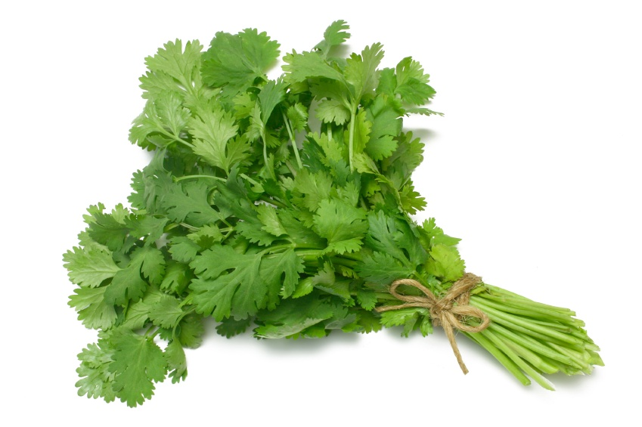
Jeera | Dhania
Cumin Seeds | Coriander
Nutty peppery flavor | Pleasantly sweet flavor with a lemony note Both the herb (cilantro) and seeds are used
Aids digestion and helps relieve nausea and diarrhea Also used as a cold remedy due to its antiseptic properties | Aids digestion; used to ease migraines and as a medicine for cold. Also used to clear the body of any mercury or lead contamination.

Slide 5
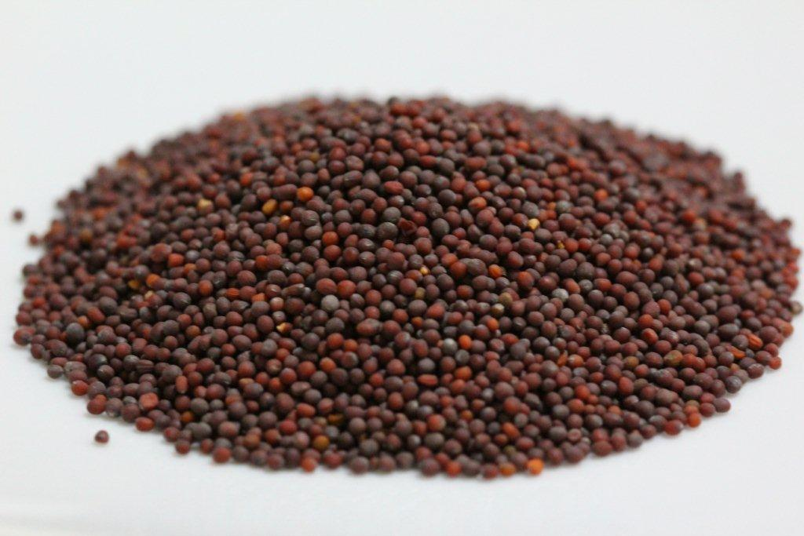
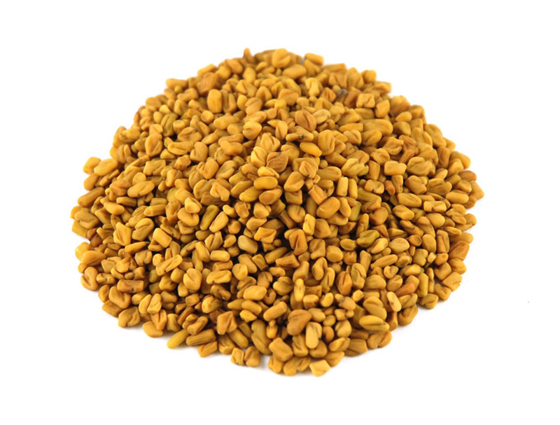
Rayi | Methi
Mustard Seeds | Fenugreek Seeds
Peppery taste (yellow mustard is not normally used in Indian cooking) | Sharp, pungent and bitter taste
Increases appetite; mustard oil is used to cure common cold, joint pains, and arthritis | Aids digestion; used to relieve pains/cramps and reduce fever Also, used to treat diabetes

Slide 6
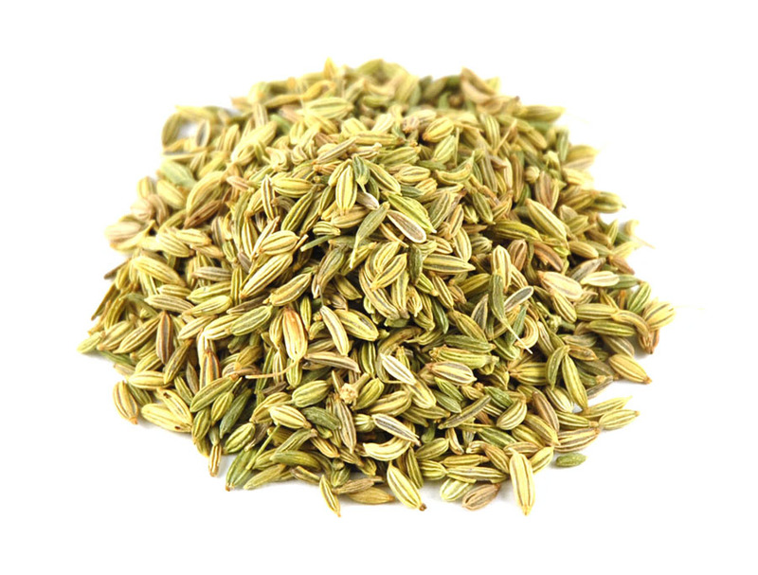
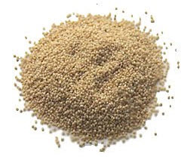
Saunf | Khus Khus
Fennel Seeds | Poppy Seeds
Licorice taste - can be chewed raw Used as a mouth freshener and an after dinner digestive stimulant | Nutty and pleasant in taste
Reduces indigestion and bloating; used to treat upset stomach Also, said to improve eyesight; used to treat glaucoma | Used as a sedative and to treat blood pressure and cholesterol Also used to treat itches and skin conditions

Slide 7
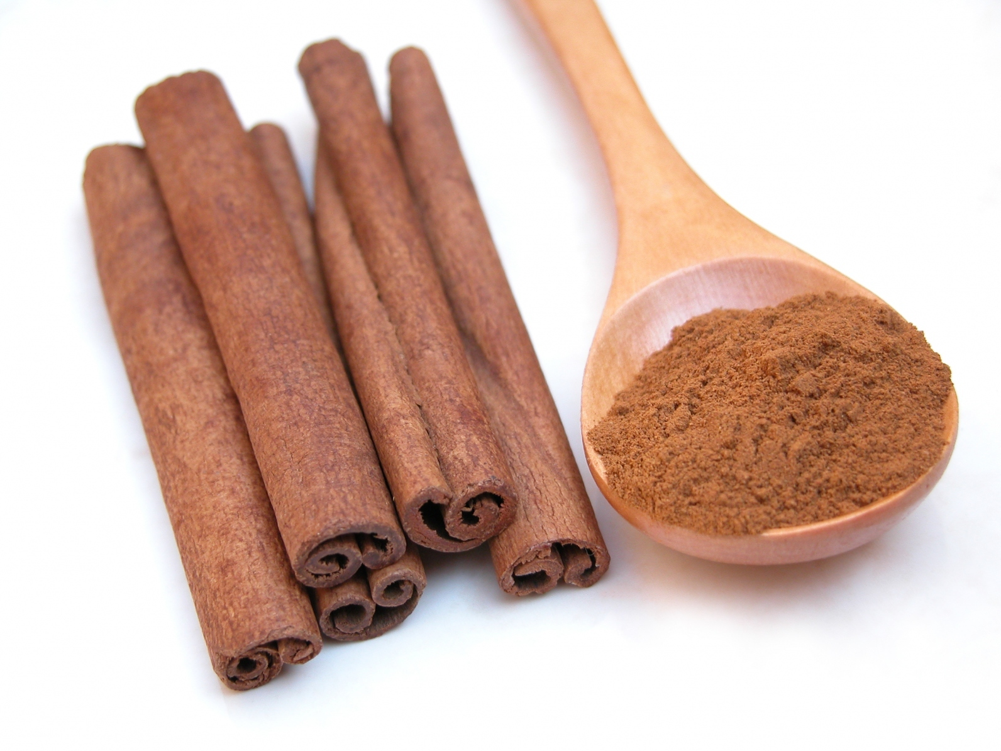
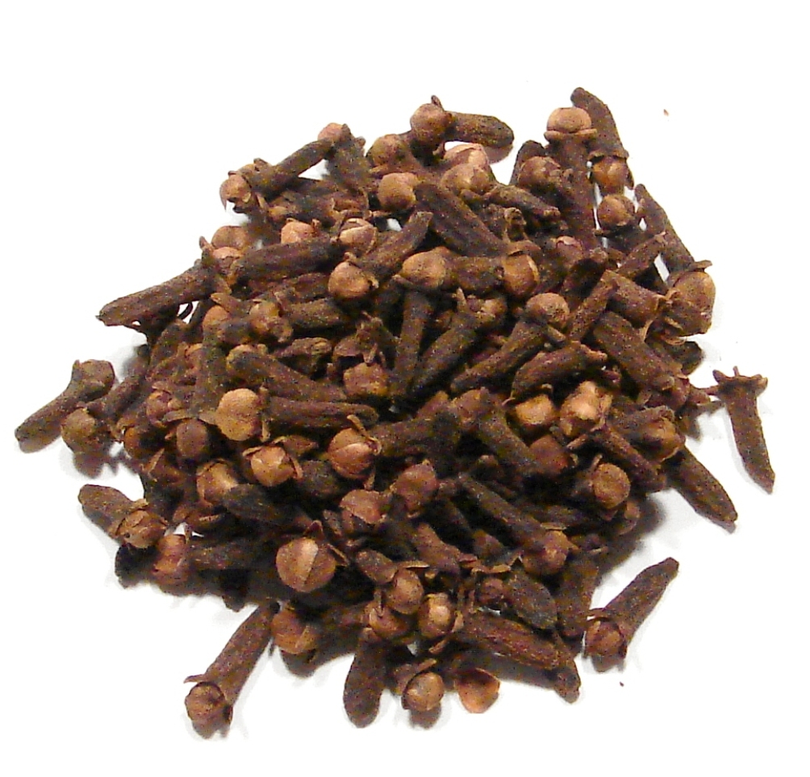
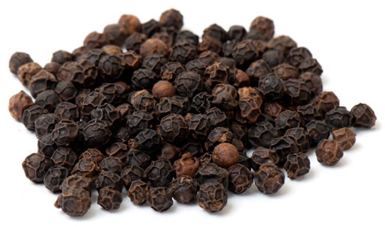
Dalchini | Lavang | Kali Mirch
Cinnamon (Bark) | Cloves (Flower Bud) | Pepper (Berry)
Sweet, woody fragrance and a spicy/warm taste | Cloves have a strong, spicy flavor with a warm taste | Mildly spicy flavor; native to India
Used to help relieve muscle spasms, vomiting, diarrhea, infections, the common cold, and loss of appetite | Used to relieve stomach upsets, vomiting & diarrhea Cloves or clove oil is a commonly used remedy for tooth pain; also used to sooth skin burns and irritations. | Used to reduce headaches, joint pain and toothaches; reduces indigestion, insomnia Also used to treat insect bites and sunburn

Slide 8
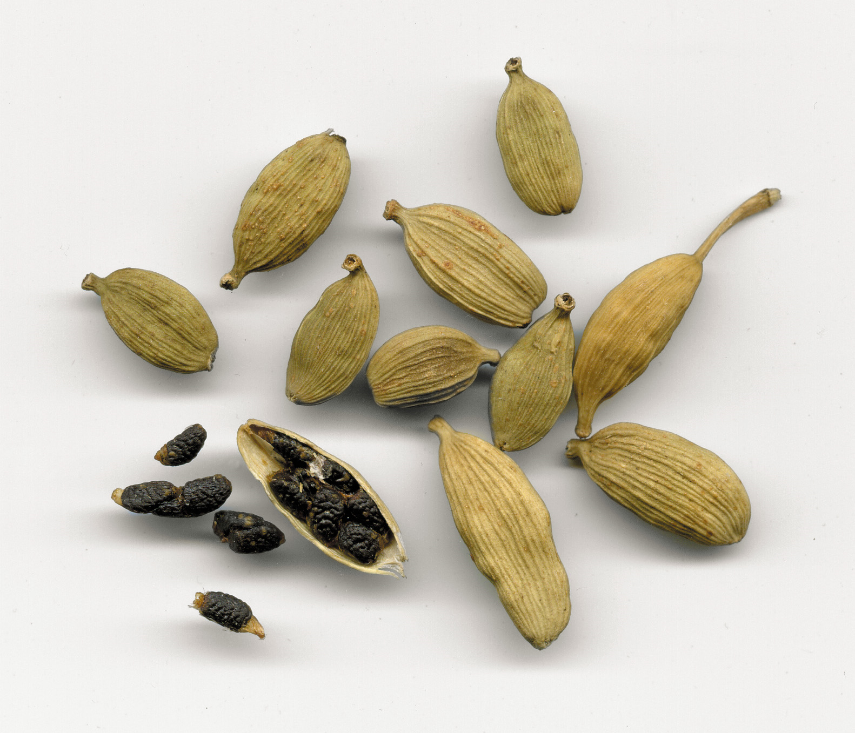
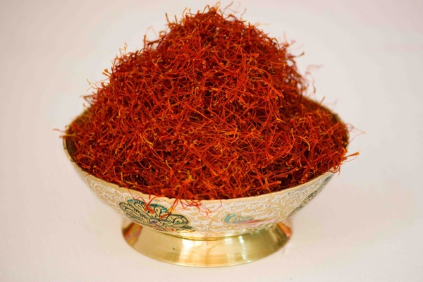
Elaichi | Kesar
Cardamom | Saffron (Stamen)
Cardamom has a strong taste and has an intense aroma. When chewed, it has a coolness similar to mint. | Adds color and aroma to food. (used in many Indian sweets; also used in Mediterranean cooking)
Used to treat tooth and gum disease Helps relive nausea and indigestion | Helps with complexion Acts on the nervous system; used as a sedative Lowers blood pressure and stimulates respiration

Slide 9
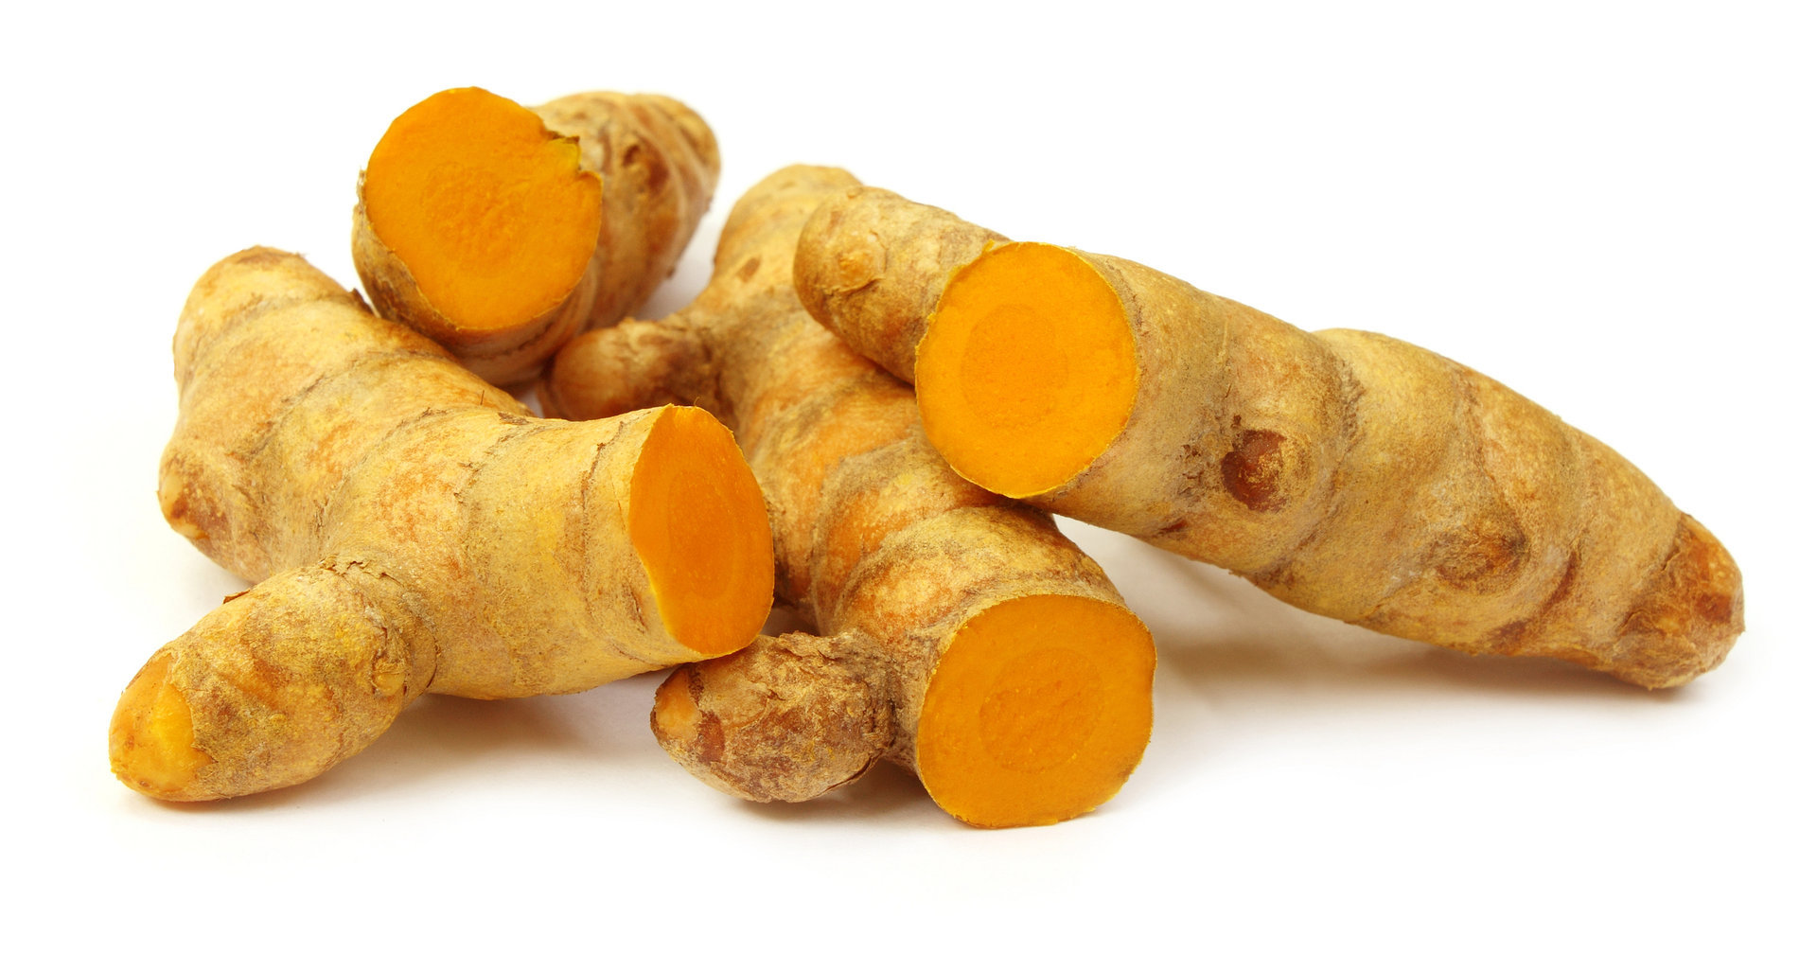
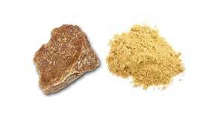
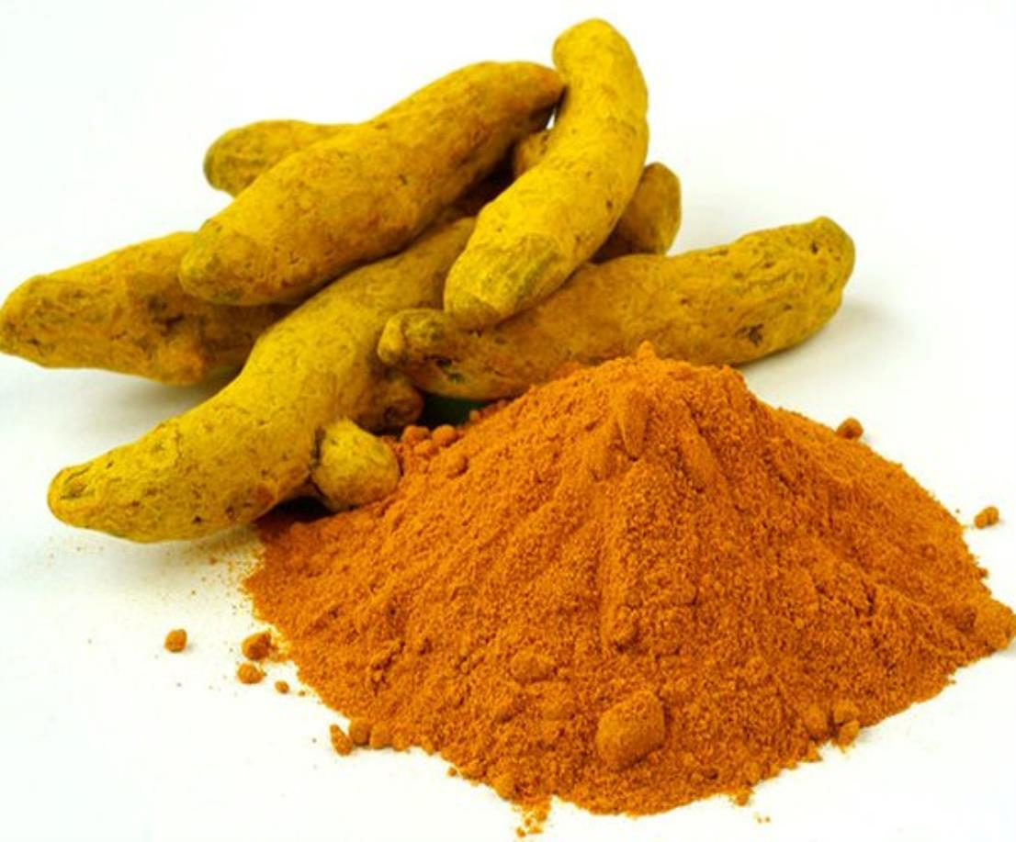
Haldi | Hing
Turmeric (Root) | Asafetida (Resin)
 | Strong and unique (fetid) smell (used to flavor vegetarian food)
Used as an anti-inflammatory and antiseptic; used to treat infections and arthritis pains Recently found to slow the growth of cancer cells; also, used to treat Alzheimer’s and multiple sclerosis. | Used a digestive aid Has antimicrobial properties Used to treat asthma and chronic bronchitis

Slide 10
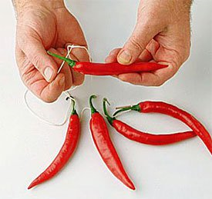
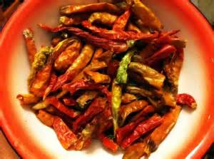
Mirchi
Chili Pepper
Chili peppers originated in the Americas. Chilies were brought to Asia by Portuguese navigators during the 16th century. Today, India is the world's largest producer, consumer and exporter of chili peppers.
Chili peppers have their spice from a component called capsaicin, which has been used as pain reliever and blood circulation aid for ages. It can ease arthritic swelling and pain, reduce fever and relieve joint aches.

Slide 11
Pulses/Legumes/Daals
Pulses are dicotelydons or dicots – the gram or lentil is hulled and split to make the Daal; some are used whole and also sprouted before use in cooking
Split Pigeon Peas or Toor (Tuvar) Dal
Green Gram or Moong Dal
Split Chick Peas or Channa Dal
Black Gram or Urad Dal
Red Lentils or Masoor Dal
Horse Gram or Kulthi Dal

Slide 12
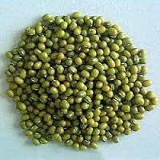
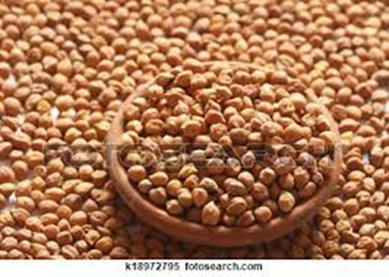
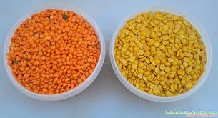
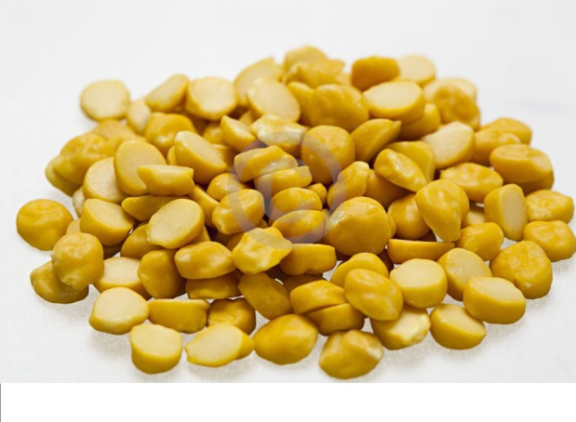
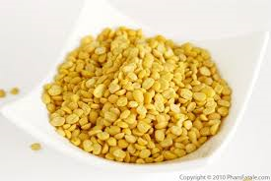
Toor Dal | Moong Dal | Channa Dal
Split Pigeon Peas | Green Gram | Split Chick Peas
Daals are sources of complex carbohydrates, protein, fiber and vitamins.

Slide 13
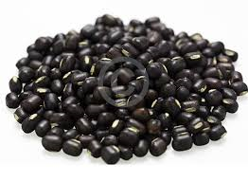
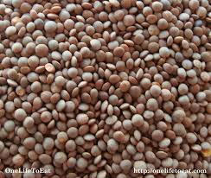
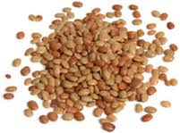
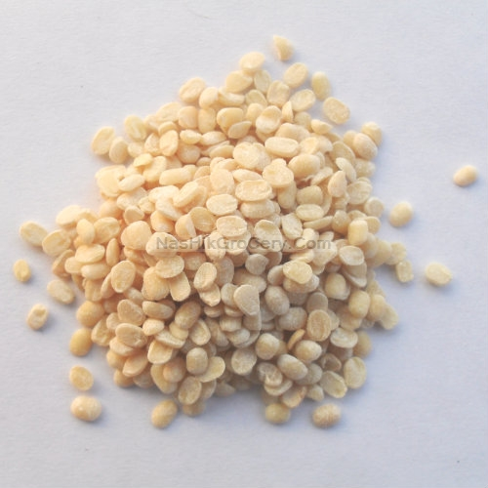
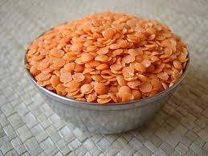
Urad Dal | Masoor Dal | Kulthi Dal
Black Gram | Red Lentils | Horse Gram
Daals are sources of complex carbohydrates, protein, fiber and vitamins.

Slide 14
Grains –Source of Carbohydrates & Vitamins
Unlike pulses, grains are monocots and are seeds of various grass species
Rice or Chawal
Wheat or Gehun
Maize or Jowar
Millet or Bajra
Barley or Jau

Slide 15
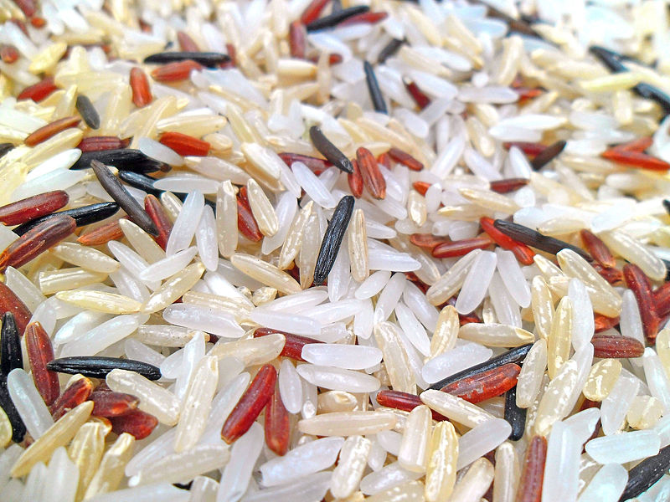
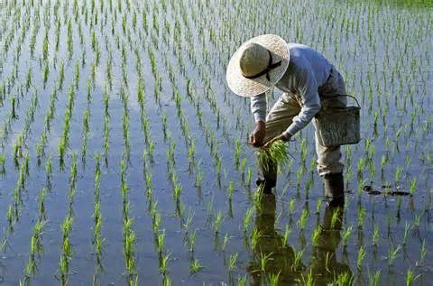
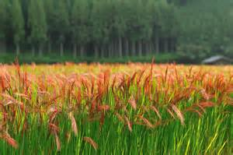
Rice or Chawal
Rice is normally grown as an annual plant in tropical areas. Rice cultivation is well-suited to countries and regions with low labor costs and high rainfall, as it is labor-intensive to cultivate and requires ample water.
Grown and consumed in the South and East India

Slide 16
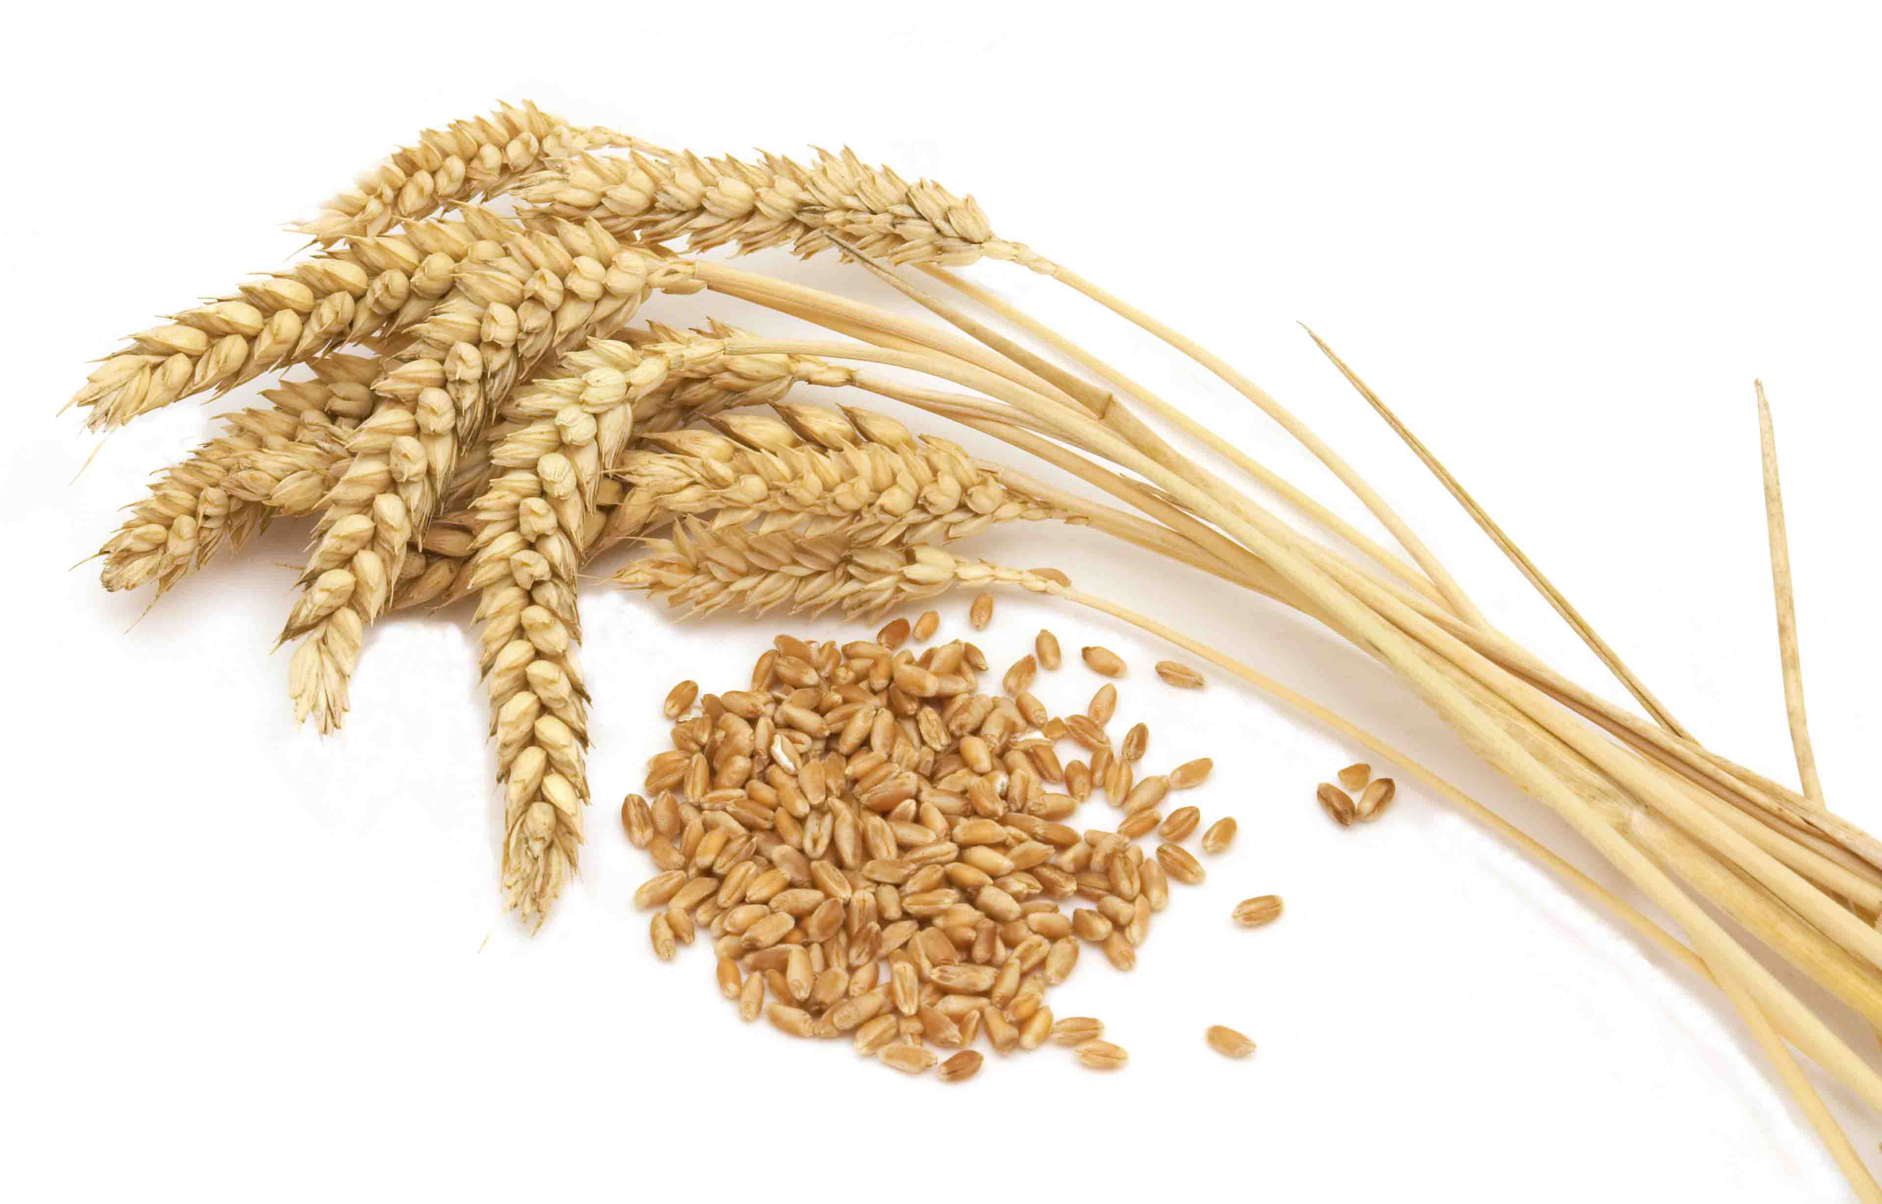
Wheat
This grain is grown on more land area than any other commercial food. World trade in wheat is greater than for all other crops combined.
Globally, wheat is the leading source of vegetable protein in human food, having a higher protein content than other major cereals, maize (corn) or rice.
Chappatis, puris are made with wheat flour
Sooji is coarsely milled wheat

Slide 17
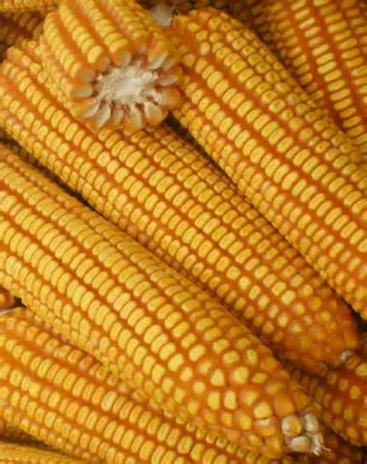
Maize or Jowar
Known as corn in English speaking countries
Corn flour is used to make rotis.

Slide 18
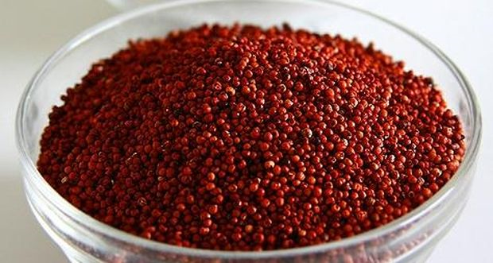
Millet or Bajra
Grown mostly in parts of Africa and South Asia
Considered the healthiest of grains
Bajra flour is used to prepare rotis, idlis, dosas and other dishes.

Slide 19
Barley
Hearty grain used in various parts of the world – looks similar to wheat.
(Not a very commonly used grain in India)

