Slide 1
COMMON TOXINS IN DOGS
Katie Grzyb, DVM
Skyline Veterinary Specialists
Tortie Extrordinaire

Slide 2
COMMON TOXINS
CHOCOLATE
RAISIN/GRAPE
XYLITOL
MARIJUANA
RODENTICIDE
NON-STEROIDAL ANTI-INFLAMMATORIES (N-SAIDS)

Slide 3
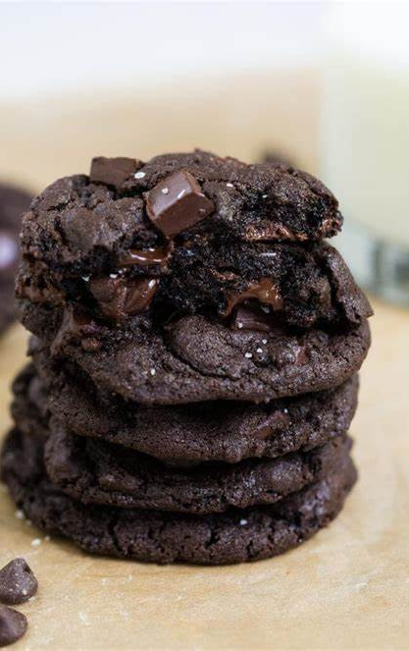
CHOCOLATE TOXICITY
Not all ingestions are toxic
Depends on:
Type of chocolate ingested
Amount ingested
Size of the patient
How quickly ingestion is discovered

Slide 4
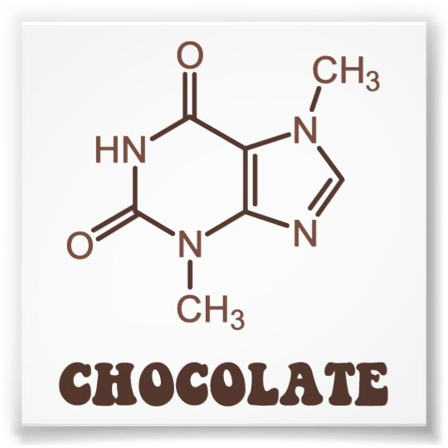
METHOD OF ACTION
The toxic components found in chocolate are known as methylxanthines
Methylxanthines include:
Theobromine
Theophylline
Caffeine
Methylxanthines block adenosine receptors and increase cAMP→ increased IC concentrations of calcium→ increased muscular contractility

Slide 5
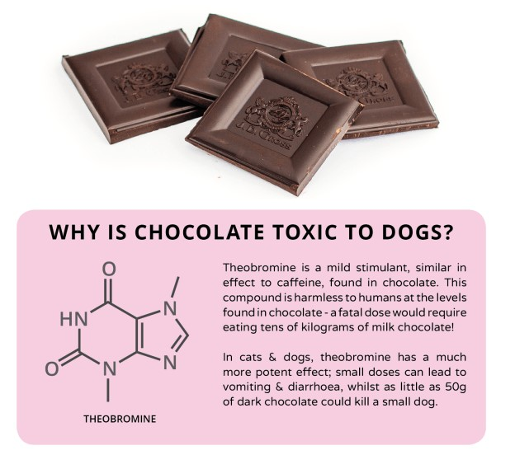
TOXIC INGREDIENTS
Xanthine is produced naturally by both plants and animals. The methylxanthines are used in the treatment of airways obstruction caused by conditions such as asthma, chronic bronchitis , or emphysema.
Caffeine (present in chocolate and coffee) and theobromine (present in chocolate) are also methylxanthines.
At low dosages, it has an immunomodulatory, anti-inflammatory and bronchoprotective effect.
Higher dosages are needed for its bronchodilator effect; however, higher dosages are often associated with toxicity.

Slide 6
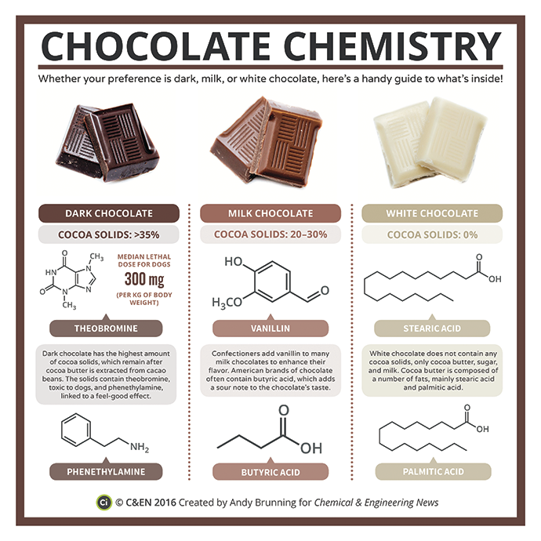
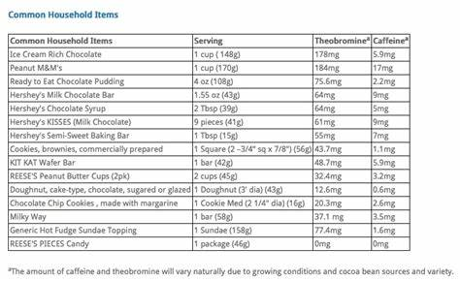
COMMON HOUSEHOLD ITEMS

Slide 7
Table 1. Toxic components in various types of chocolate (adapted from Pet Poison Helpline)
Chocolate type | Theobromine | Caffeine
White chocolate | 0.25 mg/oz | 0.85 mg/oz
Milk chocolate | 60 mg/oz | 6 mg/oz
Semisweet | 138 mg/oz | 22 mg/oz
Dark chocolate | 13 mg/oz | 20 mg/oz
Baker's chocolate (unsweetened) | 390–450 mg/oz | 47 mg/oz
Dry cocoa powder | 737 mg/oz | 70 mg/oz
Hot chocolate powder (instant) | 136 mg/oz | 15 mg/oz
Cocoa beans | 300–1500 mg/oz
Coffee beans | 0 mg/oz | 600 mg/oz
Cocoa bean mulch | 56–900 mg/oz
Chocolate Toxicity Calculator
http://veterinaryclinic.com/chocolate/calc.html
https://www.vets-now.com/dog-chocolate-toxicity-calculator/

Slide 8
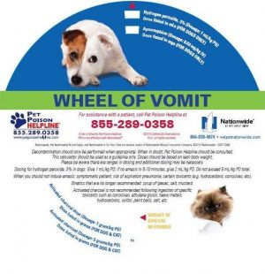
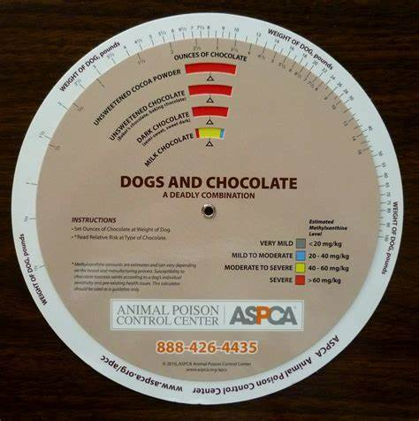
Dosing for:
Hydrogen Peroxide
Apomorphine
Activated Charcoal
Calculates methylxanthine level in:
Unsweetened chocolate
Unsweetened cocoa powder
Dark Chocolate
Milk Chocolate

Slide 9
TOXIC DOSE
Methylxanthines are toxic to both dogs and cats starting at 20 mg/kg, and lethal effects may be seen at 100 mg/kg.
To calculate toxicity risk:
Content of theobromine and caffeine in chocolate ingested
x
The amount that the patient ingested

Slide 10
CLINICAL SIGNS
Usually noted within 1-4 hours post-ingestion
Varies dependent on exposure:
20mg/kg ingestion- GI effects
40-50mg/kg ingestion- Cardiac effects
60mg/kg ingestion- Neurologic effects
100mg/kg ingestion- Death

Slide 11
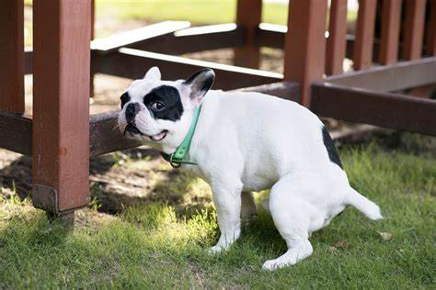
GASTROINTESTINAL EFFECTS
Vomiting
Diarrhea
Hyporexia (Decreased appetite)
(Pancreatitis- occurs due to the high fat content and can occur up to 3-5 days after ingestion- usually the same clinical signs as above)

Slide 12
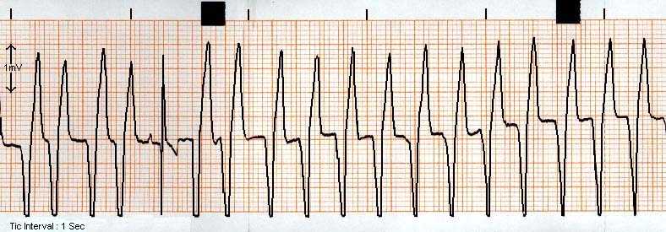
CARDIAC EFFECTS
Tachycardia (elevated heart rate)
Hypertension (elevated BP)
Arrhythmias (Abnormal heart rhythms)
Most common= Premature Ventricular Complexes (PVCs)

Slide 13
NEUROLOGIC EFFECTS
Hyperactivity
Tremors
Seizures
Coma
5. Death

Slide 14
If you are sensitive to vomit,
please close your eyes for the next slide…

Slide 15
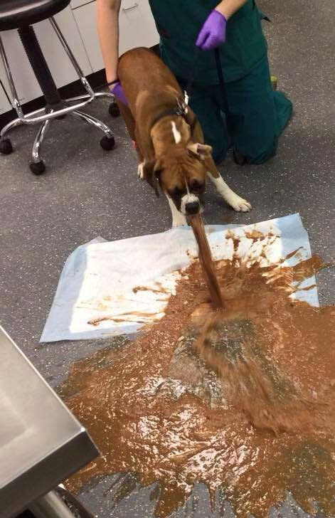
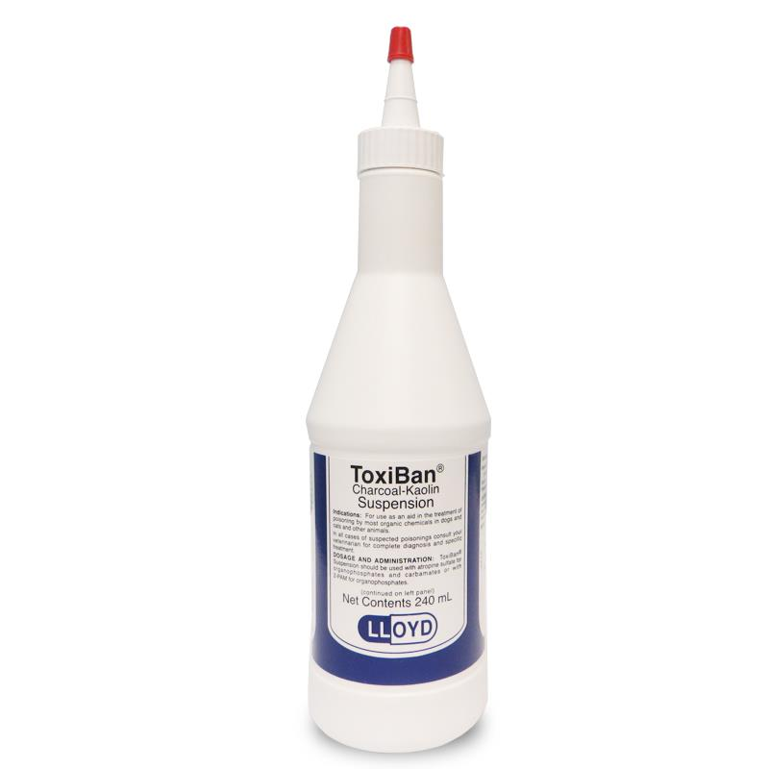
TREATMENT
1. Emesis is recommended unless:
- >2 hours since ingestion
- Patient is neurologically inappropriate (cannot protect airway)
Activated Charcoal given if able to swallow Activated carbon is a form of carbon processed to have small, low-volume pores that increase the surface area available for adsorption or chemical reactions.
- Repeated doses indicated because theobromine undergoes enterohepatic recirculation
(Enterohepatic circulation refers to the circulation of biliary acids, bilirubin, drugs, or other substances from the liver to the bile, followed by entry into the small intestine, absorption by the small intestine and transport back to the liver)

Slide 16
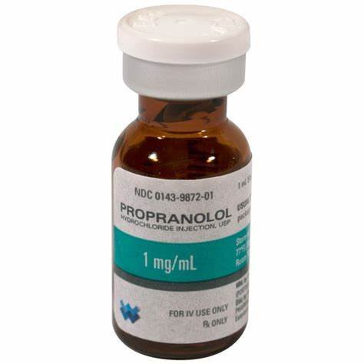
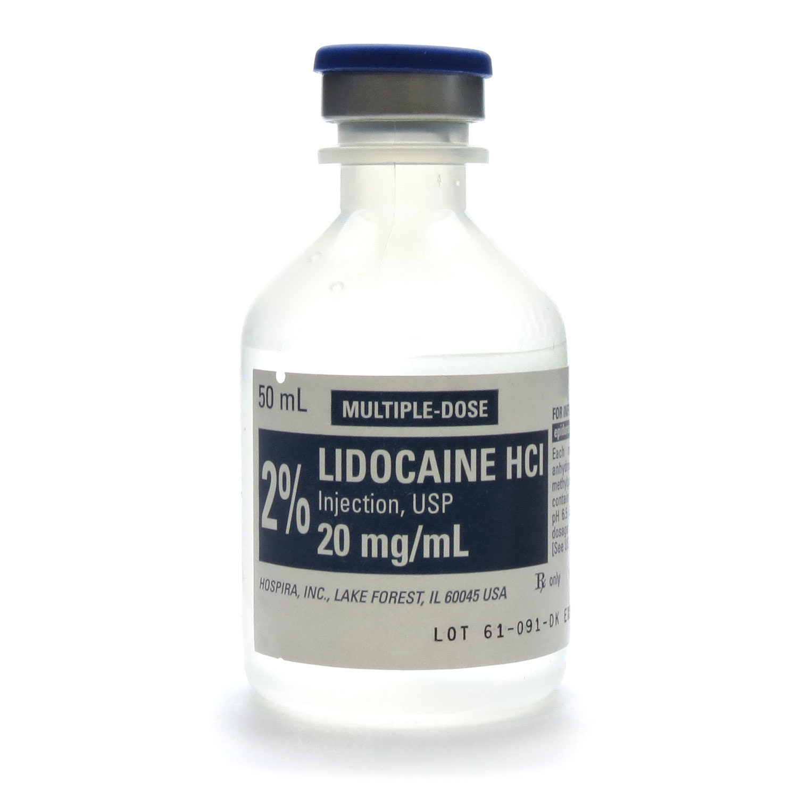
TREATMENTS (CONT.)
3. Fluid therapy
- Free access to water
- IV fluid therapy
Gastroprotectants
Frequent walks or urinary catheter placement- Theobromine is reabsorbed through the bladder wall (can last up to 96 hours)
ECG monitoring with moderate to severe ingestion
Manage tachycardia and arrhythmias PRN- beta blockers most commonly
Anticonvulsant therapy for neurotoxic effects PRN

Slide 17
PROGNOSIS
Good prognosis if low dose and if treated quickly
Better prognosis if productive emesis and induced emesis quickly after ingestion
Guarded prognosis with cardiac and low-grade neurologic signs
Poor prognosis with seizures and obtundation

Slide 18
RAISIN/GRAPE TOXICITY
It is not known if cumulative vs. a large single dose triggers reaction
Some dogs may be more sensitive to susceptibility than others.
May cause acute kidney injury (AKI)
The toxic mechanism leading to AKI is UNKNOWN.
Theories include
idiosyncratic reaction- A reaction to a medication that is unusual and unpredictable, specific to a particular pet.
metabolic disruption- occurs when abnormal chemical reactions in your body disrupt metabolism. When this happens, you might have too much of some substances or too little of other ones that you need to stay healthy.
nephrotoxic mycotoxin- toxic substance produced by a fungus which affects the kidneys

Slide 19
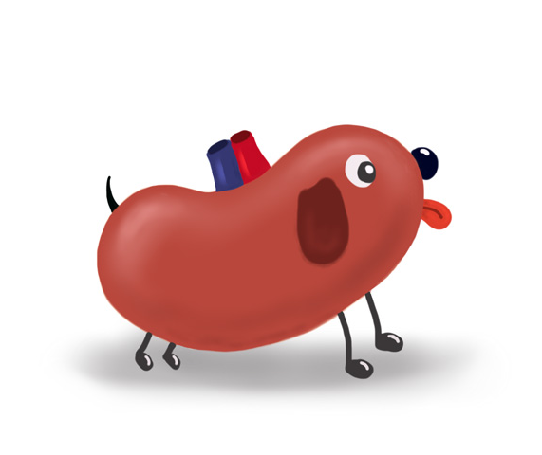
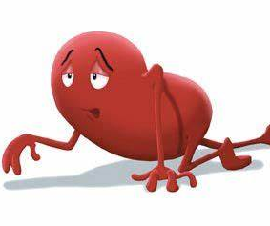
CLINICAL SIGNS
History and clinical presentation include exposure to raisins or grapes and/or vomiting, which may occur within 2 hours of ingestion.
Anorexia, lethargy, polydipsia, polyuria and diarrhea all can occur within 24 hours after the onset of vomiting.
Possible abdominal pain and signs consistent with dehydration and/or hypovolemia.
(In one review, ataxia, decreased urine production and weakness were associated with negative outcomes in grape toxicity.)

Slide 20
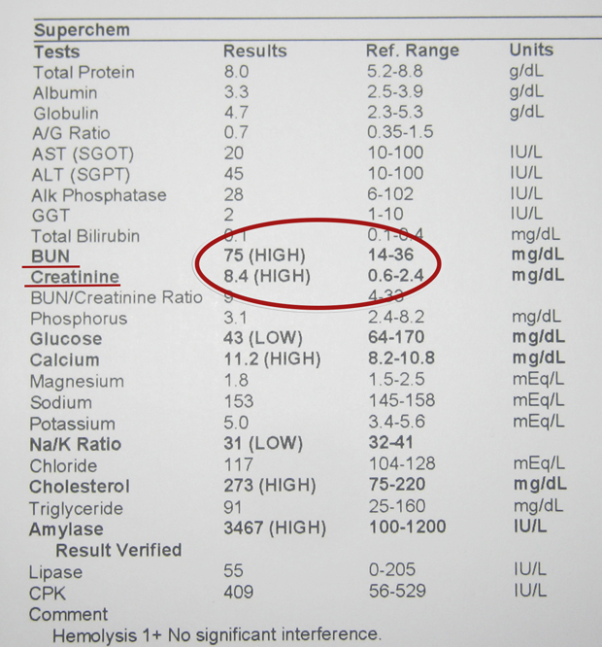
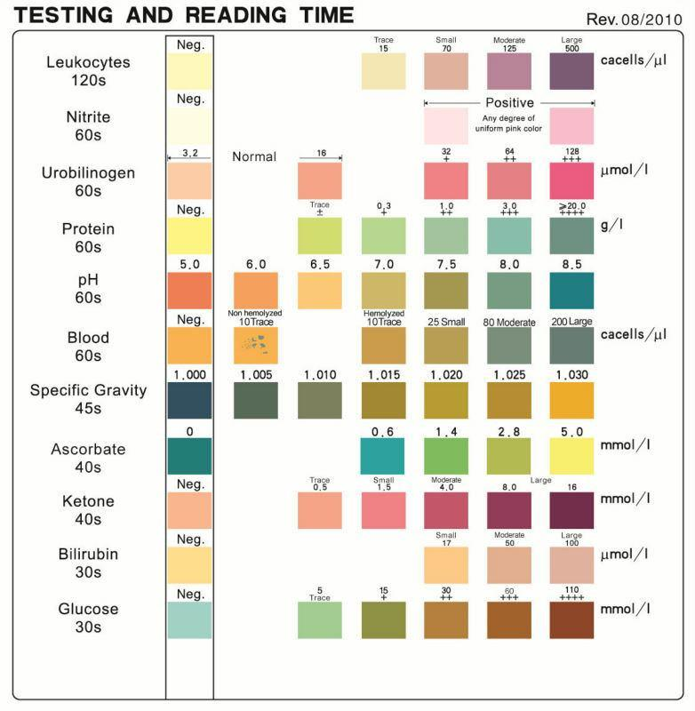
DIAGNOSTIC TESTING
Blood chemistry
Azotemia
Hypercalcemia
Hyperkalemia
Hypophosphotemia
Complete blood count
Thrombocytopenia
Anemia
Urinalysis
WBCs
Hematuria
Proteinuria
Glucosuria
Radiographs
One study showed renal size and
shape were normal
Abdominal ultrasound- can be normal or abnormal
Renomegaly
Hyperechoic renal cortices
Renal pelvic dilation

Slide 21
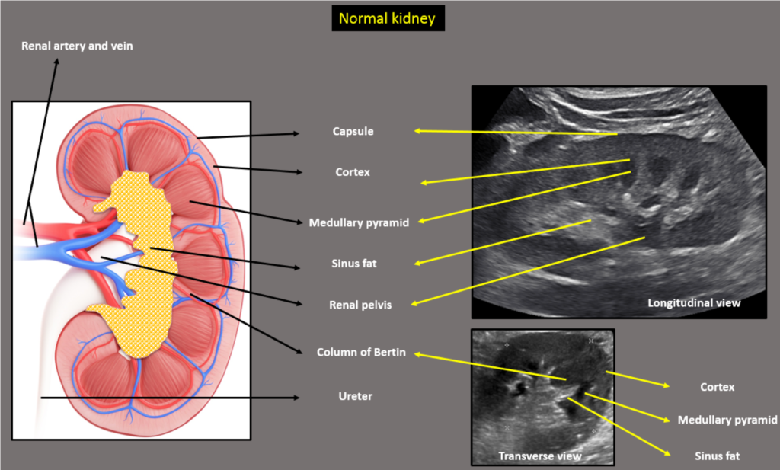

Slide 22
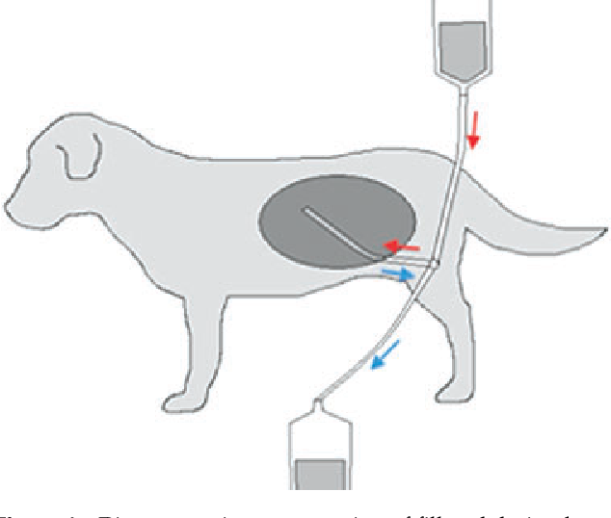
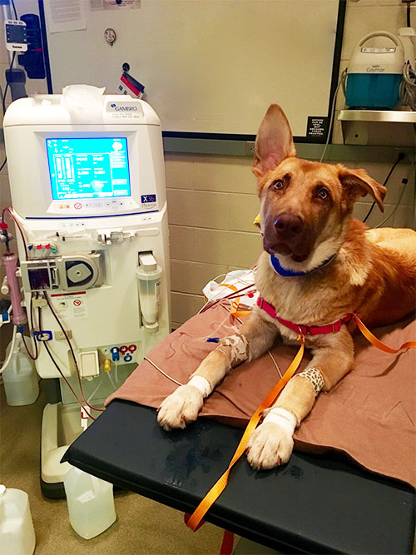
TREATMENT
Treated by elimination of the toxin and supportive care
Emesis should be induced if ingested within the past 2 hours or if unknown time of ingestion
Activated Charcoal
Treatment of AKI
Correction of fluid deficits and ensuring normal kidney perfusion
IVF Diuresis
Diuretics- anuria or oliguria (questionable if helpful)- requires urinary cathterization to measure urine output
Manage acid-base and electrolyte abnormalities- risk of metabolic acidosis, hyperkalemia and hypercalcemia
Manage GI signs- treat nausea and vomiting
Consider peritoneal dialysis or hemodialysis if owners are on board $$$ and no guarantees

Slide 23
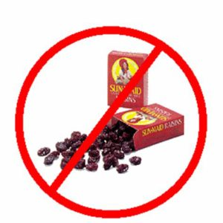
SERIAL BLOODWORK MONITORING DURING HOSPITALIZATION
Chemistry- run baseline, 24 hr, 48 hr, 72 hr
Check electrolytes more frequently – every 4-6 hours if abnormalities noted
CBC- run baseline
- if anemic, recheck BID-QID PRN
- if non-anemic and remains stable- recheck every 24-48 hours
Urine- run baseline and check in-house for casts
Urinary casts are microscopic cylindrical structures produced by the kidney and present in the urine in certain disease states. They dislodge and pass into the urine, where they can be detected by microscopy.

Slide 24
Prognosis
Good if emesis is productive and know that all grapes/raisins were removed from GI tract
Poor if kidney failure and electrolyte changes are noted without dialysis
Guarded with dialysis early in treatment
UNKNOWN TOXIC DOSE MEANS UNKNOWN PROGNOSIS UNTIL TREATMENT IS INSTITUTED!
Serial monitoring of clinical signs and blood work will help determine prognosis.

Slide 25
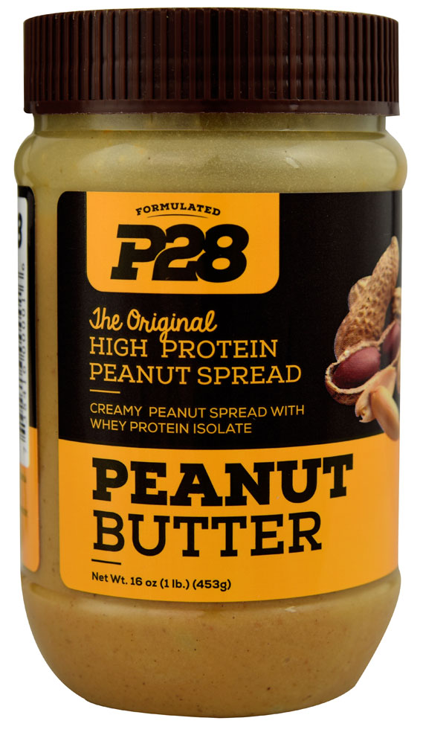
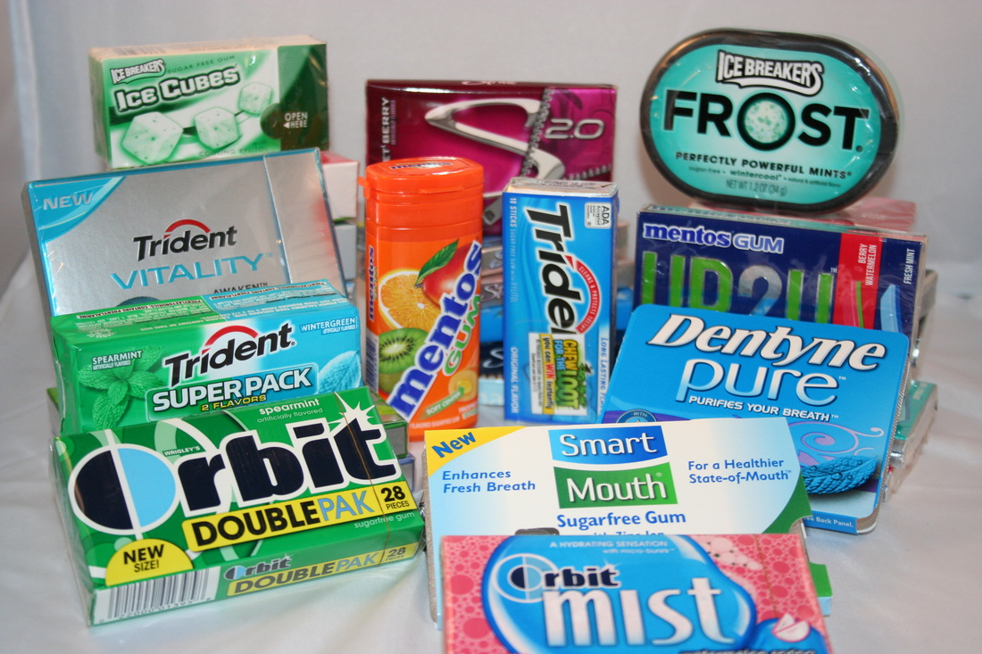
XYLITOL TOXICITY
A 5-carbon sugar alcohol
Popular alternative to sweetener- 40% fewer calories than table sugar, antimicrobial properties against oral bacteria, a low glycemic index, anticarcinogenic effects
Found in: candy, gum, baked goods, jelly, peanut butter, condiments, syrup, flavored drinks, protein bars, toothpaste, some human medications, vitamins, cosmetics, deodorants, sunscreen, etc.
It can also be found in some sports clothing due to its cooling and antimicrobial properties.
(Bioavailability not known in clothing)

Slide 26
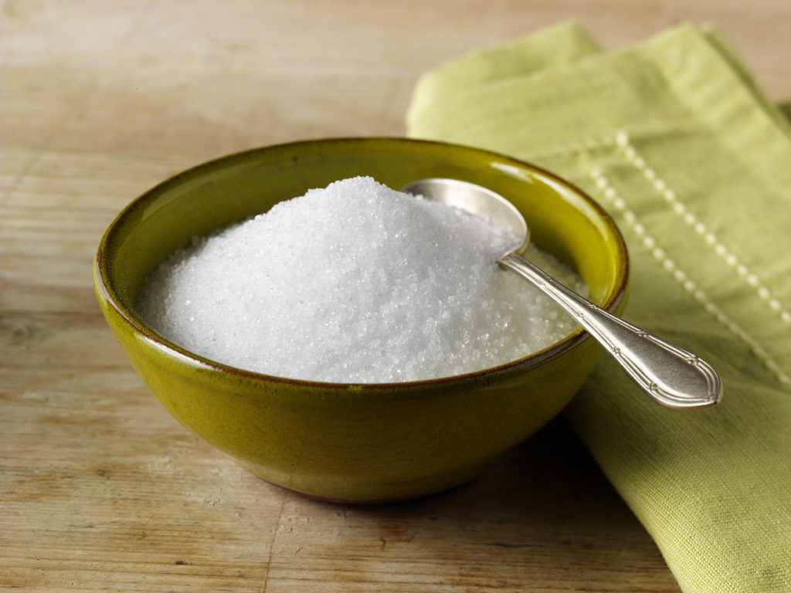
AMOUNT OF XYLITOL IN PRODUCTS
Powdered xylitol used for baking contains 190 g of xylitol per cup.
Xylitol content of manufactured food products varies considerably between different brands.
Determining the amount of xylitol in a manufactured product can be challenging because many manufacturers are unwilling to provide this proprietary information.
Manufacturers are not required to place the amount of each ingredient on a product label; the ingredient list and nutritional label can be of some assistance in determining the xylitol content of a food product. For example:
1) Check the ingredient list to determine if xylitol is present and look for any other sugar alcohols (word ending in “-tol”).
2) Look at the nutrition information under Carbohydrates to determine the amount of total amount of Sugar Alcohol present. If sugar alcohol isn’t specifically listed on the nutrition label, and if fiber and sugar content is zero, use the total carbohydrate amount as the sugar alcohol content.
3) If xylitol is the only sugar alcohol listed in the ingredient list, use that number for the xylitol per serving
4) If other sugar alcohols are listed in the ingredient list but xylitol is listed first, assume that the entire sugar alcohol amount is xylitol.
5) If other sugar alcohols are listed in the ingredient list and xylitol is not the first on the list, divide the sugar alcohol content by the place in the list that xylitol falls. (For example, if xylitol is the third sugar alcohol listed, then divide the total sugar alcohol amount by 3 to calculate the xylitol content.)

Slide 27
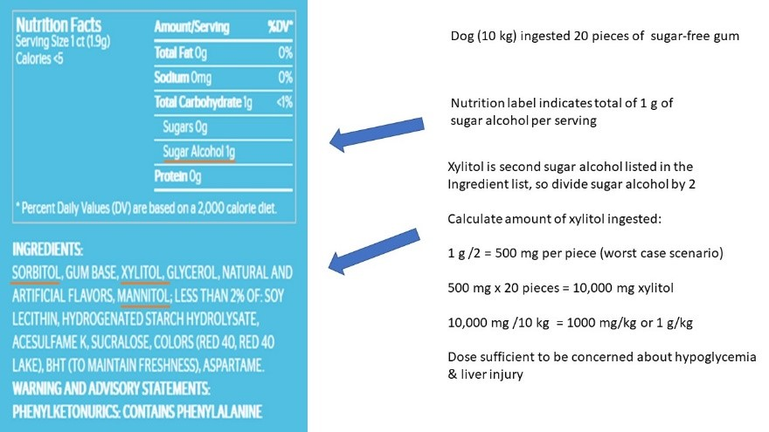

Slide 28
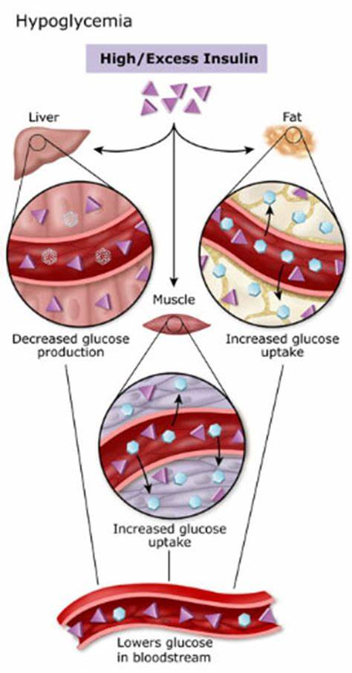
METHOD OF ACTION
Xylitol is rapidly absorbed following ingestion.
Xylitol stimulates an exaggerated insulin release→ hypoglycemia
Hepatic injury- occurs with the ingestion of large amounts of xylitol
Mechanism of action is not well understood
(May involve depletion of hepatocellular ATP storage and/or oxidative injury to cells of the liver)
Other sugar alcohols (e.g. mannitol, sorbitol, maltitol, erythritol) do not cause similar clinical effects in dogs

Slide 29
TOXIC DOSE
Ingestion of >0.075-0.1 g/kg (75-100 mg/kg) of xylitol by dogs has resulted in clinical signs of hypoglycemia
Some dogs ingesting >0.5 g/kg (500 mg/kg) have developed life-threatening acute liver failure
Individual variation in clinical response to a given dose of xylitol has been reported.
This means, there is no good dose correlation with the degree of resultant liver injury in dogs ingesting >0.5 g/kg

Slide 30
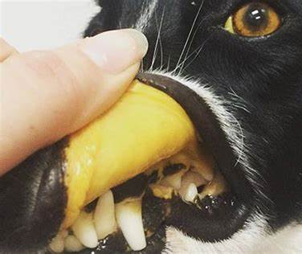
CLINICAL SIGNS
Clinical signs generally occur within 30-60 minutes of ingestion
Anorexia
Vomiting/diarrhea
Lethargy
Ataxia
Restlessness
Collapse
Seizure
Coma
Dogs that develop liver injury MAY or MAY NOT show evidence of low blood sugar prior to liver insufficiency/failure
Signs of liver injury may occur 12-72 hours after ingestion
Jaundice
Vomiting/diarrhea- sometimes discoloration to the feces (orange)
Abdominal pain
Disseminated intravascular coagulopathy (DIC)- petechiae
Hepatic encephalopathy

Slide 31
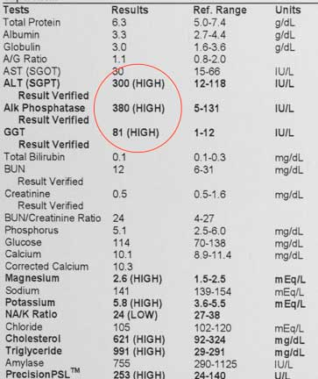
DIAGNOSIC TESTING
Blood glucose- serial monitoring every 3-4 hours for 24-36 hours
Blood chemistry-
Elevations in liver enzymes can occur within the first 4-6 hours post ingestion
Clinically, ALT and AST tend to peak 20-40 hours following ingestion
Hyperbilirubinemia with acute liver failure
Hypokalemia
Hypophosphotemia
Hypoalbuminemia with acute liver failure
Check baseline, 48 hour and 72 hours
If acute liver failure- prolonged clotting times may be noted (ACT, PT, PTT)
If DIC develops, elevated D-dimers and fibrinogen possible

Slide 32
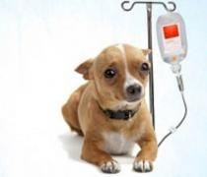
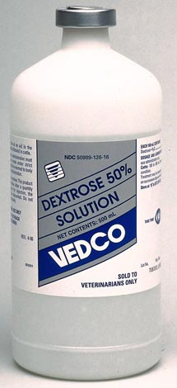
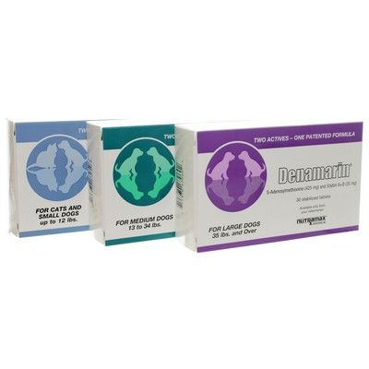
TREATMENT
Emesis if occurred within the past 30-60 minutes and patient has normal mentation
IV Dextrose administration- bolus then continuous rate infusion
IV fluid therapy- maintain cardiovascular function/hydration and manage electrolyte abnormalities
No activated charcoal- does NOT bind xylitol
Hepatoprotectants- no data on benefits
SAMe- Made by the body or synthetically and is involved in the formation, activation, or breakdown of other chemicals in the body, including hormones, proteins, phospholipids, and certain drugs.
Milk Thistle
Vitamin E
N-acetylcysteine
Antiemetics and Gastroprotectants PRN
Discharge ok when normal blood glucose for 6 hours with no IV dextrose supplementation!!

Slide 33
PROGNOSIS
Excellent with hypoglycemia only, provided medical therapy is administered
Guarded with liver toxicity
Poor in dogs that develop hyperphosphatemia, coagulopathy, or hepatic encephalopathy

Slide 34
MARIJUANA TOXICITY
Consists of dried leaves and flowers of the hemp plant
Schedule 1 controlled substance
Contains 480 compounds, including 70 different cannabinoids
Primary psychoactive canniboid is THC (synthetic form= nabilone)
Concentration of THC varies from 1-10%
Hashish (Derived from resin) 3-6%
Hashish oil 30-50%
THC content of marijuana edibles can vary tremendously.

Slide 35
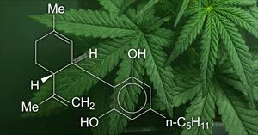
METHOD OF ACTION
Canniboids within plants interact with cannabinoid receptors in the nervous (central and peripheral) and immune system (spleen)
Interaction of cannaboids with their Central Nervous System receptors results in impaired cognition, disruption of short-term memory, incoordination, sleepiness, decreased attention and time perception

Slide 36
TOXIC DOSE
UNKNOWN
Effects different dogs differently
Also, effects differ based on what the marijuana is mixed with- such as edibles, syrups, etc
Clinical signs typically begin 30 to 90 minutes after the marijuana has been ingested
THC is stored in the body’s fat deposits thus, the effects of marijuana ingestion can last for several days

Slide 37
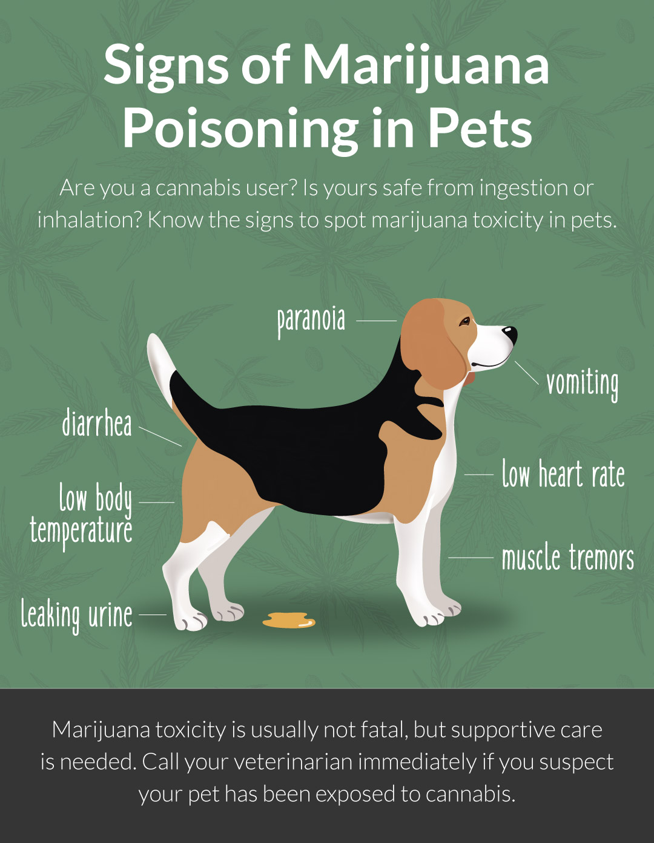
CLINICAL SIGNS
Incoordination/ataxia
Listlessness
Dilated Pupils
Bradycardia- Slow heart rate
Urinary incontinence
Hypersensitivity to light and sound
Hypothermia- Low body temperature
Signs look similar to ethylene glycol poisoning
(more serious toxicity involving antifreeze)
DVMs not obligated to report to local police!!!

Slide 38
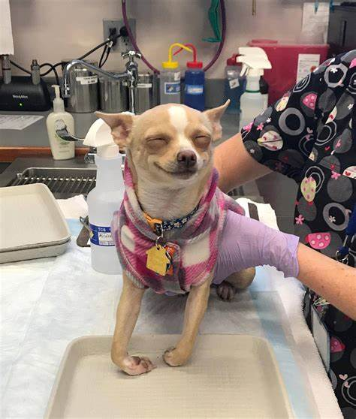
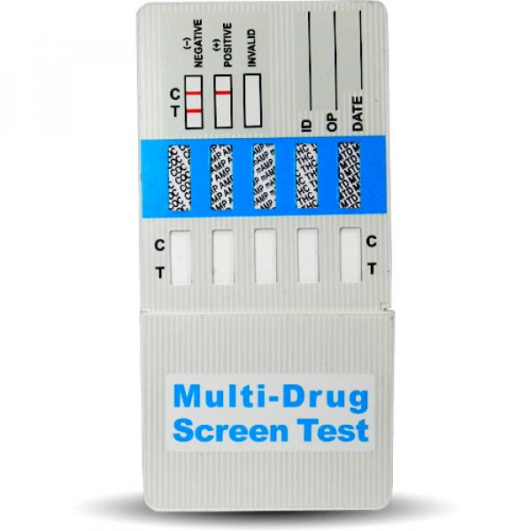
DIAGNOSTIC TESTING
Blood work- rule out anemia as a cause of weakness, check liver enzymes, kidney enzymes and any electrolyte disturbances
Blood pressure- moderate to severe ingestions can cause low BP
ECG- if large amount ingested, can cause arrhythmias
Also, if used in edibles with chocolate can cause dysrhythmias
Urine testing (similar to human drug testing) is available
Need a large amount of urine to run test appropriately
False negatives are common- metabolites relevant to the test are different between dogs and humans
Diagnosis is usually made based on history and clinical signs

Slide 39
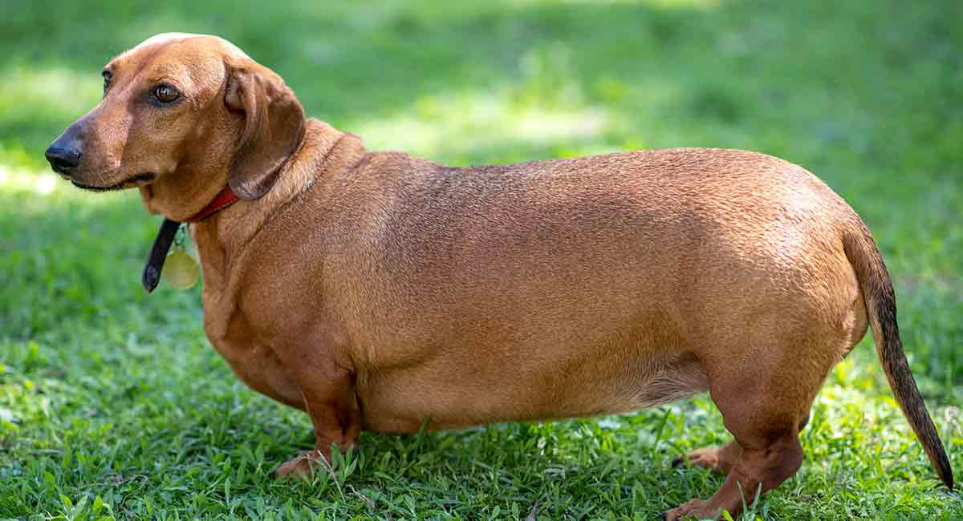
TREATMENTS
If <30 minutes since ingestion and no clinical signs, possible to induce vomiting
After 30 minutes: Difficult to induce due to nausea control properties and risk of aspiration pneumonia
Activated charcoal can be used as detoxification if recent ingestion
IV fluid support and heat support PRN
Confinement to avoid injury due to incoordination
Most patients are discharged after 24 hours of IVF and monitoring
Obese patients tend to feel effects longer

Slide 40
PROGNOSIS
Excellent if monitored closely and IVF support instituted
Guarded if obtunded (altered level of consciousness), comatoses or arrhythmias noted
Chance of fatality is statistically very small but possible

Slide 41
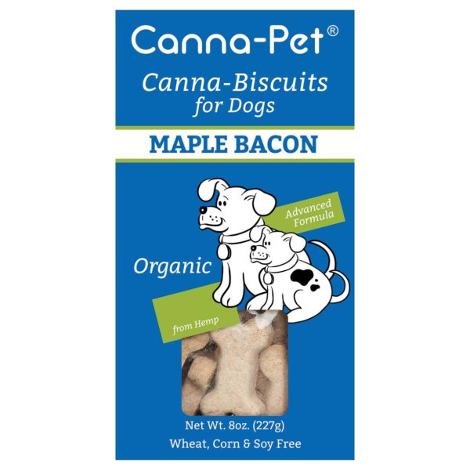
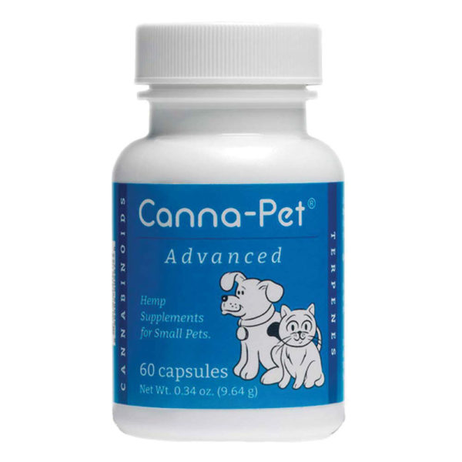
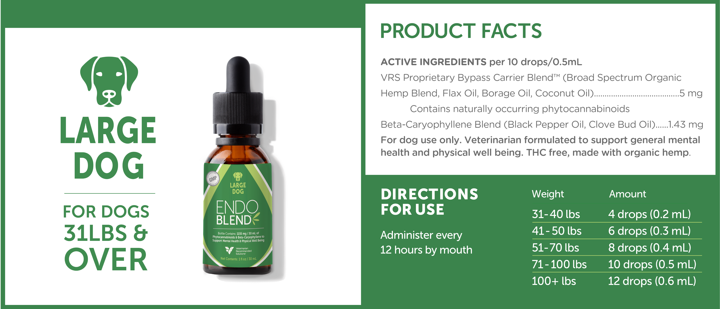
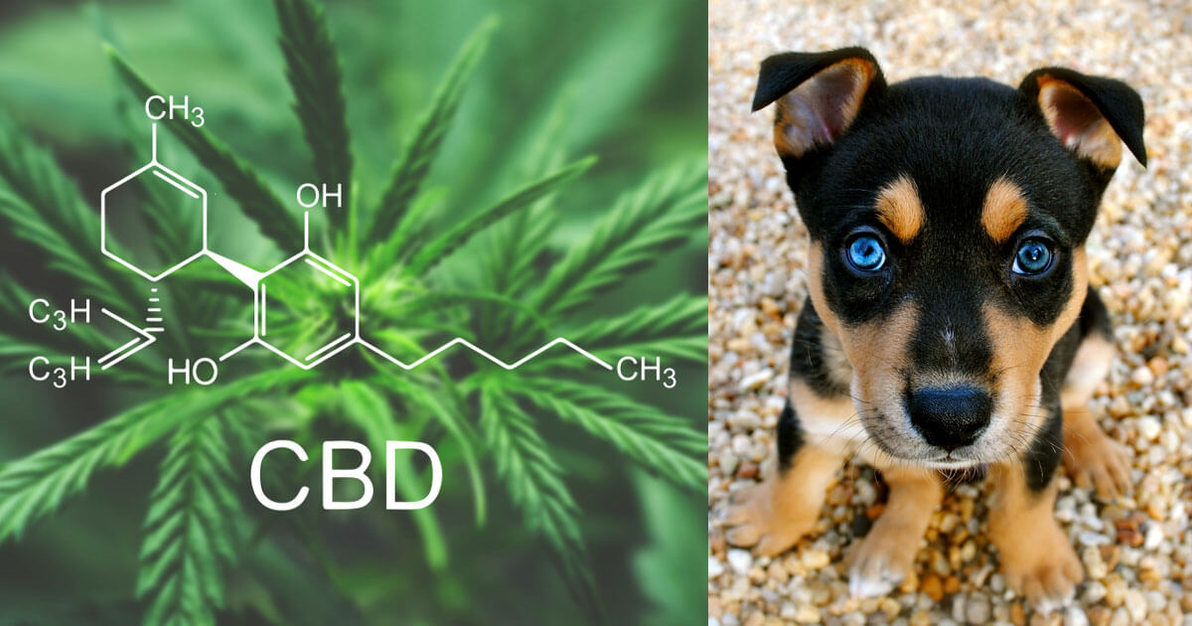
CBD INFORMATION
FDA does not recognize these products as legal
Manufacturers aren’t required to show them to be effective
Products are not required to contain the amount of active ingredient they claim on packaging
Cannabinoids are famous for intolerance effects- body becomes tolerant to the medication and more is needed to generate the desired effect
Studies show that with regular use, a toxic dose is no longer a toxic dose after only 1 week
Not legal for North Carolina DVMs to prescribe or recommend
Research on usage and dosing is sparse
Cannaboids can interact with other medications

Slide 42
ANTICOAGULANT RODENTICIDE
3 TYPES OF RODENTICIDE:
Anticoagulant – Most common
Cholecalciferol – Acute kidney failure
Bromethalin – Neurotoxic
These rodenticides are synthetic or semi-synthetic derivatives of a mycotoxin called dicoumarol (found in moldy sweet clover)
First generation- require multiple feedings or massive ingestion
Warfarin, Chlorphacinone, Coumatetralyl, Coumafuryl, etc
Second generation- “super warfarins”- single feeding needed
Brodifacoum (D-Con), Bromadiolone, Diphacinone, Difenacoum
The color, size and shape does NOT indicate the active ingredient. Essential to verify the active ingredient to treat appropriately
Generally have concentration of active ingredients between 0.0025% and 0.0025% (0.005% is most common formulation which is equal to 1.42 mg per ounce of bait)

Slide 43
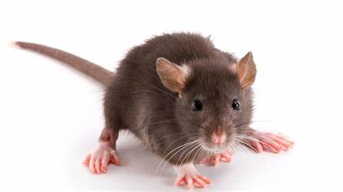
METHOD OF ACTION
Anticoagulant rodenticides act by inhibiting vitamin K epoxide reductase→ Interrupts recycling of vitamin K in the body→ Vitamin K-dependent clotting factors are no longer formed (Factors II, VII, IX, X)→ Coagulopathy (bleeding disorder)
Clinical signs usually appears 3-7 days after exposure to toxin- if pet has normal liver and coagulation function then he/she will have sufficient circulating coagulation factors to last several days
PT (measures factor VII) has the shortest half-life so this becomes prolonged first, then Factor II depletes which elevates PTT
These rodenticides are well absorbed orally and are stored in the liver and are slowly released following biotransformation (Biotransformation is the chemical modification (or modifications) made by an organism on a chemical compound.):
Warfarin and 1st generation: approximately 7 days
Bromadiolone: approximately 14 days
Brodifacoum and 2nd generation “super warfarins”: 3-4 weeks
Usually occurs from ingesting rodenticide
Transdermal exposure has been reported in humans, not in animals
Secondary or relay toxicosis is possible in animals that regularly consume poisoned rodents but ingestion of a single poisoned rodent is a low risk for toxicosis

Slide 44
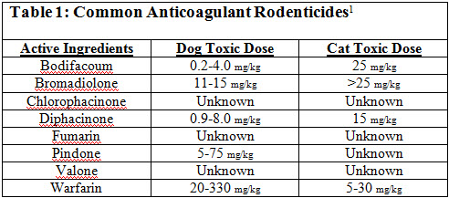
TOXIC DOSE
First generation anticoagulants- doses exceeding 0.5mg/kg
All other anticoagulants- doses exceeding 0.02 mg/kg
Animals with pre-existing liver disease or bleeding disorders may be at increased risk and shorter onset of clinical signs

Slide 45
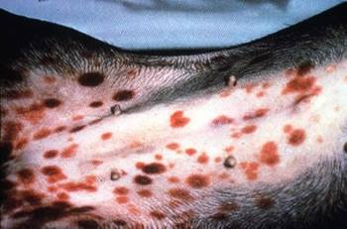
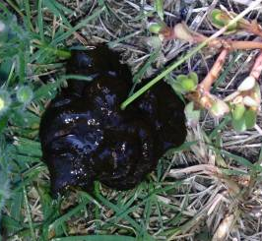
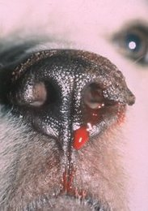
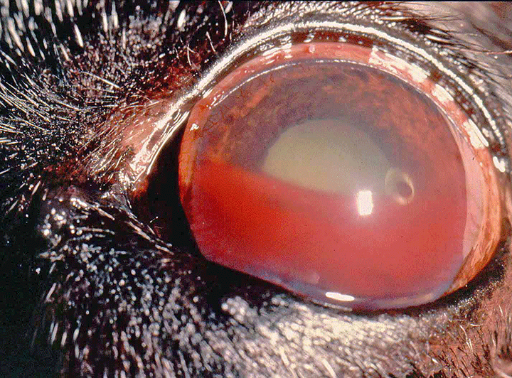
CLINICAL SIGNS
Vary depending on location and severity of hemorrhage
Common signs:
Epistaxis- bloody nose
Coughing
Dyspnea- respiratory distress
Weakness
Pallor- pale gums
Exercise intolerance
Melena- black stool
Hematochezia- bloody stool
Lameness
Hematuria- bloody urine
Paresis/paralysis
Seizures
Ecchymoses/petechiation
Upper airway obstruction
Subcutaneous swelling- swelling under the skin
Hyphema- blood inside of the eye
Exophthalmos- bulging of the eye
Abortion
Bowel Movements can be discolored due to presence of dyes in rodenticide

Slide 46
DIAGNOSTIC TESTING
Packed cell volume/total solids
Complete blood count with reticulocyte count +/- pathologist review- assess anemia as well as platelet count
Blood chemistry- monitor damage to liver or kidneys
PT/PTT- clotting times
Blood type- in preparation for any blood product transfusions
Cross matching as needed- determines blood compatibility prior to transfusions
Continuously monitor:
Hematocrit
Reticulocyte count
Respiratory rate and effort
Neurologic and orthopedic exams- R/O cerebral and joint hemorrhage

Slide 47
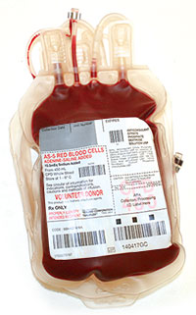
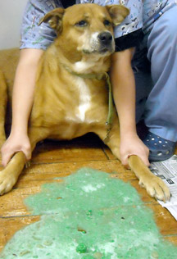
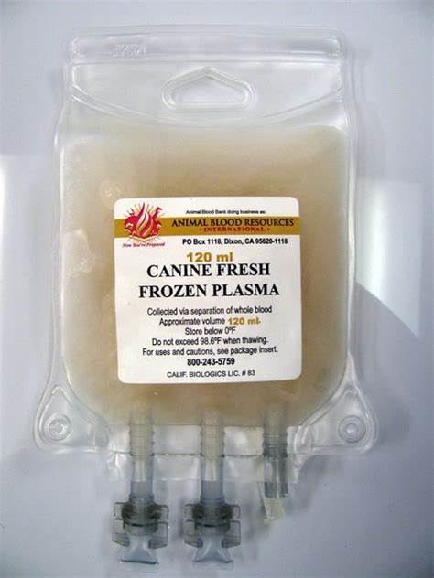
TREATMENTS
IMMEDIATE TREATMENT
Stabilize life threatening signs
A. Thoracocentesis if pleural effusion
B. Oxygen therapy PRN
C. Anti-convulsants PRN
If recent ingestion (within 4 hours), decontaminate with emesis
Activated Charcoal after emesis
If acute hemorrhage on presentation- TOO LATE for decontamination
Provide blood replacement products as needed
Whole blood 10-20 mL/kg IV
Coagulation factors by using Fresh Frozen Plasma or Frozen Plasma

Slide 48
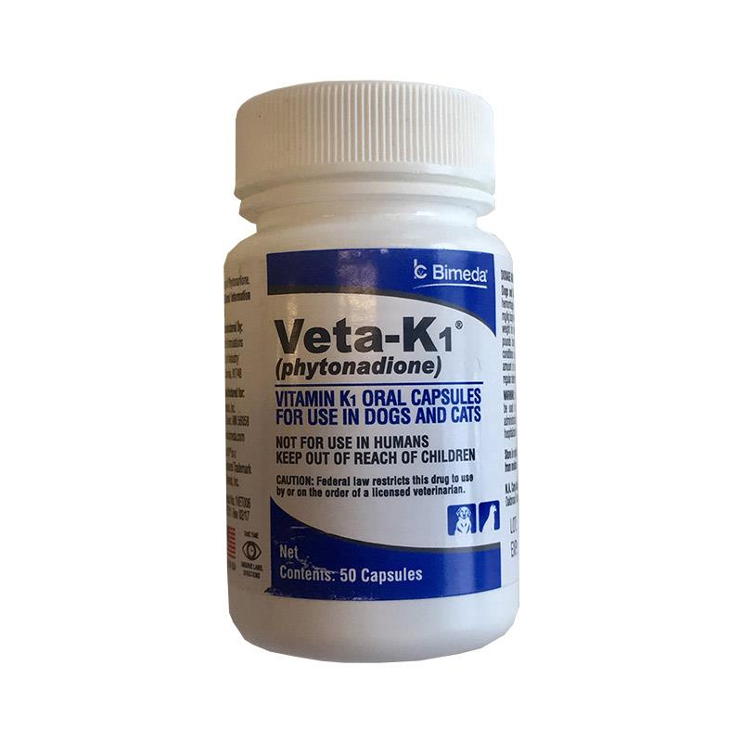
TREATMENTS (CONT)
SPECIFIC TREATMENT
Initiate Vitamin K1 therapy
Dose 3-5 mg/kg PO, SC SID or divided BID
Oral administration > injectable – fat soluble vitamin, injection can cause allergic reaction/hematoma, and Vitamin K1 is directly delivered to the liver via the portal vein
Food enhances absorption
Can use injectable formulation orally in small animals (nursing pups, rodents, birds)
Duration of treatment is dependent on the type of rodenticide ingested:
Warfarin: 14 days
Bromodiolone: 21 days
Other anticoagulants: 28-30 days
SUPPORTIVE CARE
Restrict exercise for at least 1 week after vitamin K1 therapy is done
Avoid intramuscular injections
Avoid highly protein bound medications (NSAIDs, Sulfonamides, etc)
Avoid drug interaction with certain medications (chlorampenical, metronidazole, TMS, ibuprofen, cimetidine, etc)

Slide 49
PROGNOSIS
Excellent for patients with known ingestion who are decontaminated and Vitamin K1 therapy instituted
Guarded for patients with previous liver disease or coagulopathy
Guarded for patients with pleural effusion (fluid around lungs) or pericardial effusion (fluid around the heart) in distress
Poor for paralyzed or obtunded patients

Slide 50
NON-STEROIDAL ANTI-INFLAMMATORY (NSAIDS)TOXICITY
NSAIDs are among the most common medications routinely used in medicine
Anti-inflammatory
Analgesic
Antipyretic
One of the most common intoxications seen in small animals
High likelihood that pet owners have OTC NSAIDs easily accessible in their homes

Slide 51
METHOD OF ACTION
NSAIDs are direct COX inhibitors (cyclo-oxygenase)
Arachidonic acid separates from plasma membrane following trauma/inflammation→converted to eicosanoids under the action of COX
COX 1 enzymes- “housekeeping”, necessary for homeostasis
COX 2 enzymes- inducible enzymes upregulated during inflammation
Most modern NSAIDs are reversible and have COX-2 selectivity
NSAIDs are absorbed rapidly through the GI tract with peak plasma concentrations occurring around 2-4 hours after ingestion
NSAIDs are protein bound so they have a small volume of distribution
Undergo enterohepatic recirculation and glucuronidation in the liver before elimination via urine
Elimination half-lives vary- Naproxen has the longest in dogs at 74 hours

Slide 52
TOXIC DOSE AND EFFECTS
Varies dependent of which NSAID is ingested (see next slide)
The result of overdosage is an exaggeration of the adverse effects reported with therapeutic doses
Inhibition of COX-1 associated with side effects
Some NSAIDs preferentially inhibit COX-2 and thus, have a lower risk of renal and GI effects at therapeutic doses
The major adverse effects are GI, kidney, blood, liver and CNS dysfunctions
GI
Prostaglandins are needed for gastric wall health by promoting mucus production in the stomach and maintaining normal perfusion in the intestines. COX inhibition decreases PGs→impaired mucosal protection→ risks GI ulceration (esp in stomach and duodenum)
Impairs healing of pre-existing ulcers by decreasing perfusion
Renal (kidney)
Renal tubules undergo degeneration due to hypoxia from decreased renal blood flow
Renal hypoperfusion→ decreased GFR (glomerular filtration rate) and PGs released→ PGs induce vasodilation to maintain renal blood flow and GFR function despite volume depletion
COX inhibition limits kidney protective mechanism and GFR may drop dangerously low
Most concerning when higher doses are ingested or in patients with pre-existing volume depletion
IM specialist may use terms- papillary necrosis and interstitial nephritis (pathological lesions)
Hematological (blood)
COX inhibition will impair thromboxane production→ causes platelet dysfunction
Aspirin is used for this purpose in patients at risk of thromboembolic disease (examples?)
Hepatic (liver)
Liver injury is uncommon.
Idiosyncratic reactions have been reported in some Labs at appropriate doses
Potential for hepatotoxicity increases if pre-existing liver disease exists
CNS (Brain and spinal cord)
Mechanism of action is unknown
Massive overdoses can induce ataxia, seizures, coma

Slide 53
Table: Toxic Doses of NSAIDs and Their Expected Results
All dosages above are based on acute ingestion by young, healthy animals, with no prior history of kidney disease.
Pediatric, geriatric, and patients with pre-existing gastrointetinal, kidney, liver, coagulation or central nervous system disease may be at risk at dosages lower than those listed.
NSAID | Gastrointestinal Effects | Renal Effects | CNS Effects
Carprofen | >4 mg/kg PO | >8 mg/kg PO | Possible; doses > 400 mg/kg PO in dogs
Deracoxib | >4 mg/kg PO | >8 mg/kg PO | Undocumented
Ibuprofen | >10 mg/kg PO | >75-85 mg/kg PO | Possible; doses > 400 mg/kg PO in dogs
Meloxicam | Any dose above therapeutic dose | >1.5 times therapeutic dose | Undocumented
Naproxen | Any dose | Any dose | Undocumented
Other NSAIDs: very rough rule of thumb | Any dose above therapeutic dose | >2 times therapeutic dose
Robenacoxib | Doses of 5 mg/kg/day and 10 mg/kg/day for 28 days did not cause any adverse clinical, hematological or clinical chemistry effects nor macro/microscopic lesions at necropsy. Doses of 24 mg/kg/day x 21 days resulted in vomiting, decreased activity and neurologic dysfunction (rear limb ataxia, head tilt, nystagmus); chronic interstitial nephritis and renal tubular degeneration occurred in 4 of 6 cats.

Slide 54
CLINICAL SIGNS
Although mild GI upset may occur within the first 2-6 hours following ingestion, significant GI hemorrhage and ulceration are commonly delayed for 12 hours to 4 days following ingestion.
Vomiting (+ hematemesis/”coffee grounds”), anorexia, abdominal pain, melena, hematochezia, and diarrhea may develop.
GI perforation may occur subsequent to ulceration and may result in collapse and shock from hypovolemia (dehydration) and/or peritonitis (inflammatory fluid in the abdomen).
Onset of kidney injury is usually detectable within the first 12-24 hours following ingestion, with polyuria, polydipsia, isosthenuria (low normal concentrating ability of the kidneys) as initial signs.
Glucosuria, hematuria, dehydration, oliguria, and lethargy may develop as kidney injury progresses. In most cases, kidney injury is apparent within 48 hours following an NSAID overdose, in rare instances the onset may be delayed for 3-5 days.
Neurologic signs develop following massive ingestion of some NSAIDs, so affected animals may be presented comatose and hypothermic. Other CNS effects may include ataxia, seizures, disorientation, and lethargy.
Although some effects on blood clotting can occur, clinically significant coagulation disorders are uncommon with acute NSAID overdoses.

Slide 55
DIAGNOSTIC TESTING
CBC- regenerative anemia (acute changes), non-regenerative microcytic hypochromic anemia (chronic)
Blood chemistry- hypoproteinemia, elevated BUN relative to creatinine, azotemia, AST can increase, GGT can increase
Urinalysis- Casts, glucosuria, hemoglobinuria, isosthenuria, proteinuria
Activated clotting time (blood clotting test)- can be prolonged
Blood pH- metabolic acidosis possible
Endoscopy- gastric and proximal duodenal ulceration

Slide 56
TREATMENTS
The objectives of treatment are to manage gastrointestinal ulceration, hemorrhage, and/or perforation, as well as to treat/prevent kidney injury and any CNS signs
IMMEDIATE THERAPY
Induce emesis (up to 2 hours post ingestion)
+/- Gastric lavage- under general anesthesia
Activated Charcoal- Do not use if melena or hematemesis noted
IVF diuresis- manage hydration and dilute urine
Treat seizures as needed
Comatose animals usually respond favorably to IVF and thermoregulation
Manage blood loss- transfusions as needed
Manage shock
Manage peritonitis/sepsis
(Note: Alkalinization of urine is no longer recommended for NSAID toxicosis)
SUPPORTIVE THERAPY
Use GI protectants 7-14 days after ingestion
Misoprostol- provides prostaglandins to re-establish gastric wall health (DO NOT HANDLE IF PREGNANT)
Sucralfate- coats eroded gastrointestinal mucosa
Antacids
Proton pump inhibitors (most effective, longest lasting)- Omeprazole, Pantoprazole
H2 receptor antagonists- Cimetidine, Famotidine, Ranitidine
Other antacids (least effective, short-acting)- Aluminum Hydroxide, Magnesium hydroxide

Slide 57
PROGNOSIS AND MONITORING
Monitor kidney values: Baseline, 24 hours, 48 hours, 72 hours (may need more frequent if anuric/oliguric)
If no elevations in kidney values- wean off of fluids, recheck kidney enzymes 12-24 hours off of fluids and send home
If elevation of kidney values- maintain IVF until values plateau/decline and the patient is eating and can maintain hydration
Kidney insufficiency after discharge- monitor body weights, +/- SQF therapy, kidney diets, monitor renal values as full recovery of renal tubules can take weeks to months
Gastrointestinal ulceration can take days to weeks to full resolve
Good prognosis if treatment is instituted early
Guarded long term prognosis if chronically elevated kidney values
Poor prognosis if oliguria/anuria or neurologic signs noted

Slide 59
Put these in order of least toxic to most toxic:
Baker’s chocolate
White chocolate
Dark chocolate
Milk chocolate

Slide 60
True or False: If your dog ingests marijuana and you bring her/him to a veterinarian, the veterinarian will have to report you to the authorities

Slide 61
Xylitol toxicity can lead to:
a. Low blood sugar
b. Liver failure
c. Kidney Failure
d. A & B only
e. All of the above

Slide 62
THE END
Thank you to the Carolina Working Dog Association

