Slide 1
Top 10 Differences in Spanish Culture
Created by Eva Manzano and Silvia Manent

Slide 2
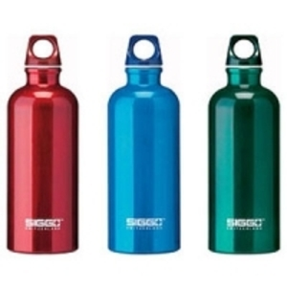
1. Reusable Water Bottles in Class

Slide 3
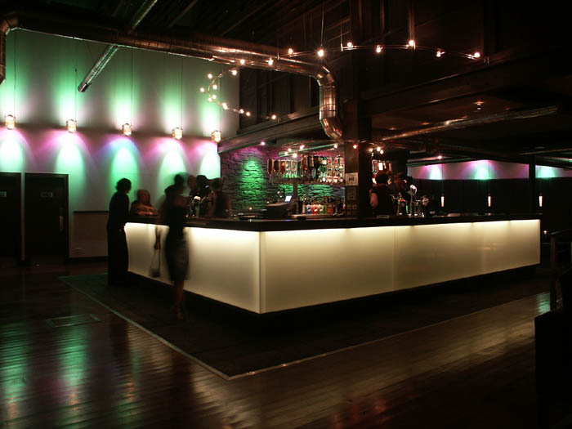
2. Night Clubs Close at 2 AM

Slide 4
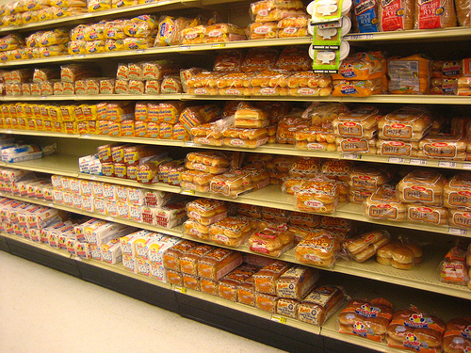
3. The Supermarket Bread Aisle is HUGE in America!!!

Slide 5
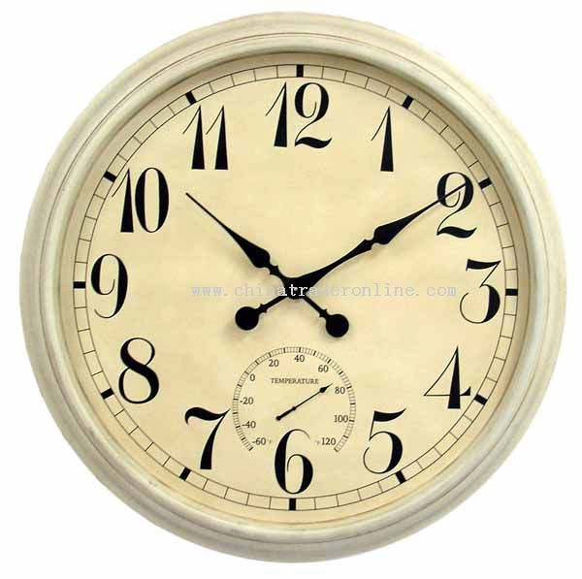
4. Everyone arrives early to class

Slide 6
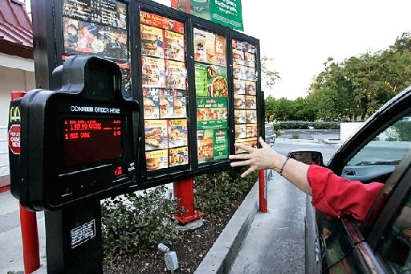
5. Drive Thru’s & Eating in The Car

Slide 7
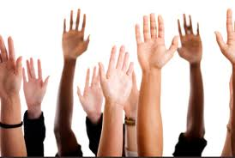
6. Class Participation

Slide 8
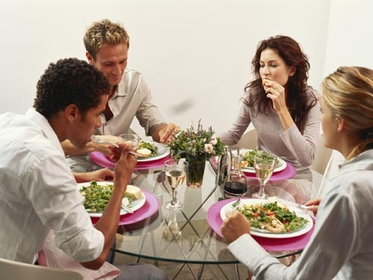
7. After lunch/dinner conversation and late meals

Slide 9
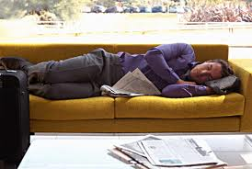
8. “SIESTA” after lunch (that’s why we’re still in a financial crisis)

Slide 10
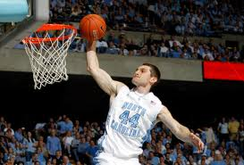
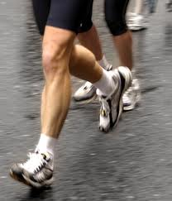
9. People exercise WAY more in America

Slide 11
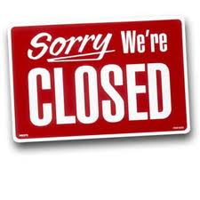
10. EVERYTHING is CLOSED on Sundays in Spain!

Slide 12
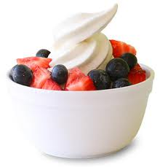
11. Frozen yogurt is not as popular as here.

Slide 13
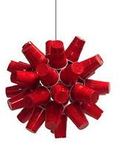
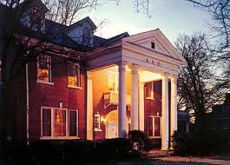
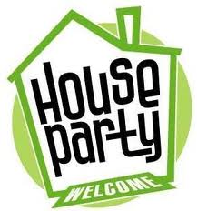
12. We don’t have Frats nor house parties.

Slide 14
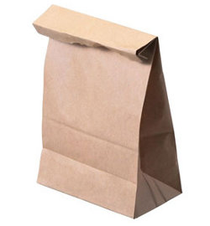
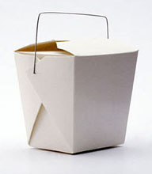
13. Doggy Bags!

