Slide 1
CE SME UPDATES
IIPS Conference
July 16-18, 2012
Presented by:
Wayne Madry
Business Systems Analyst – CE/BSP

Slide 2
Objective
Troubleshoot and develop possible generic technical solutions to workflows and processes topics
Identify Student Applications (modules) with impact to CE workflows, which are not being utilized fully
Develop strategies and support to present solutions for evaluation, implementation, and/or software adjustments/changes for CIS applications
Assess time management for topics within CIS.

Slide 3
Topics
Workflow
Portal
  Taxonomy
  Governance
  Content Contributor
  Branding
Web Attendance
HDT Process
Communication
Data Initiative
Informer

Slide 4
Customer Support
Training Needs
http://www.nccommunitycolleges.edu/Training/CIS_Training/CISTrainingHomePage.html
CIS Documentation
http://www.nccommunitycolleges.edu/CIS_Dos/index.html
Training Needs web link accesses 90-Day Training Calendar
If you have a specific training need, contact System Office at (919) 807-7178

Slide 5
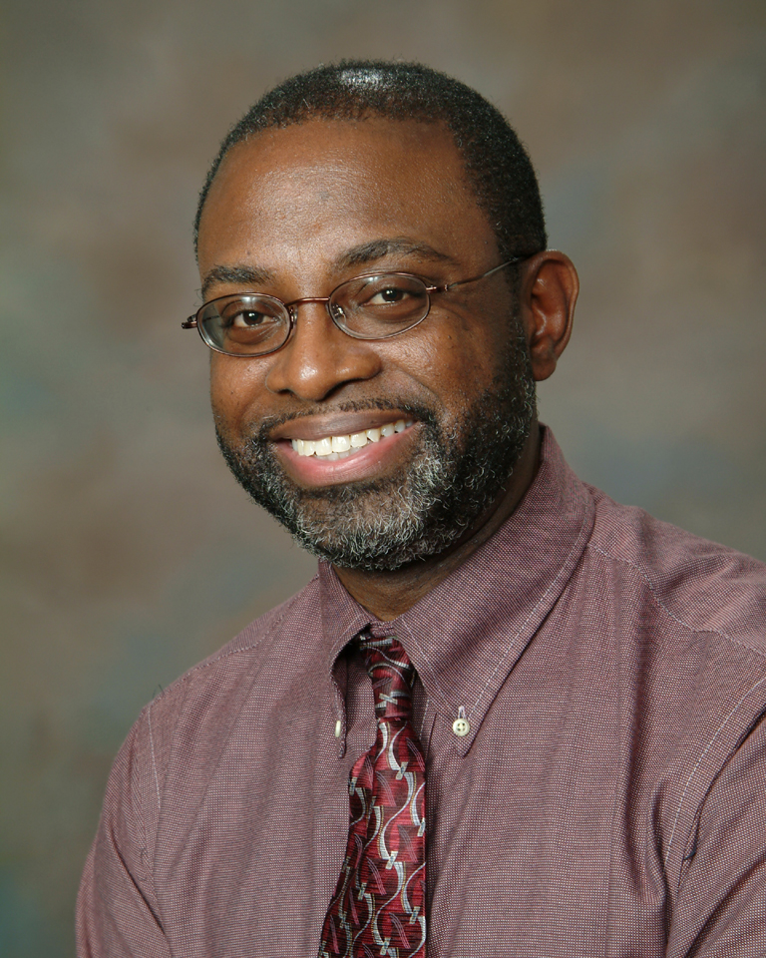
Any Questions?
Business System Analyst, CE/BSP
Mitchell Community College
(704) 978-5433
(919) 807-7178

