Slide 2
Installing Split Field Defense Agenda
Menu’s, Position Techniques, EDD’s
Install Plan and Basic Practice Shell
Pursuit Drill, Tackle Circuit , Strip Circuit
Force Drills, Game Week Prep
Video Scout Report, Google Forms,

Slide 3
Installing Split Field Defense
Structure is Crucial
Assign and Align
Shed
Pursue
Tackle

Slide 4
Defense Fronts Menu
4-2-5
Field
Sara/Sally
Split
Ears/Eyes
3-4
30 50 70 90
Outside/ Heavy/ Bear
What do we have to do to
win a championship

Slide 5
Defense Stunts Menu
4-2-5
Clap/Clobber
Pinch/Pirate
Taxi/Exit/Boat
Plugs
3-4
Slant/Angle
Net
Ox/Socks

Slide 6
Defense Blitz Menu
4-2-5
Go’s
Dog’s
Plug’s
3-4
NCAA Style (OLB and ILB)
CB Boundary Blitz
ILB’s
Safety Blitz (we don’t)

Slide 7
Defense Coverage Menu
Read Side
Read
Trap
Robber (need it vs 1 team)
We do play some 3
Away Side (choice)
Blue
Sky
Rat

Slide 8
Defense Coverage Menu
Trips
Solo
Uno (Trap)
Special (Solid, Cloud)
We do play some 3
More Trips
Super
Box (Bunch)

Slide 9
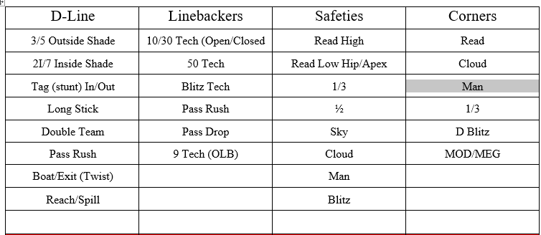
Position Techniques Required
w

Slide 10
Positional Basic Drills DLine
Stance and first step
Tag steps/Long Stick
Basic Blocks (Drive/Down/Reach)
Extension and Shed
Doubles
Spills and Heel Line Trail
Speed Rush
Bull and Pull
Draw/Screen

Slide 11
Positional Basic Drills ILB’s
Stance and first steps
Sheds and extension
OL Reads/Open vs Closed
Pulls
Blitz
Pass Drops and Breaks
Relating 3 -> 2

Slide 12
Positional Basic Drills OLB’s
Stance and first steps
Sheds and extension
9 Tech Box and Spill
Pass Drops
Relate to #2
Curl to swing of 3 (Read)
Seam Curl Flat (Zone Blitz)
Read vs Robber vs Trap
Special

Slide 13
Positional Basic Drills DB’s
Stance and first steps
Sheds and extension
Fill Drills
Read Drills
Squat (Press) Drills
Phase Drills
Man and Zone turns
1v1 Technique
Long Arm

Slide 14
Rotating 4 Day Install Plan
Day 1
Front: Field (Ears and Eyes)
Stunt: Clap Pinch (inside)
Coverage: Read Choice Solo
Formations during team: 2x2, 2x1, 3x1
Emphasis:
2 back Run Fits

Slide 15
Rotating 4 Day Install Plan
Day 2
Front: Split (Sara/Sally)
Stunt: Taxi (Outside) LB Plugs $Go’s
Coverage: Read Choice Special Sky
Formations during team: Pro Doubles/Tite Trips Trade
Emphasis:
1 back run fits (Option)

Slide 16
Rotating 4 Day Install Plan
Day 3
Front: 30/50/70
Stunt: Slants and Angles NCAA Blitz
Coverage: Fog/Rat
Formations during team: 2x2, 2x1, 3x1
Emphasis:
2 back Run Fits

Slide 17
Rotating 4 Day Install Plan
Day 4
Front: 90 (Raider, Heavy)
Stunt: Inside LB Blitzes OLB Crash Rat/Rush
Coverage: Trap
Formations during team: 2x2, 2x1, 3x1
Emphasis:
1 back Run Fits

Slide 18
Rotating 4 Day Install Plan
Day 5
Review and mix in fronts
We are ready to play/scrimmage
Situations Red Zone.. 3rd and 2 +40
4th down

Slide 19
Rotating 4 Day Install Plan
Day 6/7
Over/Under Install Dogs, Special Cloud, Robber
Motions and Trades More Option and Zone Read fits
Bunches and Stacks

Slide 20
Rotating 4 Day Install Plan
Day 8/9
3-4 Emphasis
NCAA Variations Corner Blitz
Unbalanced Lines
Review Situations.. That special team

Slide 21
Basic Practice Shell (100 minutes)
(Doubles)
15 Minutes Circuit/Pursuit
25 Indy Teach and drills specific to install
15 Assign and Align
30 Group (15 min group run 15 min group pass)
15 Team

Slide 22
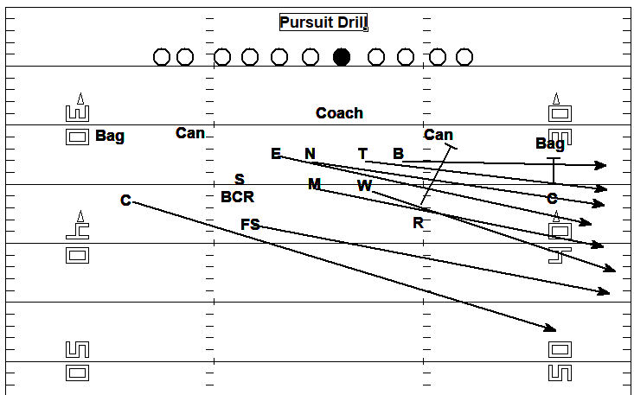
Pursuit Drills
w
Align
Stances
Hit it
Run
Demeanor!

Slide 23
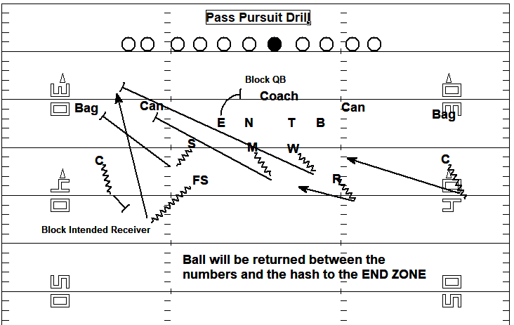
Pursuit Drills
w

Slide 24
Tackle Circuit
5 Stations. 2:30 per station 30 sec change. TEACH
6 point ext. 6 point tackle..6 point shed Angle Tackle
Pec to Pec...Start from a knee...We use a pad
Hawk Tackle ...Bags and wheel
Tracking We use a wheel here too
Compression and also strip later in the year

Slide 25
Strip Circuit (only during camp)
Tomahawk Rip/Rake
Punch
Second Man in
Scoop and Score
Cradle Knees to chest, Chin tucked
DL Block Pass with inside arm

Slide 26
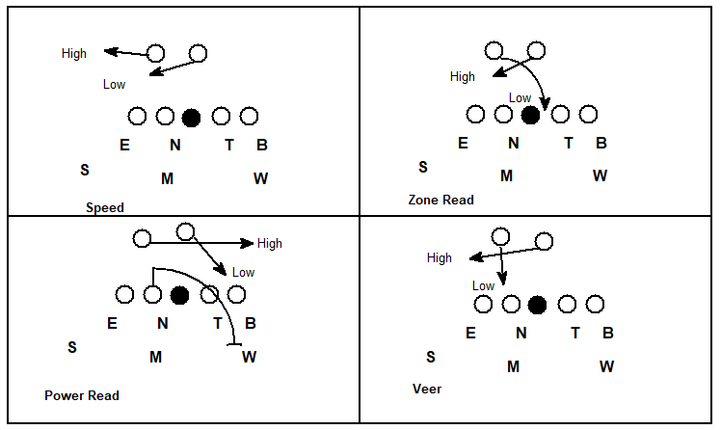
Force Drills 425 (High/Low Player)

Slide 27
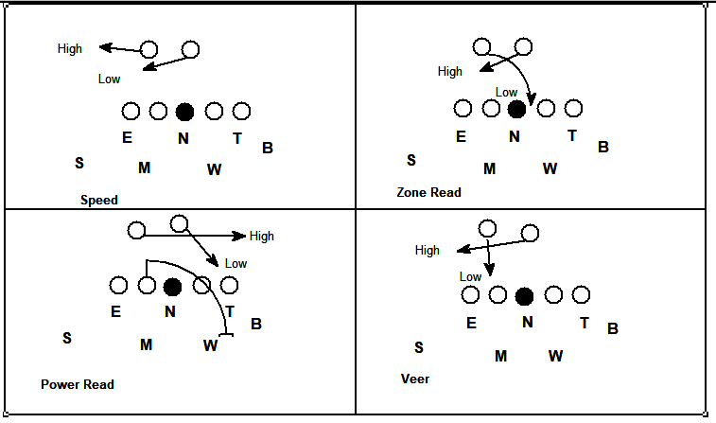
Force Drills 3-4 (High/Low Player)

Slide 28
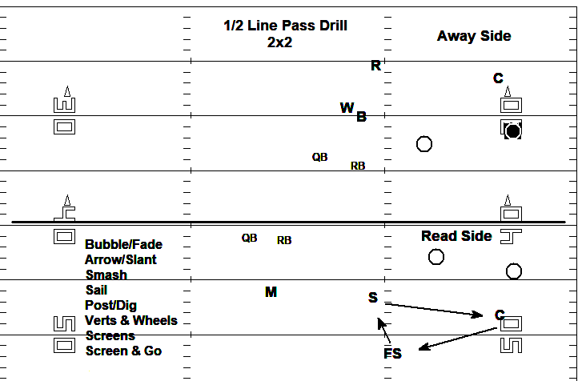
1 / 2 Line Pass

Slide 29
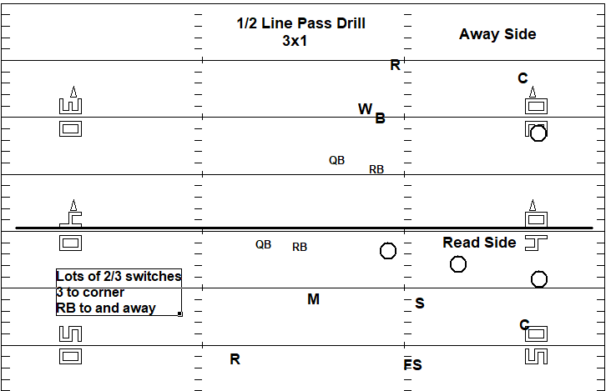
1 / 2 Line Pass

Slide 30
Google Forms
Create a Study Guide
Read Coverage Quiz

Slide 31
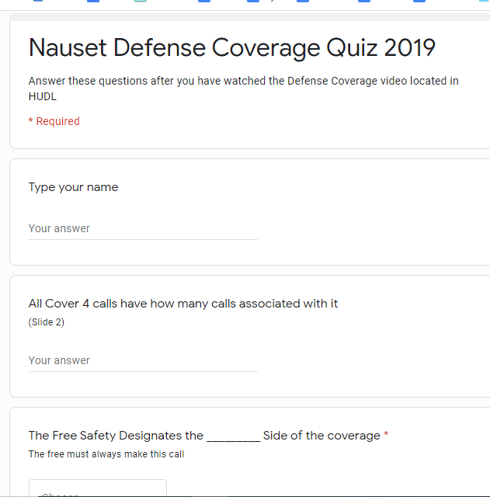
Google Forms
Read Coverage Quiz

Slide 32
Google Forms

Slide 33
Defensive Staff Game Week
Sat AM- 8:00 Meet on previous game. Thoughts?? Personnel, Corrections, We do NOT grade. Begin breakdown
9:00 kids here. See kids Love ‘em up. Lift
10:00 Film Always start together (Play List)

Slide 34
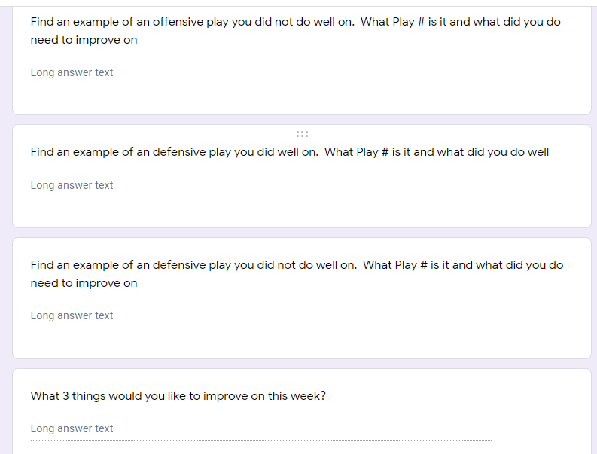
Defensive Staff Game Week

Slide 35
Defensive Game Week: Staff Film
DC: ODK play formation Motion Fld/Bnd Mot
DL: Run/Pass Hash Strength Team
DB: Name Pass Plays
Offensive Guys: Dn/Dist/Yard
Try to be done by Saturday

Slide 36
Defensive Game Week: Sunday
Breakfast w Bride THEN Game Plan
Thinking: Formations, Studs, Plays
Meet via Zoom 5pm Talk with HC before
Go Over Ready List
Send Out Hudl tips

Slide 37
Defensive Game Week: Hudl Tips

Slide 38
Video Scout Report

Slide 39
Defensive Game Week: M,T,W
10 Min Pursuit or Tackle Circuit (40 kids)
15 Min Individual
10 Assign and Align Formations (TIC) Motion etc
10 Min Group work (7v7, Inside run, 1v1, Pods)
15 Team- We MIX in the 2’s (Film)
Total Practice is never over 2:30 (150 min)

Slide 40
Defensive Game Week: Thurs
Review Subs Review Transitions
Assign and Align
15 Plays Normal, 3rd Down plan, GoalLine
QB Sneak

Slide 41
Defensive Game Week: Friday
Assign and Align or 10-12 Play Video
Box: Subs, Hash, D&D, Watch Top
Field: Make Educated Guesses, 2 signalers
Call Sheet

Slide 42
Favorite Resources
Complete Linebacking - Lou Tepper
Football’s Eagle and Stack Defense- Vanderlinden
CoachHuey.com
Quarters Coverage Made Simple - Shap Boyd
Twitter: @JerryGordonFB
Email: jgordon0508@yahoo.com

