Slide 1
Where Creativity Meets Performance
Bumble Concepts
April 27, 2022
ConsumerAcquisition.com
© Consumer Acquisition LLC – Company Confidential

Slide 2
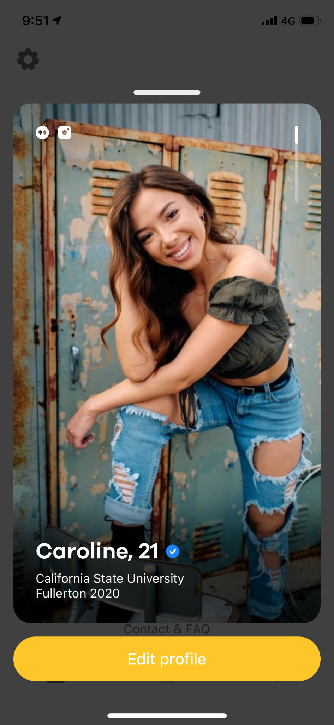
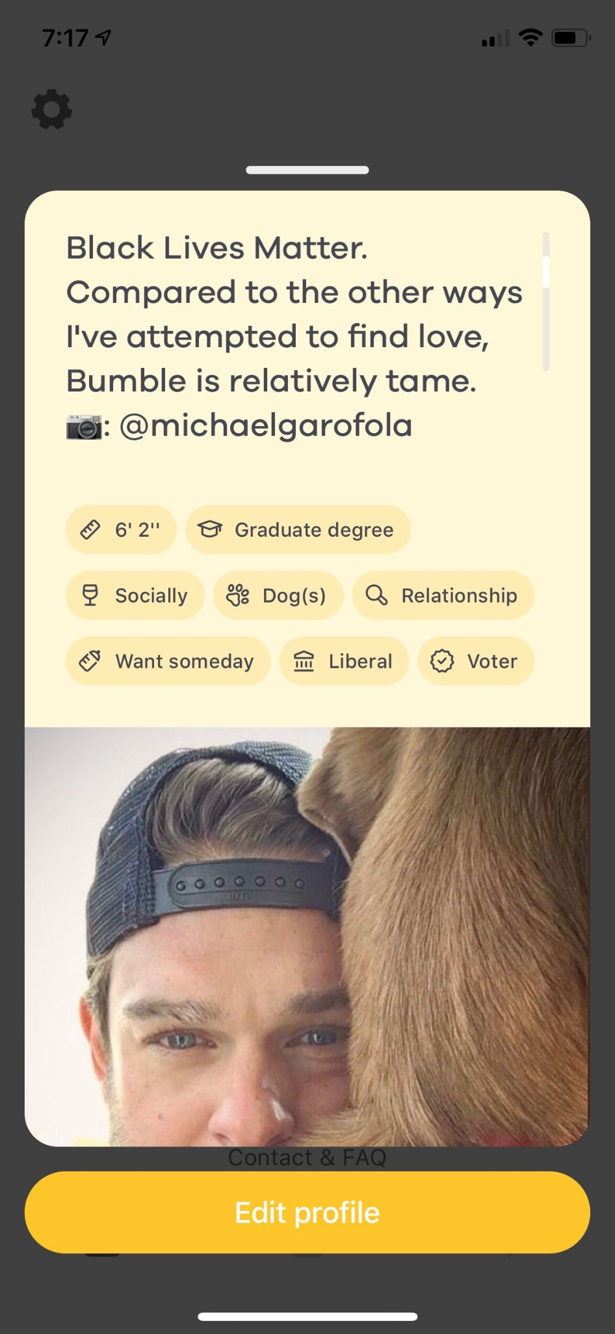
Sincere Concepts
General Ideas:
Checklists, affirmations, quizzes
Concept Idea:
Recipe for a good profile
Pinch of fun
1 cute smile
Adventure pic
List of hobbies
Try to get a pet
Have fun!
Click image to view
Click image to view
ConsumerAcquisition.com
© Consumer Acquisition LLC – Company Confidential

Slide 3
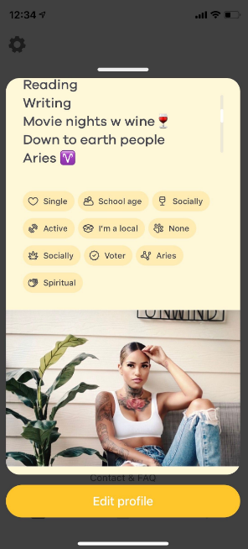
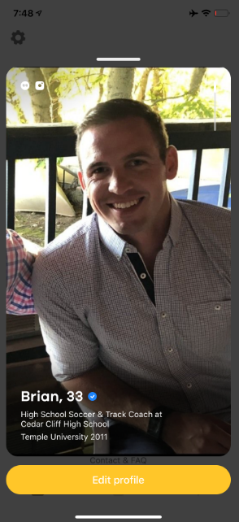
Supportive Concepts
General Ideas:
Bumble has your back, reassurance, encouragement to get back out there
Concept Idea:
Tips on how to be your Authentic Self on Bumble
Pick your actual favorite movie, not just the typical choice!
Be honest with yourself, what date ideas actually sound fun?
Don’t fear rejection, get excited about new possibilities!
Click image to view
Click image to view
ConsumerAcquisition.com
© Consumer Acquisition LLC – Company Confidential

Slide 4
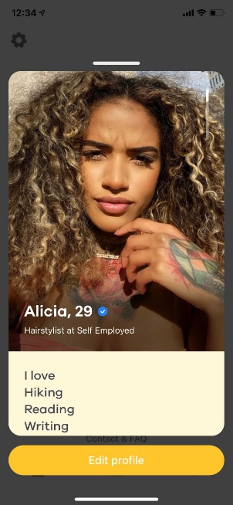
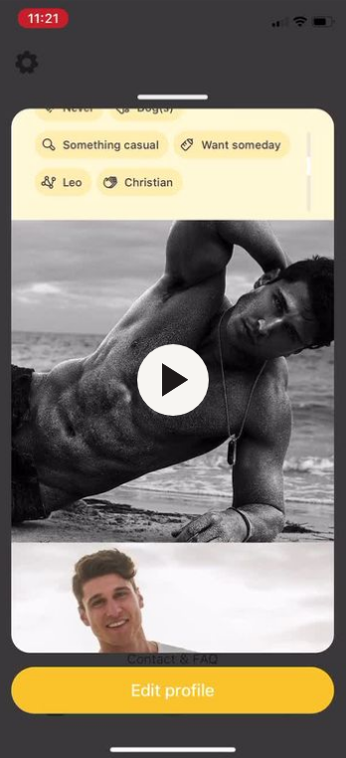
Optimistic Concepts
General Ideas:
Testing the waters, Mad Libs, positive reinforcement that people share specific interests
Concept Idea:
Zodiac Conversation Starters
Messages hitting a dead end?
Here’s a list of great conversation starters for Zodiac signs
“Virgo: My love language is acts of service, how about you?”
“What’s the most ‘fire-sign’ thing about you?”
Click image to view
Click image to view
ConsumerAcquisition.com
© Consumer Acquisition LLC – Company Confidential

Slide 5
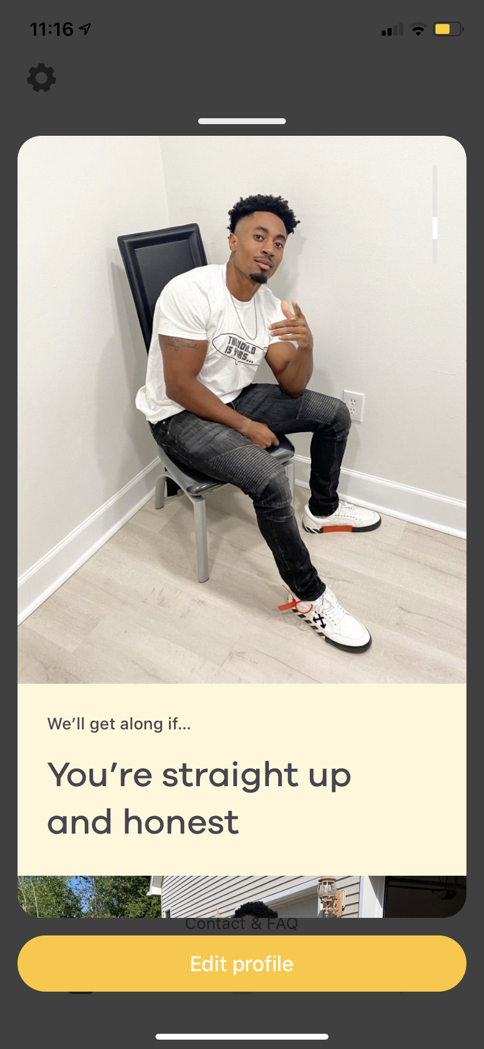
Bold Concepts
General Ideas:
Prompts, How Tos, Animated Text & Images
Concept Idea:
100%
Bold COPY: You miss 100% of the swipes you don’t take
Cut to images of users inside phone screens
We swipe through several
There is COPY across the top: Get started
Click image to view
Click image to view
ConsumerAcquisition.com
© Consumer Acquisition LLC – Company Confidential

Slide 6
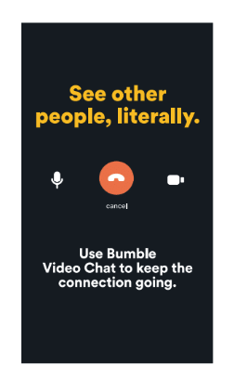
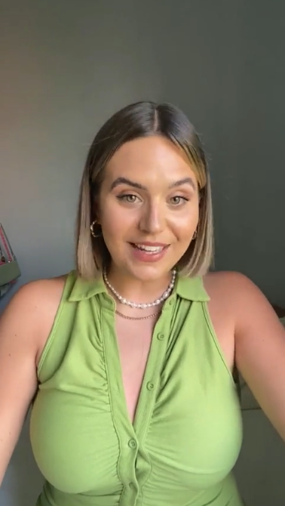
Witty Concepts
General Ideas:
Messaging exchanges, date suggestions, nudges to
chat
Concept Idea:
Video Chats Are Here
Open on a message exchange going poorly
A: How are you
B: good
A: cool
A FAIL sound goes off
COPY pops up: Better in person? Us, too.
COPY: Video Chats are here
Cut to video of 2 users chatting
Click image to view
Click image to view
ConsumerAcquisition.com
© Consumer Acquisition LLC – Company Confidential

Slide 7
Where Creativity Meets Performance
Thank you!
ConsumerAcquisition.com
© Consumer Acquisition LLC – Company Confidential

