Slide 1



Trending Investment Portfolio Strategies
Roy E. Weisert, PhD, CFP
Maegan Cahoon
Weisert Investment Services, Inc.
weisertinvestments.com
757-636-0632
tsptips.com
profunds.tips
Notes:
Weisert Investments opened in 1993
Maegan is family, my daughter
Niche Investment Advisor to friends and family, i.e. individual clients
TIPS is a subscription service
TSP TIPS started in September 2013.
TSP is Government 401K plan
Subscription service for government employees
http://www.weisertinvestments.com/tsp-tips.html
ProFunds TIPS started in August 2019
Subscription Service for anyone.
Utilizes ProFunds family of funds

Slide 2
Benefits of having an Investment Strategy?
Scenario 1) I’ve been working for a few years but am concerned about whether I’m putting the right amount of money away in my 401K and whether I’m putting them in the right funds. Is there a way that I can get a clearer picture and take more control of my investments?
Scenario 2) I’m thinking of retiring and I’ve accumulated a pretty nice retirement nest egg. But I remember back to the last bear market when some of my co-workers had to postpone their retirement date. Is there a way I can mitigate some of this market risk since I can’t afford the time waiting for the market to bounce back?
It's not what age at which you retire, it's what income level.
Past Performance is No Guarantee of Future Performance
Notes:
Do these resonate with you?
Answers two key questions

Slide 3

Investing vs Saving vs Trading
Investing
Trading
Aggressive
Moderate
Rate of Return
Conservative
Saving
Time
What type of investor are you?
Notes:
Investing continuum

Slide 4
Investment Strategy Types
Passive
  Buy and Hold
  Index Management
Blend
  Age Based
  Life Cycle
Active
  Fundamental
  Technical
Notes:
Three major categories with two subcategories

Slide 5

Age Based “100 minus” Strategy
Take your age and subtract it from 100
That’s the percentage that should be in equity stock/mutual fund
The remainder (your age) should be allocated to bonds and/or cash
Example:
  22 year old: 78% equities/22% cash and or bonds
  62 year old: 38% equities/62% cash and or bonds
Notes:
Explains what the strategy is.
Usually rebalanced quarterly (maintain percentage), annually for new target numbers.

Slide 6

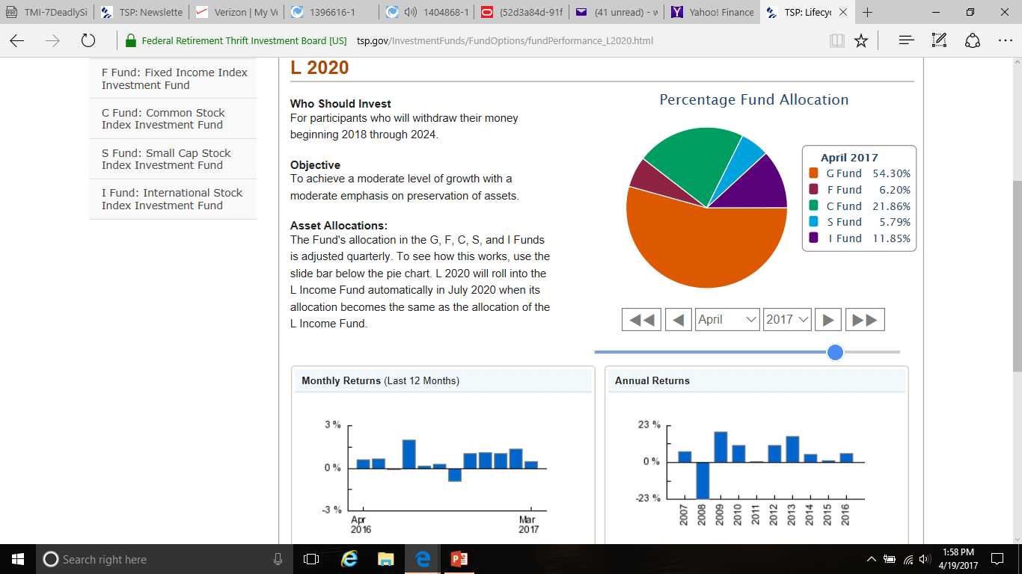
Life Cycle Strategy
AVOID LARGE LOSSES
Notes:
Takeoff on age-based strategy but done within mutual fund automatically.
The Lifecycle 2020 fund for people who will retire in 2018 thru 2024.
Bottom right: Notice that it did lose money in 2008.
That loss displayed on next slide.

Slide 7
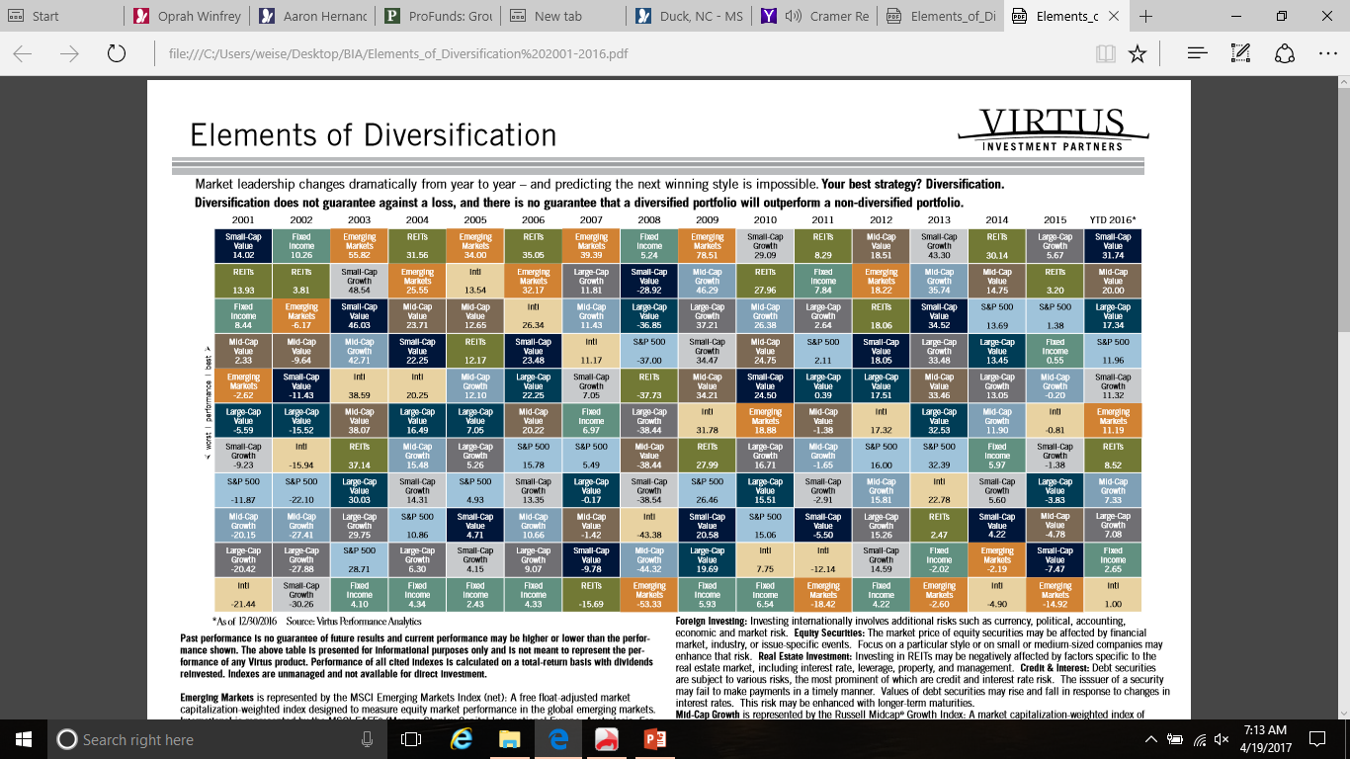
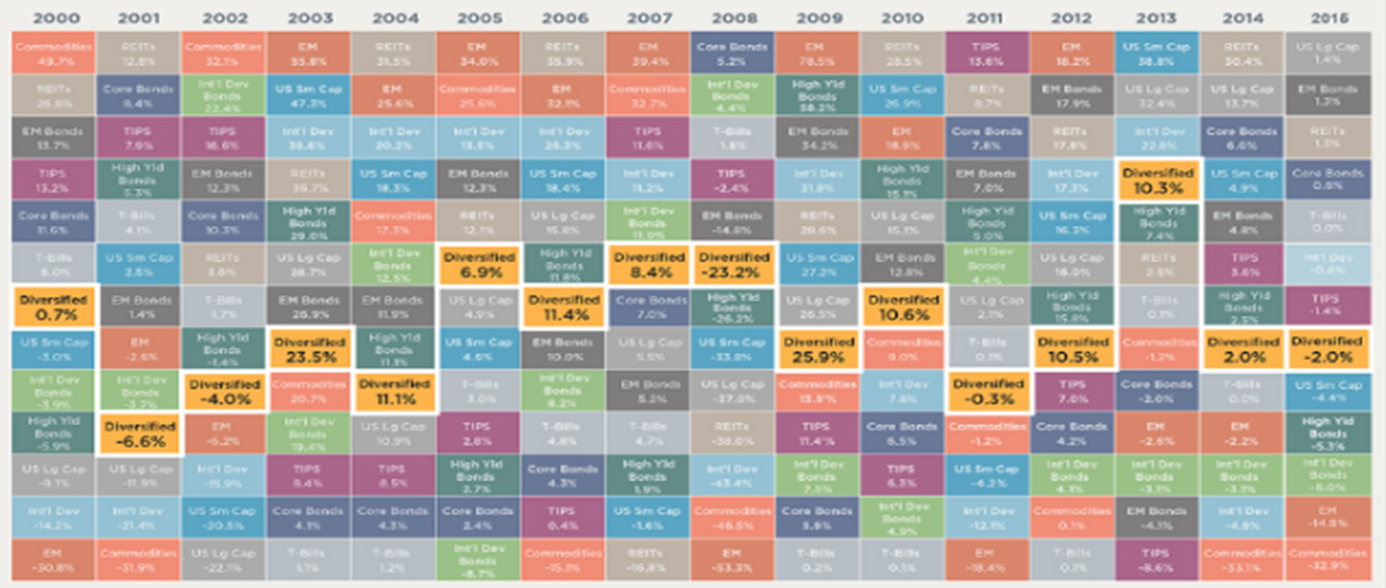
Elements of Diversification (2000-2016)
Diversification By Itself Does Not Mitigate Systemic Market Risk
Past Performance is No Guarantee of Future Performance
Notes:
How diversification is supposed to mitigate market risk.
Table shows best performing sectors (color coded) on an annual basis
Having a diverse family of funds and utilizing a ranking structure will keep you in the top performing funds
A Diversified portfolio will by name Middle of the road.
Google “Elements of Diversification” for more detail

Slide 8
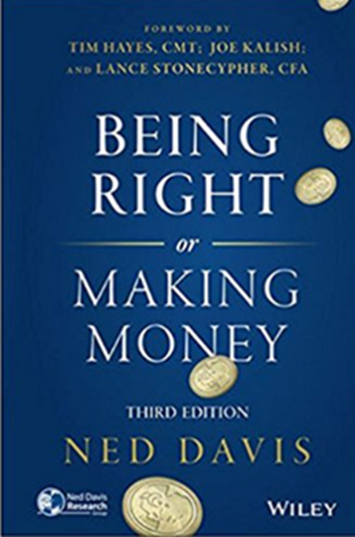
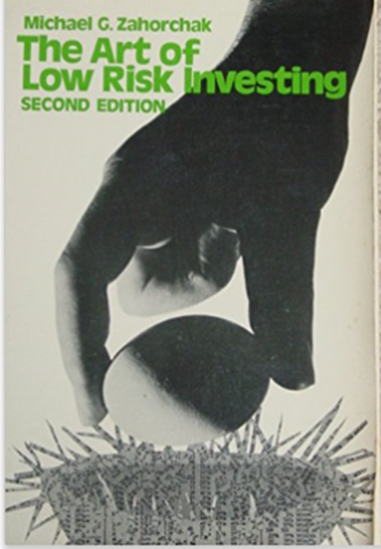
Technical Analysis
Price – the Resolution of All Forces
“A successful system for buying and selling stocks can be based on price and nothing else because in the end price is the ultimate resolution of all the forces that have an effect on any particular stock at any particular time. Everything anybody knows, thinks, believes, or feels about a stock is translated into the price at which a stock trades.”
“The Art of Low Risk Investing” by Michael G. Zahorchak
Don’t Let Emotions Drive Investment Decisions
Notes:
Technical Analysis Strategy
Price is the result of supply and demand.
Measurable

Slide 9
Stock Market Volatility
S&P 500 Index Bear Markets By Decade Since the Great Depression
  Bear Market Duration % Decline Time to Breakeven
  Mar 1937 to Mar 1938 12 Months 54.5% 8.8 Years
  May 1946 to Mar 1948 22 Months 28.1% 4.1 Years
  Aug 1957 to Oct 1957 14 Months 21.6% 2.1 Years
  Nov 1968 to May 1970 18 Months 36.1% 3.3 Years
  Jan 1973 to Oct 1974 21 Months 48.2% 7.6 Years
  Aug 1987 to Dec 1987 04 Months 33.5% 1.9 Years
  Mar 2000 to Sep 2002 30 Months 48.9% 4.9 Years
  Oct 2007 to Mar 2009 17 Months 57.7% 4.1 Years
2020 COVID Bear Market
had the quickest decline and recovery
Past Performance is No Guarantee of Future Performance
Notes:
These Bear Markets usually occur once a decade.
Usually painful not just because of loss, but emotionally due to duration and time to breakeven
COVID Bear market was much different than previous bear markets as it was only seven months

Slide 10
Avoid Large Losses
Percentage Loss to Breakeven
Loss Breakeven
-5% 5.26%
-10% 11.1%
-25% 33.3%
-33% 50.0%
-40% 60.0%
-50% 100.0%
“True or False”
I’ve made 100 % on my investments and lost 50% this past year,
so I’m still ahead by 50%?
Past Performance is No Guarantee of Future Performance
Notes:
If you have $10,000 and double it you have $20,000.
If you have $20,000 and lose $10,000 (or 50%), you’re at breakeven
People can take a 5 to 10 percent loss, but start to become emotional with further losses.
At around 25% they start saying when it gets back to breakeven I’m selling it.
At around 33% they say I can’t take it anymore and sell at the worst time

Slide 11
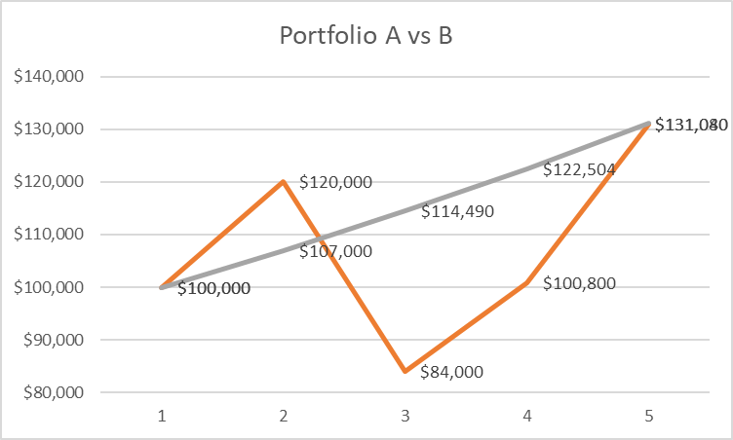
Portfolio Volatility
Portfolio A
  Year 1: 7%
  Year 2: 7%
  Year 3: 7%
  Year 4: 7%
Portfolio B
  Year 1: 20%
  Year 2: -30%
  Year 3: 20%
  Year 4: 30%
Turtle Versus The Hare
Past Performance is No Guarantee of Future Performance
Notes:
Portfolio A gains 7% annually and after four years has a value of $131,000
Portfolio B has a
20% gain in year 1,
30% loss in year 2,
20% gain in year 3, and
30% gain in year 4.
After four years B has a value of $131,000, same as portfolio A
Another “Avoid Large Losses” scenario.

Slide 12

“Buy and Hold Calamity”
On 31 December 1999, the S&P 500 closed at 1469.25
Fast forward 8 years
On 31 December 2007, the S&P 500 closed at 1468.36
Fast forward another 6+ years
On 10 January 2013, the S&P 500 closed at 1472.12
Between 31 December 1999 and 10 January 2013, the S&P 500 went essentially nowhere. This was due to the fact the market lost approximately 50% during the bear market of 2000, and another 50% during the bear market of 2008.
These 13 years of mediocrity can be called the
“Buy and Hold Calamity”
There has to be a better way!!
Past Performance is No Guarantee of Future Performance
Notes:
A real life example with “Avoid Large Losses”
13 years of treading water

Slide 13
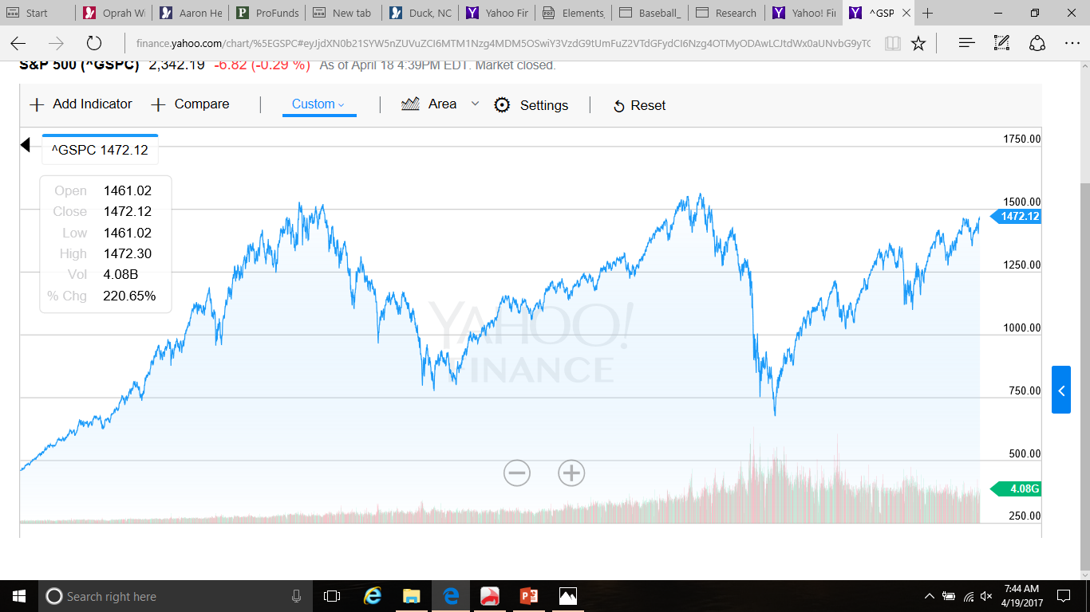
“Buy and Hold Calamity”
BULL
BULL
BULL
BEAR
BEAR
Dec 1994
Jan 2013
Notes:
This is what that period looked like on a chart
Bear markets and large losses hurt

Slide 14
Crossover Strategy
Short and Long Term MA Crossover
  Golden Cross: Buy when 50 MA crosses above 200 MA
  Death Cross: Sell when 50 MA crosses below 200 MA
Buy
Buy
Buy
Buy
Notes:
Use technical analysis to preclude large losses.
One strategy using one indicator.
Tells you “WHEN” to invest
Go to yahoo finance and set up the 50 and 200 day moving average indicators to see how your current portfolio is doing
Goes back to the “Price” slide

Slide 15
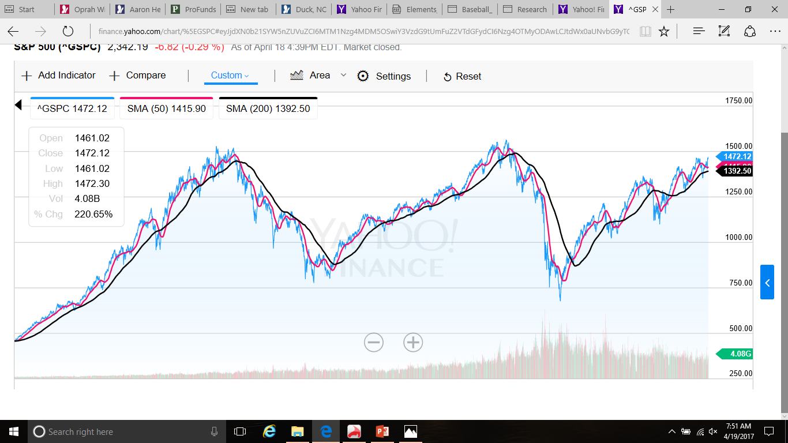
“Golden Cross” vs “Death Cross”
The Real Mark of a Genius is How Well You Perform in Bear Markets
Dec 1994
Jan 2013
Notes:
Shows instances of Cross Strategy during Buy and Hold Calamity period

Slide 16
“Buy and Hold Opportunity”
On 31 December 1999, Balance was $10,000
Fast forward 8 years
On 31 December 2007, Balance was $13,406
Fast forward another 6+ years
On 10 January 2013, Balance was $17,609
Jan 2013
Stair Step Your Way Up
Jan 2013
Dec 2007
Dec 1999
Let the Trend be you Friend
Trending Investment Portfolio Strategies (TIPS)
Dec 1994
Past Performance is No Guarantee of Future Performance
Notes:
Incorporate Cross strategy into the Buy and Hold Calamity.
When in sell area after the Death cross, just put money into cash to avoid large losses.
Stair step your way up
Very simple.
Takes patience

Slide 17

“Golden Cross” vs
“Death Cross” Summary
21 Wins/5 Losses
Average Trade: 17.14%
Greatest Gain: 115.84%
Greatest Loss: -10.82%
Notes:
Actual results of Cross strategy since 1970.
Yellow buy is still in effect
Blue box numbers includes yellow buy
1994 was greatest gain in run up to the dot.com bear market in 2000
Notice Death Cross on 10/30/2000
Out of market until 5/14/2003 (2 ½ years) when the next Golden Cross occurred
1990 was largest loss, even more than COVID bear of -9.86%
Takes emotions out of investing and avoids large losses

Slide 18
Portfolio Performance Ranking
Use Ranking formula for each fund in family
  40% of 1 month return
  30% of 3 month return
  20% of 6 month return
  + 10% of 12 month return
  Composite Return for each fund
Sort all fund’s “Composite” Returns from Best to Worst (Grades A thru F)
  40% x 5% = 2%
  30% x 10%= 3%
  20% x 15%= 3%
  10% x 20%= 2%
  10%
Notes:
Performance Ranking (PR) tells you “WHERE” to invest.
If you have a family of 50 individual mutual funds, invest in the Top funds
Run the ranking formula to determine a PR for each of the 50 funds
Sort high to low and invest in those.
Goes back to “Elements of Diversification” slide

Slide 19

Crossover/Performance Ranking Model
Golden Cross/Death Cross
“Know When to be in the Market”
Performance Ranking
“Know Where to be in the Market”
Notes:
Cross Strategy plus Performance Ranking gives you the When and Where
Refer to Weisert Investment Tripod (WIT), Strategy #3 to see the different market phases at
http://www.weisertinvestments.com/strategy.html

Slide 20
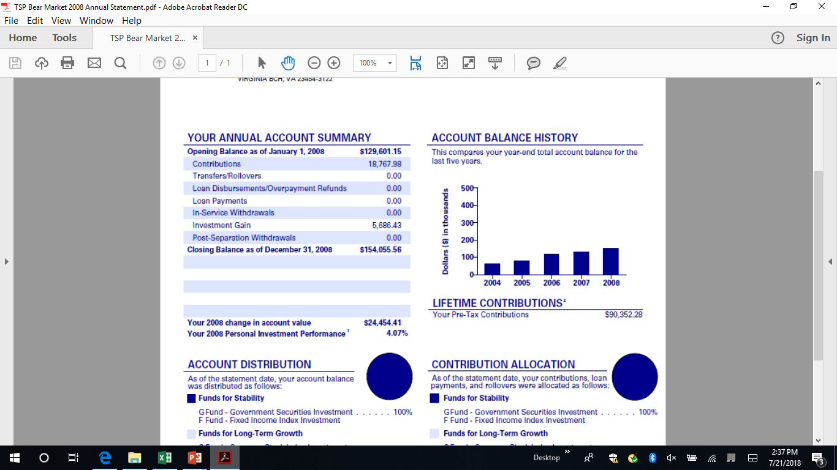
Thrift Saving Plan Performance in 2008
S&P 500 -38.59%
Notes:
Actual results
My TSP plan from 2008 bear market
Went to cash and bonds for the majority of year. Cross Strategy
Bond fund did well as interest rates were decreasing.
Bond Performance Ranking (PR) was at top of ladder
Equity funds had poor PR’s.
Basis for TSP TIPS

Slide 21
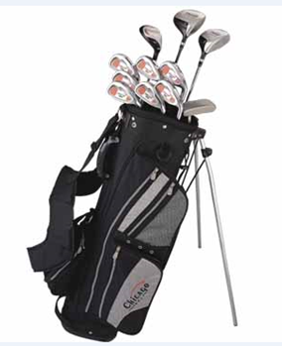
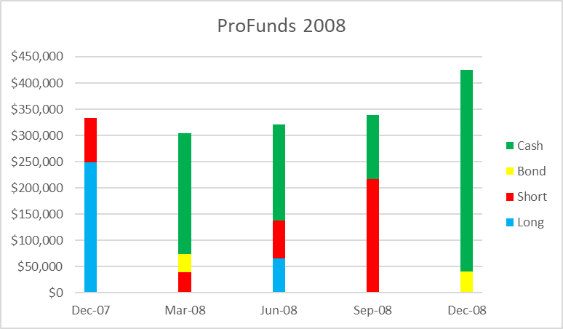
ProFunds Performance in 2008
Why ProFunds
Index Funds
Passive Management
Diversity
Inverse/Short Funds
Leveraged Funds
No Trade Restrictions
No Transaction Fees
Tax Reporting
ProFunds +27.42%
S&P 500 -38.59%
Past Performance is No Guarantee of Future Performance
Notes:
Same thing for my ProFunds family of funds accounts
www,profunds.com
Instead of using cash and bonds, used inverse index funds which go up in bear markets
Allows daily reallocations
My money is invested the same as my Weisert Investments clients.
Basis for ProFunds TIPS which is a subscription service
With ProFunds TIPS subscribers make their own reallocations
With Weisert Investments we handle the reallocations for our clients

Slide 22
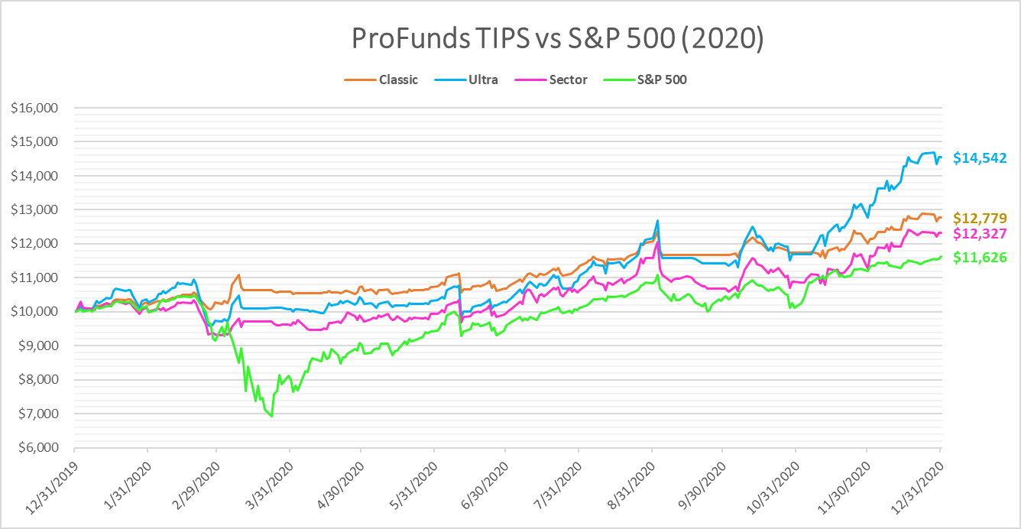
ProFunds TIPS in Last Bear Market
Avoid Large Losses
Ultra TIPS 45.4%
Classic TIPS 27.8%
Sector TIPS 23.3%
S&P 500 16.3%
COVID
Notes:
So how did ProFunds in the last COVID Bear market of 2020.
Avoided Large Losses.
Took emotions out of the equation
CLASSIC TIPS utilizes the ProFunds Classic and INVERSE funds
which have a 1:1 correlation with their underlying indices. They are
primarily structured around the Morningstar 3 X 3 matrix
ULTRA TIPS utilizes the ULTRA and INVERSE funds which have a
2:1 correlation with their underlying indices.
SECTOR TIPS includes all the funds in ULTRA TIPS but also
includes the ULTRA SECTOR, INVERSE SECTOR and NON-EQUITY funds

Slide 23
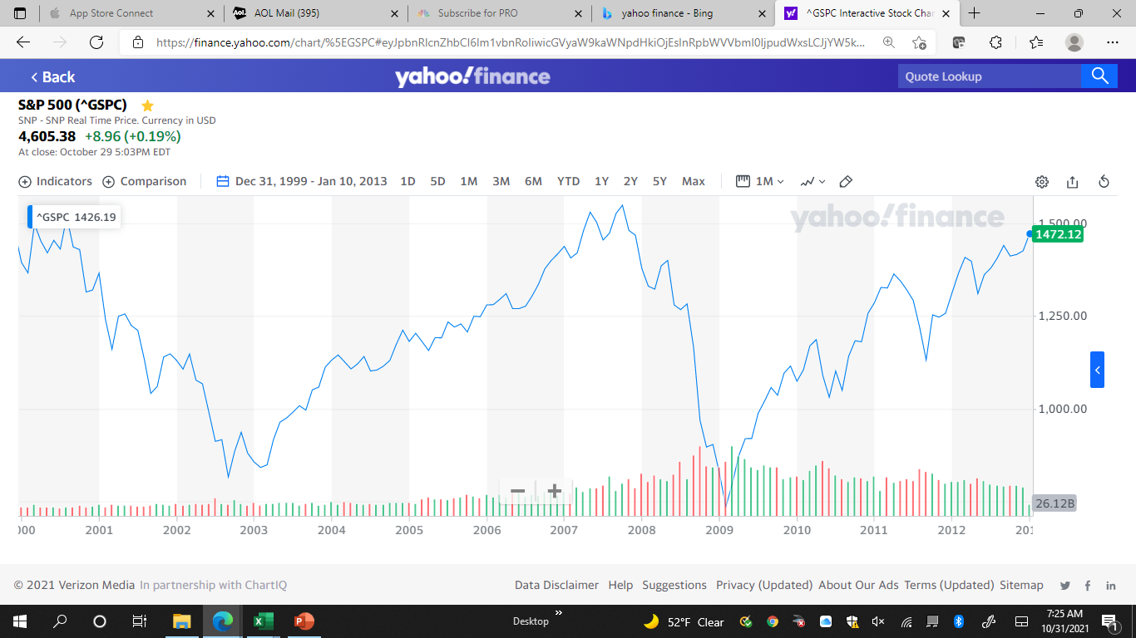
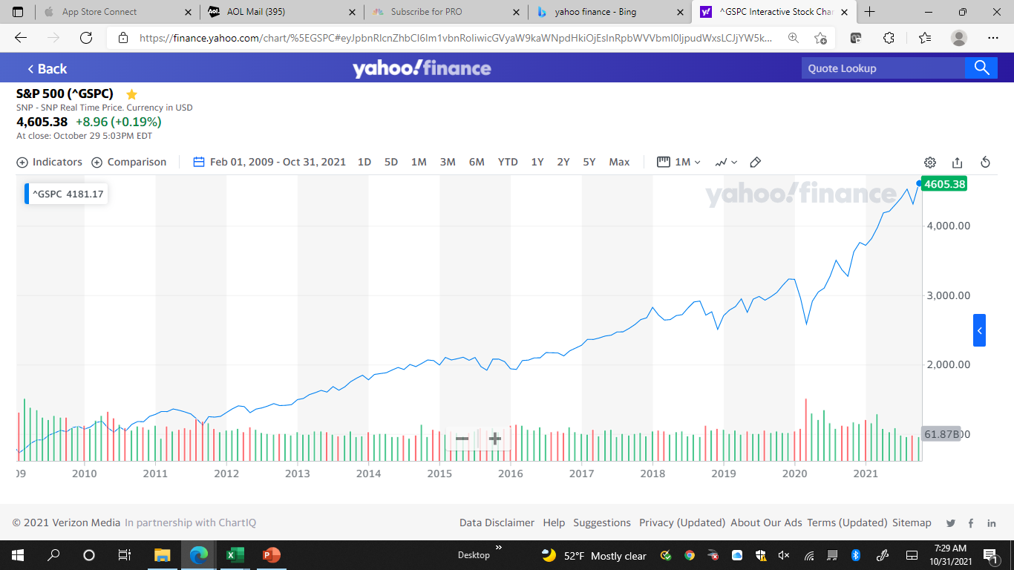
What will the next 13 years look like?
Buy and Hold Calamity
1999 through 2013
Raging Bull
2009 through 2021
OR
No One Can Predict the Future
Does this strategy answer your question(s)?
Notes:
People forget about that Buy and Hold Calamity period.
Has the Raging Bull market made us complacent?
No one can predict the future.
Think about your investment strategy

Slide 24

Notable Quotes
It's not what age at which you retire, it's what income level
Investment opportunities always come around again, lost capital does not
Procrastination is the biggest enemy of solid financial planning
The eighth wonder of the world is compound interest
The trend is your friend
Don't try to push a rope
Take some money off the table
Diversity, not diversification
Don't let emotions drive investment decisions
No one can predict the future
A 100% gain equals a 50% loss
Making money takes time, patience and persistence
He who fails to plan, plans to fail
It's easy to be good in a bull market, but a genius performs well in bear markets
In bad economic times, it is the return of your money, not the return on your money
If you lose 50% of your money, it takes 6 years of 12% returns to recover (Rule of 72)
Past Performance is No Guarantee of Future Performance
Notes:
Just some things to remember

