Slide 1
Superutilizer Analytics & Action
The Key to Value Based Care Success
Notes:
Up and running. Added

Slide 4
Requirements for Value Based Care
Transparent Communication
Performance Based Management
Transparent Outcomes

Slide 5
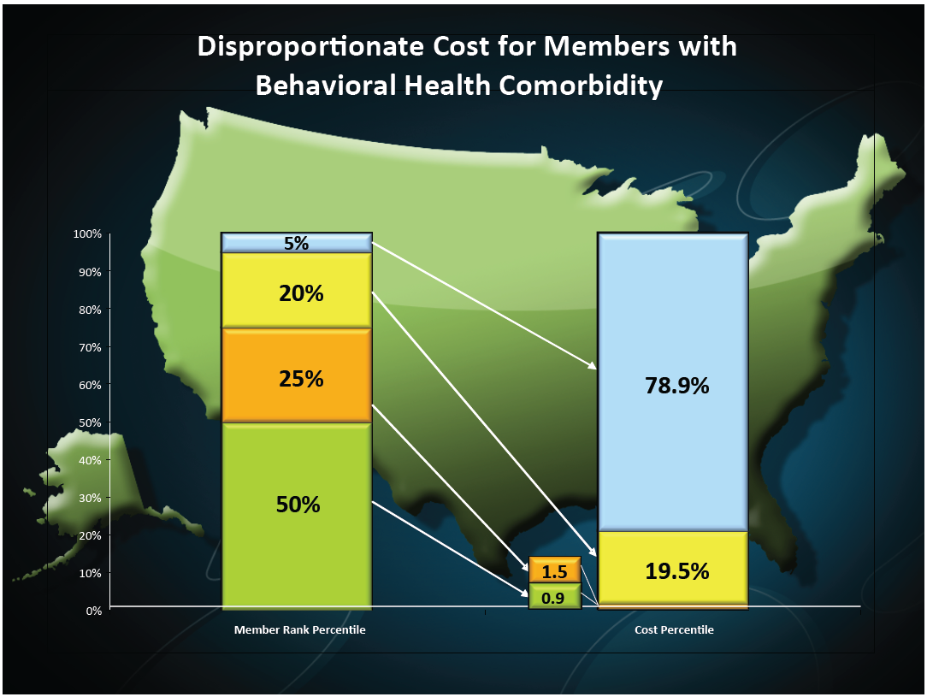

Slide 6
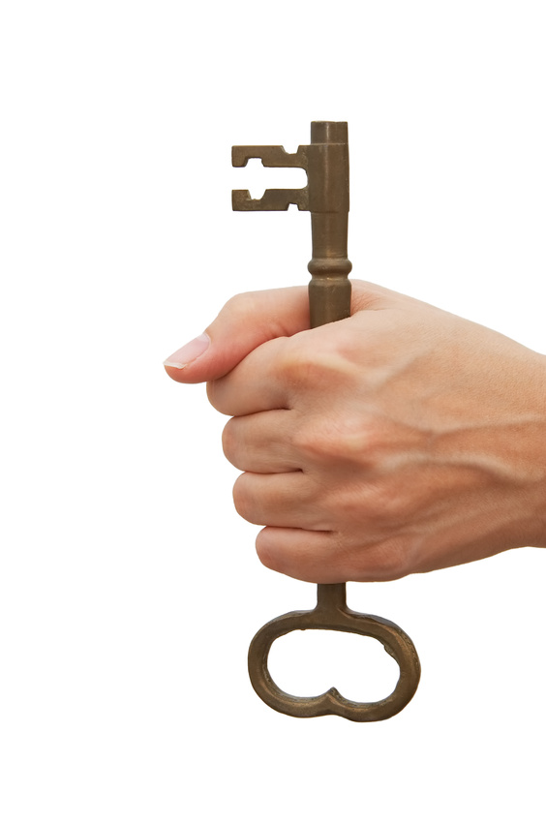
= 5%

Slide 7
5% High Utilizers
60-85% Behavioral Health Needs

Slide 8
About the 5%
For SSDI Medicaid adults, 5% = 60% of costs.
40% have MI and cardiovascular
40% have MI and CNS;
29% have MI and pulmonary disorders. (Kronick, Bella, Gilmer, 2009).
Missouri 5% high utilizers = 85% had a mental health diagnosis. (Lewin Group)

Slide 9
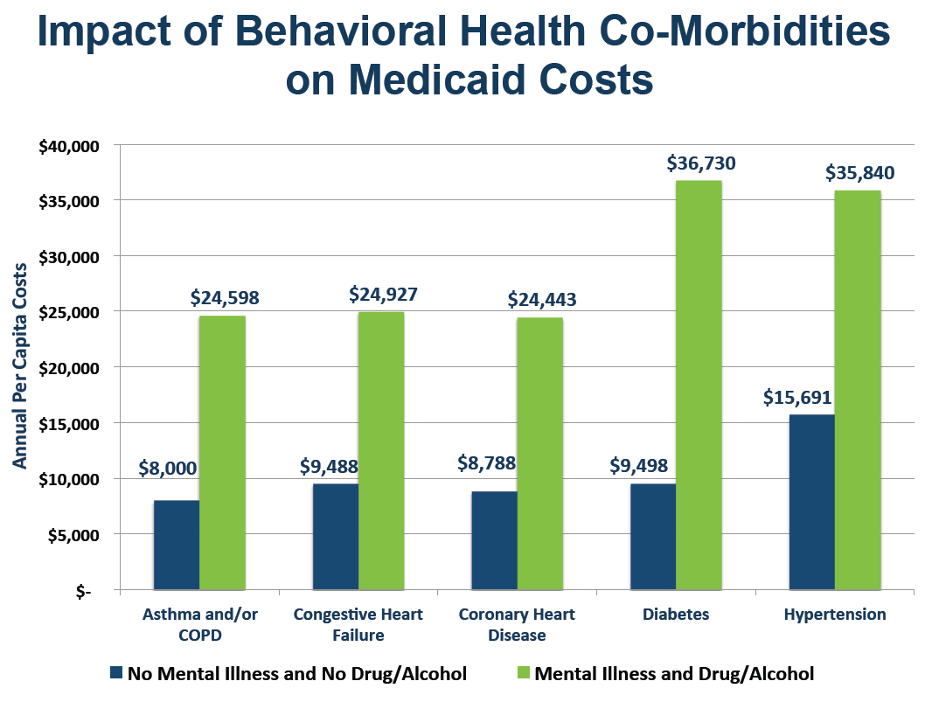

Slide 10
2009
7% CMHCs with interoperable EHRs
1/3 with EHRs at all.

Slide 11
Notes:
How many of you feel that you don’t collect enough information in your organization?
How many of you feel like you are using that data effectively to advance your organization?

Slide 12
What If CMHCs could use
21st century technologies?
Experience engaging persons with SMI & SUD?
Next day data from partner MCOs?

Slide 13
From:
Date: May 20, 2014 at 8:51:10 AM CDT Subject: < SECURE ><internal> Daily Hospitalization Alerts
Here are today’s hospitalization alerts:
Member First Name | Facility ID | Facility | Dx Code | Diagnosis | Eff Start Dt | Patient Dob | Age | IPRO Risk Score | Tot Days
John | 20350083501 | Gateway Medical Center | 599.0 | URINARY TRACT INFECTION SITE N | 11-May-14 | 12-Jul-63 | 50 | 33.3038 | 9
Paul | 626001445I8 | Middle Tennessee Mental Health Institute | 296.54 | BIPLR AFFCT D/O DPRSD SEV SPEC | 14-May-14 | 13-Jun-88 | 25 | 21.8298 | 6
Mary | 62162086600 | Horizon Medical Center | 724.5 | UNSPECIFIED BACKACHE | 17-May-14 | 10-Dec-70 | 43 | 29.9784 | 3

Slide 14
Goals
Engage all clients with their health home.
Reduce unnecessary hospitalizations.
Reduce unnecessary emergency department visits.
Improve clients’ physical health
Decrease clients’ social needs
Improve clients’ experience of care
Determine value equation.
Obtain value based care contracts.
$

Slide 15
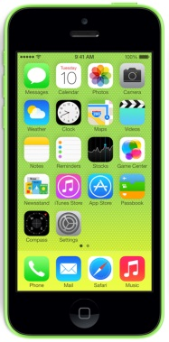

Slide 16
Case Study: “Rebecca”
Results
What worked for Rebecca
Lost 17 pounds
HgbA1c now in normal range (was in diabetic range).
1 ED visit 1st week. 1 ED visit 2nd month.
Diabetes blood sugar is more stable.
Switched from regular to diet coke.
FitBit–Loves tracking her steps.
I-Phone– Faithfully tracks food intake in FitBit ap & uses HIPAA chat to engage with wellness coach.
Accompanied exercise was key for getting moving
Wellness Coaching – has seen doctor, gotten labs, improved nutrition, gotten follow-ups, & is working her wellness plan.
Health Bucks
Swimsuit & Temporary Y pass
Yoga ball for watching TV
Hygiene items (toothbrush, soap)

Slide 17
Case Study: “Samantha
Results
What worked for “Samantha”
0 Hospitalizations
0 ER visits
Diabetes is stabilizing
HIPAA video-chat de-escalation while in crisis mode. Note, in past crisis mode → not monitoring diabetes → shaky → falls
Wellness coaching for monitoring diabetes
Centerstone Assistance: Electric Bill (had to pay for a funeral & would have been without electricity for the month).
Health Bucks
Swimsuit, yoga ball, cockroach traps

Slide 18
From our clients’ voices
“Mike”
“Sarah”
“Two years ago I was dying. A lung transplant was all that would save me, now I’ve miraculously gained 16% of my lungs back. I have an exercise program where I work out with a CPAP machine, and it has expanded my lungs back. The surgeons at Vanderbilt have no answer for what I’ve done, they're saying it's a miracle. No one’s gone from the 30's to gain their lungs back. [My wellness coach is] helping me push forward and not step back and think "well I'm dying I should give up…. The iPhone it is tremendous, and I recommend it. At night when I’m alone and not interested in TV and bored and depressed, I can pick up the phone, play a game, listen to some music, read about current events.”
“I have lost 25 pounds since I started going. I have now gone from 260 (when I had my son) to 197, and had to buy new britches.”
“Laquita”
“I love [the technology]. I use it to help, not just as a phone. Using Hipaachat to talk to [my wellness coach] is amazing. It keeps me on track, it also helps me remember to exercise, and I enter all my food. It also helps if I don’t have a computer because I can look stuff up about food, and helping in the house (like how would a chemical react if I’m using it). I looked up how to get rid of cockroaches in my apartment.”

Slide 19
Notes:
How many of you feel that you don’t collect enough information in your organization?
How many of you feel like you are using that data effectively to advance your organization?

