Slide 1
How to Search for scholarly Articles at LAVC
Robert wonser
LAVC Fall 2016

Slide 2
Go Here in your browser!

Slide 3
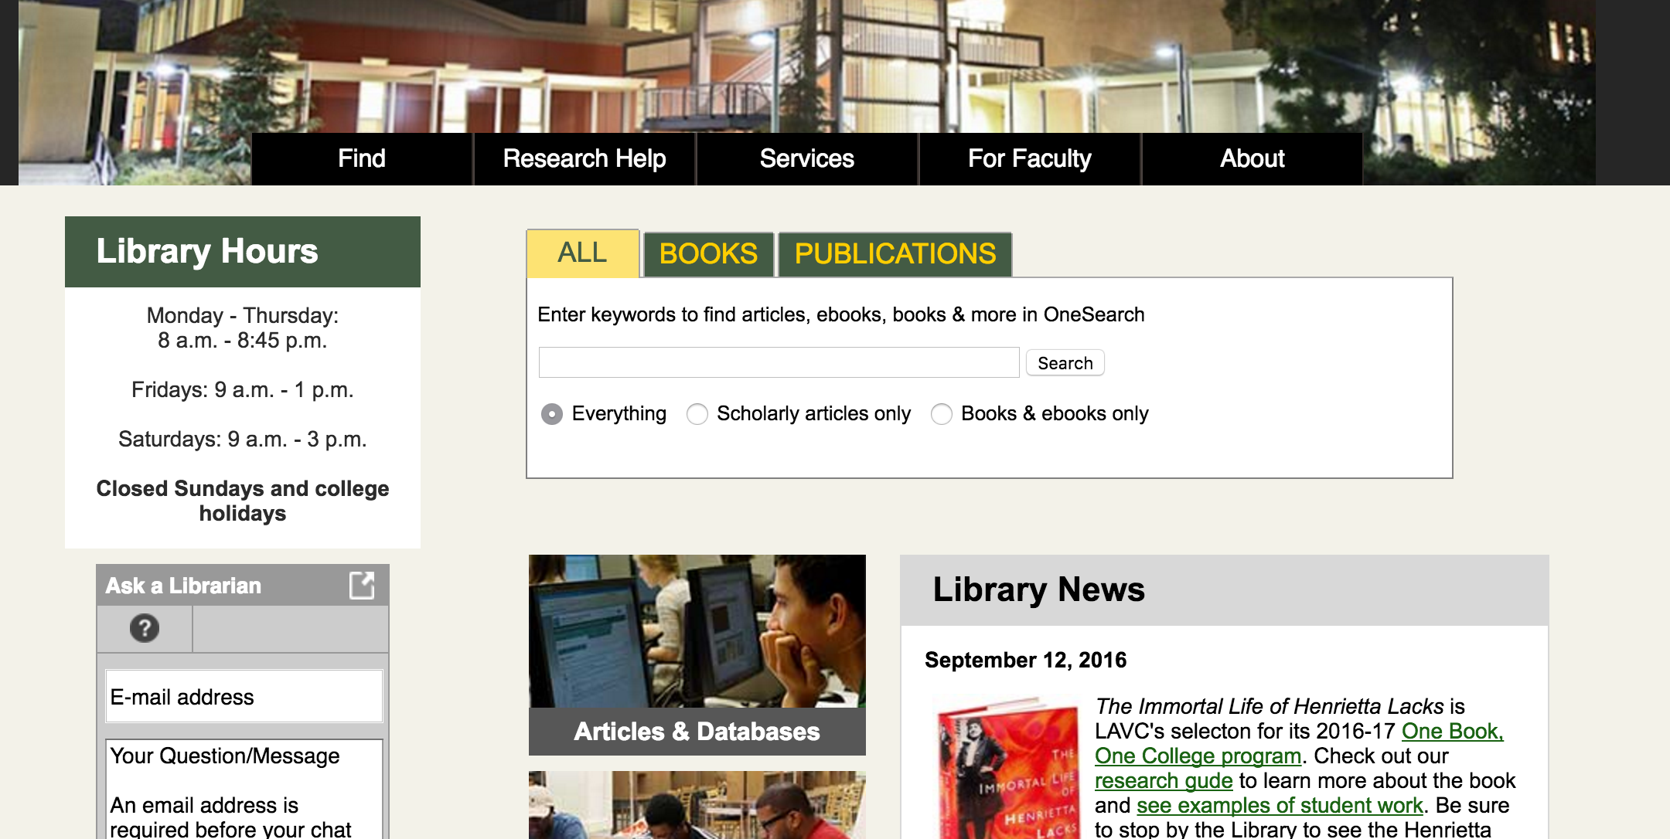
Library’s Website

Slide 4
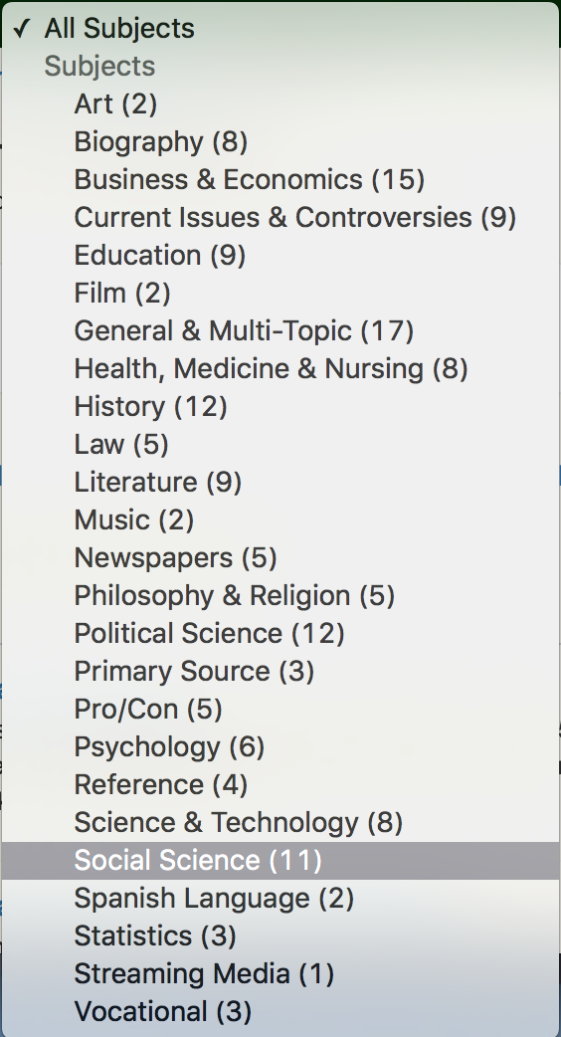
Choose Your Subject (Social Science)

Slide 5
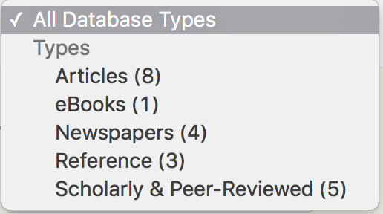
Choose “Scholarly & Peer-Reviewed”

Slide 6
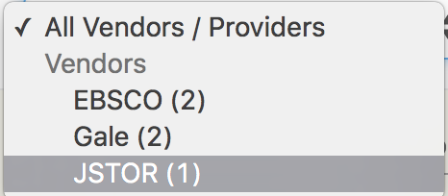
Try All, but first JSTOR

Slide 7
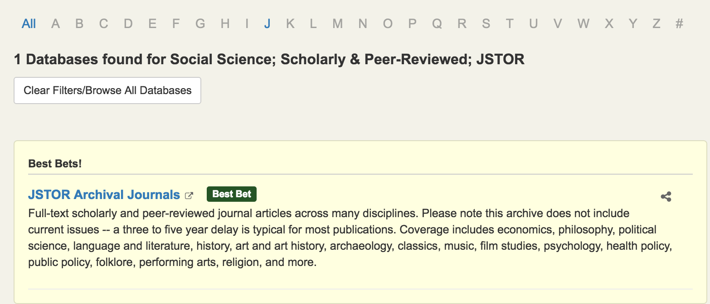
Click on the blue hyperlink

Slide 8
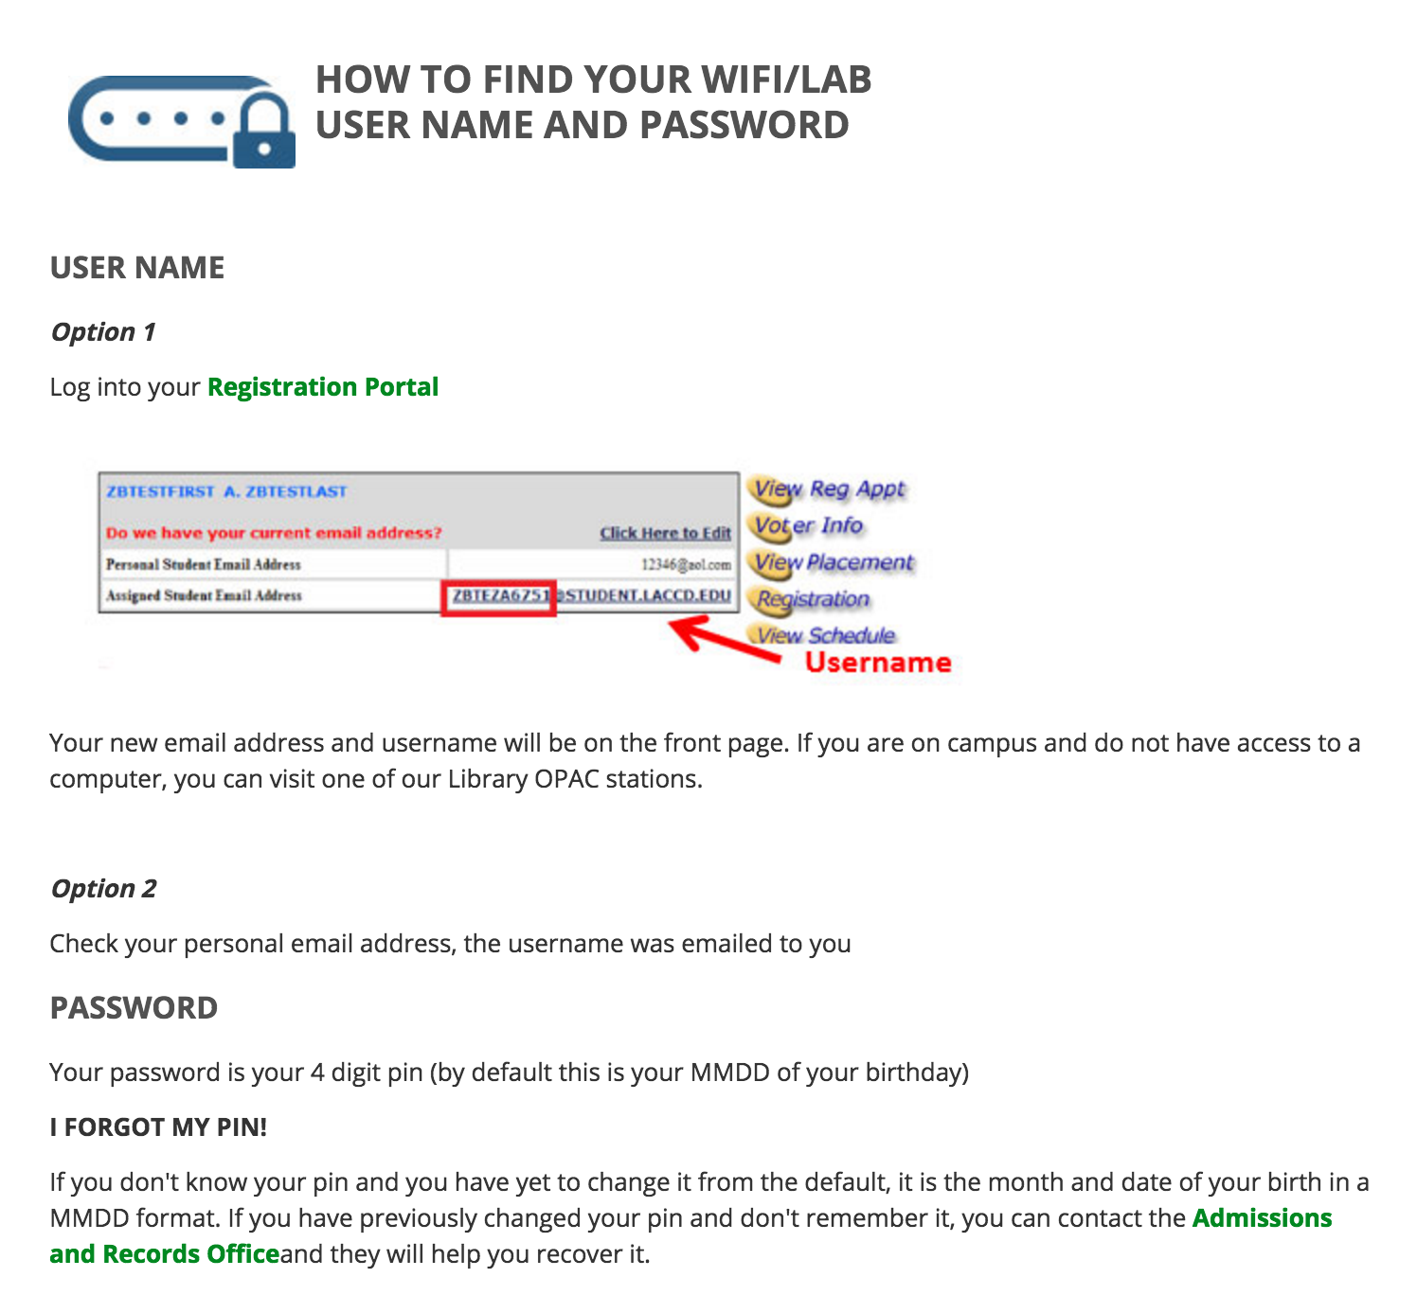
You’ll need your TIA credentials

