Slide 1
TOWN OF BEVERLY SHORES REDEVELOPMENT AUTHORITY LEASE RENTAL REVENUE BONDS, SERIES 2020

Slide 2
Lease Rental Structure
Redevelopment Authority issues bonds
The Town signs over certain property to Redevelopment Authority
Redevelopment Authority leases property to the Redevelopment Commission, for agreed upon lease payment
Redevelopment Authority pays debt service on bonds from lease payments received from the Redevelopment Commission
At the end of the termination of the lease, property will return to the Town

Slide 3
Why Lease Rental Structure?
Not subject to statutory debt limit
Statute limits the amount of debt the Town can issue
The Town’s current statutory debt capacity is as follows:

Slide 4
Why Lease Rental Structure?
Bonds can be sold on a negotiated basis
Allows greater flexibility on bond sale
Can move the bond sale if market conditions are not optimal
In times of a volatile market, can yield interest cost savings
Creates more flexibility on structuring debt around outstanding obligations

Slide 5
Tax Rate Impact
Tax rate is estimated to increase in budget years 2022 and 2023
Average increase for the three year period is $0.0677
After budget year 2023 tax rate will drop due to maturity of outstanding obligations in 2023 and 2026
See following slide for estimated debt service and lease payments and tax rate impact

Slide 6
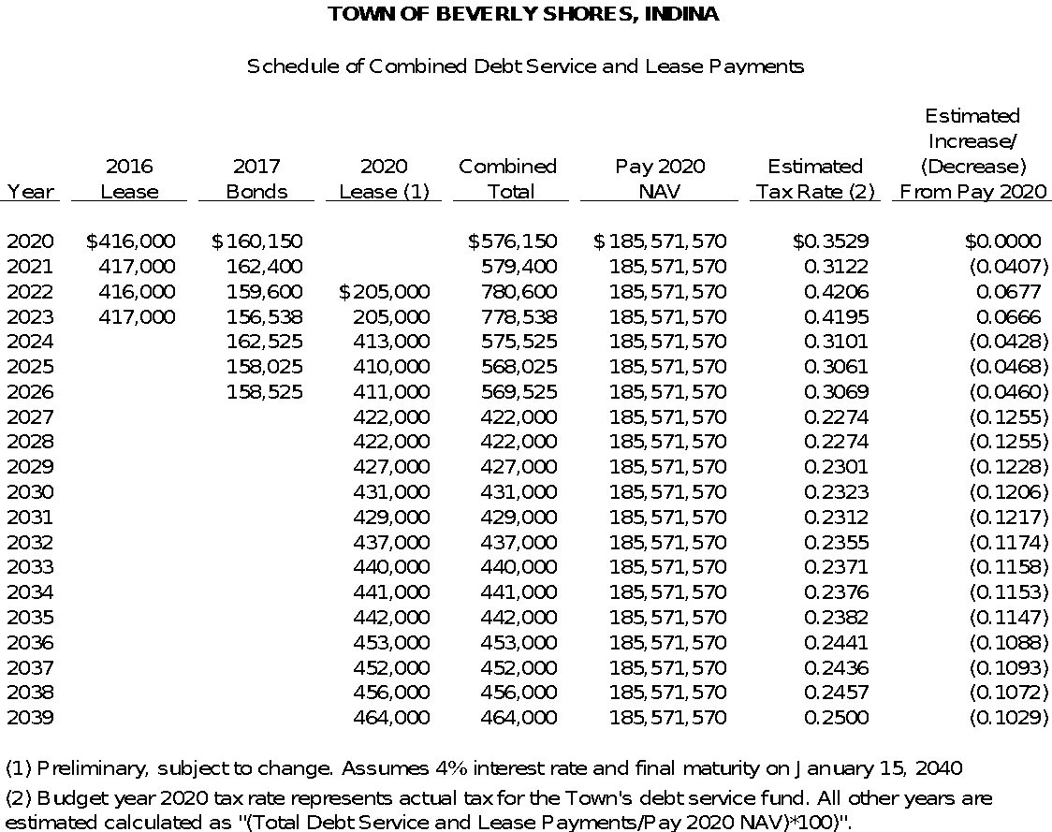

Slide 7
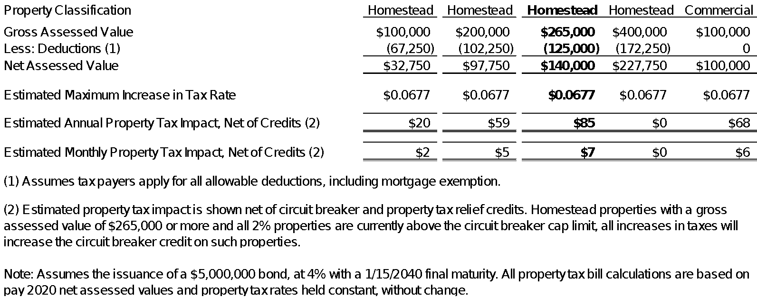
Tax Bill Impact

Slide 8
Circuit Breaker Impact
Type |  | Total NAV |  | Percentage
1% |  | 66,875,606 |  | 36.04%
2% |  | 95,283,654 |  | 51.34%
3% |  | 23,412,311 |  | 12.62%
Total |  | 185,571,570 |  | 100.00%
Pay 2020 NAV by Circuit Breaker Circuit Breaker Category

Slide 9
Circuit Breaker Impact
Circuit breaker credits are calculated based on taxing districts, and shared based on each units tax rate.
The Town of Beverly Shores, share of the circuit breaker credit is as follows:
 |  |  |  | Pay 2020 |  |  |  | Maximum Increase |  |  |  | Rate |  | Percentage
 |  |  |  | (Without 2020 Lease) |  |  |  | (Including 2020 Lease) |  |  |  | Increase/ |  | Increase/
 |  |  |  | Rate |  | Percentage |  | Rate (1) |  | Percentage |  | (Decrease) |  | Decrease
Town of Beverly Shores Total Rate |  |  |  | $0.6383 |  | 31.34% |  | $0.7060 |  | 34.55% |  | $0.0677 |  | 3.21%
Overlapping Taxing Units |  |  |  | 1.3982 |  | 68.66% |  | 1.3982 |  | 66.45% |  | 0.0000 |  | 0.00%
Total Tax Rate |  |  |  | $2.0365 |  |  |  | $2.1042 |  |  |  | $0.0677
(1) Holds the pay 2020 current tax rate constant. Only change in increase to Town of Beverly Shores due to issuance of 2020 Lease.

Slide 10
Circuit Breaker Impact
We have assumed 100% of levy paid from 1 and 2% NAV categories will be captured by circuit breakers.
The maximum estimated debt service levy increase is $205,000, and an estimated 87.38% (all 1 and 2% NAV), or $179,129, will be captured as circuit breaker credits.
Preliminary estimates, calculate the Town of Beverly’s Shore’s share of the $179,129 is 34.55% or $61,889.

