Slide 1
Proteins
the workaholics of the world

Slide 2
Living things rely on them
In all cells, and virtually all parts of cells
~50% of dry weight of human
Greek “proteios”…of the first rank

Slide 3
composition
Large molar masses
Polypeptides and metal ion or another organic molecule or ion
α-amino acids
Amino acid residues
glycine

Slide 4
Basic Processes
Chemical catalysis
Mechanical support
Communication
Adhesion
Movement
Defense
Transport
Storage

Slide 5
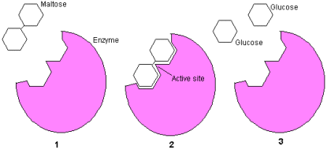
Chemical catalysis
Enzymes
Lower E_{a}
Largest group
1000’s

Slide 6
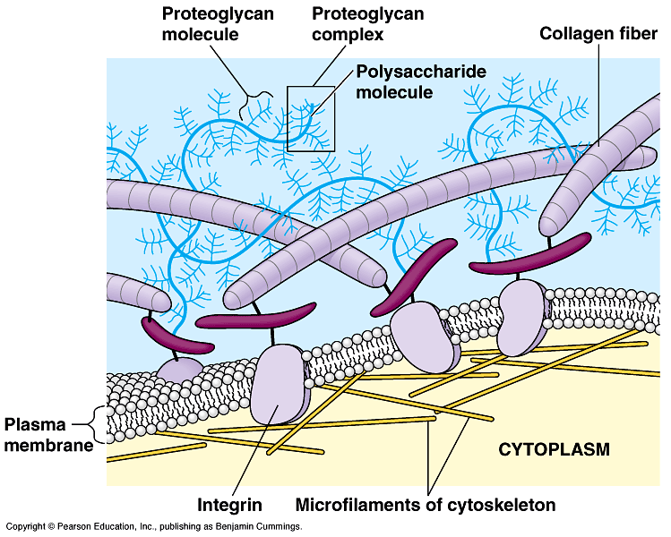
Mechanical support
Cytoskeleton
Extracellular matrix

Slide 7
communication
Signals within and between cells
Cytokines
recognizing and interpreting or reacting to signals
Receptors & transducers

Slide 8
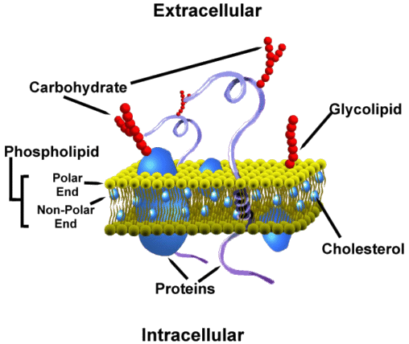
adhesion
Surface
Btw cells
Btw cell & ECM

Slide 9
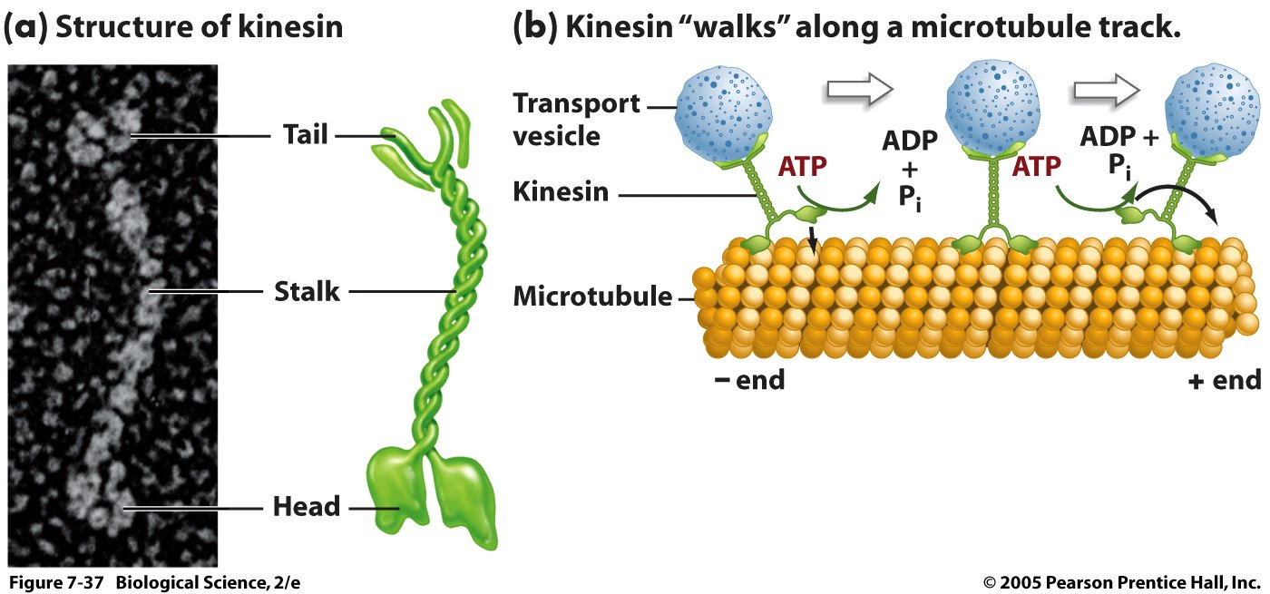
movement
Known as motor proteins

Slide 10
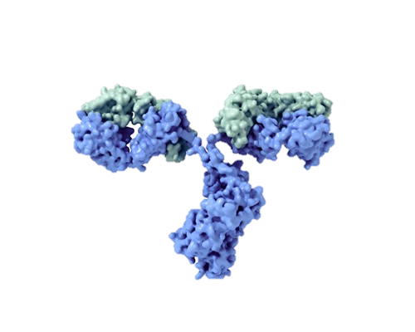
defense
Immune response
Antibodies (immunoglobulins)
Recognize targets
Notes:
IgG

Slide 11
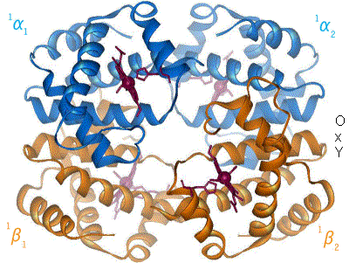
transport
Within & between cells
Notes:
hemoglobin

Slide 12
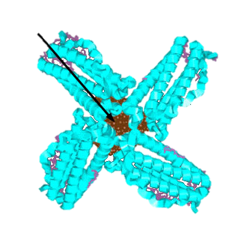
storage
Hold on to small molecules or ions until needed for later use
Notes:
ferritin

Slide 13
Amino acids
20 α-amino acids
All but 1 are stereogenic at the α carbon
Carboxylic acids with amino group on α carbon

Slide 14
1° structure
Sequence of amino acids
Ultimately determines
shape due to spatial limitations
Chemical properties
environment

Slide 15
Peptide bond
Link amino acids to each other
Condensation rxn btw carboxyl and amino of two amino acids
Linus Pauling
Rigid planar structure

Slide 16
Pedptide bond

Slide 17
Pedptide bond

Slide 18
Peptide bond

Slide 19
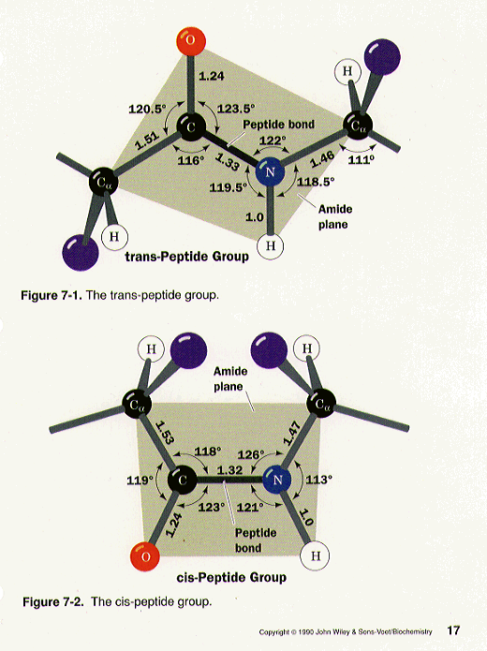
conformations
Two possible– relative to α-C’s
trans*
cis
Proline preceders—still only ~10%

Slide 20
sequences
“cys-tyr-phe-gln-asn-cys-pro-arg-gly” is the primary structure for vasopressin
“cys-tyr-ile-gln-asn-cys-pro-leu-gly” is the primary structure for oxytocin

Slide 21
sequences
n! = # possible sequences where
n is number of amino acids
Tripeptide made of tyrosine, histidine, and cysteine…how many possibilities?
What are they?
n! = # possible sequences where
n is number of amino acids

Slide 22
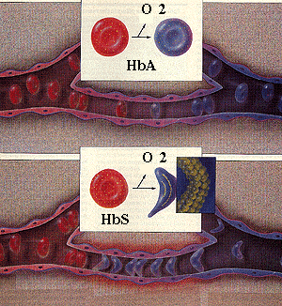
sequences

Slide 23
2° Structure
Determined by H-bonding either
Within
α-helix
Wool, tendons
Between
β-pleated sheet
Silk, muscle

Slide 24
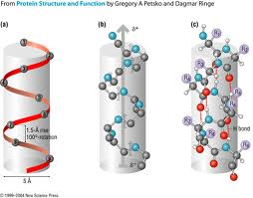
α-Helix

Slide 25
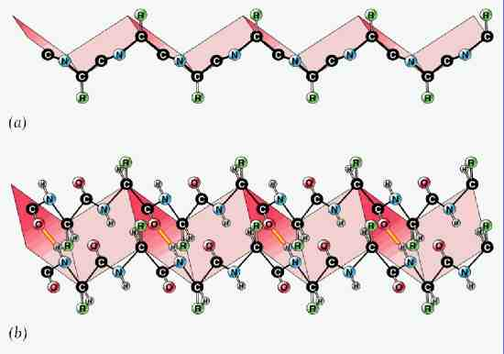
β-pleated sheet

Slide 26
3° Structure
Overall shape determined by van der Waals forces as well as ionic and covalent bonds
Long & narrow
Globular

Slide 27
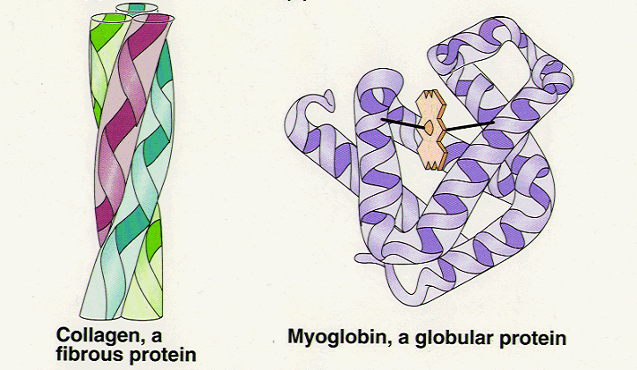
3° Structure

Slide 28
