Slide 1
SAFETY
West Branch Middle School CBI

Slide 2
What will we be learning today?
Housekeeping
Lifting Heavy Objects
Hand Tools
Responsibility

Slide 3
HOUSKEEPING
Good housekeeping reduces hazards and accidents.
Keep your work area clean.
A clean work area is a safe work area.
Clutter, messy areas lead to accidents.
Put things away when finished with them.
Clean up spills immediately.

Slide 4
It is up to all of you to clean the room and make sure that everything is put away before you leave for the day.

Slide 5
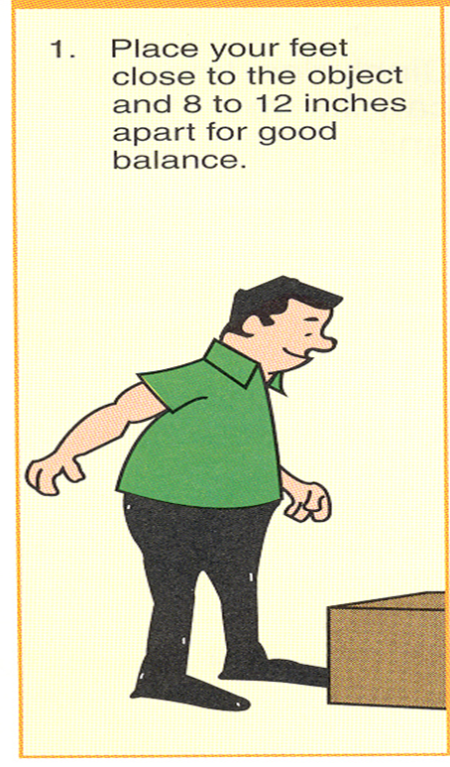
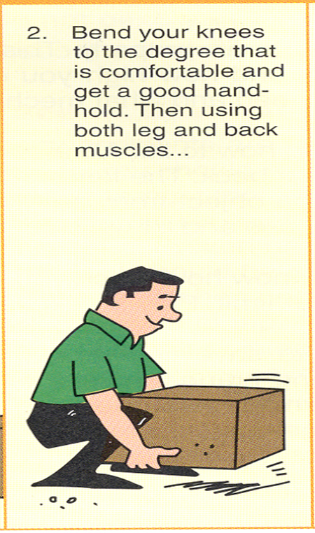
HOW TO LIFT HEAVY OBJECTS

Slide 6
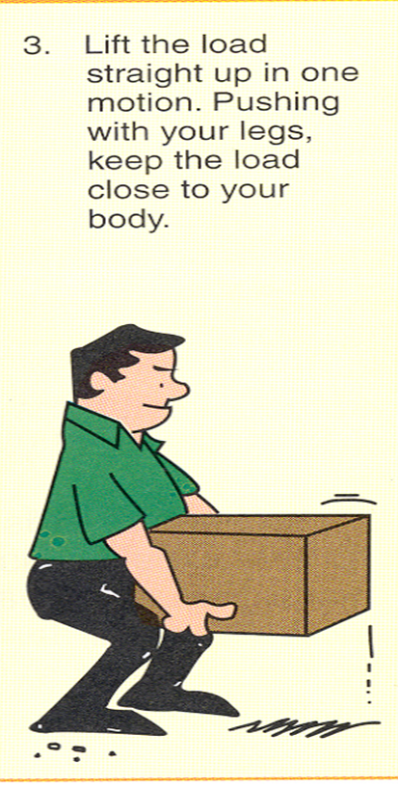
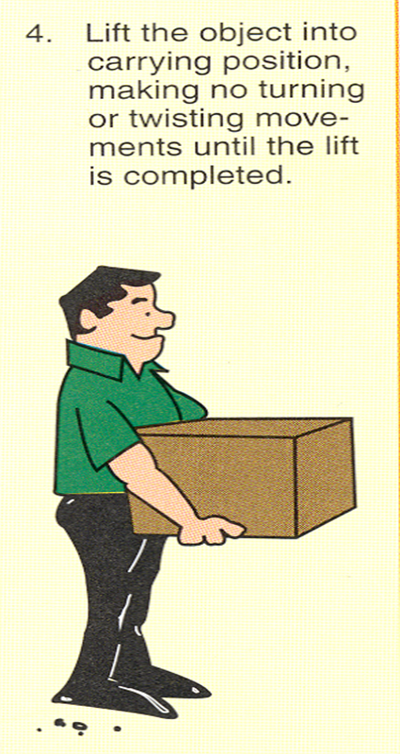
HOW TO LIFT HEAVY OBJECTS

Slide 7
How to Lift Heavy Objects
Lift with your leg and arm muscles
Keep your back as straight as possible
Always carry the load close to your body
Be sure you have good footing
Be sure you can see where you are going
Ask for help when necessary

Slide 8
Lets Practice It

Slide 9
Safety With Hand Tools
Never use a tool for a job that it was not intended
Carry sharp, pointed tools with points down, never run with them
If you need help, ask for it.
No horseplay!

Slide 10
Who is Responsible for Safety?
EVERYONE
IS
RESPONSIBLE!

Slide 11
Review
Keep your mind on what you are doing.
Remember that it only takes one mistake to ruin it for everyone.
Keep your hands to yourself.
When using tools, use them correctly.
Use a teammate to help lift when needed.
If you cannot follow the rules you will be removed from class.
Have fun but be safe.

