Slide 1
Notes:
We started with a vision: to impact world health and free people from physical and financial pain, and in the process, create the most trusted and respected health and wellness company in the world.
Today, we continue to provide safe and effective nutritional products that help people just like you and me look better, feel better, and live in the bodies they’ve always wanted!

Slide 2
Notes:
But before we share what’s available to you both physically and financially, please know that everything we do is based upon our core value of integrity. Which to us means always doing the right thing the right way.
Therefore, we want you to know two things upfront: Our products only work when you use them, and our financial opportunity only works if you do.
For more information about the effectiveness of our products, visit IsagenixHealth.net/Research. For more information about the Isagenix income opportunity, visit IsagenixEarnings.com

Slide 3
Notes:
Resolutions ... we all have them. And if you search online, you’ll find the top resolutions are to lose weight, improve our finances, get a new job, eat healthier, and manage our stress better. In fact, these are so important, they’ve remained the top five resolutions for years! So, what about you? Would accomplishing one or more of these top five resolutions interest you? If you answered yes, you’re not alone ...

Slide 4
Notes:
We feel the same way, too! In fact, we believe everyone deserves to experience a healthy, joyful, and abundant life! If that sounds good to you, then allow me to introduce the company that has been helping people feel better physically and live better financially!

Slide 5
Notes:
Today, Isagenix is an internationally trusted and respected family-owned company that since 2002 has helped tens of thousands of people, in 26 markets around the world, reach their own personal resolutions, whether those resolutions were physical, financial, or both.

Slide 6
Notes:
Because at Isagenix, we help people eat better, feel better, look better, move better, and do better. And when you become part of our ever-expanding family, then you will know: We are simply better together!

Slide 7
Notes:
So, what about you? Are you living the life you want to live? Or is there an area of your life that you would like to improve? Perhaps physically, financially, or both?

Slide 8
Notes:
We ask because when it comes to making resolutions, most people know what they want. They want to eat better, feel better, look better, move better, and do better financially. We all seem to be saying the same things. We want to live in a better body. We want to live out of a bigger bank account. And we want time to enjoy both! For most people, that would be a new way of living ...

Slide 9
Notes:
That new way of living starts by making healthier choices and plugging into a community of like-minded people. We simply call it The Art of Wellbeing.

Slide 10
Notes:
At Isagenix, healthier choices means a no-compromise commitment to the products we provide — products that are backed by science and nutritionist approved. Products that are responsibly sourced to minimize our global footprint and maximize our product reliability.
We only use dairy protein cows that are never treated with routine antibiotics. Our products are made with natural ingredients, which means we don’t use artificial flavors, colors, or sweeteners. And our products are gluten-free.
But we don’t stop there. We test everything for quality, microbial activity, heavy metals, and over 70 different pesticides. Because that’s what no-compromise means to us!

Slide 11
Notes:
Then, we ship our products directly to your door so you can enjoy the best we have to offer every day. Imagine how your body will feel when you give it the balanced nutrition it needs. The right vitamins and minerals from organic whole foods like spinach, kale, mushrooms, and more ... and each of our shakes contains 24 grams of protein to support muscle building and fat burning. They’re available in dairy-based and plant-based options. Your choice. They take only minutes to make, and they taste so good! You’ll love them, and your family will keep coming back for more.

Slide 12
Notes:
In addition to providing your body with our delicious, nutrient-dense shakes, we also understand the importance of gently cleansing your body from the inside. Although we have been doing this since 2002, today intermittent fasting is one of the most searched for topics on the internet. But at Isagenix, we still do it differently. Because we complement our fasting protocol with the nutrients your body needs so you can enjoy the experience and the benefits of intermittent fasting with ease. Aloe, berries, turmeric, and peppermint protect and nourish your body while supporting your body’s own detoxification system.

Slide 13
Notes:
The adaptogens and superplant nutrients packed into Ionix Supreme create a stress-busting beverage your body will love. The herbal adaptogens will help your body better handle the negative effects of stress while improving your mental focus and physical performance, too!

Slide 14
Notes:
And when it comes to snacks, we’ve got you covered with our nutrient-dense Whole Blend IsaLean Bars. These great-tasting peanut butter crisp treats have 0 grams of added sugar and pack a whopping 20 grams of high-quality protein along with the right balance of vitamins and minerals from organic foods to support your muscles and your metabolism!

Slide 15
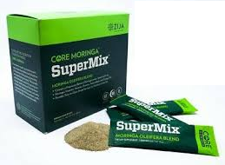
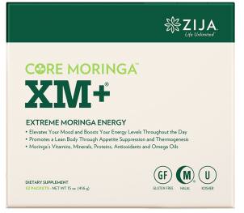
“Natures Miracle Tree”
*2100+ Mg of Moringa Oleifera
*(Leaves Seeds And Fruits) *+Energy of Green Tea,
Ginseng & *Brigham Tea

Slide 16
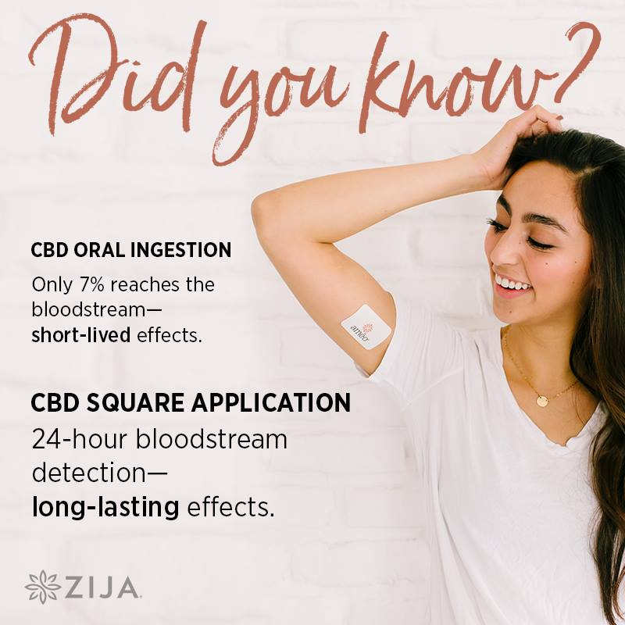
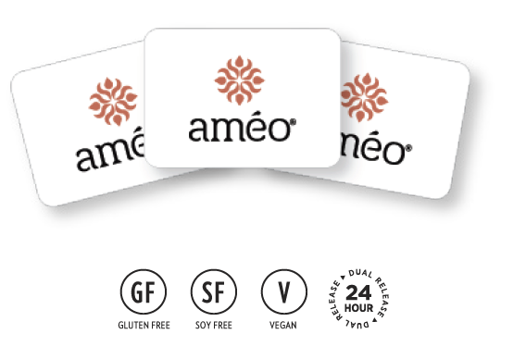
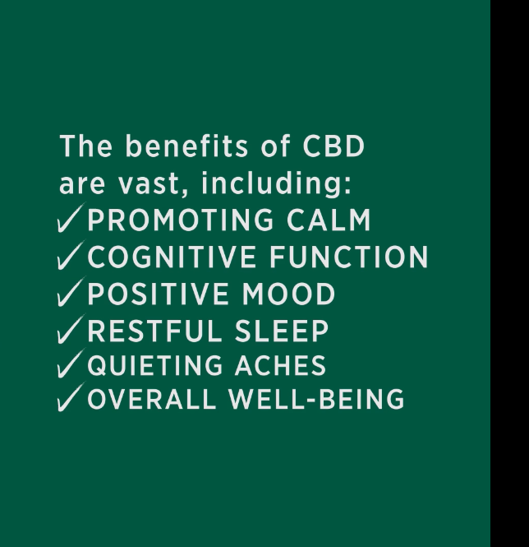

Slide 17
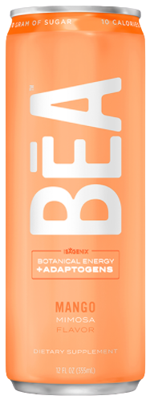
BĒA™ Sparkling Energy Drink
$39.99/27BV Case of 12
ISAGENIX

Slide 18
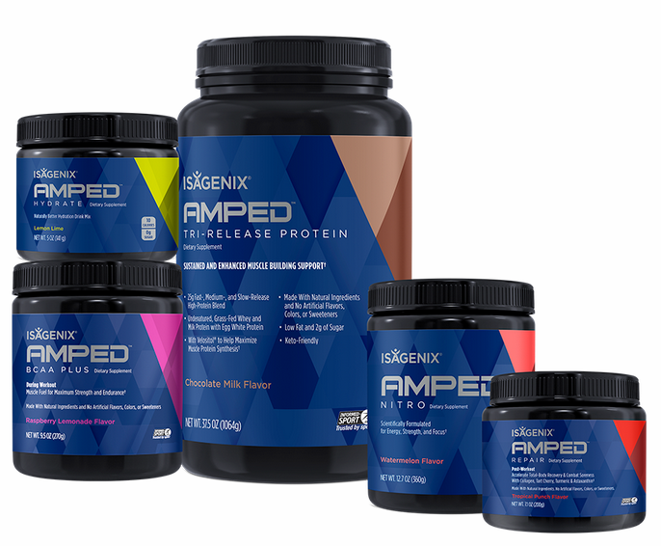
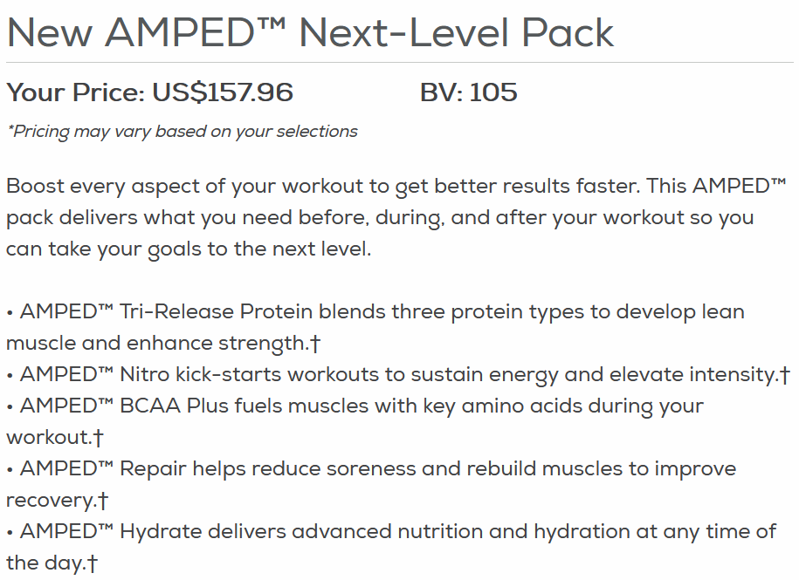
NEW AMPED™ Next Level Pack
ISAGENIX

Slide 19
ISAGENIX ELIXIR

Slide 20
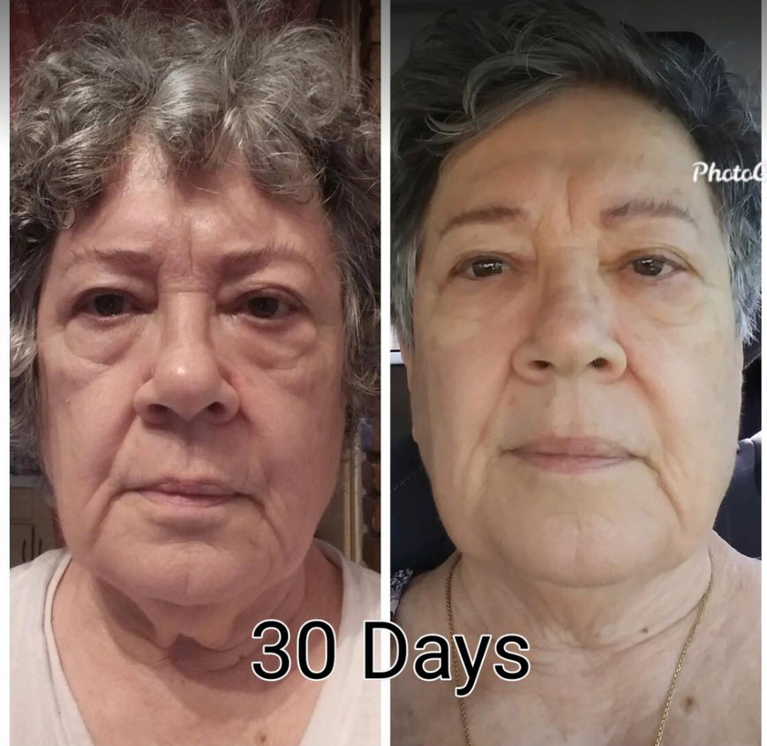
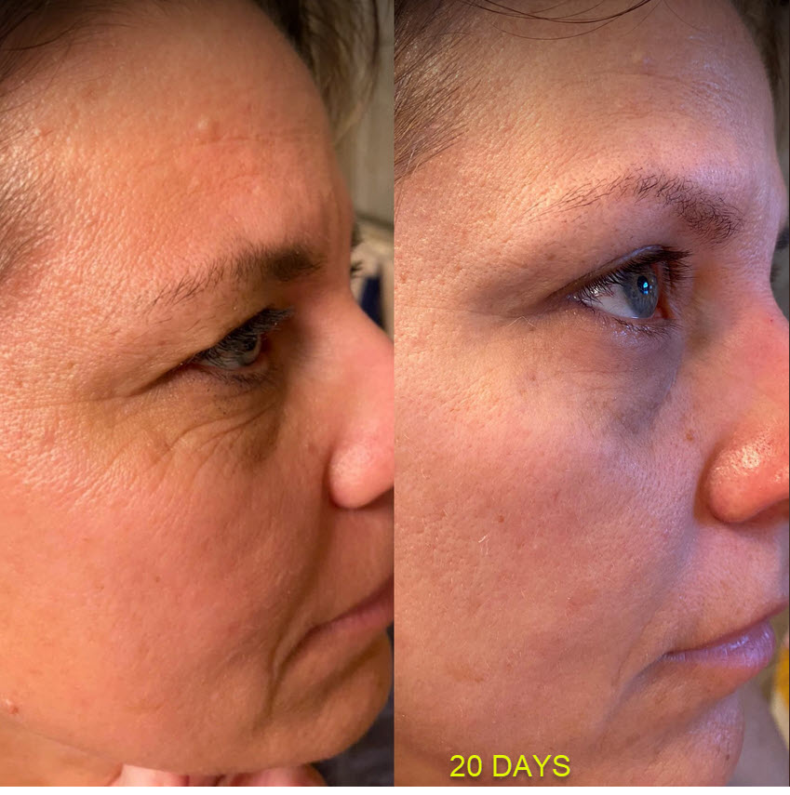
ISAGENIX ELIXIR

Slide 21
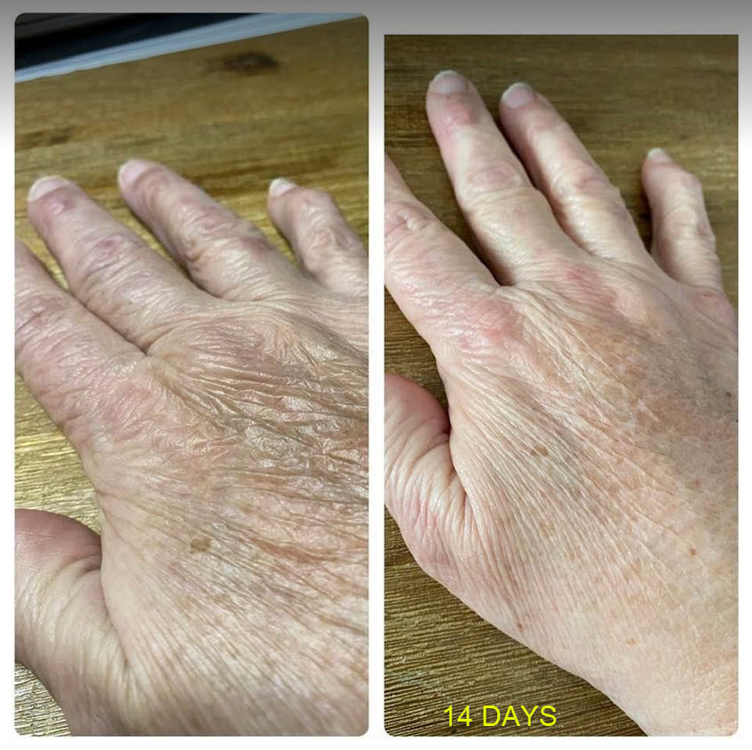
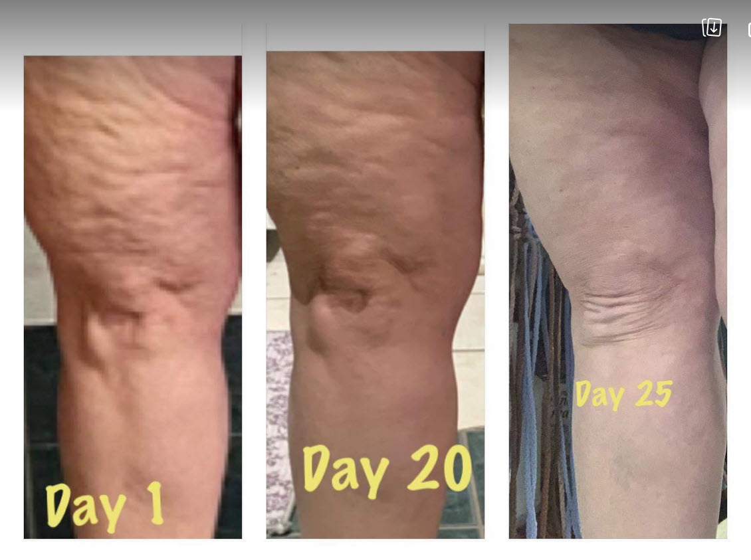
ISAGENIX ELIXIR

Slide 22
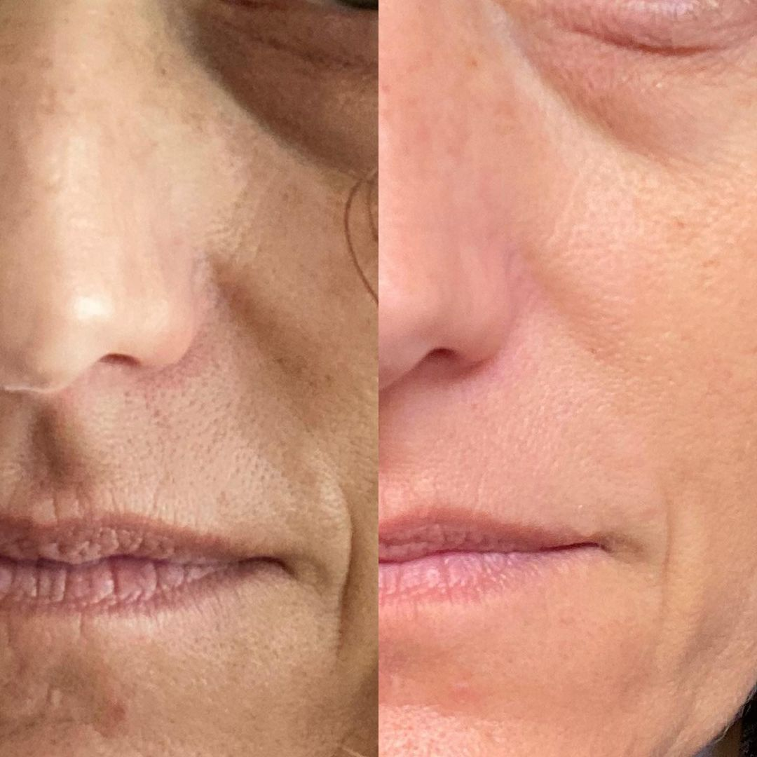
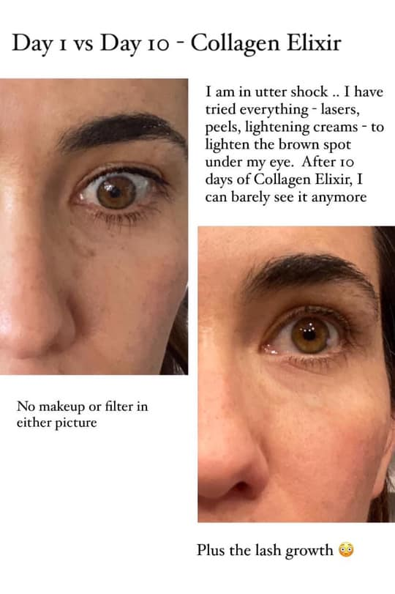

Slide 23
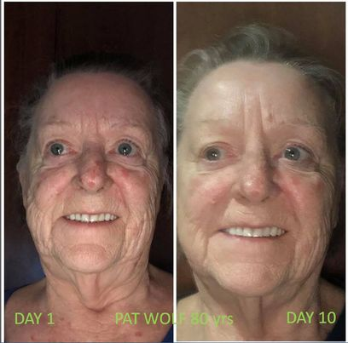
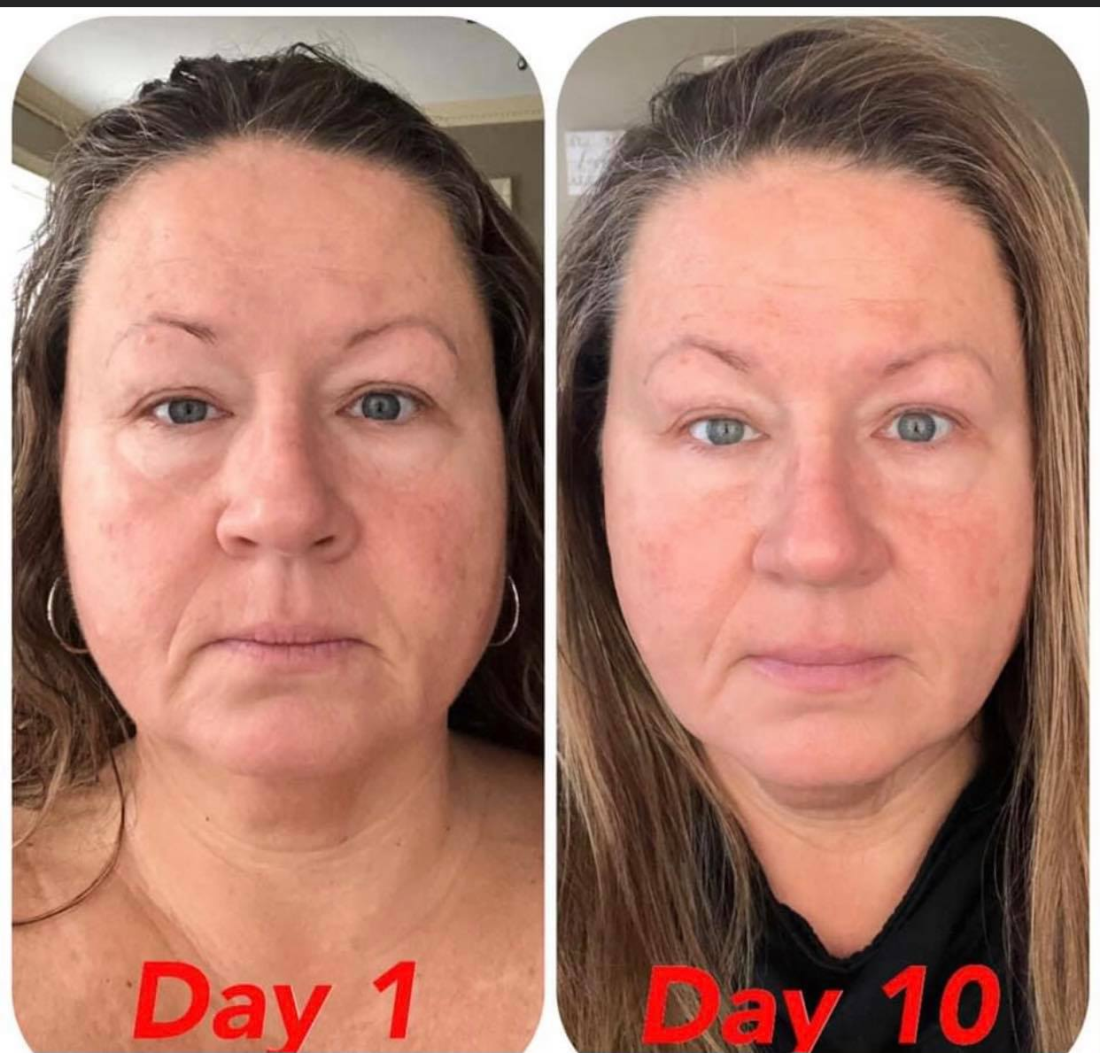

Slide 24
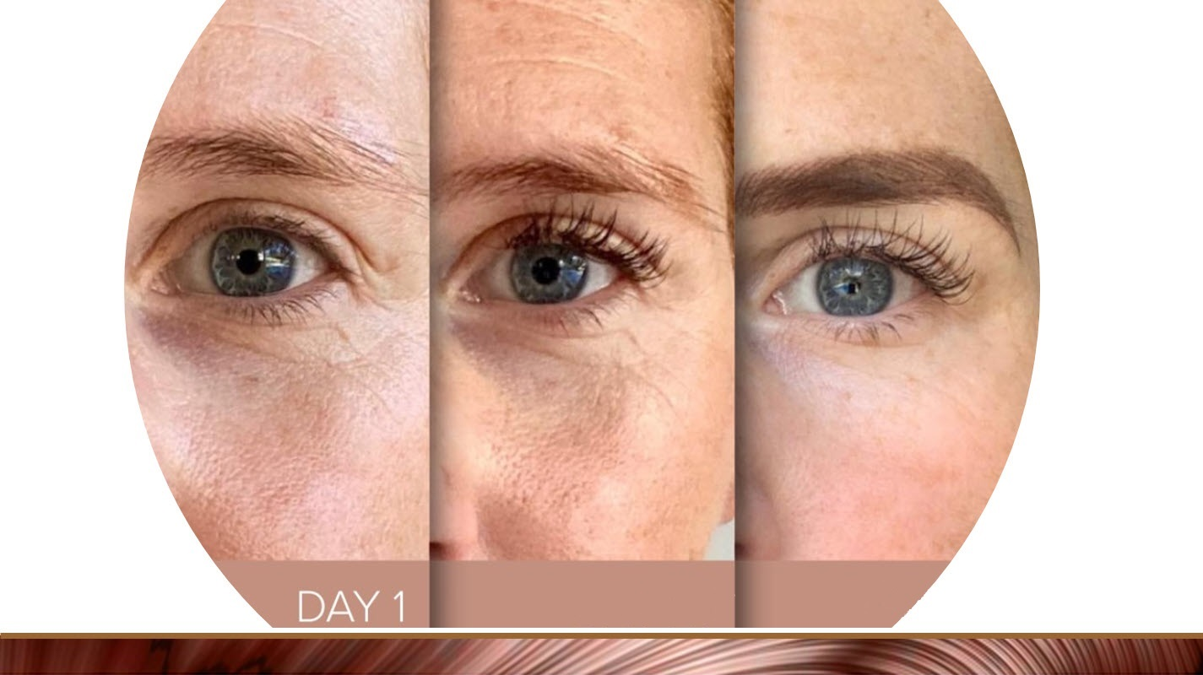
DAY 21
DAY 37
DAY 31

Slide 25
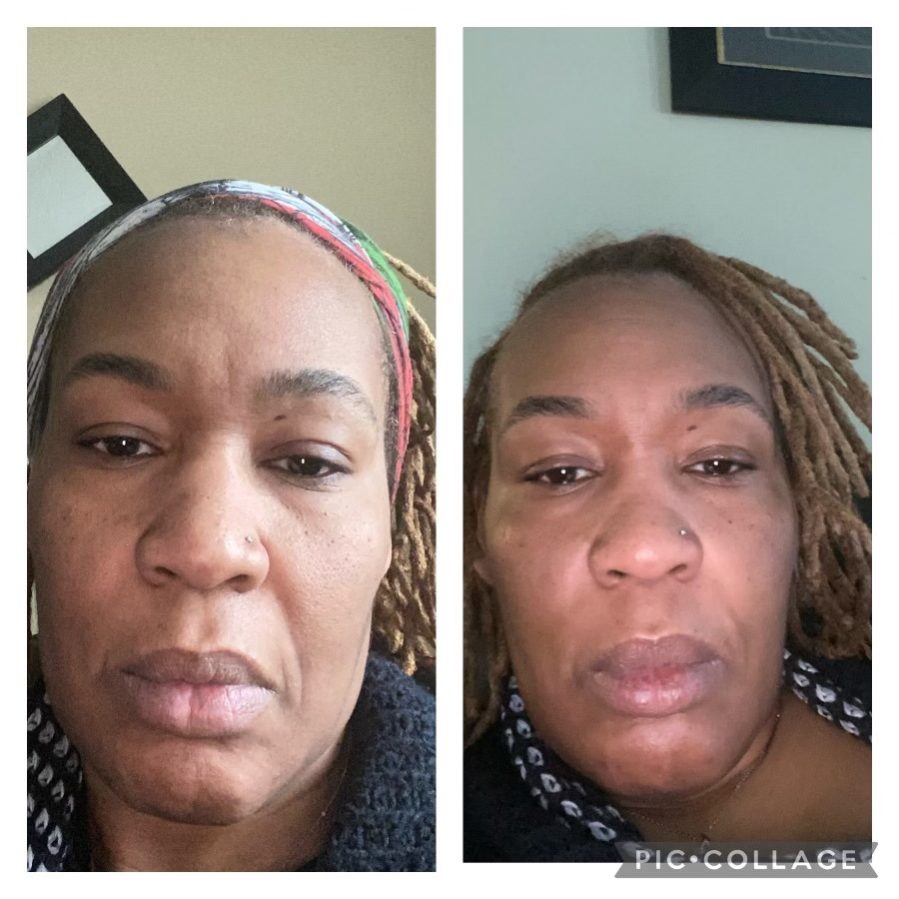
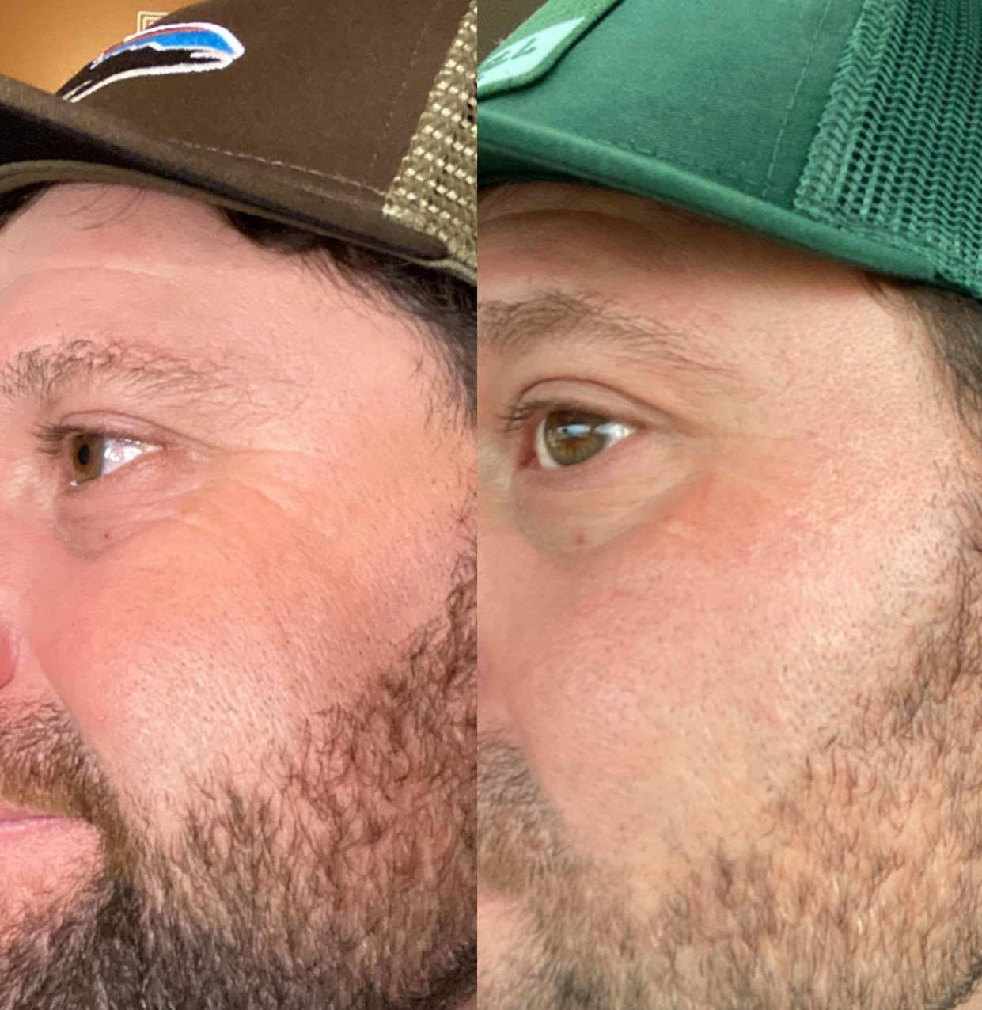
Day 1
Day 10
Day 1
Day 21

Slide 26
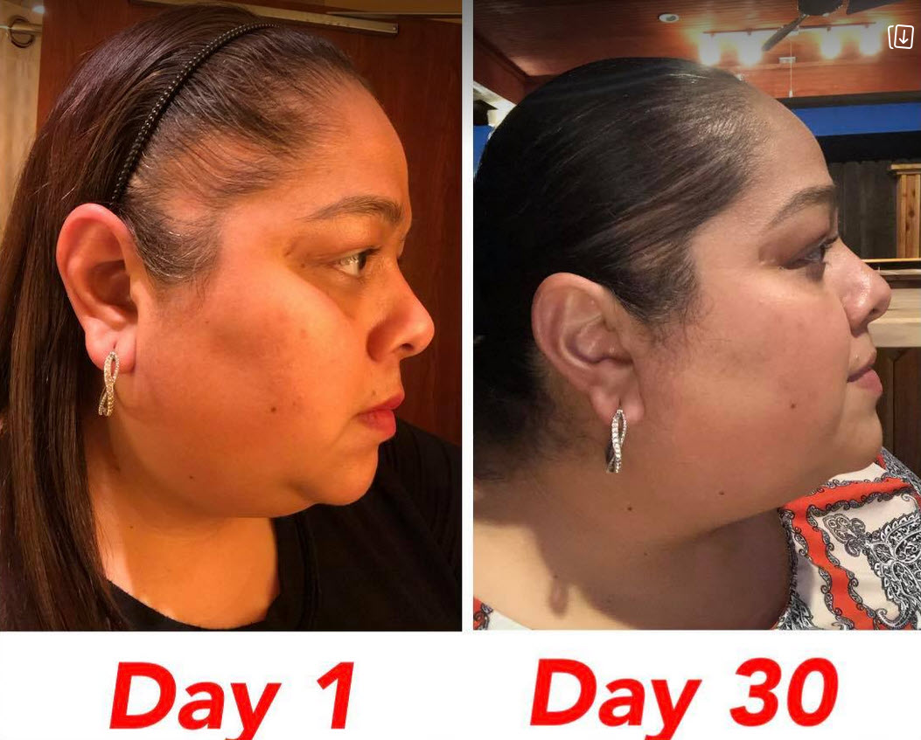
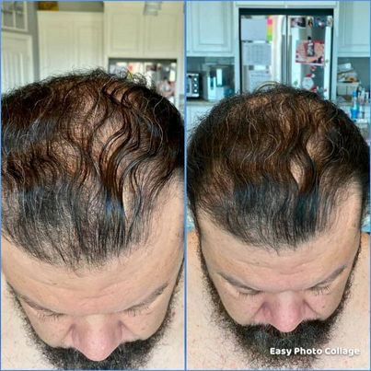
14 Days
ISAGENIX ELIXIR

Slide 27
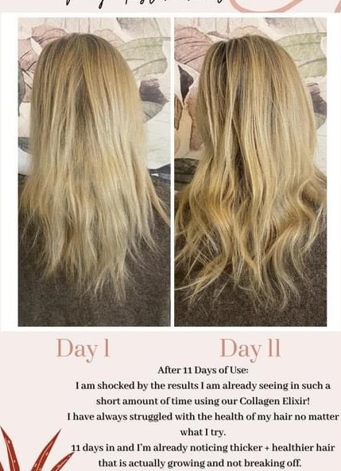
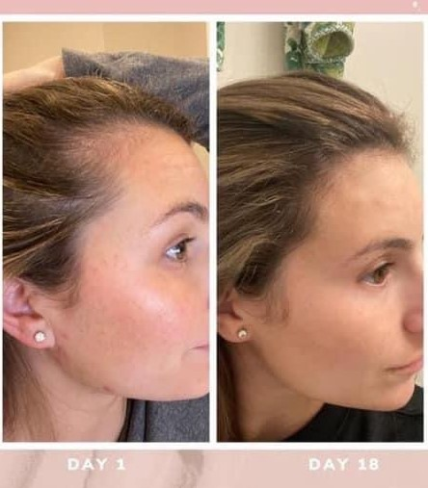

Slide 28
Notes:
In addition to feeding your body, cleansing your body, and protecting your body from oxidative stress, we offer targeted solutions so you can look and feel your best! Looking for a better night’s sleep? We have a solution for that! Want better digestive health? We have a solution for that! Trying to eat more vegetables? We have a solution for that! Wanting more energy throughout the day? We have a solution for that! Looking for healthier snacks? We have a solution for that! And if you work out or you’re an athlete — collegiate, professional, or Olympic — and if you seriously want to take your performance to a whole new level, then we’ve got a solution for that, too! No kidding!

Slide 29
Notes:
But you don’t need to take our word for it. At Isagenix, we do things differently. As mentioned earlier, we test every product. But we also test our systems scientifically to ensure you get the results you’re looking for! For example, when Isagenix was compared to the heart-healthy diet — the medical gold standard — those using the Isagenix System experienced two times more weight loss and 78% more fat loss and kept two times more muscle! That’s impressive! You can read more about our published peer-reviewed scientific research at IsagenixHealth.net/Research.

Slide 30
Notes:
If you’re in your 20s or 30s and you want to look better and feel better, then Isagenix can help with that!
(you can show all transformation slides or just the one that is catered to the audience you are speaking to and hide the remaining 3)

Slide 31
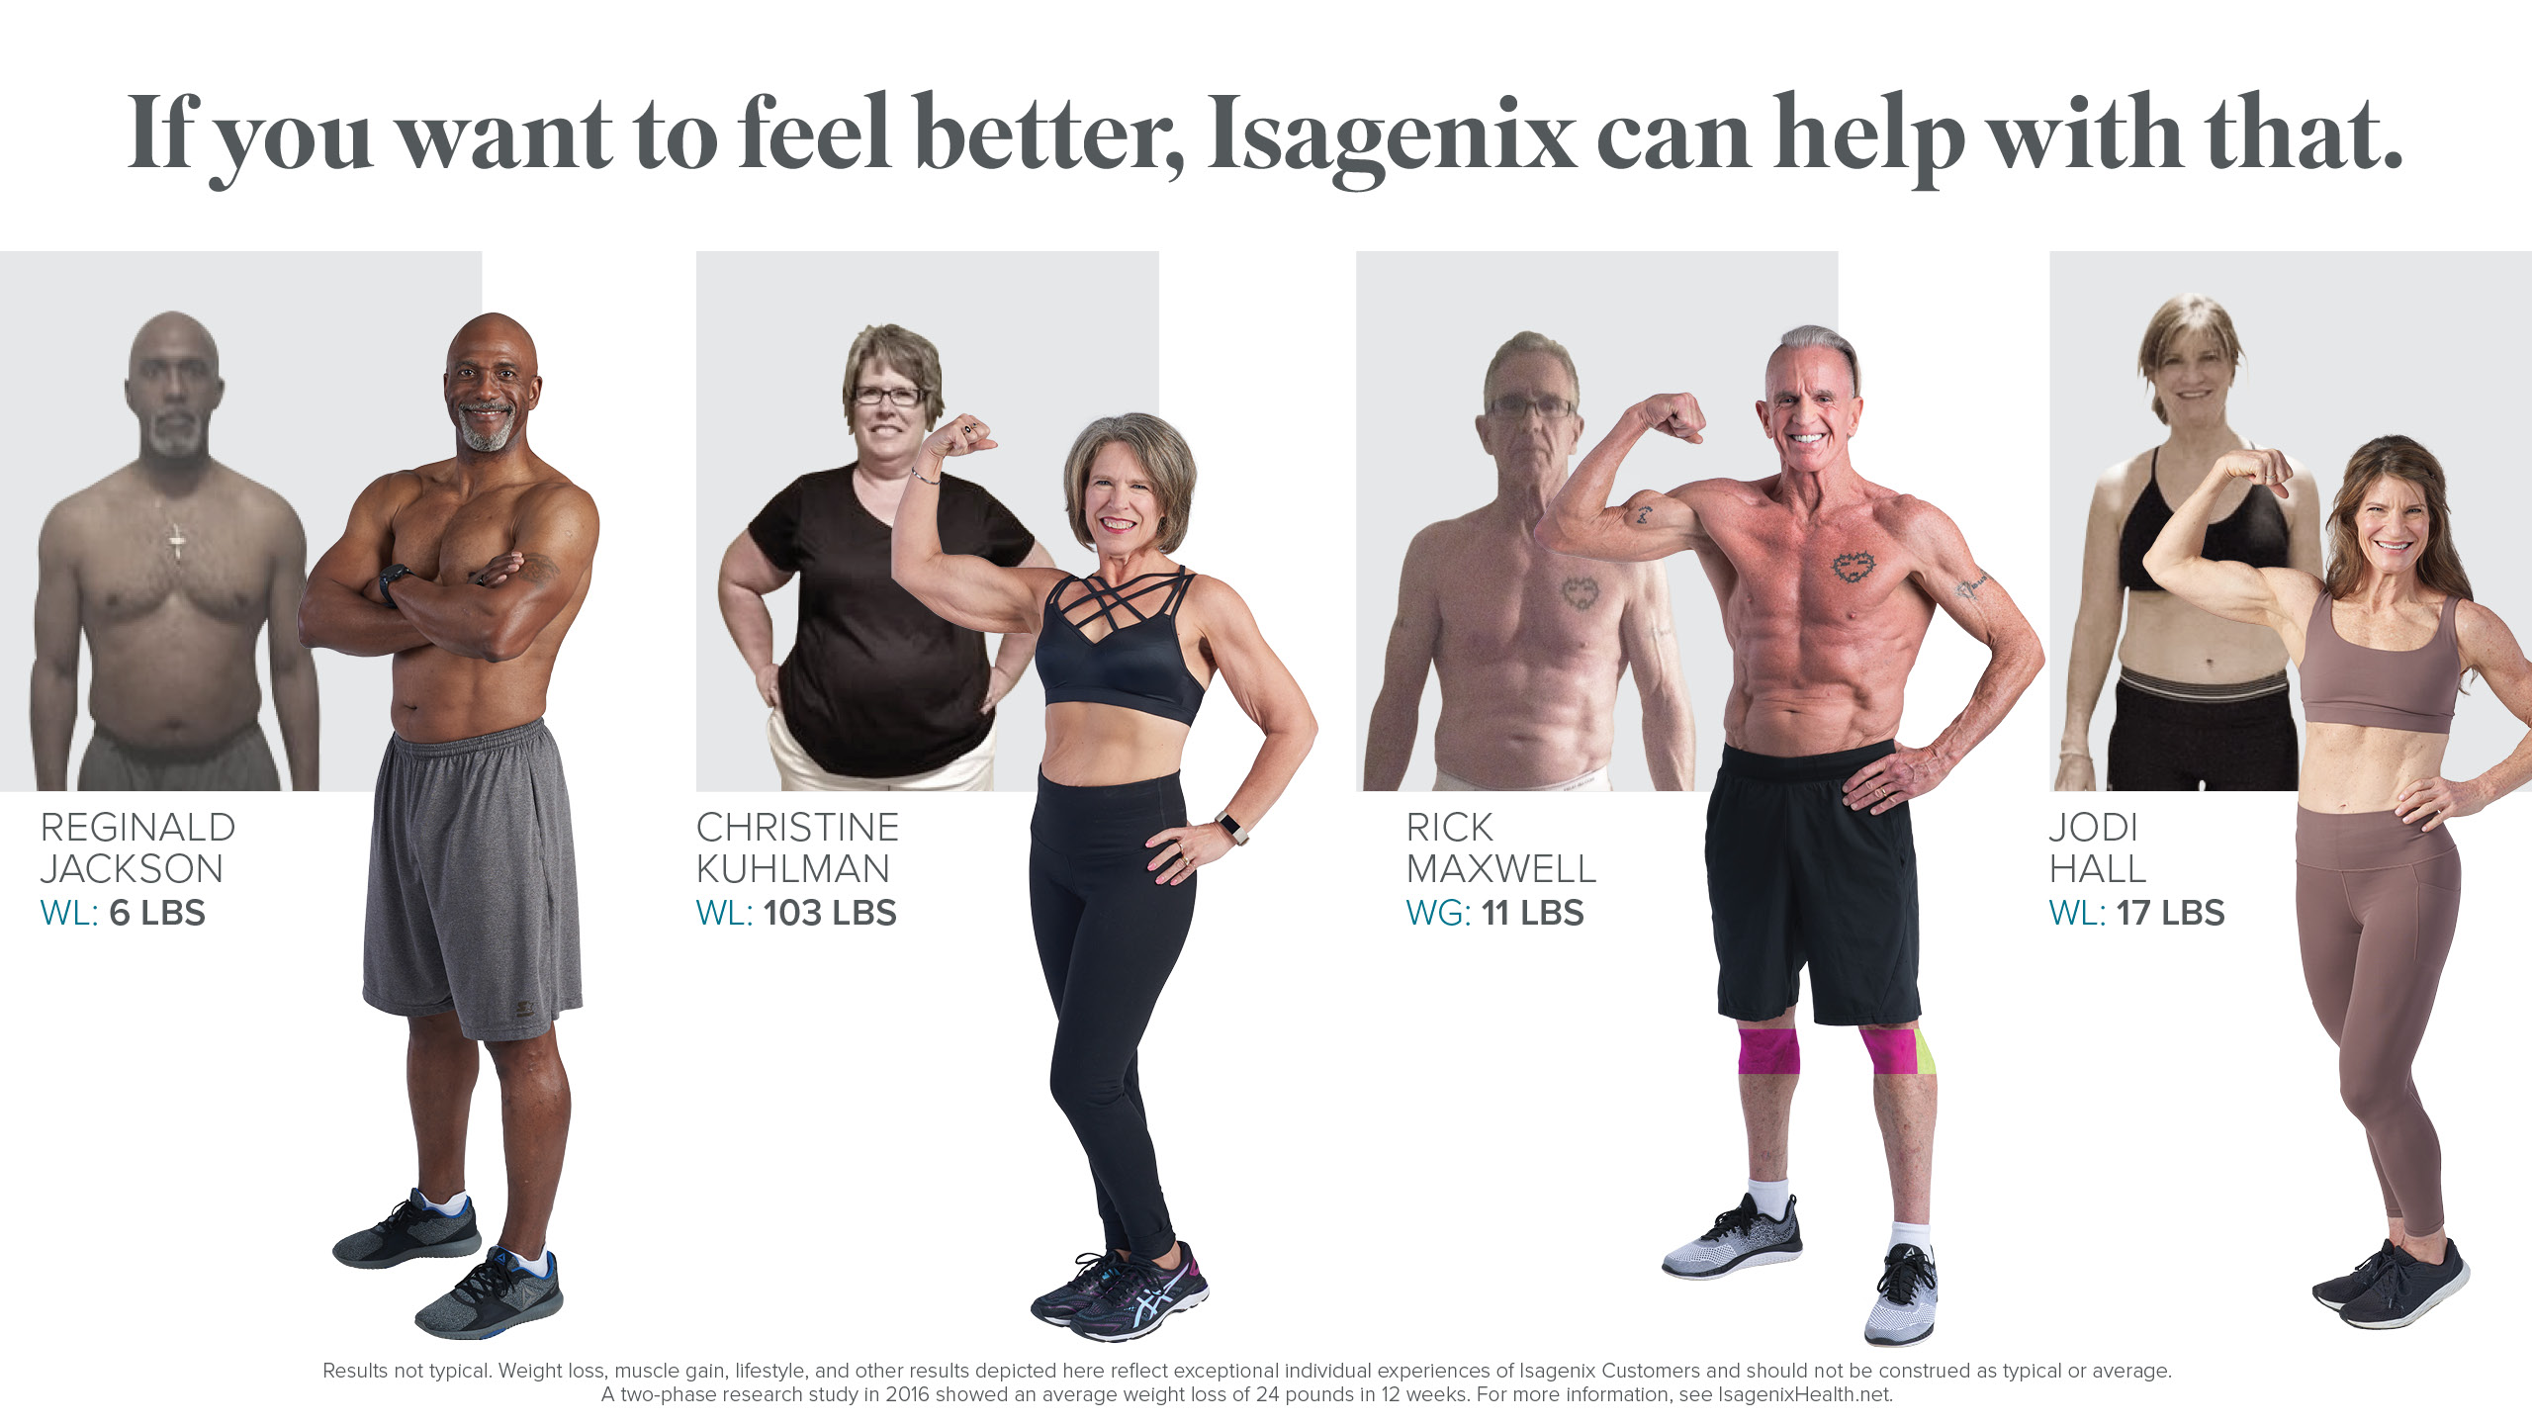
Notes:
If you’re in your 60s or beyond and you want to look better and feel better, then Isagenix can help with that!
(you can show all transformation slides or just the one that is catered to the audience you are speaking to and hide the remaining 3)

Slide 32
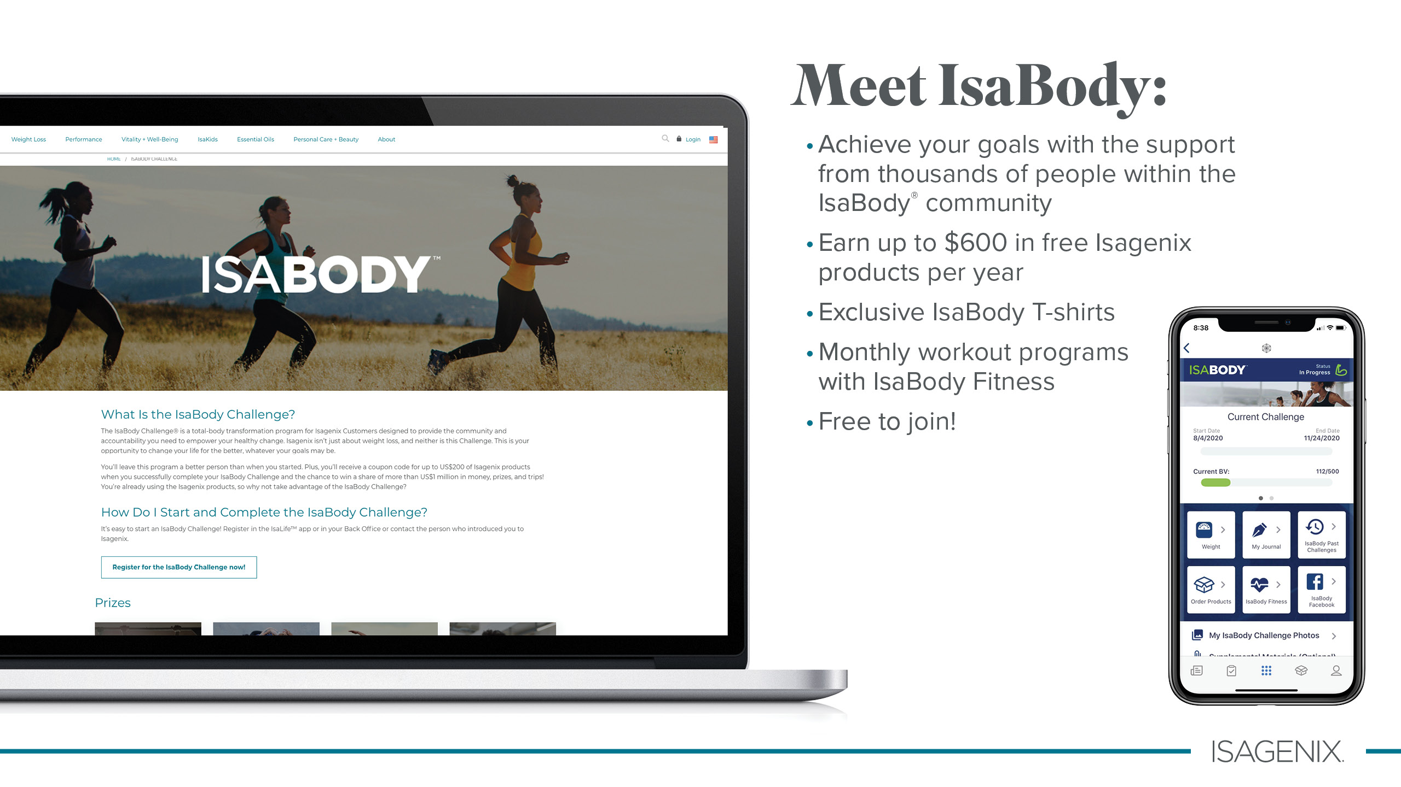
Notes:
All of this is possible because we offer products and systems that work, AND we provide a community to support you every step of the way. At Isagenix, we believe everyone deserves to live in a better body! So we help you, and our community helps you, too! Best of all, IsaBody is free to join and offers you monthly workout programs, exclusive IsaBody T-shirts, and up to $600 in free products every year!

Slide 33
Notes:
Imagine looking better, feeling better, and loving these products so much that you’ll want to share ...

Slide 34
Notes:
... And imagine if you could get paid for sharing the gift of Isagenix with those you care about most. So why might you consider the opportunity side of Isagenix? Because most people need more money!

Slide 35
Notes:
Let’s face it: Most people were taught to go to school to get a good education so they could get a good job, climb the corporate ladder, and eventually earn six figures per year. That seemed to be the ultimate financial goal! But even for those among the top 9% who have accomplished those goals, life is still expensive. Whether you are paying off student loans or you have graduated to paying down your credit card debt, millions of people are struggling to make ends meet.

Slide 36
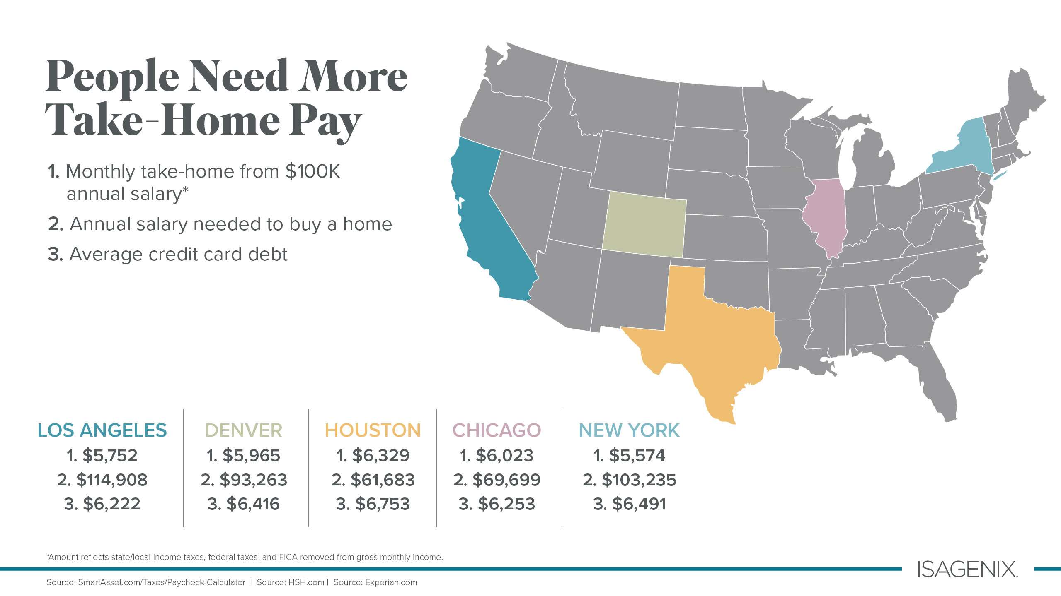
Notes:
The truth is that after-tax income, even for someone earning $100,000 per year, doesn’t leave much to live on — let alone try to get ahead! People need more take-home pay, and they need a different way to earn it!

Slide 37
Notes:
Trading time for money is rarely the best way to get ahead, but what if there was a different way to earn some additional income? Well, there is! And we believe that one of the best ways to accomplish this is to partner with us.

Slide 38
Notes:
Imagine the opportunity to share the gift of Isagenix with those you care about most — and to learn how to leverage social media to expand your network even further — so you can potentially earn even more. Because when you can work when you want, from wherever you want, with the people you enjoy being around most, you’ll understand why thousands of people in countries around the world love earning additional income by sharing the gift of Isagenix.

Slide 39
Notes:
It’s a classic win-win! You get to feel better using the products, and you get to live better with the opportunity to earn daily pay, weekly commissions, and monthly bonuses! All for sharing the gift of Isagenix with others.

Slide 40
Notes:
Getting started is simple. Setting up your Customer account is free, and it only takes about 10 minutes to decide what products would be right for you!

Slide 41
Notes:
Then, when you’re ready to earn some extra income by helping other people set up their own online accounts, upgrade to an Associate. There is a $29 annual fee, and that fee provides you with your own personal Isagenix website, online training and support, and so much more!

Slide 42
Notes:
Here’s an example of how you can earn daily pay by sharing the products you love. Say you have two friends, you share the gift of Isagenix with them, and they both decide to order the same system you did. In this example, Mary orders a Value Pack for about $599 and David does the same a few days later. The income you would earn for the first Value Pack would be $100. The income you would earn for the second Value Pack would also be $100. Now this is where it gets exciting!

Slide 43
Within 30 Days $100.00 Consultant Bonus
Notes:
If Mary and David both ordered the same Value Pack in the same commission week, Isagenix would double your commission from $100 to $200 for each Value Pack! In this example, you would earn $200 for helping Mary and $200 for helping David. AND you would also earn a one-time Rank Advancement Bonus of $100 if you accomplished this in your first 30 days! That’s $500!

Slide 44
MANAGER
Within 60 Days $250.00 Crystal Bonus
Notes:
When Mary and David learn that you earned $500 for helping them get started, they may decide to join you by upgrading to an Associate themselves. They’ll share the gift of Isagenix with the people they care about most and have the same opportunity to earn an additional income!
We can see that when Mary and David each personally help two people get started with Isagenix, you earn an additional $100 for helping Mary help two people get started, and an additional $100 for helping David help two people get started!
Again, in this example, you started with a Value Pack. Then you helped two people do the same thing (what we call You Share). Those two people also decided to do what you did (what we call They Share). If we add everything up so far, you would have earned $700 for what we see pictured in this example!
But wait, there’s more ... because if you accomplished this in your first 60 days, Isagenix would also give you an additional one-time bonus of $250! Bringing your total to $950 just for helping people eat better, feel better, look better, move better, and possibly even do better financially! How awesome is that?!

Slide 45
Notes:
The potential to do well long term surprises most people. As previously mentioned, more than 300 people have already cumulatively earned over $1 million since they began sharing Isagenix with others. How? By teaching others to do what they’re doing one conversation, text message, or social media post at a time. Then, over time, as their team begins to grow — and more and more Customers are introduced to the gift of Isagenix — the commissions earned can really add up.
Here’s how it works: Isagenix converts currency, which is different around the world, into business volume, or BV. Then, each time your total team’s Customer purchases total 900 BV — with 600 BV on one side and 300 on the other — you can earn $54! And that continues 24 hours a day, from Sunday midnight ET until Sunday midnight ET, until you reach 250 Cycles, or $13,500, per week! If you qualify as an Executive, you can earn an additional 10% Executive Match for helping those you have personally introduced to Isagenix for up to an additional $13,500 per week!
Imagine that! Living in a better body and living out of a bigger bank account, and if done properly, having the time to enjoy both!

Slide 46
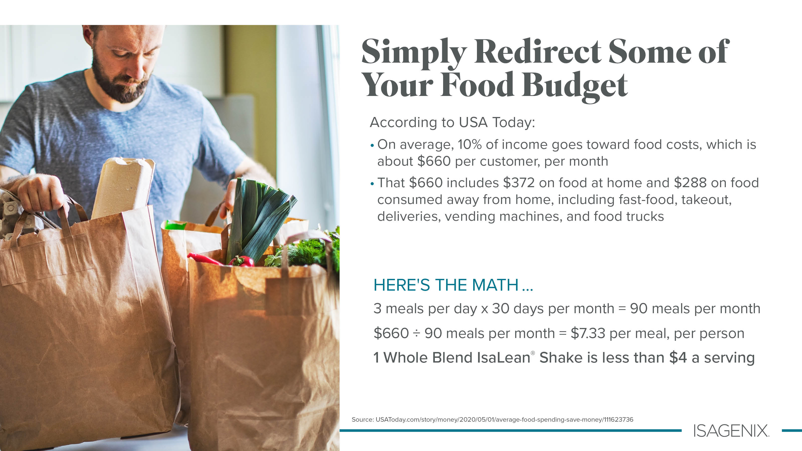
Notes:
When you think about it, all we really do at Isagenix is show people how to redirect some of their existing food budget from wherever it’s currently going over to Isagenix so they can enjoy the scientifically proven benefits of our amazing products themselves — sometimes without even spending more money! For example, one of our delicious Whole Blend IsaLean Shakes costs less than most people are paying for one of their current meals.
Think about it like this: When you become a Customer, you get to use our products to look better, feel better, and have more energy than you ever thought possible. When you decide to become an Associate, you get to earn an income by sharing that same gift of Isagenix with others!

Slide 47
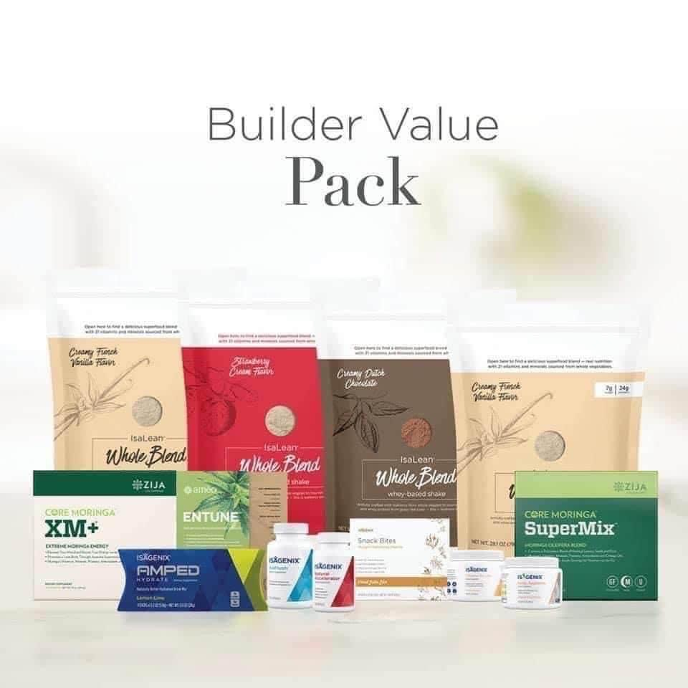
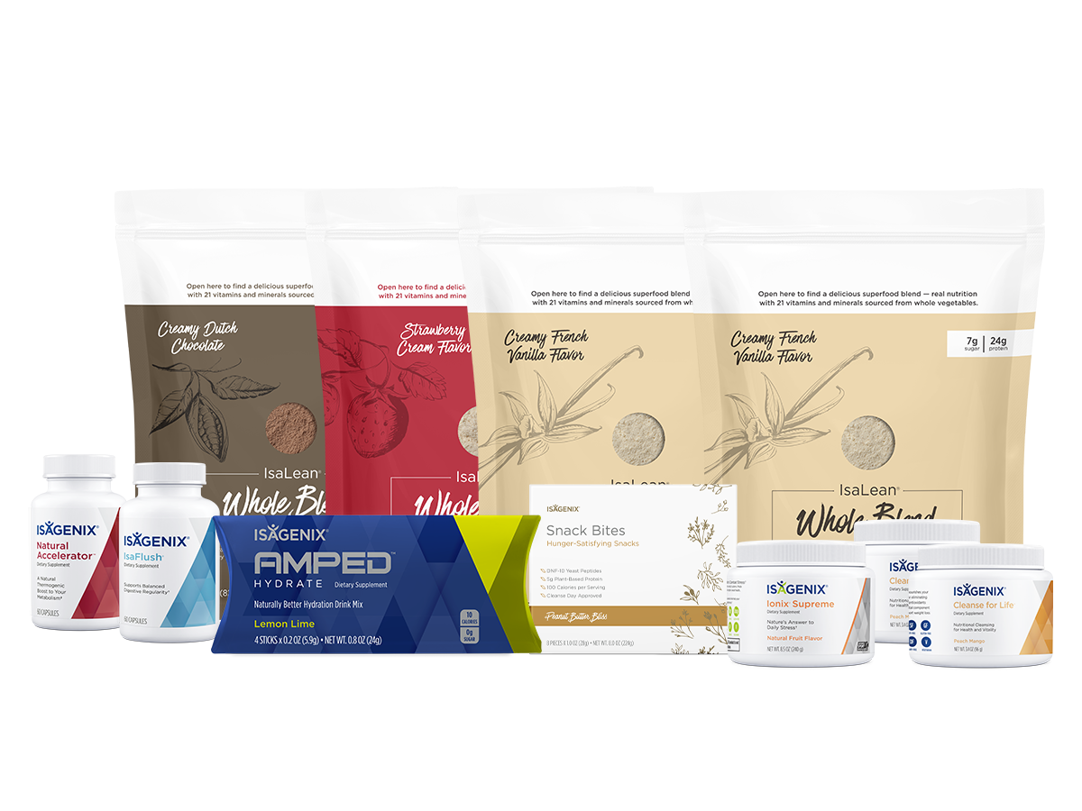
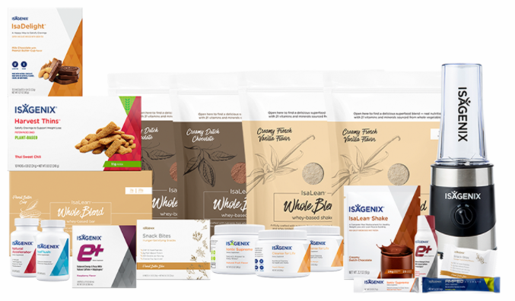
GET STARTED TODAY! Get in where you FIT in!
56 MEALS
Builder Value Pack
Starting at US $504.74 (with rewards) 361BV
(no rewards) Preferred Customer US $534.43
Weight Loss Premium Pack
Starting at US $400 (with rewards) 185 BV
(no rewards) Preferred Customer US $441.70
Weight Loss Basic Pack
Starting at US $273.67 (with rewards) 164BV
(no rewards) Preferred Customer US $285.61
$17 A DAY
$14 A DAY
$9 A DAY
Free Shipping (with rewards)
Free Associate Fee (with rewards)
Costs are not exact and may vary based on the products selected.
ISAGENIX
ISAGENIX

Slide 48
Notes:
Because we offer a 30-day satisfaction guarantee, you can get the cost of the products back if you don’t love them. So please get back with the person who introduced you to Isagenix and let them know you’re ready to get started today!

Slide 49
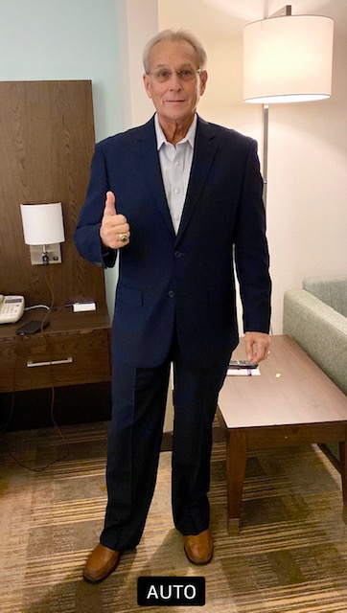
6 Months 65 LBS
8 Years 70 LBS

Slide 50
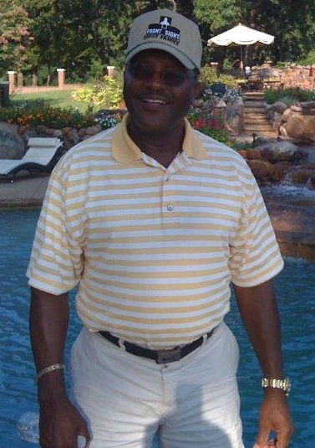
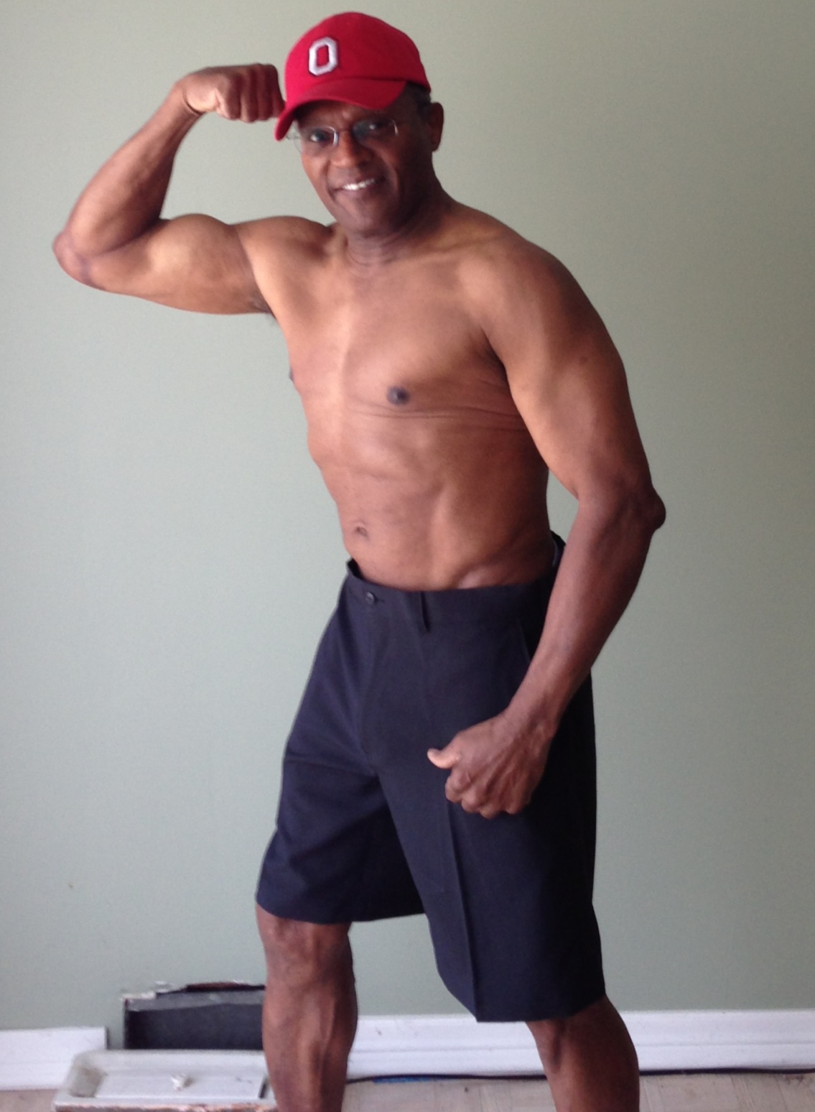

Slide 51
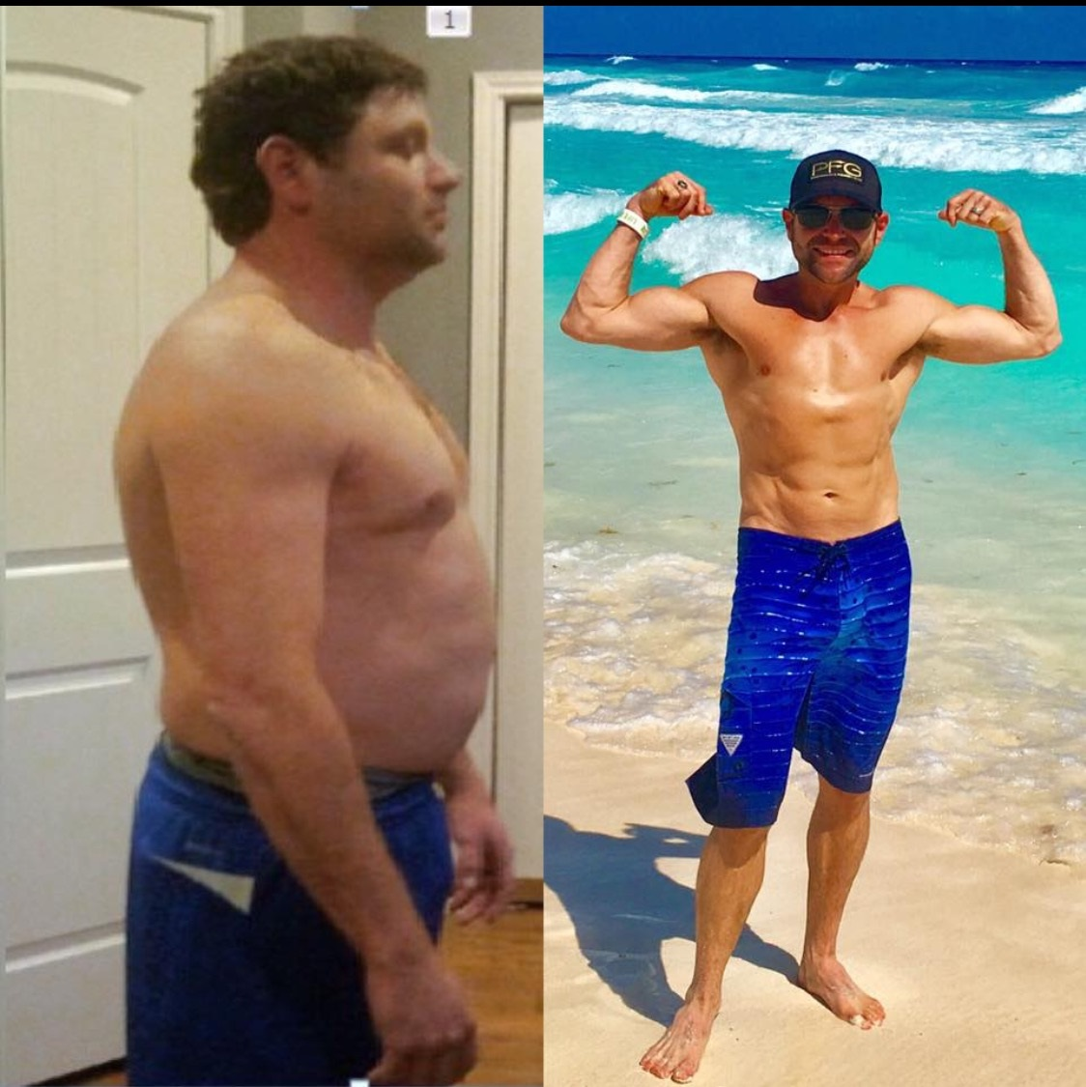

Slide 52
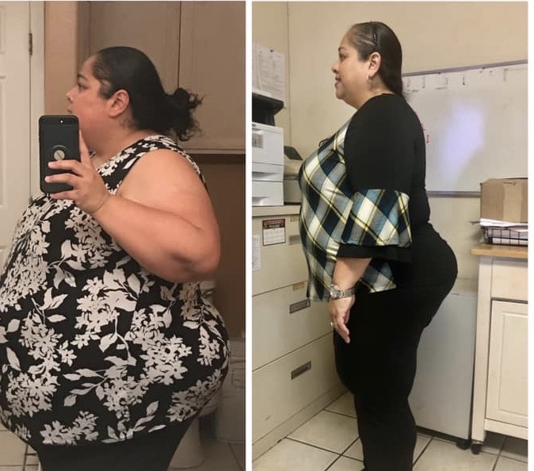
YOLI PEREZ
170 LBS 22 MO.

