Slide 1

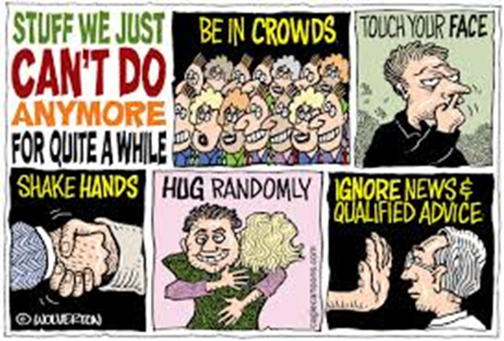
BUSI 406-3 (Didow): The top priority is your safety and your well being
Are you okay?
What do you need from me, the UBP, KFBS, or UNC?
Are you following the Federal and State guidelines to lessen the spread of coronavirus?
  Stay at home if you can -- “Shelter in Place”
  Practice social distancing
  Wash your hands frequently
  Cover your sneeze of cough
  Avoid touching your eyes, nose, and mouth
How can you do some good in the world in this challenging and difficult circumstance?
  Family
  Friends
  Neighbors

Slide 2
BUSI 406-3 (Didow) Final Exam Information
Final exam will be taken online on Canvas through the “Quizzes” tab
Final exam will be available for you to take anytime within the following 48-hour window:
  Exam will open at noon (EST) Tuesday, April 28
  Exam will close at noon (EST) Thursday, April 30
You will have a maximum of 3 hours to complete the exam
  Once you start the exam, the clock starts
  You can submit the exam when you are done. Otherwise, the exam will close automatically at the end of 3 hours.
  If you have technology issues, please email me immediately at nick_didow@unc.edu
I am happy to answer questions prior to noon on 4/28

Slide 3
Final Exam Information
Instructions
  Honor and sign UNC Honor Code Pledge
  Closed book, closed notes, closed Internet exam
  NO smart device use (e.g., phone, watch, tablet, laptop) is permitted
  You may use the calculator function on your computer.
The final exam will be on all class material covered in Chapters 8–19
Final Exam Format
  50 Multiple Choice Questions (1 point each; total 50 points)
    Choose the BEST answer
  Case with several Short Answer Questions (total 50 points)
    Word limits will be specified for each question
    Please respect the word limits. Your words past the word limit will neither be read nor evaluated as part of your response.

