Slide 1
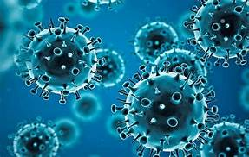
COVID in Pregnancy
Pearls and Perils of Management
Cornelia R. Graves, MD
Medical Director, Tennessee Maternal Fetal Medicine
Director of Perinatal Services, St. Thomas Health
Co-Director, Collaborative Perinatal Cardiac Center
Professor, University of Tennessee
Clinical Professor, Vanderbilt University
Adjunct Professor, Meharry Medical College

Slide 2
Disclosures
I have no financial relationships to disclose

Slide 3
Objectives
At the end of this discussion, the participant will be able
Describe the viral etiology of SAR2-COVID 19
Describe the pathophysiology of the SAR2-COVID
Describe the disparities and racial inequities that surround COVID-19
Describe the impact of COVID-19 in pregnancy
Implement evidenced based guidelines for treatment(including vaccine recommendations)and use of telehealth
Address the impact of COVID-19 on offspring

Slide 4
COVID-19: The Virus
Virology and Pathophysiology

Slide 5
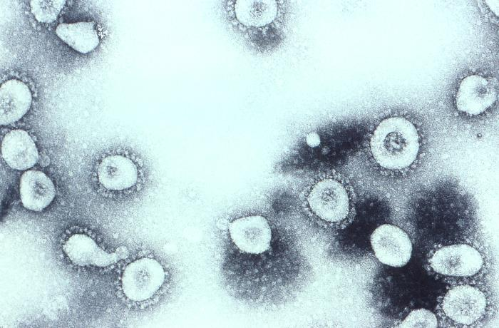
Coronavirus is group of RNA viruses
Cause disease in birds and mammals
One of the largest RNA virus
Have spikes that project from their surface giving the appearance of a corona

Slide 6
Subtypes of Coronavirus
Alpha, Beta, Delta, Gamma
Most cause mild respiratory symptoms; the common cold
The most virulent are beta viruses
MERS-CoV, a beta virus that causes Middle East respiratory syndrome (MERS)-2002
SARS-CoV, a beta virus that causes severe acute respiratory syndrome (SARS)-2012
SARS-CoV-2, which causes COVID-19-2019

Slide 7
Timeline for COVID-19
Jan 20, 2020
CDC announces airport screenings
Jan 21, 2020
First US case
Jan 31, 2020
WHO declares global health emergency
February 3, 2020
US declares a global health emergency
Issues travel restrictions
Nov 19, 2019
First case noted in Wuhan
Postulated to be from the market
Dec 1, 2019
More cases are seen
Jan 9, 2020
Announced by the WHO (59 cases

Slide 8
Lifecycle of the coronavirus

Slide 9
COVID-19 Subtypes
Up to 8-10 different strains
May explain differences in outbreaks and symptoms

Slide 10
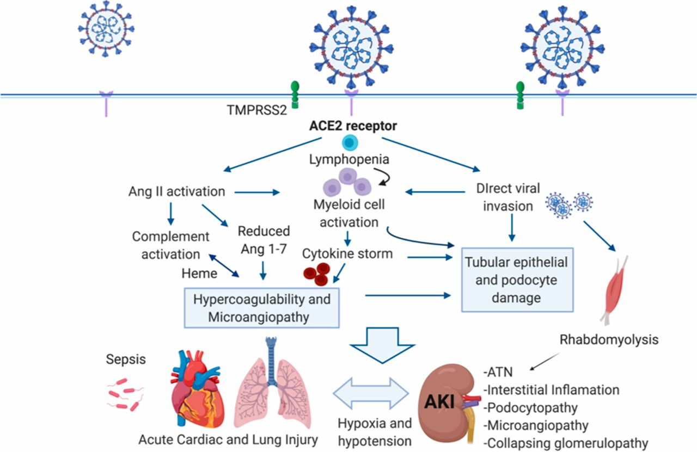
Pathophysiology of COVID-19

Slide 11
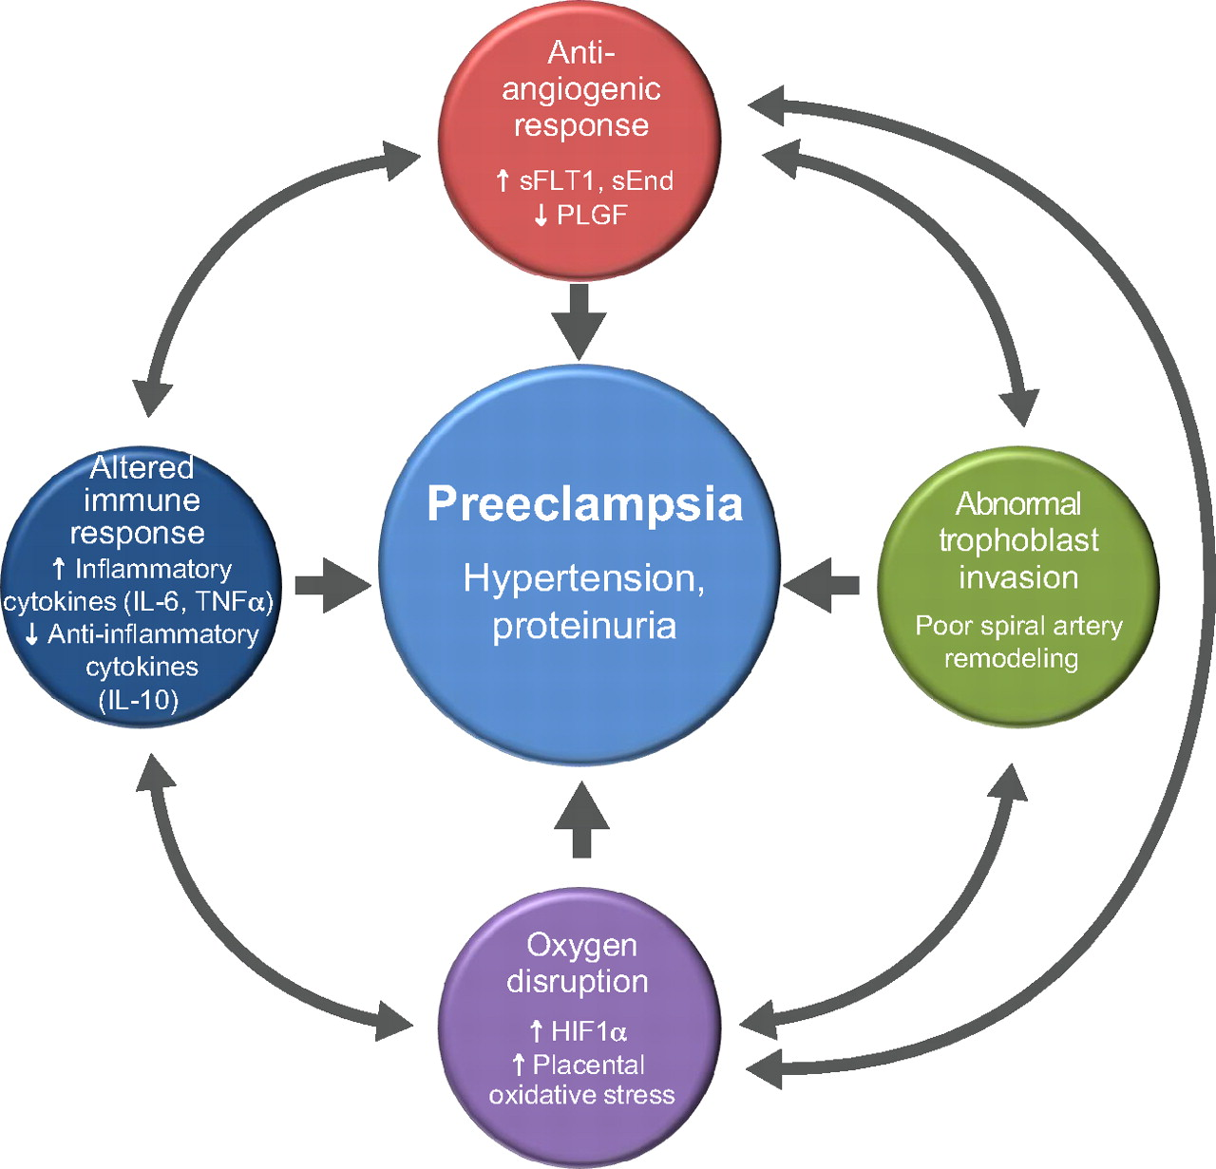
Pathophysiology of Preeclampsia

Slide 12
Symptoms of infection with COVID-19 occur 2-14 days post exposure
Fever or chills
Cough
Shortness of breath or difficulty breathing
Fatigue
Muscle or body aches
Diarrhea
Headache
New loss of taste or smell
Sore throat
Congestion or runny nose
Nausea or vomiting

Slide 13
Long term symptoms of COVID-19
Common
Fatigue
Shortness of breath
Cough
Joint pain
Chest pain
Less Common
Difficulty with thinking and concentration
Depression
Muscle pain
Headache
Intermittent fever
Fast-beating or pounding heart
CDC 2020

Slide 14
Severe long term complications
Cardiovascular
Cardiomyopathy
Respiratory
Chronic Lung Injury
Renal
Chronic renal disease
Dermatologic
Skin Changes/rash
Hair loss
Neurological
Stroke
CDC, 2020

Slide 15
Racial Inequities in COVID-19

Slide 16
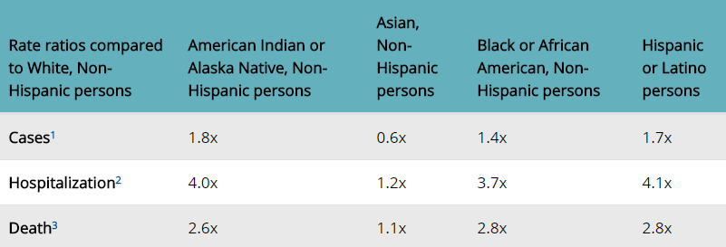
Racial Disparities in COVID outcomes
CDC, 2020

Slide 17
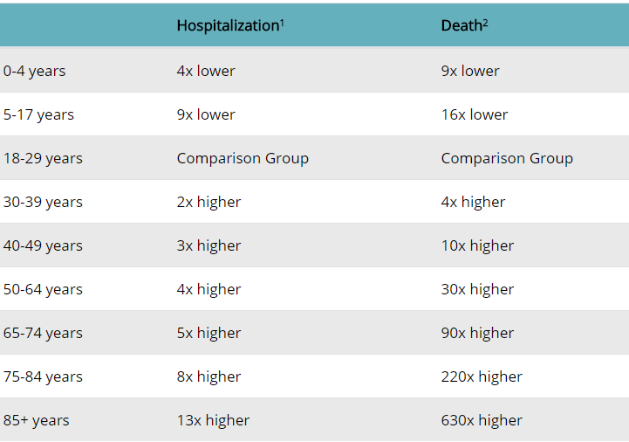
Hospitalizations and Death as related to age
CDC, 2020

Slide 18
Why are people of color more likely to be affected?
Front line exposures
Clerks
Janitors
Public transportation
Healthcare
Chronic Illness
Diabetes
High blood pressure
Heart Disease
Obesity
Poor diet
Genetics

Slide 19
Social Determinants of Health Unequal Care

Slide 21
Meharry leader says medical college 'somehow' didn't get first wave of COVID-19 vaccines
Despite the fact they staffed ALL of the testing sites in Nashville
Despite the fact, that their president, who is an international expert in infectious disease who sits of the FDA Board for emergency release and served as a member and resource for the Metro Task Force
Despite the fact, the hospital is Nashville’s only safety net hospital

Slide 22
Dr Susan Moore: Dies of COVID-19
Had to ask for appropriate treatment
Was denied pain medications
Was told her chest X-ray was negative
Went to another hospital, but died after admission
Leaves son and 2 parents with dementia
Hospital states” they will have diversity training”
USA Today, Dec 2020

Slide 23
Help!! My patient has COVID

Slide 24
Our Case
32 year old G1 presents with complaints of SOB, cough and headache. She reports that her partner is an essential worker and has been going to work every day
On exam, her temperature is 102 F and she is breathing 38 times per minute. BP is 145/106. HR is 120 bpm
What are the steps in management and treatment of this patient???

Slide 25
Maternal Presentation of COVID
Cough
Fever
Shortness of breath
Preeclampsia-like syndrome
May be associated with hyper-inflammatory state
Postpartum Hemorrhage

Slide 26
COVID Testing
COVID PCR
Takes at least 24 hours for results
90-95% detection rate
Antibody testing
~80%
COVID Rapid Antigen testing
15 minutes
About 70-75% accurate

Slide 27
Workup for COVID
Chest x-ray
Ground glass appearance in lower lung fields
CBC, Comprehensive metabolic panel
Leukopenia
Thrombocytopenia
Elevated liver function test
D-dimer
Elevated, greater than 1000
BNP
May be elevated in myocardial dysfunction
Ferritin
Elevated in severe cases
C-reactive protein
May be elevated, difficult to interpret in pregnancy
Procalcitonin?
Elevated ; unchanged in pregnancy

Slide 28
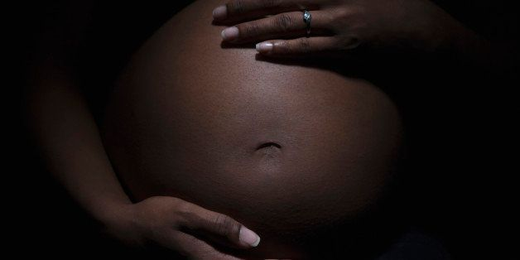
Physiologic Changes in Pregnancy

Slide 29
Physiologic Changes
Hyperventilation
Begins in the 1st trimester
Increases by 48% at term
Stimulated by progesterone
Due to an increase in minute ventilation which increases 20% to 40% above baseline

Slide 30
Physiologic Changes
Oxygen consumption increased by 20%
FEV₁ remains unchanged
Tidal volume is increased
Decreased in functional residual capacity by 18%
Pulmonary vascular resistance decreases by 34%
Colloid osmotic pressure decreases by 14%

Slide 31
Physiologic Changes
Respiratory Alkalosis
Compensated renal acidosis, pH remains unchanged
Resting arterial CO2 tension about 30 mmHg or less
Resting arterial O2 tension about 105 mm Hg
Shift of oxygen dissociation curve to the right

Slide 32
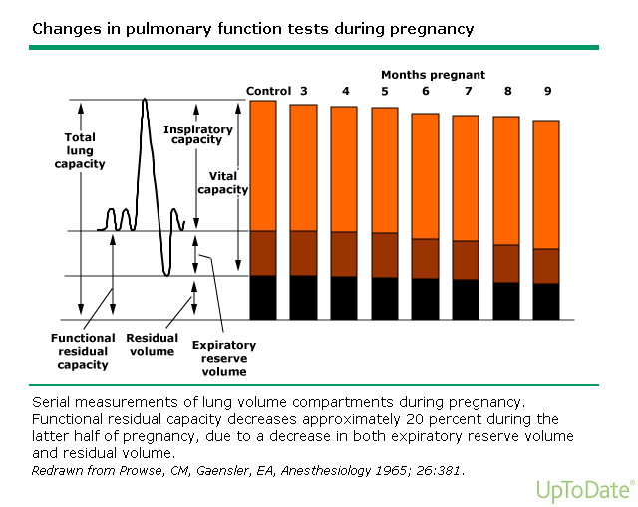

Slide 33
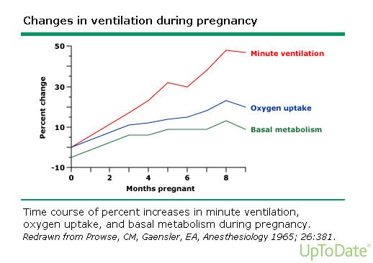

Slide 34
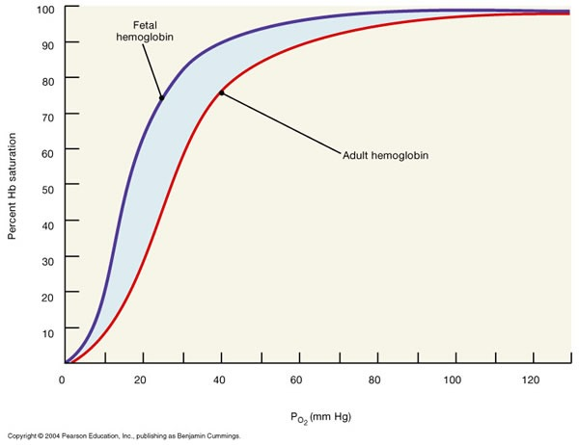

Slide 35
When to Admit the Pregnant Patient with COVID
Patient can not maintain oxygen saturation of at least 95%
Chronic illnesses-i.e. asthma, diabetes, hypertension
Respiratory rate greater than or equal to 30-35
Fetal or other obstetrical concerns

Slide 36
MMWR, 2020
Over 8,000 patients with COVID-19 in the US.
Hospital admission rate was 6x higher in pregnant women than in non-pregnant women
Pregnant women are more likely to end up in the ICU (aRR-1.5) and require mechanical ventilation(aRR-1.7)
No change in mortality over non pregnant women

Slide 37
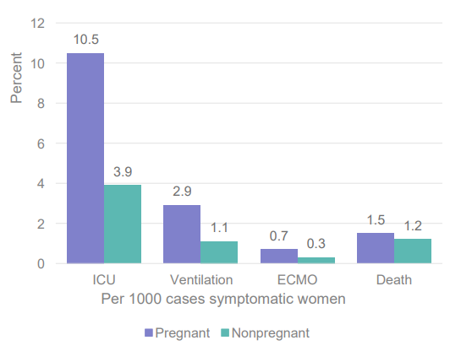

Slide 38
Treatment
Supportive care
Oxygen therapy
High Flow Nasal cannula
Noninvasive positive pressure ventilation
Mechanical Ventilation

Slide 39
Case Study(continued)
The patient is placed on oxygen by nasal cannula but cannot maintain her saturations at 95% without at least 3L. She is breathing ~28-32 times per minute
What are you next steps??

Slide 40
Treatment
Dexamethasone
Dosing-6mg daily for up to 10 days
RECOVERY STUDY
Double blind randomized placebo trial
Lower 28 day mortality in those needing respiratory support
NEJM, July 2020

Slide 41
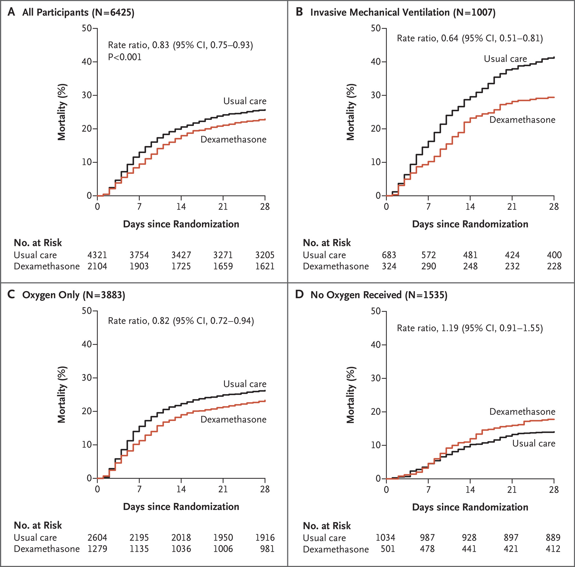

Slide 42
Treatment
Convalescent plasma
Small randomized studies show some benefit; other studies do not
Should be started when patient has an oxygen requirement
Data suggest patients receiving plasma may form antibodies earlier than those who do not

Slide 43
Treatment
Remdesivir
Inhibitor of the viral RNA-dependent , RNA polymerase
Shown to be effective against SARS-CoV-1 and MERS-CoV
Initially used for compassionate care in special groups
Pregnancy and children less than 18 years of age
Required release and request from the FDA
Has been used successfully in pregnancy
Anderson J, et al. Case Rep Women’s Health. 2020 May 16;27

Slide 44
Treatment
Remdesivir
ACTT-1 trial
1062 patients; 1:1 randomized control trial
Remdesivir more likely than placebo to shorten recovery time (OR-1.5)
Decrease incidence of respiratory tract infection
Begel et al. Remdesivir for the Treatment of Covid-19—Final Report NEJM 383(19):1813-1825

Slide 45
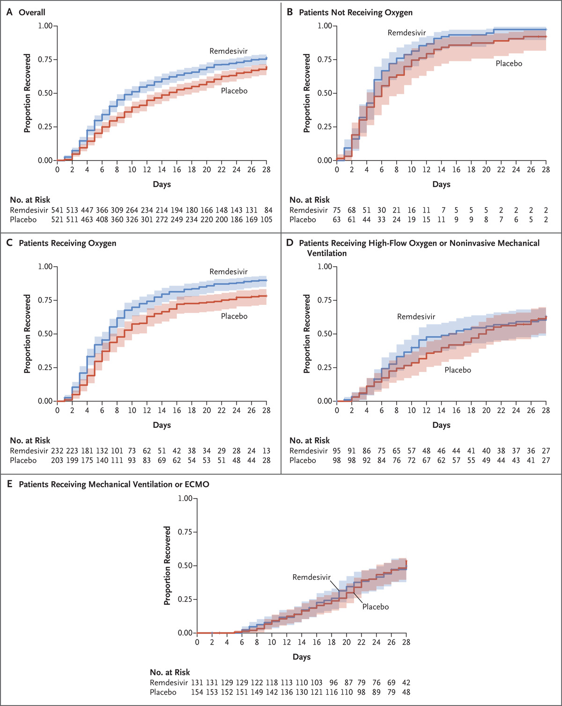
JH Beigel et al. N Engl J Med 2020;383:1813-1826.
Kaplan–Meier Estimates of Cumulative Recoveries.
Notes:
Figure 2. Kaplan–Meier Estimates of Cumulative Recoveries. Cumulative recovery estimates are shown in the overall population (Panel A), in patients with a baseline score of 4 on the ordinal scale (not receiving oxygen; Panel B), in those with a baseline score of 5 (receiving oxygen; Panel C), in those with a baseline score of 6 (receiving high-flow oxygen or noninvasive mechanical ventilation; Panel D), and in those with a baseline score of 7 (receiving mechanical ventilation or extracorporeal membrane oxygenation [ECMO]; Panel E).

Slide 46
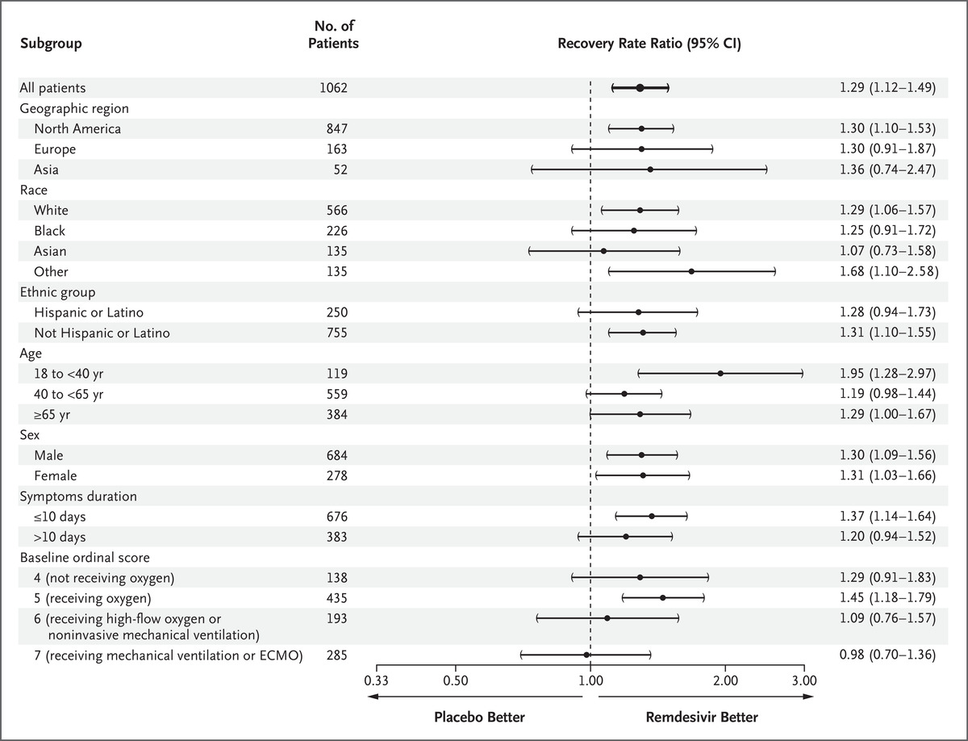
JH Beigel et al. N Engl J Med 2020;383:1813-1826.
Time to Recovery According to Subgroup.
Notes:
Figure 3. Time to Recovery According to Subgroup. The widths of the confidence intervals have not been adjusted for multiplicity and therefore cannot be used to infer treatment effects. Race and ethnic group were reported by the patients.

Slide 47
Treatment
Anticoagulation
Essential for treatment
Dose-40mg to 60 mg bid
Controversial
Should patients who have COVID continue anticoagulation during pregnancy and postpartum?
MY OPINION IS YES!!!!

Slide 48
Newer Therapies
Monoclonal antibodies (Bamlanivimab)
Emergency use on Nov 9, 2020
Can be used during pregnancy
Used for mild-moderate COVID infection
Has not been shown to change outcome in severe disease
Oral medication (Molnupiravir)
Blocks transmission of COVID within 24 ours
Still in clinical trials

Slide 49
Respiratory Failure
Evaluation
Examine the patient
Assess oxygen saturation
Less than 95% in pregnancy is concerning
Assess ventilation
Remember Type 2 failure
Assess respiratory rate
>30

Slide 50
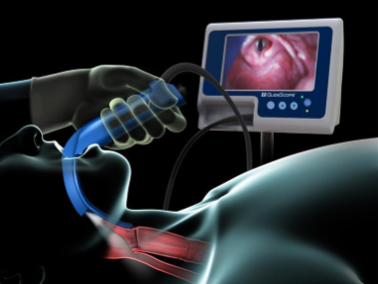
Things to consider with Intubation
Placement of ET tube
Laryngeal edema and need for a smaller size tube
Video laryngoscope
Failure 8x more likely in pregnancy

Slide 51
Clinical Key Questions ????
Does the patient appear to be becoming unstable
What are your available resources
Can the patient maintain adequate oxygenation using your current therapy
What is the status of the fetus
Does the patient have a full stomach

Slide 52
Things to Consider
Maternal stabilization or need for transport
Consider early intubation and airway protection
Fetal intervention—yes or no

Slide 53
Remember structural issues unique to pregnancy
Heavier chest wall due to breast enlargement
Patient positioning-prone positioning is not contraindicated and may be helpful

Slide 54
Strategies for Mechanical Ventilation in Pregnancy
Parameter
Tidal Volume | 5-8 ml/kg PBW
Inspiratory Rate | 60 L/min
Respiratory Rate | 15-18 breaths/min
Oxygen Saturation Goal | > or=95%
Carbon dioxide Goal | Avoid hypercapnia, mild hypercapnia <50 may be ok
PEEP | 5 mm Hg
Peak pressure limit | 30-35 cmH20

Slide 55
Principles of ECMO
Basic principle
De-saturated blood is drained via venous CO2 is removed, O2 added through an “extracorporeal” device (an oxygenator), and the blood is then returned to systemic circulation via another vein (VV) or artery (AV)

Slide 56
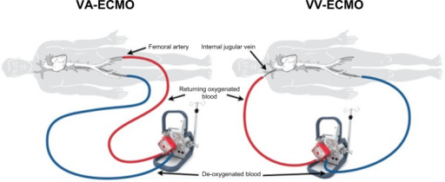

Slide 57
ECMO Outcomes
18 patients
4 were pregnant
Median maternal age-32.6 years
Median gestational age-32 weeks
Maternal survival
16 out of 18-(88.9%)
Fetal survival-(77%); 100% if viable
4 patients delivered on ECMO
Agerstrand et al, (Ann Thorac Surg 2016;102:774–9)

Slide 58
Viral pneumonia in pregnancy
Increased mortality rates when compared to the general population
2009-H1N1
32% admission rate; 4x more likely to be admitted
6 maternal deaths
SARS
Maternal death-18%
MERS
Maternal Death-25%
COVID-19
Maternal death-1.2%

Slide 59
When should I delivery the fetus?
Consider delivery after 34 weeks gestation if prolonged illness is expected
Some case reports suggest 28 weeks with COVID
Individualized care
No data to suggest delivery improves maternal outcomes
10 patients
Delivery reduced oxygen requirements by 28%
No change in lung compliance
Tomlinson MW, et al. Obstet Gynecol. 1998;91:108-11.

Slide 60
Fetal outcomes
Lancet 2020
9 patients delivered by C/S-Wuhan
No transplacental transmission
No maternal deaths
No increase in respiratory complications
Arch Pathol Lab Med 2020.
38 cases
No transplacental passage
No increase in maternal respiratory symptoms

Slide 61
Fetal Outcomes
Preterm labor and delivery-21%
Cesarean section for severe COVID-28%
Stillbirth-1.9%
Neonatal Death-0.8%
Recovered COVID patients
Possible IUGR
Management
Consider antenatal testing in recovered patients
No consistent documentation of transplacental or vertical transmission

Slide 62
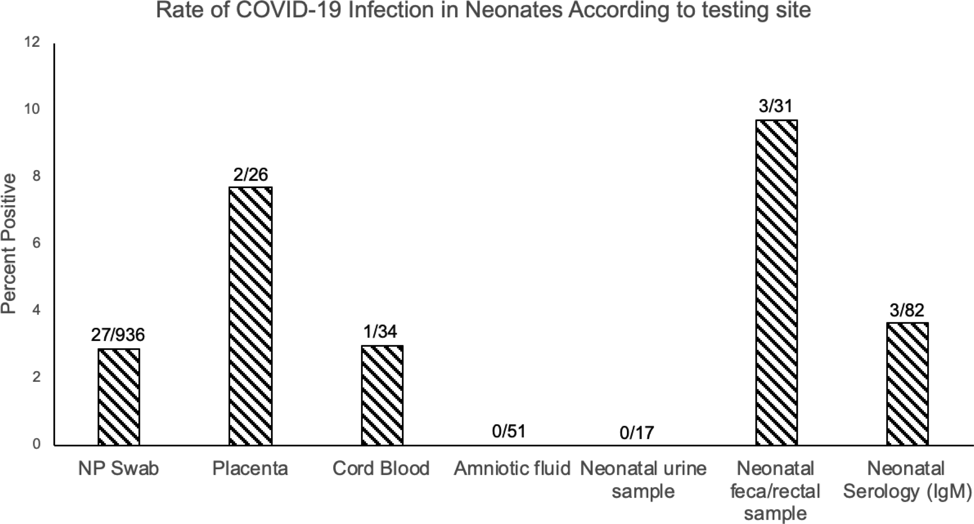
American Journal of Obstetrics & Gynecology
Volume 224 Issue 1 Pages 35-53.e3 (January 2021)
DOI: 10.1016/j.ajog.2020.07.049

Slide 63
Breastfeeding and Lactation

Slide 64
Oh Doctor, what about vaccine???

Slide 65
How was the COVID Vaccine Developed

Slide 66
How effective is the vaccine
Vaccine is touted as more than 90% affected
This means if 10% of the unvaccinated group get the disease but only 1% of the vaccinated group get the disease
Better than the flu vaccine
Disease course will be lessened
Important in pregnant patients where T-cell function is compromised

Slide 67
Vaccine Counseling
SMFM strongly recommends that pregnant and lactating people have access to the COVID-19 vaccines and that they engage in a discussion about potential benefits and unknown risks with their healthcare providers regarding receipt of the vaccine. Vaccination is available during pregnancy. Counseling today was based on available data on vaccine safety with the lack of data related to fetal risk, risk of the pregnant person for SAR-CoV-2 infection acquisition, and their individual risk for severe disease. The patient is aware that pregnant and lactating women were excluded from vaccine trials and that further studies are ongoing, and safety data will become available in the coming months. We discussed that recent data indicates that pregnancy is an independent risk factor for COVID-19 disease severity, with an increased risk of ICU admission, mechanical ventilation, extracorporeal membrane oxygenation (ECMO), and death among pregnant patients with symptomatic COVID-19 infection compared with symptomatic nonpregnant patients. Although the absolute risk of severe morbidity and mortality remains low, reports have demonstrated a 3-fold increased risk for ICU admission.

Slide 68
Vaccine Counseling
Recent data also indicate that there may be an increased rate of preterm birth and stillbirth among pregnant symptomatic and asymptomatic patients with SARS-CoV-2 infection. The patient understand that because it is not a live vaccine there is no risk of genetic modification to people receiving the vaccine. Fetal risk: The risk from mRNA vaccines is thought to be low due to the expected degradation of mRNA in the circulation. The Advisory Committee on Immunization Practices (ACIP) reports that preclinical studies have been reassuring. We discussed that decision-making needs to balance these theoretical risks with the risks associated with delayed vaccination and the possibility of maternal SARS-CoV-2 infection.
After our conversation, the patient wishes to consider her options

Slide 69
Other Considerations

Slide 70
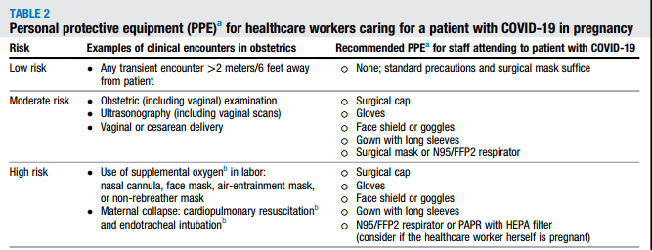
PPE for the Caregiver

Slide 71
Telehealth in COVID
May help provide care for patients and avoid exposure
Used in our resident system for patients with COVID, O2 saturation monitor
Our practice (MFM) sees about 20% of patients by telehealth
Diabetes follow up
Hypertension management
Provider spacing
Helps to identify patients that may need hands-on care

Slide 72
Key Points
Sars-CoV 2 or COVID-19 is a novel RNA virus
Pregnant patients are at increased risk for respiratory compromise and an ICU admission
Racial disparities exist in outcome and treatment
The treatment for COVID-19 in pregnancy is similar to the non-pregnant states

Slide 73
Key Points
Fetal monitoring is recommended for patients who have recovered from COVID during pregnancy
Patients admitted to the ICU should be managed by a multi-disciplinary team with special attention to the physiological changes in pregnancy
Vaccination is not contraindicated in pregnancy, however, given our limited data a detailed discussion between the patient and her caregiver is advised.
While there is limited guidance, it is the opinion of the speaker that anticoagulation should be continued as an outpatient in patients affected by COVID-19

Slide 74
Thank you

Slide 75
Evaluation Link for CME Credit
https://redcap.link/COVID_in_Pregnancy

Slide 76
Selected References
Figueiro-Filho EA, Yudin M, Farine D. COVID-19 during pregnancy: an overview of maternal characteristics, clinical symptoms, maternal and neonatal outcomes of 10,996 cases described in 15 countries. J Perinat Med. 2020 Nov 26;48(9):900-911. 33001856.
RECOVERY Collaborative Group, Dexamethasone in Hospitalized Patients with Covid-19 - Preliminary Report. N Engl J Med. 2020 Jul 17:NEJMoa2021436. doi: 10.1056/NEJMoa2021436. Epub ahead of print.
Beigel JH, Tomashek KM, Dodd LE, et al .ACTT-1 Study Group Members. Remdesivir for the Treatment of Covid-19 - Final Report. N Engl J Med. 2020 Nov 5;383(19):1813-1826.
Anderson J, Schauer J, Bryant S, Graves CR. The use of convalescent plasma therapy and remdesivir in the successful management of a critically ill obstetric patient with novel coronavirus 2019 infection: A case report. Case Rep Womens Health. 2020 May 16;27

