Slide 1
Rule 59 Protocol General Staff Education
What EVERY school employee should know.

Slide 2
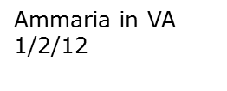
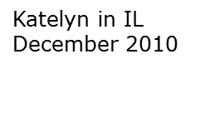
VISION
No one should die
from an asthma attack
or severe allergic reaction
(anaphylaxis)
Notes:
AIRE Nebraska is a non-profit organization receiving no state or federal funding. This organization exists solely with individual and corporate donations.
In 1998 two students died in NE from an asthma attack – it was from those tragedies that the idea of an emergency breathing protocol arose. In May 2003, the NE State Board of Education mandated that every school in the state of NE be prepared to deal with a life-threatening breathing emergency due to asthma or severe allergic reaction (anaphylaxis).
AOAN partners with the NE Dept of Education and is committed to increasing public awareness of asthma and allergies in meeting its mission to ensure that all NE schools have the education, training and medications to respond to life-threatening breathing emergencies at school.

Slide 3
Emergency Response to Life-Threatening Asthma or Systemic Allergic Reactions (Anaphylaxis) (Rule 59 protocol)
This is why you are here:
In Nebraska it is mandated that schools be prepared to treat a life-threatening asthma or severe allergy attack (NDE - Title 92 NAC Chapter 59)
Education & training
Medications & equipment
Purpose – to save the lives of those suffering from asthma and LTA (life-threatening allergy) who are undiagnosed and do NOT have a plan and medications at school
Omaha, NE – late 1990’s – asthma deaths at school
This protocol does not replace a diagnosed child’s asthma/allergy action plan or medications
The Emergency Response to Life-Threatening Asthma or Systemic Allergic Reactions protocol is administered 50-75 annually in Nebraska
Notes:
The Rule 59 protocol is used an average of 60 times each school year.
All Accredited Schools, Approved Schools, and Approved Early Childhood Education Programs shall adopt and implement the Emergency Response to Life-Threatening Asthma or Systemic Allergic Reactions (Anaphylaxis) Protocol.
Keep in mind that diagnosed student’s should have an action plan and medications at school and that the protocol is intended for the undiagnosed or first-time reaction at school. However, they are also the back-up should a student’s plan not provide the relief intended – for example, a diagnosed asthmatic, action plan and meds at school, but waited too long and unable to inhale a therapeutic dose of albuterol – the protocol would be there to back-up if need be.

Slide 4
Learning Objectives At the end of this module, the participant will:
Be able to identify what is in the classroom that may cause an allergy or asthma attack
Recognize signs/symptoms of an allergy or asthma emergency
Know how to activate your school’s Emergency Response Team
Notes:
Introduce your school’s Emergency Response Team members, if present
Post ERT member list and inform all staff of list location(s).
Give names of ERT members
Discuss how the ERT is activated in your school

Slide 5
Asthma Facts
Asthma affects academic performance
The majority of incidents happen in the beginning of the school year – Aug, Sep, Oct, Nov
The greatest number of incidents occur in conjunction with activity
Lack of sleep due to nighttime asthma can cause
poor memory
lack of concentration
mood swings
Data: Asthma Prevalence Health Care Use and Mortality: United States, 2005-2009. National Center for Health Statistics Reports, January 12, 2011, Number 32
Dynasty Reese - Omaha, NE
10 yrs old – passed away 5/13/12
Notes:
An estimated 10.5 million school days are lost per year nationwide because of asthma. The child with mild-moderate asthma misses an average of 10 days per school year and the child with severe asthma misses 30 days per year.
Lost school days affect the child’s self-esteem, grades, sport activities and relationships.
Asthma also causes parents to miss work and be less productive due to sleepless nights.
Asthma is the most common chronic childhood disease and accounts for most of student absences.
In a classroom of 30, three or more children are likely to have asthma.
According to the 2005 Youth Risk Behavior Study, 19.2% of high school students have been told by a doctor or nurse that they have asthma.
Before puberty, asthma in boys is 3X higher, during adolescence things tend to equal out & after that, adult-onset asthma is more common in women than men. (Sharma & Bye 2011 – emedicine.medscape)

Slide 6
Asthma Management at School
Schools can be a safe and healthy environment for students and staff with asthma or allergies
Use asthma action plans to guide use of medications and to avoid asthma triggers
Make students’ quick-relief inhalers readily available for them to use as needed in buildings and on field trips
Take steps to fix indoor air quality problems like mold and outdoor air quality problems such as idling school buses
CDC Vital Signs – Asthma in the US, May 2011

Slide 7
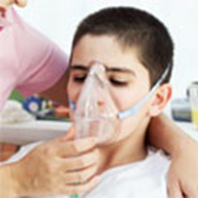
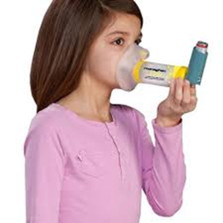
What Is Asthma?
Asthma is a lung disease caused by narrowing and thickening of airways to triggers, and can be life threatening
Asthma is a chronic (life-long) disease, with symptoms that may come and go and is often related to allergies
Asthma is the most common chronic childhood disease and accounts for the largest number of missed school days
In Nebraska, the greatest number of asthma-related episodes occur in students with a history of asthma
Notes:
Children do not usually “outgrow” asthma. They may be symptom free for long periods of time, but the tendency for and asthma attack is always there.
According to the 2005 Youth Risk Behavior Survey in Nebraska, among the students with asthma, the percentage who had an episode or attack in the previous 12 months: 40.4%

Slide 8
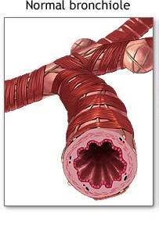
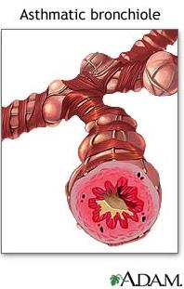
What is happening during an asthma attack?
Airway inflammation – the airway lining becomes red, swollen and narrow
Bronchoconstriction – the muscles that encircle the airway tighten/spasm
Airway obstruction – as the airway tightens and narrows, it can be very difficult to get air in and out of the lungs
Airway hyperresponsiveness – the muscles that encircle the airway respond more vigorously and quickly to smaller amounts of allergens and irritants
Secretions (mucus production) within the airway lining increases
Notes:
In asthma, the airways of the lung become narrow and obstructed.
Swelling and increased mucus in the airway lining causes the airway to become rigid and interferes with airflow
As the airways become obstructed, it becomes harder to breathe out and the lungs get filled up with air. This causes chest tightness and shortness of breath

Slide 9
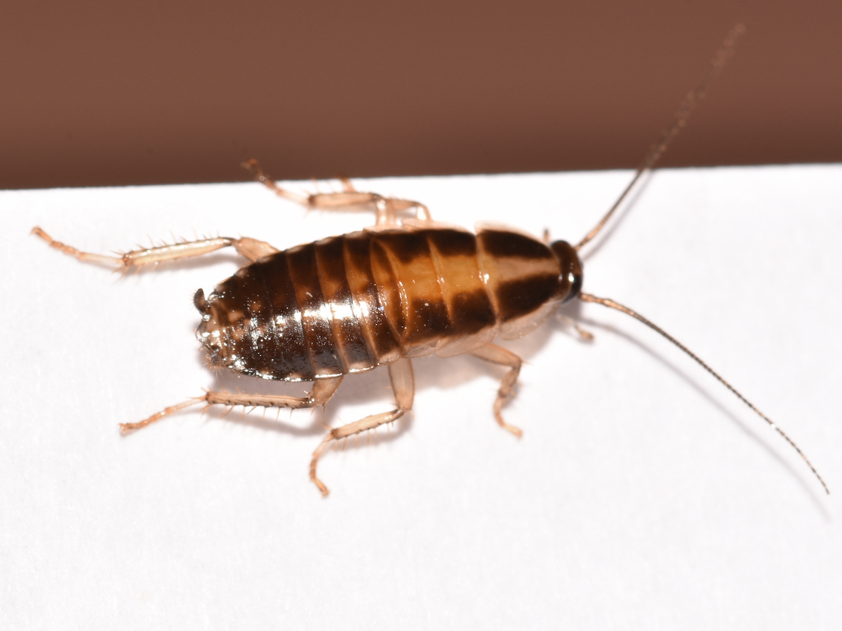
Asthma triggers at school
Notes:
Presenter: These are some of the most common asthma triggers found in a classroom setting (incl. field trips). Keep in mind that some, or all, of these may need to be eliminated for health safety reasons if you have a student for whom this is a trigger.
Field Trips – Consult with your school nurse a few weeks PRIOR to a field trip to discuss the students with health needs which need to be taken into consideration. Those students’ action plans and prescribed medications will need to be accommodated on the field trip. The school’s medications for the Emergency Response Protocol are to remain in the building.

Slide 10
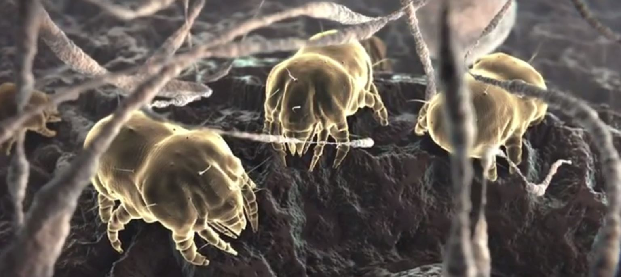
Asthma Triggers
Tobacco smoke
Mold and mildew
Pollutants resulting from poor ventilation
Pets with fur or feathers
Cockroach or mouse droppings
Strong Odors (chemicals, cleaning agents, paint, air fresheners, perfumes, dry erase markers, magic markers, glue/paste, fumes from soldering or welding)
Exercise
Cold / damp weather
Extreme emotional expression (stress, anxiety, anger or crying)
Mechanical responses such as prolonged sneezing, yelling or laughing
Common cold, influenza or other respiratory infections
Certain foods –peanuts, milk, soy, shellfish, eggs
Notes:
It is so important for you to recognize the things in a student’s environment that may be triggering their asthma as a result of an allergic reaction.
Check out this list and think about your classroom – you have the ability to control student exposure to many, but not all triggers.
Upper respiratory infections are the most common cause of asthma attacks in children.
Crying or laughing can trigger asthma symptoms
Weather conditions, such as cold weather can also make asthma worse
Respiratory reactions can occur after exposure to foods that are vaporized through heating, which would support a policy against using food allergens in the classroom for science or craft projects

Slide 11
What YOU can do to reduce and/or eliminate triggers in your school…
Establish and enforce a tobacco-free policy that prohibits tobacco use on all school property and in school vehicles
Establish no-idling policy for all vehicles on school property
Provide adequate ventilation, low humidity, and good air circulation
Clean the classroom regularly, avoiding sprays and harsh cleaning solutions
Remove or cover volatile materials in arts and science areas
Avoid using products that have strong fumes/odors or dust residue (certain pens, glues, paints, candles, air fresheners, perfumes, and chalk)
Keep classrooms free from pets and plants
Notes:
There should be no tobacco products allowed on school property, including after-school hours sporting events
The use of chemicals or cleaning agents that have strong odors should be limited to times when the students are not present
Use of scented candles, room air fresheners or wearing of perfumes or body sprays by staff or students should be discouraged
There should be no pets with fur or feathers (except service animals) inside the school building
Children can bring animal dander to school on their clothing which can be transferred via carpets, clothes hanging together or even just close proximity and cause an allergic/asthmatic reaction to another student.
Damp and wet areas can be ideal places for mold growth

Slide 12
Signs and Symptoms of an Asthma Attack
Coughing
Wheezing
Difficulty breathing or shortness of breath
Chest pain, heaviness or feeling of tightness
Rapid breathing
Tired, no energy, “hitting the wall”
May feel or act anxious
Blue or grayish tinge to lips or nailbeds
Sitting in tripod position
Gallagher 2002
Notes:
Not every person will display every symptom, for instance some asthmatics cough constantly during an attack but never wheeze. Some wheeze but never cough.

Slide 13
Rules of Two™
If You:
Have asthma symptoms or take your quick-relief inhaler more than Two times a week (prior to exercise doesn’t count for this)
Awaken at night with asthma symptoms more than Two times a month
Refill your quick-relief inhaler more than Two times a year
While all the rules definitely apply, a school would be more likely to notice that a student is using their quick-relief inhaler more than twice a week than the other indications.
Guidelines suggest that when any of these rules apply, an appointment with a physician is indicated.
Rules of Two is a federally registered service mark of Baylor Health Care System. ©2011 Baylor Health Care System.
Notes:
Baylor’s Rules of Two™ - These can be a strong indicator that a person’s asthma is not under control.
Other issues could be that the student has poor inhaler technique, the student hasn’t been using their daily long-term medication, or perhaps they need a daily long-term medication – all issues which indicate an appointment with a physician for evaluation.

Slide 14
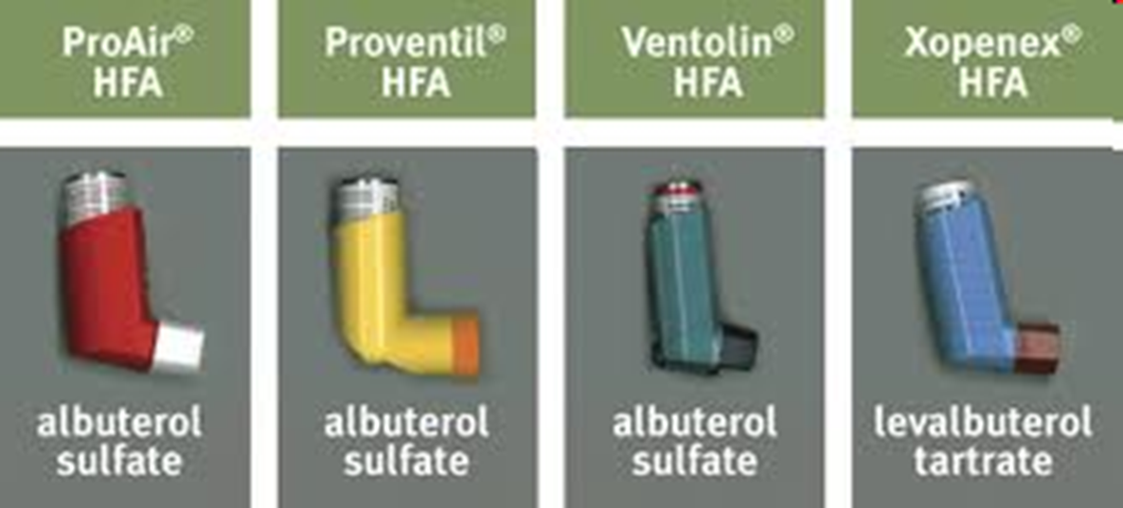
Quick-relief Inhalers
ProAir
RespiClick DPI
Notes:
These are the quick-relief inhalers that a school will see coming in for a student’s asthma, chronic bronchitis or reactive airways disease. Student’s are allowed to self-carry their quick-relief inhalers provided that certain hoops are jumped through. Student’s are to report quick-relief inhaler use to the school so that this usage is monitored. If you see a student using their quick-relief inhaler, please let the school nurse know.

Slide 15
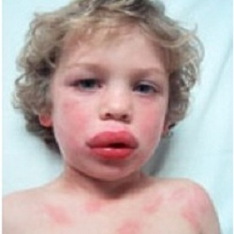
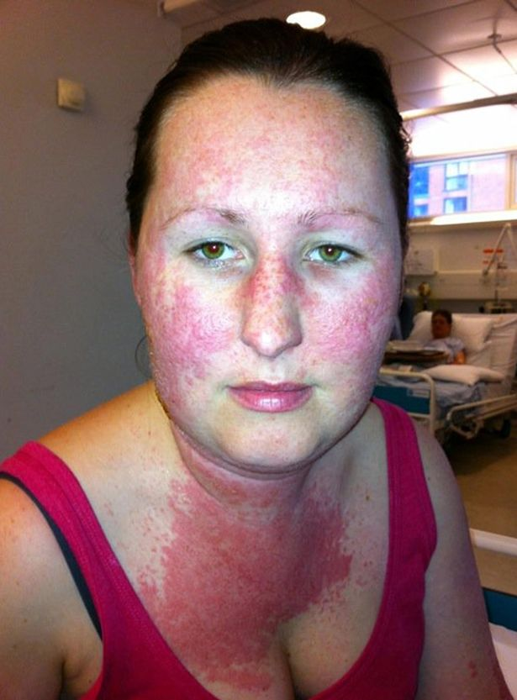
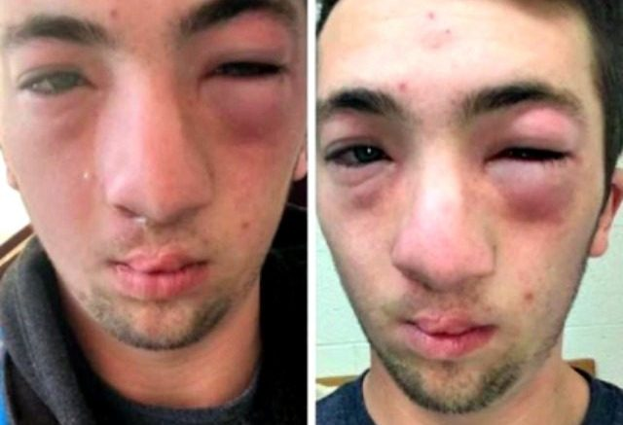
Severe Allergic Reaction (Anaphylaxis)
Anaphylaxis is a medical emergency caused by an acute systemic (whole body) allergic reaction characterized by bronchial inflammation and constriction, and vascular collapse
In Nebraska, allergic-related events are increasing annually:
2012-2013 - 14%
2016-2017 - 40%
Epinephrine (adrenaline) is the medication of choice for handling an anaphylactic reaction
Food Allergy & Anaphylaxis Network
Notes:
Benadryl will NOT save a life – it ONLY relieves itching and hives.
Epinephrine is considered a generally safe drug (side effects include: tremor, paleness/flushing and rapid heartbeat)
This person may DIE without treatment
Symptoms occur within minutes or up to 2 hours post-exposure, rarely – up to 4 hours later
Can occur with no previous allergic reaction
Greater risk for individuals with asthma, hayfever, or eczema

Slide 16
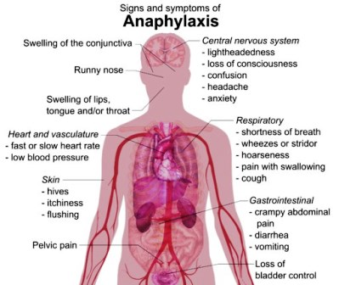
Symptoms of Anaphylaxis
Notes:
Symptoms of a reaction can vary from person to person
Symptoms can also vary from one reaction to another, even for the same person
Left unattended, these symptoms can lead to death

Slide 17
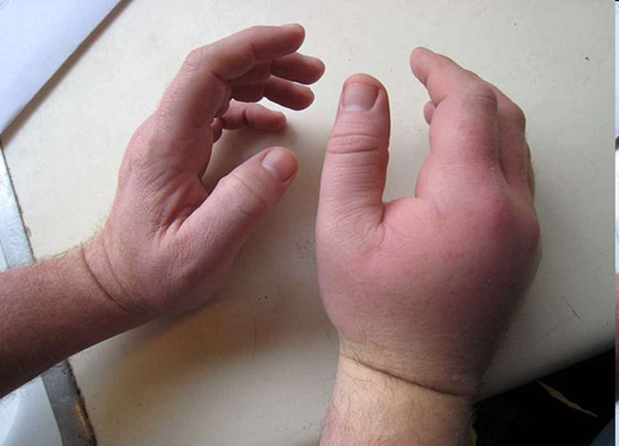
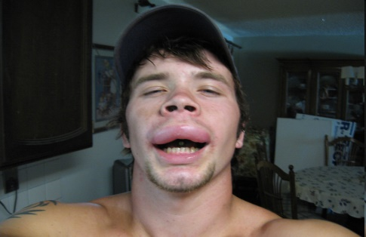
These can trigger an allergic reaction
Foods – peanuts/tree nuts, milk, wheat, eggs, fish/shellfish, soy
Any food, at any time may cause a reaction!
Medication
Insect stings
Reactions can vary from mild and localized to systemic (whole body) and life-threatening.
Latex –balloons, erasers, gloves, band aids, adhesive tape
Unknown
Exercise (after eating certain food)
Notes:
Some allergies are so severe that the food does not have to be eaten to cause a reaction. Some reactions are triggered by touching the allergen or surfaces where the allergen has had contact.
The risk of allergic reaction associated with skin contact or inhalation of allergens is low, but young children, who may be more likely to touch their mouths, could ingest the food protein after initial skin contact. (FAAN)
Keep in mind that the risk is low, but there are children who will react to a protein on contact and it is important to know the child’s past history of reactions.
There is no cure. The only way to prevent a reaction for a food allergy is strict avoidance
Sesame is an example of a food allergy growing in prevalence around the world

Slide 18
Urticaria – nettle rash or hives
http://www.clinicaladvisor.com/food-allergies/slideshow/226
Notes:
Medical Term – Urticaria
Lay Terminology – nettle rash or hives
This reaction was caused by cereal

Slide 19
Red Rash
http://www.clinicaladvisor.com/food-allergies/slideshow/226
Notes:
Food allergy reaction of unknown origin

Slide 20
swelling

Slide 21
How a Child Might Describe an Allergic Reaction
"This food's too spicy."
"My tongue is hot [or burning]."
"It feels like something’s poking my tongue."
"My tongue [or mouth] is tingling [or burning]."
"My tongue [or mouth] itches.“
"It [my tongue] feels like there is hair on it."
"My mouth feels funny.“
"There's a frog in my throat."
"There’s something stuck in my throat."
"My tongue feels full [or heavy]."
"My lips feel tight."
"It feels like there are bugs in there." (to describe itchy ears)
"It [my throat] feels thick."
"It feels like a bump is on the back of my tongue [throat]."
Food Allergy & Anaphylaxis Network
Notes:
SO important to know a child’s past history of reactions!!

Slide 22
What Should You Do?
If you think someone is having a severe asthma attack or anaphylaxis, seek assistance immediately.
Stay calm-Call 911
Notify the school nurse and/or activate the school’s Emergency Response Team
Do not hesitate and do not leave the student unattended
WHAT IS THE PLAN FOR YOUR BUILDING?
IS EVERYONE AWARE OF HOW TO ALERT THE TEAM?
IS EVERYONE AWARE OF WHO IS ON THE TEAM?
Notes:
The 3 R’s of an emergency plan are:
Recognize symptoms early
React quickly
Review what caused the reaction after things calm down
Diagnosed children/staff – follow their action plan using their medications – if, no favorable response and person is declining the Rule 59 meds are back-up
Undiagnosed children/staff – have no action plan or medications, thus the Rule 59 protocol comes into play if situation is life-threatening
All staff should know the plan for their building, who is on the team and how to activate this team – please take a few minutes to share this with your staff.

Slide 23
Auto-injectable Epinephrine
Schools are required to stock EpiPens® or the generic EpiPens®
Students and staff may be prescribed any of the other devices.
*** If you have a student in your class who is prescribed an epinephrine auto-injector, you should be trained in that specific device.
Notes:
The landscape for auto-injectable epinephrine changes almost annually.
What you see above is correct for Fall 2017.
Cost can be quite high and there is a variety of assistance for families to be able to access epinephrine. If you have a student who does not bring epinephrine to school, but states they are allergic, ask for an action plan or note from the doctor and work with this family to obtain epinephrine for school as it is up to the family to provide personally prescribed medications for their child. AIRE Nebraska can help troubleshoot if need be.

Slide 24
Epinephrine
Epinephrine is the drug of choice for severe allergic reactions.
Individuals can die quickly without epinephrine.
For a severe asthma episode, epinephrine acts as a bronchodilator and rapidly opens the airways.
For a severe allergic reaction, epinephrine raises blood pressure and relieves airway constriction.
Epinephrine is effective for about 15 minutes, 911 must be called immediately.

Slide 25
Emergency Response to Life-Threatening Asthma or Systemic Allergic Reactions (Anaphylaxis) (Rule 59 protocol)
AIRE Nebraska recommendations:
All staff receive annual general asthma/severe allergy education, including unlicensed school personnel
3 persons per building – trained annually
General asthma / severe allergy education
Emergency Response Team training by someone with a scope of practice
Medications
Elementary – at least, 1 dose EpiPen® & EpiPen Jr® + 3 vials of albuterol
Middle & High School – at least, 1 dose EpiPen® + 3 vials of albuterol
Equipment – nebulizer compressor + tubing & nebulizer cup kit
Practice Drill - annually
Notes:
The Rule 59 protocol is used an average of 60 times each school year.
All Accredited Schools, Approved Schools, and Approved Early Childhood Education Programs shall adopt and implement the Emergency Response to Life-Threatening Asthma or Systemic Allergic Reactions (Anaphylaxis) Protocol.
Keep in mind that diagnosed student’s should have an action plan and medications at school and that the protocol is intended for the undiagnosed or first-time reaction at school. However, they are also the back-up should a student’s plan not provide the relief intended – for example, a diagnosed asthmatic, action plan and meds at school, but waited too long and unable to inhale a therapeutic dose of albuterol – the protocol would be there to back-up if need be.

Slide 26
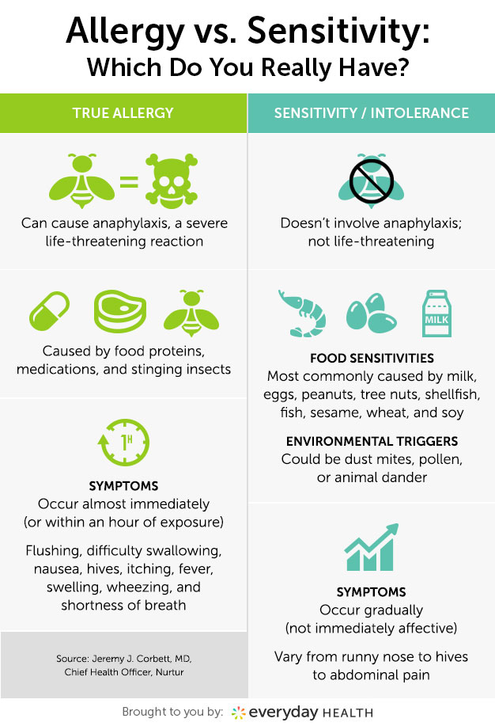
Food Allergy vs. Intolerance
Food Allergy
Causes an immune system reaction
Can be life-threatening
(anaphylaxis)
Food Intolerance
Doesn’t involve the immune system
No risk of anaphylaxis
Might be able to eat small amounts of the food without reaction
Mayo Clinic
Notes:
Food intolerance is the body’s lack of an enzyme to digest milk proteins (for example).

Slide 27
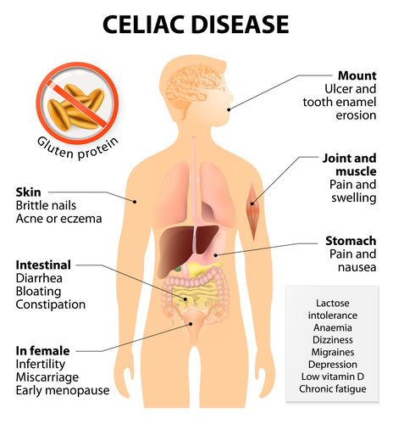
Celiac Disease
Permanent adverse reaction to gluten (found in wheat, rye, barley and malt) causing damage to the small intestine and not allowing food to be properly absorbed
Accidental ingestion is not immediately life-threatening – anaphylaxis is not a risk
Food Allergy & Anaphylaxis Network
Notes:
Wheat-allergic people have an IgE-mediated response to wheat protein. These individuals must only avoid wheat. Most wheat-allergic children outgrow the allergy.
Are kamut and spelt safe alternatives to wheat? No. Kamut is a cereal grain which is related to wheat. Spelt is an ancient wheat that has recently been marketed as safe for wheat-allergic individuals. This claim is untrue, however. Wheat-allergic patients can react to spelt as they do to common wheat.

Slide 28
Students’ Right to Breathe
In Nebraska, students may self-carry and self-administer their prescribed asthma or anaphylaxis medications at school or a school-related event.
Legislation requires certain steps to be taken:
Required at school: 1. Parental consent and a release *
2. Asthma/Anaphylaxis Action Plan* - signed by parent & physician
Any time a student uses their prescribed medication for asthma or anaphylaxis they are to notify school personnel.
If a student uses their prescribed medication other than as prescribed, disciplinary action may be taken, however this shall not include limiting or restricting the medication to the student. The school must notify parents/guardians.
If a student who is self-managing injures another student by misusing prescribed medications the parents/guardians of (self-managing) student are responsible for any and all costs associated.
* these are required to be updated annually
Nebraska Revised Statute 79-224, Laws 2006, LB 1148, § 1.
Notes:
What is recommended: Back-up medication— everyone forgets things now and then, but this way it will be there even in that case.
Staff should have copies of action plans and know who in their classes are self-managing their asthma/allergy. Students are to notify school personnel any time they use their prescribed medication. Talk to these students and make a plan for this – make sure to communicate to the health office and document this use.

Slide 29
Managing & Controlling Asthma or Allergies: How to Avoid a Breathing Emergency
PARENT RESPONSIBILITIES:
Notify school of student’s allergies/asthma
Provide written medical documentation, instructions, and medications as directed by a physician
STUDENT RESPONSIBILITIES:
Avoid know triggers for allergies/asthma
Learn to recognize & respond to their own symptoms, as appropriate for age and ability
Report symptoms to staff/nurse.
Notes:
For a student diagnosed with asthma or potential severe allergic reactions, management requires a teamwork approach
Parents, student, school and physician each play a part in making sure the student is safe at school
Parents need to communicate with school staff about their child’s condition and what their reaction or attack typically looks like.

Slide 30
Managing & Controlling Asthma or Allergies
SCHOOL RESPONSIBILITIES:
Share the students’ asthma/allergy action plan appropriately
Inform the parent/guardian that the student may qualify for a 504 Plan
Implement environmental guidelines that promote safe and healthy indoor air quality
Ensure that there is an Emergency Response Team available to administer emergency medications in the event of a life-threatening breathing emergency
Provide basic asthma and anaphylaxis education to all staff
Notes:
Having an asthma/allergy action plan and medications for the student who is already diagnosed is paramount in allowing the school to safely accommodate the student.

Slide 31
Questions & Answers
Please feel free to call or email with questions or concerns which you may have:
AIRE Nebraska
Andrea Holka
402-616-9600
andrea@airenebraska.org
State School Nurse Consultant
School Health Program Manager
Carol Tucker RN, BSN, NCSN
402-471-1373 – 1-800-801-1122
carol.tucker@nebraska.gov

