Slide 1

The New World of Work:
Are You Ready for What’s Next?
CUES Michigan Conference
February 6, 2019

Slide 2

Who used
Artificial
Intelligence
this morning?
Will you
tomorrow?
Notes:
What do you think about when you hear the phrase “future of work”?

Slide 3
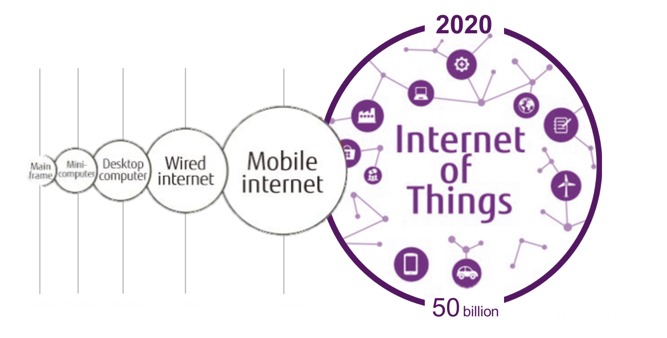
Exponential advances in technology’s capabilities, reshaping the ecosystem of the workplace
@ravinjesuthasan
Notes:
This is our current reality.
Agility, speed, innovation and collaboration. What might be seen as attributes of lean start-ups are taking center stage for many leading organizations - and federal agencies - with long, proud histories. You are facing digital disruption in every facet of your agency and your role.
Increasingly, robots, autonomous vehicles, commoditized sensors, artificial intelligence, and the Internet of Things are re-shaping the way we interact in life and in the government; the work ecosystem is in a continuous state of flux, moving and growing as it adapts to flourishing technology.
Organizations and workers balance long-term bets and flexibility under uncertainty by engaging automation to adapt to frequent changes and rapid skills obsolescence.
KPMG study
Convergence of business and talent challenges
In HR, there is serious debate over what jobs will remain 10, 15 or even simply 5 years from now. The jobs that remain will require thought, empathy, creativity, critical thinking…things that can’t be automated. How does HR prepare our organizations and future workers for this shift? And, will HR’s role expand to be uber connected to the way work gets done across the enterprise bringing new solutions to the business? At the moment, we’re behind the curve; we have to accept it, own it and change it.

Slide 4



INDUSTRIAL REVOLUTIONS AND WORK
The Fourth Industrial Revolution is characterized by robotics and other technology: A disruptive fusion
The Assembly Line
2nd Industrial
Revolution
Late 19th to early
20th century:
“The assembly line”
“Nikefication”
3rd Industrial Revolution/ 1st Machine Age
1960s – 1990s:
“Nikefication” and core competencies
“Uberization”
4th Industrial
Revolution
2000s:
“Uberization”
Notes:
In the late 19th century we had the second industrial revolution – this was characterized by the assembly line and we started to see work organized into jobs and jobs lead to careers – workers began to see their company as a social institution.
Companies as social institutions
Organization of work into jobs
Jobs as careers
As we moved in to the third industrial revolutions – we began to see some changes particularly around the type of work that was done within a company – nike led the charge on outsourcing and focusing on the core competency of the company. Organizations began to shift and find the best way to deliver value.
Technology enablement and the web
Companies as the nexus of contracts
Streamlining of jobs to enable outsourcing
As we move into the 200-’s we are seeing a new shift – we might call it “uberization” – companies are platforms to get work done – and will begin to see both companies and talent taking advantage of a truly connected world.
Lots of talk among economists projecting the impact that AI systems and machines will have on the human workforce, and this one, from the World Economic Forum, predicts a “Fourth Industrial Revolution,” characterized by unprecedented “developments in genetics, artificial intelligence, robotics, nanotechnology, 3D printing, and biotechnology.”
Mobile, sensors, AI and machine learning
Companies as platforms
Disaggregation of work into activities
Talent on demand
Our challenge will be to use this to our advantage

Slide 5
Organizations are beginning to understand that a new reality is on the horizon
78%
50%
78%
feel threatened by digital
start-ups
Are considering deconstructing jobs
and identifying which tasks can
best be performed by automation
in the next year or in the near future
are paying more for certain
skills
45%
51%
48%
fear they
may become obsolete in
3-5 years
Will be identifying the emerging
skills needed for roles in the
next year or in the near future
are enabling
the use of
non-employee
talent
Sources: 2017 Willis Towers Watson Future of Work Global Survey; Digital Transformation Index, published by Dell Technologies (partnership with Vanson Bourne), based on interview of 4,000 business leaders across 16 countries; CEO Soothsayers (a survey of Fortune 500 CEOs), Fortune, June 15, 2017.

Slide 6

The Future of Work challenges us to rethink the traditional organization, jobs and reward frameworks with the new realities of digitalization, permeable organizations, shorter assignments and individualized rewards
willistowerswatson.com
6

Slide 7

Automation will result in new combinations of work, talent, skill requirements and work relationships…
27%
of organizations are changing the way their jobs are designed to be done by those with more skills; set to
rise to 45% in
3 years
25%
of organizations are changing the way their jobs are designed to be done by those with lower skills; set to rise to 42% in
3 years
Use of free agent workers set to rise by 50%
in the next
3 years
FTEs set to reduce from 83%
to 77%
globally in the next 3 years

Slide 8
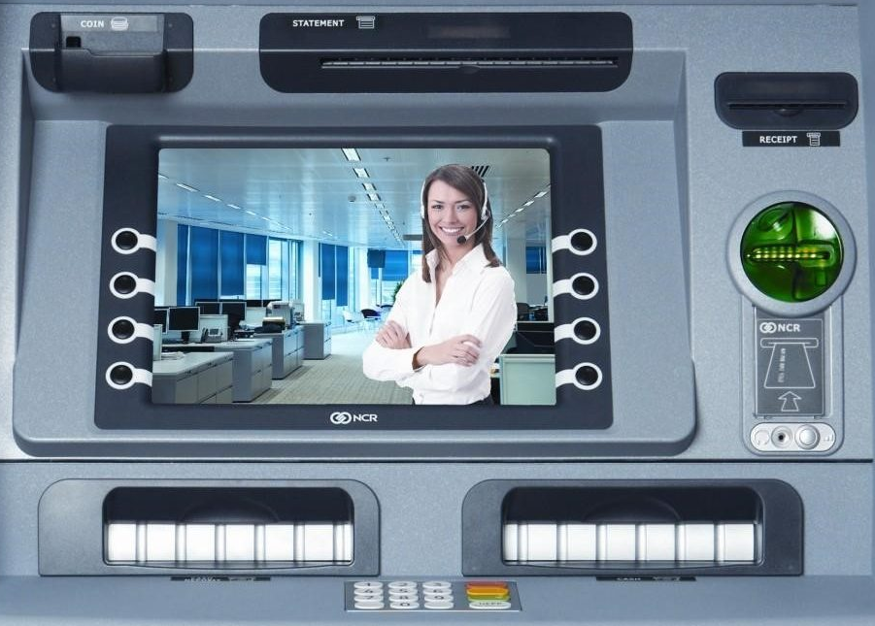
We know robots and Artificial Intelligence are displacing certain types of work
We know robots and Artificial Intelligence are displacing certain types of work
willistowerswatson.com
8

Slide 9
Automation and digitalization are impacting jobs in financial services
Automation Advances
Potential Job Eliminations
Electronic stock tickers and trading tickets Increased automation of core processes ATMs
Rapidly declining prices of automation software Rise of pattern recognition by software (i.e., machine learning) for investment analysis Rise of robots for lending and advice Rise of technology for claims processing
Artificial intelligence scalability (i.e., computers that are able to anticipate needs and complete tasks independently) Information processing digitization
PAST
1980–2000
Administrative clerks Branch staff Phone-based stock traders and stockbrokers
Financial analysts Researchers Transaction processing (e.g., claims, loans) Financial advisors/brokers Institutional traders
Client-facing positions (e.g., salespeople) Information processing-focused positions Financial advisers
PRESENT
2000–2020
FUTURE
2020 and Beyond
Over the next 20 years, jobs in the financial services industry are considered at “high risk” of automation—more than any other skilled industry—about 54% of all jobs may be eliminated
Source: Willis Towers Watson Analysis. And “The Robots are Coming for Wall Street”, The New York Times Magazine, Nathaniel Popper
Notes:
In banking, mobility is undeniably enabling more robust service offerings for consumers. At the same time, banks and credit unions are having to compete with bank-less, peer-to-peer mobile payments between consumers through platforms such as Venmo, Apple Pay Cash and Zelle.

Slide 10

What are we seeing in financial services and credit unions specifically?
74%
3%
Number of people using their mobile phones for banking
2014……...800 million
2019……...1.75+ billion¹
of banking executives believe the industry will be completely transformed by intelligent technology²
of banks intend to significantly increase their investment in reskilling their employees over the next three years²
Artificial Intelligence
is a rising trend among FIs to improve customer satisfaction, reduce inefficiencies and fight fraud
Virtualizing the
in-branch consumer experience with Interactive Teller Machines (ITMs)
Replace in-person tellers with a quick digital connection to an offsite cluster of tellers serving a region of banks and credit unions, similar to a call center atmosphere
1 Juniper Research 2014
2 Accenture 2018 Future Workforce Banking Survey
Notes:
in-person tellers will ultimately be replaced with a quick digital connection to an offsite cluster of tellers serving a region of banks and credit unions, similar to a call center atmosphere

Slide 11


Digital readiness cuts across business, people and HR priorities
WHERE ARE YOU NOW? WHERE DO YOU WANT TO BE?
Emerging
Advancing
Leading
Transforming
“Do Digital”
“Be Digital”
Multiple levers will need to be pulled to achieve the strategy:
Products & Services | Customer Orientation | Technology & Tools | Structure | Internal Processes | Culture | Human Capital Management
Notes:
Do Digital – Emerging
Emerging digital strategy
Reactive—focused on content, social media and website development, or a pure ecommerce play
Advancing
Digital strategy being formulated, and current digitalizing efforts are somewhat fragmented
Digital capabilities and tools are being identified and are in early stages of development
Leading
Digital strategy is fully developed and clearly articulated in an integrated fashion
Digital capabilities and tools are deployed to parts of the business
Be Digital – Transforming
Coherent and integrated digital strategy is part of the organization’s culture and constantly evolving with changing business environment
Digital capabilities are embedded across the organization and are critical to drive value

Slide 12

What does this mean for companies?
1
Rethinking work and talent solutions
2
Modernizing
total rewards
3
Redefining the employee
and talent experience

Slide 13

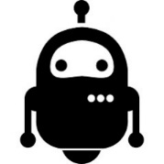

CHANGING EMPLOYMENT RELATIONSHIP
There is a plurality of means for getting work done and the use of non-employee talent is rising
Traditional
employees
Outsourcing
Free agents
Alliances
Talent
platforms
Volunteers
Robotics
Artificial
Intelligence

Slide 14
Understand today’s business. Articulate tomorrow’s vision
for work. Identify the gaps.
Create a strategy to optimize how work is done to achieve the vision.
Reinventing Jobs
Deconstruct
Jobs
Reevaluate
Reskill
Talent
Optimize Work & Reconstruct Jobs
Business
Strategy
Business Outcomes
and Cultural Transformation
Current
Capabilities
& Business Model
Notes:
Taking the Re-inventing Roadmap to the next level
The Future is Now: Reinventing Jobs and Realigning Talent to Work

Slide 15
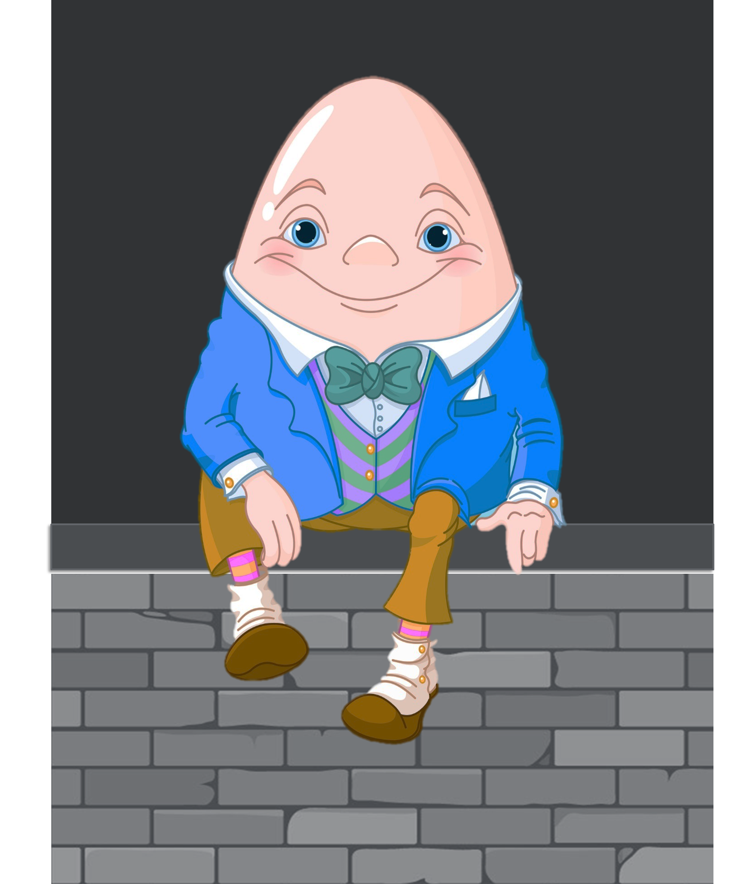
The old way…
A full-time job in a traditional organization

Slide 16
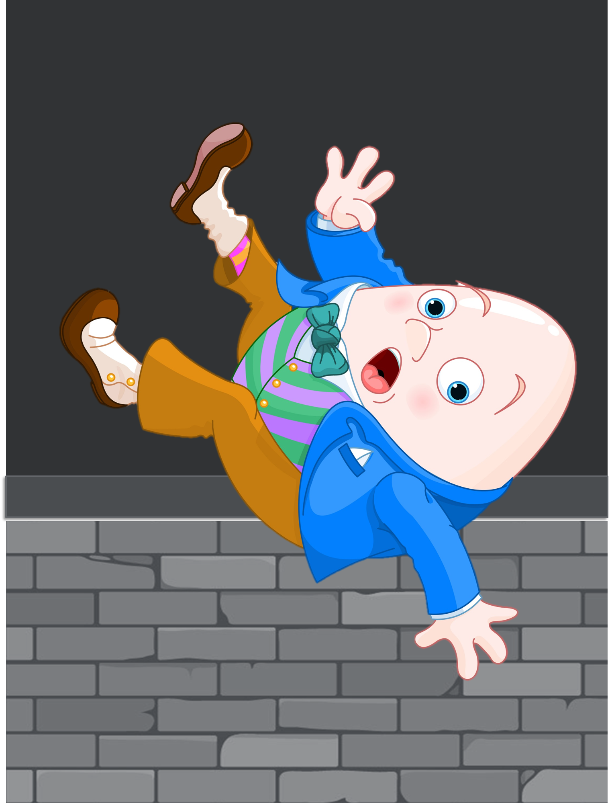
Times have changed
Jobs can’t keep up in the new environment

Slide 17
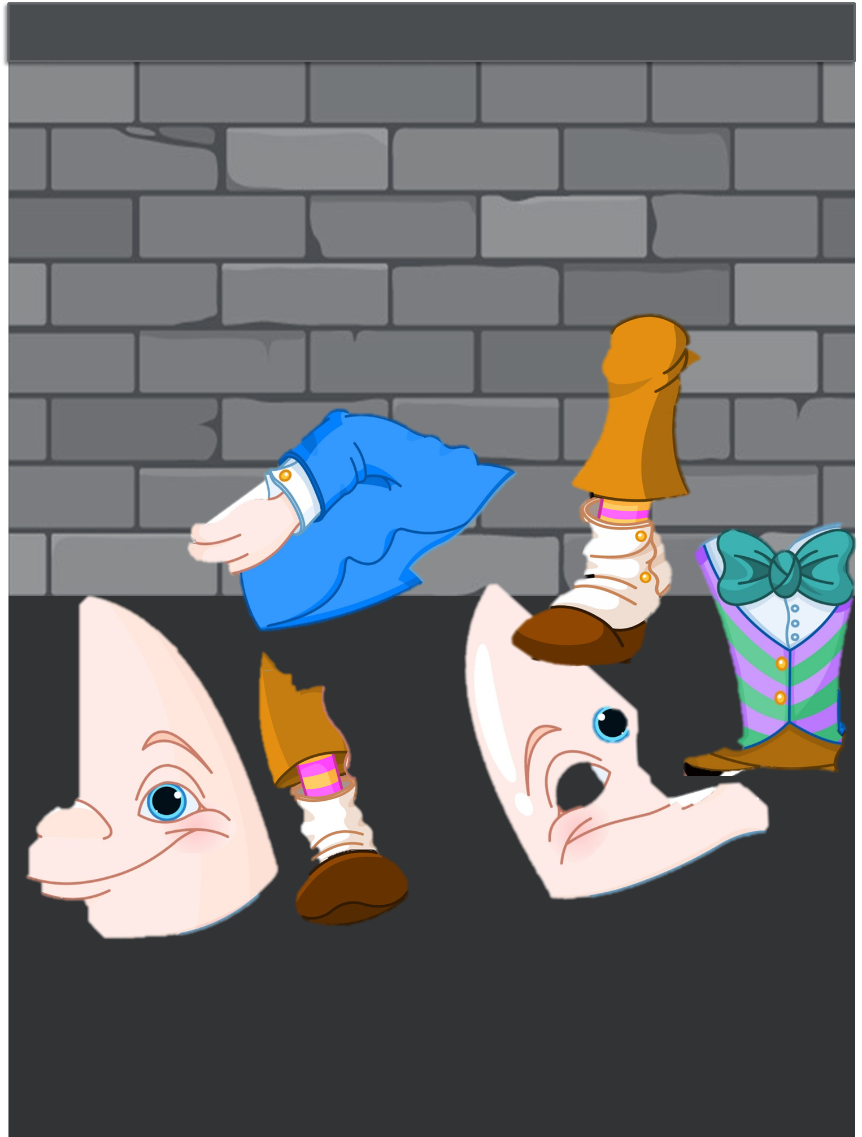
Let’s examine each piece of the work
…and determine what our business needs in the future

Slide 18
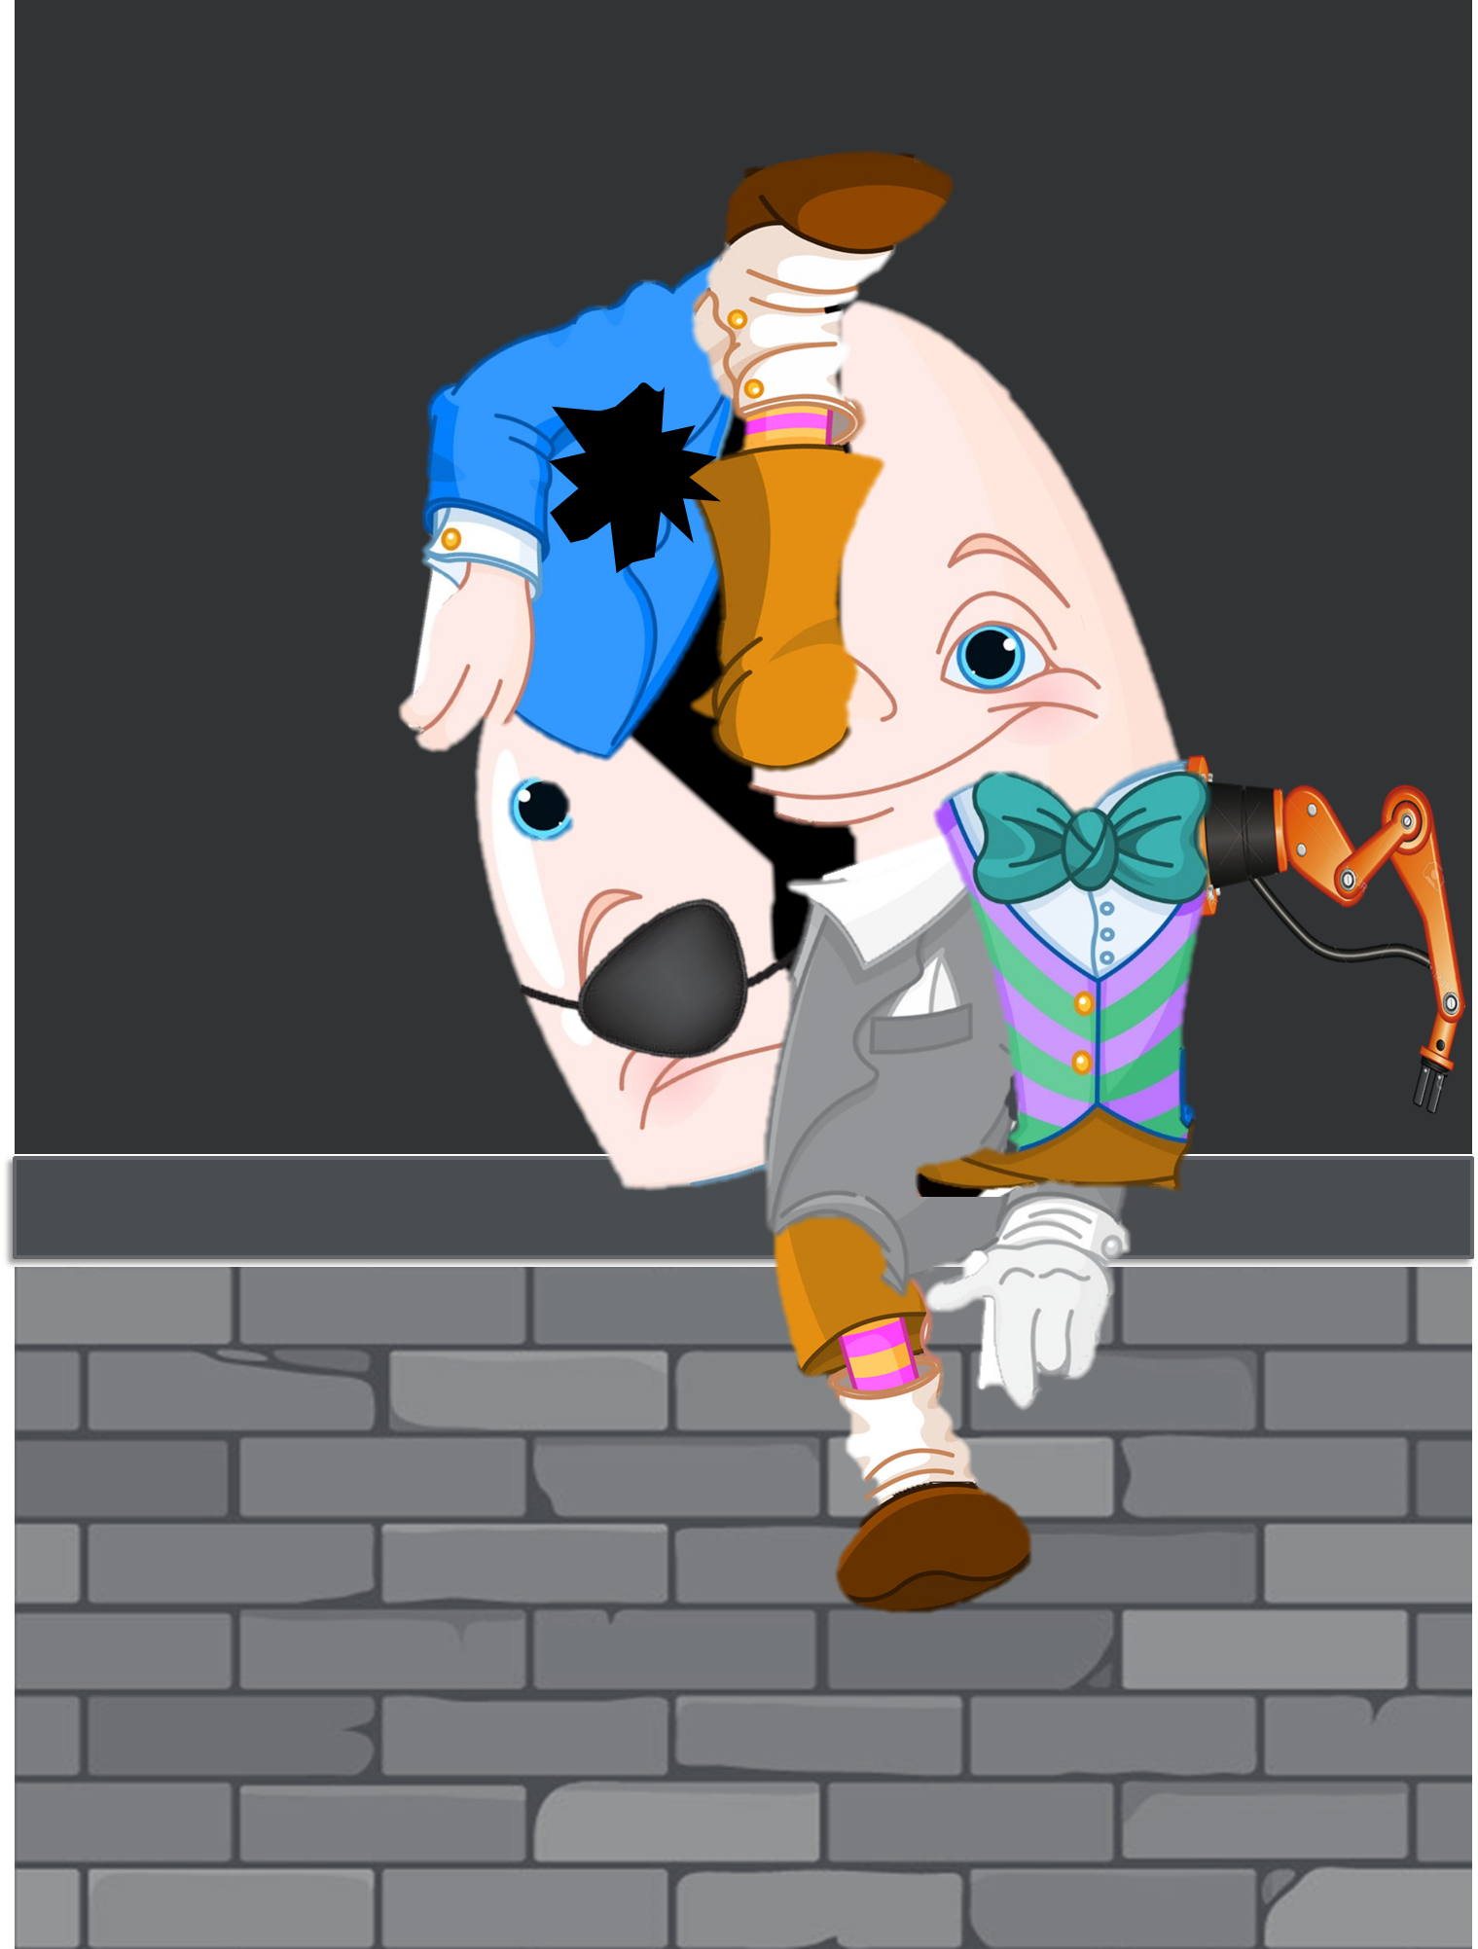
… and reconstruct
…in a way that supports the new reality

Slide 19
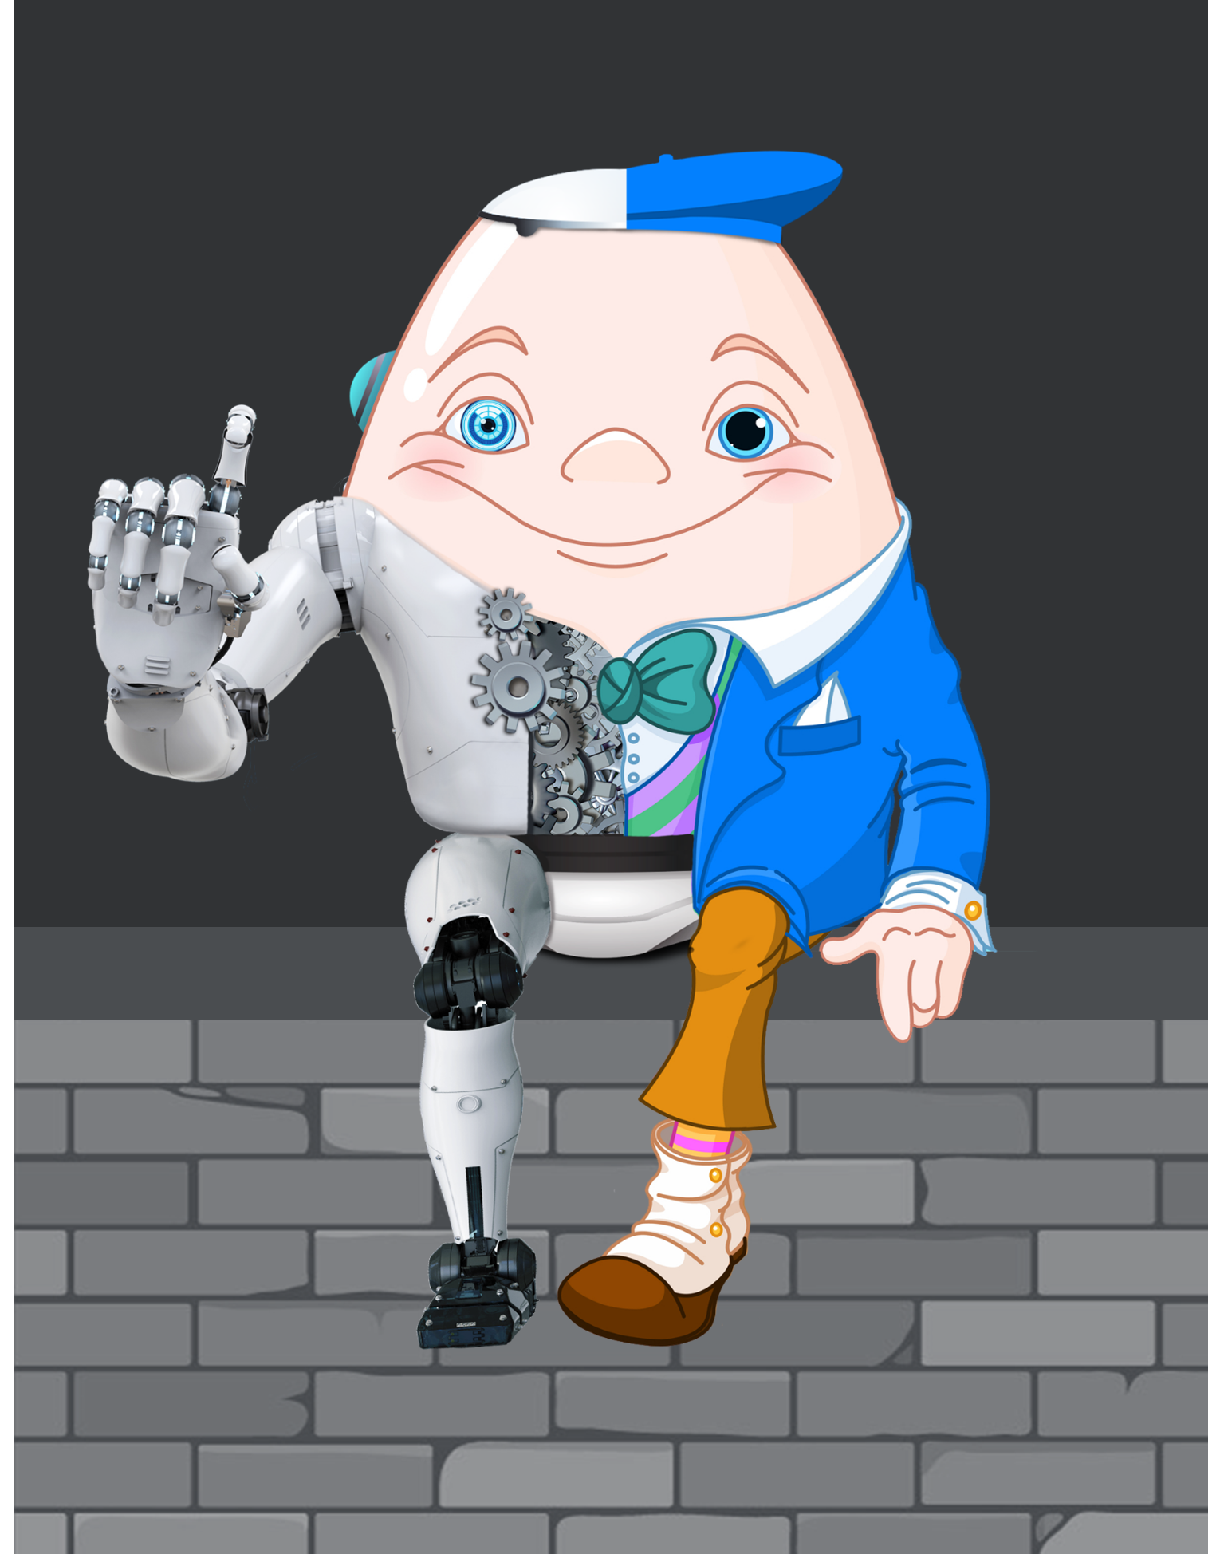
… and reimagine
Our jobs may never look the same again

Slide 20
The Future of Work introduces new opportunities for Inclusion and Diversity (I&D) strategies
Inclusion is the key to overcoming industry stigma and allow us to attract, retain and engage the best
employees in
the industry
Embedding I&D into culture means we can effectively demonstrate an appealing Talent Value Prop
(TVP)
Diverse skills and viewpoints can make organizations more
innovative and effective in their business
decisions
Having an I&D strategy helps organizations fill global talent gaps
Inclusive leadership builds trust amidst uncertainty and provides the foundation for more effective change leadership
It demonstrates commitment to a
shared purpose and empowerment
of the workforce

Slide 21
The Future of Work requires that we continue to modernize rewards
WHO
WHERE/HOW
WHEN
Digital skills, millennials, part-timers, contingent
How do we compete
for this talent?
What programs do
they need and want?
How do we create consumer-grade experiences?
Remote teams,
AI and virtual collaboration
How do we enable remote teams to be productive?
What programs do we need to support people in remote locations?
Always on
How do we manage “always on” stress and productivity?
How do we help the workforce balance work and life?

Slide 22

Talent Experience is at the heart of making your organization stronger, delivering outstanding outcomes and inspiring amazing people to work for you.
willistowerswatson.com
22

Slide 23

Leaders and managers have a critical role to play
Leading
Measuring
Communicating
Involving
Learning
Sustaining
willistowerswatson.com
23

Slide 24
CHANGING REQUIREMENTS OF LEADERS
The shift that will be asked of you
FROM:
TO:
Organizing and
filling jobs
Deconstructing, automating/redeploying and reconstructing
A mindset of “learn,
do, retire”
A mindset of learn, do, learn, do, rest, learn...
Employment qualifications
Work readiness
Salaries for intact jobs
Market prices for activities and tasks that can be viewed in multiple ways based on unique circumstances
Job architectures and movement from one job to another
Work architecture that provide seamless and continuous matching of skills to tasks
Traditional career ladders or lattices
Reskilling pathways that reflect individual motivations, attributes, enabling skills and technical competencies
Reinventing Jobs, Jesuthasan and Boudreau, Harvard Business Review Press, 2018

Slide 25

A clear course of action…
Understand how technology and automation are impacting work
Define the reskilling pathways
Lead and engage around the new ways of working
willistowerswatson.com
25
Notes:
Identify new or different skills needed to guide the future
Gain an understanding of the workforce of your future
Clarify the new desired organizational culture
Assess how can work be deconstructed to be done in a more efficient and effective way
Determine how you accommodate a range of work options (from AI and Robotics to contingent labor)
Align the right rewards to the workers
Build out your learning and development programs to ensure you upskill the workforce to meet your future needs -- STEM
Better incorporate learning and development into your rewards programs
Build out an Talent Value Proposition that takes advantage of technology touchpoints inside and outside of your organization
Leverage technology and data insights to shape a value proposition for all types of workers

Slide 26
Thank you!
Jill Havely
Managing Director, Talent & Reward
Midwest Region Leader – Talent Line of Business
jill.havely@willistowerswatson.com

