Slide 1
Cataract Surgery
Madhav Vempali
Vempali Medical Ltd

Slide 2
The healthy eye
Light rays enter the eye through the clear cornea, pupil and lens.
These light rays are focused directly onto the retina, the light-sensitive tissue lining the back of the eye.
The retina converts light rays into impulses, sent through the optic nerve to your brain, where they are recognized as images.
70% of the eye's focusing power comes from the cornea and 30% from the lens.
Eye anatomy

Slide 3
The healthy eye

Slide 4
What is a cataract?
Clouding of the normally clear lens of the eye
Healthy lens
Lens with a cataract
Clouding of the normally clear lens of the eye . . .
. . . can be compared to a window that is frosted or yellowed.

Slide 5
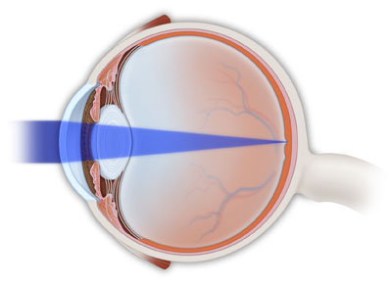
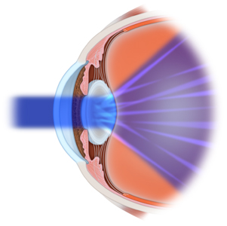
What is a cataract?
A clear lens refracts light onto the retina and fine-tunes our focusing ability.
A cloudy lens prevents light from focusing sharply on the retina.

Slide 6
What is a cataract?

Slide 7
A cataract is not:
a film over the eye;
caused by overusing the eyes;
spread from one eye to the other; or
a cause of irreversible blindness.

Slide 8
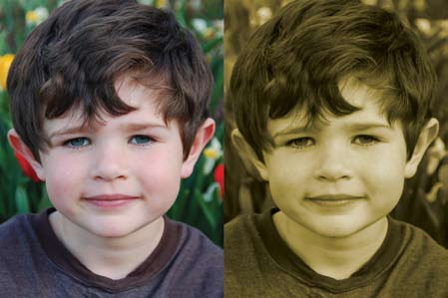
Symptoms of cataracts
Painless blurring of vision
Glare or light sensitivity
Poor night vision and/or difficulty driving at night
Double vision in one eye
Needing brighter light to read
Fading or yellowing of colors
Yellowing of colors

Slide 9
What causes cataracts?
Aging of the eye (most common)
Family history
Medical problems, such as diabetes
Injury to the eye
Medications, especially steroids
Long-term, unprotected exposure to sunlight
Previous eye surgery

Slide 10
How quickly does a cataract develop?
Most age-related cataracts progress gradually over a period of years.
Non-age-related cataracts, especially in younger people and people with diabetes, may progress rapidly over a short time.
Cataract development varies among individuals, and may even be different between the two eyes.
Protection from excessive sunlight may help slow the progression of cataracts (UV-protective sunglasses or eyeglasses).

Slide 11
How is a cataract treated?
Surgery is the only way to remove cataracts.
If symptoms of cataract are not affecting your normal activities, surgery may not be needed.
Sometimes a simple change in your eyeglass prescription can help delay the need for surgery.

Slide 12
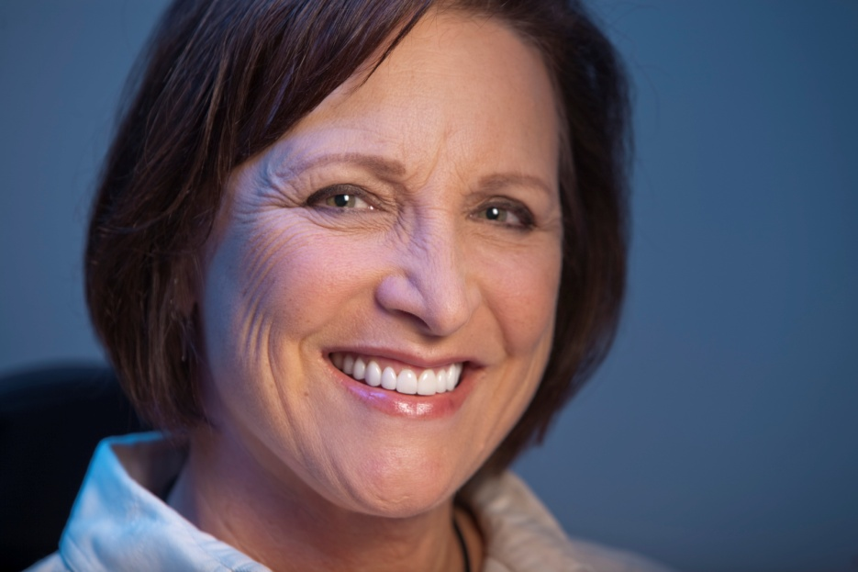
When should cataract surgery be performed?
When cataracts cause enough vision loss to interfere with your daily activities, such as:
performing your job;
driving safely;
reading and watching TV in comfort; and
taking medication.
You and your ophthalmologist (Eye M.D.) should decide together when surgery is appropriate.

Slide 13
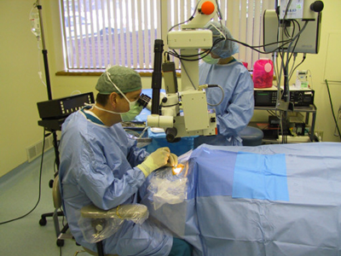
How is cataract surgery performed?
Outpatient procedure (usually)
Local or topical anesthesia

Slide 14
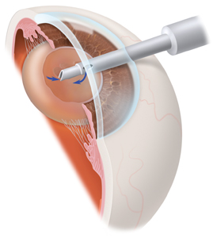
How is cataract surgery performed?
A small incision is made close to the edge of the cornea.
A tiny, high-frequency ultrasound instrument is inserted that breaks up the center of the lens.
Broken-up cloudy lens material is removed through the incision.

Slide 15
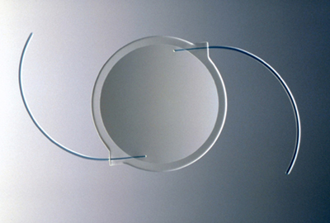
How is cataract surgery performed?
An intraocular lens (IOL) implant is inserted into your eye to replace the cloudy lens.
An IOL is customized for your eye, restoring focusing power.

Slide 16
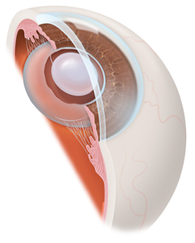
How is cataract surgery performed?
Usually the IOL is placed behind the iris (posterior chamber lens).
Sometimes the IOL is placed in front of the iris (anterior chamber lens).
IOL in eye

Slide 17
How is cataract surgery performed?

Slide 18
What can I expect from cataract surgery?
Most cataract surgical procedures are performed without complications and result in immediate improvement in vision.
You will apply eyedrops for several weeks following surgery to reduce the possibility of infection and/or inflammation in the eye.
You may need an eyeglass prescription to obtain your clearest vision following surgery.

Slide 19
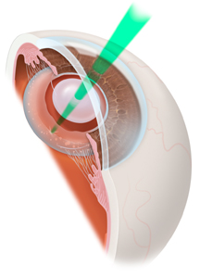
Posterior capsulotomy
In a small number of cases, the natural capsule supporting the IOL can become cloudy after cataract surgery.
Posterior capsulotomy is laser surgery to open the cloudy capsule and restore clear vision.
Posterior capsulotomy

Slide 20
Posterior capsulotomy

Slide 21
Cataract surgery to restore clear vision
More than 1.4 million people in the U.S. have cataract surgery each year.
More than 95% of cataract surgeries are performed with no complications and improved vision.
You and your ophthalmologist should decide together when cataract surgery is appropriate for you.

