Slide 1
Adult Education
Services for Minors
Jay Baker - Asst. Administrator of Adult Education

Slide 2
Adult Education (AE) Background
Federal program
Workforce Innovation and Opportunity Act (WIOA)
State is pass-through entity (Dept. Labor & Workforce Dev.)
14 grant-holders, local providers of AE services
4 school systems
5 TBR agencies
5 non-profits
All providers are bound to federal and state laws, rules, and regulations

Slide 3
AE Background (continued)
Two primary services:
Enrollment in local AE program - academic instruction and advisement
HiSET® exam oversight
These services are independent, but related

Slide 4
Enrollment in Local AE Program for Instruction & Advisement

Slide 5
To Be Clear . . .
We want kids to stay in school!
Local AE providers encourage them to stay in school
However, AE is a good alternative when necessary

Slide 6
TN School Attendance Law
Children ages six (6) through seventeen (17), inclusive, who reside within the State must attend public or nonpublic school, unless the individual:
Already has a secondary school diploma or equivalent;
Is enrolled and making satisfactory progress in a State-approved adult education program leading to the attainment of a high school equivalency diploma; or
Is seventeen (17) years old and enrolled in a home school.
See Tenn. Code Ann. § 49-6-3001(c)(1-2)

Slide 7
Adult Education Student Eligibility
WIOA - Federal requirements:
Student must be at least sixteen (16) years of age, and
Must not be enrolled or required to be enrolled in secondary school under State law.
Home school is considered secondary school, as is any public, private, or church-related school.
See WIOA Title II § 203(4)(A-B)

Slide 8
AE Enrollment Process
AE programs must verify that a minor student is not enrolled in secondary school.
A minor’s school enrollment is determined by her/his parent or legal guardian.
A parent or guardian has the right to withdraw a minor student from school and enroll her/him in AE.
AE enrollment satisfies compulsory attendance requirement.
The parent or guardian must complete and sign an official approval form before enrolling their student.
This includes affirming that the student has been withdrawn from secondary school, including home school.

Slide 9
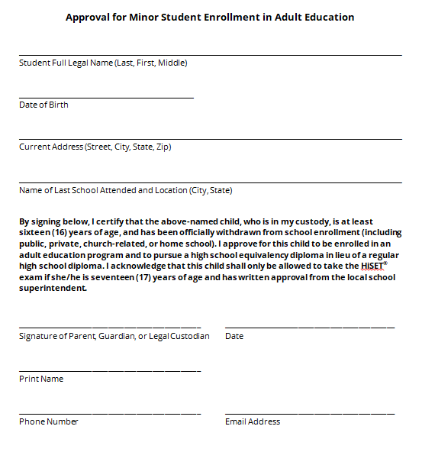

Slide 10
AE Enrollment Process (continued)
The AE program must contact the local school system where the student resides
Inform of the student’s enrollment
Establish the process for progress reporting

Slide 11
Withdrawal & Home School
Students who are withdrawn from public school in order to enroll in AE are considered “dropouts”.
Also affects graduation rate.
Students who are withdrawn from public school in order to enroll in home school (or other non-public school) are not considered “dropouts”.
Does not affect graduation rate.
See TN Dept. of Education EIS Appendices

Slide 12
Withdrawal & Home School (continued)
However, home schooling has very specific requirements that a parent agrees to.
Enrolling a student in AE is not a part of home school.
Parents should not be encouraged to withdraw their child to home school, just to then turn around and enroll them in AE.

Slide 13
Accountability for Student Progress
AE only satisfies compulsory attendance if the student is “enrolled and making satisfactory progress” in an AE program.
AE “must provide a report to the local board of education at least three (3) times each year relative to the child’s progress.”
The AE program must contact the local school system where the student resides
Inform of the student’s enrollment
Establish the process for progress reporting
See Tenn. Code Ann. § 49-6-3001(c)(2)(b)

Slide 14
Accountability (continued)
The school system is ultimately responsible for ensuring this process is in place and adhered to.
“The sole responsibility and authority for the enforcement of the compulsory attendance laws is placed in the local board of education and its designated employees and officers.”
If the local board of education determines the student is not making satisfactory progress, then the student shall be subject to the regular school attendance requirements.
See Tenn. Code Ann. § 49-6-3006(a)
See Tenn. Code Ann. § 49-6-3001(c)(2)(b)

Slide 15
Accountability (continued)
Local school systems are still accountable for the attendance and academic progress of home-schooled students and AE students
In sum, there needs to be strong lines of communication among:
The parent
The AE program staff
The school system staff
The student’s best interest is the priority

Slide 16
HiSET® Exam Oversight

Slide 17
High School Equivalency Diploma
TN high school equivalency diploma
Credential issued by TN Dept. of Labor & Workforce Development, Adult Education Division
Attained by passing the HiSET® exam
Adult Education Division is administrative liaison between ETS (HiSET) and Tennessee public
Equivalency diploma does not count as a regular diploma for graduation rates
See 20 U.S. Code § 7801(43)(B)

Slide 18
HiSET® Exam
Does not require enrollment in AE
17 - minimum age for taking the exam
17-year-old must have written recommendation from local school superintendent
Regardless of where student is enrolled
Superintendents may choose to deny recommendation
Encourages minors to stay in school
See Tenn. Comp. R. & Regs. 0520-01-03-.06(5)(c)

Slide 19
HiSET® Exam (continued)
Good option for students who will not graduate on time
Does not require the student to drop out
Good option for home-schooled students
Does not require withdrawal from home school
Regular diplomas are not issued
Good option for students who move in
Does not require the student to enroll in the school system

Slide 20
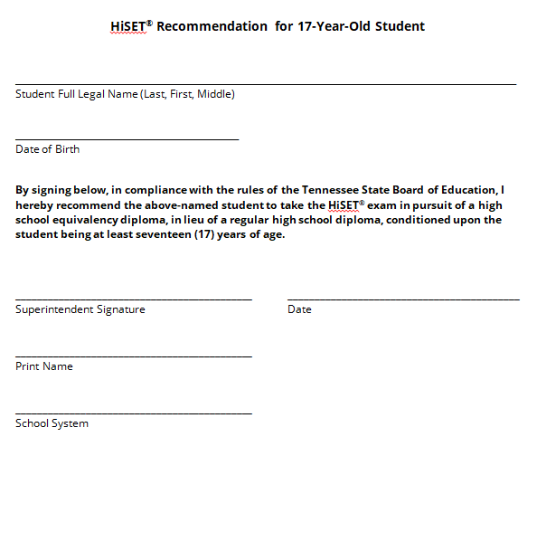

Slide 21
Adult Education
Services for Minors Policy

Slide 22
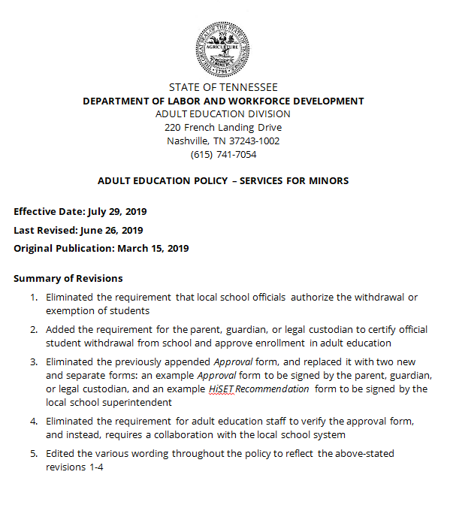

Slide 23
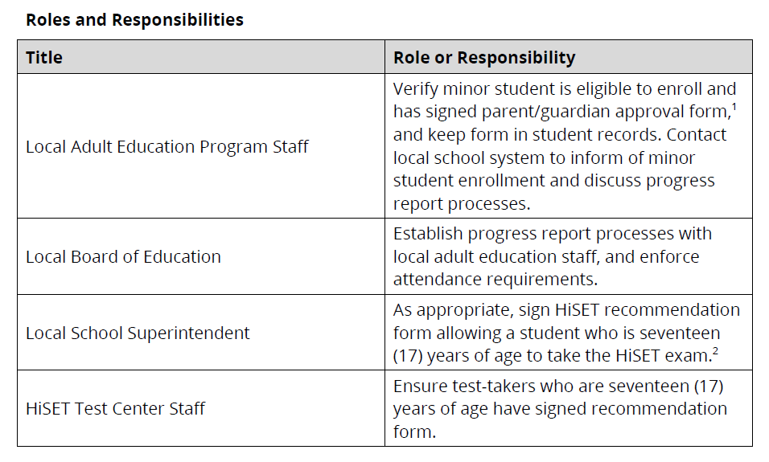
Policy

Slide 24
Policy (continued)
Link: Services for Minors Policy
URL: sites.google.com/view/aestaff

Slide 25
Questions?
Contact Me!
Jay.Baker@tn.gov
(615) 532-5057

Slide 26
Thank You!
Jay.Baker@tn.gov
(615) 532-5057
Find Presentation at: tinyurl.com/aeminors

