Slide 1
Think Tanks in the U.S. Political System
Craig Vincent Mitchell, PhD
Web site: craigvincentmitchell.co
E- mail: craigvmitchell@gmail.com

Slide 2
Overview: Part I
Nature
History
Conclusions

Slide 3
The Nature of Think Tanks
Elitist View
Pluralist View
According to C. Mills Wright think tanks are instruments deployed strategically in the service of a ruling class political agenda.
G. William Domhoff suggests that the purpose of think tanks is to assist in the business of top down policy making.
Think tanks are one of many that compete to shape public policy,
Pluralists refuse to assign a particular role or character to think tanks.

Slide 4
The Institutionalist
View of Think Tanks
The institutional approach focuses on the rules and constraints within which think tanks are embedded and the personnel networks they coordinate.
Think tanks comprise a heterogeneous array of organizations with a wide range of possible effects.
Think tank affiliated policy experts are members of an “epistemic community”- or a network of policy oriented actors whose members share a certain brand of expertise, such as legal or scientific knowledge.
Multiple epistemic communities may coexist within the world of think tanks

Slide 5
John Goodman,
President of NCPA in 2005
Think tanks are not the same as advocacy groups.
Think tanks are not the same as universities
Think tanks are not the same as market actors
Think tanks are not the same as political interest groups or an agent of the state.
He recommends geographic separation from Washington D.C.
A good policy expert is an intellectual entrepreneur.

Slide 6
Think Tanks: Definition
According to James McGann, “Think tanks are public policy research analysis and engagement organizations that generate policy- oriented research, analysis and advice on domestic and international issues, thereby enabling policymakers and the public to make informed decisions about public policy.”

Slide 7
Think Tank: Definition
Thomas Medvetz explains that the term “think tank” is not clearly defined.
Think tanks link political and intellectual practice in American life.
Think tanks have collectively developed their own social forms, conventions, norms and hierarchies.
Think tanks occupy a sub- space located at the crossroads of the academic, political, economic, and media.

Slide 8
Think Tank Affiliations
Category | Description
Autonomous and Independent | Independence from any one interest group or donor
Quasi- independent | Autonomous from government, but controlled by an interest group or donor
Government Affiliated | A part of the formal structure of government
University Affiliated | Located at a university
Political Party Affiliated | Formally affiliated with a political party
Corporate (for profit) | Affiliated with a corporation or merely operating on a for profit basis

Slide 9
The Number of
Think Tanks in 2015
1262 in Asia
774 in Central or South America
1770 in Europe
398 in Middle East and North Africa
1931 in North America
615 in Sub- Saharan Africa
96 in Oceana
6,846 Total

Slide 10
Number of Think Tanks in America
1835 Total in the USA
397 in Washington D.C.
3 in Alaska or Delaware

Slide 11
The Public Policy Process
Problem Identification
Policy Formation
Policy
Adoption
Policy Implementation
Policy Evaluation

Slide 12
Overview: Part II
Nature
History
Conclusions

Slide 13
The First Think Tanks
James Smith traces the origins of think tanks to the American Social Science Association in 1865.
Patricia Linden points to the National Conference on Social Welfare in 1873.
Donald Abelson points to the Russell Sage Foundation in 1907.
Thomas Medvetz points to the Carnegie Endowment for International Peace in 1910.
James McGann points to the Brookings Institution in 1921.

Slide 14

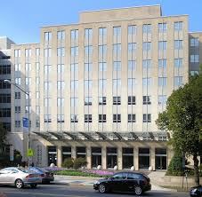
The Brookings Institution

Slide 15
The History of Think Tanks
The Brookings Institution was named after a successful St. Louis businessman: Robert Somers Brookings.
Brookings also created the Institute for Government Research and its two sister organizations.
Institute of Economics and a graduate school
Brookings Institution
1927
Institute for Government Research
1916
Institute of Economics
1922
Graduate School
1924

Slide 16
Institute for Government Research
The Institute for Government Research’s aims corresponded to those of the American Political Science Association.
In 1908 the APSA addressed a letter to the Carnegie Institution pointing out a need for the establishment in Washington of a department of research in political science and suggested that the Carnegie institution take steps in that direction.
The primary focus of the IGR was public administration

Slide 17
Charter for the Institute for
Government Research
To conduct scientific investigations into the theory and practice of governmental administration, including inquiries into the form of organization and manner of operation of federal, state and local governmental bodies and offices in the United States of America; the powers, duties, limitations and qualifications of officers; the methods of administration employed; the character and cost of results obtained and the conditions affecting the efficiency and welfare of governmental officers and employees;

Slide 18
Charter for the Institute for
Government Research
to carry on such inquiries, directly or with the cooperation of governments, learned societies, institutions of learning or of other agencies and individuals and to make public the results of its investigations; to maintain a library for the use of the society or its members and officers and those affiliated with its work; and to prosecute such other inquiries and perform such other services as may tend to the development and application of the principles of efficiency in governmental administration.

Slide 19
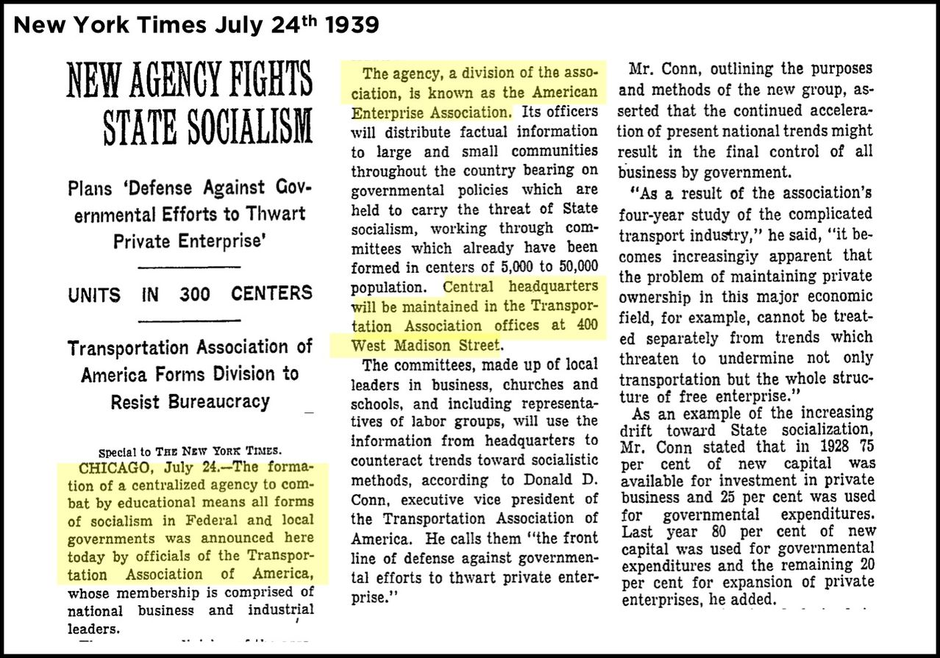
American Enterprise Association

Slide 20
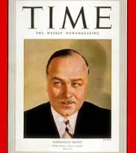
American Enterprise Association
Lewis Brown founded the American Enterprise Association in New York City (1938- 1956).
He remained as president until his death in 1951.
Brown was a staunch anti- statist.
The AEA had no full time policy experts. Instead, it acted as a broker for legislative studies and arranged lectures

Slide 21
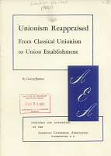
American Enterprise Association
Allen D. Marshall became president of the AEA in 1953.
It moved to Washington D.C. in 1956.
Marshall hired William Baroody from the Chamber of Commerce to serve as the executive director of the Washington D.C. office.

Slide 22
The Post World War II Situation
Both of the major think tanks assumed the Liberal Technocratic Consensus
The consensus was the position of the elite, progressivists.
This consensus consisted of support for the New Deal (liberalism) and the neo- classical synthesis in economics.
The neo- classical synthesis in economics is the traditional view of microeconomics and the Keynesian view on macroeconomics.
All research was to be non- partisan and unbiased.
Brookings Institution
American Enterprise
Association

Slide 23
The Marketplace of Ideas
The Liberal Technocratic Consensus continued until the mid- 1960s.
The Consensus was replaced with the Marketplace of Ideas.
The Marketplace of Ideas allowed think tanks to be partisan.

Slide 24
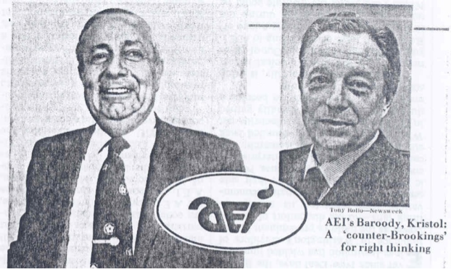
William J. Baroody
AEI President 1962- 1978

Slide 25
The American
Enterprise Institute
Baroody succeeded Allen D. Marshall
Renamed the organization the American Enterprise Institute.
They welcomed the transition from the Liberal- Technocratic Consensus to the Marketplace of Ideas.
In the mid 1970s, the AEI identified themselves as neo- conservatives
By the late 1970s, the AEI had established itself as a legitimate counterpart to the Brookings Institution.

Slide 26
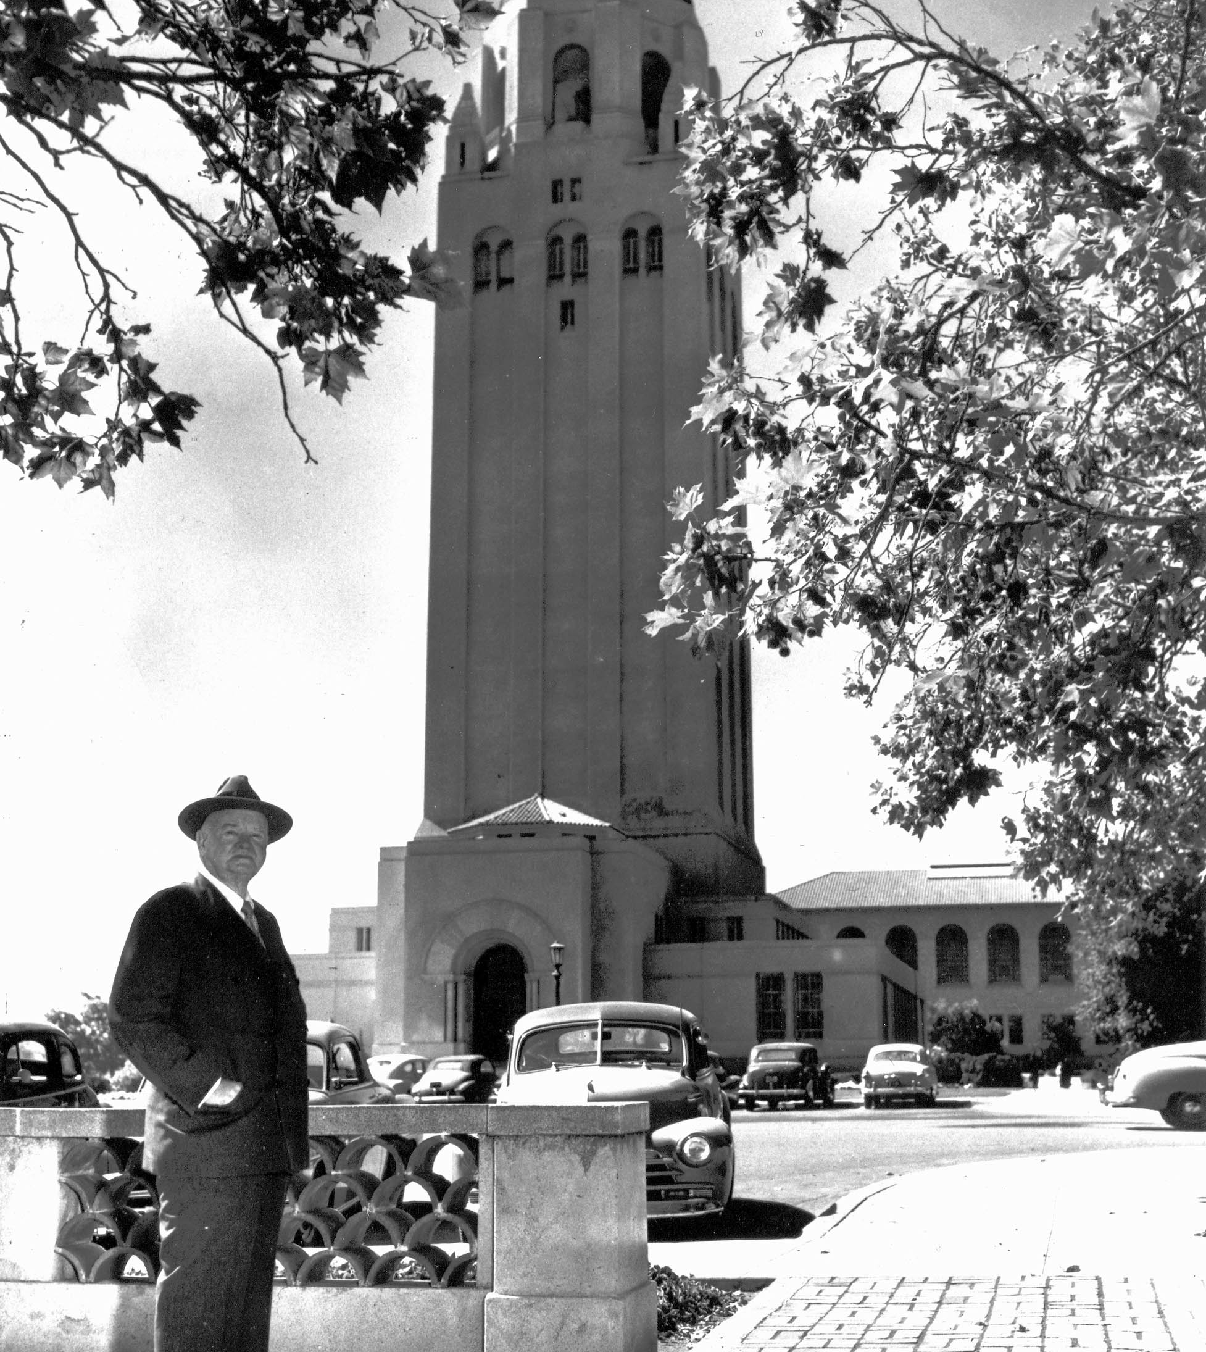
The Hoover Institution
Formed as a library in 1919 at Stanford University by Herbert Hoover before he became the President of the United States.
It was originally an anti- communist research library.

Slide 27

The Hoover Institution
In 1964, Herbert Hoover wanted to move the institution into more of a conservative think tank.
Glen Campbell left the Heritage Foundation and took over at the Hoover Institution to move it in the right direction.

Slide 28

Heritage Foundation
Founded February 1973 by Paul Weyrich, Edwin Feulner and Joseph Coors.
Their intent was to be a conservative think tank that was more responsive to the needs of policy makers than AEI.
Their research was not as thorough as that done by AEI, but it provided essential information in a timely manner for legislaters

Slide 29
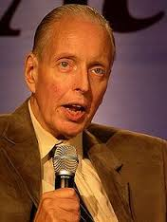
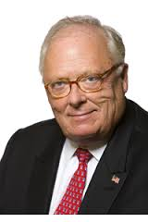
Heritage Foundation
Paul Weyrich
Edwin Feulner

Slide 30
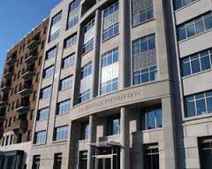
Heritage Foundation
The Heritage Foundation quickly established itself as a leading think tank by preparing a complete policy agenda for Ronald Reagan, before he was elected president.
Since then, The Heritage Foundation has become one of the most significant think tanks in the American political scene.

Slide 31

Cato Institute
The institute was founded in December 1974 in Wichita, Kansas as the Charles Koch Foundation and initially funded by Charles Koch. The other members of the first board of directors included co-founder Murray Rothbard, libertarian scholar Earl Ravenal, and businessmen Sam H. Husbands Jr. and David H. Padden.
The institute changed its name in 1976 to Cato Institute after Cato's Letters, a series of British essays penned in the early 18th century by John Trenchard and Thomas Gordon

Slide 32
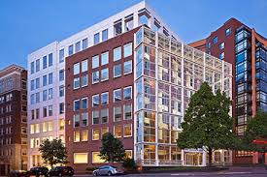
Cato Institute
Cato relocated first to San Francisco, California in 1977, then to Washington, D.C. in 1981, settling initially in a historic house on Capitol Hill. The Institute moved to its current location on Massachusetts Avenue in 1993.
Cato consistently ranks among the top think tanks.

Slide 33
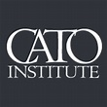
The Cato Institute
Many Cato scholars advocate support for civil liberties, liberal immigration policies, drug liberalization, and the repeal of Don't Ask Don't Tell and laws restricting consensual sexual activity.
The Cato Institute officially resists being labeled as part of the conservative movement because "'conservative' smacks of an unwillingness to change, of a desire to preserve the status quo".[

Slide 34
Conservative Think
Tanks in the 1980s
Conservative
Think Tanks
American Enterprise Institute
(neo- conservative)
Hoover Institution
(conservative)
Heritage Foundation
(conservative)
Cato Institute
(libertarian)

Slide 35
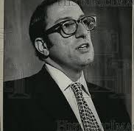
AEI in the 1980s
William J. Baroody Jr.
President from 1978-1986
William Baroody Jr. moved AEI in a more centrist position.
Baroody failed to develop an endowment.
He failed to properly manage and budget for AEI
AEI lost 25- 30 staff members to the Reagan administration
AEI was on the verge of bankruptcy when he resigned
Momentum shifted to the Heritage Foundation.

Slide 36
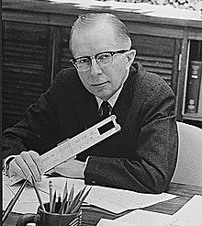
AEI in the 1980s
William Baroody Jr was replaced by the respected economist Paul McCracken
He hired his replacement, Christopher DeMuth in 1986.
Demuth was replaced by Arthur Brooks in 2008.

Slide 37
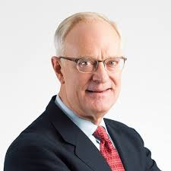
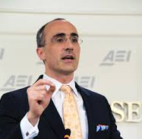
American Enterprise Institute
Christopher DeMuth
(1986-2008)
Arthur Brooks
(2008- present)

Slide 38
Overview: Part IIl
Nature
History
Conclusions

Slide 39
Conclusions
There is no one universally accepted definition of a think tank.
The number of think tanks around the world is increasing.
Most policy work is being done in think tanks.

