Slide 1
Engaging with Israeli culture through the Eurovision experience
An adult lesson plan
Prepared by Shirel Richman & Iris Karlin
With connection to The Ultimate Jewish Teacher’s Handbook chapter: “Engaging with Israel”

Slide 2
Aims & Goals
Engage our adult students with Israeli culture.
Establish meaningful connection with the collective Jewish Homeland,
linking past and present cultural elements with that of Am Yisrael.
Explore Jewish diversity and diverse Jewish values.
Familiarize the students with the representative songs of Israel.
Learn about the Israeli involvement in the Eurovision contest.
Develope identification with Israel and Israeli culture.
Engage in small groups in learning and supporting of assigned songs.
Provide directions to the “game play” of judging in the Eurovision
Invite an informal interactive notion of engagement with Israel

Slide 3
Our mission
We wish to engage our students with Israeli culture, by taking them in an adventure that
imitates the Israeli experience of Kdam-Eurovision (pre- Eurovision contest that takes place
publically in Israel). Every year the Israeli music industry is engaging the whole state with
choosing the best Israeli song of the year, to represent Israel in the European contest of songs.
It is an exciting event, full of patriotism, and togetherness (as the nature of competitions).
The lesson will put the students in the position of presenters and advocators of the songs.
Each group will be assigned a different city in Israel (and provided with information about the city).
The group song is chosen by the performer’s origin city.
The different groups will present the different contestants, all past winners of the Kdam Eurovision,
who represented Israel in the Eurovision. The experience will conclude as we role play the
competition judging stage, giving points in Hebrew, but ending with “Dous Pois”, an Israeli
(eurovision-ary) take on the Eurovision’s scoring tradition.

Slide 4
Materials
Prepared links / recordings of the chosen songs / performances. (Lyrics and translations included in the videos)
“Resume cards” of information about the songs - Performer (short bio + picture), relevant information of the song.
General information of the city it represents.
“Judge form” - with space for the students to write and express their own thoughts
and opinions about the performance during the presentations: (Music, content, context to the city/politics, performance, design etc.)
Score signs - 1,2,3,4,5,6,7,8,9,10,11,12 (and the numbers in Hebrew, and in English transliteration in the back)
Final assessment form
Classroom Management
Room Setup - One large screen connected to a LapTop and sound system.
6 iPads or other devices to provide the groups with the ability to watch and hear their videos.
Transitions - The students will part from the main classroom, to smaller chambers, where they can watch the Videos.

Slide 5
Timeline
Teacher Presentation - Eurovision background (5’ minutes)
Small Groups Activity - Engagement with the song and planning the presentation (10’ minutes)
Small Groups Presentations to the whole class - 6 minutes per group (36’ minutes total)
Small group concluding thoughts and evaluation - (5’ minutes)
Big group final evaluation of “our Israeli Eurovision” and announcement of the “all-time” winning Israeli song (4’ minutes)

Slide 6
Big Idea(s)/Enduring Understanding(s):
(Based on the Teacher’s Handbook Chapter 37)
Student will engage with a modern society narrative experience with language, symbols and culture.
Students will establish meaningful connection with current and past Israeli experience.
Students will explore diversity (different ethnicities, gender diversity, diverse body image, diverse dress and different physical features)
Expose the students to Hebrew words, now used internationally, as they appear in the music (Diva, Halleluya…)
Encourage the students to become a part of the experience with their Hebrew name or their own imaginary Hebrew identity.
Create a meaningful connection to Israel through rhythms and music.
Build integral relationship with Am Yisrael, Eretz Yisrael and the land of Israel.
Our ultimate goal is to cultivate excitement, passion, to facilitate a connection of our students with Israel, Symbols, language, people, cultural heroes, places (landscapes) and time (past, present and future).

Slide 7
Essential/Inquiry Questions for assessment
Can Americans be involved in this Israeli cultural life?
Can we connect to our Jewish identity through Israeli culture (not Jewish per se)?
Can we connect to “Eretz Yisrael” through experiencing its culture?
Can Israeli music reflect Israel’s ethnic, gender, and body image diversity?

Slide 8
Student Objectives:
Students will engage in listening to Israeli music and learn about it.
Students will present the background, content and context to bigger ideas of leading songs that represented Israel in the world.
Students will associate their group with an Israeli city, and learn about the cities assigned to their peers.
Students will advocate for, and represent specific Eurovision songs.
Students will engage as active representors and judges in an Israeli cultural tradition.
Students will develop a relationship with their peers through engaging with Israel.
Students will connect and deepen their relationship with Israel and its culture.

Slide 9
Performance Tasks
Students will present a 3 minute presentation demonstrating knowledge and understanding of a song that was assigned to them, and will state the Israeli city they represent. (3 min’ video, 3 min’ presentation - total of 6 min’)
After the presentations, the students will engage in small group dialogues discussing Israeli cultural identification.
Students will rank the songs presented, individually and within their group.
Students will assess their experience and engagement with this Israeli cultural experience.

Slide 10
Learning Activities
Set induction
We will start the lesson with a short video clip of musical highlights from Israeli Eurovision songs.
This will introduce the topic and focus the students on the topic and spark their interest.
Putting the lesson in context
We will present a roadmap of the cultural experience we are learning about, linking it to the roadmap of the lesson today (roadmaps are attached in slides 19 & 20) and give the students the learning objectives.
We will then divide the students into small groups, and each group will get a different handout (attached at the end), with Anecdotes about the Israeli city their group is named after, a short “resume” of the Eurovision singer that came from this city, Lyrics / translation and context of the song.
Each group will get an iPad or a device with the link given by the teacher, and watch the song they will represent.

Slide 11
Learning Activities continuation…
In small groups, students will watch the performance they were assigned to and answer:
Detailed questioning sequences
What do you like about this song?
What do you like about the performance elements (choreography / staging / costumes / design)
What message does this song/ the artist bring?
Does this music sound Israeli? Does it sound Jewish?
Why should this song win? (No wrong answers! Be as serious or silly as you wish!)
In the big group - Presentations & Performance
Students will present and advocate their song, while the other students take notes.
Then the students will engage in a Judging “role playing” activity
(as described through Bloom’s taxonomy in the following slides)

Slide 12
Bloom’s Taxonomy
We will expose our students to the cognitive domain along with the affective domain. The students will experience the music, its harmony, rhythms, as well as the production aspects of choreography and will be involved emotionally with this Israeli music.
Our lesson will also contain the psychomotor domain: practical and physical aspects of moving and transitioning between locations, actively presenting, and then engaging in a judges “scoring” role playing, as they evaluate and raise score signs (Total Physical Response, see slide 15). The nature of competition would also bring excitement which will elevate the experience and will make it more memorable.

Slide 13
Cognitive Domain (Bloom’s Taxonomy)
We will have to apply real-world context first, and only then refer to the theory
Applying: Teachers will introduce the cultural experience, and relate it to our lesson of Engaging with Israeli Culture.
Understanding: in small groups students will summarise, interpret, discuss and convert the information into their presentation
Remembering: With the large group, the small groups will recite/ state / tell facts and basic concepts related to the song, and identify/ explain what is unique about the song, and why (or why not, criticism is also welcome) it should win the competition.
Analyzing: In small groups the students will gather the information, make connections between ideas, categorize, devise and conclude, how they are going to score and choose their winners.
Evaluating: Back in the big group, the students will judge / appraise by giving a value - a score for each song, and then reframe and justify their decision
Creating: Through the role playing as Judges, reimagining the experience, the class will formulate a new winner.
Hopefully, this process will spark further interest to follow the Eurovision in the future and advocate for Israel.

Slide 14
Effective Domain
Receiving: Learning what the Eurovision experience is and identifying how it is relevant to us. The class will be divided into groups. The group will watch the performance.
Responding: Lctive participation - labeling elements of the performance, getting ready to present and report the selected piece.
Valuing: attaching value to what we see/hear/feel in the clip, the song’s content and context. Studying together, explaining, justifying, sharing.
Organization: In reaction to the different presentations, individuals and small groups will compare the elements of the different songs, and how they feel about them, relate to their content and context. Students might defend / explain / generalize and synthesize the songs.
Characterization: Listening, qualifying and questioning the content / context, revising and then by judging - influencing the outcome of our demonstrated contest.

Slide 15
Psychomotor Domain
Fundamental movements - Transitioning physically between locations from one group to the other.
Non-discursive communication - group presentation - express, and interpret.
Total Physical Response* - Raising the scoring signs.
* An educational system based on the Total Physical Response (TPR) by Dr. James Asher, is focused on always
keeping attention on the learners, adapting to each student, and thus expressiveness is promoted. One of the
principal techniques of TPR is the communicative focus, which consists of communicating with lots of gestures,
facial expressions, signs and movements to reach an understanding without having to translate or explain.

Slide 16
Closure activity
As described previously, the closure activity is a part of the roadmap, and the engagement process of “Imitating” the Kdam Eurovision experience.
We hope the engaged students, will feel the adrenalin rush of the competition, and the catharsis of the winning declaration, concluding their Eurovision journey.
We will close the lesson with the winning song performance (confetti cannons might be involved!), followed by a conversation regarding the experience, bringing up our Essential/Inquiry Questions for assessment, as described in slide 7.
We will ask them to write to us (giving them the option to write it right after the lesson, or email it to us later) an exit card, which will serve as assessment for us (see slide 34).

Slide 17
Reflection
Follow-Up/ Exit card : In an email, or on paper we would like our students to answer these following questions:
Did you enjoy the experience of engaging with this Israeli culture activity?
How do you think it went?
How would you do it differently next time?
Do you think you will follow-up on future Eurovision contests?
Our own reflection would be a summarized combination of:
The students’ engagement and excitement during the lesson.
The students’ remarks in the final discussion about the experience.
Follow-up email responses and informal reaction following the lesson.

Slide 18
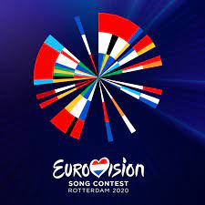
Roadmap of the Eurovision contest
Songs from around the country apply for the first round of the competition.
1st round - Kdam Eurovision - (קְדַם אֵירוֹוִיזְיוֹן)
hearing / watching the contestants
Round of evaluation by the local judges
The representing song is chosen.
2nd round - Eurovision
Big show presentation of the songs from all over Europe
Round of evaluation by countries -
Winning song is chosen! Winning country is announced to host the next year’s competition.

Slide 19
Roadmap of our lesson
Eurovision and Israel - Introduction
Small groups engagement with a past winning song
Kdam Eurovision - (קְדַם אֵירוֹוִיזְיוֹן) presentations
Small groups evaluations
Judging/ scoring process
All time winningest Israeli song announced :)

Slide 20
Eurovision songs chosen and the cities they represent
Hallelluya - Gali Atari - (Rechovot)
Abanebi - Yizhar Kohen - (Givatayim)
Diva - Dana International - (Tel Aviv)
Toy- Netta Barzilay (Hod Hasharon)
Feker Libi - Eden Alane’ - (Jerusalem)
I.M - Michael Ben David (Ashkelon)

Slide 21
Handout 1 - Rechovot
Established in 1890
Population: 147,901 (updated Feb 2022) It’s the 13th biggest city in Israel
Famous people: Gali Atari, Eyal Golan, Ilanit Levi
Location: Merkaz (Center) of Israel, South Mishor Ha-Chof
(Israeli coastal plain)
Famous as the city of Machon Veitzman of Science,
and as the home for the Hebrew University Faculty of Agriculture

Slide 22
Cont. H a l l e l l u y a - G a l i A t a r i
Born in 1953. Her parents immigrated to Israel from Yemen.
She is the sister of the actress Yona Atari & Shosh Atari, a radio /TV personality
She was the female vocalist with the Milk and Honey band.
Their song, “Hallelujah”, won first place at the Eurovision Song Contest 1979.
The song was voted the winner and was a success on the European charts.
And brought the following year’s competition to Israel (almost bankrupting it)
Music: Kobi Oshrat; Lyrics: Shimrit Or
Link to their winning performance of Halleluya
Link to lyrics & translation

Slide 23
Handout 2 - Giv’atayim
Established in 1922
Population: 61,244 (updated Feb 2022)
Notable people: A. B. Yehoshua (born 1936), writer, novelist
Oded Kattash (born 1974), basketball player and coach
Izhar Cohen (born 1951), singer
Location: Merkaz (Center) of Israel, South Mishor Ha-Chof
(Israeli coastal plain)
Famous for the "two hills" on which it was established:
(Borochov Hill & Kozlovsky Hill)

Slide 24
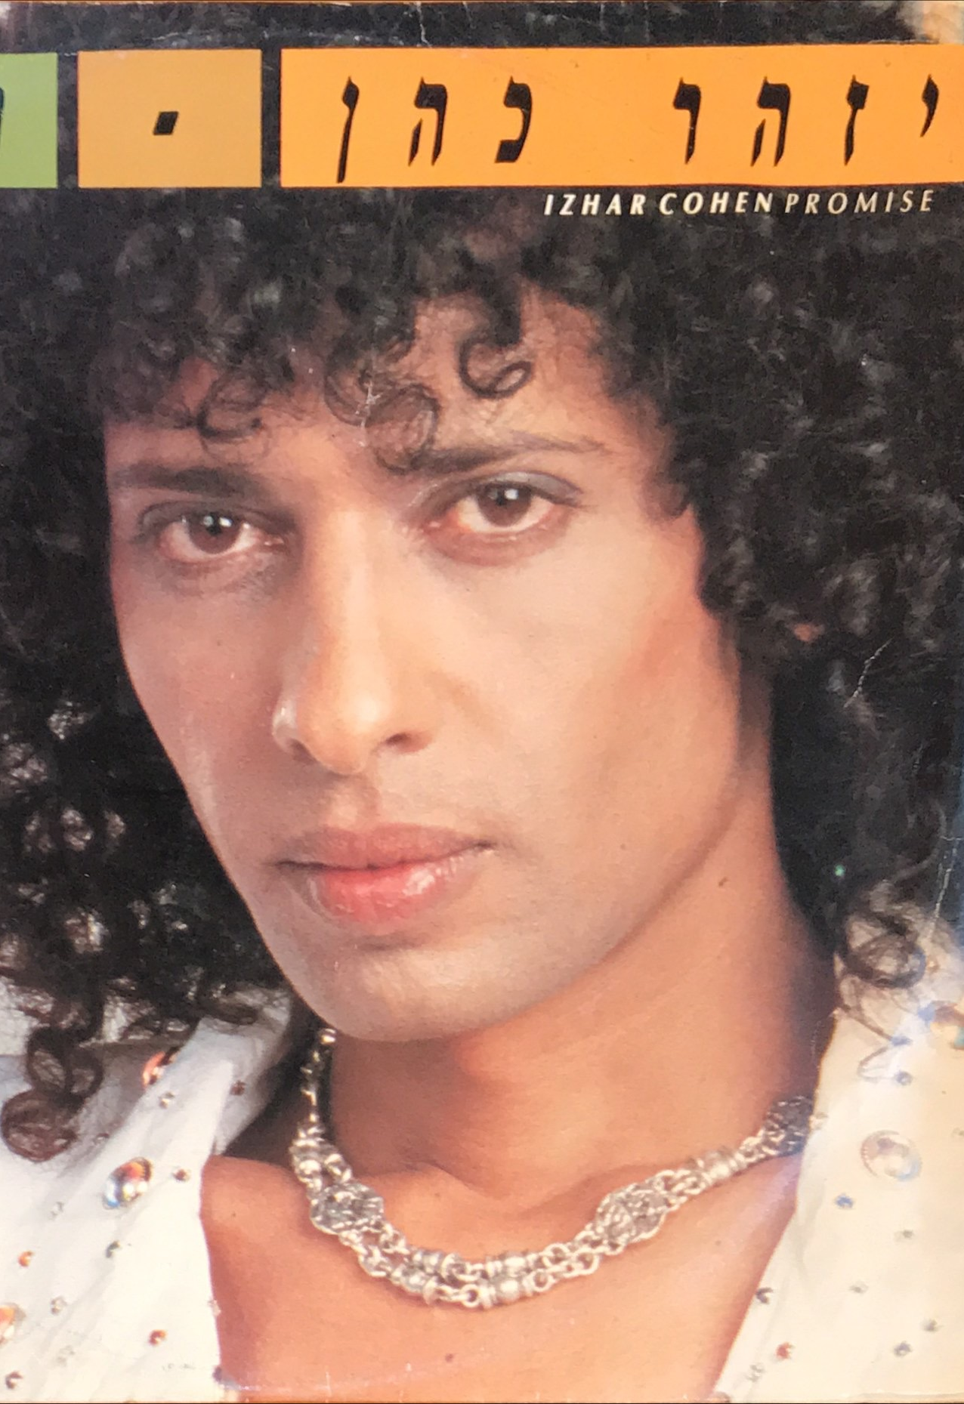
Cont. A b a n i b i - Y i z h a r C o h e n
Born in 1951. His parents, famous singers immigrated to Israel from Yemen.
His siblings all became famous singers/entertainers: Hofni, Pini, and Vardina
At 18, Cohen joined the IDF's "Nachal" singers group.
During the 1970s Cohen was one of the most played singers in Israel.
Representing Israel, he won the 1978 Eurovision Song Contest
with the group Alphabeta performing "A-Ba-Ni-Bi". Music: Nurit Hirsh; Lyrics: Ehud Manor.
Link to his winning performance of Abanibi
Link to lyrics & translation

Slide 25
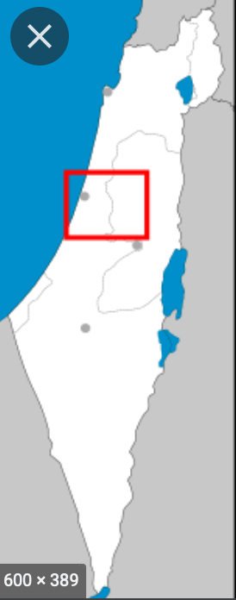
Handout 3
Tel-Aviv
Established in 1934
Location: Merkaz (Center) of Israel, Israeli coastal plain
Population: 468,809 (updated Feb 2022) Second biggest city in Israel!
“Fun” fact: Tel Aviv was announced as the most expensive city to live in in 2021 (Paris was second place)
Culture: Home of Israeli LGBTQ+ community, Israeli Opera, many theaters, famous beaches, markets and shopping centers, cinemas, museums, parks, tourism center of Israel, etc. Tel Aviv hosted the Eurovision in 2019.

Slide 26
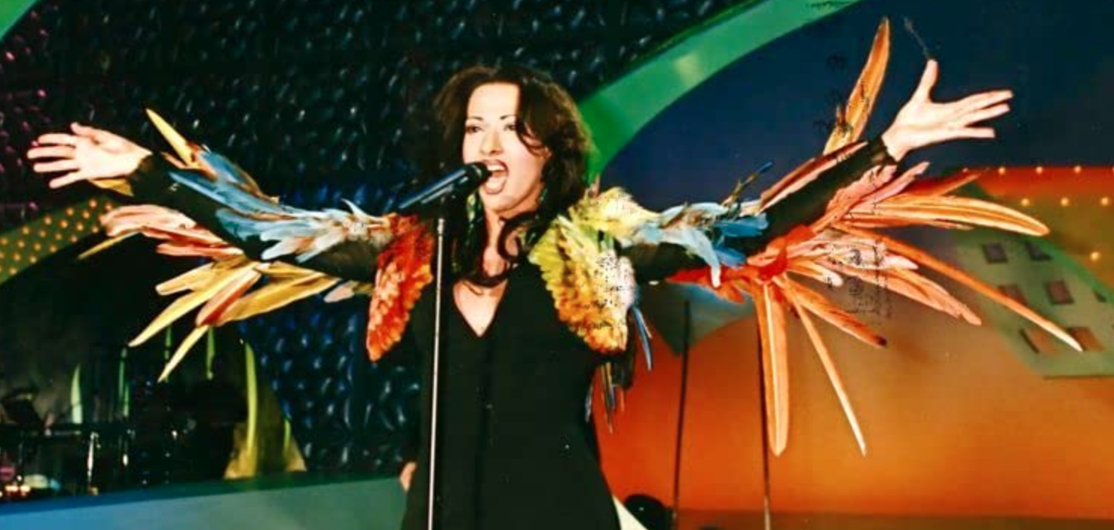
Diva - Danna International
Sharon Cohen was born in Tel Aviv, Israel in 1969
to a family of Yemenite-Jewish descent. She was
the winner of the Eurovision Song Contest 1998 in
Birmingham with the song "Diva".Though assigned male at birth, she identified as female from a very young age. She wanted to become a singer from the age of eight, when she watched Israeli singer Ofra Haza perform her song "Chai" in the 1983 Eurovision Song Contest. She came out as transgender at the age of 13.
At 18 years of age, Cohen (still legally male at the time) earned a living as a drag queen, parodying many famous female singers. In 1993, Dana International flew to London for male-to-female sex reassignment surgery and legally changed her name to Sharon Cohen. That same year Cohen released her first album, titled Danna International in Israel (2 n’s!). Danna International soon became a gold record in Israel.
Link to the winning performance of Diva
Link to Lyrics and translation

Slide 27
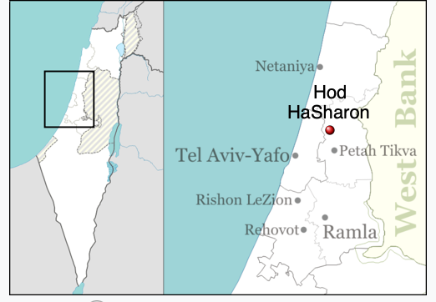
Handout 4 - Hod Hasharon
(literally "Splendor of the Sharon plain")
Established in 1964
Location: Central District of Israel
Population: 65,414 (updated Feb 2022)
Notable people:
Danny Ayalon (born 1955), politician and former Israeli ambassador to the U.S
Shira Haas (born 1995), actress (Shtisel, Unorthodox)
Bar Refaeli (born 1985), model and actress
Netta Barzilai (born 1993), singer, winner of the Eurovision Song Contest in 2018
Fun fact: Created through the merger of Hadar, Ramatayim, Ramat Hadar and Magdiel.

Slide 28
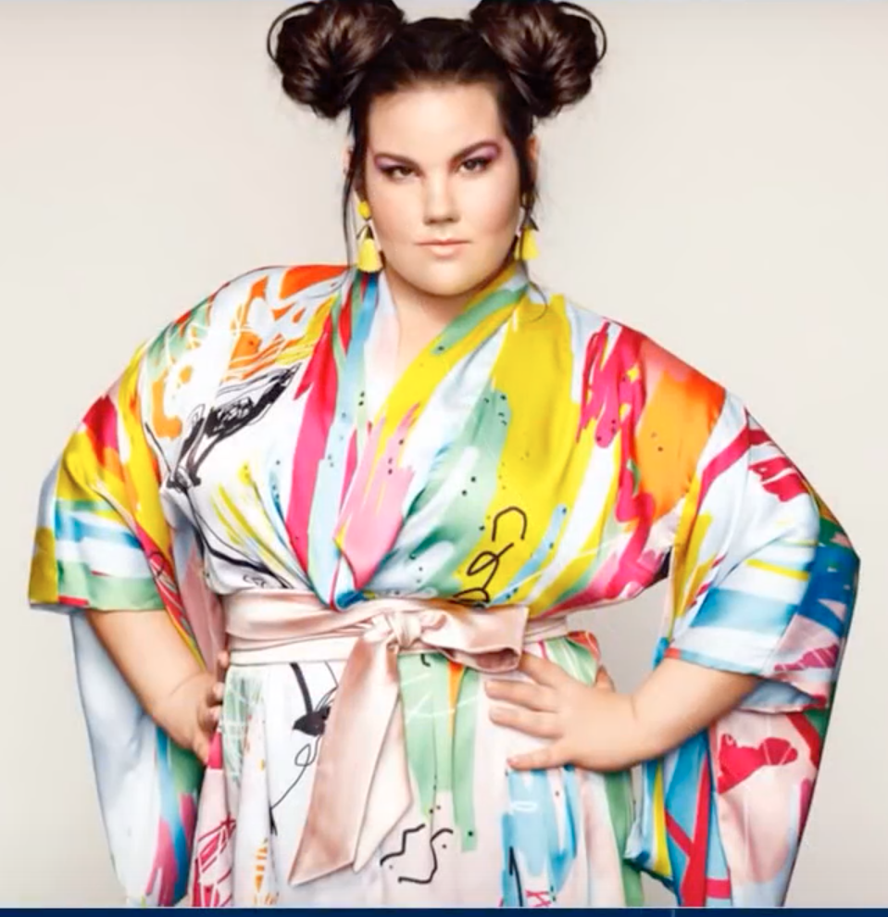
T o y - N e t t a B a r z i l a y
Netta Barzilai, also known mononymously as Netta, was born in 1993
An Israeli singer-songwriter, musician and looping artist.
She represented Israel in the 2018 Eurovision held in Lisbon, Portugal.
Her song "Toy", marked Israel's fourth win in the Eurovision Contest (after 1978, 1979, and 1998).
“Toy” was inspired by the “MeToo” movement and promotes ideas of feminism and strong femininity.
Netta proudly represents a new model of body image and inspires young Israeli women to love themselves just the way they are.Netta’s use of a “looper” on stage raised musical and aesthtical questions in the Eurovision regarding “what is live music”?
Link to the winning performance of Toy
Link to the lyrics & translation

Slide 29
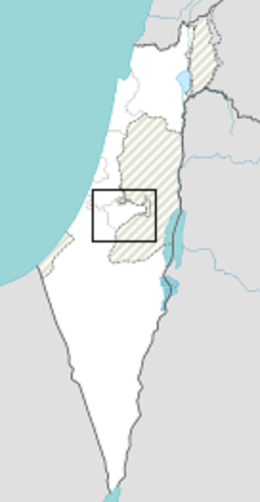
Handout 5 - J e r u s a l e m
Situated on a plateau in the Judaean Mountains between the
Mediterranean and the Dead Sea, it is one of the oldest cities in the world,
and is considered holy for the three major Abrahamic religions: Judaism, Christianity, and Islam.
The part of Jerusalem called the City of David showed signs of settlement in the 4th millennium BCE.
Population: 966,346 (updated Feb 2022)
Famous figures: King David (c. 1040 BCE – c. 970 BCE), second King of the united Kingdom of Israel
Isaiah, a prophet of ancient Israel living around the time of 8th-century BC Kingdom of Judah
Eliezer Ben-Yehuda (1858–1922), credited for the revival of the Hebrew in the modern era
Natalie Portman (born 1981), Israeli-American actress,
Famous locations: The Old City, The Western Wall, The Market (Shuk), Museums, Hebrew University,
The Knesset, Yad Vashem, Mount Herzl and many more.

Slide 30
F e k e r L i b i - E d e n A l e n e
Born in 2000, Jerusalem.
Eden had been set to represent Israel in the Eurovision
Song Contest 2020 with her song "Feker Libi". After the
cancellation of the 2020 contest due to the COVID-19 pandemic, she was internally chosen to represent Israel in the Eurovision Song Contest 2021, this time with "Set Me Free".
Alene was born to Ethiopian-Jewish parents who made Aliyah separately. Alene attended religious Jewish elementary school and middle school, although she then attended the secular Jewish high school of the Hebrew University Secondary School and majored in theatre.
She was enlisted in 2018 as a soldier in to the Israel Defense Forces (IDF), and served in the military band of the Education and Youth Corps. She received an honorable discharge in October 2020.
Link to the winning performance (pre- Eurovision) of Feker Libi
Link to Lyrics and translation

Slide 31
Handout 6 - Ashkelon
The ancient seaport of Ashkelon dates back to the Neolithic Age.
In the course of its history, it has been ruled by the Ancient Egyptians,
the Canaanites, the Philistines, the Assyrians, the Babylonians, the Greeks, the Phoenicians, the
Hasmoneans, the Romans, the Persians, the Arabs, the Crusaders, the Mamluks (distroyed it in 1270)
Population: 149,176 (updated Feb 2022)
Notable people: Yael Abecassis (born 1967), actress
Shlomo Glickstein (born 1958), professional tennis player
Boris Polak (born 1954), world champion and Olympic sport shooter
Location: coastal city in the Southern District of Israel on the Mediterranean coast
Famous for its archeological landmarks as the ruins of 4th- to 6th-century bath houses.

Slide 32
Cont. I.M - M i c h a e l B e n D a v i d
Born in 1996. His parents immigrated from Ukraine and Georgia.
He has 4 siblings
Declared himself as Homosexual at the age of 16, and soon after his mother
“chazra bitshuva” (became orthodox).
Ben David auditioned for The X Factor Israel, which would be used to select Israel's
representative for the Eurovision Song Contest 2022, and won the final
with his song "I.M" that will represent Israel in the Eurovision Song Contest
Link to his winning performance of I.M
Link to lyrics (it’s all in English :)

Slide 33
Contestant Evaluation card
to fill individually during presentations
Judge’s Hebrew name (by birth or by choice) _______________________________
Song | Music | Lyrics | Choreography | Design | Content | Context
Haleluya
Abanebi
Diva
Toy
Feker Libi
I.M

Slide 34
Exit card
Hebrew Judge’s name (by birth or by choice) ________________________
Did you enjoy the experience of engaging with this Israeli culture activity? Y / N / not sure
How do you think it went? _________________________________________________________
________________________________________________________________________________
Were you frustrated at any point? If so, when?___________________________________________
________________________________________________________________________________
How do you feel we could address your frustration next time? ______________________________
________________________________________________________________________________
Is there anything you think could be done differently next time? ____________________________
________________________________________________________________________________
Do you think you will follow-up on future Eurovision contests? _____________________________
________________________________________________________________________________

