Slide 1

Summary of COA and Addendum
North Delta Water Agency Board Meeting
February 6, 2019

Slide 2

History and Background
  Reclamation and DWR recognized need for criteria for coordinated operation of the CVP and SWP
  Initial agreement entered into in 1960
  Reclamation and DWR developed and signed a more detailed operations agreement, COA, in 1986
  COA took into account “subsequent developments and changes in the two projects” since 1960
  Suspends but does not supersede the 1960 Agreement

Slide 3
History and Background
  COA established terms under which the Projects could use their respective water rights to:
  Ensure CVP and SWP Contractual and Regulatory responsibilities are met
  Maximize the ability to operate the CVP and SWP to meet:
    Water right and contractual obligations upstream of the Delta
    Delta Water Quality and Flow objectives
    Joint Delta Water Right Requirements
    CVP and SWP Water Right and Contract Obligations that depend upon diversions from the Delta

Slide 4
Key 1986 COA Definitions
In-basin Uses (IBU)
  Legal uses of water in the Sacramento Basin
  Includes water required to meet “provisions of Exhibit A” (D-1485)
Balanced Water Conditions
  Stored water releases plus unregulated flow ≈ In-basin Uses plus Exports
Excess Water Conditions
  Stored water releases plus unregulated flow > In-basin Uses plus Exports
Un-stored Water Available for Export
  Total Exports > total Stored Water Releases

Slide 5
1986 COA Article 6 Sharing
When water must be withdrawn from storage to meet In-basin Uses
  Sharing Responsibility: 75% CVP / 25% SWP
When Un-stored Water is Available for Export
  (Exports > storage withdrawals and Balanced Water Conditions)
  Sharing Available Supply: 55% CVP / 45% SWP
Export Capacity During Periods of Export Constraints
  Shared 50% CVP / 50% SWP
  “Handshake” agreement

Slide 6
Key 1986 COA Assumptions
  1986 Regulatory Conditions (D-1485)
  Specific CVP and SWP Facilities
  Specific CVP and SWP Demands (including In-basin Uses)
  Agreement based on assumed yield under 1928-1934 Drought Conditions
  Periodic review

Slide 7
System Changes Since 1986
New facilities added - CVP, SWP, and Others
SWRCB established New Delta Standards in 1995 and 2000 (WQCP)
Biological Opinions issued pursuant to ESA
Changes have resulted in restrictions on operations and affected the ability of the Projects to achieve water supply objectives
Sharing of responsibilities for meeting New Delta Standards and export capacity during export constraints was not addressed in COA

Slide 8
Addendum to COA
  Recent drought highlighted need for review of COA
  Sharing formulas developed and negotiated using methods similar to those used for COA (1986)
  Environmental Assessment resulted in Finding of No Significant Impact (FONSI)
  Signed by DWR and Reclamation on December 12, 2018
  Implementation began January 1, 2019

Slide 9
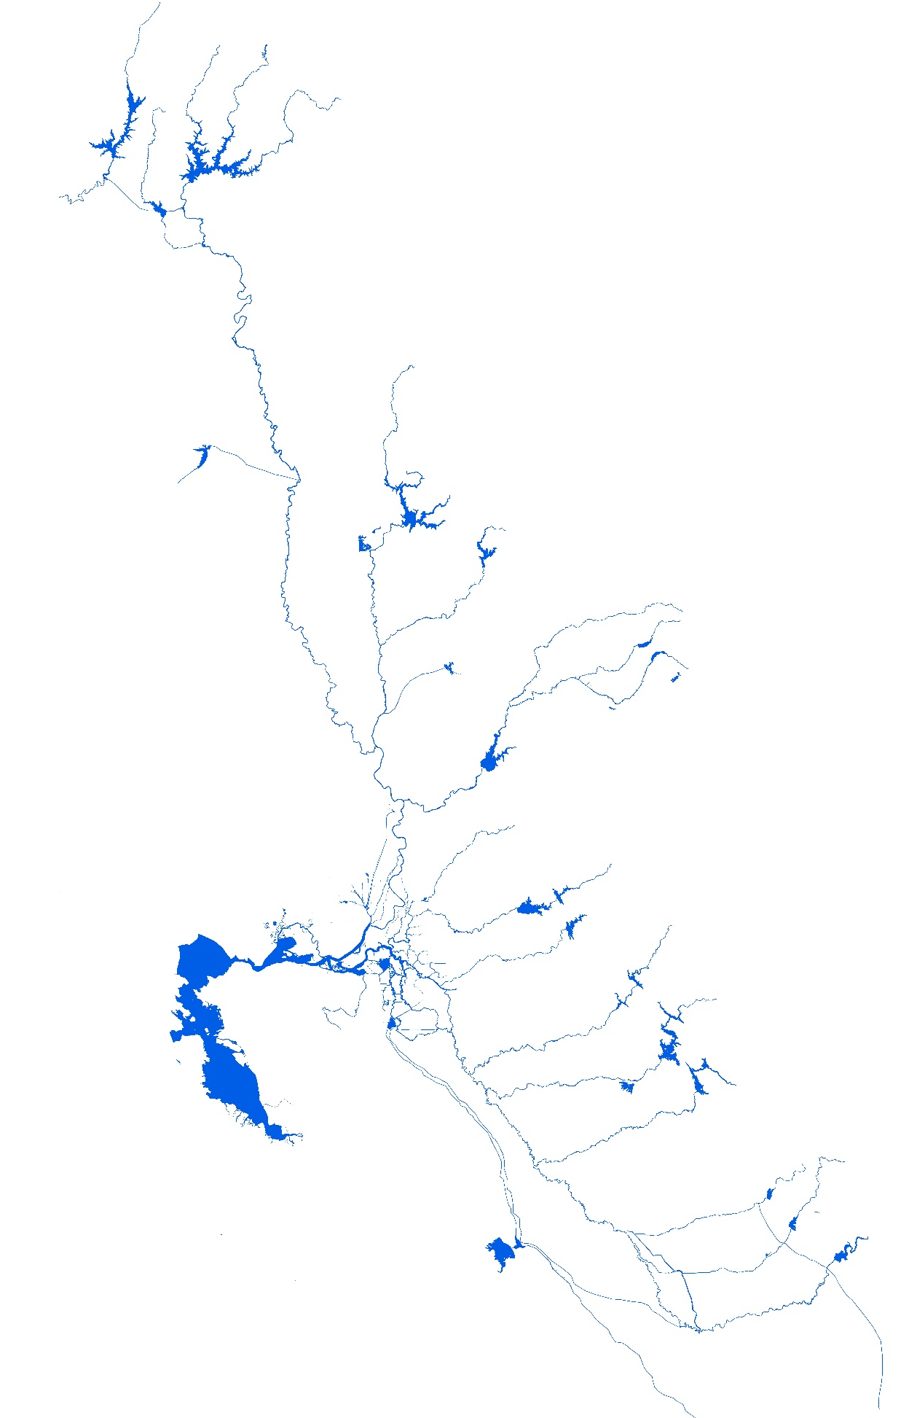
Sharing Responsibility for Meeting IBU During Balanced Conditions
Shasta
Trinity Import
1986
Oroville
25%
SWP
75%
CVP
In-basin Use
Folsom
2019
40-30-30
Year Type | SWP
Wet | 20%
Above Normal | 20%
Below Normal | 25%
Dry | 35%
Critical | 40%
CVP
80%
80%
75%
65%
60%
Outflow
Delta
CVP Exports
SWP Exports

Slide 10
Sharing Un-stored Water Available for Export
Shasta
Trinity Import
1986
Oroville
45%
SWP
55%
CVP
In Basin Use
Folsom
2019
SWP | CVP
45% | 55%
Outflow
Delta
CVP Exports
SWP Exports

Slide 11
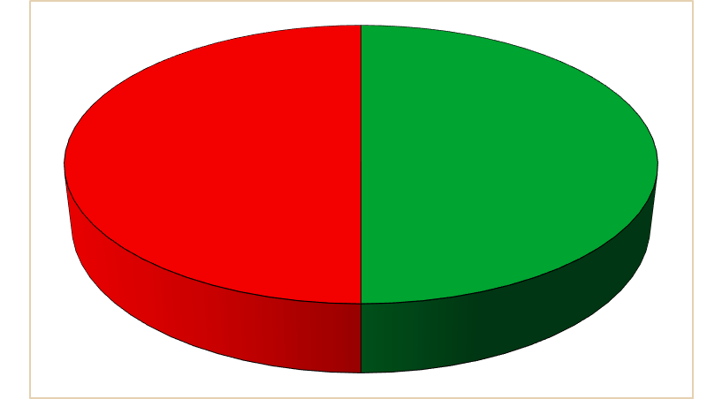
Sharing of Export Capacity When Exports are Constrained
Shasta
Trinity Import
Informal Sharing 1995-2018
Oroville
50%
SWP
50%
CVP
In Basin Use
Folsom
2019
Delta | SWP | CVP
Excess | 40% | 60%
Balanced | 35% | 65%
Outflow
Delta
CVP Exports
SWP Exports

Slide 12
Conclusions
  FONSI showed no changes in meeting Delta water quality requirements
  Increased IBU obligation for SWP could result in reductions in
      SWP Exports
      Storage in Oroville in driest years

Slide 13
Questions?

