Slide 1
TN Attendance Conference Debra Mullins | Sr. Product Manager debra.mullins@powerschool.com
September 25, 2019

Slide 2
Wednesday Agenda:
9:00am – 9:30am Debra Mullins Introductions, PS SIS Updates, Support
9:30am – 10:30am Debra Mullins Compliance Roadmap and Open Discussion
10:30am – 11:30am Doug Quinton Ed-Fi Roadmap, Pending Updates and Open Discussion
11:30am – 1:00pm Break Lunch
1:00pm – 2:00pm Curtis Coulter EIS Processing troubleshooting, Important Setup and FAQ’s
2:00pm – 2:15pm Break
2:15pm – 3:00pm Tim Jones Power User Session – Student Classification Customization
3:00pm – 4:00pm PowerSchool Team Breakout Session

Slide 3
Welcome! Wednesday, September 25th
TN - PowerSchool Team:
Curtis Coulter – Compliance Coordinator
Debra Mullins – Compliance, Sr. Product Manager
Doug Quinton – EdFi, Development Product Manager
Jim Swaney – TN Sales Rep

Slide 4
Support

Slide 5
TN Support Initiative:
Implemented, January 2019 to grow TN Knowledge within support. Curtis and I worked with support leadership to expand our process that will help with TN knowledge within Support.
Knowledge Transfer
Videos – EIS troubleshooting on high traffic areas, such as EIS processing
Knowledge based documentation
Extract level troubleshooting tips
Report FAQ’s
Setup for EIS
Etc.
Support is converting these documentations to a consumable format and they will be shared on Community for all users.
Known Issues
Support is kept up to date on any EIS extract issues and will reach out to development as needed.

Slide 6
TN Support Initiative:
Support Resources
Support
Having a case number is crucial to improving TN support and for having your PS team members escalate issues to development or to high levels within support.
Your PS team will always ask for a case prior to assisting.
Reminders: Set correct Priority, Include STR’s and Submission timeline for your item. This will speed the work necessary on your case.
Product Manager
If you have a support case that is critical OR you are concerned with the time it’s taking for support to respond, send an email to the PM. The PM will…
Escalate the case to support
Review the case for possible known issues, workarounds or customer guidance
Arrange assistance outside of support, if necessary.
Curtis Coulter, Compliance Coordinator
Support will reach out to Curtis if they are blocked by any TN support case and work directly with him to troubleshoot.
Escalated items from support – sent to Curtis as his availability allows.

Slide 7
TN Support Levels:

Slide 8
TN Support Levels:

Slide 9
TN Support Levels:

Slide 10
TN Support Levels:

Slide 11
Support and Process update – Open Discussion and Questions?

Slide 12
TN Compliance - PS The Road Ahead
Debra Mullins|Sr. Product Manager

Slide 13
Compliance – Roadmap 2019 Q4
Continued efforts – Stability Phase
Defect resolution
Improvements for compliance product stability and reaction time:
Expanded regression testing
Escalated items follow a retrospective review
Communication and Documentation
Improvements:
Extract updates – Beta
Product touchpoints – reach out to Compliance Product for urgent issues, escalations and/or status of a ticket where needed.
Performance
Improvements for Extract performance time
Each monthly release will include a performance enhancement

Slide 14
Compliance – Roadmap 2019 Q4
NEW Extracts
Updated architecture to Audit-Based Extracts
Removal of State Event Queue
Removal of old processing and over developed extracts with Core dependencies.
Extracts that require a Core release.
Each extract will be moved to Audit-Based
Slow removal of current extracts

Slide 15
NEW TN Extracts – Audit Based
What will this look like?

Slide 16
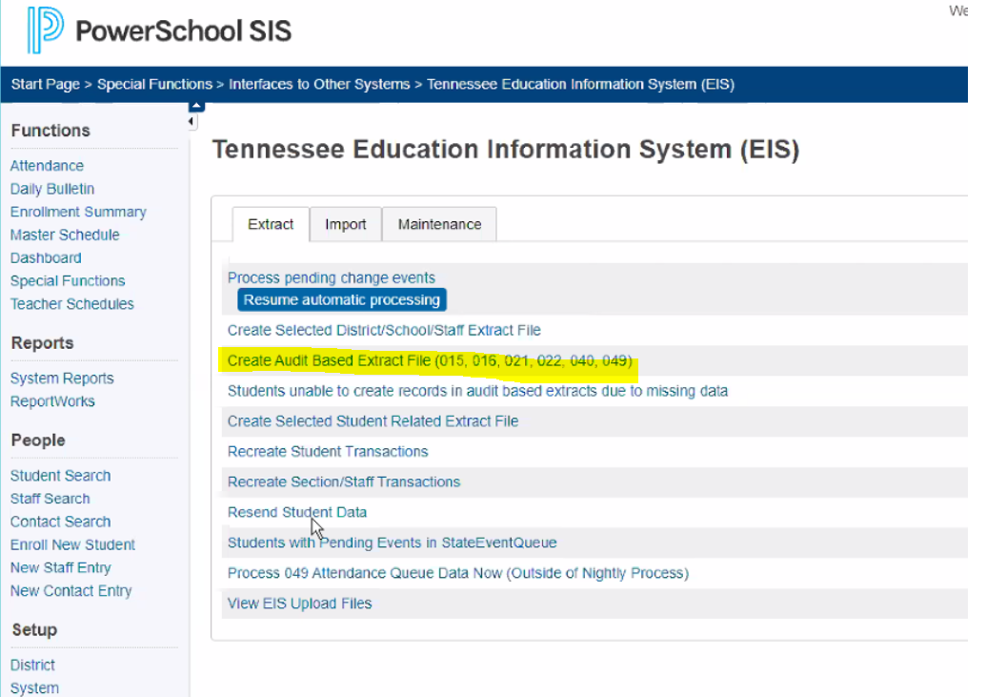

Slide 17
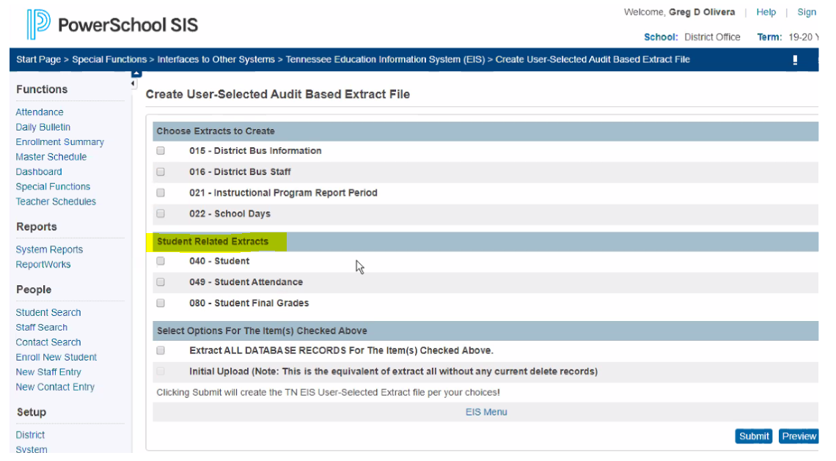
Extracts listed by Category

Slide 18
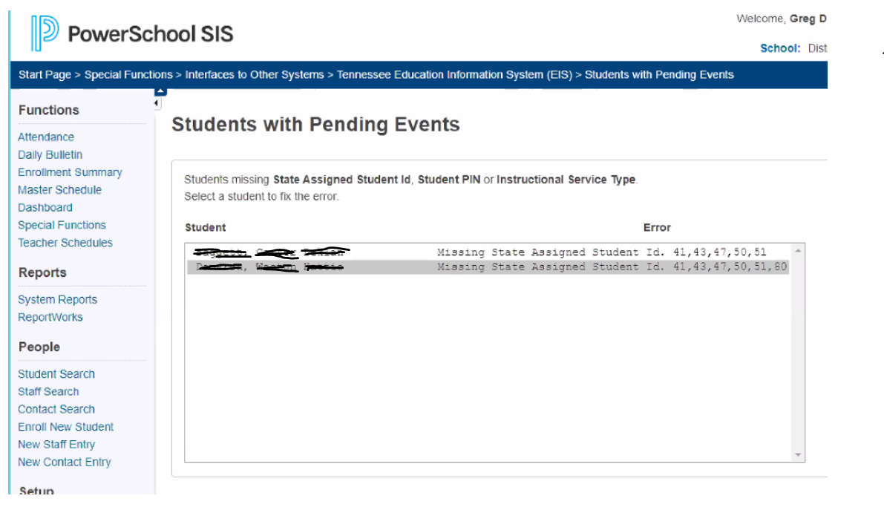
Current Error handling

Slide 19
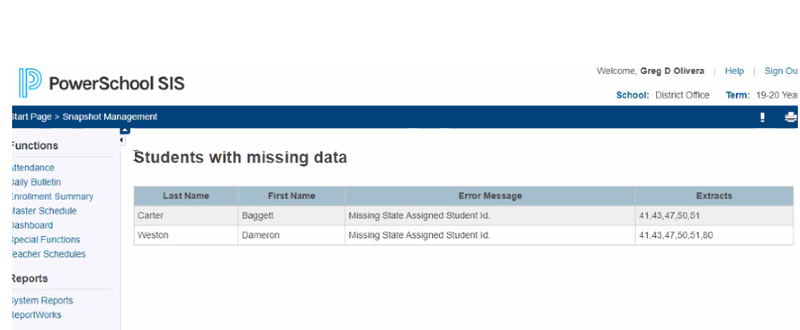
NEW TN Extracts – Features for 2020 Error Handling Dashboard
New interactive Error handling

Slide 20
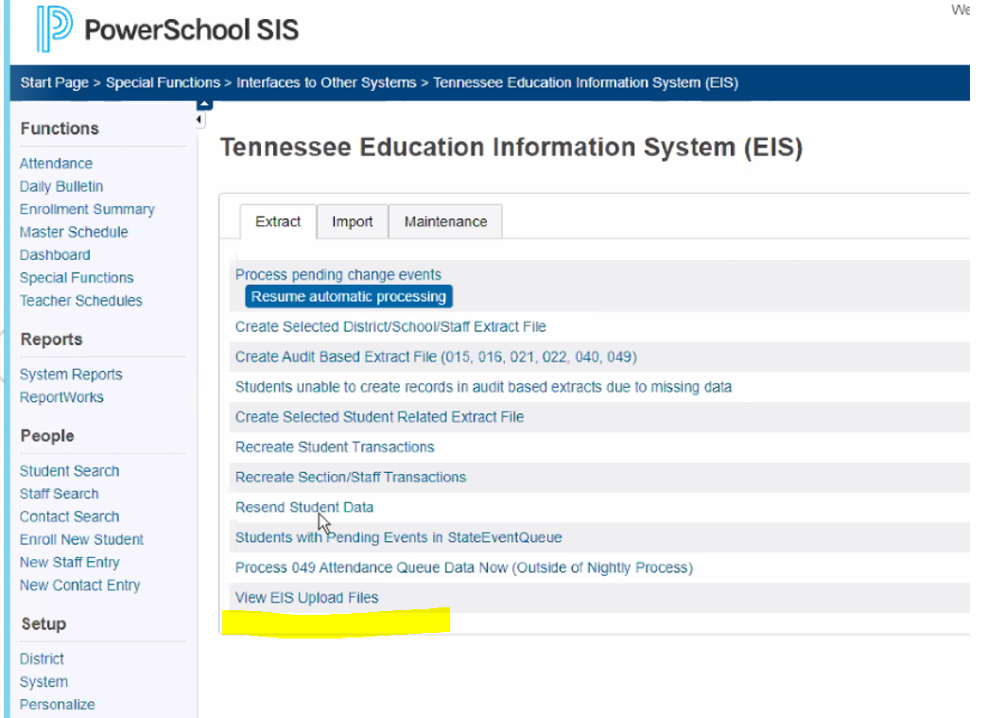
NEW TN Extracts – Features for 2020 Extract Submission Automation
Automated or Manual Extract Processing/Submission

Slide 21
Compliance – Roadmap for New Extracts
Timeline
Kickoff
Beta (TN_40) – September
October Release
TN_40 & TN_49 (all customers)
Monthly Releases
Will include 2-3 extracts until completion
Upon Completion of New Extract project:
New Extract Error Handling Dashboard
Extract Automation to EIS

Slide 22
Compliance – Reminders
September Release 9.26.19
Key Items:
Performance updates
Vocational Codes for 2019-20
New Staff Fields (Hire Entry/Exit Dates and Cell Phone)
Extract All – pulling students missing State Id’s
TN_41 and TN_48
User Group Call
Monthly
Let me know if you’d like to attend.

Slide 23
Compliance Questions?

Slide 24
Thank you!
Your PowerSchool Team
Contact Information:
Curtis Coulter
curtis.coulter@powerschool.com
Debra Mullins
debra.mullins@powerschool.com
1.916.693.7747
Doug Quinton
doug.quinton@powerschool.com
Jim Swaney
james.swaney@powerschool.com

